Slide 1
LCLS-II Cryomodule Transport Issues
Chris Adolphsen for the LCLS-II Collaboration
June 28, 2018

Slide 2
Transport History Overview
Before Jan. 2018, JLab CM01 was transported a total of 4400 km without major incident nor loss of performance – thought to validate procedure
During Jan. 2018, first FNAL CM (#6) transported to SLAC, a 3500 km trip – shock loggers indicted only a few large (g > 1.5) events, however:
  Beam line arrived vented (vacuum not monitored during trip)
  Observed loose/missing BPM feedthrough flange bolts (and other loose bolts)
  Sent back to FNAL for full inspection - found Cavity 4 and 5 cold bellows had cracks and there was several areas within CM were parts rubbed together
Major effort launched to find causes and cures – this talk highlights some of the findings

Slide 3
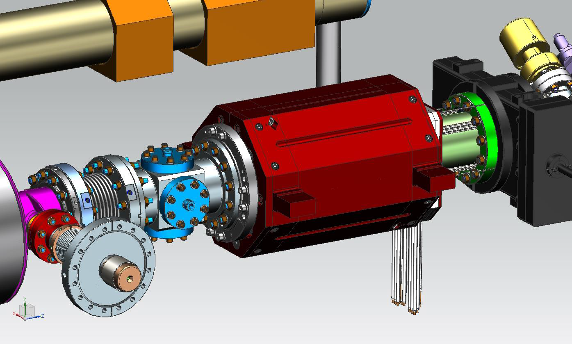
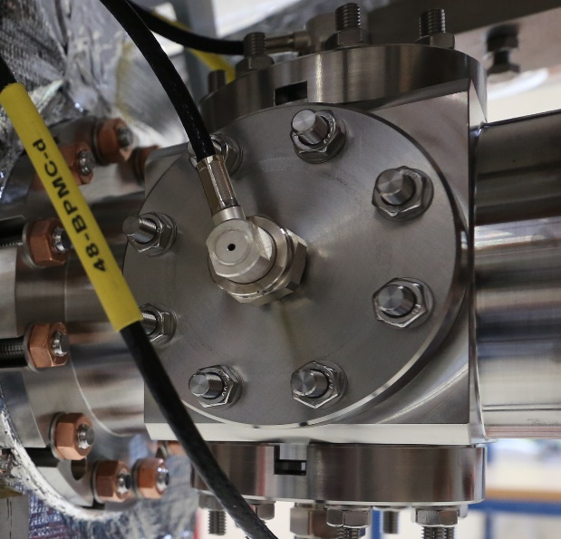
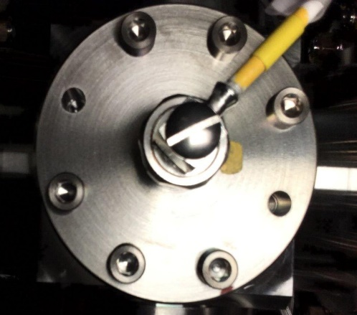
BPM Issue
EU-XFEL Fasteners
Missing
Screws
Found Grade 2 Ti socket head cap screws were used instead of specified Grade 5 on all BPMs. Also, washers were not used for this BPM
Did extensive follow-up studies: bolt deformation and seal crush vs torque, cold cycle and shake tests, etc.
Large plastic deformation of Grade 2 screws at specified torque (near yield limit) may have caused them to loosen under subsequent stresses
BPMs being retrofitted without venting using EU-XFEL fastener approach (Grade 5 Ti stud/SS nut combination)

Slide 4
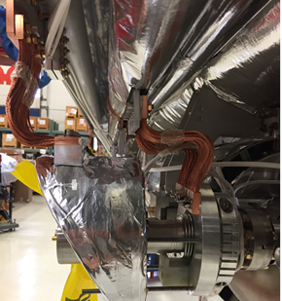
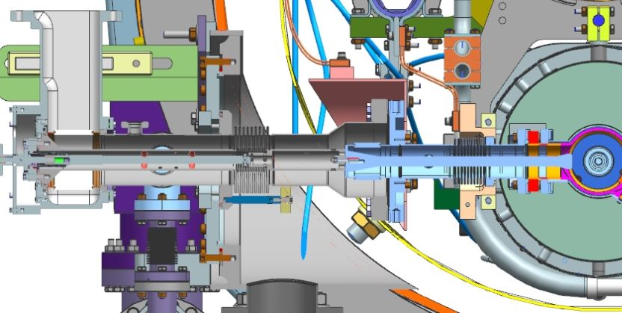
Coupler to Cavity Motion
Push Rod
Warm section constrained axially along coupler by push rod
Thus cold section bellows take up relative warm section to cavity axial motion
Cold mass not constrained vertically by posts – can rock if large enough force (e.g. truck taking a sharp turn). Gas return pipe can also bend laterally between posts (few mm per g of force)

Slide 5
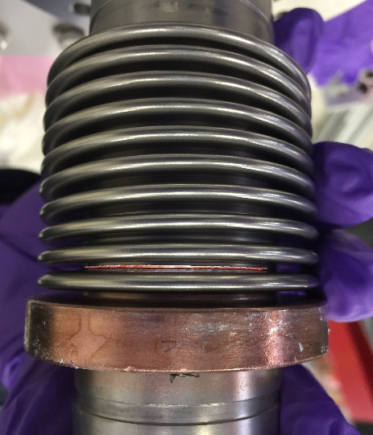
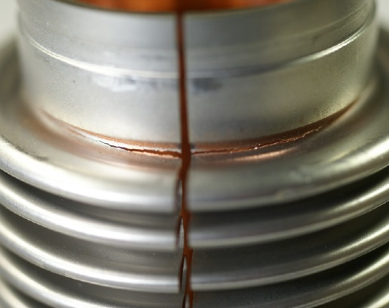
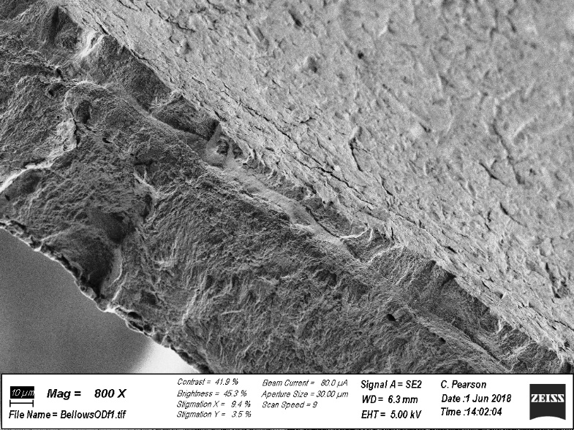
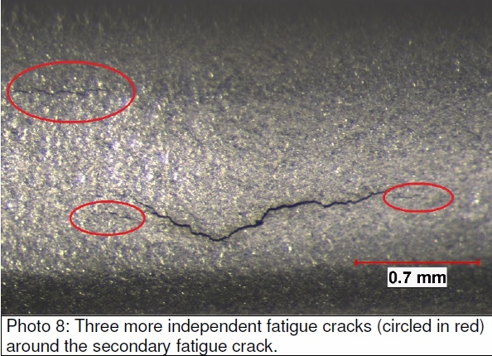
Bellow Cracks (at 3 and/or 9 o’clock)
Cavity 5
Cavity 4
SLAC (Chris Pearson) Report on Cavity 4 Bellows: “This is an example of high stress low cycle fatigue. That is, the material at the fracture location experienced multiple bending stress cycles at or above the yield strength, work hardening locally and eventually failing in a brittle manner.”
SGS report on Cavity 5 Bellows: “Fatigue fracture initiated on the outside surface at multiple locations at grain boundaries that were infiltrated with braze metal. Uni-directional bending stresses initiated and propagated the multiple fatigue cracks completely through the bellows.”

Slide 6
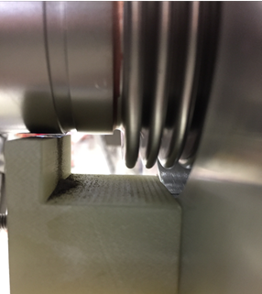
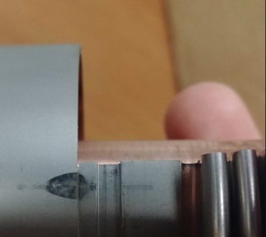
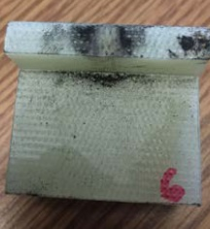
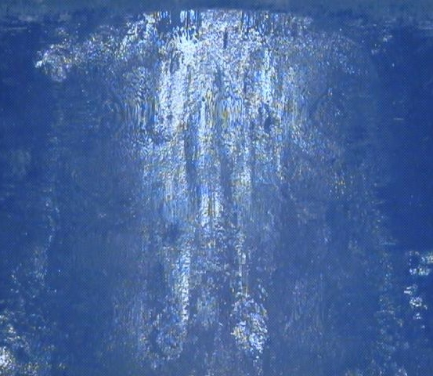
Coupler Scraping on G-10 Stops
Cavity 4
Cavity 6
4 mm
Nominal vertical gap between coupler and G-10 stop = 1 mm
All 8 couplers showed signs of rubbing – produced black G-10 powder
Cavity 6 worst – 100 um G-10 removal depth – scape marks indicate main motion along coupler axis, probably < +/- 2 mm for those that cracked

Slide 7
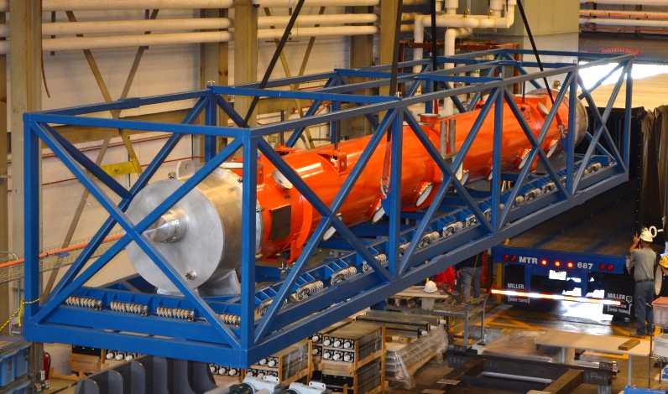
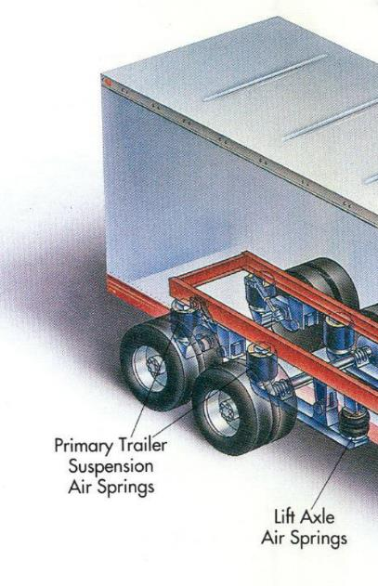
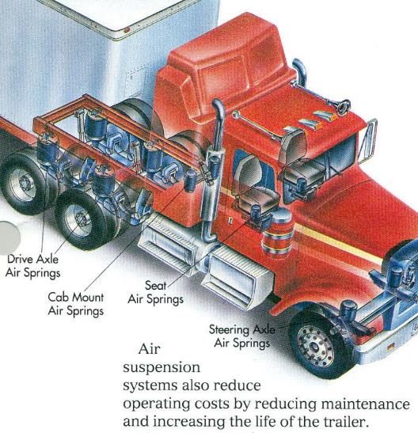
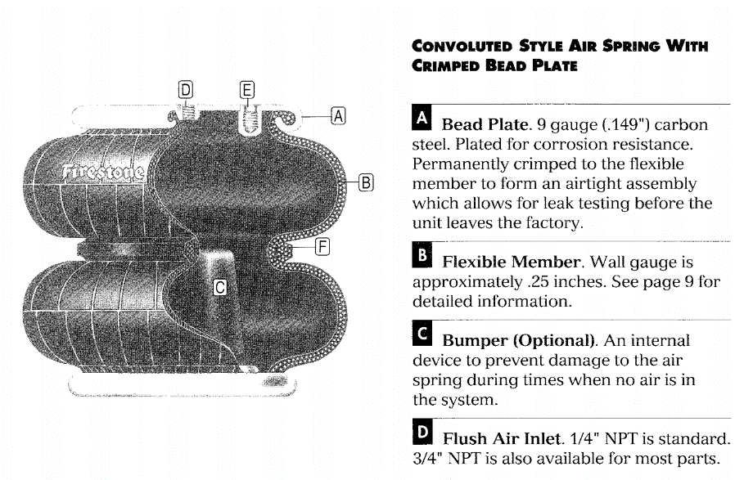
Shock Suppression
Transport Frame with Rope Springs: ~ 10 Hz Response
Y: Vertical
Note: Most high-g shocks last only ~ 10 ms
But exiting freeway via a clover leaf can produce several second ~ 0.5 g lateral forces
X: Lateral
Z: Axial
Air Ride System: ~ 1.5 Hz Response

Slide 8
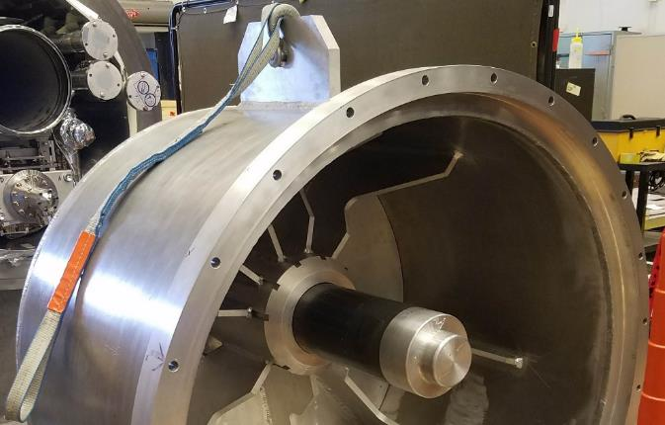
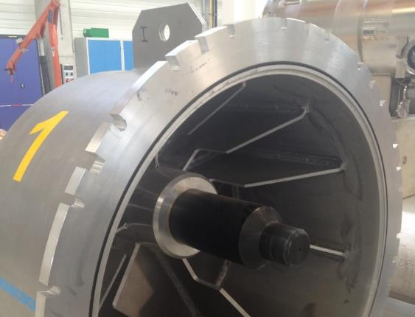
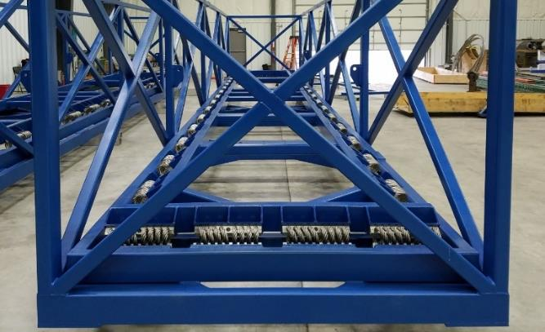
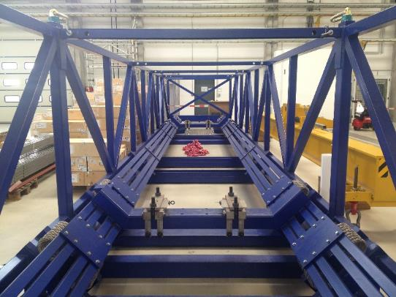
FNAL CM06 Transport Findings
Truck bed curved vertically, which required shimming of CM support frame at ends – not done properly – will support at ends only
Tie down of frame to bed allowed some lateral motion – will correct and use better CM-to-Isolation Frame connection
End cap plug used to constrain Gas Return Pipe relies on frictional force laterally and probably did not made proper contact at one end due to gate valve interference (bolt bent) – will use EU-XFEL design
+/- 20 degC inner to outer cryostat temp differences during trip, which changes axial forces constraining Gas Return Pipe – will add spring loading
Isolation Frame design different than for EU-XFEL – accelerometer data does not seem to show vertical isolation – under investigation
Cold Mass support posts only held vertically by gravity so can rock – will constrain vertically
50 K shield free to rock (rubbing observed) – will better constrain
Route taken different than requested – will better enforce/monitor
LCLS-II
EU-XFEL

Slide 9
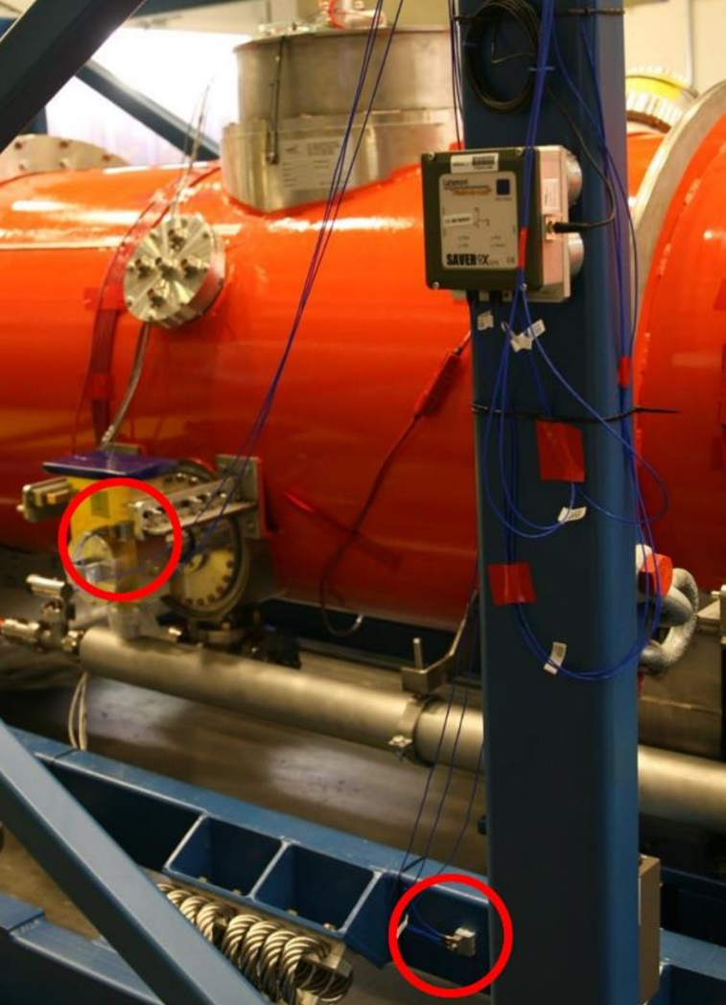
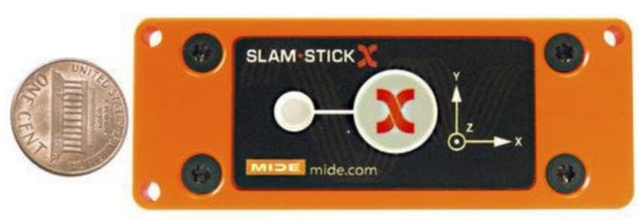
Triaxial Accelerometers
Saver9X
Various commercial accelerometers used for monitoring shock outside and inside CM – not all are robust
Ones that provide quick summary plots:
  Saver9X: includes GPS and temperature monitoring – records shock events (1 sec at 500 Hz) and can sample periodically
  GP1: records shock events (2 sec @ 100 Hz) and peak values in 30 sec intervals – data low pass filtered at 45 Hz which unfortunately suppresses peak shock values
Ones that record continuously
  SLAM STICK: records at 500 Hz
  X2: records at 500 Hz
Data can be converted to motion (weigh Fourier components by 1/ω²), accurate down to ~ 1 Hz

Slide 10
Example of Reconstructed Coupler and Cavity Motion during JLab CM07 Round Trip to Bristol, VA in April 2018 – Selected 10 s window around > 1 g shock
‘Coupler’ = Cavity 4 CF100 Flange Shroud, ‘Cavity’ = Cavity 4 Coupler Flange

Slide 11
Divide 1 hour of data into 10 sec slices – resulting statistics
Cavity appears inertially isolated in X

Slide 12
RMS Fourier Amplitudes and Ratios
Air Ride
Red curve is resonance response:
Freq = 10 Hz
Q = 2.5
Cavity to Vac Vessel Modes ?
Coupler Modes ?

Slide 13
Max Peak to Peak Motion vs 10 second Slice Number

Slide 14
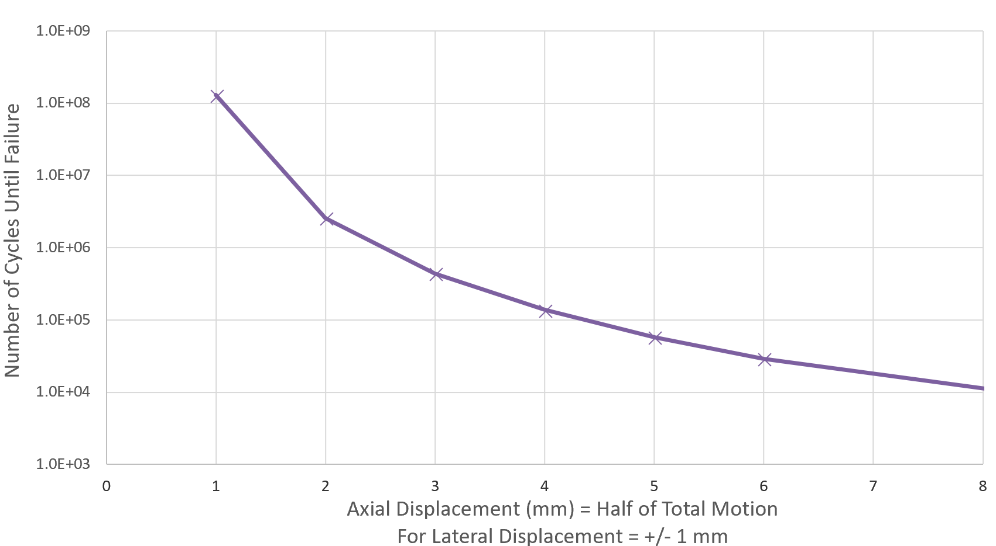
Expansion Joint Manufacturers Association (EJMA) Lifetime Estimate Algorithm
Suggests motion measured during JLab Road Test would not cause fatigue failure
Twice JLab Road Test Typical Coupler-to-Cavity Motion
Max Displacement during CM F06 FNAL to SLAC RT Based on Scraping Imprint
60 hours @ 2 Hz
Toshiba Test
Vendor Spec

Slide 15
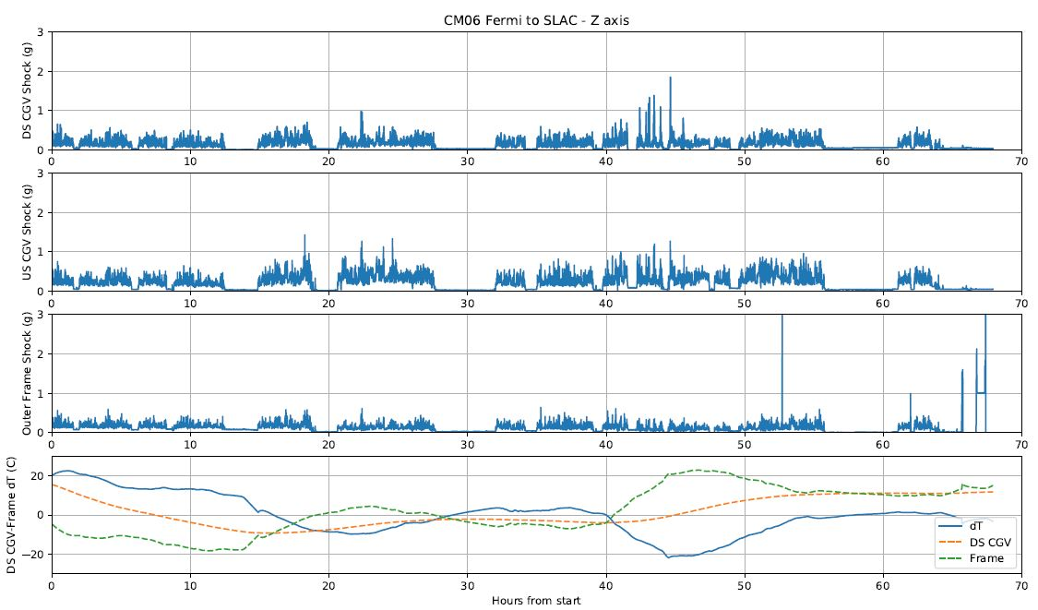
FNAL to SLAC GP1 and Temperature Data
Down-Stream Gate Valve
One large shock to Frame but not Gate Valves ?
Up-Stream Gate Valve
Peak Shock (g) Recorded in 30 sec Intervals
Outer CM Transport Frame
CM
Unloading

Slide 16
Large Z Shock Acceleration Data

Slide 17
Reconstructed Motion

Slide 18
Summary
Do not fully understood what caused vent/damage but much learned from resulting investigation that is being applied to existing CM assemblies.
Transport improvements being implemented for the next CM delivery, from FNAL to SLAC starting July 9
  Short transport tests will be done in advance with extensive instrumentation, including positions sensors
  If bellow cracks occurs again, may remove warm coupler sections prior to shipment
Special thanks to those who led this investigation:
  Naeem Huque (JLab)
  Brian Hartsell, Jamie Blowers and Jeremiah Holzbauer (FNAL)
  Tom Peterson (SLAC)

