Slide 1
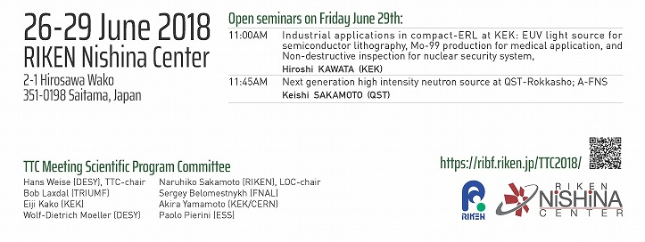
Welcome & Introduction
Hans Weise, DESY
June 26th, 2018
Notes:
How to edit the title slide
Upper area: Title of your talk, max. 2 rows of the defined size (55 pt)
Lower area (subtitle): Conference/meeting/workshop, location, date, your name and affiliation, max. 4 rows of the defined size (32 pt)
Change the partner logos or add others in the last row.

Slide 3
The mission of the TESLA Technology Collaboration
The mission of the TESLA Technology Collaboration is
to advance SRF technology R&D and related accelerator studies across the broad diversity of scientific applications, and
to keep open and provide a bridge for communication and sharing of ideas, developments, and testing across associated projects.
To this end the Collaboration supports and encourages free and open exchange of scientific and technical knowledge, expertise, engineering designs, and equipment.
The TTC organizes regular collaboration meetings where new developments are reported, recent findings are discussed and technical issues are concluded. This time, TTC meeting is hosted by RIKEN Nishina Center on 26-29 June 2018.

Slide 4
WG-1; What are the performance limits for low beta resonators? WG-2; How to improve the present specification for bulk Niobium? WG-3; High Q and high gradient performance? WG-4; Special applications of SRF cavities? Hot topic session: Warm vacuum sections between low beta cryomodules

Slide 5
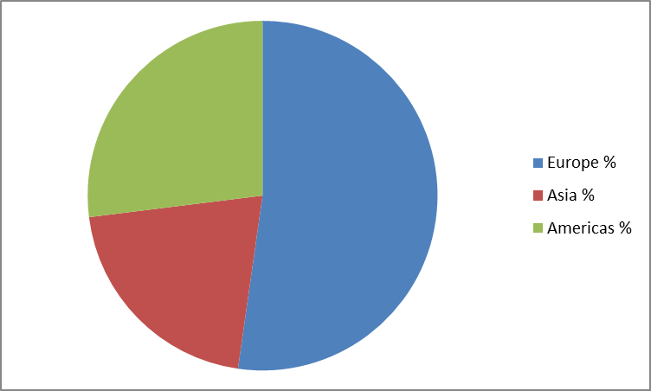
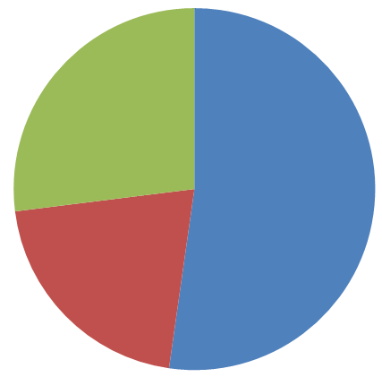
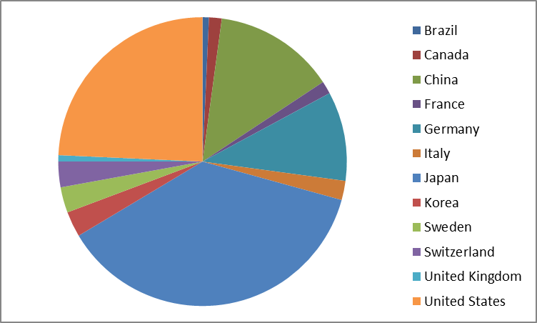
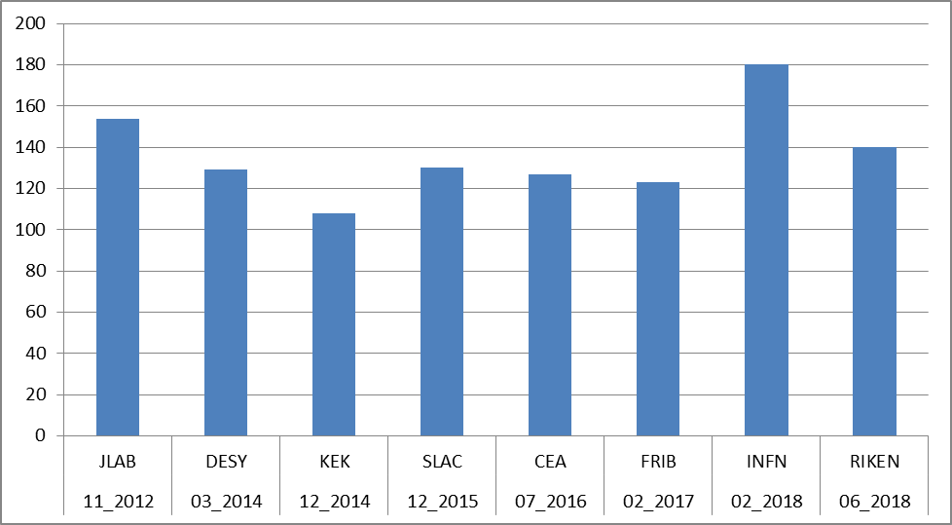
Number of TTC Meeting Participants
RIKEN
MILANO
143 participants
22% from industry
av. 136

Slide 6
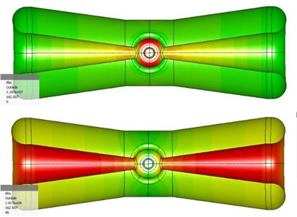
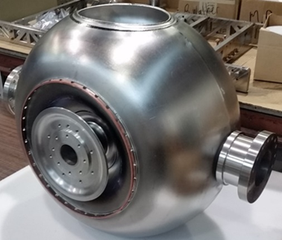
WG-1; What are the performance limits for low beta resonators?
Bob Laxdal (TRIUMF), Han Li (Uppsala University), Kazutaka Ozeki (RIKEN)
There are a variety of significant low to medium beta projects being pursued using non-elliptical TEM mode cavities (QWR, HWR, single and multiple spokes). Projects include FRIB, ESS, RISP, C-ADS and RIKEN. In principal, the performance limits for non-elliptical cavities should be similar to elliptical cavities but the cavities typically operate in a lower frequency range and with unique geometries. Comparing performance across the variants is not as evolved as with 1.3GHz elliptical cavities. The scope of this working group is to discuss the known limitations of TEM mode accelerating cavities. The range of discussion should include:
Performance results Q, Rs(B) vs Ea, B from various labs
Experience with heat treatments including doping
Role of rf frequency
Multipacting issues
4K vs 2K operation

Slide 7
WG-2; How to improve the present specification for bulk Niobium?
Sam Posen (FNAL), Claire Antoine (CEA), Akira Yamamoto (CERN/KEK)
Bulk Niobium is at present the most common material for superconducting RF cavities in accelerator applications. Niobium specifications are well established and successfully used for different projects. But recent experience has compelled us to re-evaluate the Niobium material specification in view of advanced technologies like Nitrogen doping and infusion treatments where performance in terms of High Q and/or High Gradient is pushing the limits of the material. The scope of WG-2 is to review the existing Niobium specifications in terms of both High Q and High Gradient performance and discuss the different needs with respect to:
Optimized specification for low BCS resistance, low residual resistance including low trapped flux sensitivity, and for high peak field.
Other specification considerations including thermal conductivity
Mechanical fabrication methods (deep drawing, hydroforming, extrusion) and the needed mechanical properties.
Mechanical stability during operation with respect to Lorentz force detuning, microphonics and pressure vessel code.
…

Slide 8
WG-2; How to improve the present specification for bulk Niobium?
Sam Posen (FNAL), Claire Antoine (CEA), Akira Yamamoto (CERN/KEK)
Bulk Niobium is at present the most common material for superconducting RF cavities in accelerator applications. Niobium specifications are well established and successfully used for different projects. But recent experience has compelled us to re-evaluate the Niobium material specification in view of advanced technologies like Nitrogen doping and infusion treatments where performance in terms of High Q and/or High Gradient is pushing the limits of the material. The scope of WG-2 is to review the existing Niobium specifications in terms of both High Q and High Gradient performance and discuss the different needs with respect to:
…
Optimized specification in terms of final surface finish with electro polishing or buffered chemical polishing.
Considerations of Large grain and single crystal applications.
The discussion in the WG-2 should analyze the properties of Niobium and their influence on different applications. Specifically, there is an existing specification that can be used by the vendors that would result in material complying with a reduced pinning requirement. The aim is to give the community information that would help augment the specifications for future projects.

Slide 9
WG-3; High Q and high gradient performance
Alex Romanenko (FNAL), Marc Wenskat (DESY), Kensei Umemori (KEK)
Bulk Niobium is at present the most common material for superconducting RF cavities in accelerator applications. Over the last several years new treatments including High Temperature doping and Low Temperature infusion have been used to reach unprecedented performance of Niobium cavities in terms of High Q and/or High Gradient. Most of the work has concentrated on cavities operating at 1.3GHz driven by CW applications like LCLS-II and future pulsed operation like the ILC. The scope of this working group is to discuss the most recent results with respect to pushing niobium towards Higher Q and Higher Gradient. Discussions should include:
High temperature doping results across the laboratories including both cavity results and sample analysis
Low temperature infusion results across the laboratories including both cavity results and sample analysis.
New results at other cavity frequencies that could shed light on the core understanding
Recent additions to our theoretical or technical understanding of either phenomenon.

Slide 10
WG-4; Special applications of SRF cavities
Jacek Sekutowicz (DESY), Ben Hall (HZB), Rama Calaga (CERN)
Besides the accelerator cavities for the main linacs, special SRF cavities find application in
SRF electron guns,
harmonic SRF cavities for bunch lengthening and increased charge density and
crab and deflecting mode cavities for bunch rotation (crabbing), RF separation or beam diagnosis.
In WG-4 the applications and approaches for the different designs of the three types of cavities should be presented.
Aspects of the cavity fabrication, treatment and operation should be discussed.
Existing solutions and experience should be exchanged.
In particular, WG-4 should discuss and identify needed future developments.
The aim of this working group is to address the ongoing issues and difficulties for the three types of cavities.

Slide 11
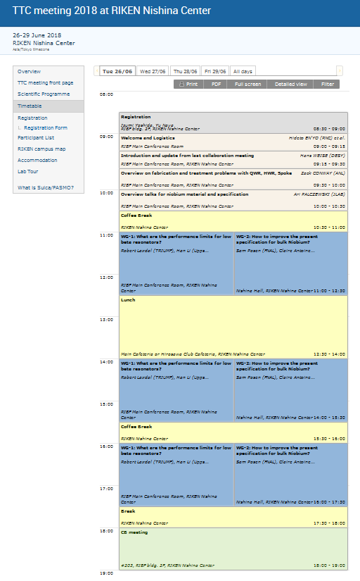
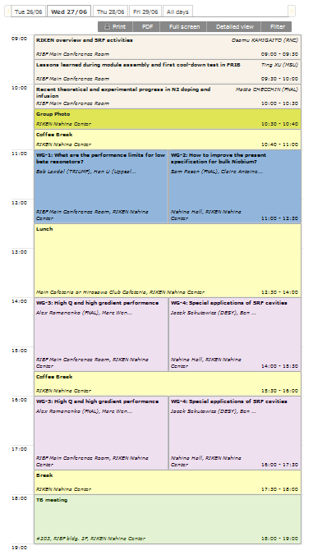
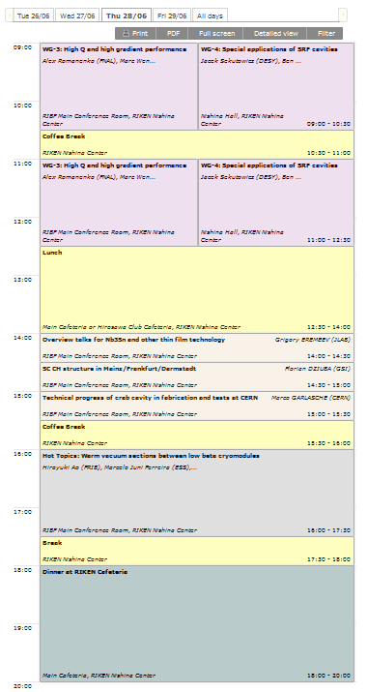
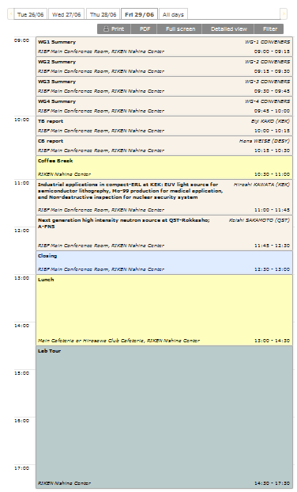
https://indico.desy.de/indico/event/20010/timetable

Slide 12
Hot topic session: Warm vacuum sections between low beta cryomodules
Hiroyuki Ao (FRIB), Marcelo Juni Ferreira (ESS), Hiroshi Imao (RIKEN)
Low beta accelerators are designed with normal conducting sections between the cryomodules, hosting focusing and beam diagnostic elements.
This session is dedicated to the discussion of practical issues for these machines, reviewing design criteria of warm sections. Participation of vacuum experts should be encouraged, in order to discuss the preparation procedures of these sections with those followed for the SRF components. The large variety of beam diagnostics elements required for low beta linacs are not always fully compatible with the application of the full cleaning and high pressure rinsing procedures used in the SRF community.
Procedures for limiting particulate production near the cryomodules should be reviewed and compared to the state of the art experience followed by electron accelerators like XFEL or LCLSII. New NEG pumps appeared lately on the market, promising high pumping speeds with a high degree of compatibility for particle-free applications, and some large infrastructures, as the ESS, will employ them as the main pumping method for the warm sections. Latest developments and measurements performed in different laboratories (JLAB, ESS, STFC, …) in this direction should be reported.

Slide 13
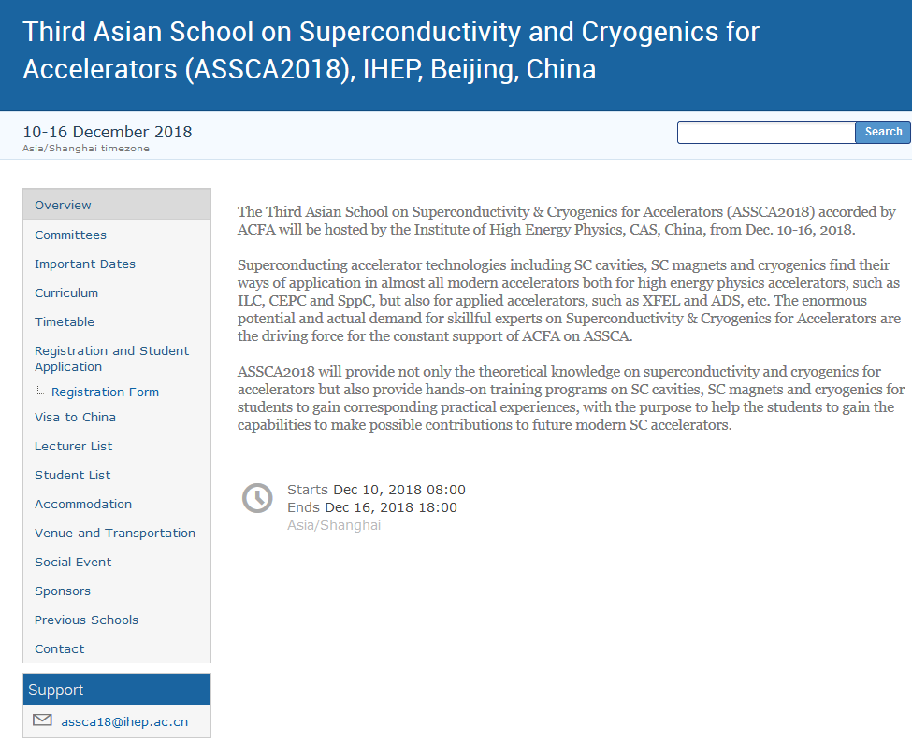
Announcement of TTC related Meetings

Slide 14
Bring together a diverse group of experts spanning the key disciplines (LLRF, Mechanical, and Cryogenic engineering) critical to the design and operation of SRF cavities and cryomodules, in particular those operated with high Q/narrow bandwidth and pulsed conditions.
Identify the key microphonic and detuning (Lorentz) issues experienced in facilities currently operating, and lessons learned which can inform the design and installation of those under construction and being proposed.
Present the latest developments in each discipline with the overall goal of producing quiet cryomodules, and addressing noise via both simple passive methods, and advanced active compensation techniques.
October 25 and 26, 2018
Hotel/Conference Center: New York Marriott at the Brooklyn Bridge, Brooklyn, NY
Contact: Kevin Smith ksmith@bnl.gov or Curt Hovater hovater@jlab.org
2nd Workshop on Cryomodule Microphonics & Resonance Control
October 25 and 26, 2018

Slide 15
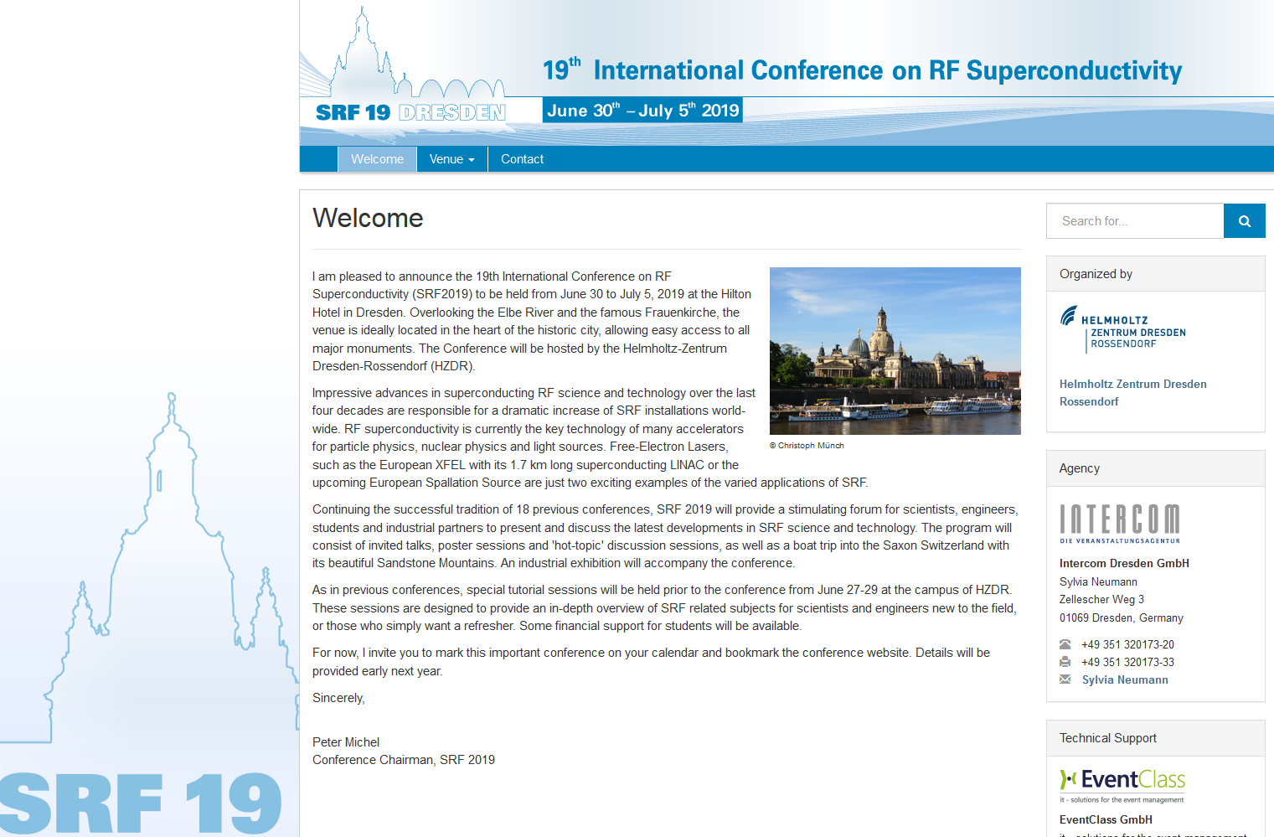
Announcement of TTC related Meetings

Slide 16
Overview TTC related Meetings
8th Workshop on Thin Films and new ideas for pushing the limits of RF Superconductivity | INFN Legnaro | October 8 – 10, 2018
Cryomodule Microphonics and Resonance Control | Co-hosted by BNL and JLAB in New York City | October 17 – 28, 2018
Third Asian School on Superconductivity and Cryogenics for Accelerators (ASSCA2018) | IHEP Beijing | December 10 – 16, 2018
TESLA Technology Collaboration Meeting | to be announced | Dec 2018 or Jan 2019
19th International Conference on RF Superconductivity (SRF2019) | Helmholtz Zentrum Rossendorf Dresden | June 30 to July 5, 2019

Slide 17
The actual TTC Meeting was prepared in an enthusiastic way and with great care…
Naruhiko Sakamoto (RIKEN), LOC-chair, and his team
and the
TTC Meeting Scientific Program Committee chaired by Eiji Kako (KEK) & Wolf-Dietrich Moeller (DESY)
SPC | WP Leaders
Hans Weise (DESY), TTC-chair Bob Laxdal (TRIUMF) Eiji Kako (KEK) Wolf-Dietrich Moeller (DESY) Naruhiko Sakamoto (RIKEN) Sergey Belomestnykh (FNAL) Akira Yamamoto (KEK/CERN) Paolo Pierini (ESS) | Bob Laxdal (TRIUMF) Han Li (Uppsala University) Kazutaka Ozeki (RIKEN) Sam Posen (FNAL) Claire Antoine (CEA) Akira Yamamoto (CERN/KEK) Alex Romanenko (FNAL) Marc Wenskat (DESY) Kensei Umemori (KEK) | Jacek Sekutowicz (DESY) Ben Hall (HZB) Rama Calaga (CERN) Hiroyuki Ao (FRIB) Marcelo Juni Ferreira (ESS) Hiroshi Imao (RIKEN)
THANK YOU!!!

