Slide 1

HL-LHC WP4
Crab Cavities & RF
R. Calaga on behalf of HL-LHC WP4
27 June 2018 - CERN

Slide 2
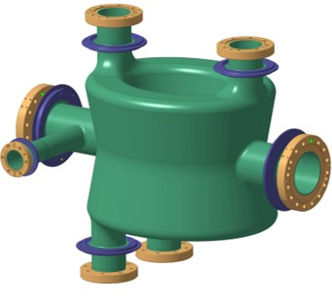
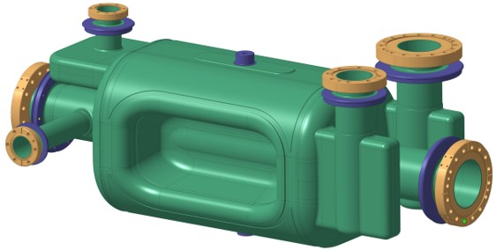
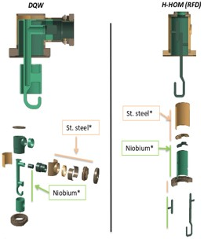
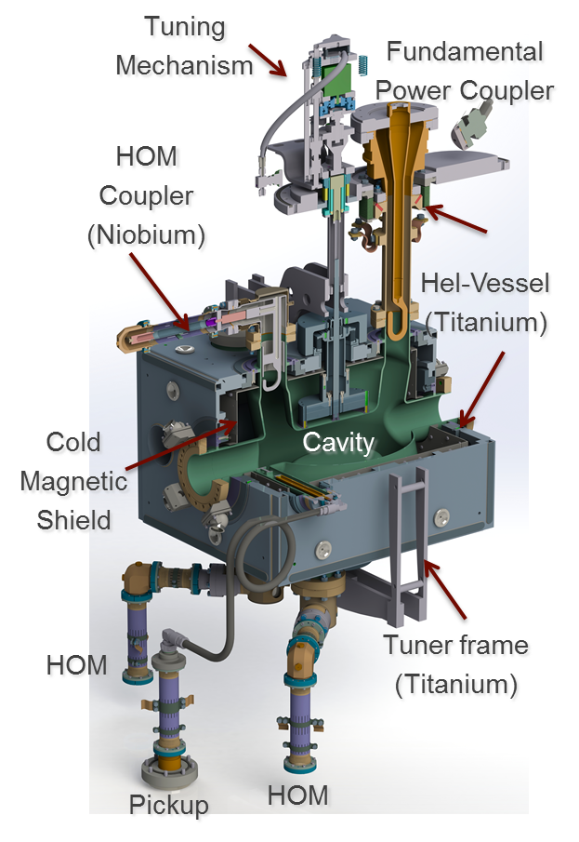
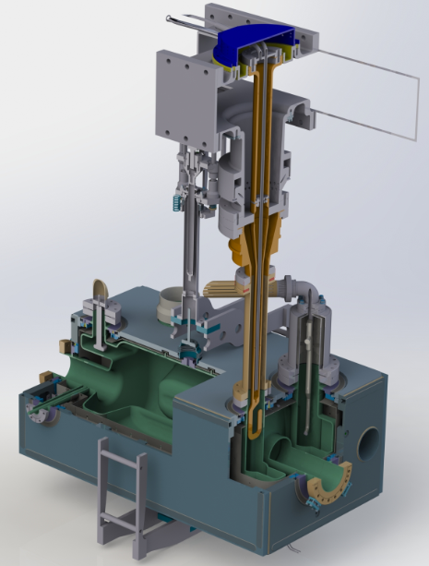
SPS Cavities 2K Volume
Main Mechanical interfaces:
He-vessel: Bolted-welded concept
Tuner: Symmetric tuning + warm actuation
Three point support + alignment system
Main RF interfaces
1 FPC: Single ceramic coaxial line
3 HOMs: Two stage filter, coaxial
1 PU: Cu-Nb for field probe + HOM

Slide 3
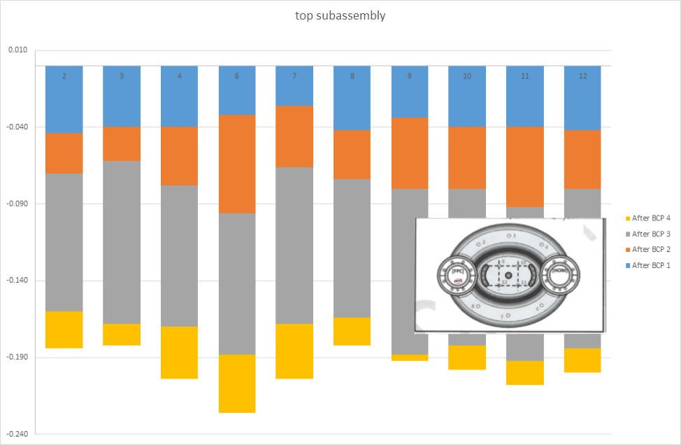
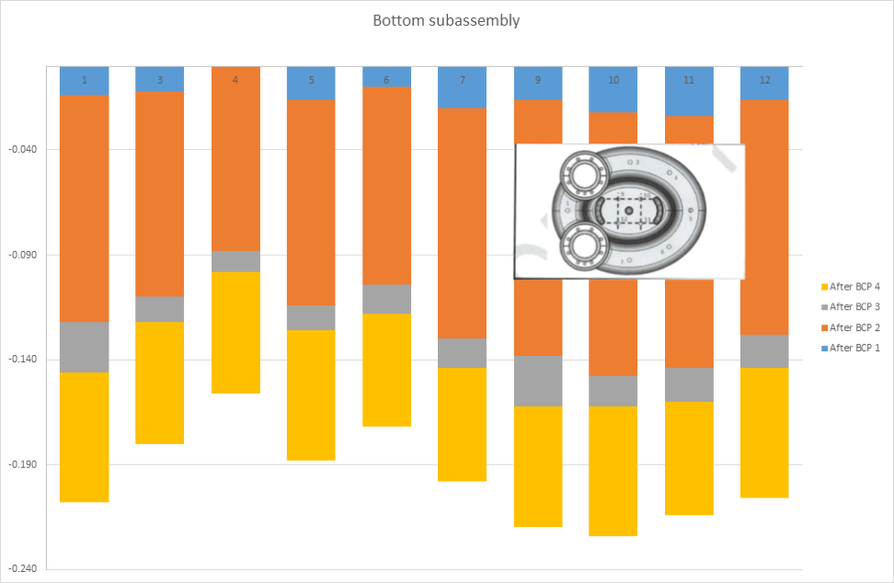
DQW Surface Preparation
Top/bottom asymmetry in surface removal
Approx 48 hours heat treatment with Nb-caps
More than 60 hrs of HPR + 120 deg bake
Courtesy: TE-VSC
For RF-Dipole: See P. Berrutti

Slide 4
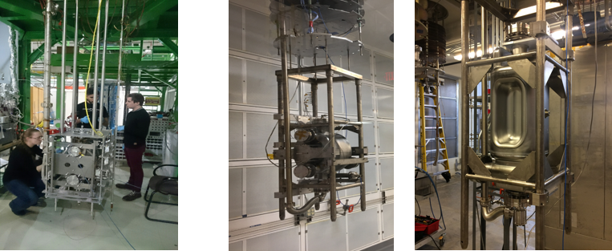

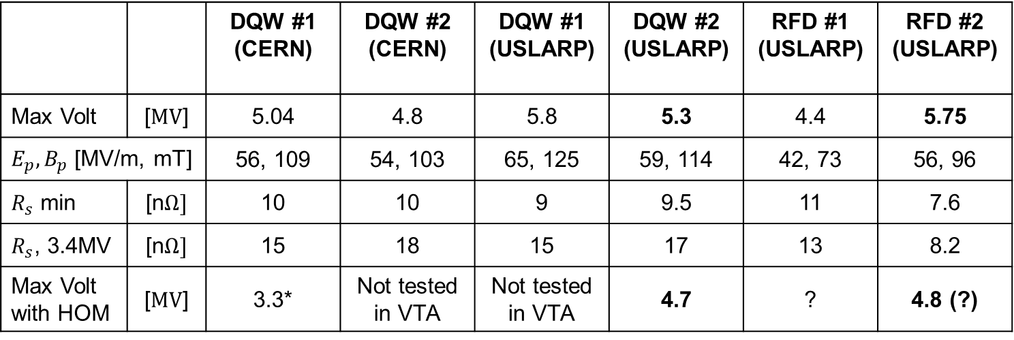
SPS Cavity Results (6 Cavities)
Nominal Spec $V_{kick}=3.4 MV$, $R_{s}=10 nΩ$
 |  | DQW #1 (CERN) | DQW #2 (CERN) | DQW #1 (USLARP) | DQW #2 (USLARP) | RFD #1 (USLARP) | RFD #2 (USLARP)
Max Volt | [$MV$] | 5.04 | 4.8 | 5.8 | 5.3 | 4.4 | 5.75
$E_{p}, B_{p}$ [MV/m, mT] |  | 56, 109 | 54, 103 | 65, 125 | 59, 114 | 42, 73 | 56, 96
$R_{s}$ min | [n$Ω]$ | 10 | 10 | 9 | 9.5 | 11 | 7.6
$R_{s}$, 3.4MV | [n$Ω]$ | 15 | 18 | 15 | 17 | 13 | 8.2
Max Volt with HOM | [$MV$] | 3.3* | Not tested in VTA | Not tested in VTA | 4.7 | ? | 4.8 (?)
CERN DQW
USLARP DQW & RFD
*Dressed cavity tests at CERN in VTA revealed feedthrough leaks during thermal cycling, a fix is being prepared

Slide 5
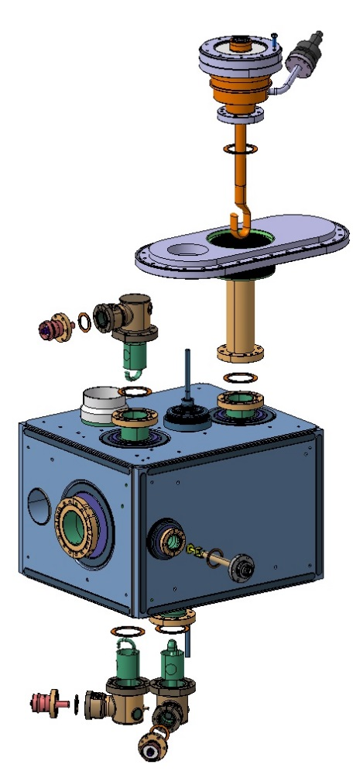
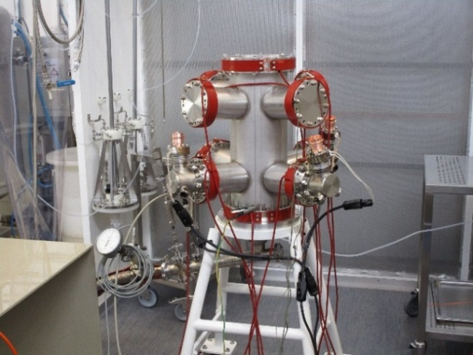
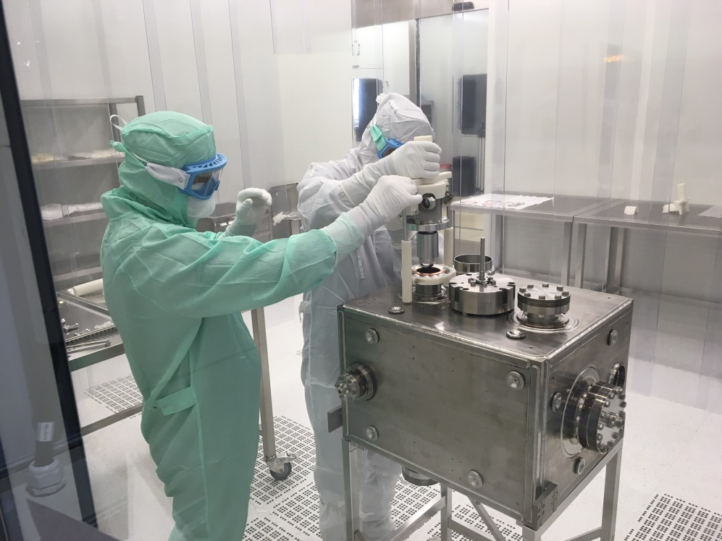
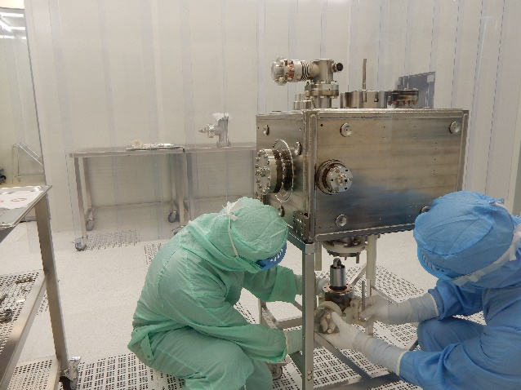
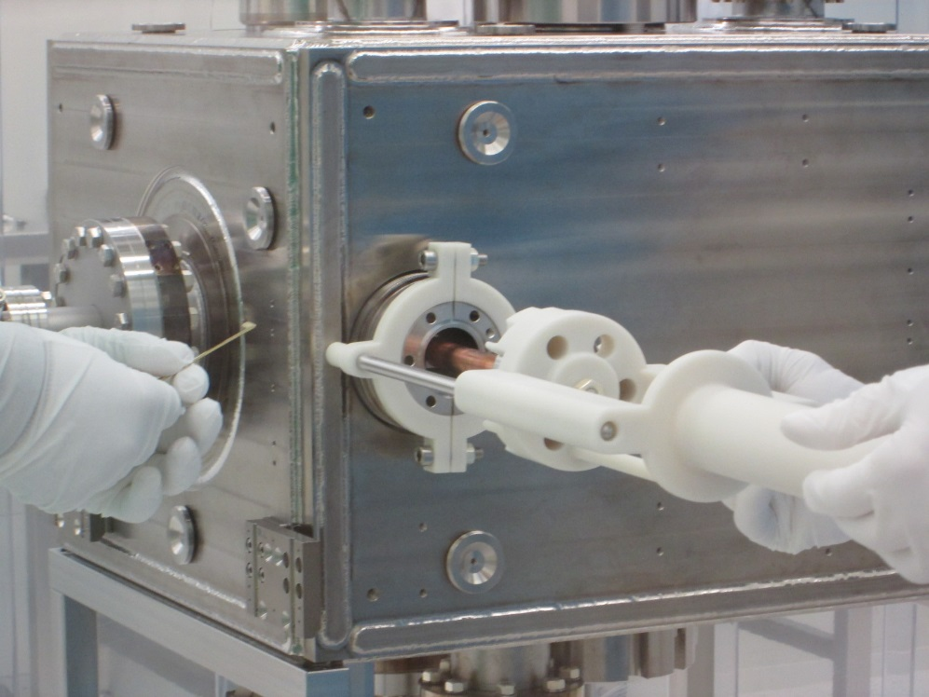
HOMs & Pickups
Courtesy: RF-SRF, RF-PM
Rinsing tool for HOMs+PU
3D printed tool for mounting
Not easy by hand
5

Slide 6
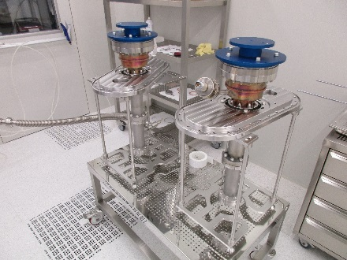
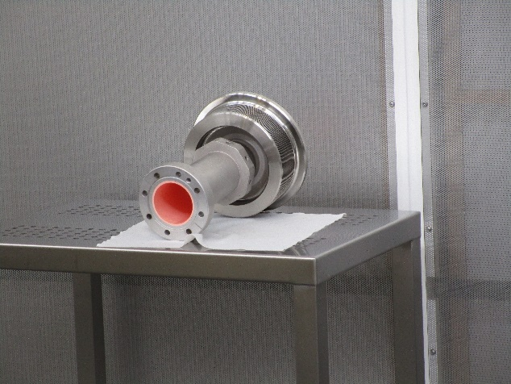
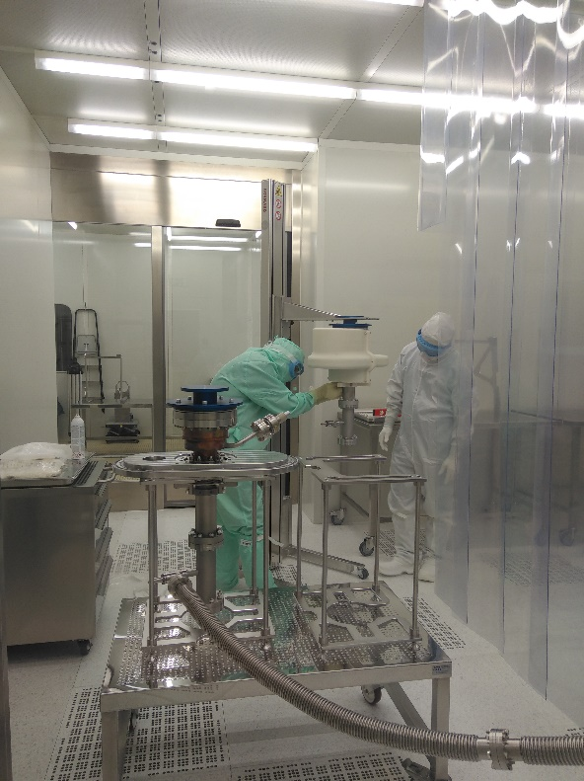
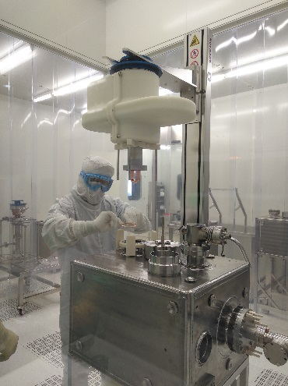
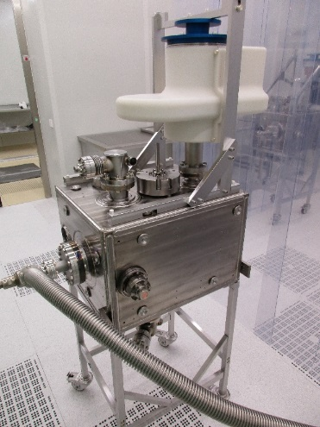
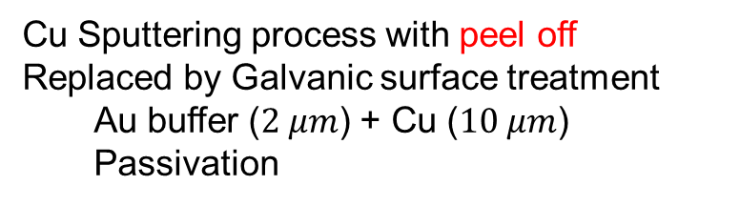
Fundamental Power Coupler
Courtesy: RF-PM, RF-SRF
FPC Double-Wall Tube
Cu Sputtering process with peel off
Replaced by Galvanic surface treatment
Au buffer ($2 μm$) + Cu ($10 μm$)
Passivation
Mounting done without N2 gas flushing
3D printed tooling for mounting

Slide 7
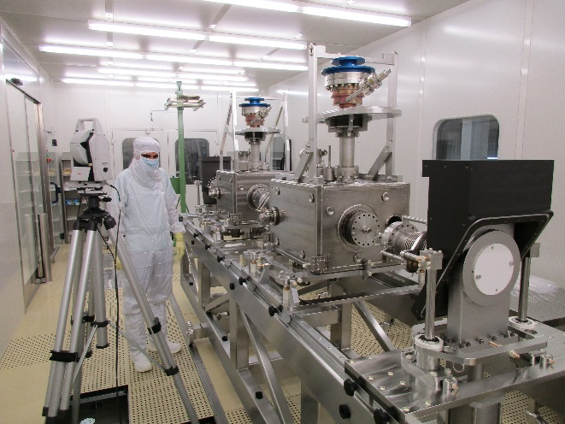
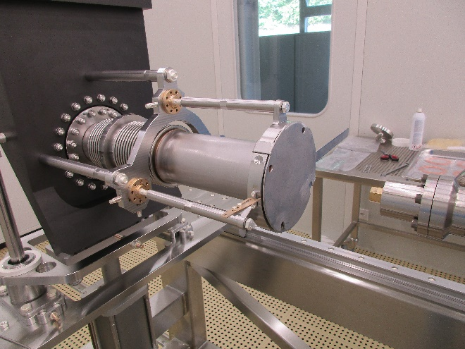
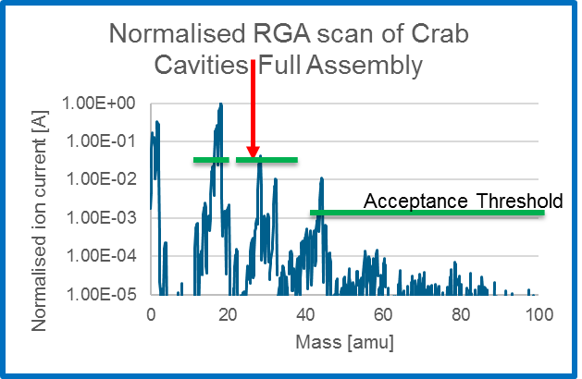
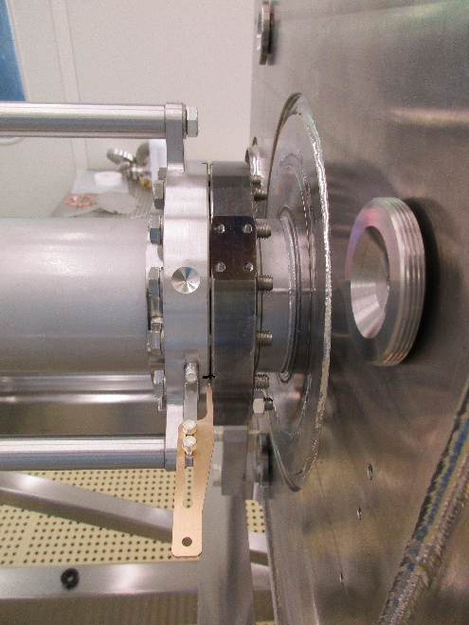
String Assembly, ISO4
Courtesy: RF-SRF, Survey
Alignment of components for the string connection in ISO4
Z
X
Y
Connection done without N2 gas flushing
Final Leak check

Slide 8
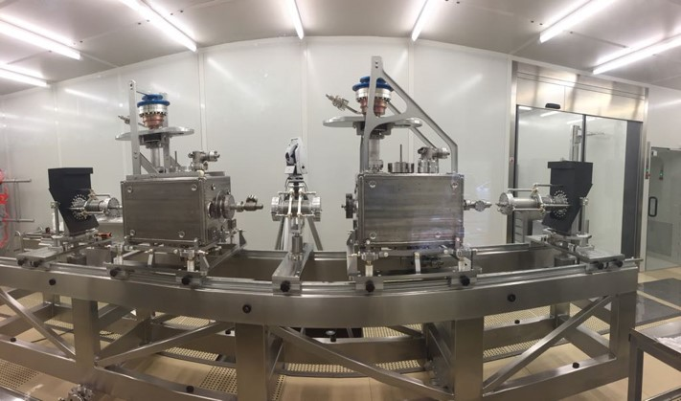
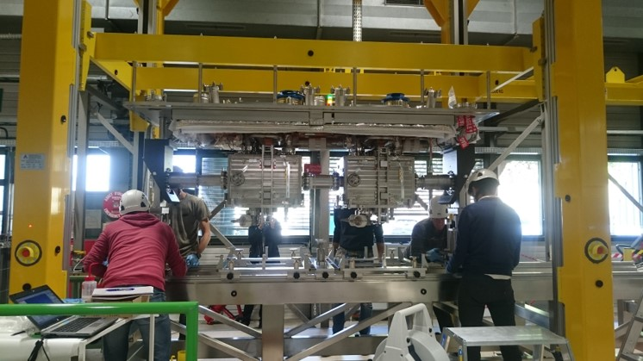
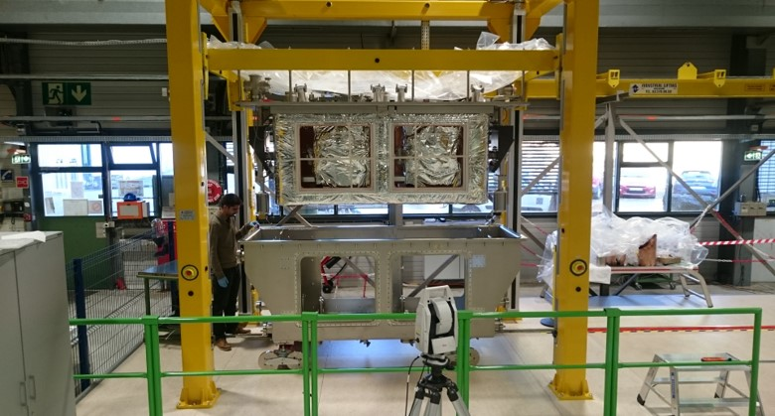
String & CM Assembly
Cleanroom String
Top Plate Assembly
Cryomodule Assembly
Courtesy: EN-MME

Slide 9
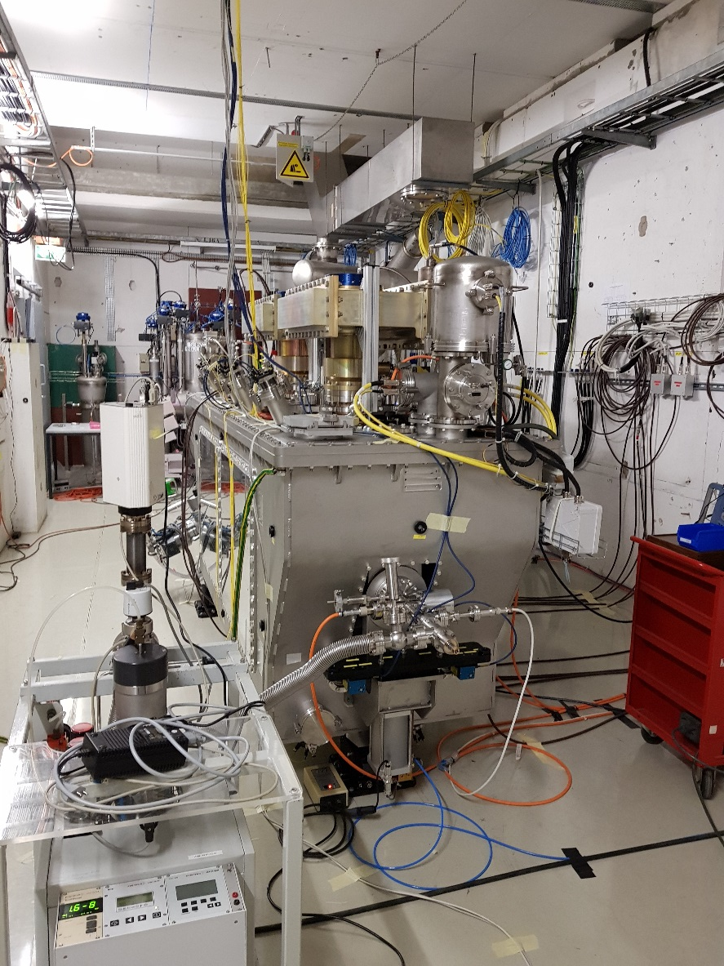
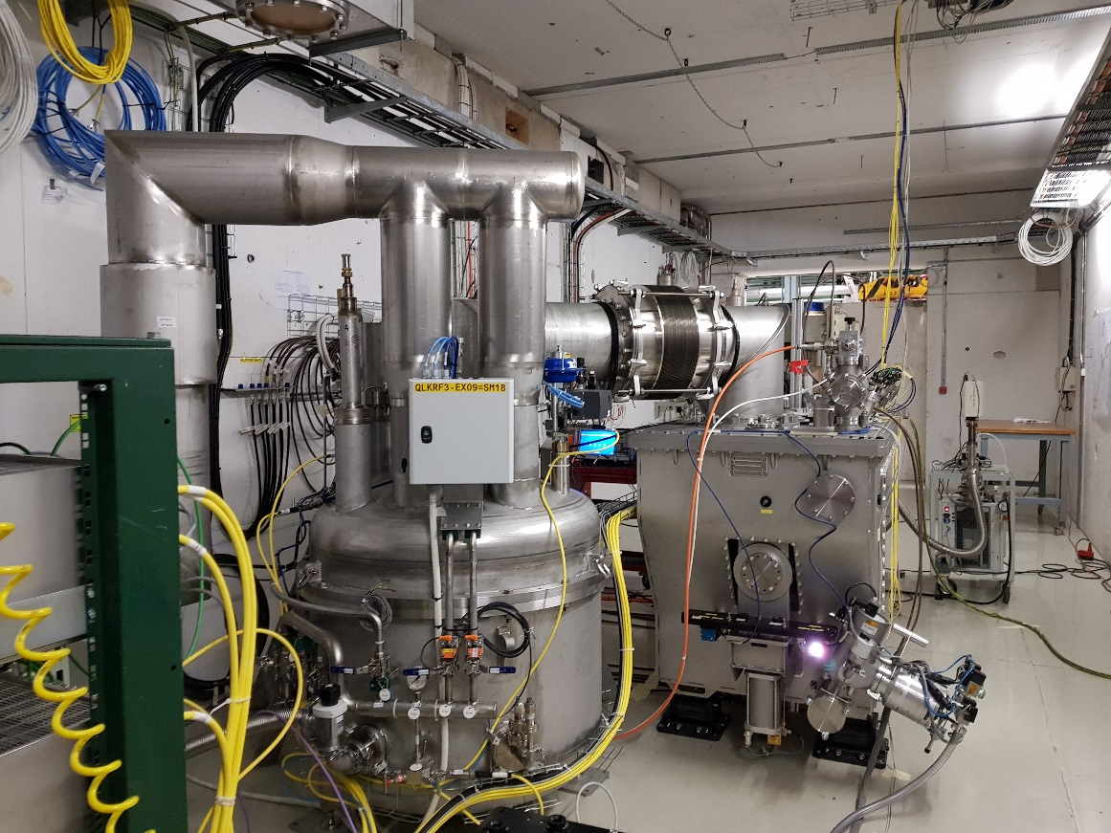
SM18 Horizontal Tests
Horizontal tests before tunnel installation – very short

Slide 10
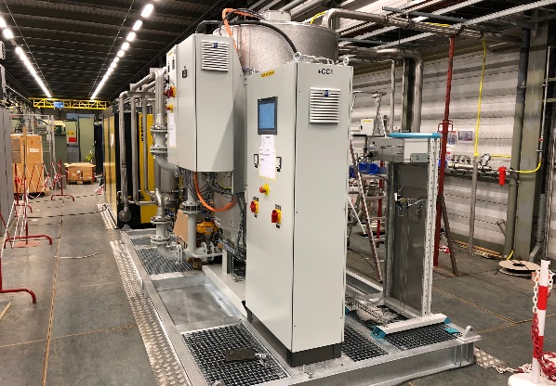
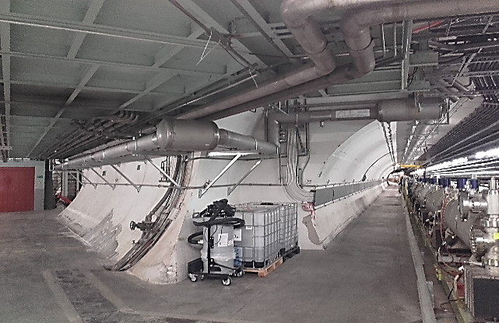
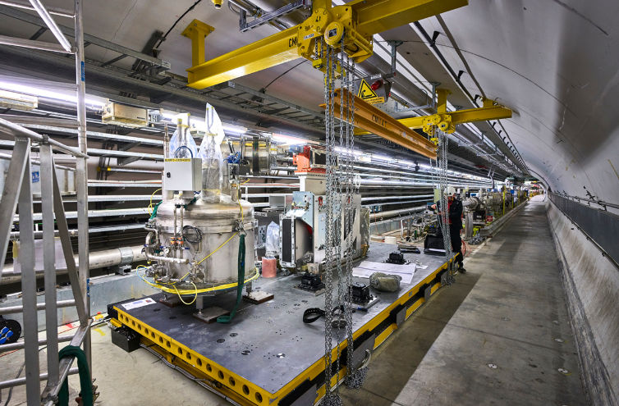
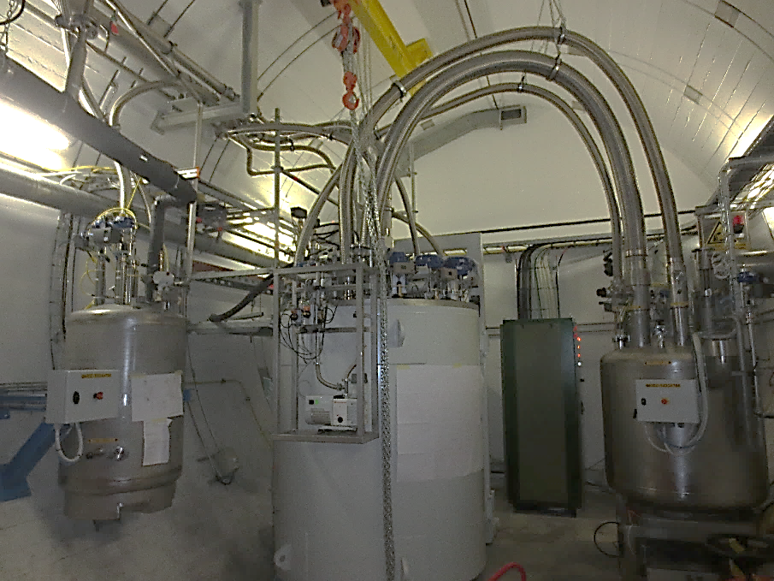
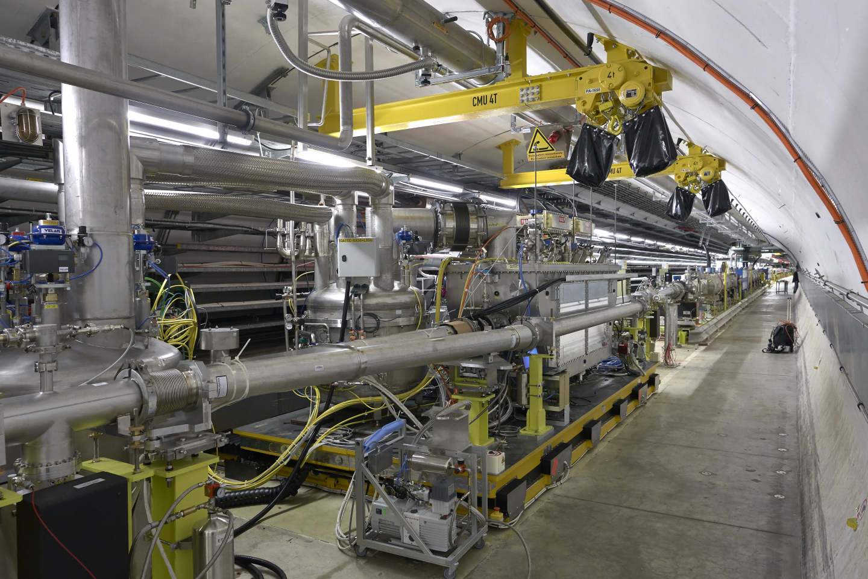
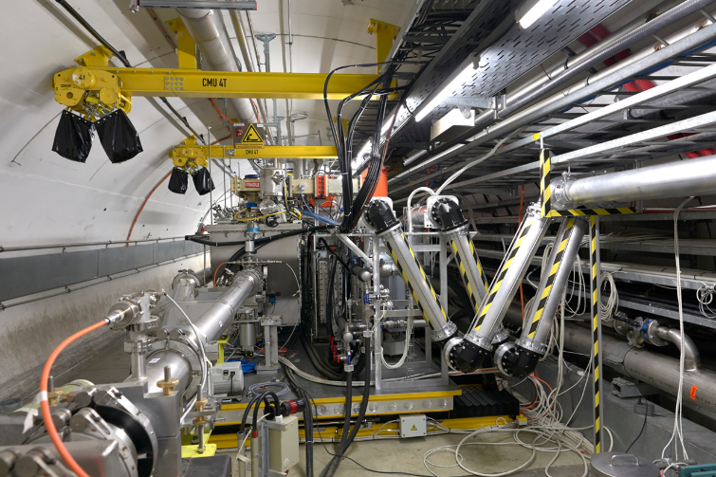
Tunnel Installation (SPS-BA6)
Compressor
80m long cryo distribution line
Cryo-service-box
Transfer-table
510 mm
movement in/out
Articulated vacuum Y-chamber with carbon coating
LN2 Phase separator
VB1
V-shaped coupling for RF waveguides
Cold-box
SPS-DQW Cryomodule

Slide 11
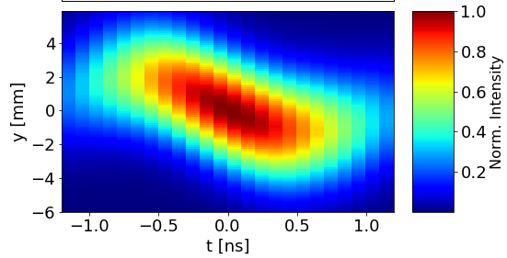
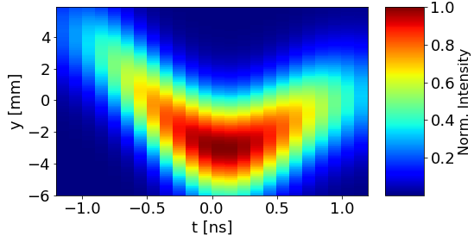
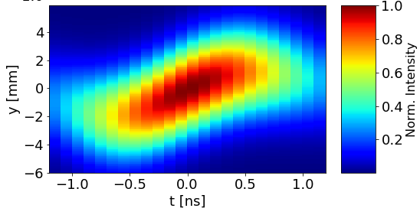
Recent Beam Experiment
0 Deg
First crabbed beam: May 23, 2018
RF phase scan w.r.t the beam phase with cavity 1
90 Deg
180 Deg
1 MV in cavity 1 (up to 2MV) – 4.5 K
~50 kV in cavity 2, limited by cavity vacuum
Thermal cycle and down to 2K this week

Slide 12
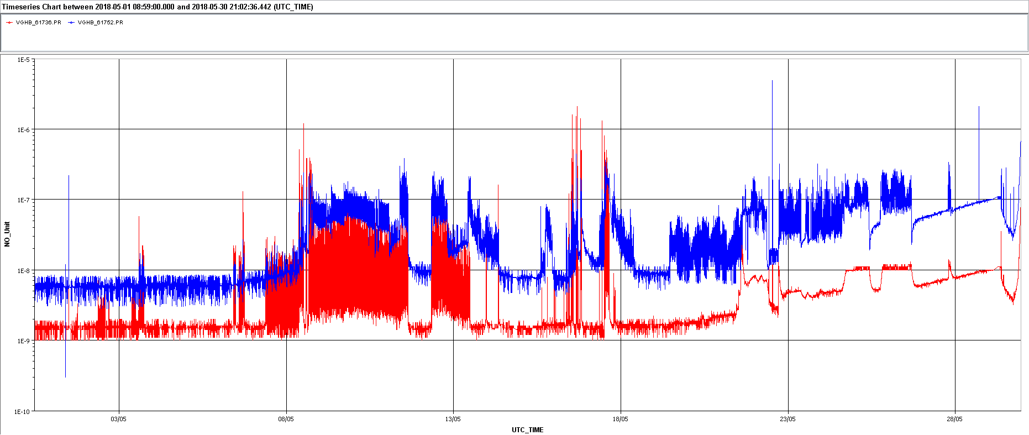
RF Conditioning, Vacuum Evolution, May 2018
RF Conditioning of C1 & C2
Upward trend, to be improved after thermal cycling & pumping
No static offset, timber plotting artifact

