Slide 1
The SRF Gun Project at SLAC
Bruce Dunham and Nora Norvell
With inputs from Theo Vecchione, and XJ Wang

Slide 2
Motivation: We need a 3-4X reduction in emittance for the LCLS-II-HE project
Emittance at Undulator
Photon Energy (keV)
LCLS-II Injector
The emittance at the injector will need to be at least 4X lower than we can generate now to reach 20 keV (< 0.1 um needed)
Electron Energy (GeV)
Notes:
You saw this figure earlier as part of the HE presentation, but it conveys the key point for this presentation
This plot shows the photon energy obtainable at 8 GeV for various emittances.
With the current LCLS-II injector, 12.8 keV at 8 GeV is predicted.
Lowering the beam emittance at the undulator provides harder x-rays
To reach 20 keV, need 0.1 um at the undulator, about 4X lower than we can do today
Developing a new injector to reach harder x-rays is much cheaper than doubling the linac energy or adding an SC undulator
Can imagine a staged approach, culminating in a new injector. Just changing the photocathode and laser may get us to the middle of the range

Slide 3
Injector Requirements for future XFELs
The main goal for our injector R&D program is to develop an electron injector for future XFELs that enables the generation of x-rays > 20 keV at 8 GeV
The main requirements for the full injector are:
100 MeV beam energy
1 MHz repetition rate
ε_{N} =0.1 μm at 100 pC bunch charge (at the undulator)
ε_{N} <0.1 μm at 100 pC bunch charge (at the injector end)
ability to tailor the longitudinal phase space
photocathodes with a lifetime of at least 1 week
visible/IR drive laser preferred for enhanced laser shaping

Slide 4
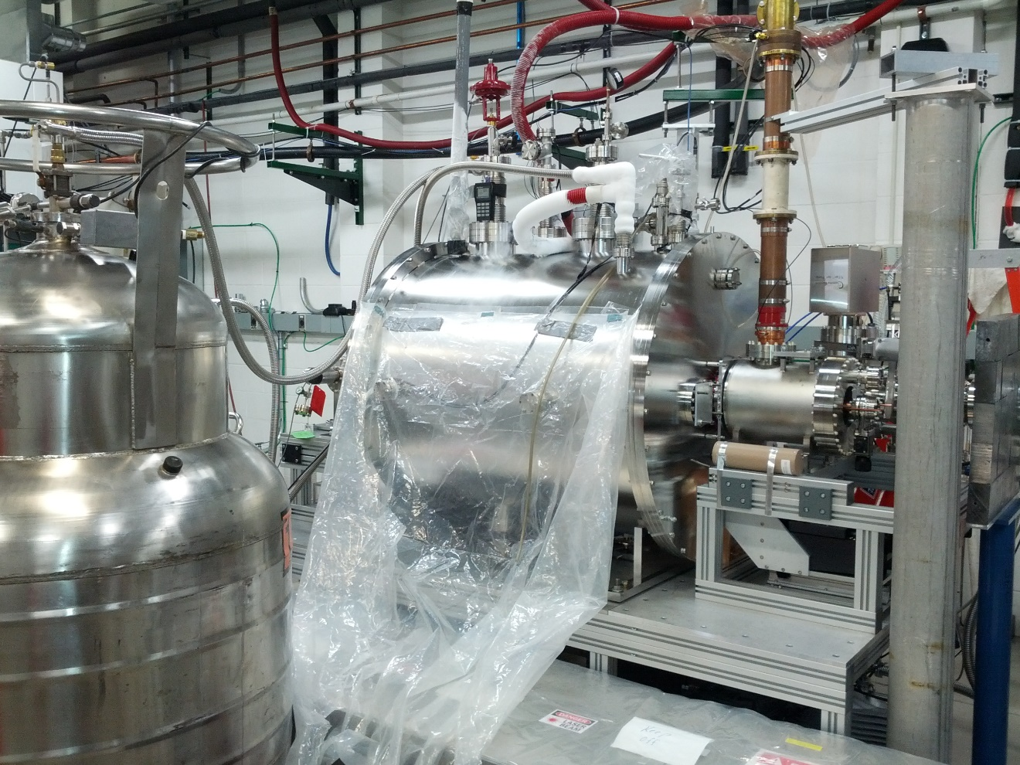
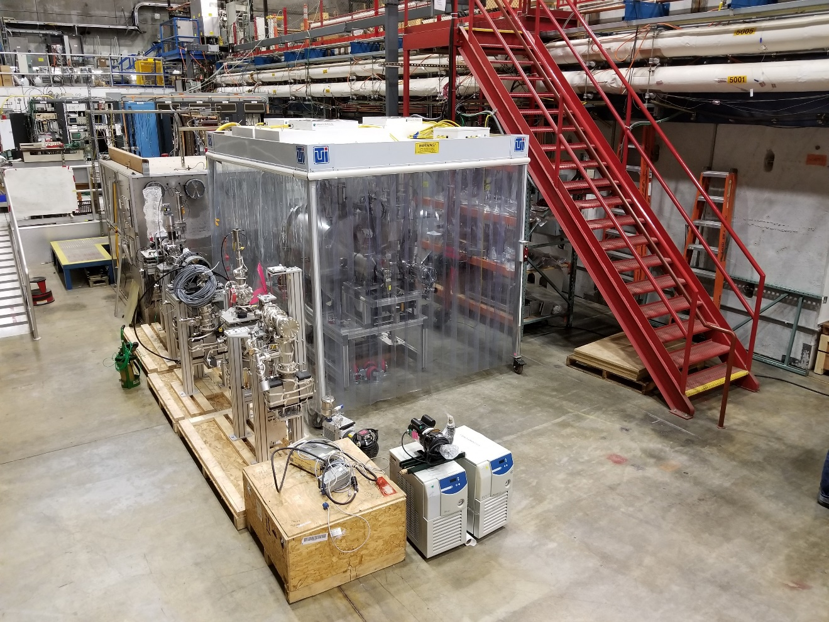
Recommissioning the 200 MHz ¼ Wave WiFEL Gun
Opportunity to demonstrate SRF gun technology for both LCLS-II HE and UED/UEM
Design parameters
45 MV/m gradient
4.0 MeV beam energy
1 um emittance @ 200 pC
Recommissioning goals
Validate hardware survived relocation
Replicate previous results
WiFEL system at Wisconsin
Previously demonstrated performance
Q₀ > 3e9
26 MV/m gradient w/o photocathode
12 MV/m gradient w/ Cu photocathode
1.1 MeV beam energy
0.7 μm emittance for 12 pC @ 1.1 MeV
1.5 μm emittance for 100 pC @ 1.1 MeV
WiFEL system relocated at SLAC

Slide 5
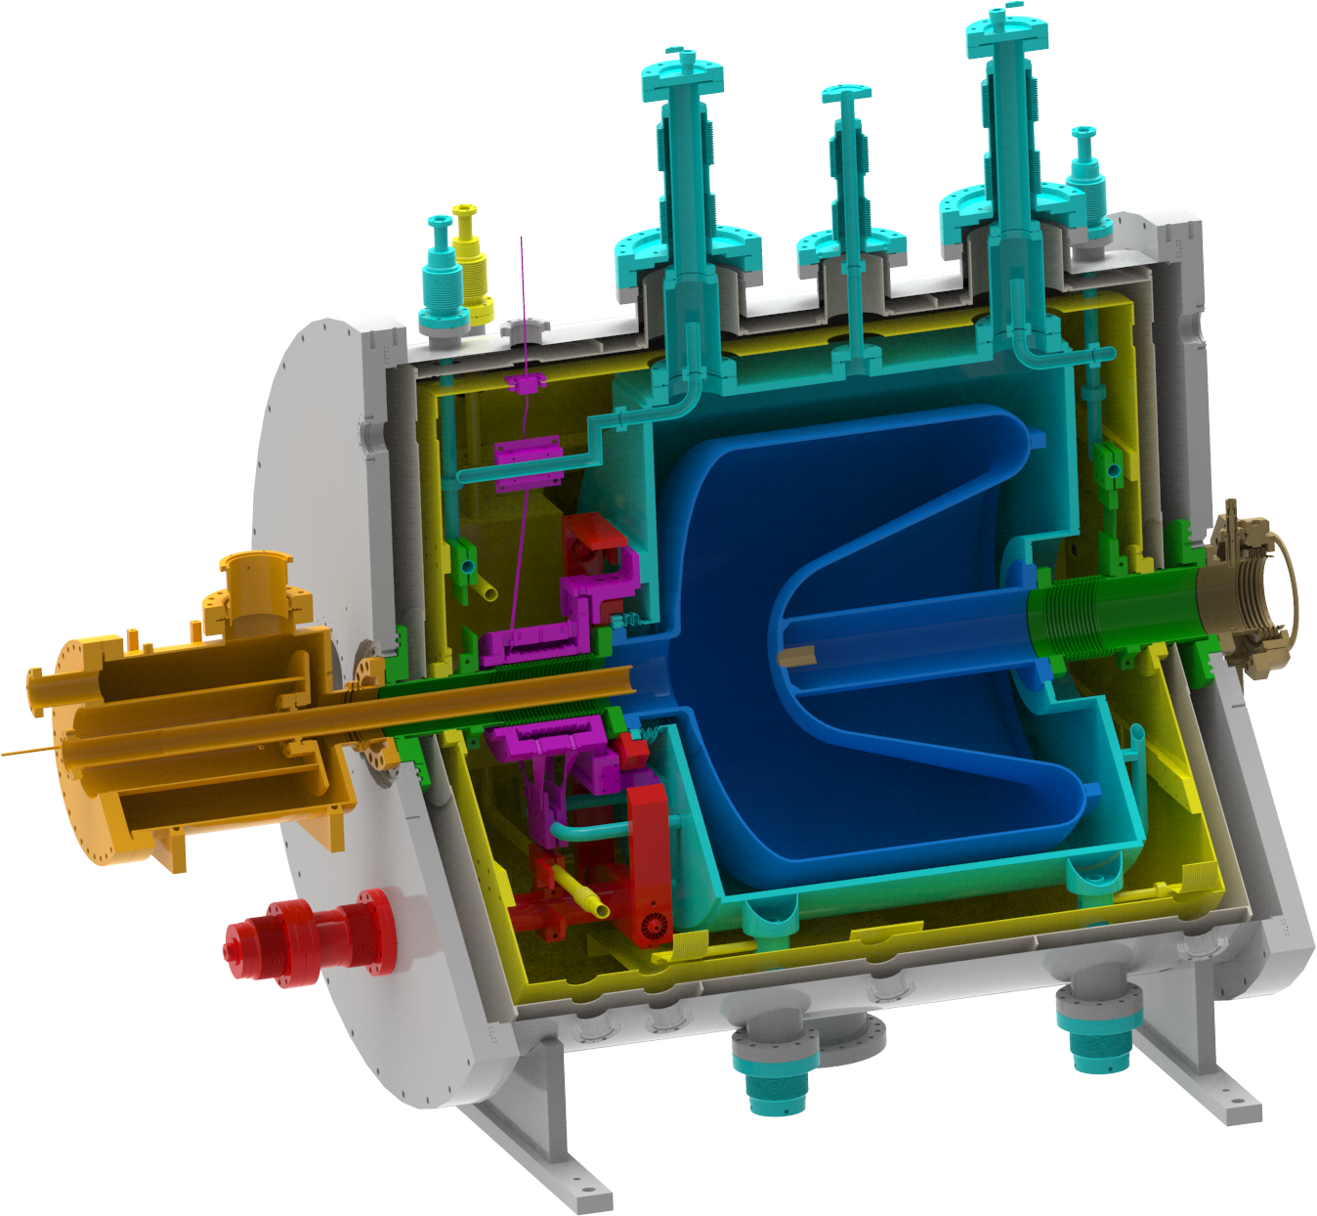
SLAC SRF Gun Design
Vacuum Vessel
Magnetic Shield
LN Shield
LHe Vessel
RF Cavity
Photocathode Stalk
Vacuum/Beam Pipe
High TC Solenoid
RF Tuner
RF Coupler

Slide 6
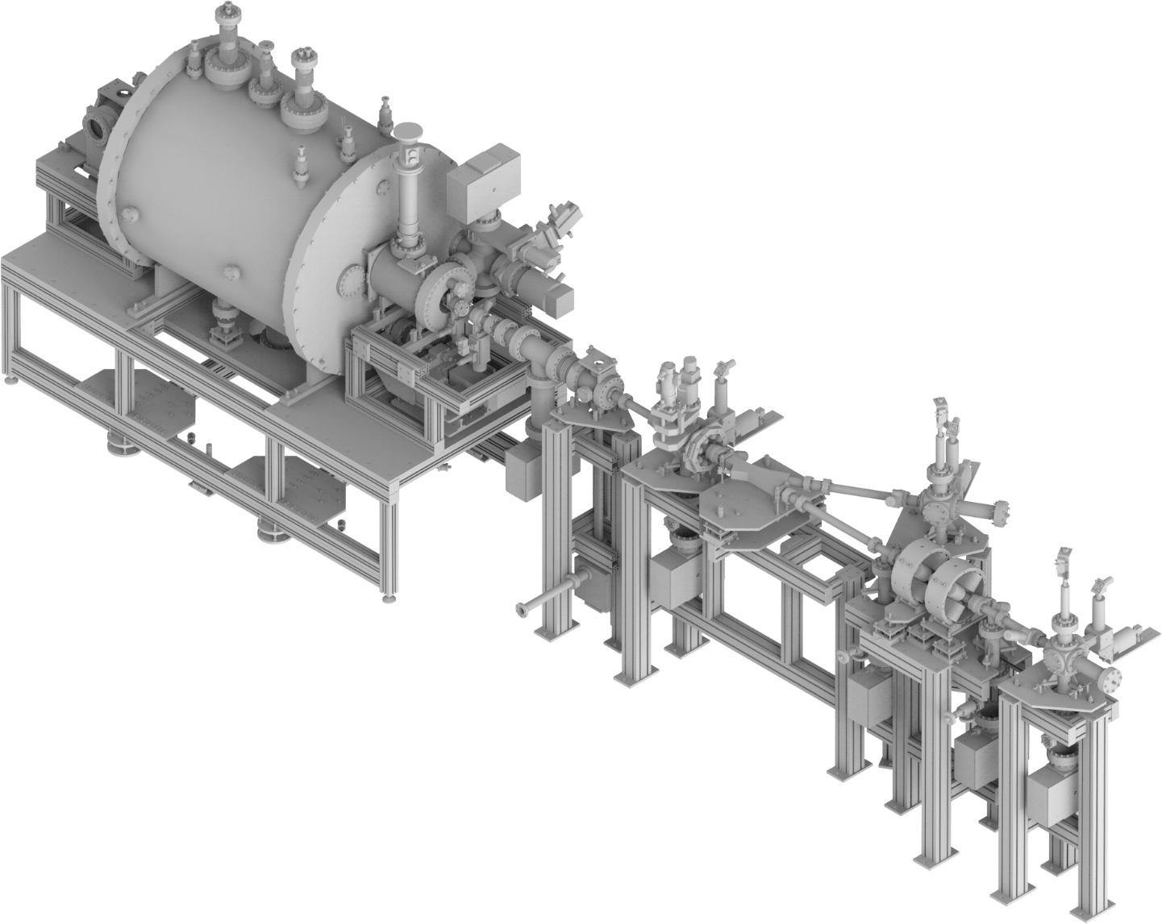
SLAC SRF Gun Beamline Layout
Solenoid
Profile
Monitor
Profile
Monitor
Faraday
Cup
Laser
beam
Profile
Monitor
Corrector
Corrector
Faraday
Cup
Bend
Quadrupoles

Slide 7
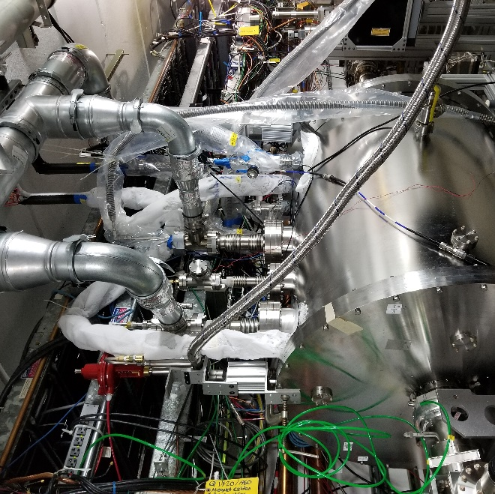
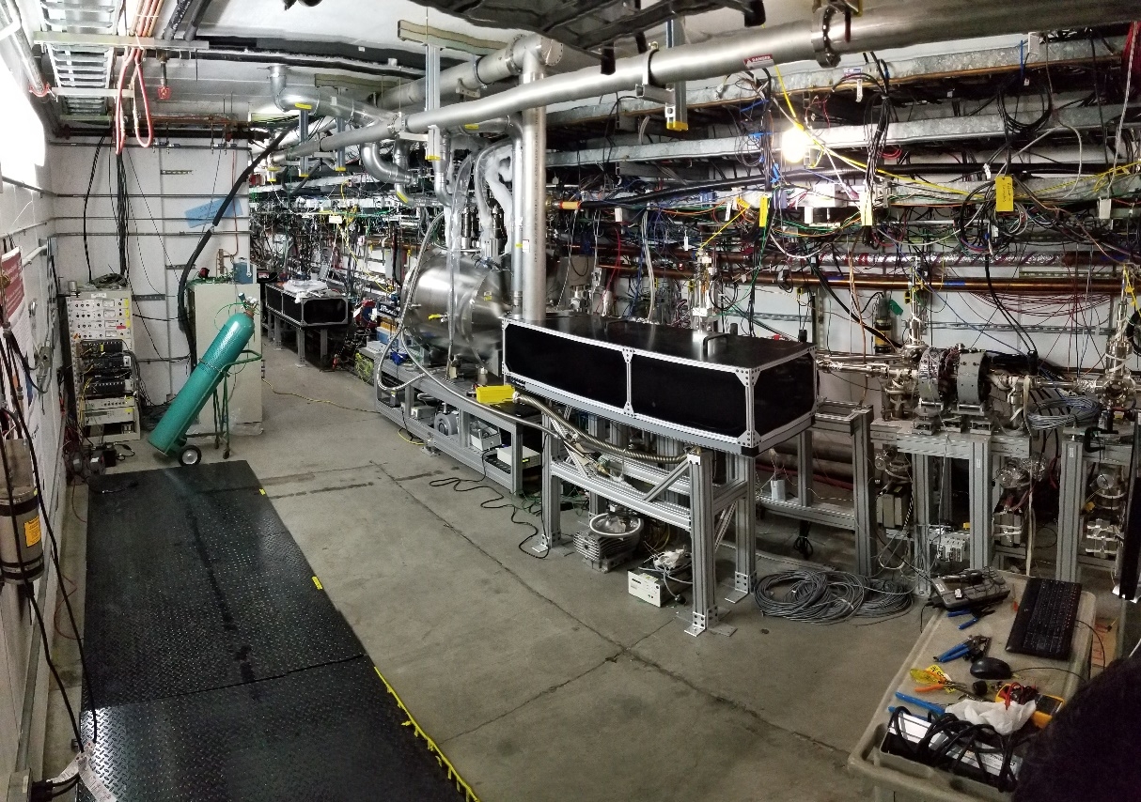
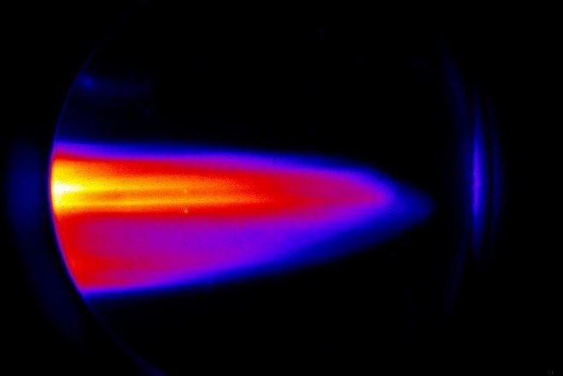
Six Months (and Several Safety Reviews) Later…
& operating
System Installed
~100 pC @ 1.1 MeV

Slide 8
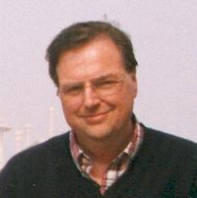
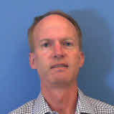
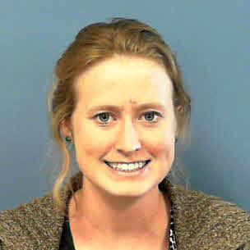
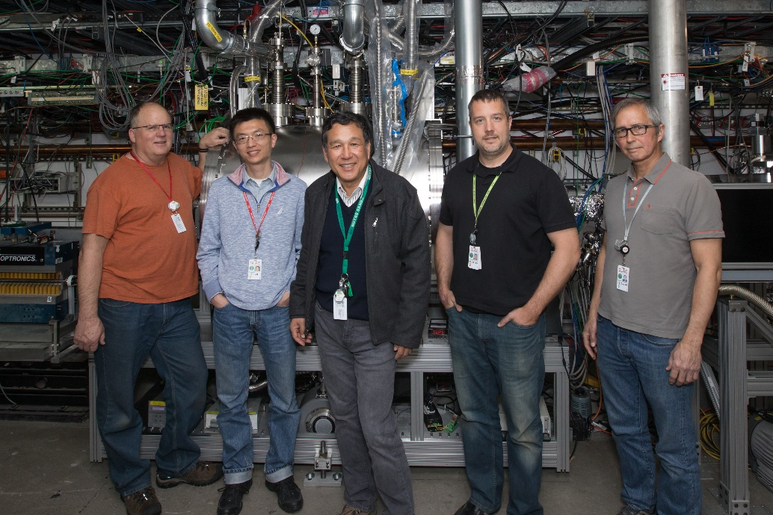
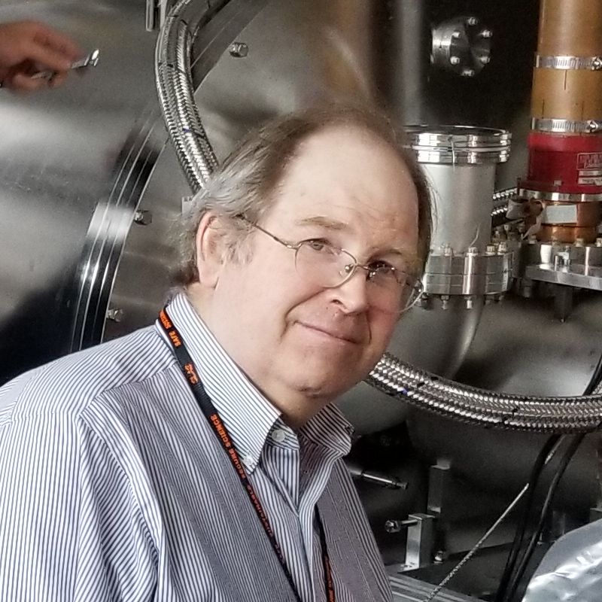
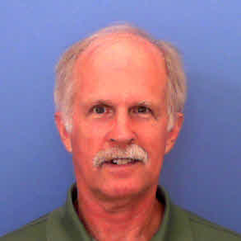
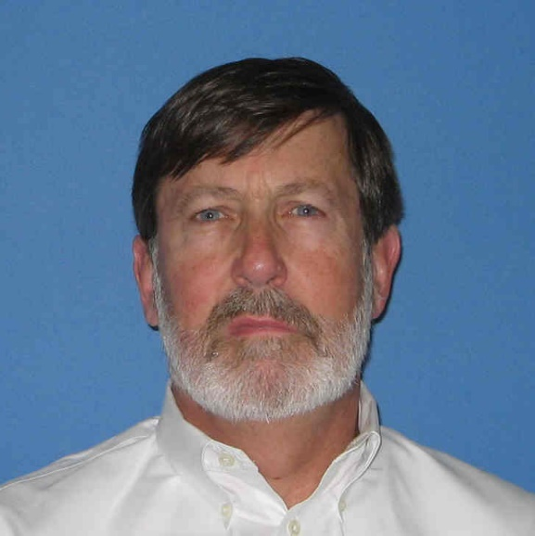
SLAC SRF Gun Project Team
Chris
Adolphsen
Bruce
Dunham
Nora
Norvell
Keith
Jobe
Renkai
Li
Xijie
Wang
Theo
Vecchione
Stephen
Weathersby
Bob
Legg
Tom
Peterson
John
Seabury

Slide 9
Next Steps
We are applying for funds to purchase a 4K 100W closed-loop Helium System
Design and build a cathode load lock system
Replace the copper coating on the cathode tube
Fix the laser-RF synchronization
Add an accurate emittance measurement system

