Slide 1
ISAC-I and ISAC-II
Phase I
Phase II
Cold traps
DTL
RFQ

Slide 2
ISACII SC-Linac
Phase II SCC 2010 3 CM’s 6+6+8 cav/CM Veff=20MV
Phase I SCB 2006 5 CM’s 4cav/CM Veff=20MV
Cold traps

Slide 3
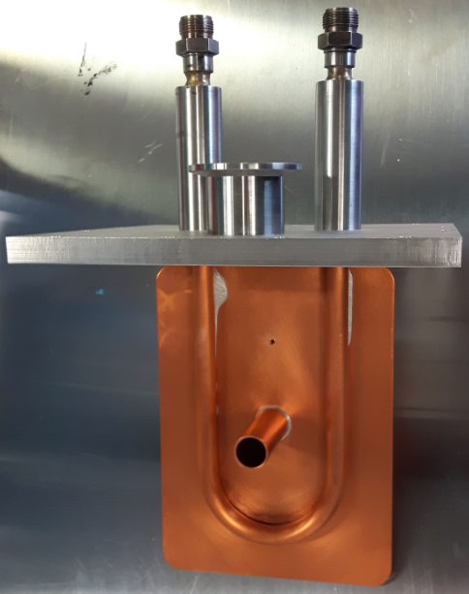
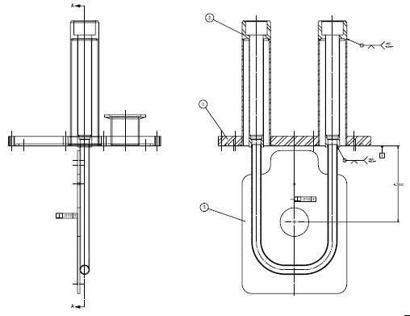
ISAC-II Cold Trap
LN2 tubing
Beam tube

Slide 4
Cavity Gradient in SCB1
2014
2015
2016
2013
2017
2018

