Slide 1
EP of LHC crab cavities

Slide 2
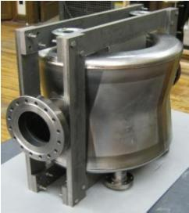
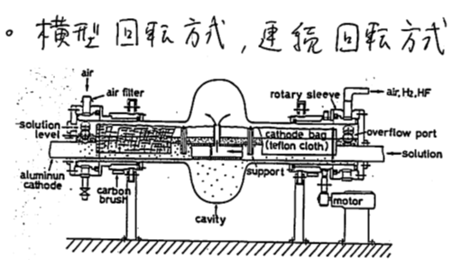
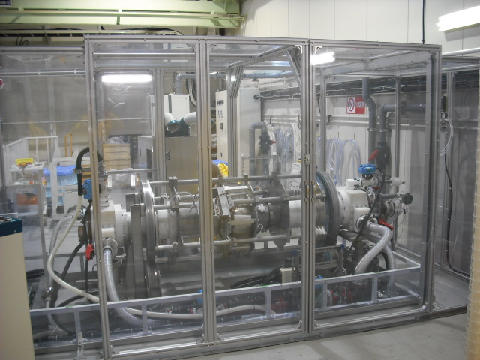
EP of LHC crab cavities
LHC Crab cavitis for LH-LHC
Compact and complicated cavity structure to meet space requirements
High fields are required for sufficient bunch rotation
  3.4 MV per cavity at 400 MHz with Q=10¹⁰,T=2K
  (KEKB crab: 1.4 MV at 509MHz with Q=10⁹,T=4.4K)
Surface treatment is one of important issues
  CP(Chemical polishing) is used so far
EP (Electro-polishing)
First applied to TRISTAN SRF cavities at KEK
Horizontally rotating technique
Smoother surface than CP
Standard treatment method for high field cavities
VEP (Vertical EP)
We proposed an R&D on application of EP to LHC crab cavities
Horizontally rotating technique is difficult to apply
Develop vertical EP at our EP station
BNL DQW cavity
Horizontally rotating EP system developed for TRISTN SC cavities
Our EP apparatus for 500 MHz cavity

Slide 3
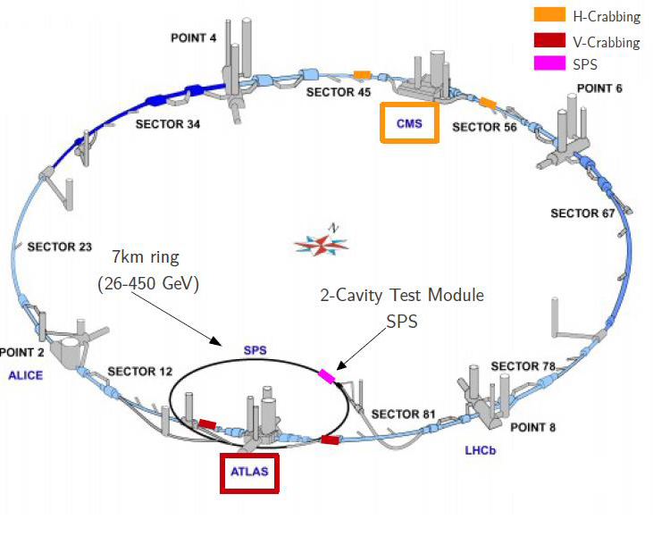
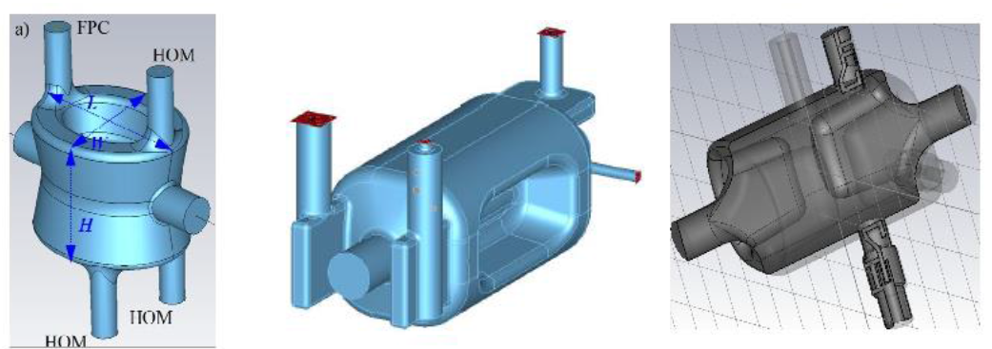
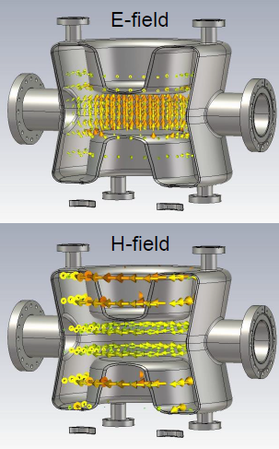
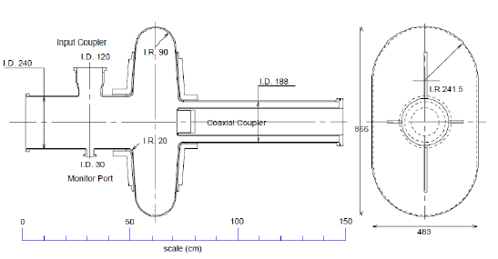
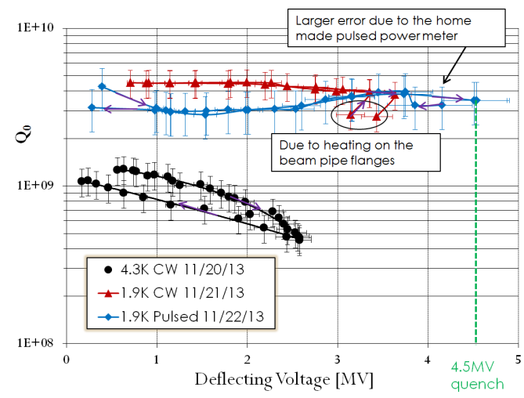
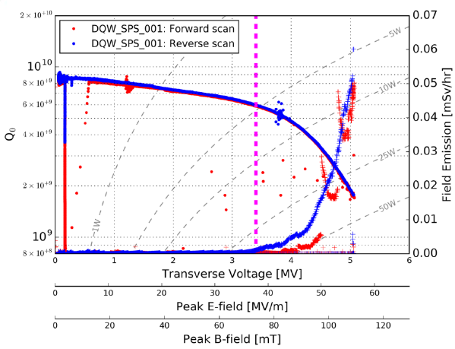
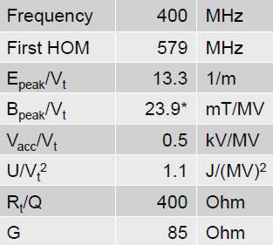
Crab crossing for HL-LHC
Several designs for LHC crab cavity
DQW of BNL
RFD of JLab
4 Rod of UK
KEKB crab
We applied VEP to DQW, proof of principle (PoP) cavity to improve Q factors
SPS cavity fabricated and tested at CERN
RF parameters
Cold test
CERN
BNL

Slide 4
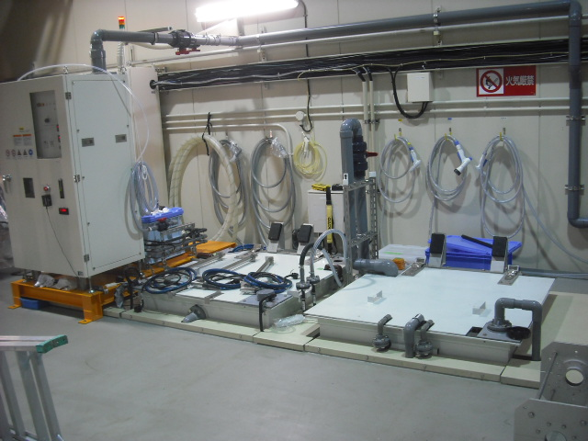
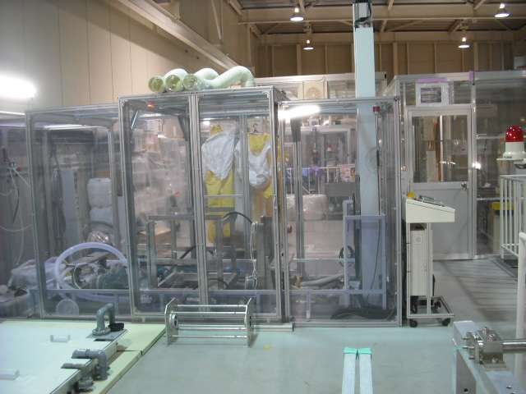
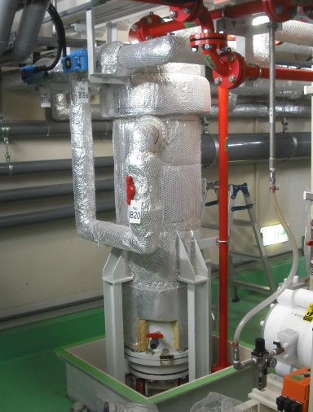
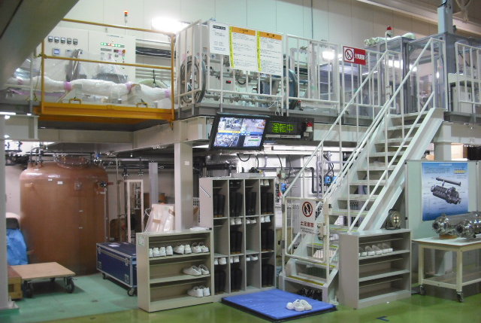
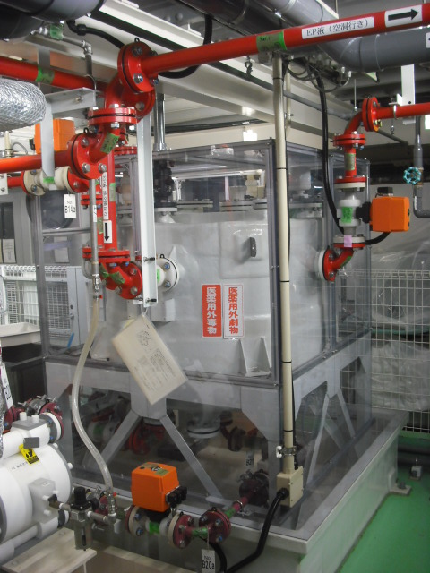
Ultrasonic rinsing bath and shower rinsing tank
Movable EP bed
Electrolyte heat exchanger
Specifications
Electrolyte tank: 500L
Electrolyte flow rate: 40L/min
Heat exchanger: PFA shell and tube type
Power supply: 50V-1000A
Ultra-pure water tank: 2500L
Ultrasonic system: 40kHz, 3.6kW
500L electrolyte tank
2500L ultra-pure water tank
Our EP facility for 500MHz SRF cavity at KEK

Slide 5
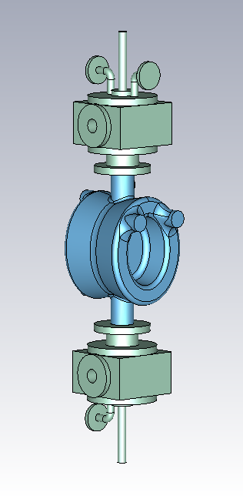
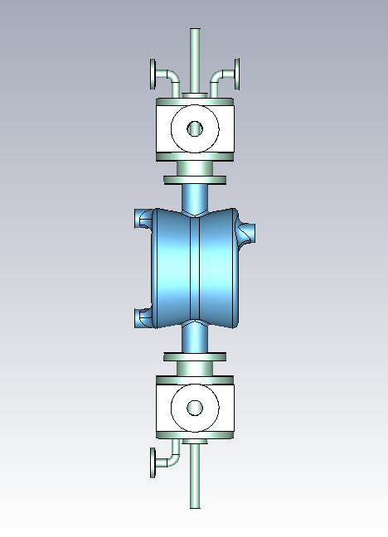
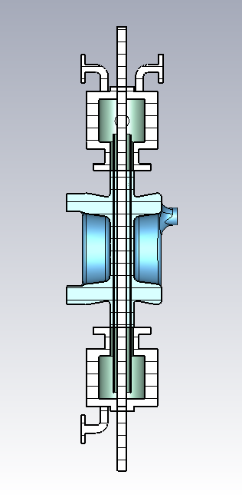
Vertical EP apparatus design
N₂ inlet
H2 outlet
Upper Teflon box
Electrolyte outlet
Al electrode: 32Φ
Teflon cathode bag
Electrolyte inlet
Lower Teflon box
Drain port

Slide 6
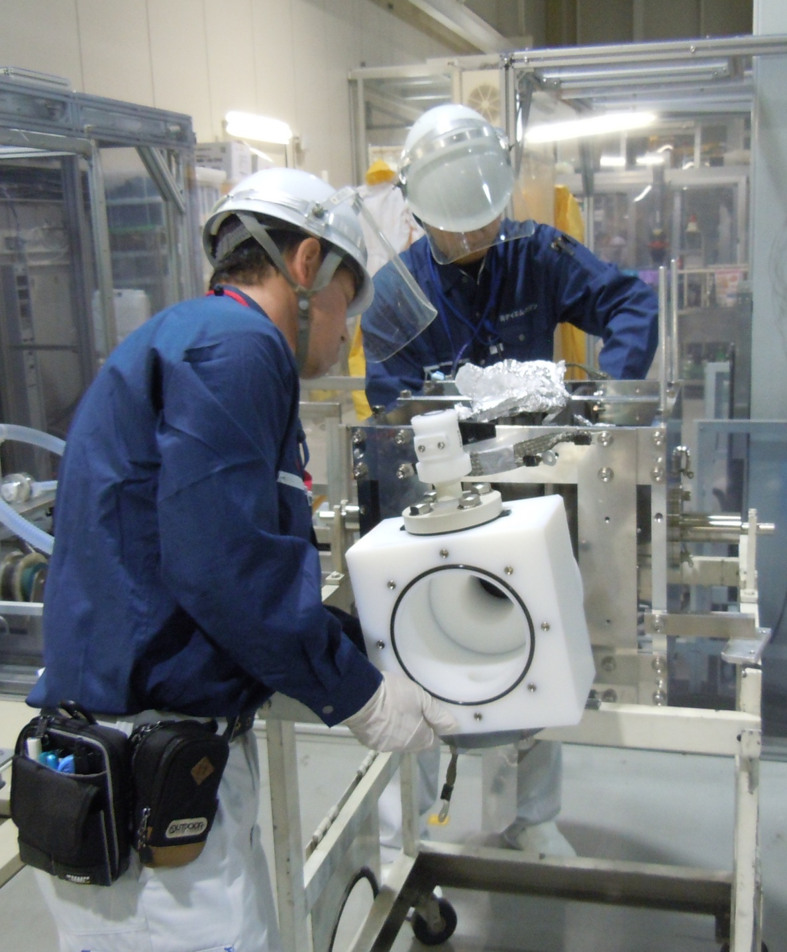
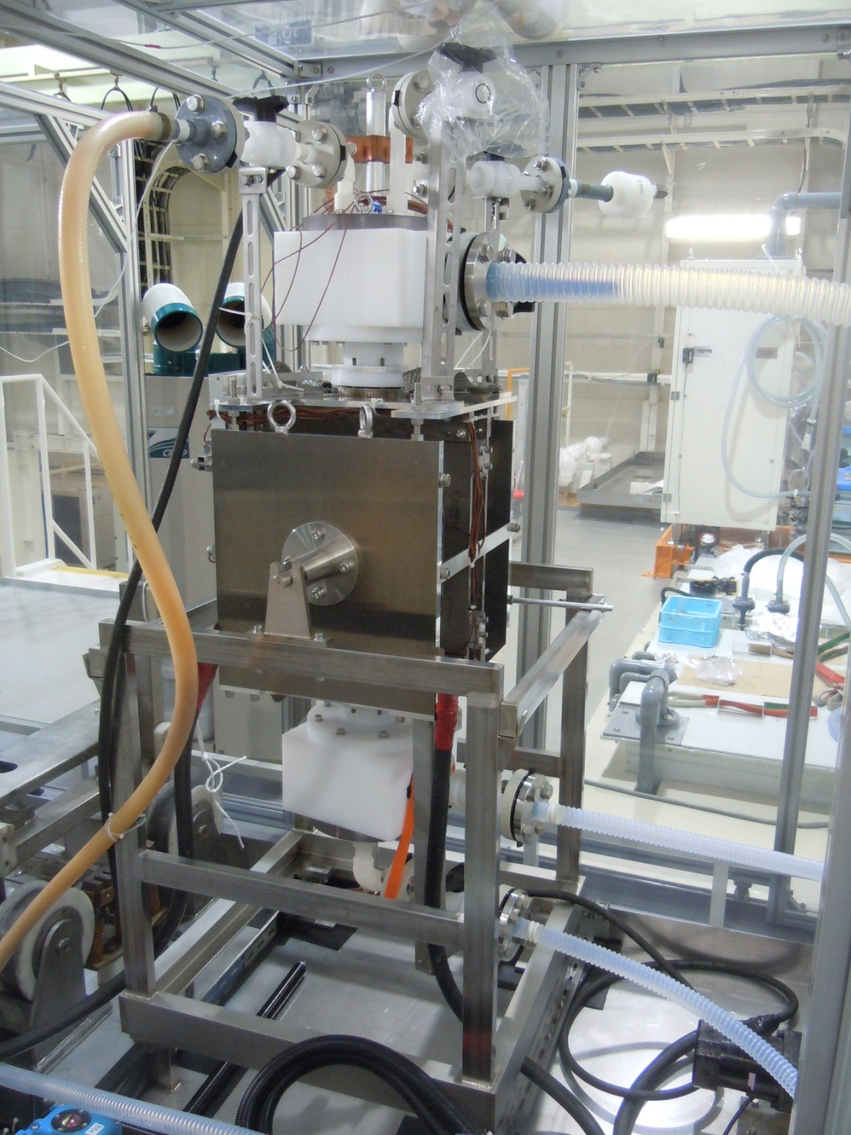
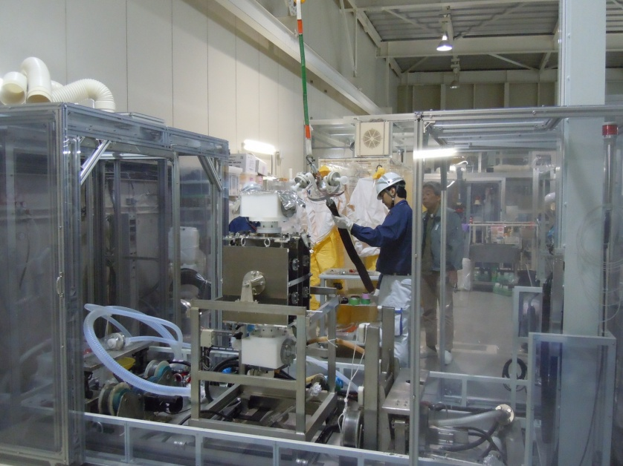
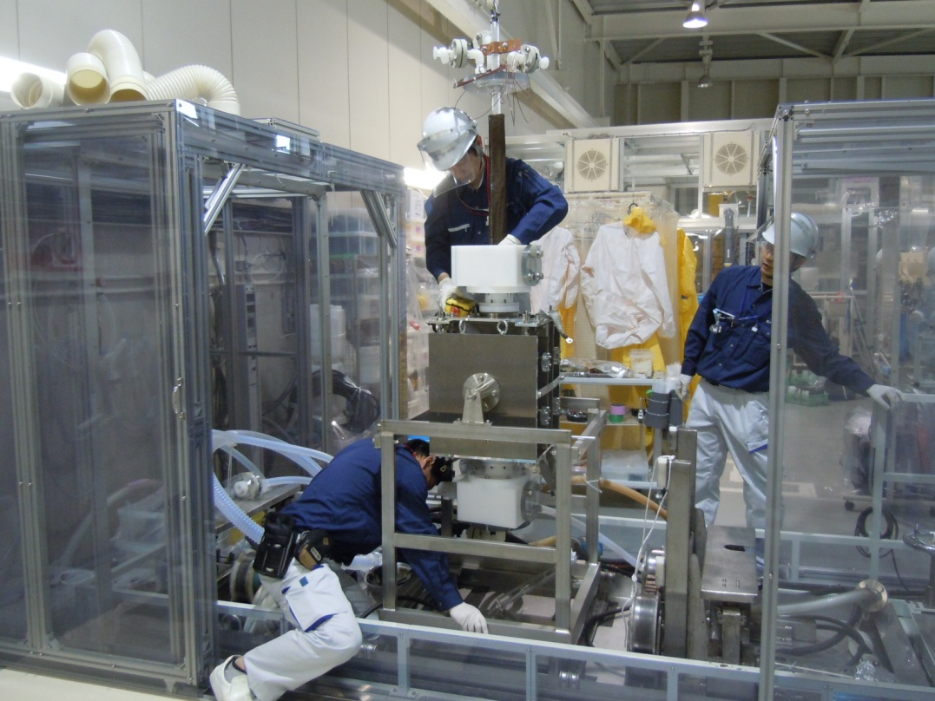
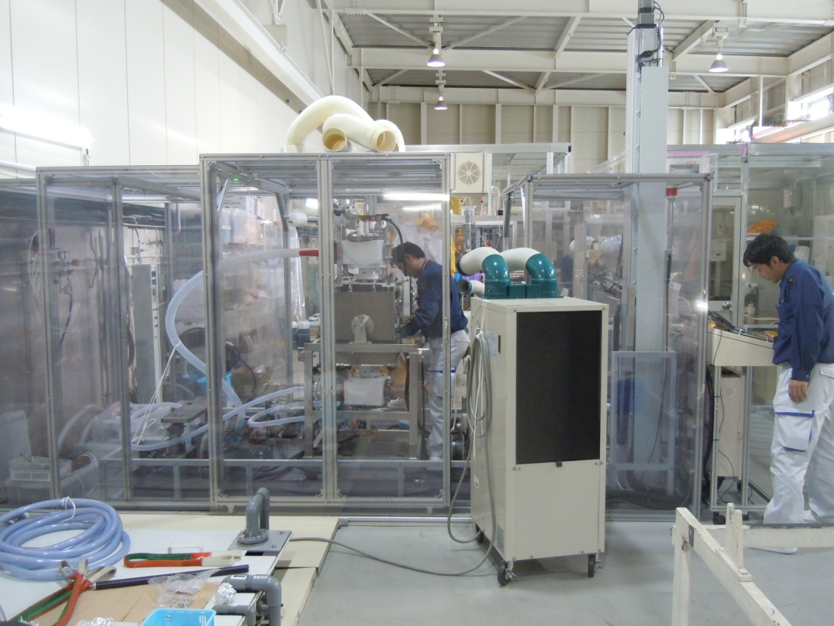
Setting up EP apparatus
Attaching Teflon box
Setting cavity at EP station
Ready for VEP
Inserting AL electrode
Connecting pipes and electric cables

Slide 7
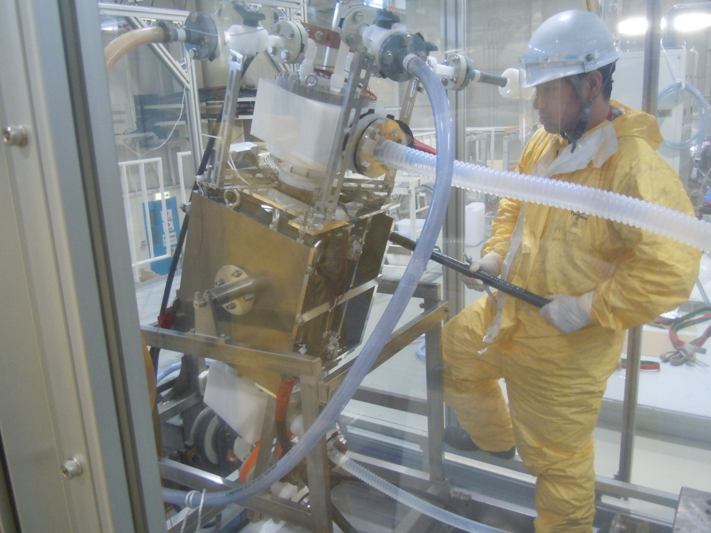
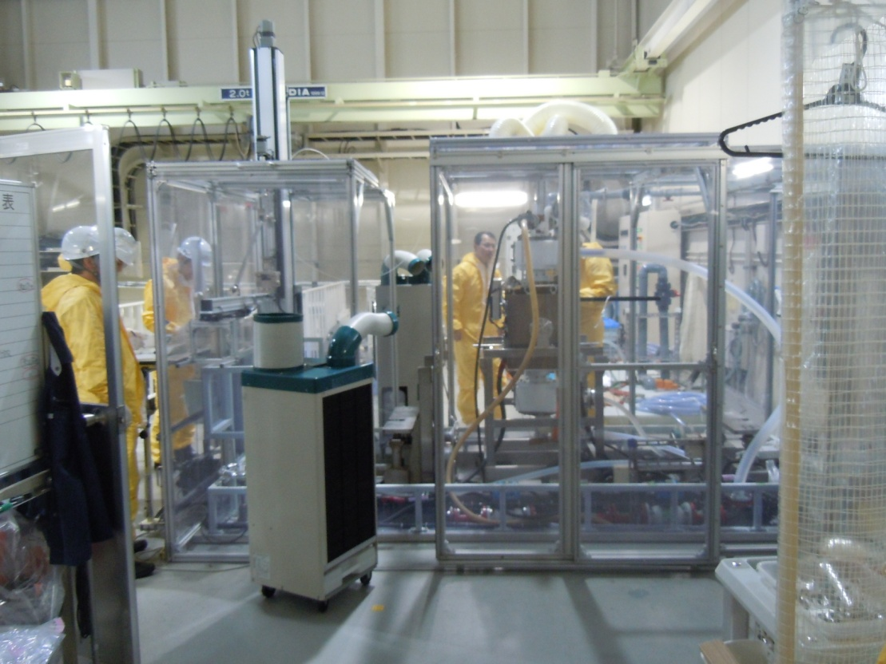
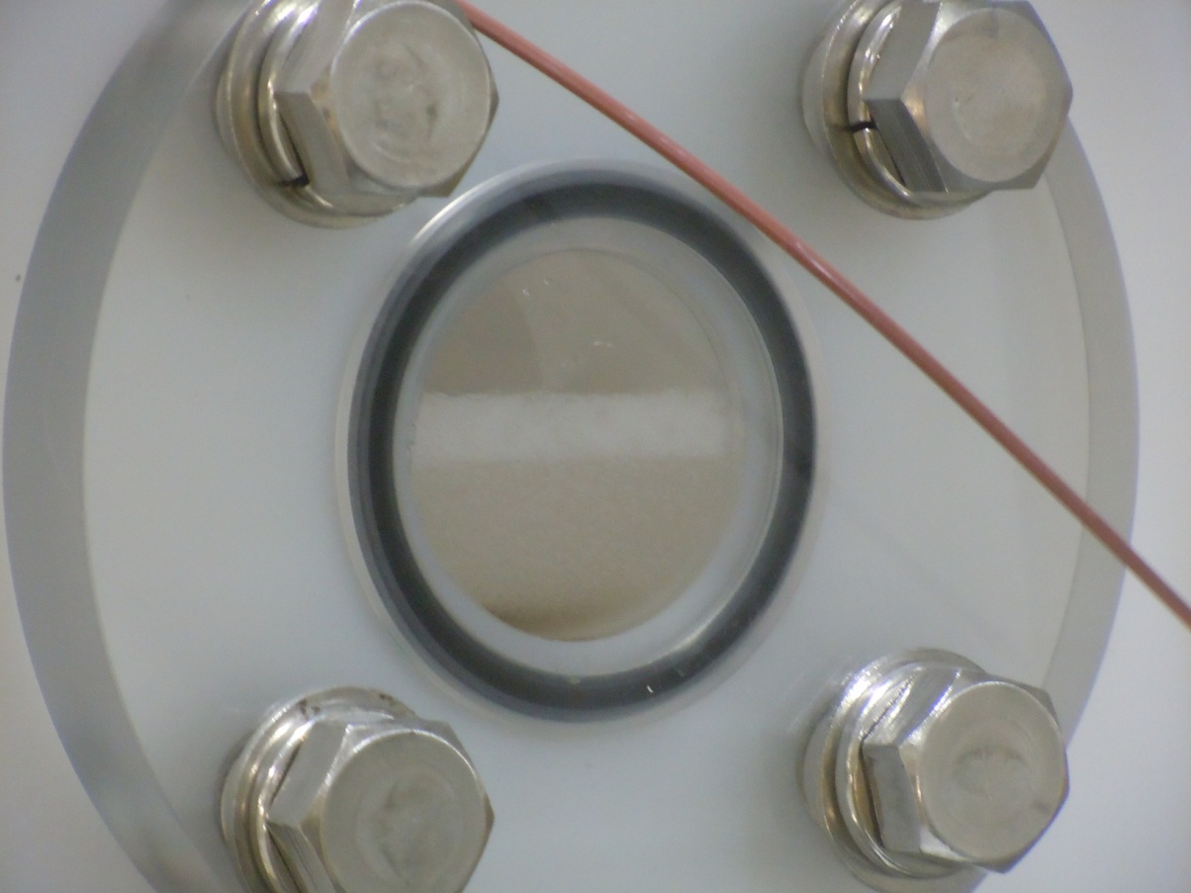
Vertical EP at KEK
Every 30 minutes we stopped EP to check the surface removal and tilt the cavity to agitate and remove air/H2
VEP conditions
Average current: 120 A
Average current density: 18 mA/cm²
Applied voltage: 17 V
Electrolyte flow rate: 15L/min
Electrolyte temperature: 28 C
Cavity cell temperatures < 40 C
Total integrated current: 293 Ah
Hydrogen bubbles
Upper Teflon box

Slide 8
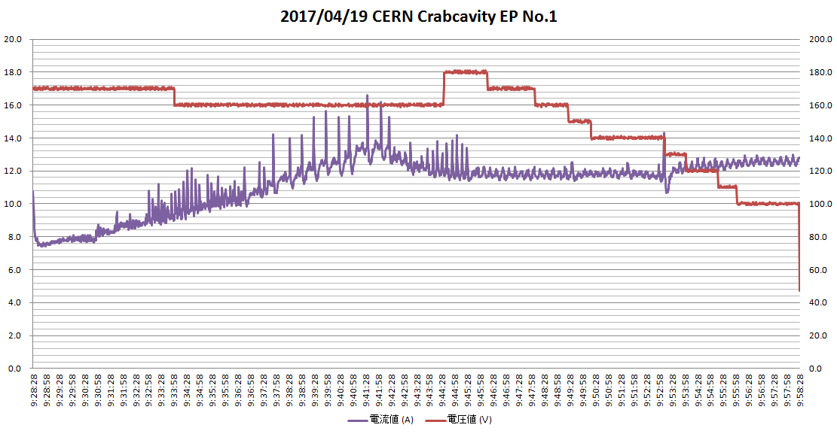
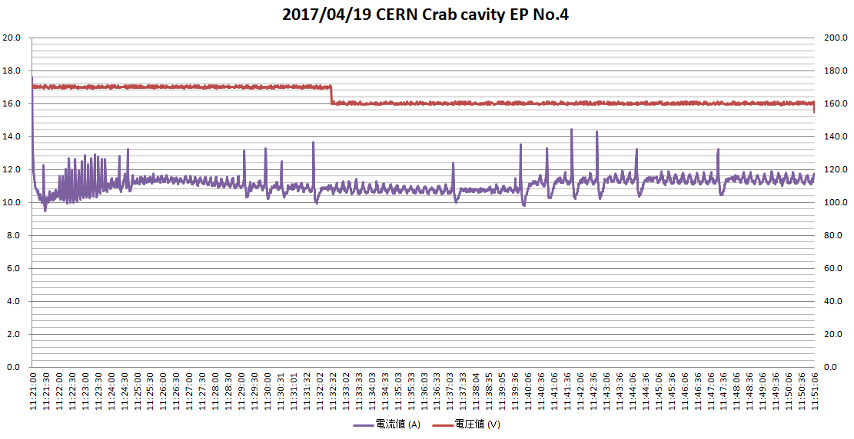
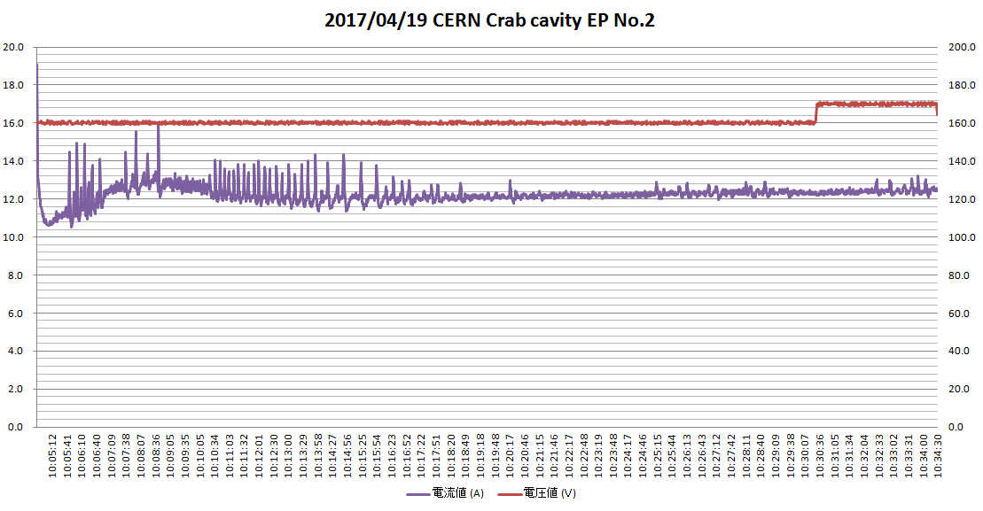
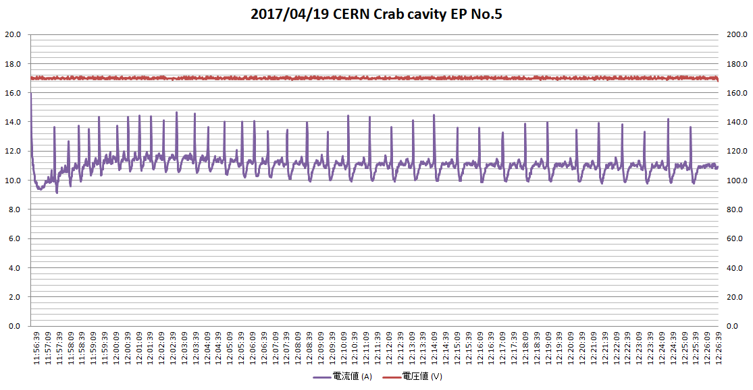
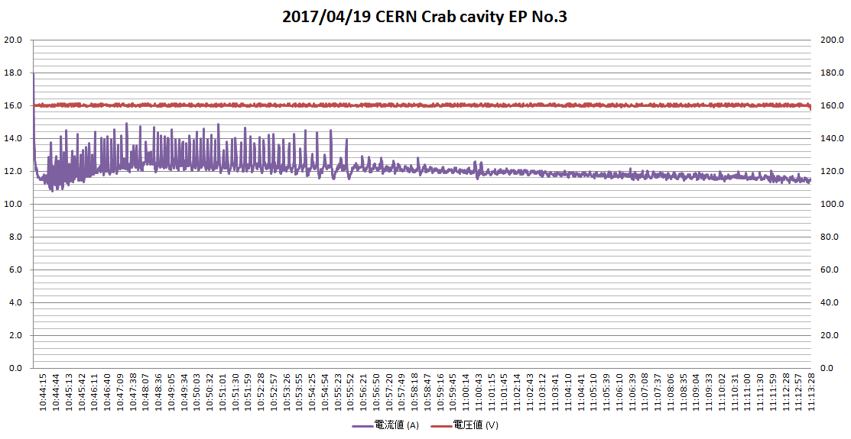
Applied voltage and current
20V
200A
1St round
V: 17 to 10 V
I: 80 to 120 A
4th round
V: 17~16 V
I: ~110 A
0V
0A
30minutes
2nd round
V: 16~17 V
I: ~120 A
5th round
V: 17V
I: ~110 A
Average voltage: 17 V
Average current: 120A
Average current density: 18 mA/cm²
3rd round
V: 16 V
I: ~120 A

Slide 9
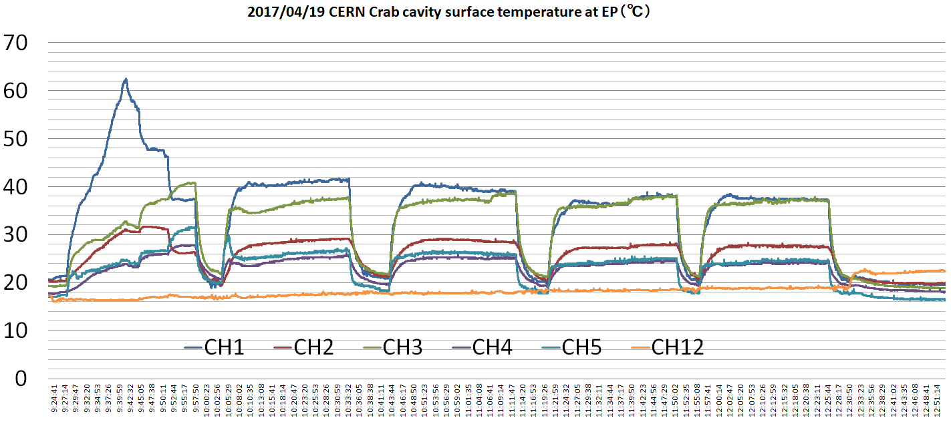
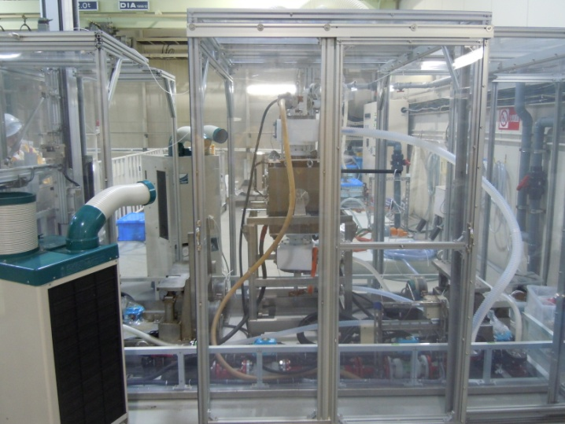
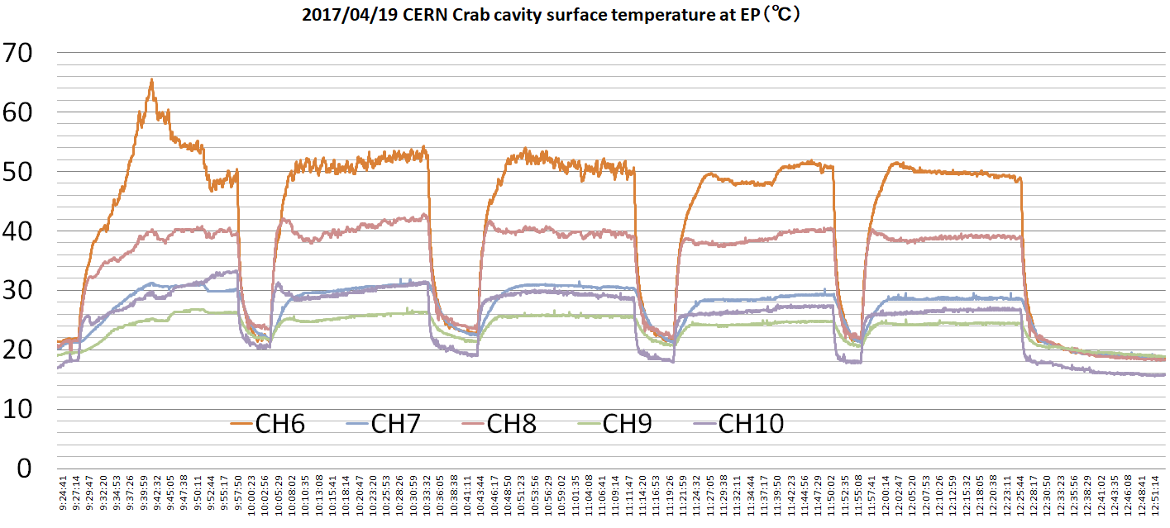
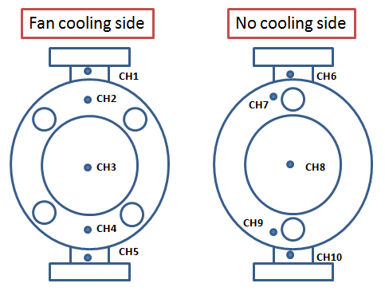
Temperatures during VEP
Temperatures at the upper beam pipe were higher than others. Temperatures at the top plate of the inner conductor were around 40 deg. Other temperatures were below 30 deg. We need to apply more cooling fans to cool down the upper beam pipe and top plates.
Fan cooling side
Fan cooling side
No cooling side
CH12: VEP room temperature
DQW cavity
Cooling fan
No cooling side
~40°
~50°
~40°
~40°

Slide 10
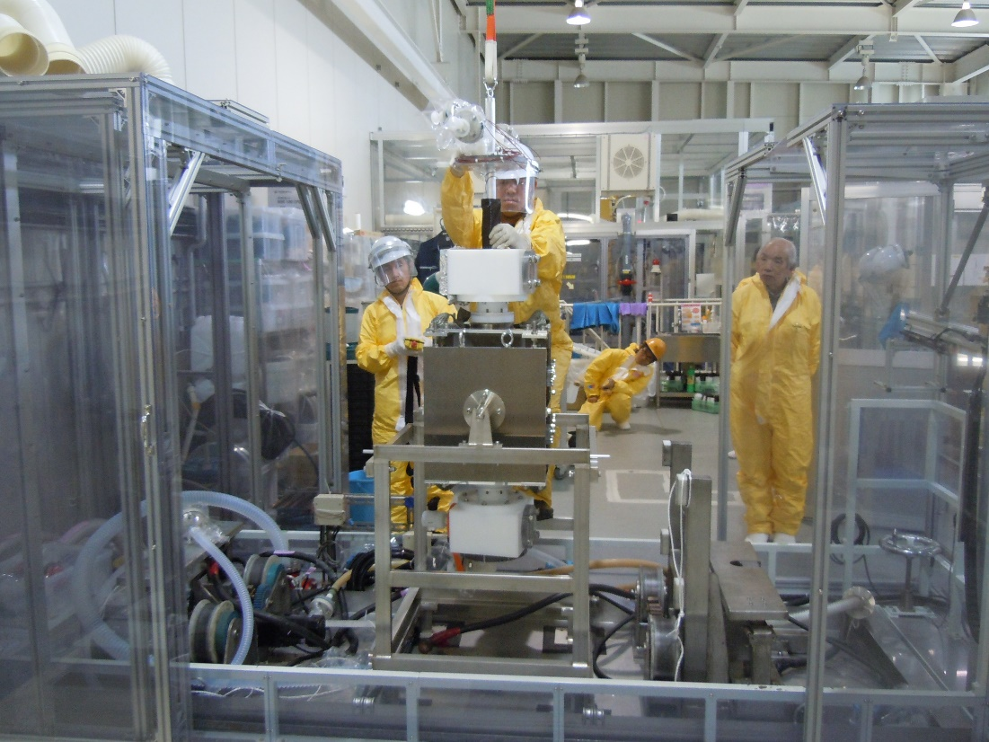
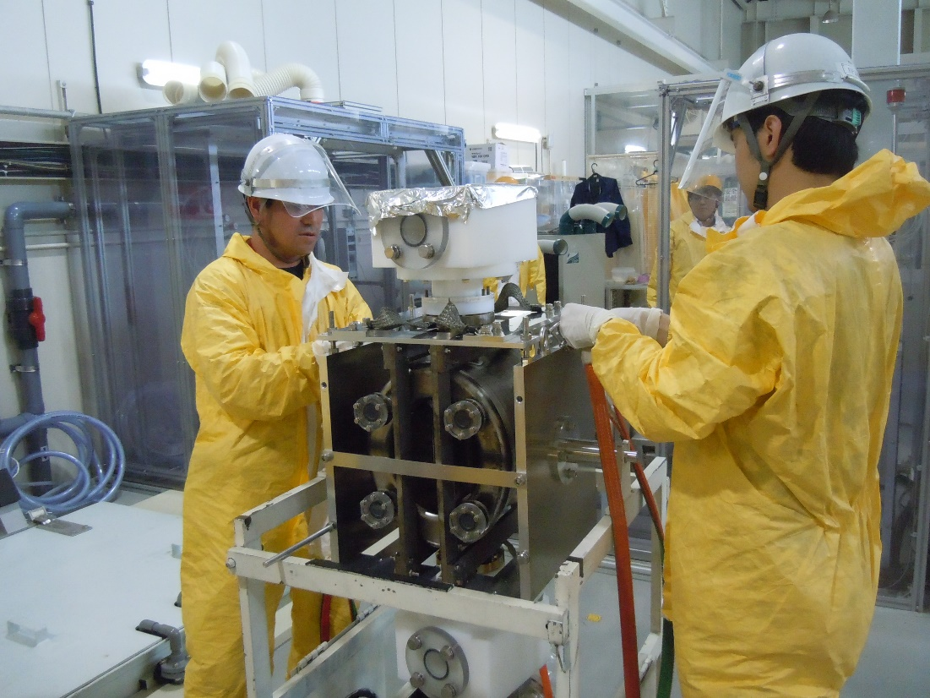
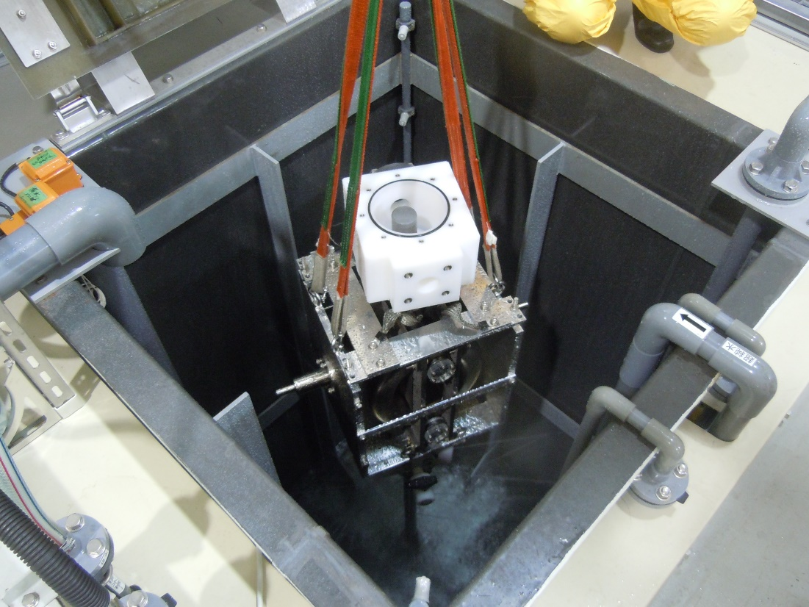
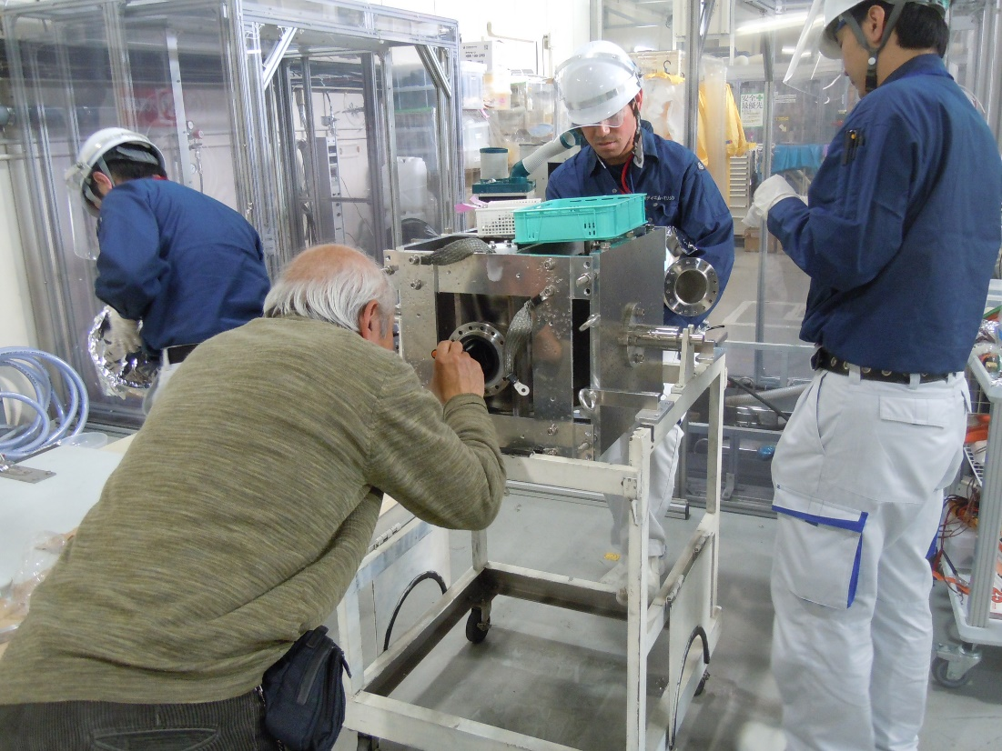
After VEP
Taking off Teflon boxes
Taking off the central electrode
Low pressure water shower rinsing with Teflon boxes for 10 minutes
Inspection of the inner surface

Slide 11
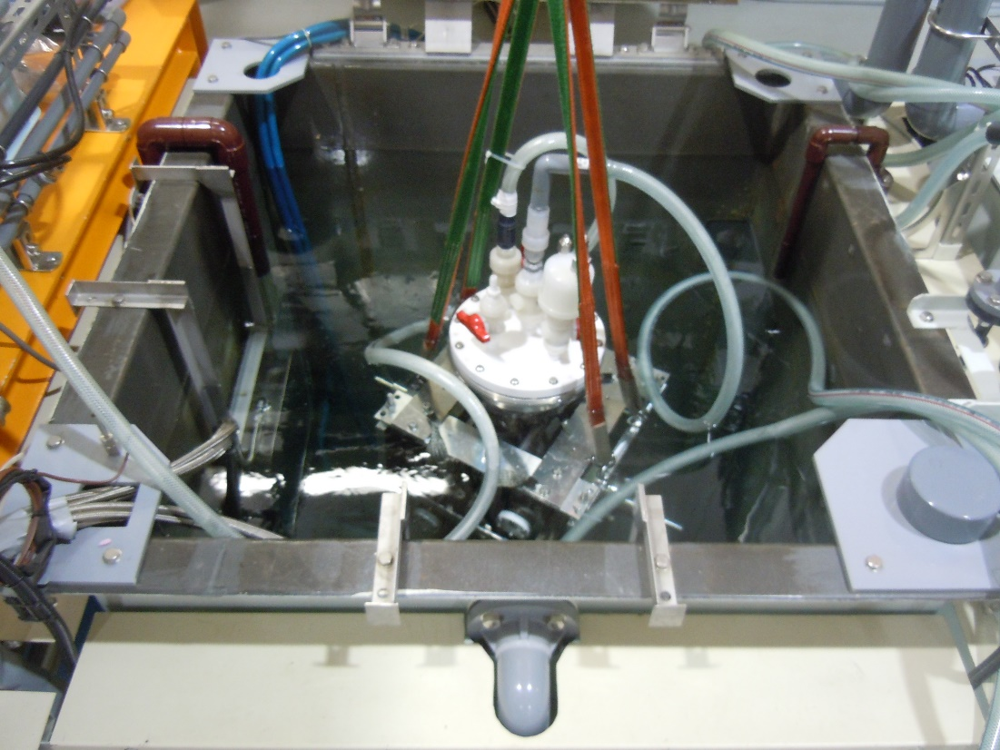
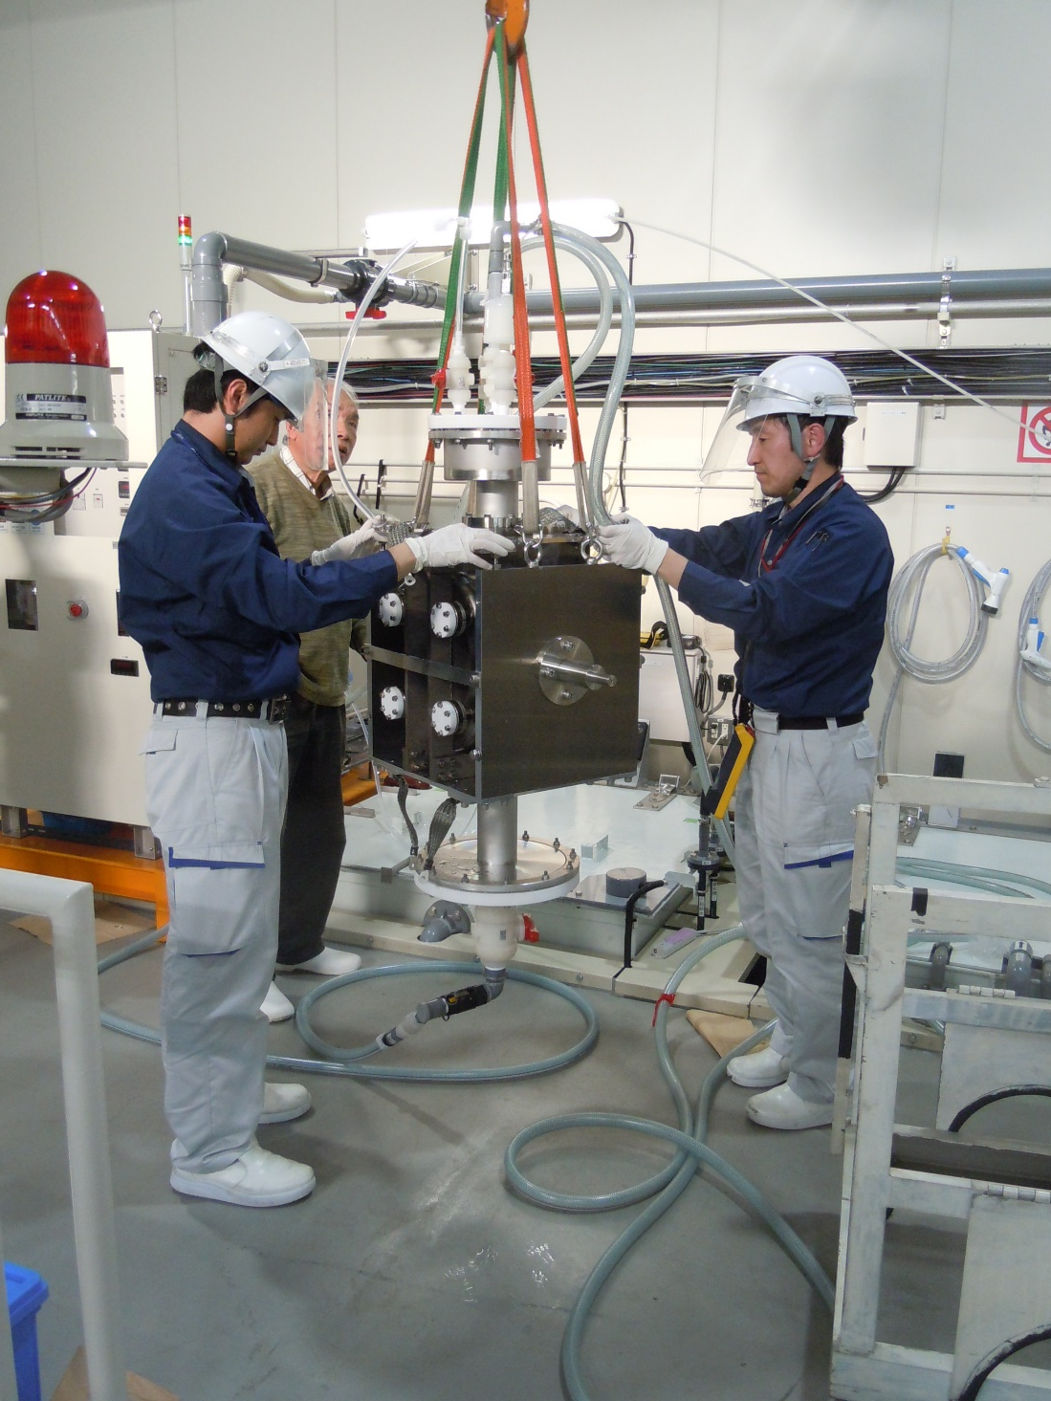
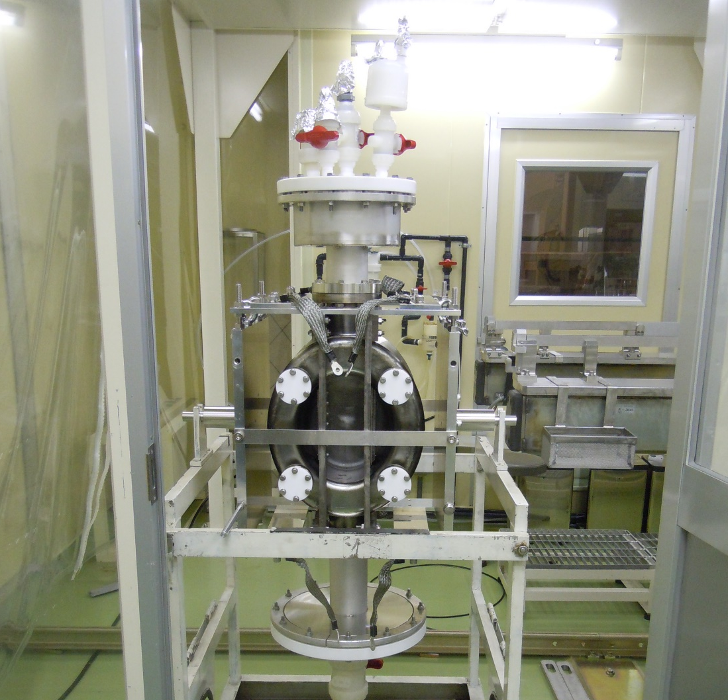
Rinsing procedure
Ultra sonic rinsing for an hour in a 50 C hot water bath
Ozon water rinsing for 10 minites with overflowing ozon water
Cavity in our clean room

Slide 12
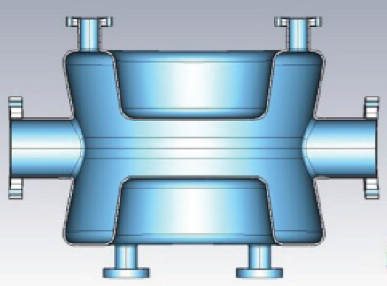
Vertical EP results
Sufficient surface removal obtained
VEP results
Average removal thickness: 35 μm (from I*T integral)
From thickness measurement;
Top plate: 44 μm
  Almost uniform polishing
Bottom plate: 22 μm on average
  Slightly position-dependent
  Upper part: 25 μm
  Middle part: 19 μm
  Lower part: 20 μm
Wall (between top and bottom plates)
  Position-dependent
  Upper part: 30 μm
  Middle part : 29 μm
  Lower part : 80 μm
Bottom plate
Upper part
Upper wall
Middle wall
Top plate
Bottom plate
Middle part
Lower wall
Bottom plate
Lower part
Electrolyte flow
Large removal. Need to improve. Turnover during polishing is an option.

Slide 13
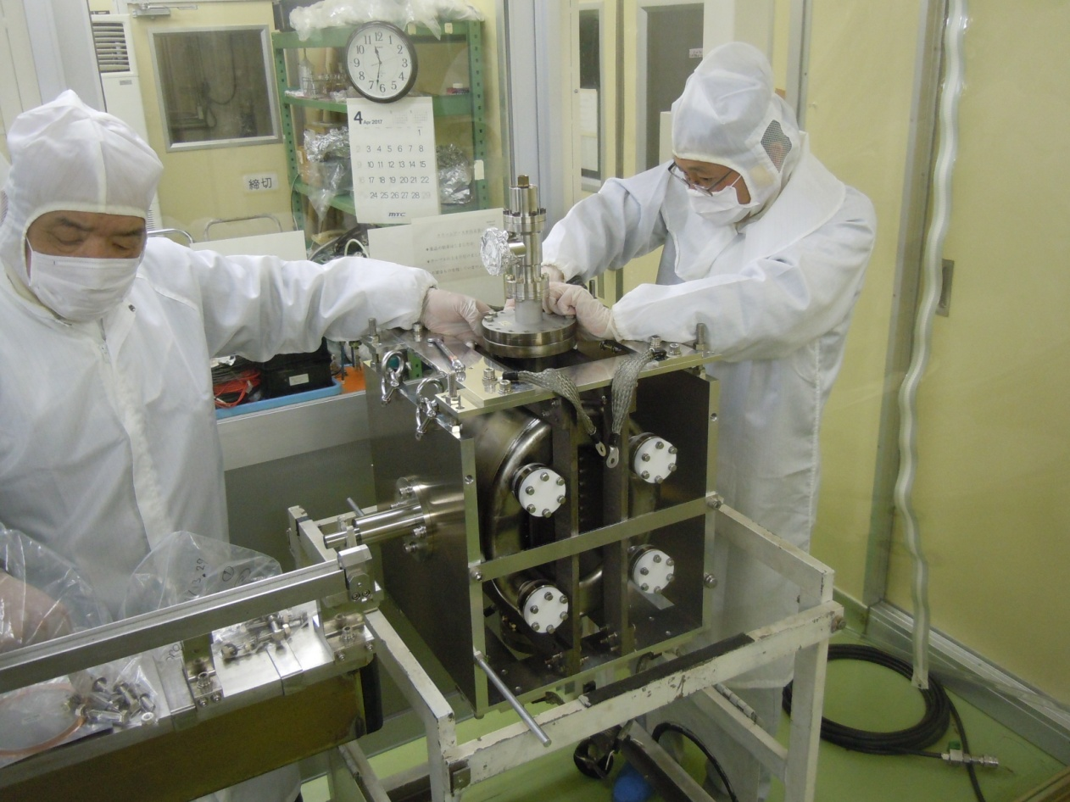
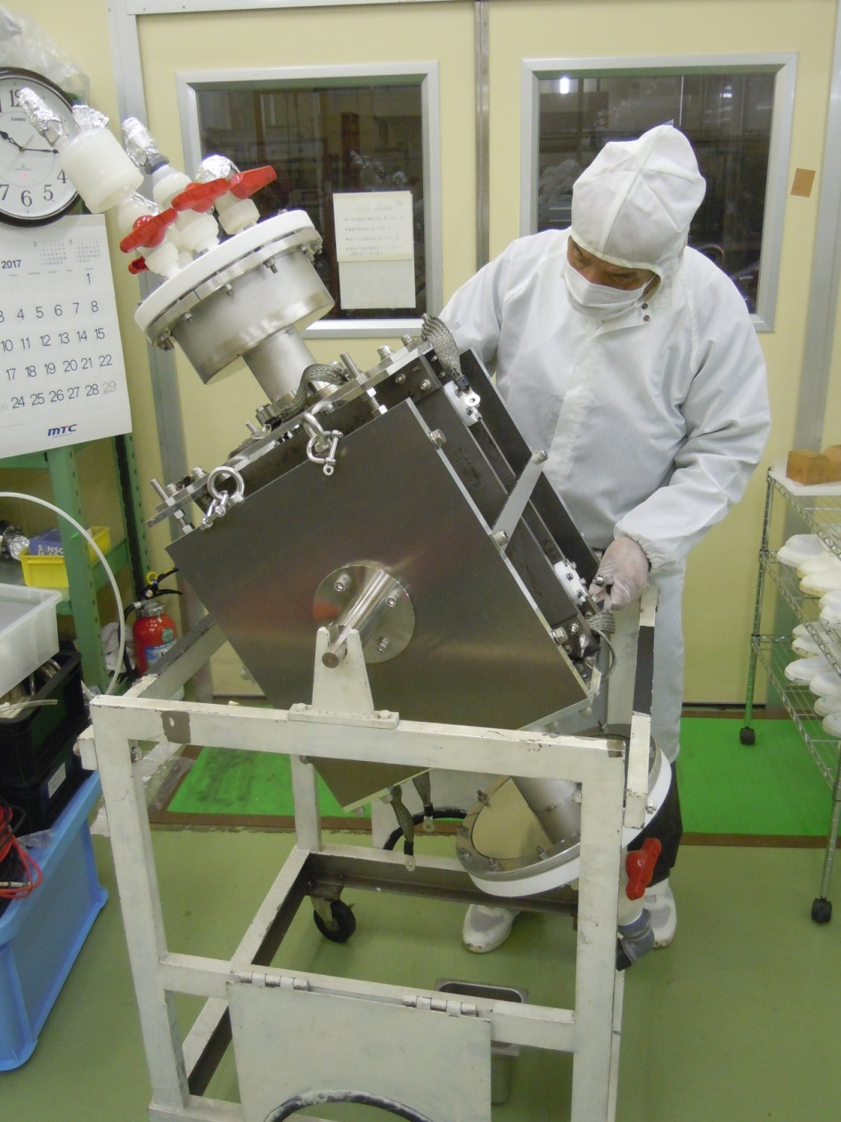
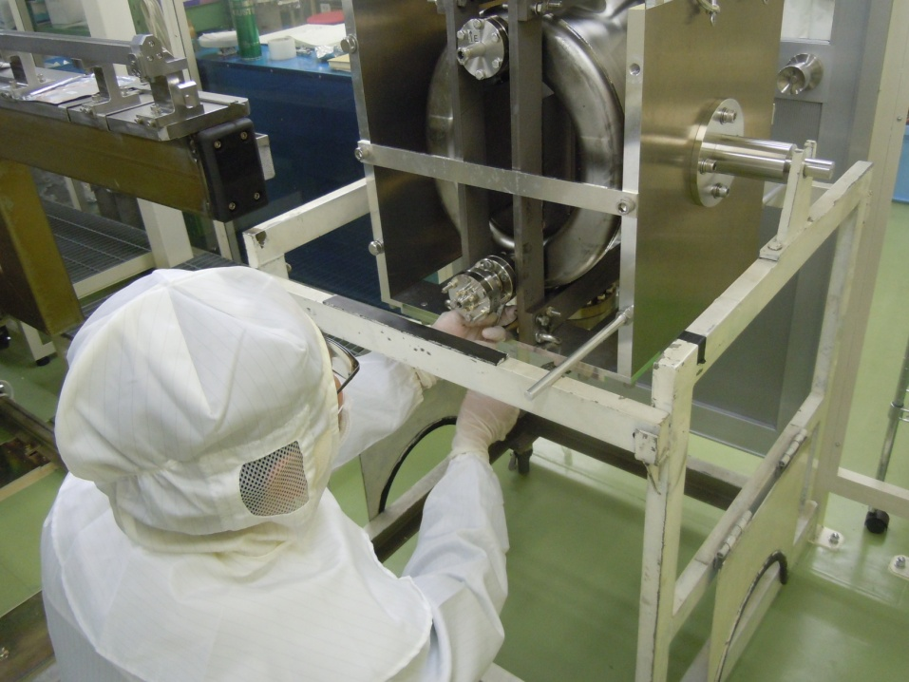
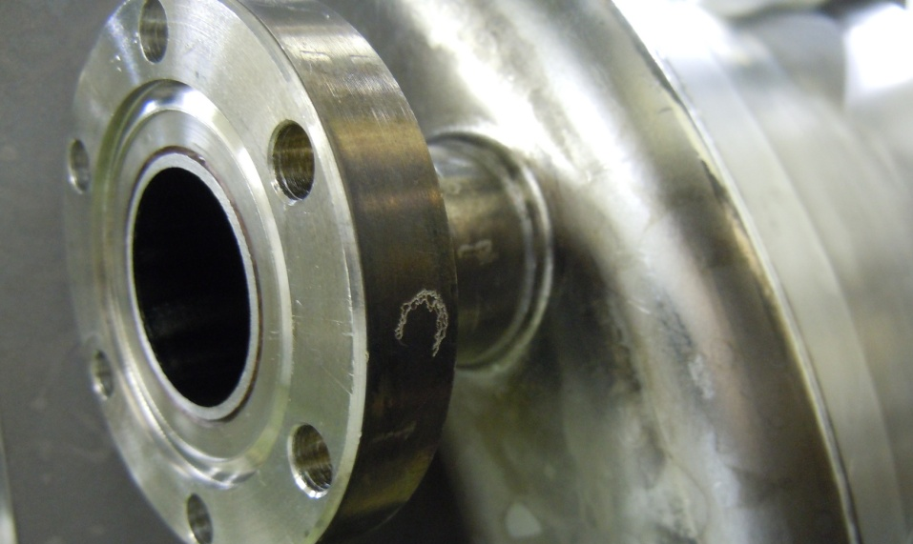
Assembly in our clean room for cold test
Almost all port flanges leaked several times before we used annealed gaskets from CERN. We also increased tightening force on each volt from 15 N・m (our standard) to 35 N・m(<40 N・m CERN procedure). One flange was sealed with indium wire.
Micro-particles may contaminate the cavity during the gasket exchange.

Slide 14
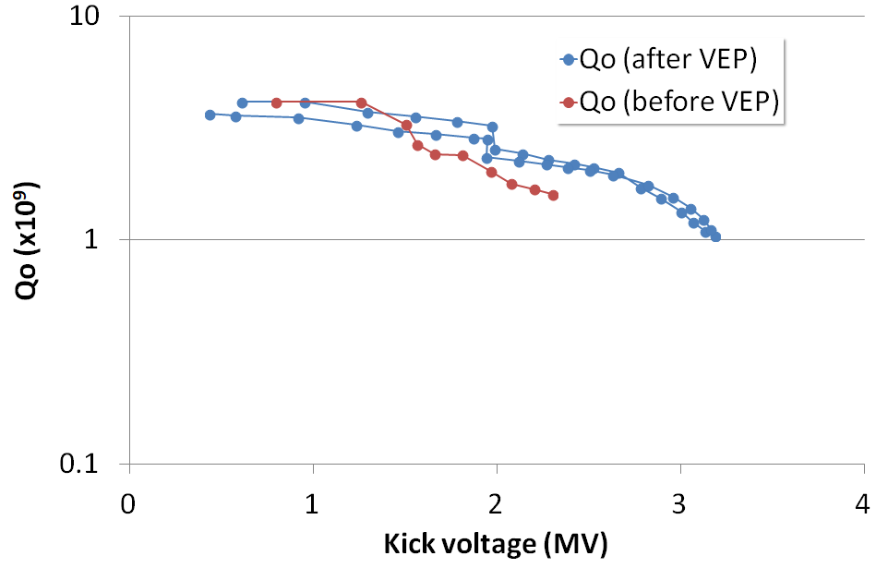
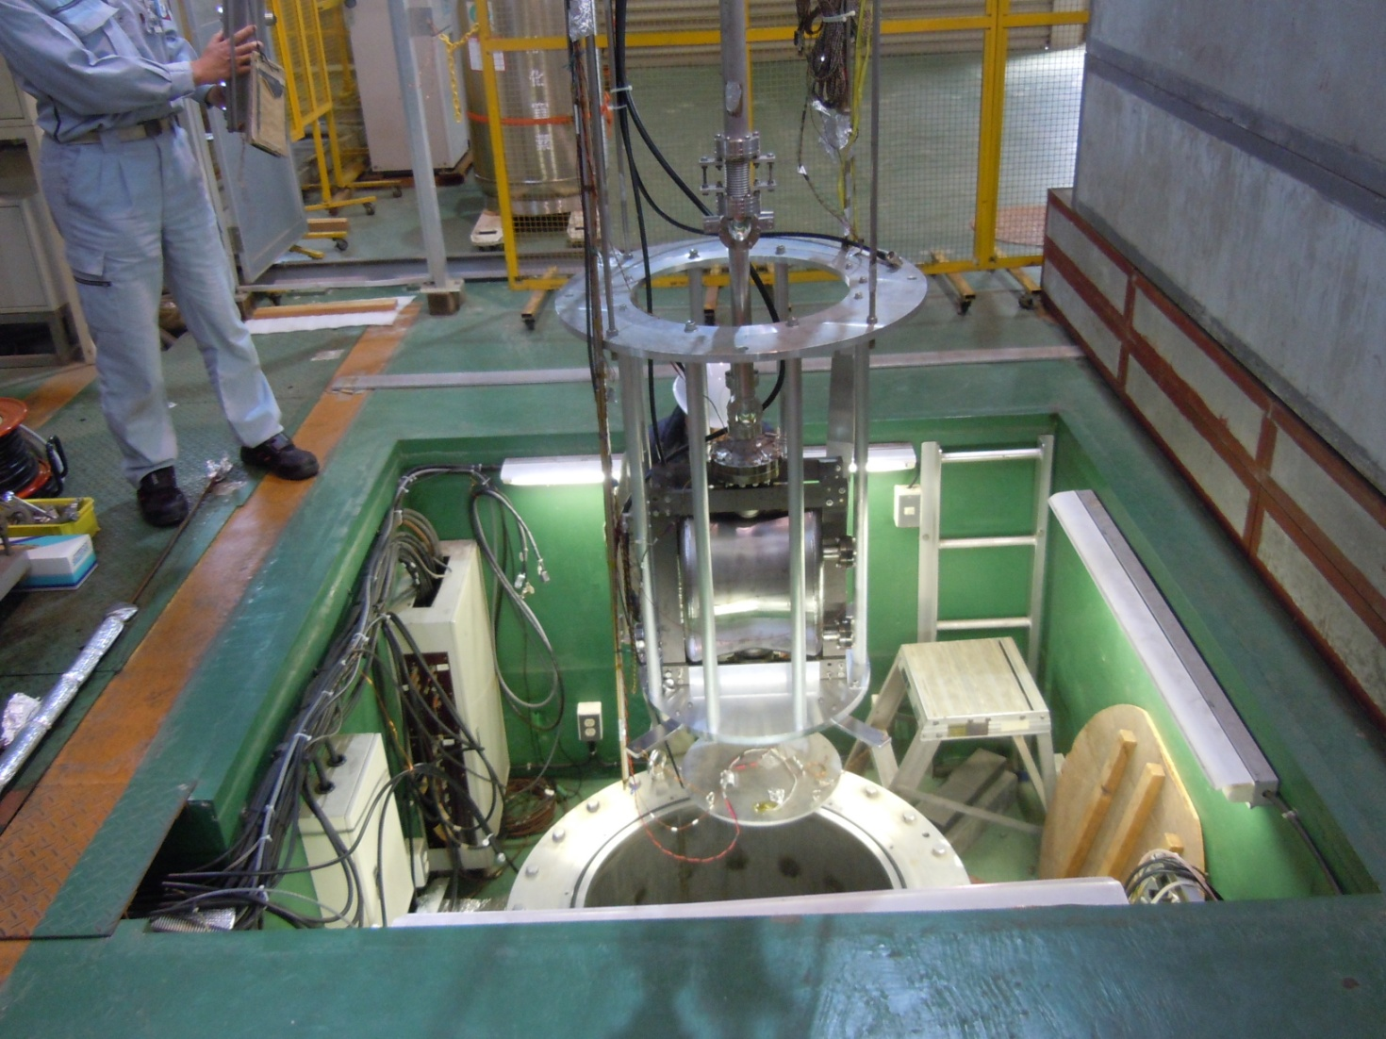
Cold test of the LHC crab cavity at KEK
Our cold test stand modified from the KEKB system cooled the cavity to 2K. Newly developed 400 MHz RF measurement system worked to measure the cavity performance before and after the VEP.
Results of cold tests
Q factors are almost the same at low fields. Significant improvement was not observed for this cavity.
Heating at beam pipe flanges limited its fields.
Field emission was observed at relatively low fields (2.6MV), suggesting particle contamination during leakage repairing.
2.2 K, 403.8 MHz
Qo=4.2x10⁹
Multipacting
Q factors are almost the same at low fields.
Large heat generation at beam pipe flanges observed, that limited the cavity voltage.
Not well processed, since we almost run out liquid Helium during cool-down.
LHC Crab cavity being installed in a cryostat

Slide 15
Summary
Vertical electro-polishing was first applied to LHC DQW PoP crab cavity
  Current and voltage were controlled
    Average current density: 18 mA/cm²
    Cell temperatures blow 40 deg.
      Need more cooling to keep cavity temperatures below 35 deg.
  Average removal thickness is 35 microns
    Top plate: 44 μm
    Bottom plate: 22 μm
    Wall: 30~80 μm
      Removal at lower wall is large
      Need to be improved
      Turn-over during EP is an option for uniform removal
Heavy VEP of ~100 μm is feasible
  VEP could be also applied to other non-elliptical cavity shapes
RF performance after VEP
  Almost the same Q factors after VEP, Q=4.2x10⁹ at low fields
  Significant heat generation at the beam pipe flange limited the cavity voltage
    Need to use low loss flanges or beam pipe extension

Slide 16
backup

Slide 17
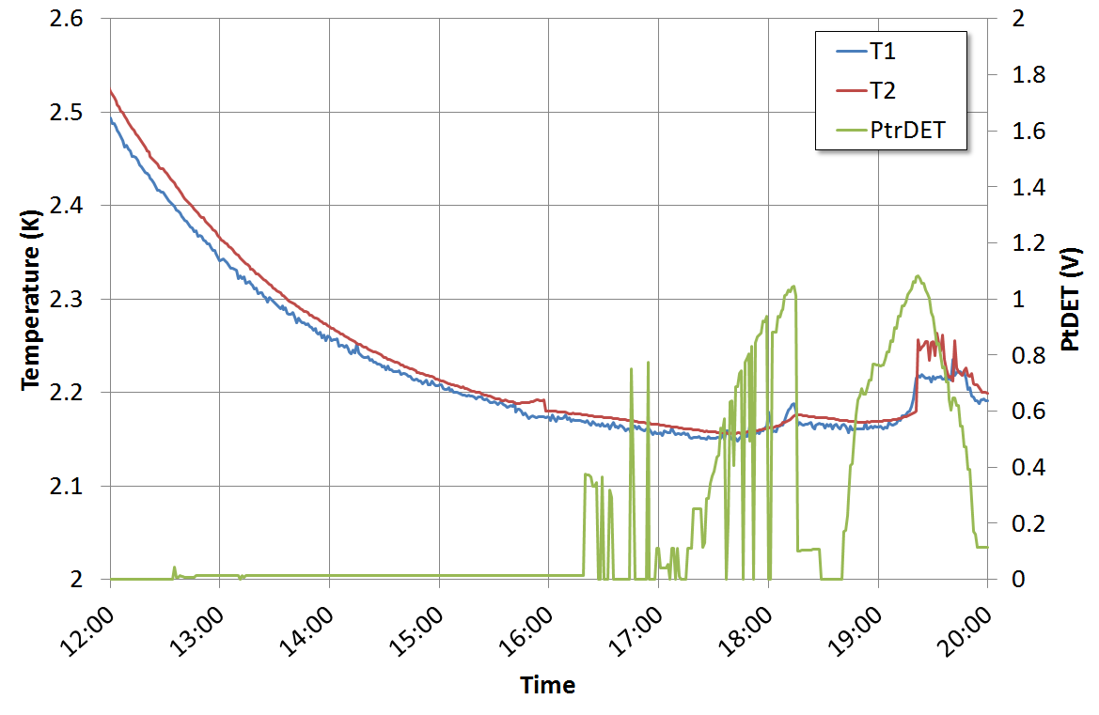
Temperatures of the beam pipe flanges during RF measurement
T1: Upper beam pipe flange temperature
T2: Lower beam pipe flange temperature
1st measurement
2nd measurement
T_{1/2}measurement
Multipacting at 0.1 MV

Slide 18





