Slide 1
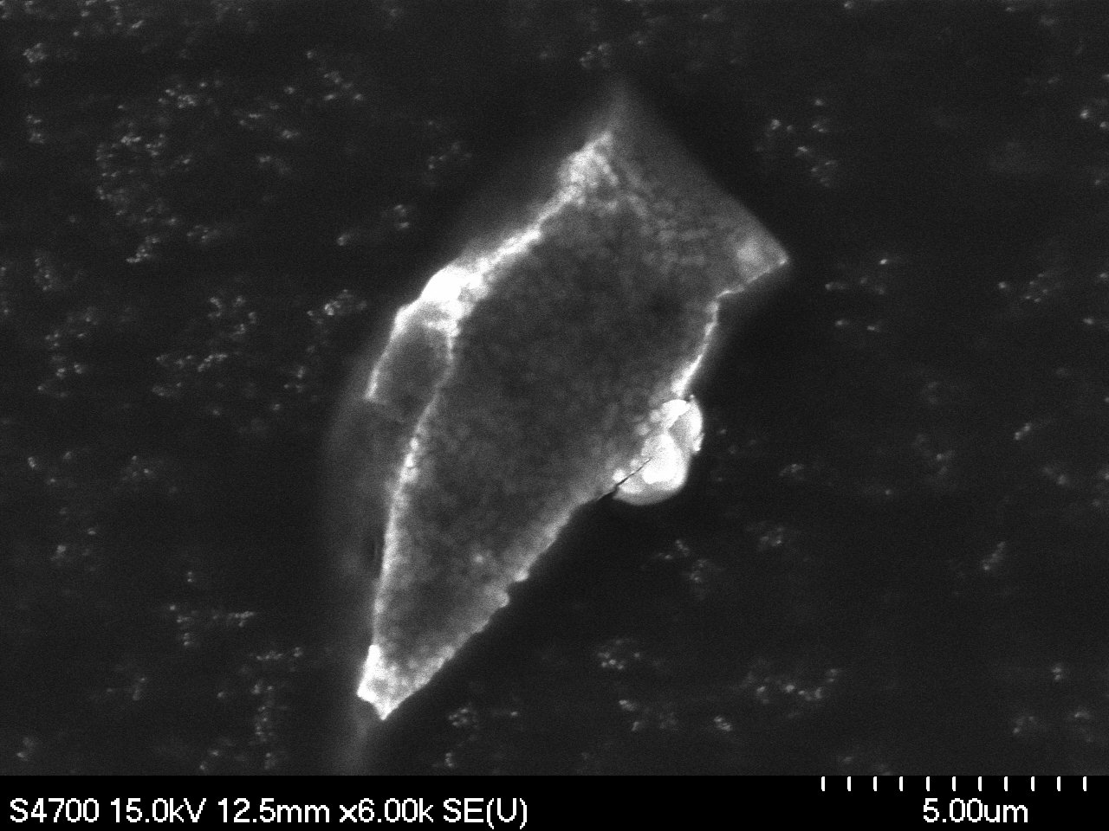
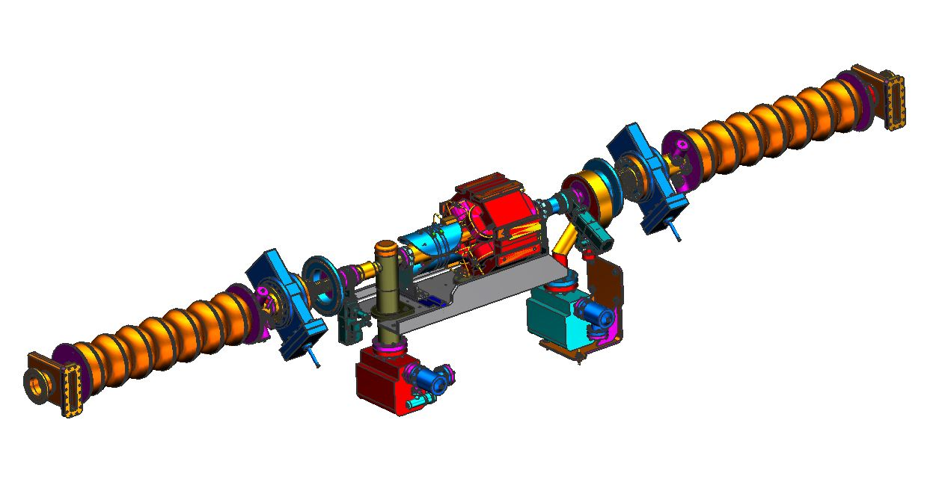
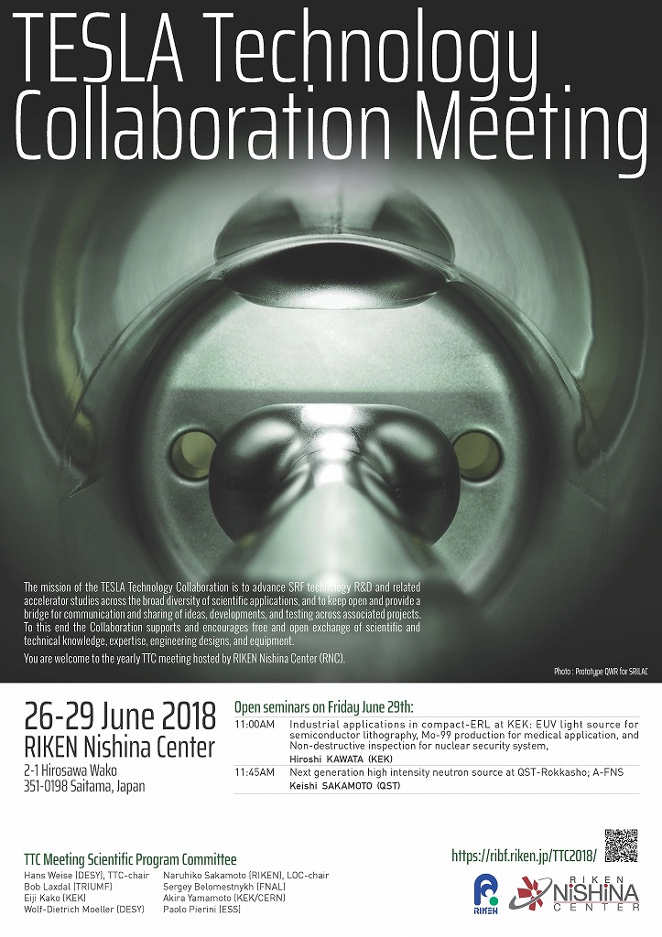
Particle Contamination in CEBAF Beam-Line
Sources and Mitigation
Rongli Geng

Slide 2
CEBAF
Multi-pass recirculating CW polarized electron accelerator
Construction 1987-1993, operation since 1994
4 GeV design energy
Major upgrade 2011-2017 to 12 GeV
Simultaneous beam delivery to 4 experimental halls
Two SRF linacs, 1.1 GeV each
Segmented cryomodule (CM) topology
52 each 8-cavity CMs + 1 each “quarter” CM
418 multi-cell cavities
CM names: C20/C100 signifies 20/100 MV voltage
Warm girders US and DS each CM
Same SRF technology used for JLAB FEL/LERF
3 each CM, 24 cavities
Dedication May 2, 2018
Alex Bogacz
2018 Summer Lecture

Slide 3
CEBAF Warm Beamline Components – Warm Girder Systems
~ 1 m long beamline, 35 mm bore diameter
Stainless steel pipes, bellows
Section for Quad
Section for Corrector magnet
Standard UHV cleaning
Added requirement: low particulate since 2016
Particle counter QA/QC
Beam diagnostics:
BMP
Wire scanner
Viewer (insertion device), Chromox-6 screen
Vacuum
Ion pumps
Conventional type 30 L/s
Differential (50% Ti, 50% Ta) 30 L/s
Pump current as beamline vacuum monitor
Vacuum joints: 2-3/4 inch Conflat
Cu gasket
DP at each end of each linac

Slide 4
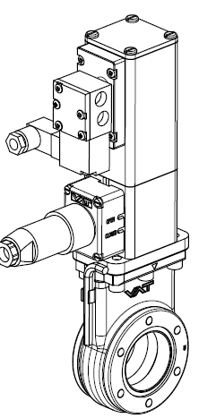
CEBAF Warm Beamline Components – CM Cold to Warm Transition
~ 40 cm long, bore diameter 76 mm / 35 mm
Stainless steel pipes, bellows
Manual GV
Two each all metal VAT 47.2 series for hermetic 8-cavity cavity string in C100 CMs
Two each Viton seal for hermetic cavity pair in C20/C50 CMs
VAT mini UHV GV, 01032-UE44-ADU1
Two each for hermetic CM beamline
Viton seal
Actuated in case of need for cavity protection
Close or open time 0.7 sec
Fast GV at end of each linac, 10 ms
Ion pump
Differential type (50% Ti, 50% Ta) 30 L/s
Maintain cavity string vacuum after assembly
Monitor beamline vaccum
Trigger beamline GV closure
VAT 47.2
VAT mini GV

Slide 5
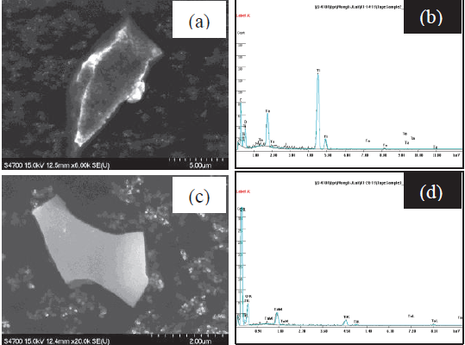
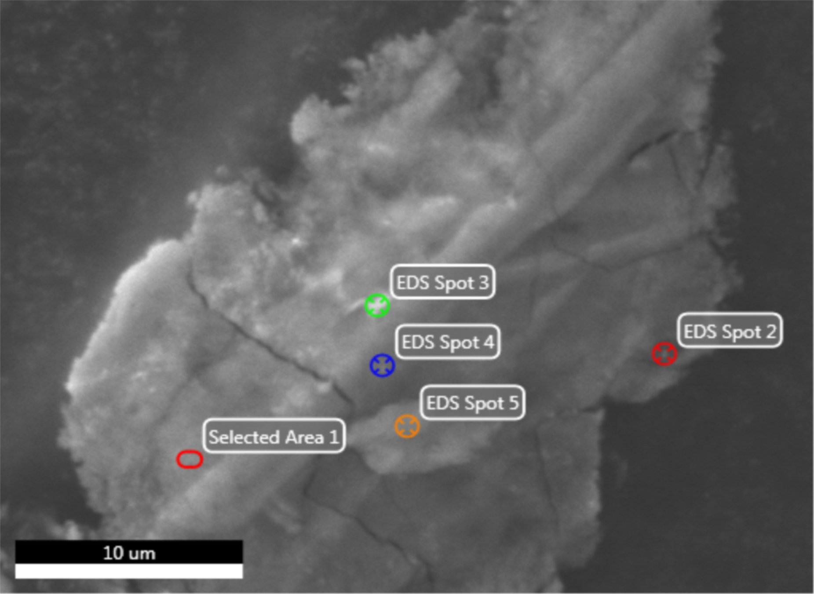
Particulate Particles
Particulates collection from UHV beam-line surfaces of components extracted from accelerators
First collection from cavities in CM FEL2 in 2014
Outcome triggered effort in CEBAF since 2016
Metallic particulates dominant species
Evidence of long distance transportation of Ti/Ta particulates generated by ion pump
Similar species found in cavities and girders
Mitigation:
Outlaw hi-potting of ion pumps
Replace ion pump by new NEG pumps
Re-clean girder UHV components with control for low-particulates
New equipment/procedure for tunnel installation of interface joints between CM and girder
10 µm, Ti/Ta
4 µm, Ti/Ta
S0137 – C2-9 – Area 14
Copper
20 µm
S-0152_C1-21
Indium, Niobium, & Steel
Steel
Indium
10 µm x 60 µm
From Franklin cavity #2, cell 2
Indium
Indium
Nb

Slide 6
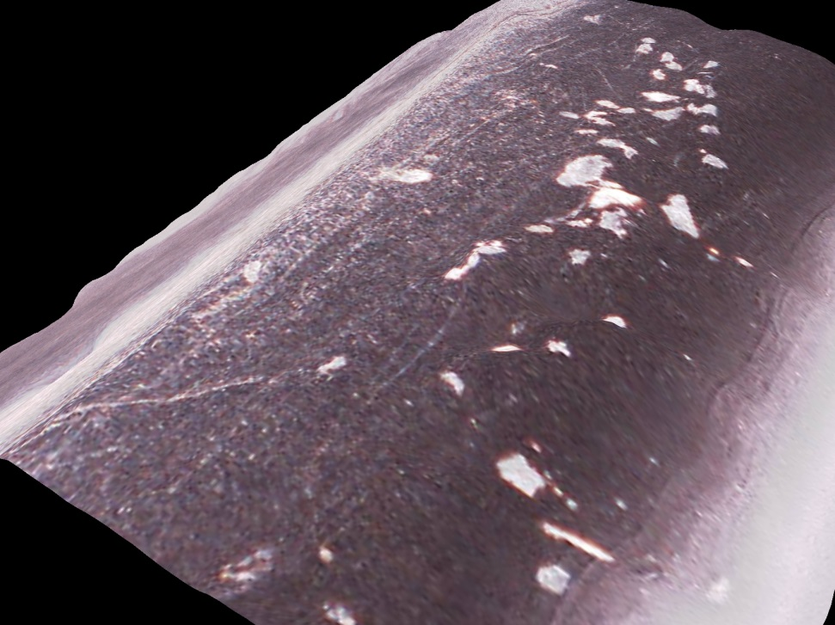
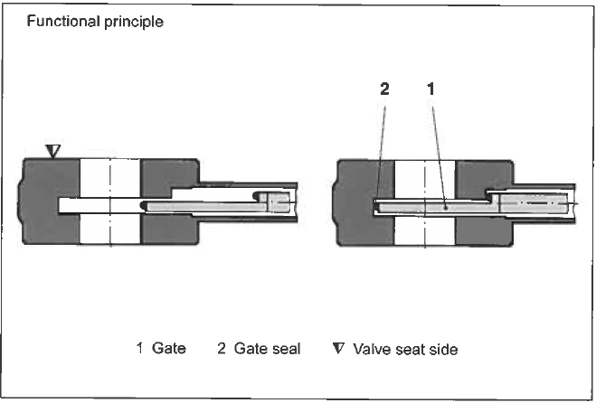
Particulate Particles - Continued
Observation of particulates captured by Viton O-ring
Particulates embedded in sealing path
Injured seals cause unwanted GV leaks
Indicate captured particulates are charged
Mitigation:
Reduce cycling beam-line GV by raising interlock threshold from 1×10⁻⁷ to 5×10⁻⁷ Torr (pressure spikes)
Reduces particulate generation

Slide 7
Molecular Particles
RGA gas species analysis from CM warmup show major frozen gases are hydrogen and water vapor
Large difference in mono layers of frozen gases between C100 CM and C20/C50 CM
We are studying the effect of room temperature warmup for benefit of field emission reduction
This understanding justifies replacement of ion pumps with NEG pumps for much better hydrogen pumping

Slide 8
Lessons Learned and Open Questions
Particle (particulate and molecular) contamination in CEBAF beamline is a topic of interest for its impact to accelerator energy reach and operation reliability
New insights from identification of particulates collected from UHV surfaces of beamline components extracted from accelerators led to new solutions for particulate control
Clean warm girder components with particulate QA/QC
New portable clean room and procedure for connecting CM and girder in tunnel
Adjust ion pump practice
Replace ion pumps with NEG pumps
Adjust gate valve interlock vacuum pressure threshold
Large frozen gases in C100 CM’s - studies of its source and mitigation under way
Open questions to be answered:
How to prove particulate transport in beamline? Driving force?
Which GV is better: All-metal or Viton sealed?
What is the best procedure for GV cycling?
What is the best vacuum sensor in SRF linac?
How to remove settled metallic particulates from cavity surface?

Slide 9
Backup Slides

Slide 10
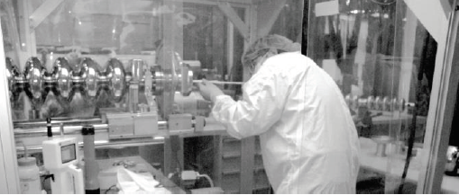
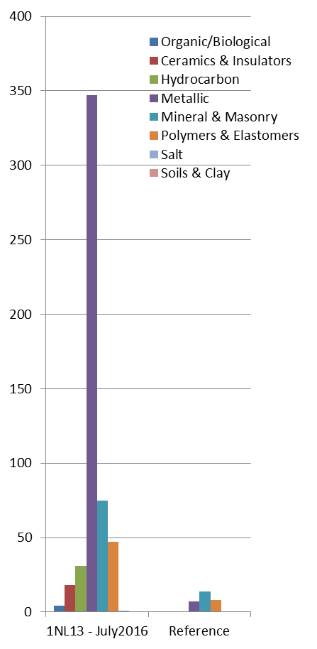
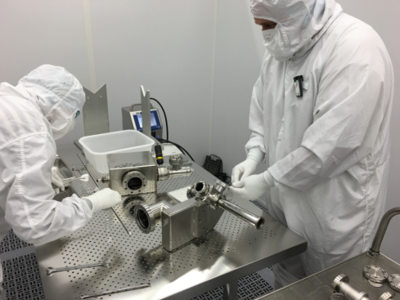
Particulate Particles Collection and Identification
Identification of particulates collected from UHV surfaces of beam-line components extracted from accelerators
First collection from cavities in CM FEL2 in 2014
http://accelconf.web.cern.ch/AccelConf/SRF2015/papers/mopb035.pdf
Follow-up effort in CEBAF CM’s and girders
2 CM’s (C20, C50) and 3 girders 2016-2017
2 CM’s (C100, C20) and 4 girders this summer
https://www.jlab.org/indico/event/227/session/7/contribution/26

Slide 11
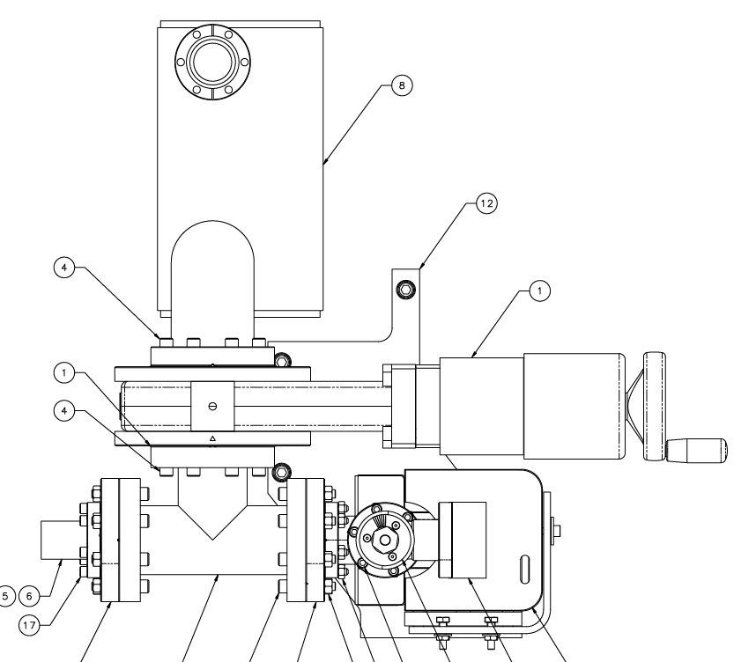
NEG & Ion Hybrid Pumps Replacing Ion Pumps
SAES Capacitorr® ZAO HV 200
200 L/s for hydrogen
Gamma Vacuum 25S-DIX-2D-OP-N-N
Preserve compatibility with existing control systems
Gate valve isolates NEG from beam-line for activation
1st implementation in 1L12 CM and DS girder in summer 2016
2nd implementation in 1L13 CM and DS girder in summer 2017
Particulate compatibility of NEG studies established justification
Performance not affected up to 34 MV/m in a 1.3 GHz 10cell cavity

Slide 12
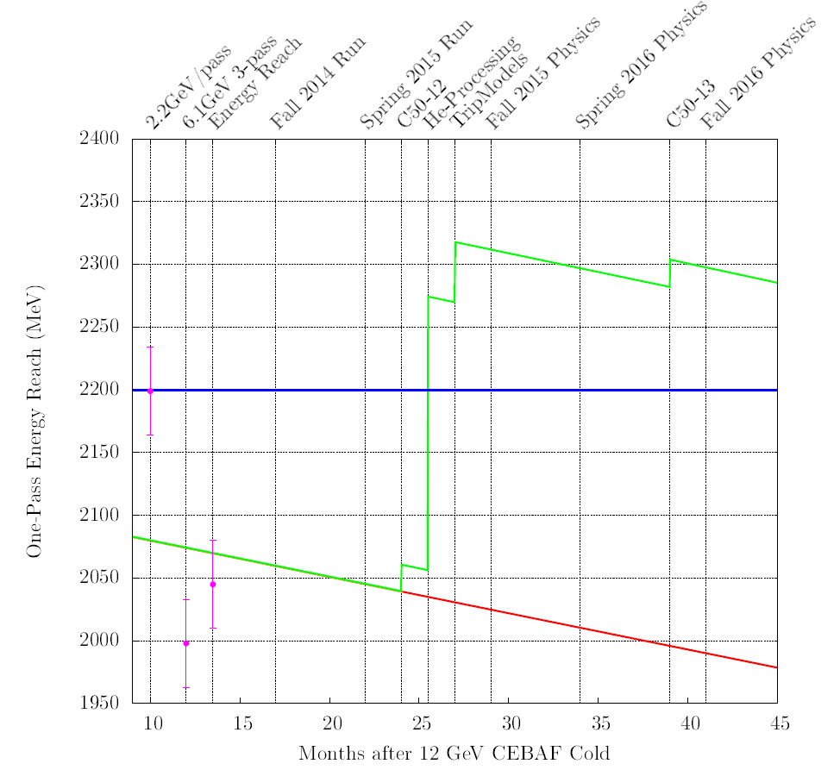
CEBAF “Gradient Degradation” - I
Mitigation:
helium processing
module refurbishment
(C50 -> C75)
Loss rate: 34 MeV/pass-year.
Cryomodules consisting original 5-cell cavities
based on operations data since 1995.
R. Bachimanchi, J. Benesch, M. Drury, A. Freyberger, R. Geng, J. Mammosser, “2014 Update: CEBAF Energy Reach and Gradient Maintenance Needs”, JLAB-TN-14-024

Slide 13
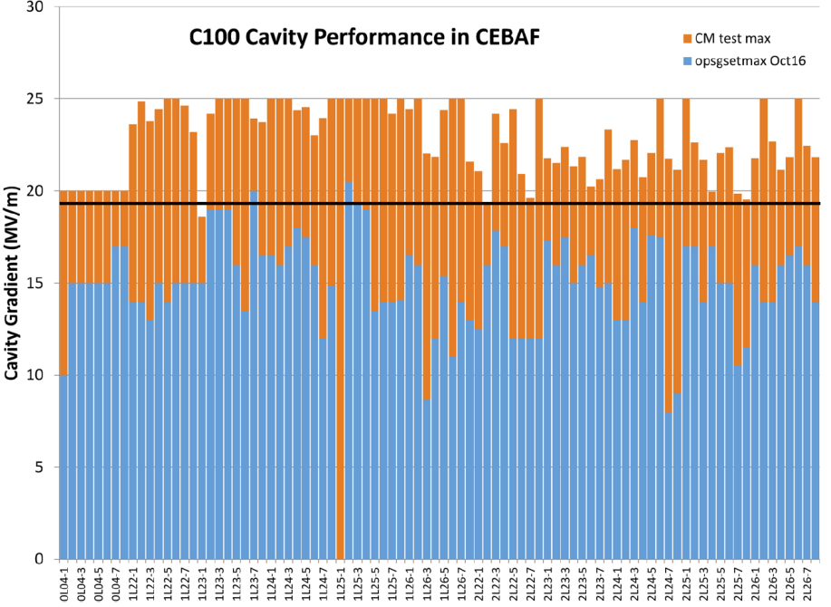
CEBAF “Gradient Degradation” - II
New 12 GeV upgrade7-cell Low-Los shape cavities
Cryomodule
Final qualification
individual cavity
Linac

