Slide 1
FRIB Beamline Integration Plan
Hiroyuki Ao
TTC Meeting at RIKEN, Wako, June 26 - 29, 2018

Slide 2
Warm and Cold Transition in FRIB Linac
Red lines show “SRF particle-free” warm beam transports
Beamline length ~3 m, inner diameter 40~47.5 mm, made of SUS
Vacuum
Entrance and exit of cryomodules pumped down by a 75L/s ion pump
Pressures achieved < 5E-9 Torr
Diagnostics
BPMs cleaned with SRF particle-free procedure
Movable devices avoided as much as possible
Q1
(To target)
Linac Segment 3
β=0.53
β=0.53 Matching
Linac Segment 1
β=0.085 matching
β=0.085
Linac Segment 2
β=0.041
(RFQ)
β=0.29
β=0.53
Gate valve (Slow)
Fast gate valve

Slide 3
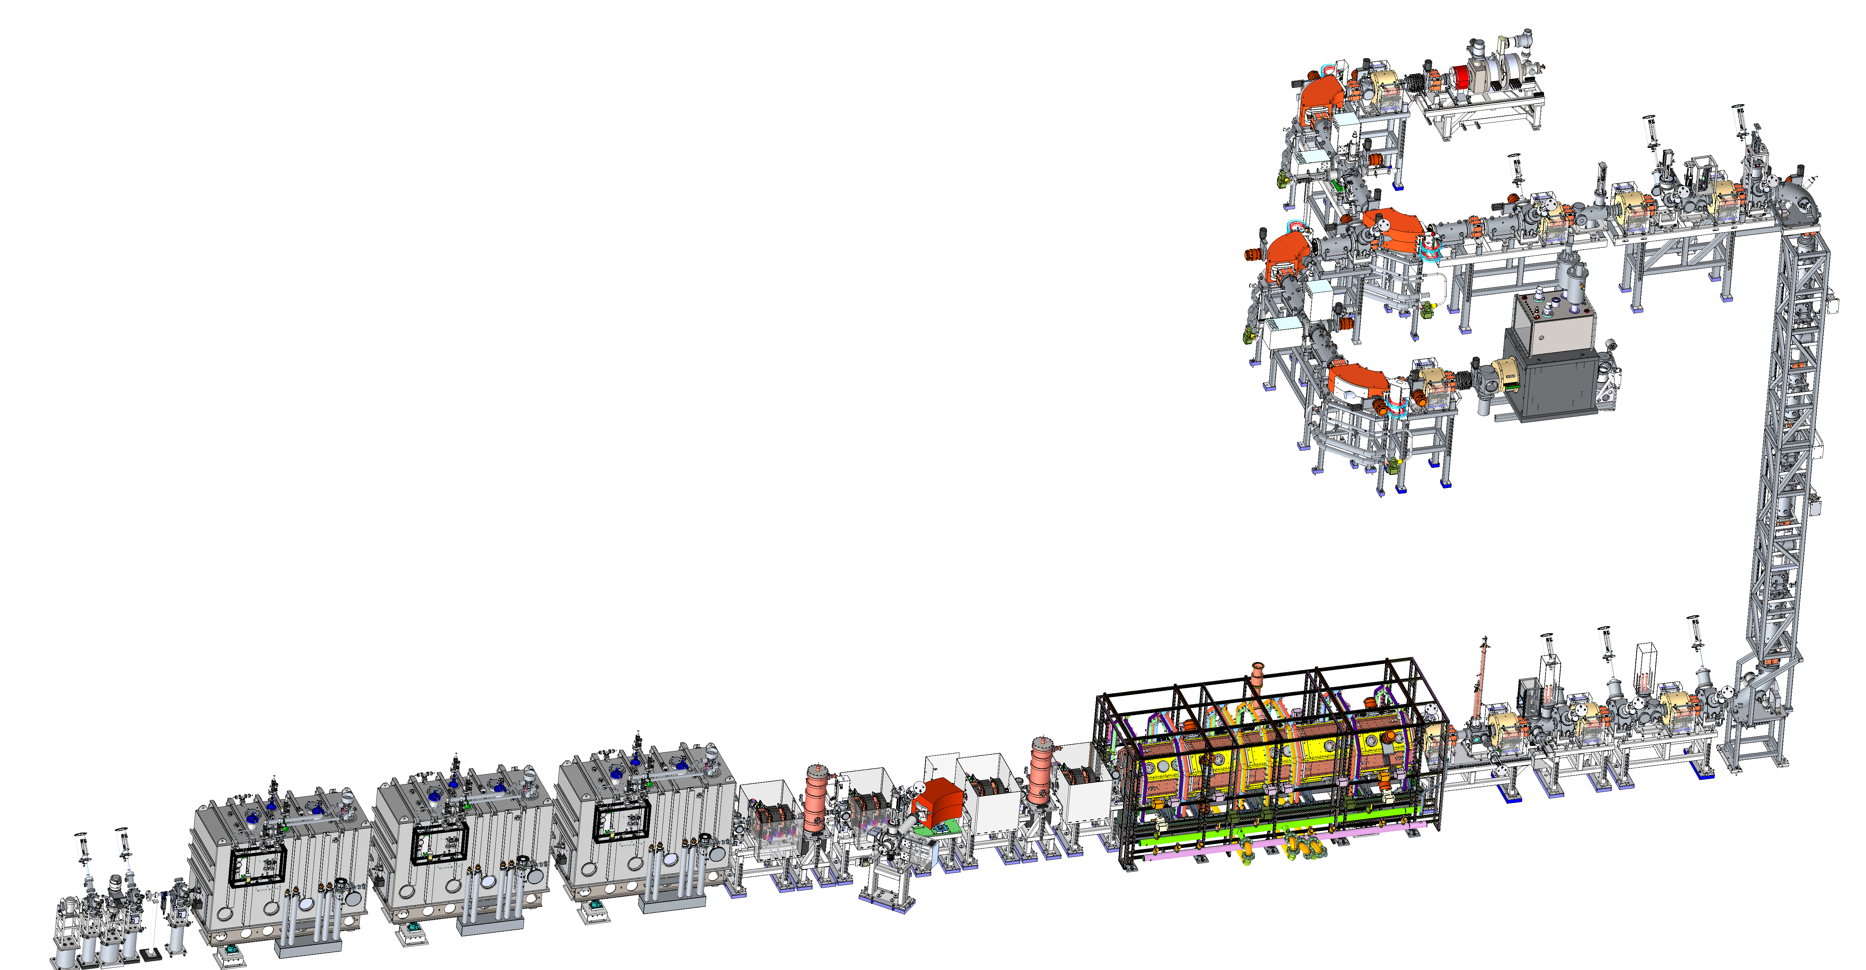
Cold (SRF) Installation Progressing
ARR02 beam commissioning includes the three β = 0.041 cryomodules (CMs) and the diagnostic station (D-station) in Linac Segment 1 (LS1)
Room temperature
Electron Cyclotron Resonance
Ion Source (ECR IS)
β=0.53
β=0.53 Matching
β=0.085 matching
β=0.085
β=0.041
β=0.29
β=0.53
Particle test performed to observe particle migration for profile monitors and fast gate valves
Superconducting ECR IS
(Not yet)
FGV
PMs
Vertical drop
FGV
Warm
Cold (SRF)
β=0.041 cryomodule
LEBT
MEBT
RFQ
D-station
(FGV actuated by P>2E-5 Torr)

Slide 4
Profile Monitor Particle Counts
Q6
(PM)
F
J
K
L
E
G
H
I
A
B
C
D
Slowly (<1 Torr/sec) pump out chamber to <1 Torr from downstream end of chamber
Actuate profile monitor 100 times
Slowly vent chamber with filtered, dry N2
Perform particle counts at end of beam pipe
Location | Particle Counts (0.3 um part./sq in)
A | 1.83, 0.17
B | 0.17, 0.33, 1.67
C | 0.33, 7.33, 0.17, 0.67
D | 0.0, 0.33
E | 0.0, 0.0
F | 7.33, 4.5, 19.33, 1.17, 3.5
Location | Particle Counts (0.3 um part./sq in)
G | 0.0, 0.0
H | 0.0, 0.0
I | 0.0, 5.67, 0.17
J | 0.0, 0.0
K | 0.17, 0.0
L | 5.83, 0.5
Courtesy: I. Malloch

Slide 5
FGV Particle Counts
Q2, 6
Slowly (<1 Torr/sec) pump out chamber to <1 Torr from downstream end of chamber
Actuate fast gate valve only one time
Slowly vent chamber with filtered, dry N2
Perform particle counts at end of beam pipe
VAT Series 752
Q
P
O
N
M
L
A
B
C
D
E
F
H
G
Pump Cart
K
J
I
Location | Count
A | 24.19
B | 0.19
C | 11.35
D | 0.84
E | 0.39
F | 3.35
Location | Count
G | 3.23
H | 1.68
I | 0.84
J | 2.39
K | 1.87
L | 3.55
Location | Count
M | 1.68
N | 0.71
O | 0.19
P | 0.00
Q | 0.84
*All counts are 0.3 um part./sq in
Courtesy: I. Malloch

Slide 6
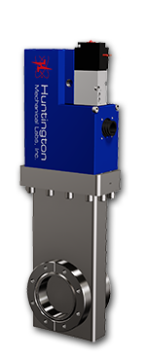
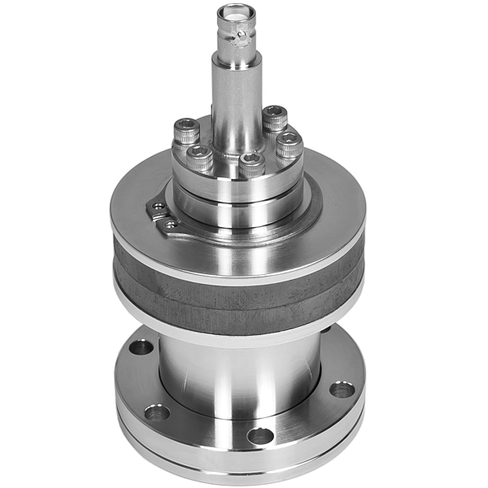
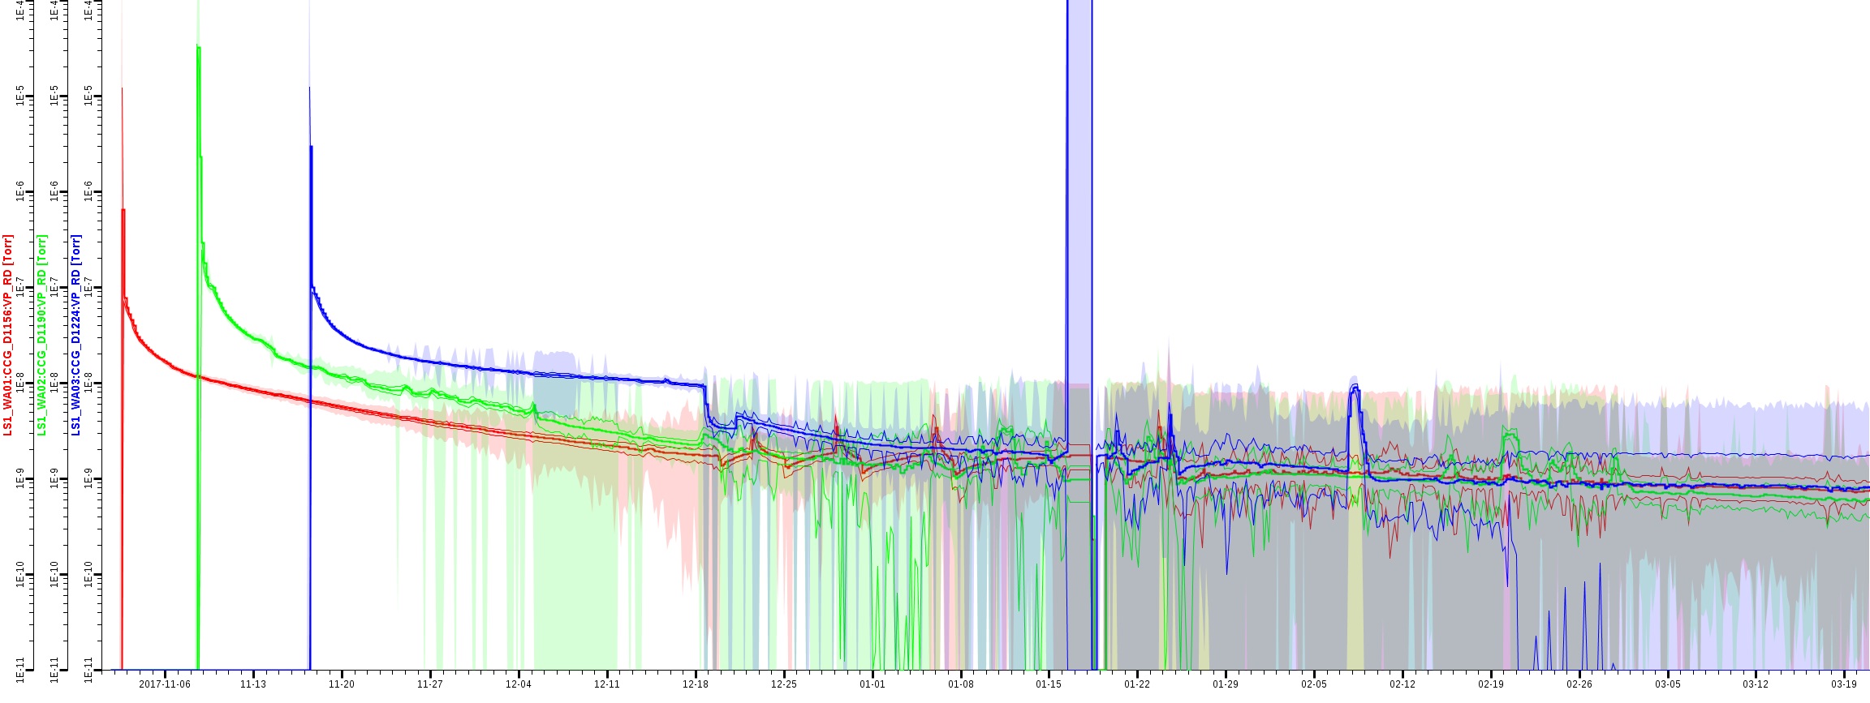
GVs, CCGs
Gate Valves (Huntington)
See TTC2017 at FRIB, B. Oja
CCGs (Agilent IMG-300)
Radiation-resistant and bakeable to 250ºC during operation
Range: 1 x 10⁻³ to 1 x 10⁻¹¹ Torr
Fluctuate less than 1E-8 Torr
Q5
1e-8 Torr

Slide 7
Final Comments
Establishing cleanroom quality control and clean assembly procedures are well recognized as being critical to SRF accelerator performance
Sometimes initial beamline design/scope DOES NOT include mitigation plans for cold and warm transition regions… (e.g. gate valves, cold traps, …)
Beamline integration has been conducted considering combination of cost and performance (FRIB has added 5 additional GVs and particle count tests so far)

Slide 8
Backup Slides

Slide 9
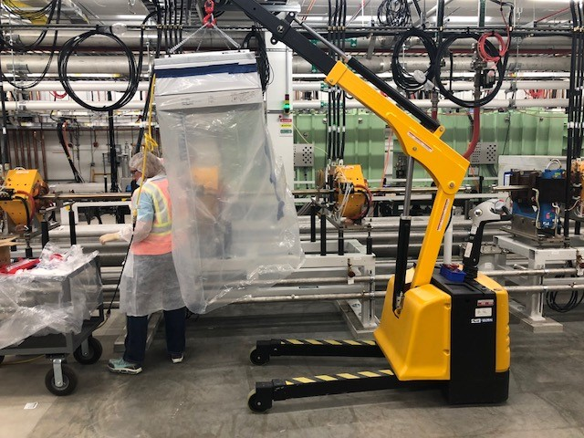
UHV (Warm) Installation
Minimize contamination during “warm” installation
HPEA filter
PPE:
gloves, caps, masks, half-cleanroom garments

Slide 10
Common Questions about Warm and Cold Transition (By R. Geng)
1. What is the design of warm beamline systems next to a cold SRF cryomodule? size (ID and length) and material of the beam pipe? type and capability of vacuum pumps? beam diagnostic instruments (such as BPM, wire scanner, beam viewer etc)? 2. What kind of gate valves are used to isolate the cavity string from the warm beamline system? fast valve or slow valve? under what conditions these valves are actuated? 3. Are NEG pumps used? if yes, how these pumps are activated? 4. What is the cleaning procedure for the warm beamline system? What is the QA/QC for the cleanliness/particulate count? 5. What kind of vacuum gauges are used for beamline vacuum monitoring? are they resistant to ionization radiation?
A. See slide 2
A. See slide 3
A. No
A. See slide 6

Slide 11
Common Questions about Warm and Cold Transition (By R. Geng)
6. What kind of particulate monitoring has been done for controlling particulate generation and movement for individual components (pump, gate valve) and integrated warm beamline systems? 7. What have you learned from beam operation of SRF accelerators wrt particulate generation and movement and the impact to field emission characteristics? Cryo modules long term performance against warm section openings? or cryo-modules performances and specific beam instrumentations replacements?
A. See slide 4 and 5
A. Not yet

