Slide 1




Coaxial Resonators for Fundamental Study
Bob Laxdal, Zhongyuan Yao
RF/SRF Group
June 27, 2018

Slide 2
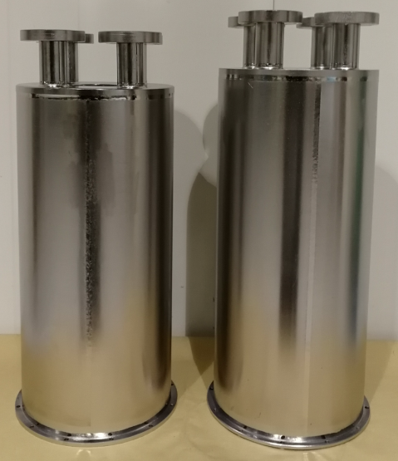
Outline
Introduction
Design Requirements
Cavity Design
RF ancillaries
Outlook

Slide 3
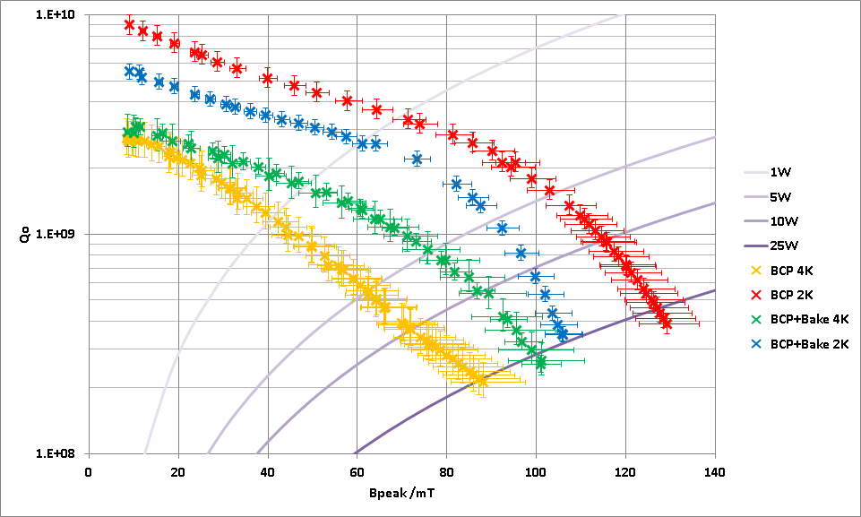
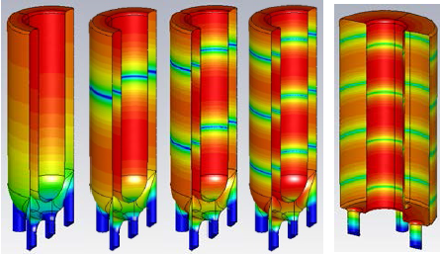
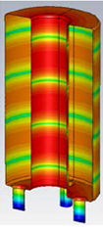
Outline
Purpose
  Study the medium field Q-slope in low β resonators.
  What is the role of rf frequency on field dependent resistance
  What are optimum treatments
Method
  Use coaxial test resonators to measure rf performance at different harmonics for the same test cycle
  Investigate field dependent surface resistance as a function of frequency, temperature and treatments, including heat treatments and doping

Slide 4
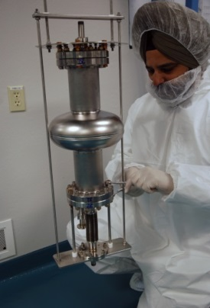
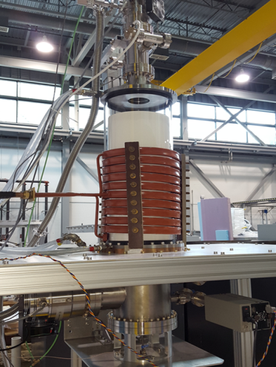
Design Requirements
The cavities are designed as the coaxial equivalent of a 1.3GHz single cell cavity for TEM R&D
TRIUMF has an rf induction oven for experimental heat treatments – the oven is sized to host 1.3GHz single cells and the new coaxial test cavities
Uniform inner conductor is required.
  A common T-map insert can be employed to characterize the surface losses locally in addition to the global Q-measurement.
The design is simplified.
  No beam ports, cavity jacket, nor stiffeners
  Require cleaning ports for BCP and HPR

Slide 5
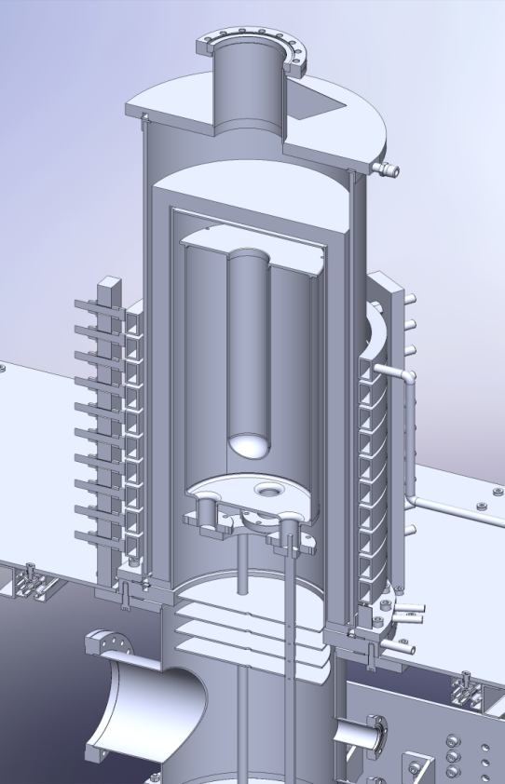
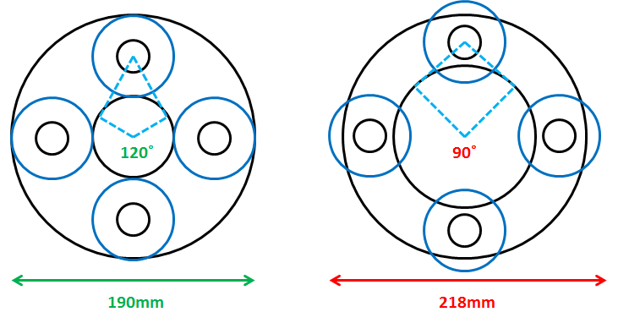
General Design
Cavity dimensions
  QWR Φ200ˣ470mm
  HWR Φ200ˣ449mm
Inner conductor
  Cylinder geometry
  Ellipsoid cap for QWR
Cleaning ports
  HPR can cover the entire RF surface
  Will be used for BCP
  Will be used as RF ports for test
505mm
φ218mm
Coaxial Cavity in Oven

Slide 6
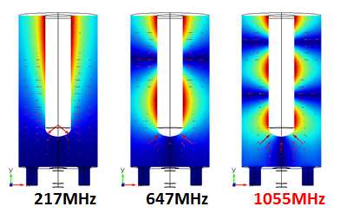
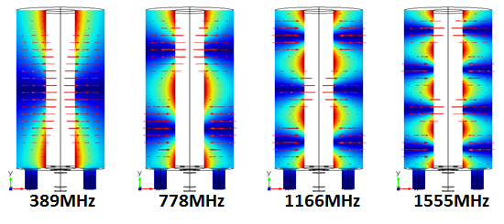
Lowest Modes
This geometry gives a lower frequency range of 200MHz for the QWR and 400MHz for the HWR
Mode\Freq | QWR | HWR
1 | 217 | 389
2 | 647 | 778
3 | 1055 | 1166
4 |  | 1555

Slide 7
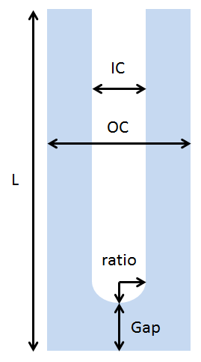
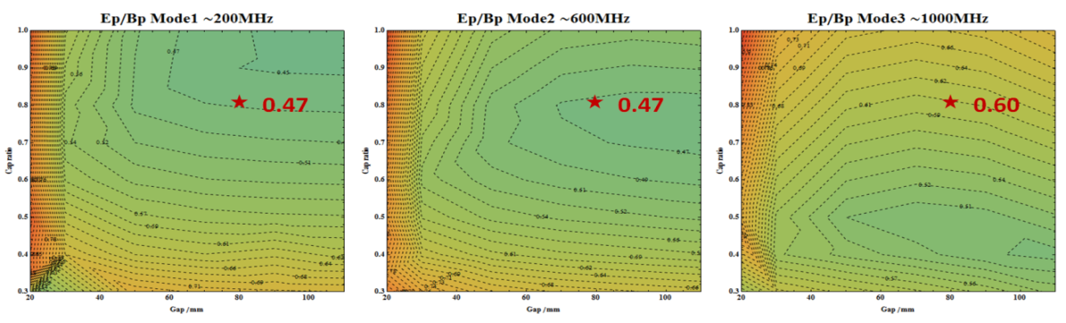
Lowest Modes
Critical dimensions are swept to reduce Ep/Bp for the 2 lowest QWR modes
Peak field ratio (E_{peak}/B_{peak})
  QWR
    Ep/Bp=0.47MV/m/mT for 200MHz and 600MHz modes
  HWR
    Ep/Bp=0.3 MV/m/mT as theoretical value
IC=60 mm
OC=180 mm

Slide 8
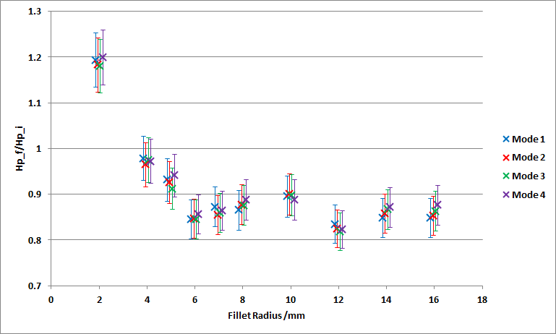
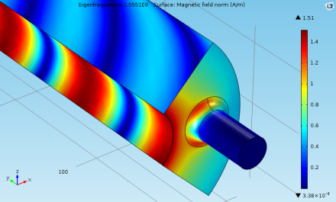
RF Design
Avoid local field enhancement (HWR)
Reduce power loss on SS blanks (HWR)
  Extend the length of ports
  The ratio of power losses on SS blanks and niobium is 1% or less for all TEM modes
Modes separation (QWR & HWR)
  The minimal difference is 38MHz for 3rd TEM mode and lower TE112 mode in HWR

Slide 9
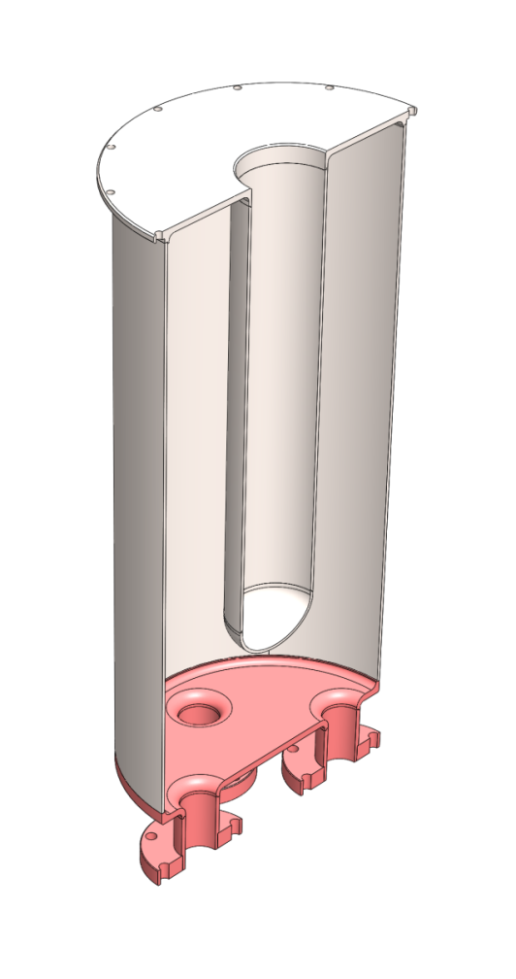
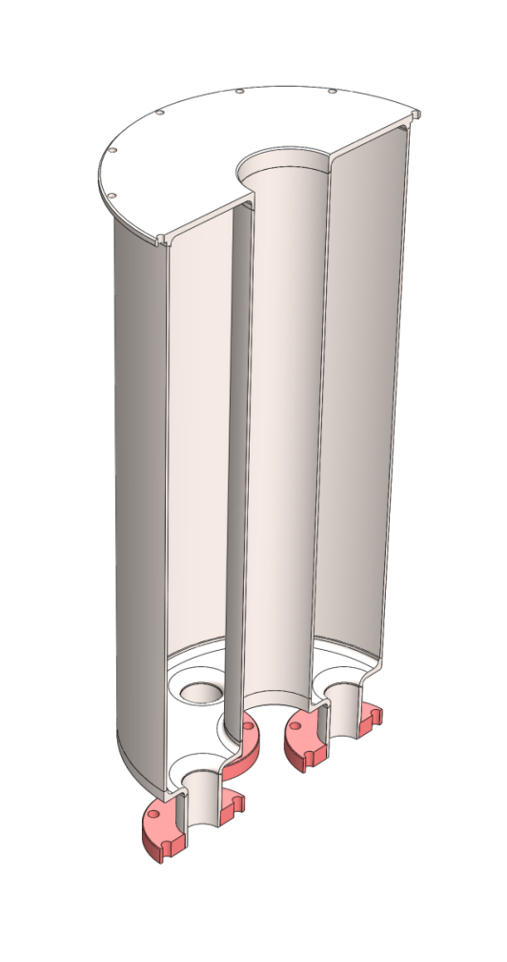
Fabrication
All Niobum structure with reactor used in low loss areas to reduce cost
Cavities fabricated at Ningxia
200mm
200mm
470mm
449mm
61mm
60mm
RG Niobium

Slide 10
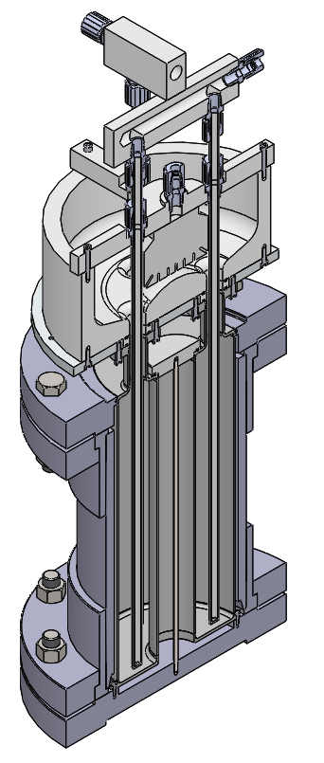
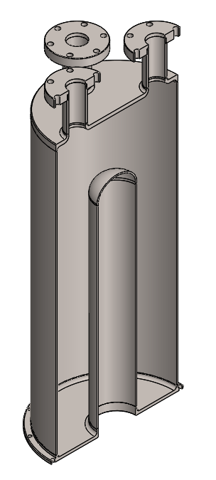
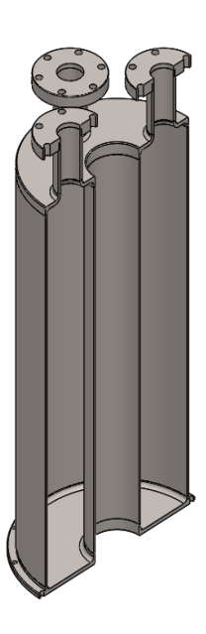
Supporting Equipment
BCP fixtures are now prepared with etching to begin next week

Slide 11
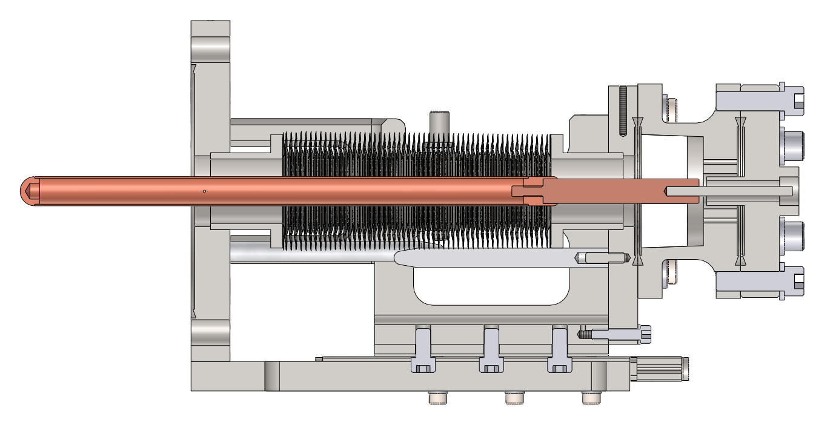
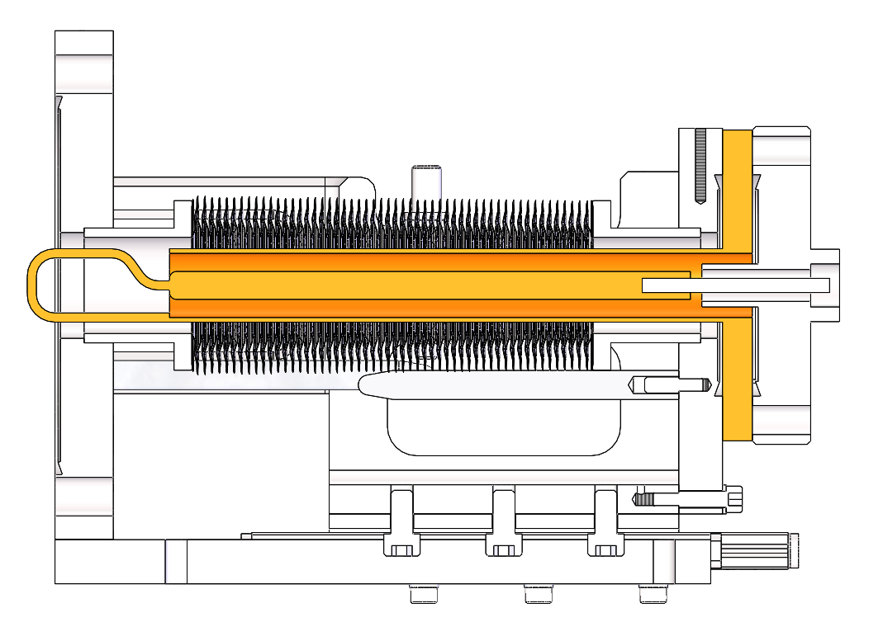
Supporting Equipment
Two new variable rf couplers have been prepared and are being assembled.
Antenna for QWR and loop for HWR
25~65mm
207mm

Slide 12
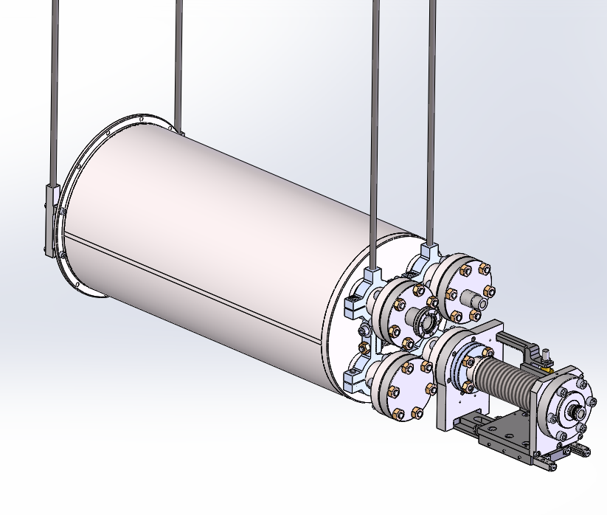
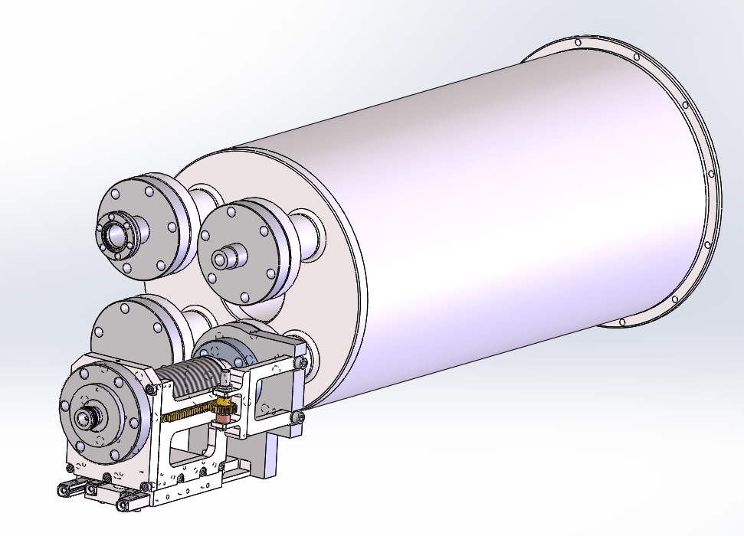
Supporting equipment
Cold test fixtures are in hand

Slide 13
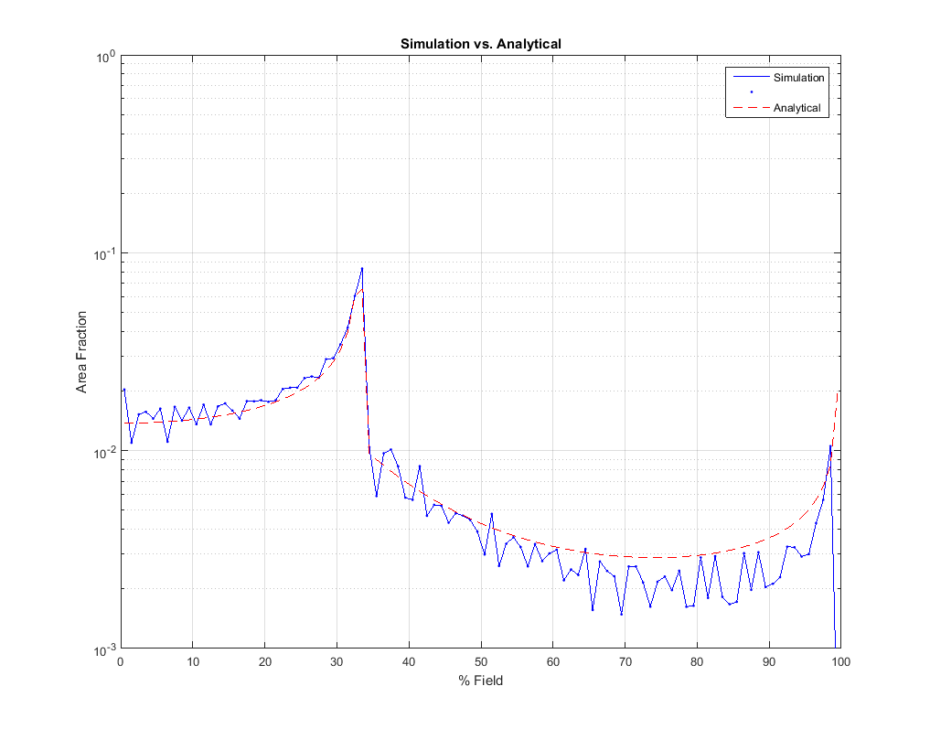
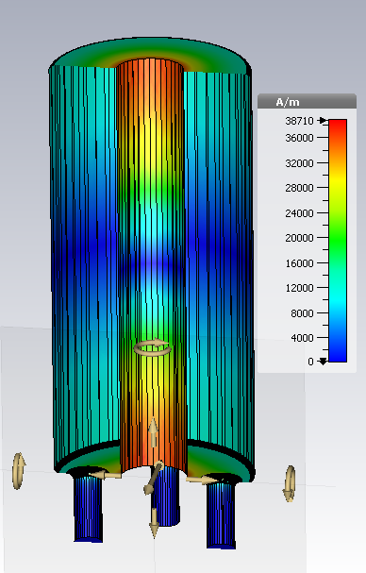
Extracting Rs(B)
Coaxial resonators have a wide distribution of magnetic field amplitude across the rf surface
This has to be taken into account when extracting Rs(B) from Q measurements (details of distribution will vary slightly from mode to mode in QWR)

Slide 14
Summary
Coaxial cavities have been fabricated and our being prepared for first cold test next month
Goal is to test the cavities at the fundamental and higher harmonics to characterize field dependent rf losses as a function of rf frequency
A UHV rf induction oven is now available for heat treatment studies

Slide 16
Resonate Frequency
Mode | Frequency /MHz | Mode Type
1 | 217 | TEM
2 | 647 | TEM
3 | 892 | TE111
4 | 1055 | TEM
5 | 1103 | TE112
6 | 1361 | TEM*
7 | 1400 | TE113
8 | 1600 | TE211
9 | 1604 | TEM*
Mode | Frequency /MHz | Mode Type
1 | 389 | TEM
2 | 778 | TEM
3 | 905 | TE111
4 | 1128 | TE112
5 | 1166 | TEM
6 | 1424 | TE113
7 | 1555 | TEM
8 | 1602 | TE211
9 | 1738 | TE212

