Slide 1
Half-Wave Coaxial Test Cavities at ODU
Results and Plans
Work supported by NSF Grant PHY-1416051
TTC Meeting
RIKEN, 26-29 June 2018

Slide 2
Introduction
Our goal is not necessarily to achieve the highest fields and lowest surface resistance
It is to get a better understanding of the physics of the mechanisms limiting the performance in the frequency range of interest for accelerators
The research consists of experimental and theoretical parts to address the unresolved issues of the surface resistance of superconductors at high rf field, and in particular how the surface composition and structure can be modified and tuned in order to reduce surface resistance.
One of the most effective ways to understand a physical process is to analyze its frequency dependence
It is very much work in progress

Slide 3
Research Tool – Half Wave Coaxial Cavity
Cavity designed to provide range of frequency particular interest of accelerators: 325, 650, 975, 1300 MHz.
Field distribution almost identical in all TEM modes
  The same surface will be exposed to the highest fields at all frequencies
TEM modes should be sufficiently separated by other TM and TE modes.
Should be able to achieve high rf surface field.
Should be free of multipacting.

Slide 4
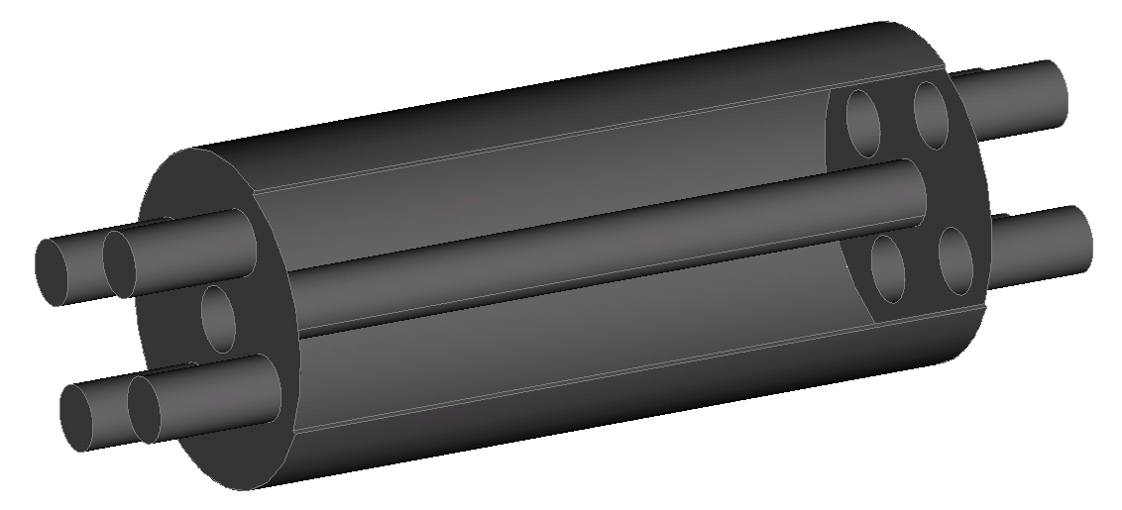
Research Tool – Half Wave Coaxial Cavity
Lowest power dissipation for a given H_{p} on center conductor
  Smallest a possible, but big enough to be able to provide sufficient cooling
  b/L=0.25, shallow minimum, tweak to separate TE and TM modes
Mode | f (MHz) | G (Ohm)
TEM1 | 325.4 | 59
TEM2 | 650.8 | 119
TE111 | 869.6
TEM3 | 976.1 | 179
TE112 | 1034.9
TE113 | 1265.4
TEM4 | 1301.3 | 239
TE211 | 1470.1
2b=202 mm
2a=40 mm
L=459 mm

Slide 5
Surface Fields of TEM Modes
Surface Electric Field
Surface Magnetic Field
325 MHz
650 MHz
325 MHz
650 MHz
975 MHz
1300 MHz
975 MHz
1300 MHz

Slide 6
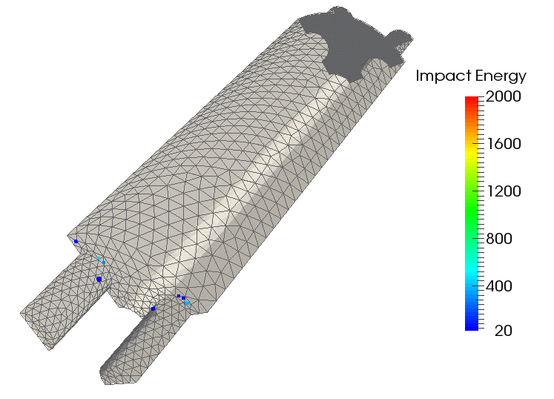

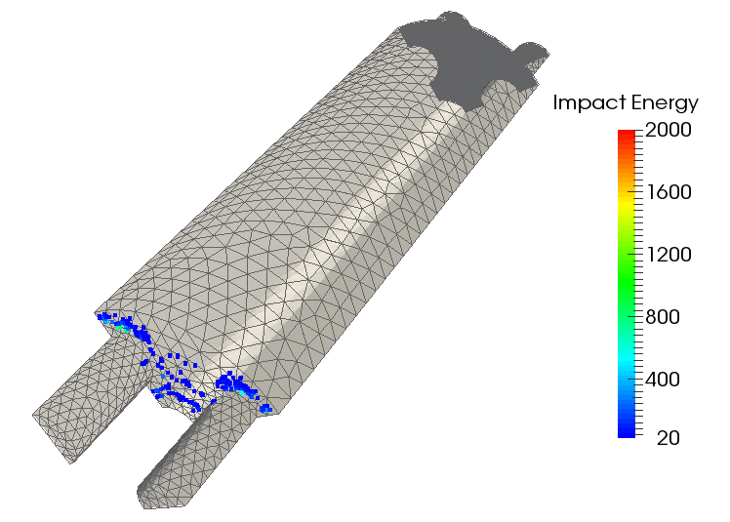

Multipacting Levels – Half-Wave Coaxial Cavity
325 MHz
650 MHz
975 MHz
1300 MHz
Multipacting levels at the end plate in the cavity
Higher multipacting levels at higher frequency
Multipacting was processed gradually with increasing frequency

Slide 7
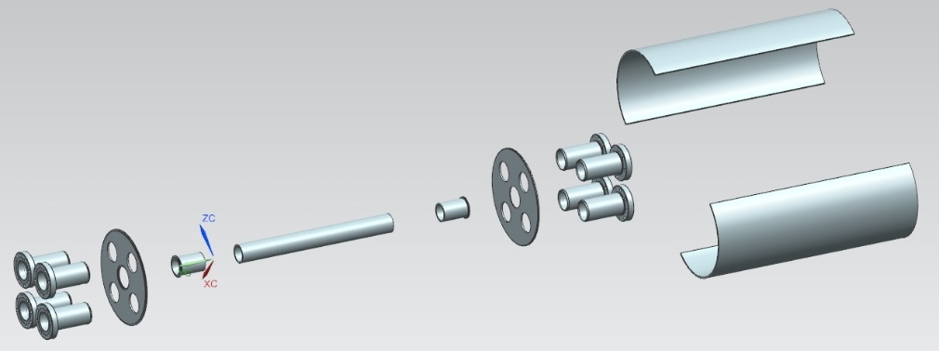

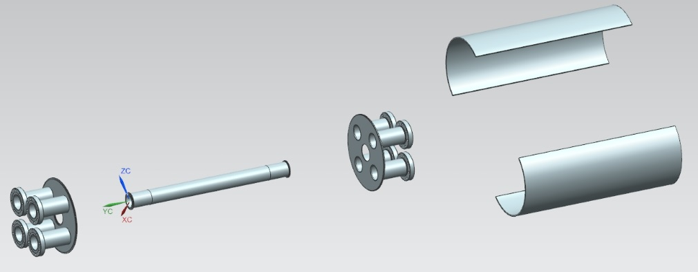
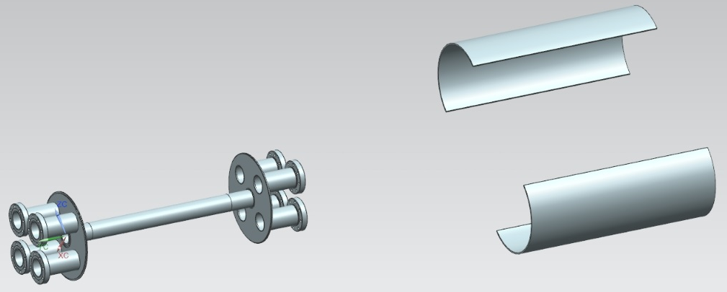
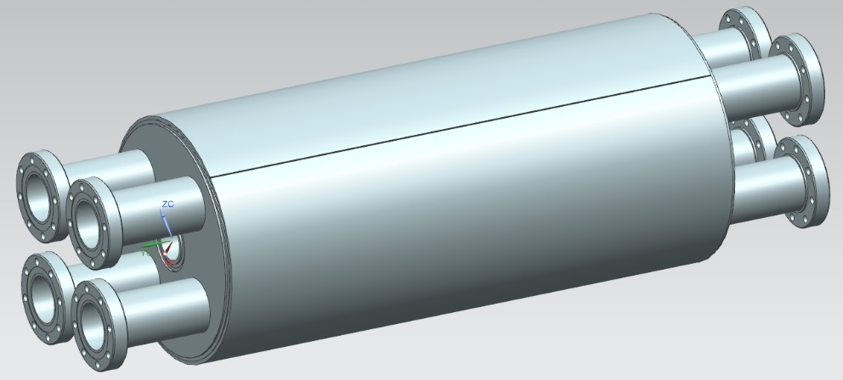
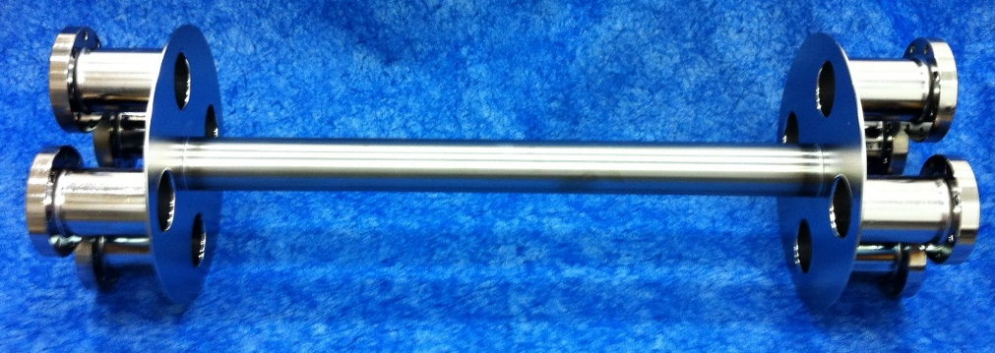
Fabrication Sequence

Slide 8
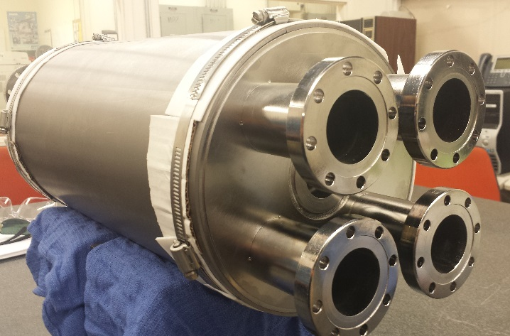
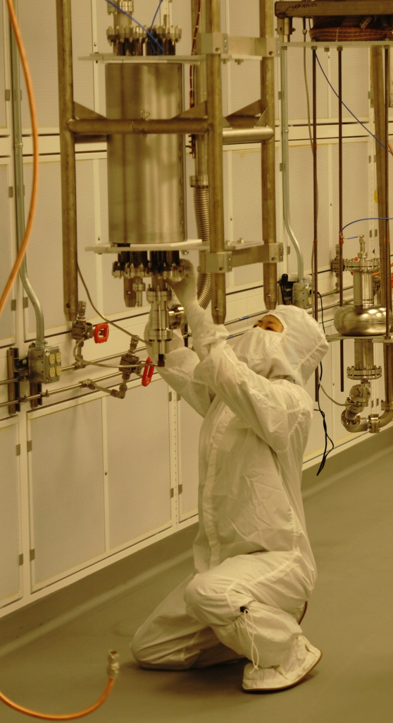
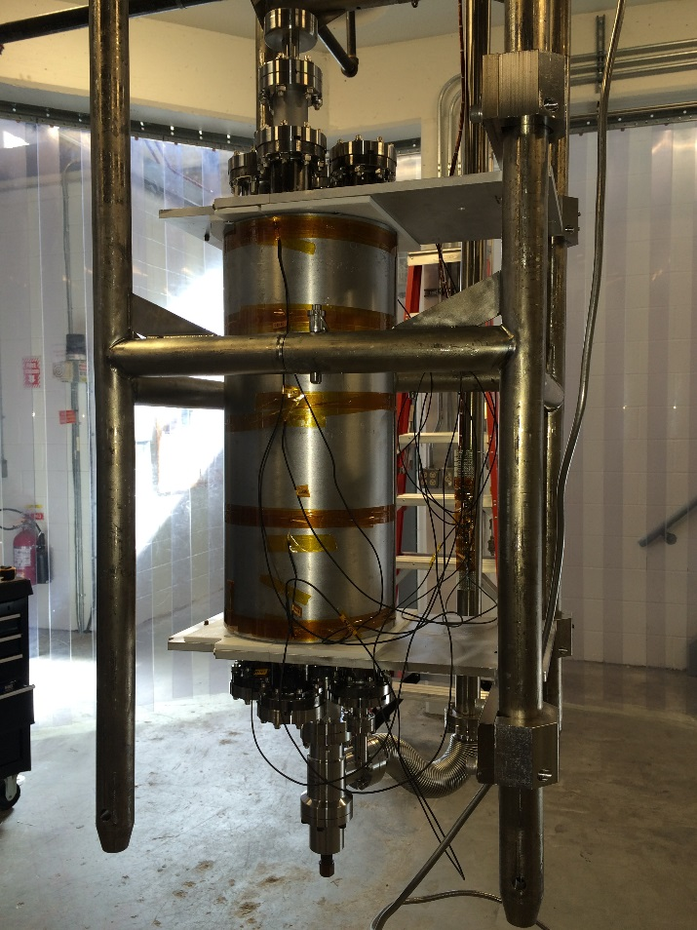

Research Tool – Half Wave Coaxial Cavity
Fabricated cavity with many ports for diagnostics capability
Cavity ready for cold test
Clean room assembly

Slide 9
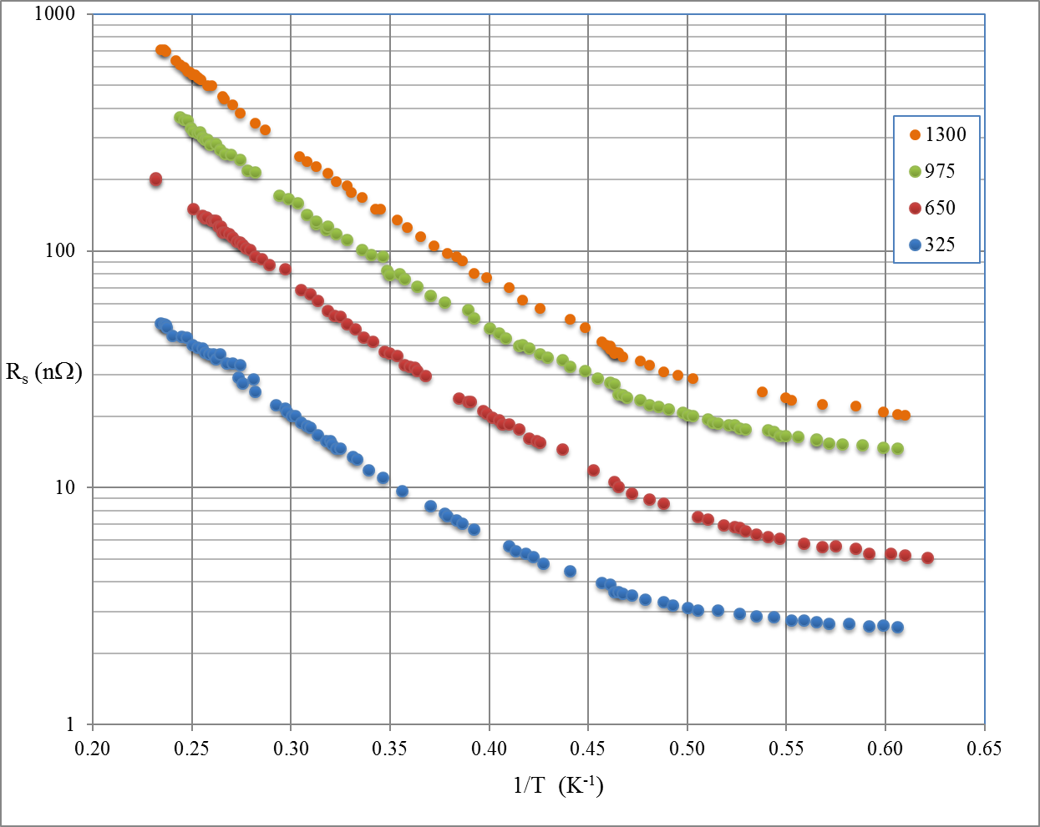
Low Field Frequency Dependence
No low-T baking

Slide 10
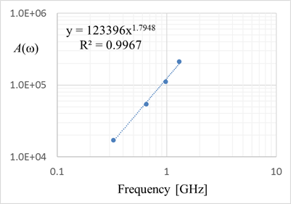

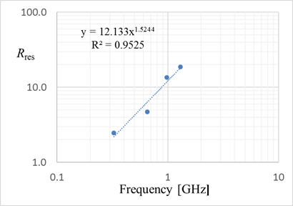
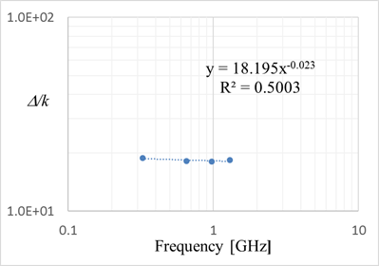
Low Field Frequency Dependence

Slide 11
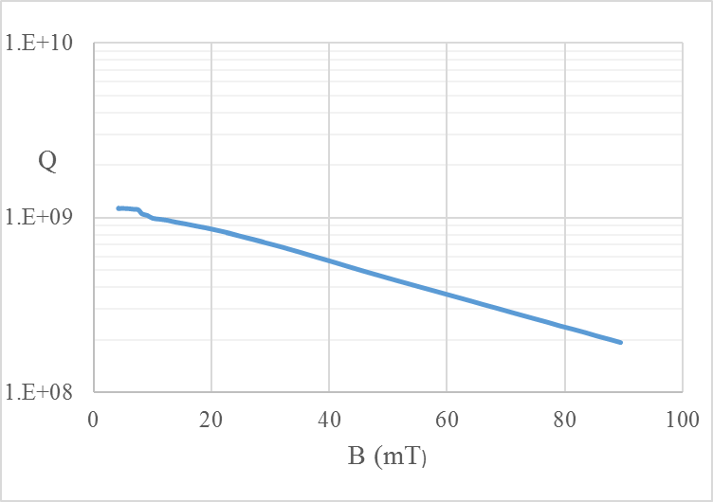
Field Dependence of Surface Resistance
No low-T baking

Slide 12
Extracting Real R_{s}(H) from Q(H_{p})
Geometrical factor
Average surface resistance
Define a(h) as the fraction of the total cavity area where
  Continuous, monotonically increasing
  a(0) = 0 a(1) = 1

Slide 13
Extracting Real R_{s}(H) from Q(H_{p})
Model by
  H₀ arbitrary, to make coefficients dimensionless
  α_{i} : suite of non-negative real numbers
Assume
  Continuous, monotonically increasing
  [1-a(h)] is the fraction of the total cavity area where

Slide 14
Application to Half Wave Coaxial Cavity

Slide 15
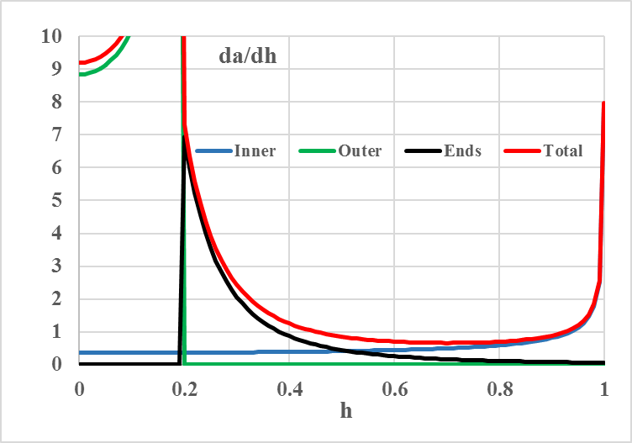
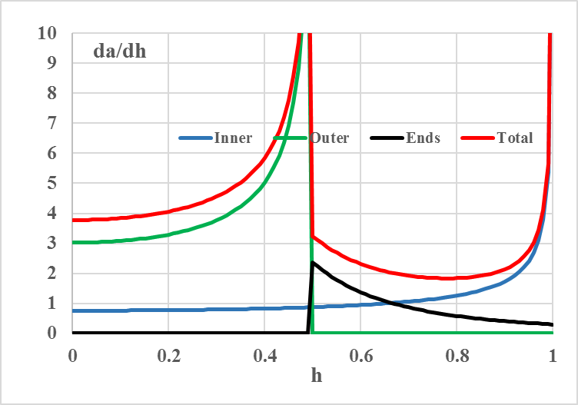
Application to Half Wave Coaxial Cavity

Slide 16
Application to Half Wave Coaxial Cavity

Slide 17
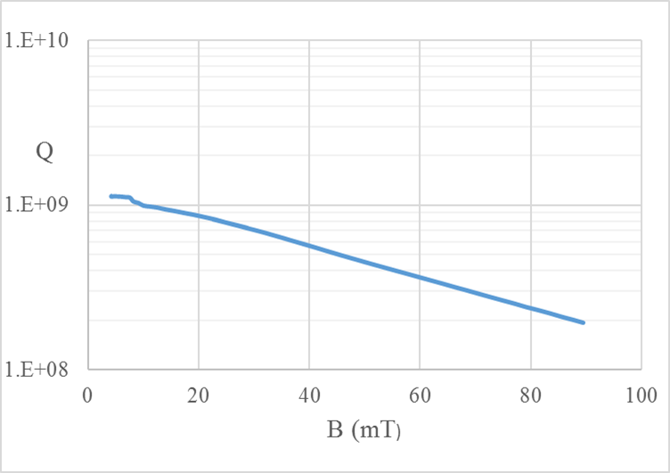
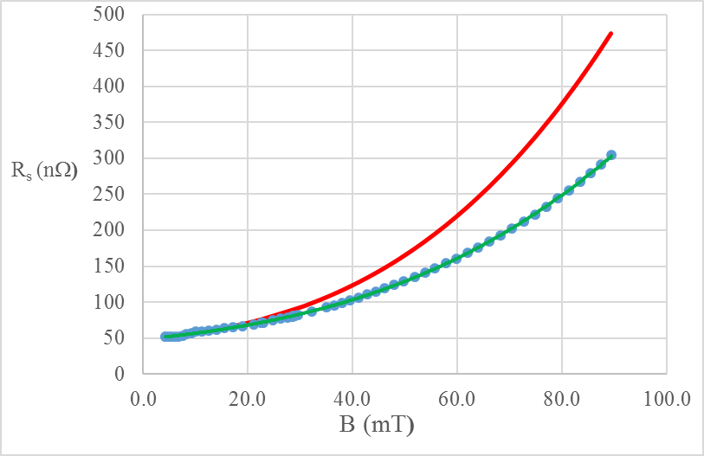
Field Dependence of Surface Resistance

Slide 18
On-going Work and Plans
Influence of low temperature baking on Α(ω), Δ/k, R_{res} , R_{s}(H)
  No baking, 6 hours, 6+6 hours, 6+6+12 hours, 6+6+12+24 hours
Next:
  same thing with N infusion
  Trapping of magnetic field
  …..
Now building 2 new almost identical HW cavities
  OD slightly bigger for ease of assembly
  Entirely made of Nb to be able to go to high temperature
    Nb₃Sn coating
    High temperature heat treatment

