Slide 1
Doping Results as a Function of Different Material for LCLS-II
Dan Gonnella
For the LCLS-II Project

Slide 2
Outline
Introduction to LCLS-II
Cavity Preparation
Nitrogen-Doping in LCLS-II
Vertical Test Results by Material
Cryomodule Test Results by Material
Conclusions

Slide 3
Outline
Introduction to LCLS-II
Cavity Preparation
Nitrogen-Doping in LCLS-II
Vertical Test Results by Material
Cryomodule Test Results by Material
Conclusions

Slide 4
Introduction to LCLS-II
The SRF linac is closely based on the XFEL/ILC/TESLA Design
It consists of 35 cryomodules each with 8 cavities – total of 280 cavities
The 280 1.3 GHz 9-cell cavities have a very ambitious Q specification:
Additionally, cavities must reach 19 MV/m
2.7 x 10¹⁰ at 16 MV/m and 2 K
2.5 x 10¹⁰ at 16 MV/m and 2 K
Q specification lowered in VT due to addition of stainless steel blank on short side of cavity – adds ~0.8 nΩ of R_{res}

Slide 5
Outline
Introduction to LCLS-II
Cavity Preparation
Nitrogen-Doping in LCLS-II
Vertical Test Results by Material
Cryomodule Test Results by Material
Conclusions

Slide 6
Cavity Preparation
In order to achieve the ambitious Q specification, all 9-cell cavities for LCLS-II are prepared with nitrogen-doping
Original recipe:
140 μm bulk EP
800ºC degas for 3 hours in vacuum
2 minutes at 800ºC in 20-30 mTorr of N₂
6 minutes at 800ºC in vacuum
5-7 μm light EP

Slide 7
Cavity Preparation
In order to achieve the ambitious Q specification, all 9-cell cavities for LCLS-II are prepared with nitrogen-doping
Original recipe:
140 μm bulk EP
800ºC degas for 3 hours in vacuum
2 minutes at 800ºC in 20-30 mTorr of N₂
6 minutes at 800ºC in vacuum
5-7 μm light EP

Slide 8
Cavity Preparation
In order to achieve the ambitious Q specification, all 9-cell cavities for LCLS-II are prepared with nitrogen-doping
Original recipe:
140 μm bulk EP
800ºC degas for 3 hours in vacuum
2 minutes at 800ºC in 20-30 mTorr of N₂
6 minutes at 800ºC in vacuum
5-7 μm light EP
Cavities are being produced by Research Instruments GmbH (RI) and Ettore Zanon S.p.a (EZ)
Niobium was procured from Tokyo Denkai and OTIC Ningxia

Slide 9
Outline
Introduction to LCLS-II
Cavity Preparation
Nitrogen-Doping in LCLS-II
Vertical Test Results by Material
Cryomodule Test Results by Material
Conclusions

Slide 10
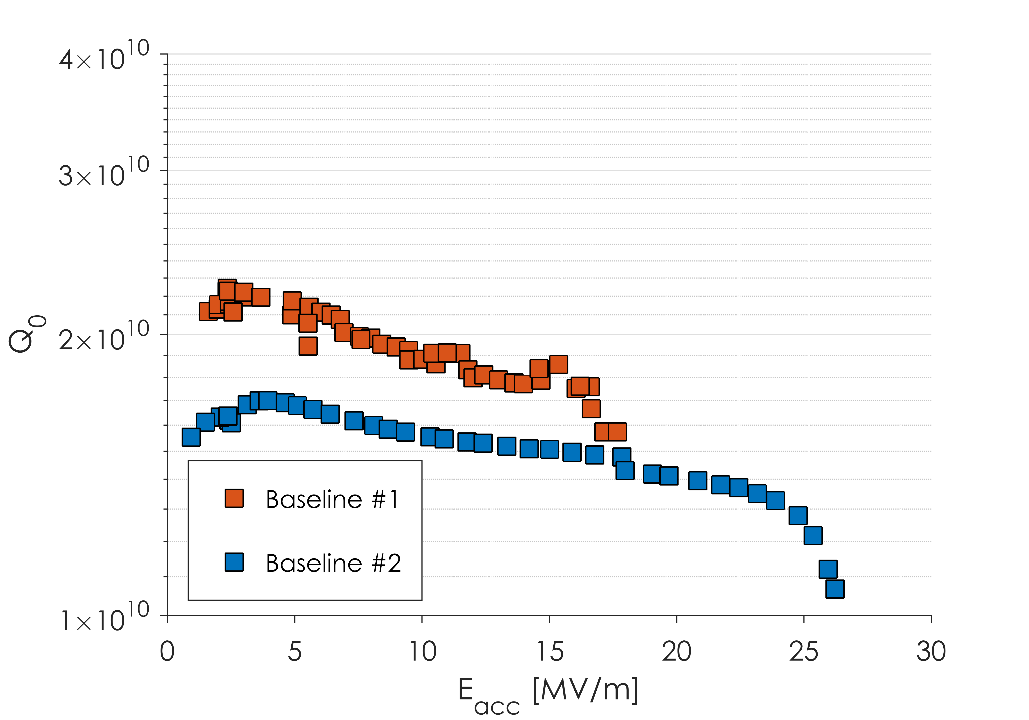
Nitrogen-Doping Introduction

Slide 11
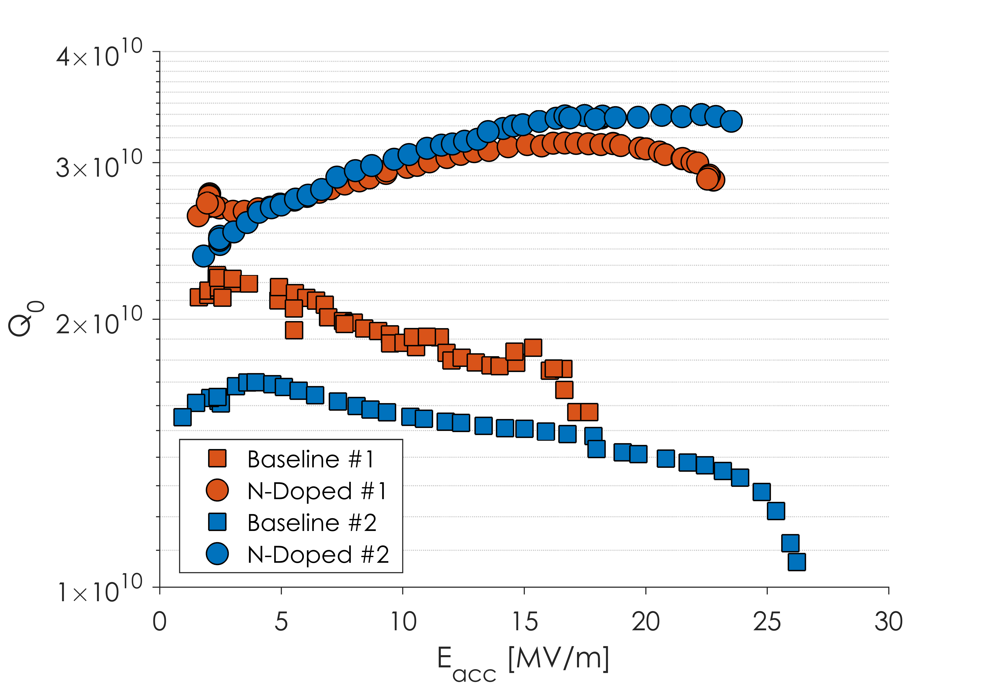
Nitrogen-Doping Introduction
Q is improved by 2 mechanisms:
Higher starting Q₀
Anti-Q slope
Both of these are a resulting of a changing R_{BCS}
Q₀’s of >3x10¹⁰ can consistently be produced

Slide 12
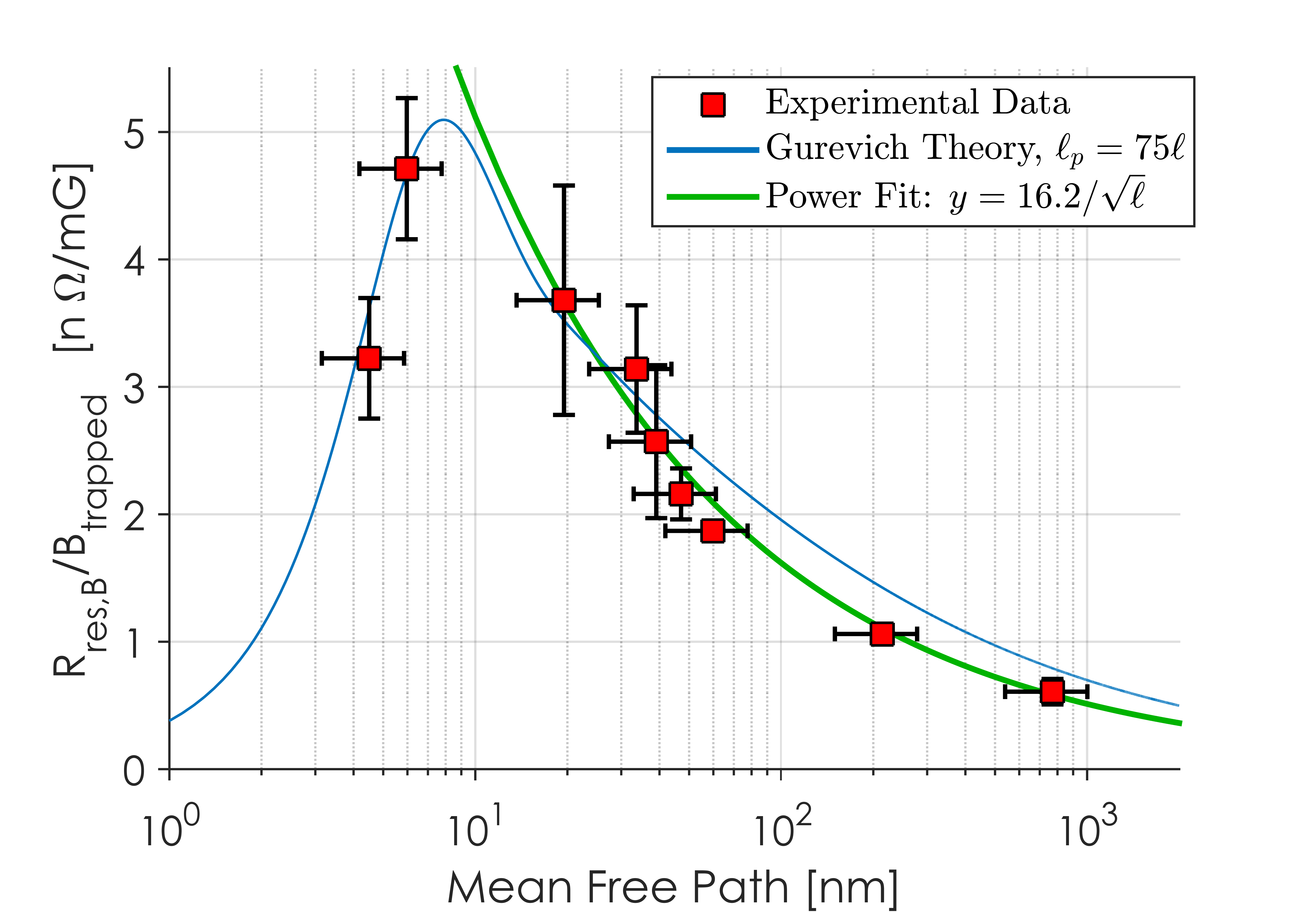
Drawbacks of N-Doping
Q₀ is significantly improved by the lowering of R_{BCS}
There is a tradeoff however with R_{res}
Nitrogen-doped cavities are more sensitive to losses from trapped magnetic flux
For the same amount of trapped flux, a N-doped cavity will have a higher R_{res} than an un-doped cavity
3.4x for the LCLS-II cavity recipe
This requires efficient flux expulsion or small ambient magnetic fields to maintain high Q₀

Slide 13
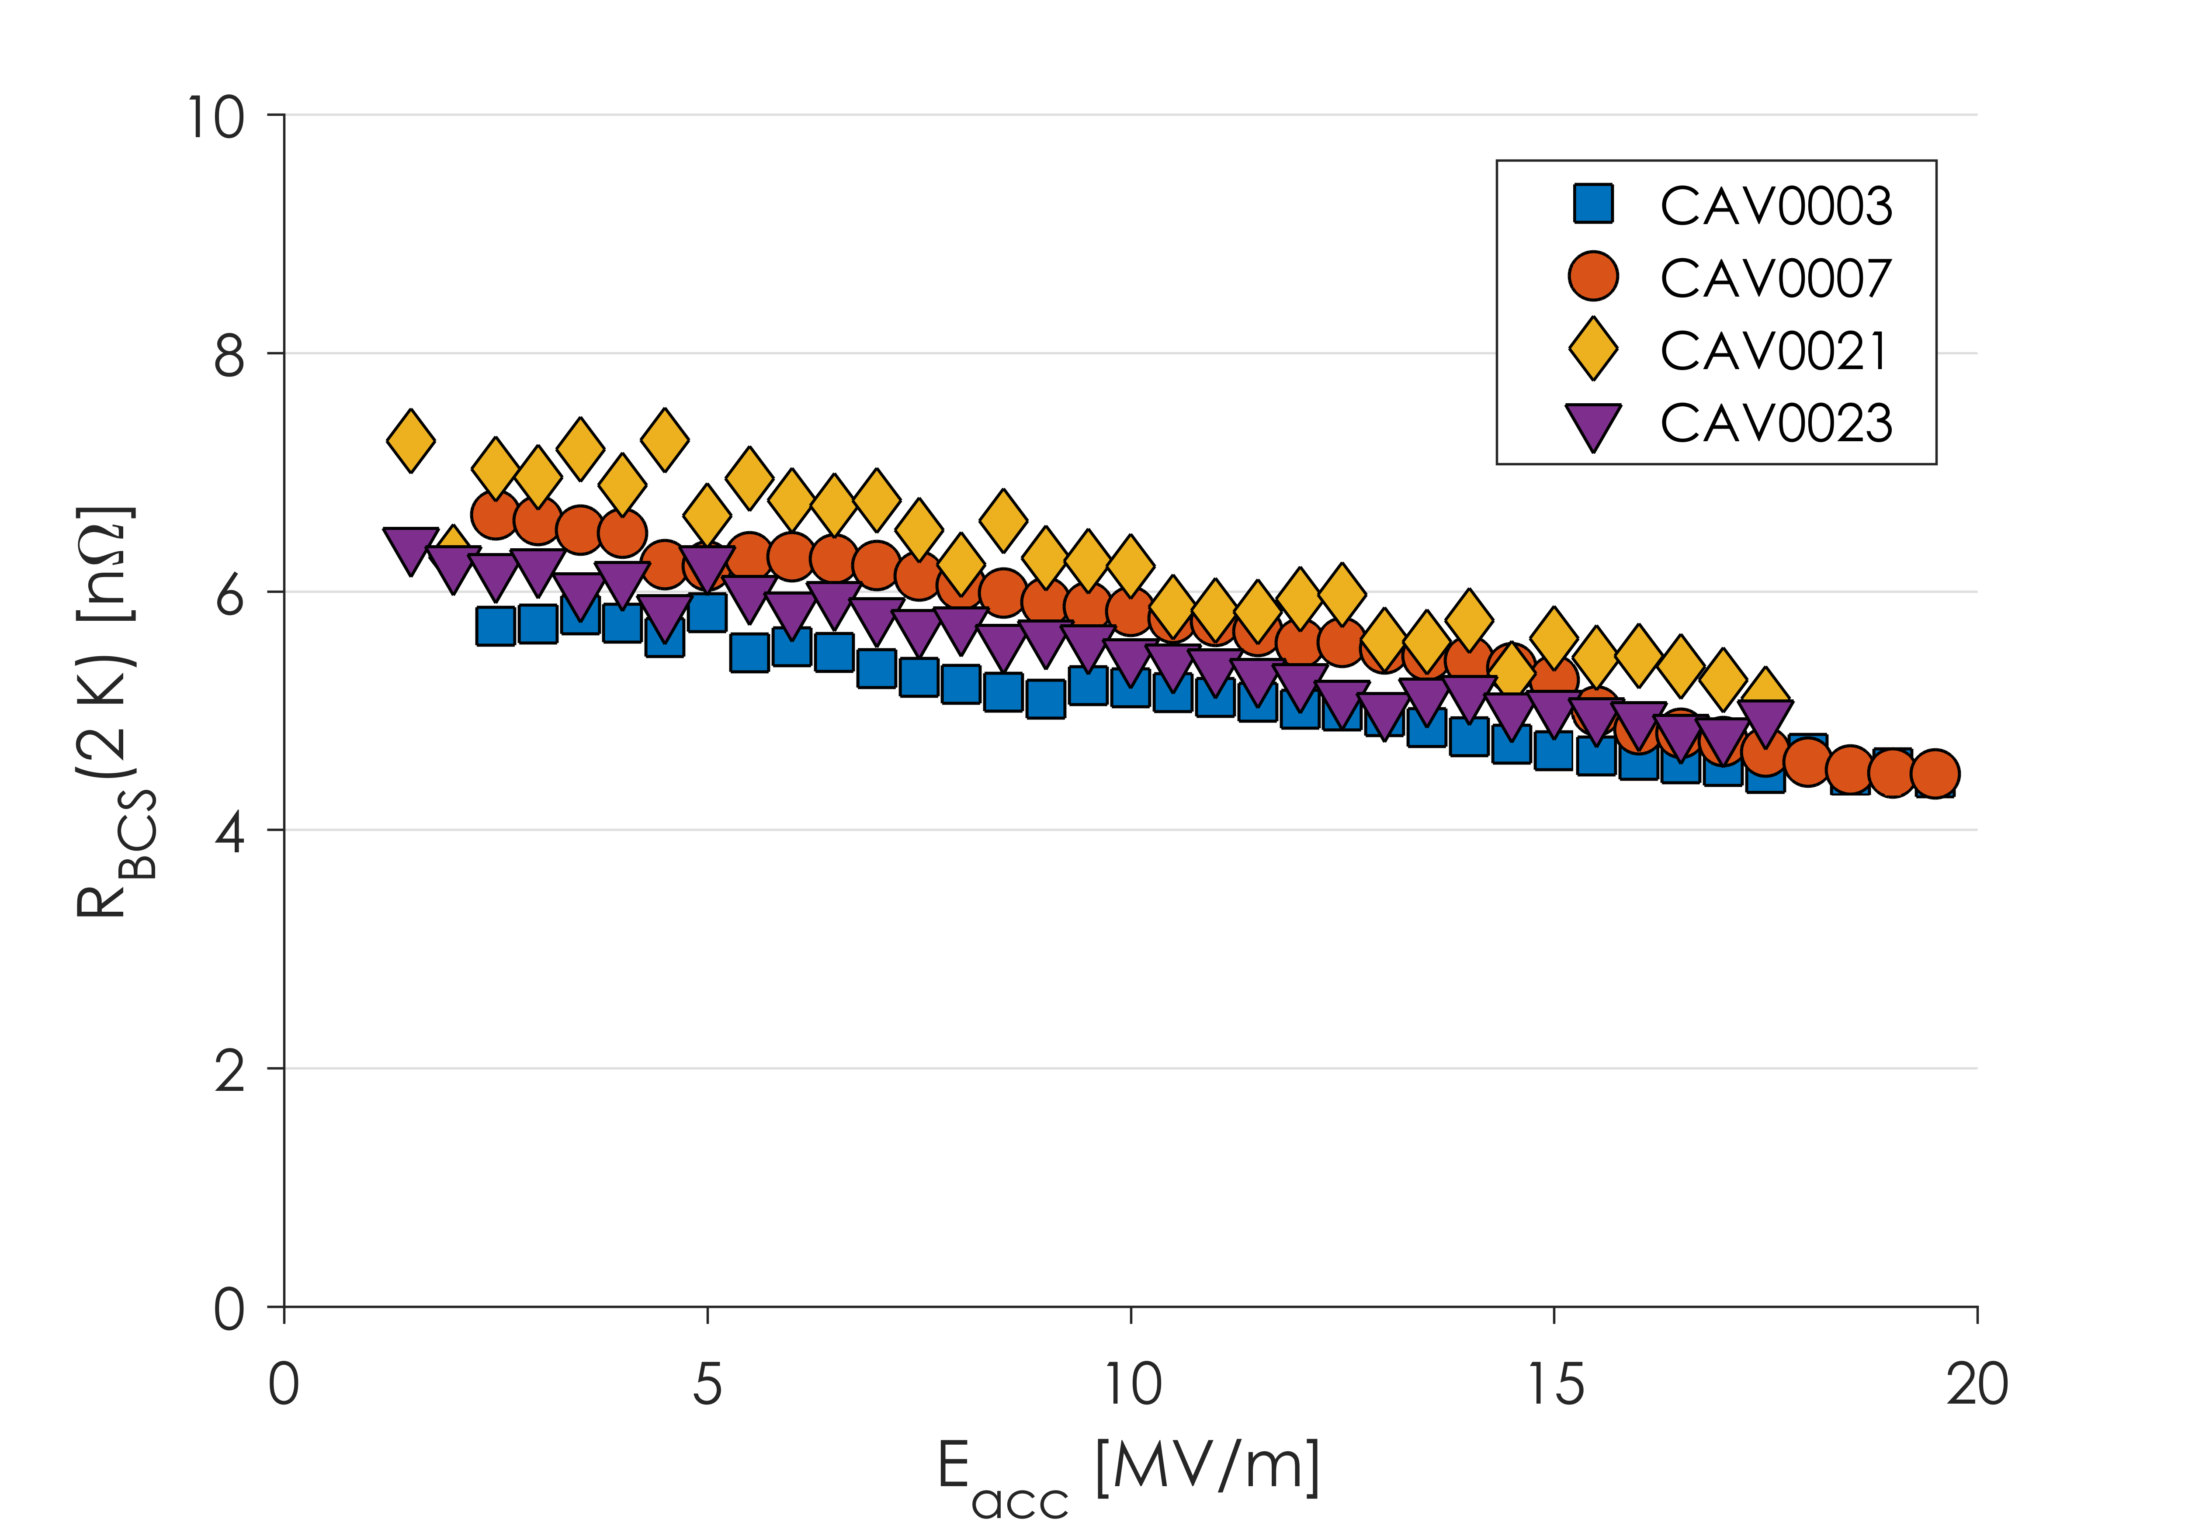
R_{BCS} in Production Cavities
Strong Anti-Q Slope
Decreasing R_{BCS} from ~7 to ~4 nΩ
Production cavities show similar anti-Q slope to R&D cavities

Slide 14
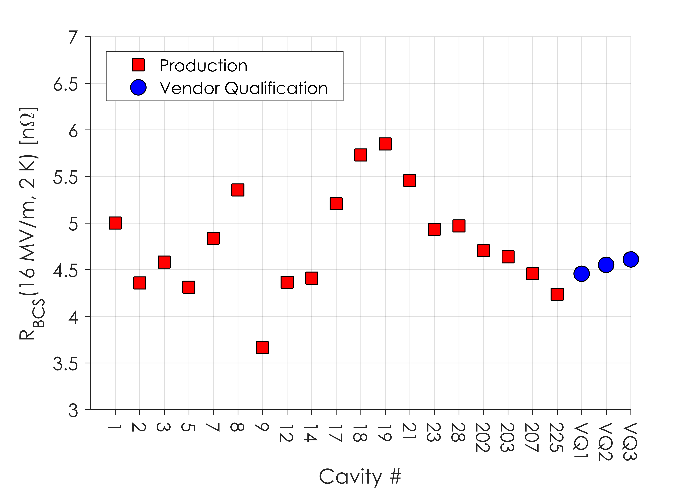
R_{BCS} in Production Cavities
R_{BCS} consistently between 4 and 6 nΩ at 16 MV/m
Mix of Material from 3 Vendors
R_{BCS} at 16 MV/m and 2.0 K is consistently 4-6 nΩ
This is consistent with “2/6” N-Doping developed in the R&D phase of LCLS-II

Slide 15
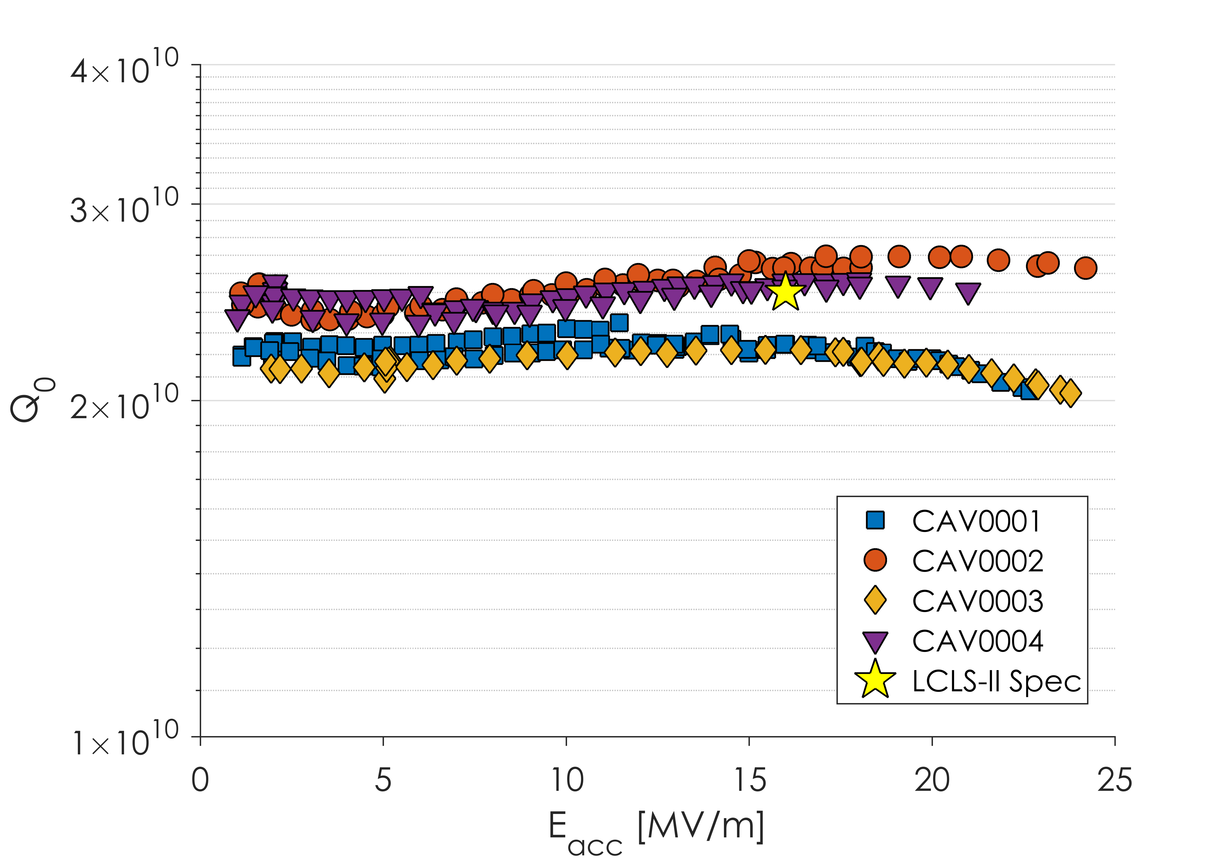
Q vs E for First Article Cavities
Some Great Cavities
Some Good Cavities
All these cavities tested in very low (0-1 mG) magnetic fields

Slide 16
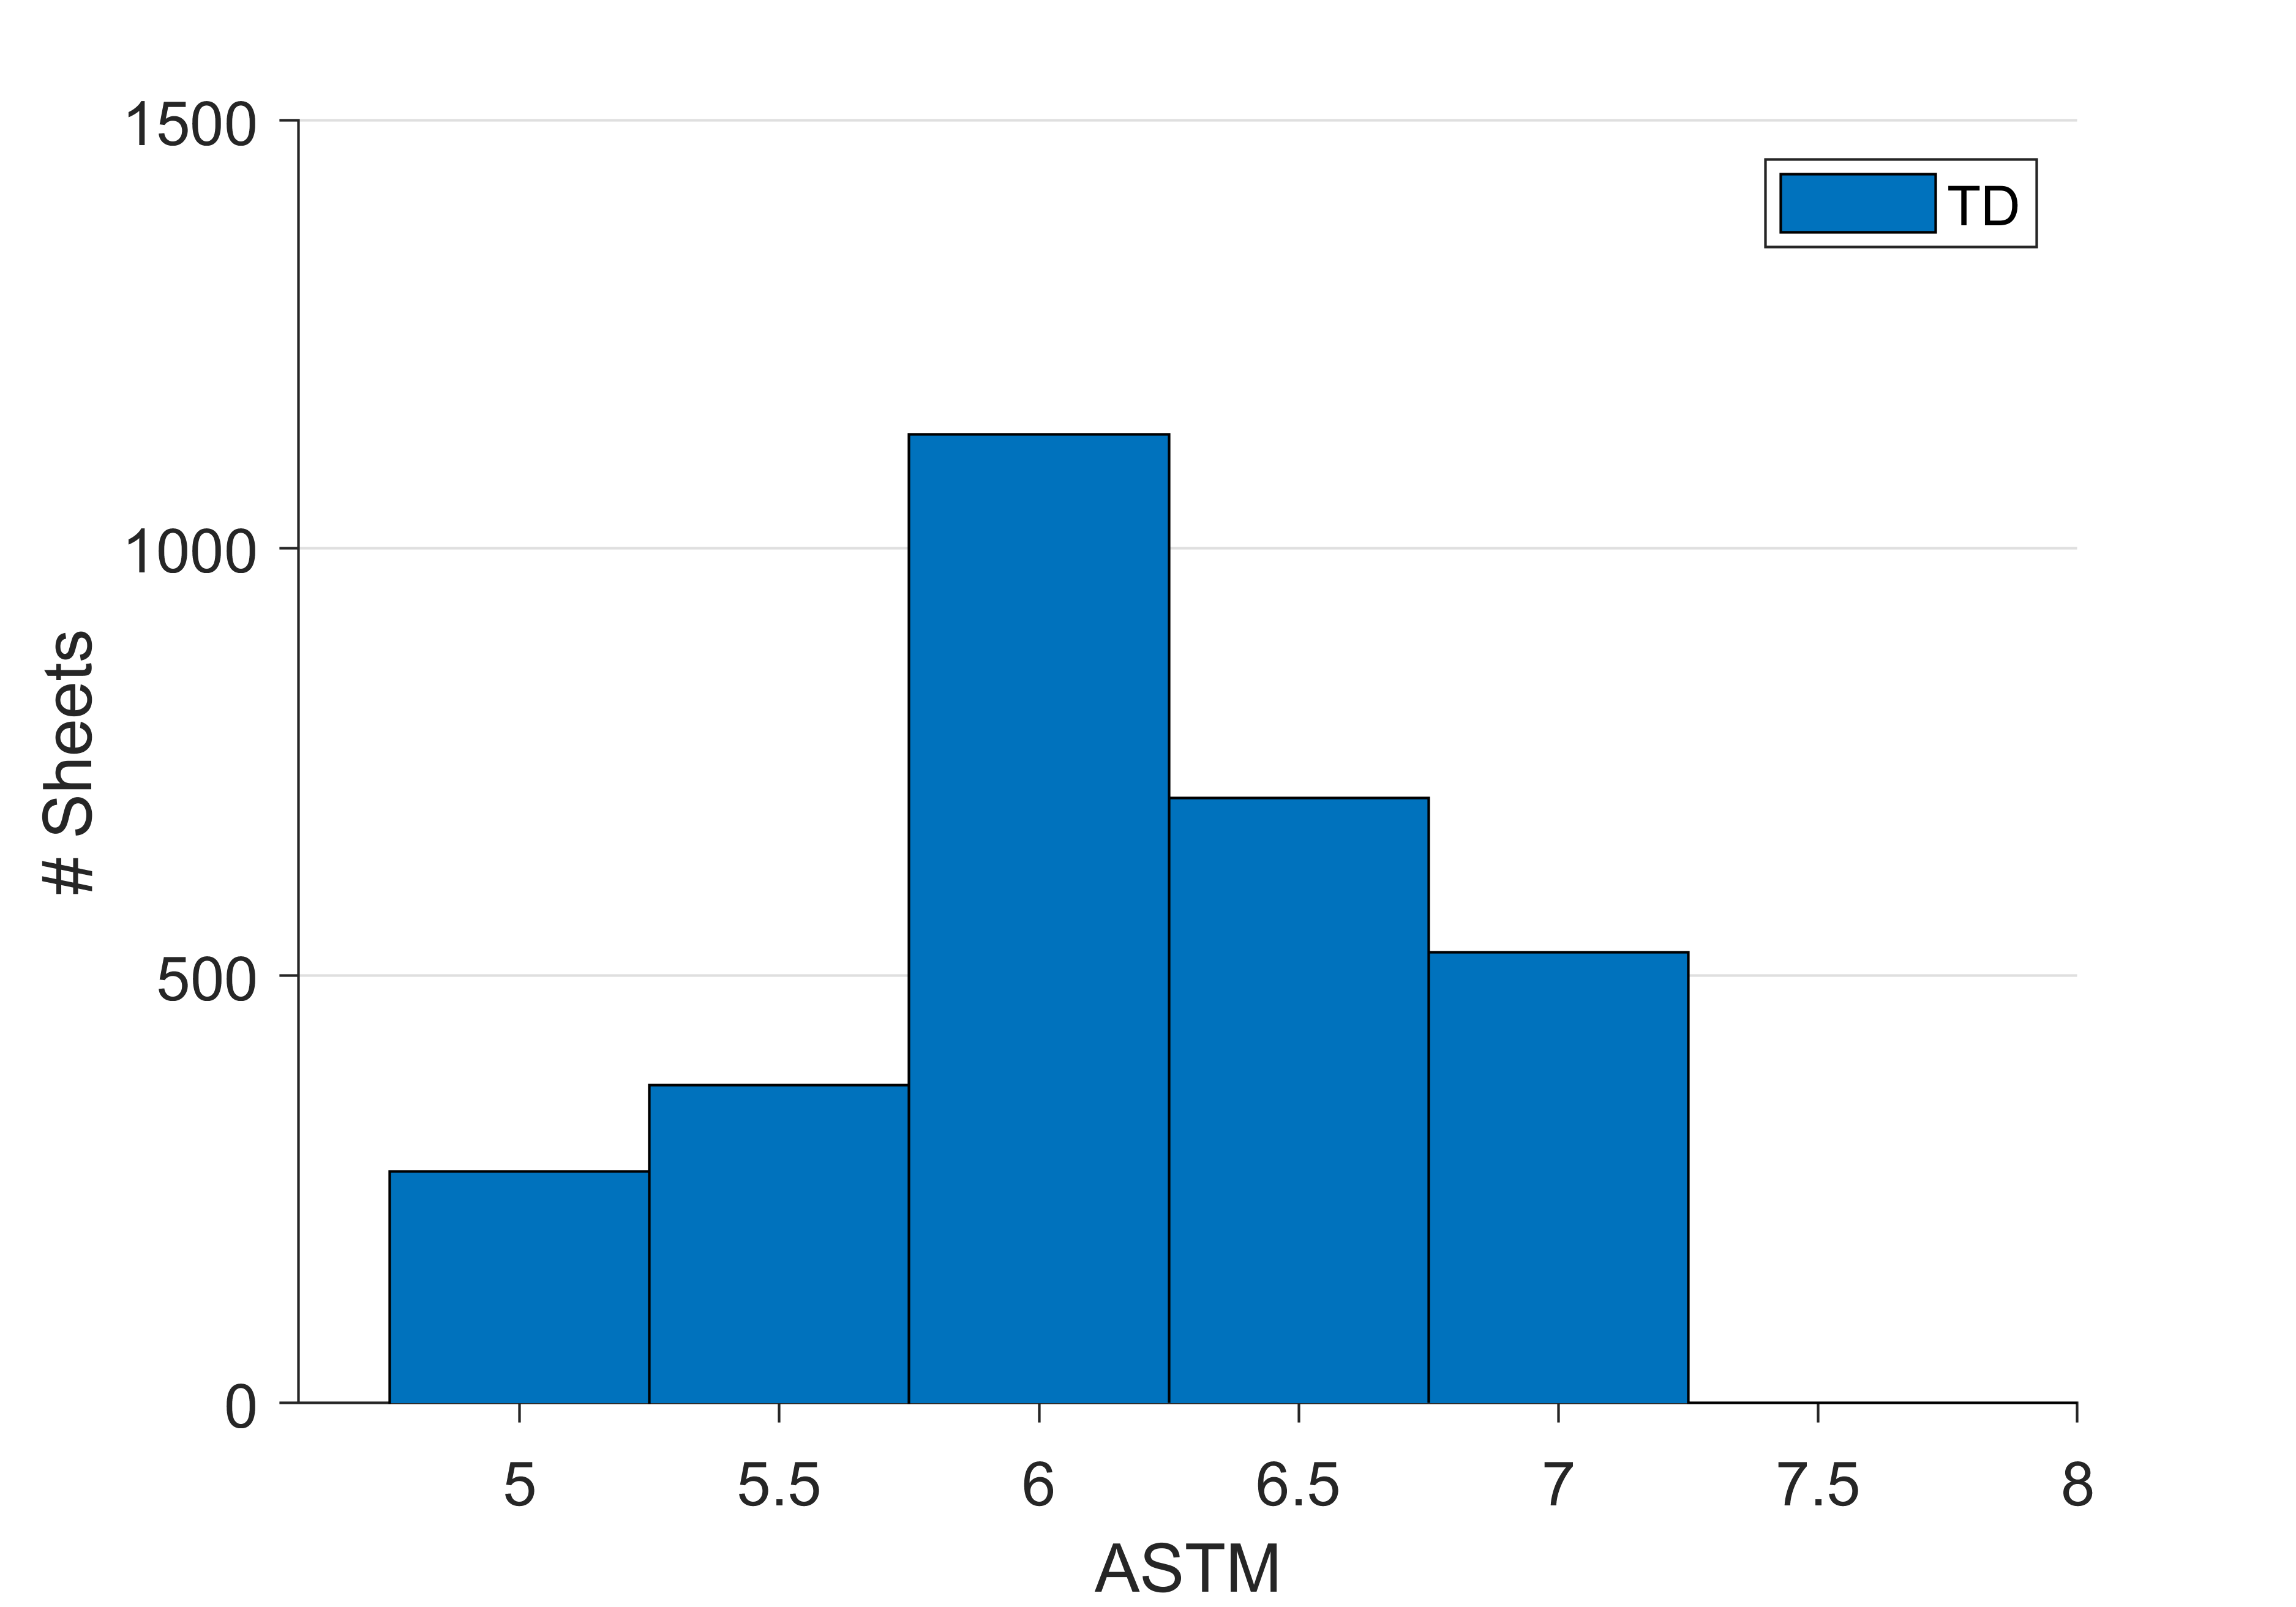
Niobium Material Overview
266 cavities originally ordered
3011 TD sheets

Slide 17
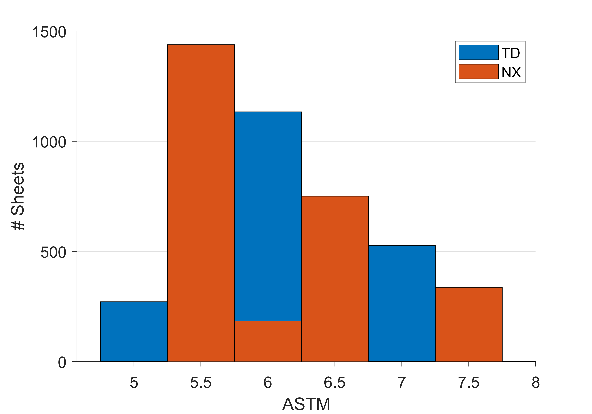
Niobium Material Overview
266 cavities originally ordered
3011 TD sheets
2710 NX sheets
337 of those sheets were “Lot C” (ASTM>7)

Slide 18
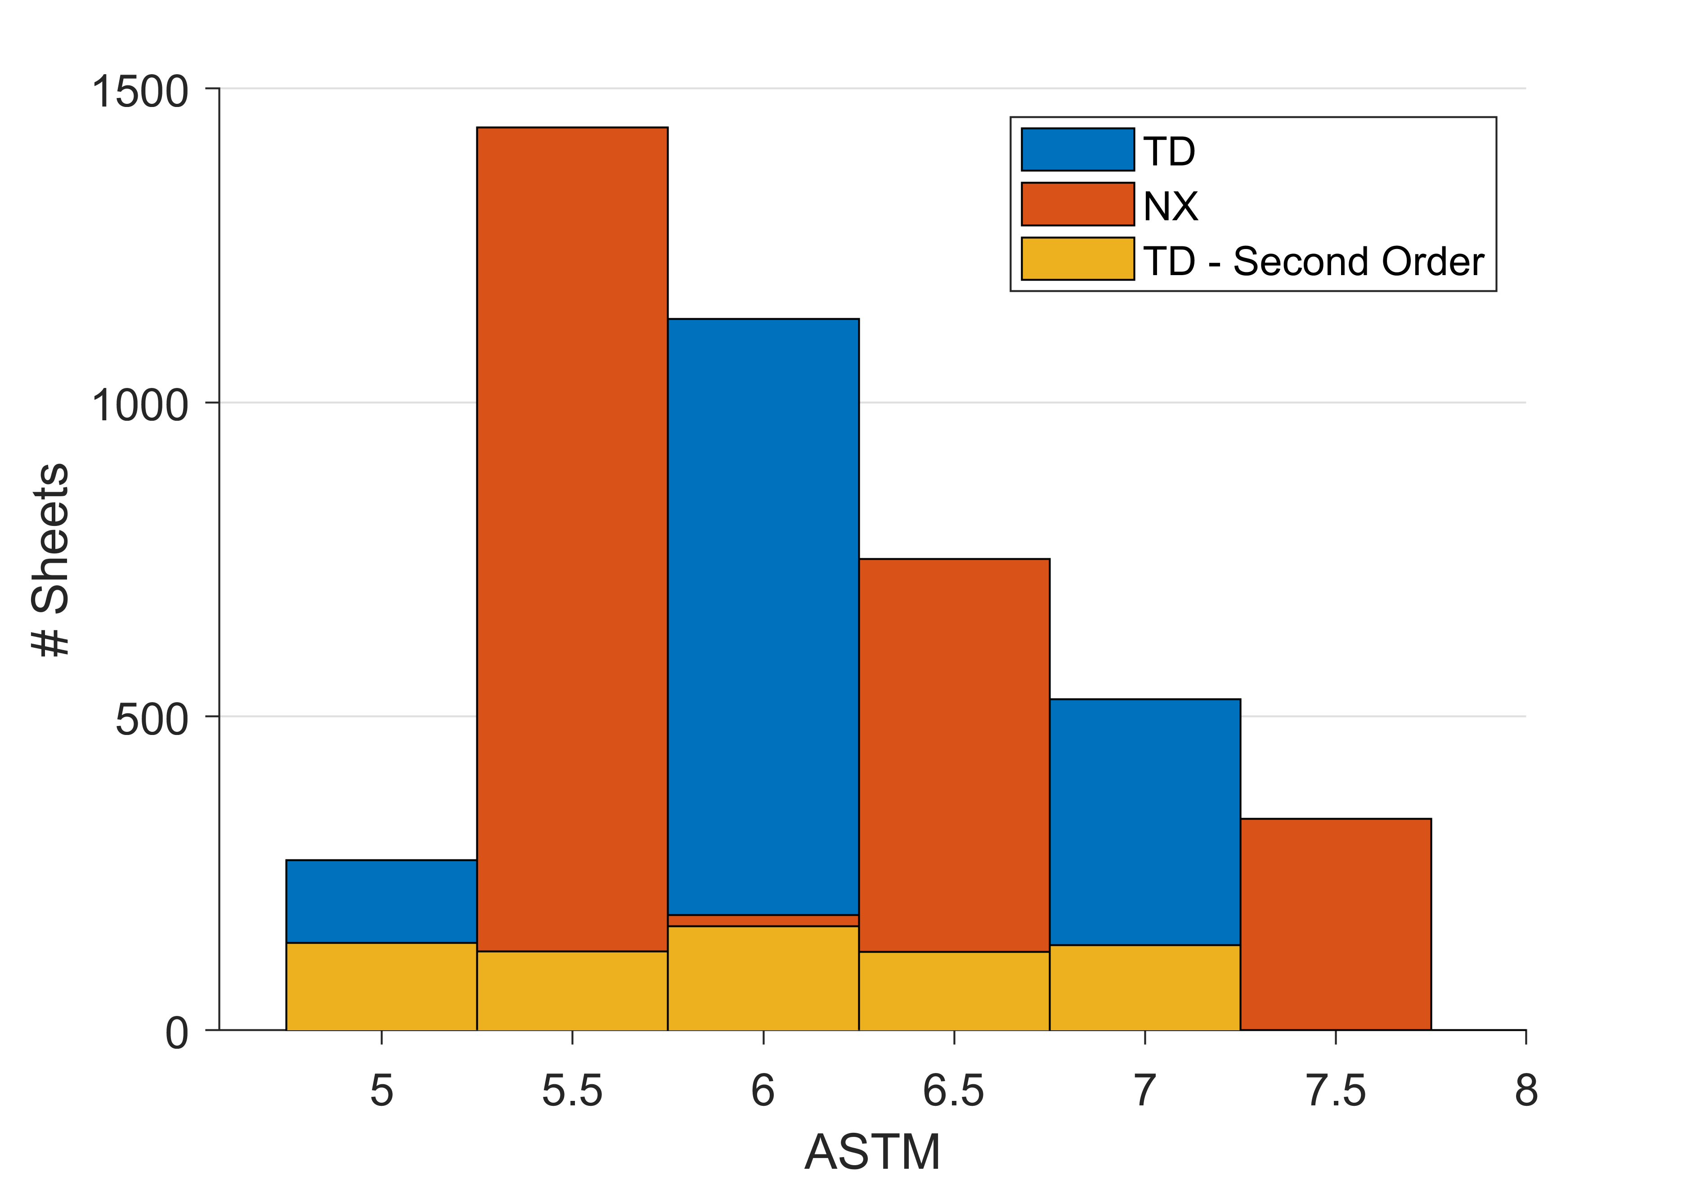
Niobium Material Overview
266 cavities originally ordered
3011 TD sheets
2710 NX sheets
337 of those sheets were “Lot C” (ASTM>7)
Additional cavities ordered, bringing total to 375
692 additional TD sheets purchased to complete the order
Define: Lot A: ASTM<6
Lot B: 6<ASTM<7
Lot C: ASTM>7

Slide 19
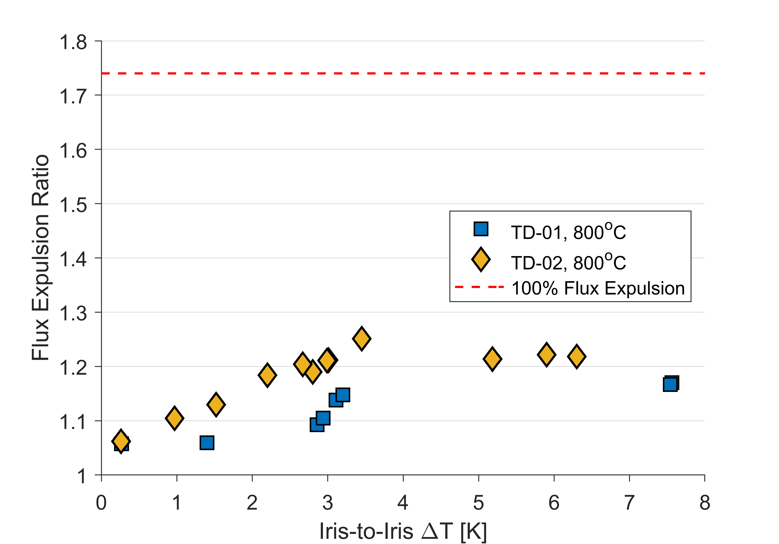
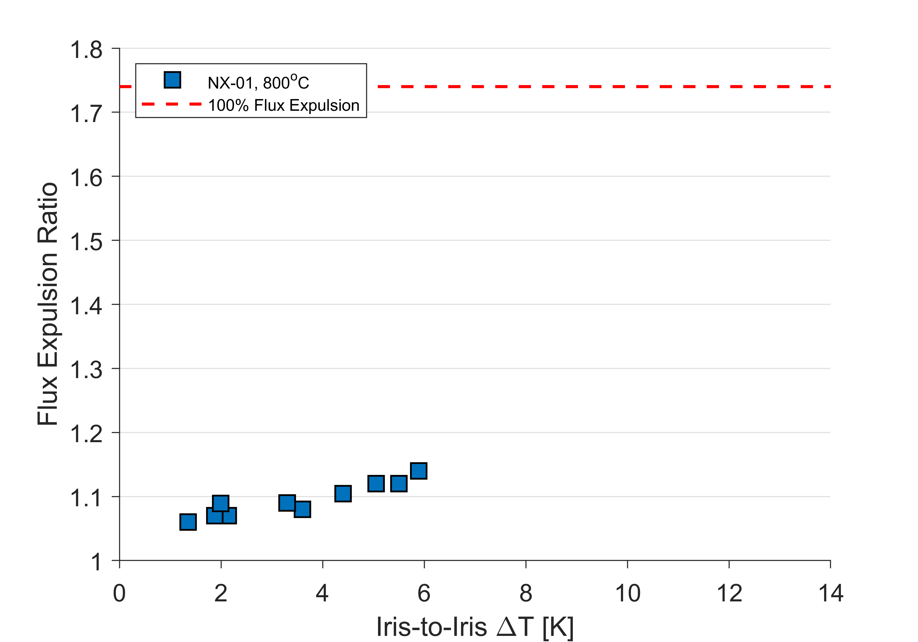
Flux Expulsion in Original Material
TD
NX
Data from A. Palczewski
Data from S. Posen
TD material shows poor flux expulsion after 3 hours at 800ºC
NX material shows poor flux expulsion after 3 hours at 800ºC

Slide 20
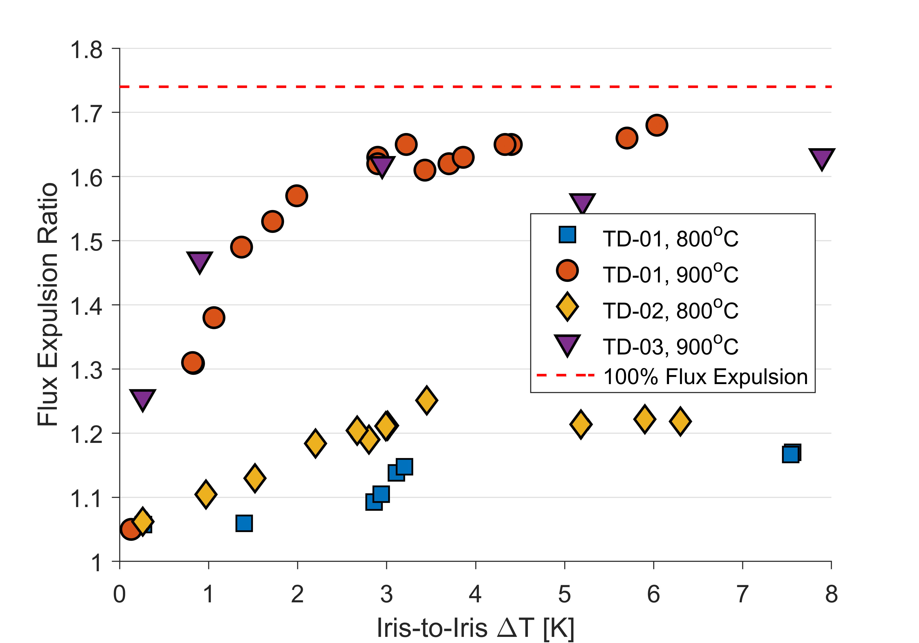
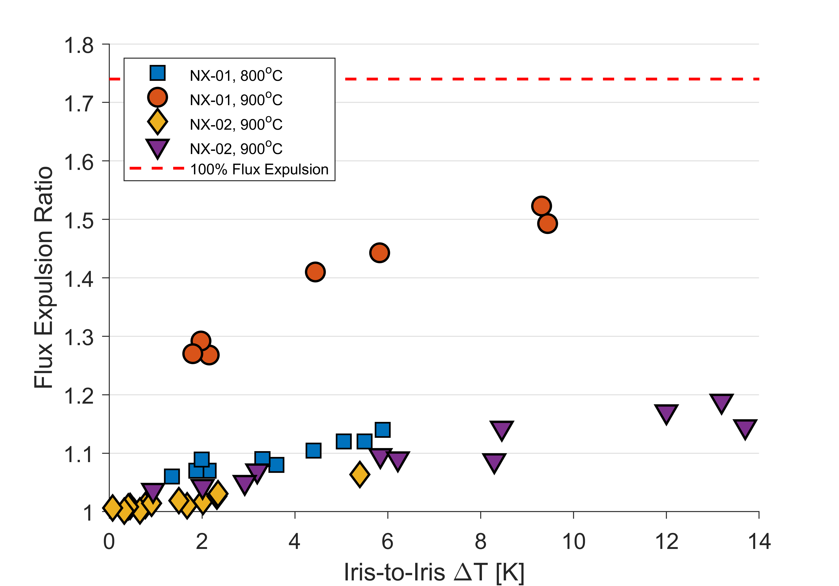
Flux Expulsion in Original Material
TD
NX
Data from A. Palczewski
Data from S. Posen
TD material shows poor flux expulsion after 3 hours at 800ºC
Improved to near perfect when temperature raised to 900ºC
NX material shows poor flux expulsion after 3 hours at 800ºC
900ºC did not significantly improve flux expulsion

Slide 21
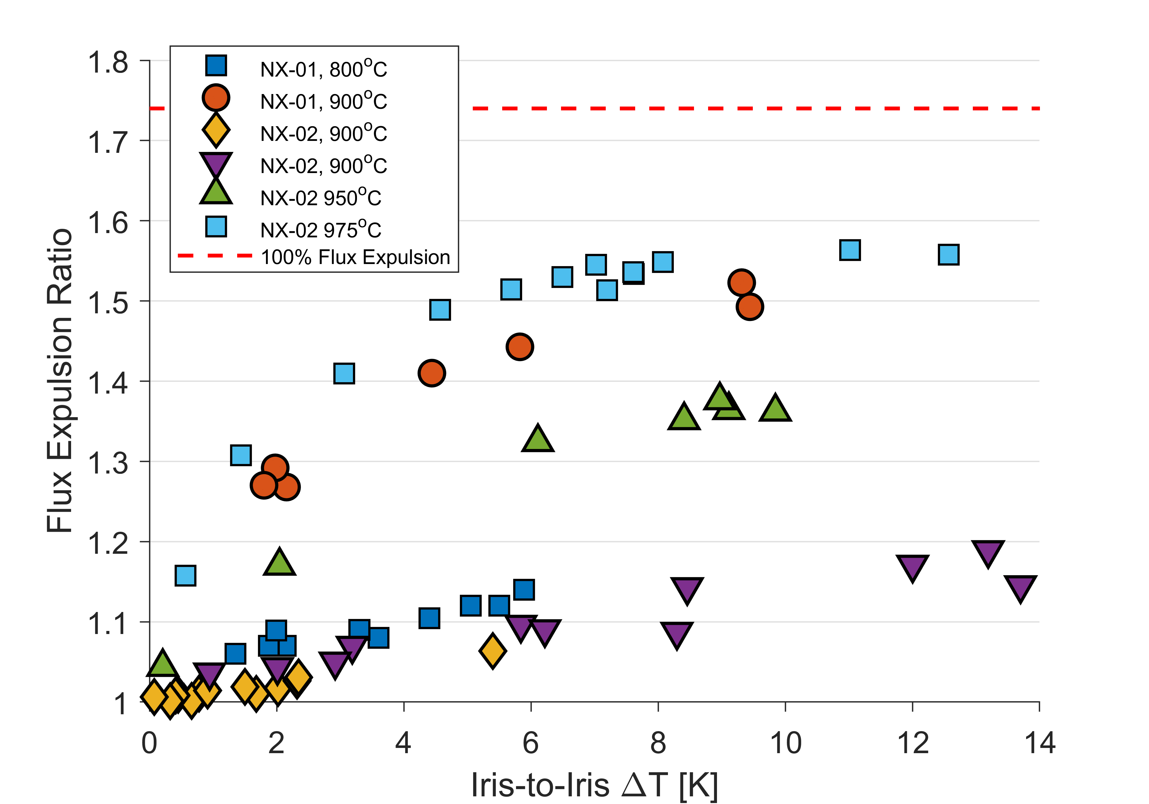
Flux Expulsion in Original Material
TD
NX
Data from A. Palczewski
Lesson Learned:
Flux expulsion must be verified on lot of material to ensure Q₀ meets specification
Data from S. Posen
TD material shows poor flux expulsion after 3 hours at 800ºC
Improved to near perfect when temperature raised to 900ºC
NX material shows poor flux expulsion after 3 hours at 800ºC
900ºC did not significantly improve flux expulsion
950 and 975ºC necessary

Slide 22
Cavity Preparation
In order to achieve the ambitious Q specification, all 9-cell cavities for LCLS-II are prepared with nitrogen-doping
Updated recipe:
200 μm bulk EP
900ºC degas for 3 hours in vacuum for TD cavities
950/975ºC degas for 3 hours in vacuum for NX cavities
2 minutes at 800ºC in 20-30 mTorr of N₂
6 minutes at 800ºC in vacuum
5-7 μm light EP

Slide 23
Q vs E for First Article Cavities

Slide 24
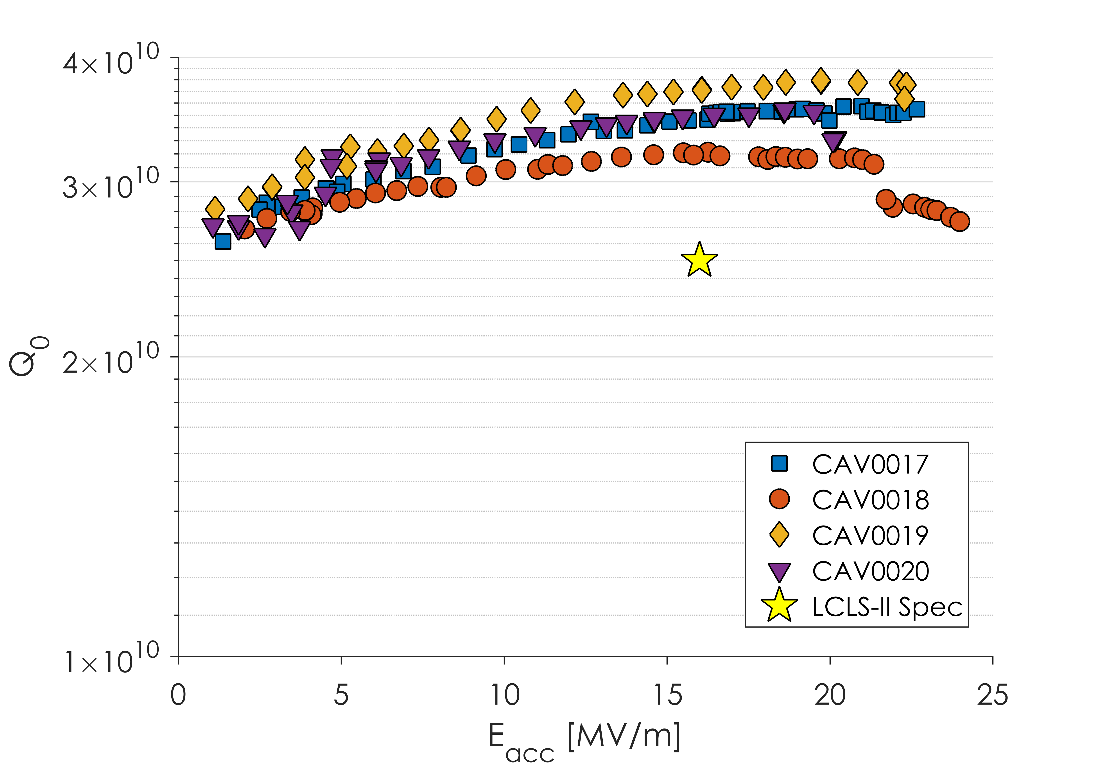
Q vs E for First Article Cavities
Nitrogen-Doping has been successfully transferred to cavity vendors

Slide 25
Outline
Introduction to LCLS-II
Cavity Preparation
Nitrogen-Doping in LCLS-II
Vertical Test Results by Material
Cryomodule Test Results by Material
Conclusions

Slide 26
LCLS-II Vertical Test Requirements
Cavity Requirements for 9-Cell Qualification:
Q ≥ 2.5x10¹⁰ at 16 MV/m and 2.0 K
E_{max} ≥ 19 MV/m
No detectable field emission on final power rise

Slide 27
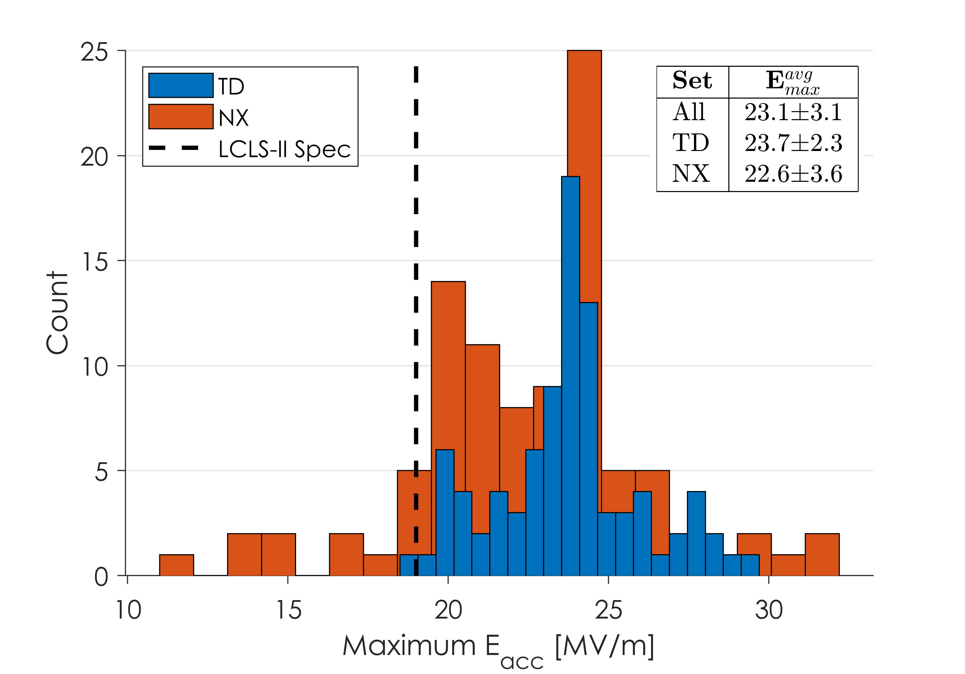
Quench Fields by Material in VT
Nearly all cavities exceed the LCLS-II gradient specification
Average quench fields are ~23 MV/m, consistent with expectations from 2/6 Nitrogen-doping recipe
No significant difference in quench fields between material batches

Slide 28
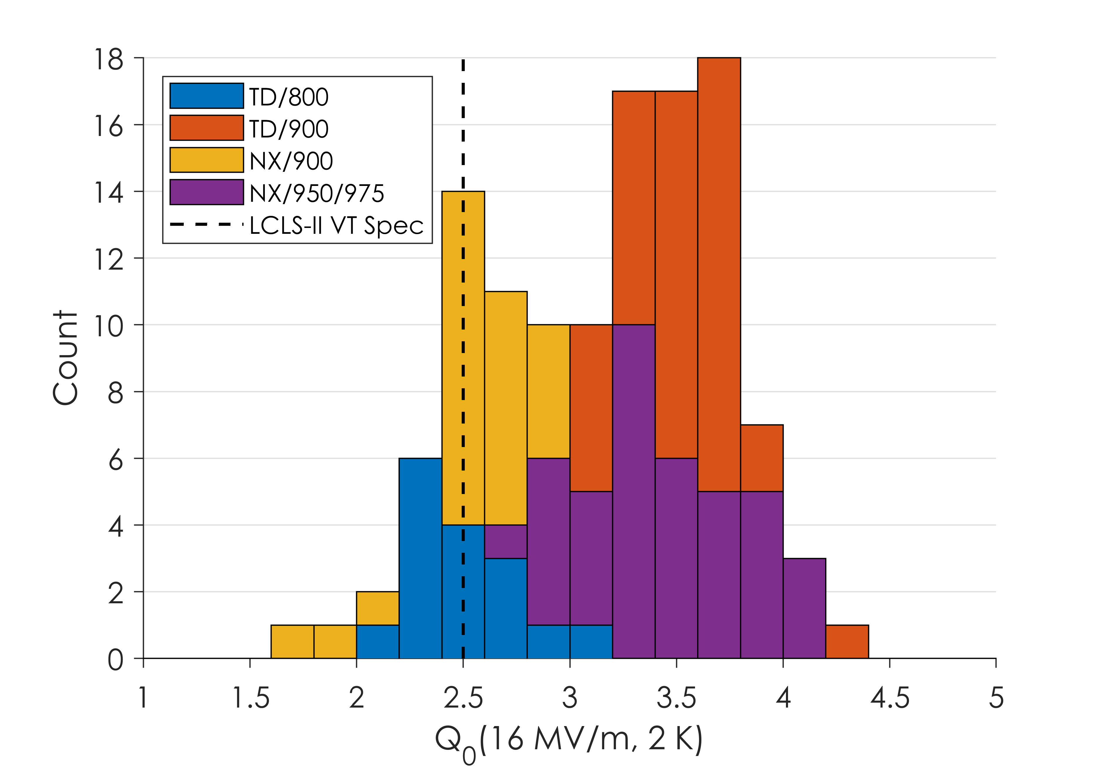
Q₀ by Material in VT
Large spread in Q₀ in vertical test due to differences in heat treatments and material
Material | <Q₀> at 16 MV/m, 2K
TD/800* | 2.5x10¹⁰
TD/900 | 3.3x10¹⁰
NX/900* | 2.6x10¹⁰
NX/950/975 | 3.3x10¹⁰
*TD/800 tested in lower magnetic fields than NX/900

Slide 29
Outline
Introduction to LCLS-II
Cavity Preparation
Nitrogen-Doping in LCLS-II
Vertical Test Results by Material
Cryomodule Test Results by Material
Conclusions

Slide 30
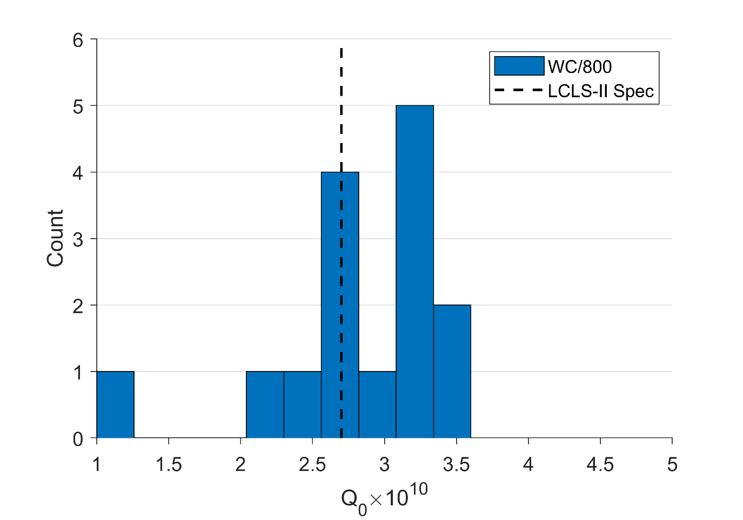
Cavity Performance in CM by Material
Q₀ for Cavities in CMs Tested at FNAL
Prototype cavities typically showed Q₀ above spec

Slide 31
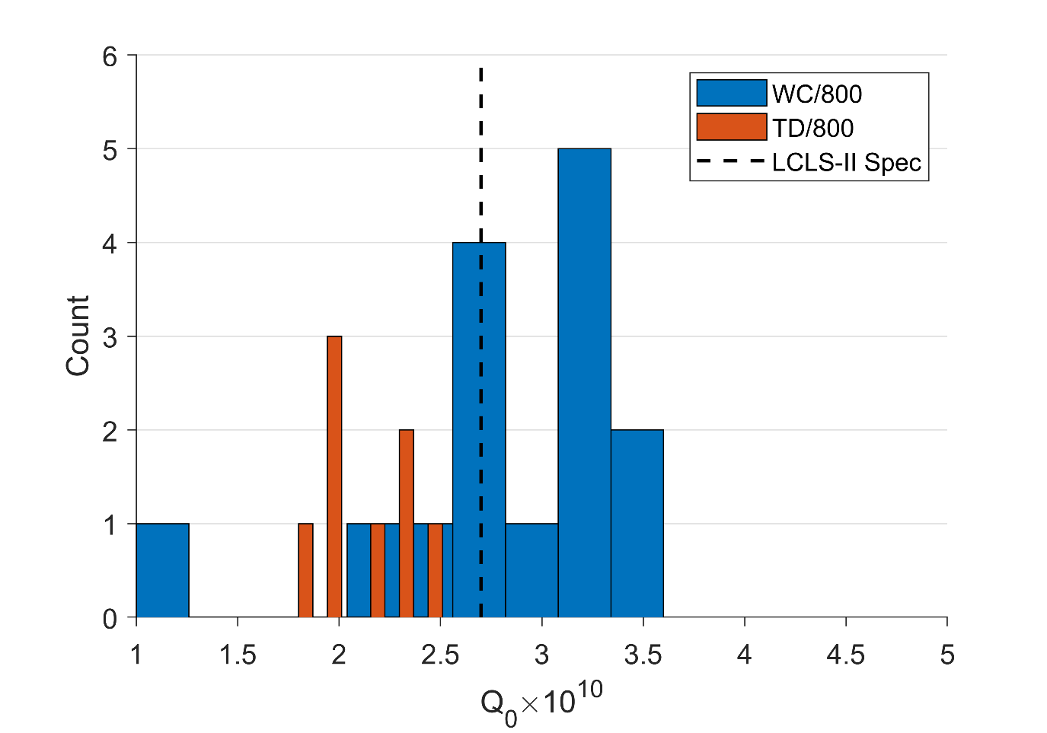
Cavity Performance in CM by Material
Q₀ for Cavities in CMs Tested at FNAL
Prototype cavities typically showed Q₀ above spec
TD/800 cavities are consistently below spec
TD/800 = Cavities produced with Tokyo Denkai material, heat treated at 800ºC

Slide 32
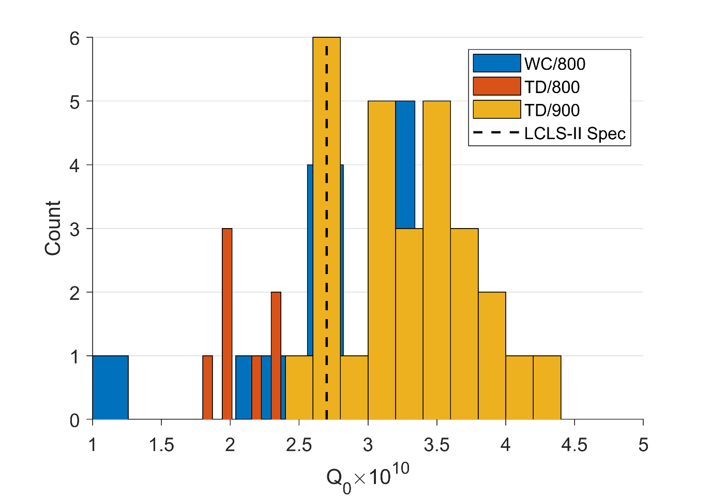
Cavity Performance in CM by Material
Q₀ for Cavities in CMs Tested at FNAL
Prototype cavities typically showed Q₀ above spec
TD/800 cavities are consistently below spec
TD/900 cavities consistently far exceed the spec
TD/900 = Cavities produced with Tokyo Denkai material, heat treated at 900ºC

Slide 33
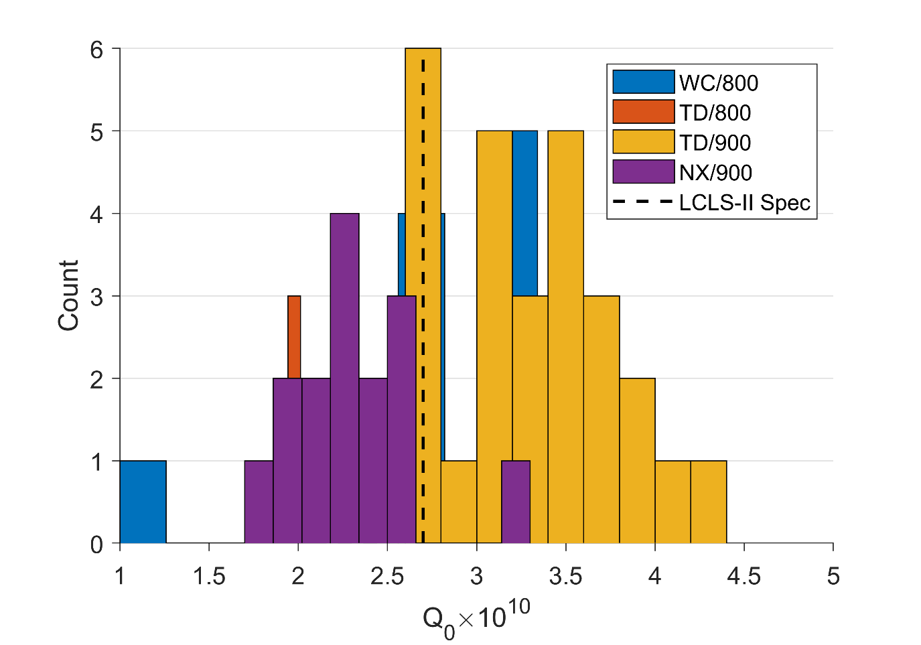
Cavity Performance in CM by Material
Q₀ for Cavities in CMs Tested at FNAL
Prototype cavities typically showed Q₀ above spec
TD/800 cavities are consistently below spec
TD/900 cavities consistently far exceed the spec
NX/900 cavities perform similarly to the TD/800 cavities and do not meet spec
NX/800 = Cavities produced with Ningxia material, heat treated at 900ºC

Slide 34
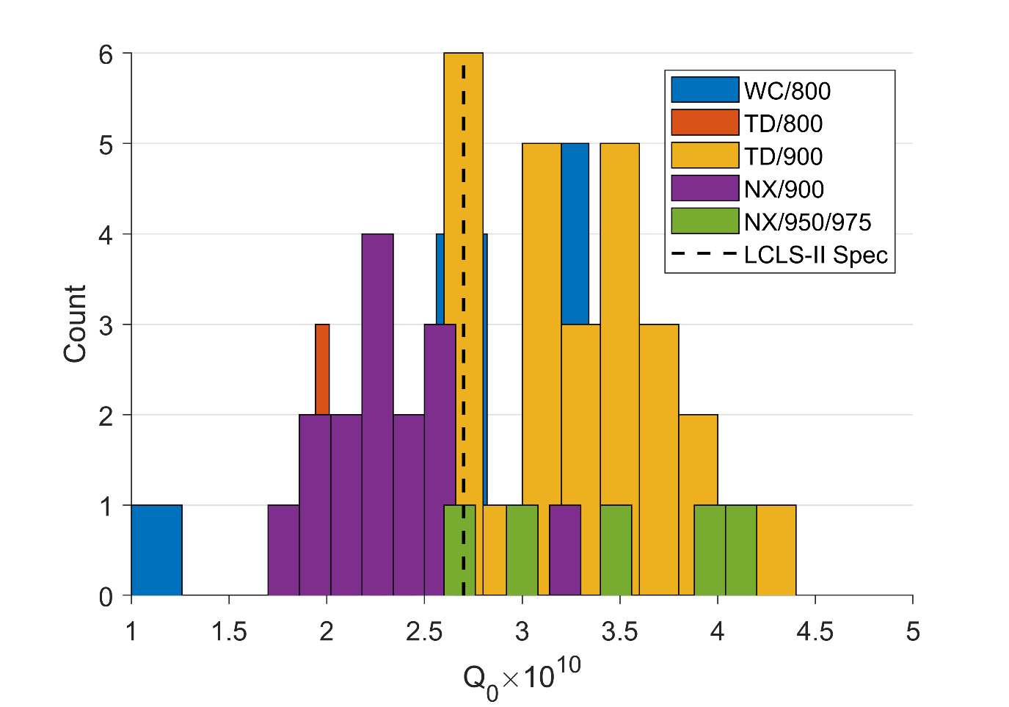
Cavity Performance in CM by Material
Q₀ for Cavities in CMs Tested at FNAL
Prototype cavities typically showed Q₀ above spec
TD/800 cavities are consistently below spec
TD/900 cavities consistently far exceed the spec
NX/900 cavities perform similarly to the TD/800 cavities and do not meet spec
NX/950 cavities perform similarly to TD/900 (limited statistics)
NX/950 = Cavities produced with Ningxia material, heat treated at 950ºC

Slide 35
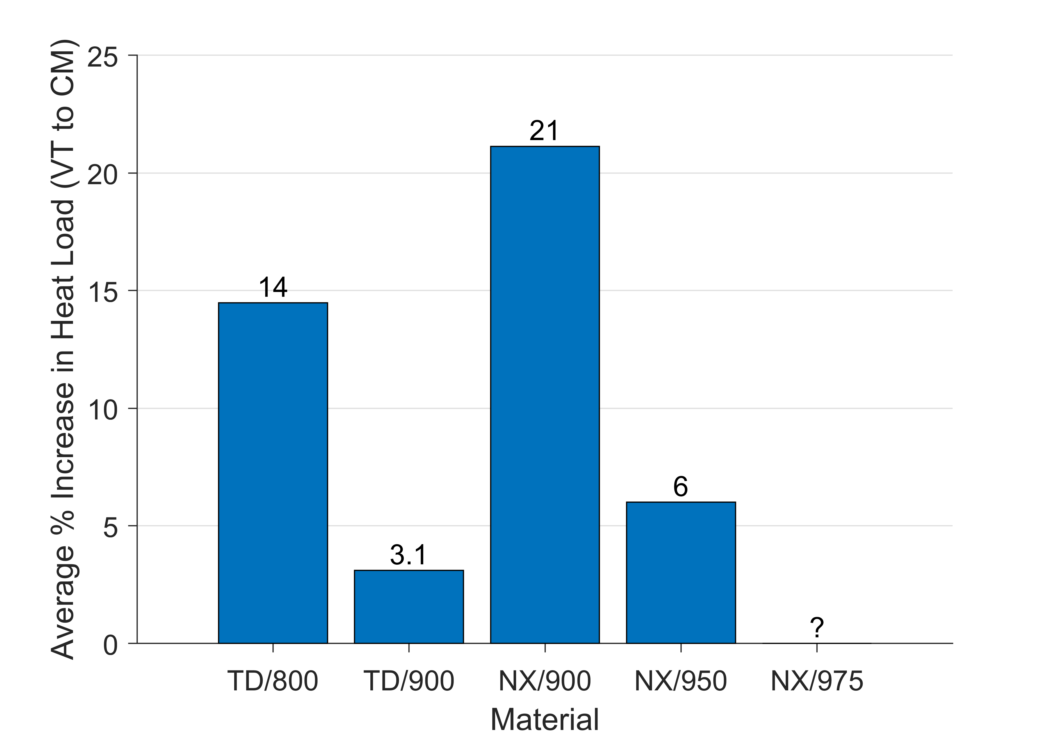
Changes from Vertical to Cryomodule Test
Assumes 16 MV/m operation
Limited Statistics
Changes in performance from VT to CM by material are significant depending on the flux expelling properties

Slide 36
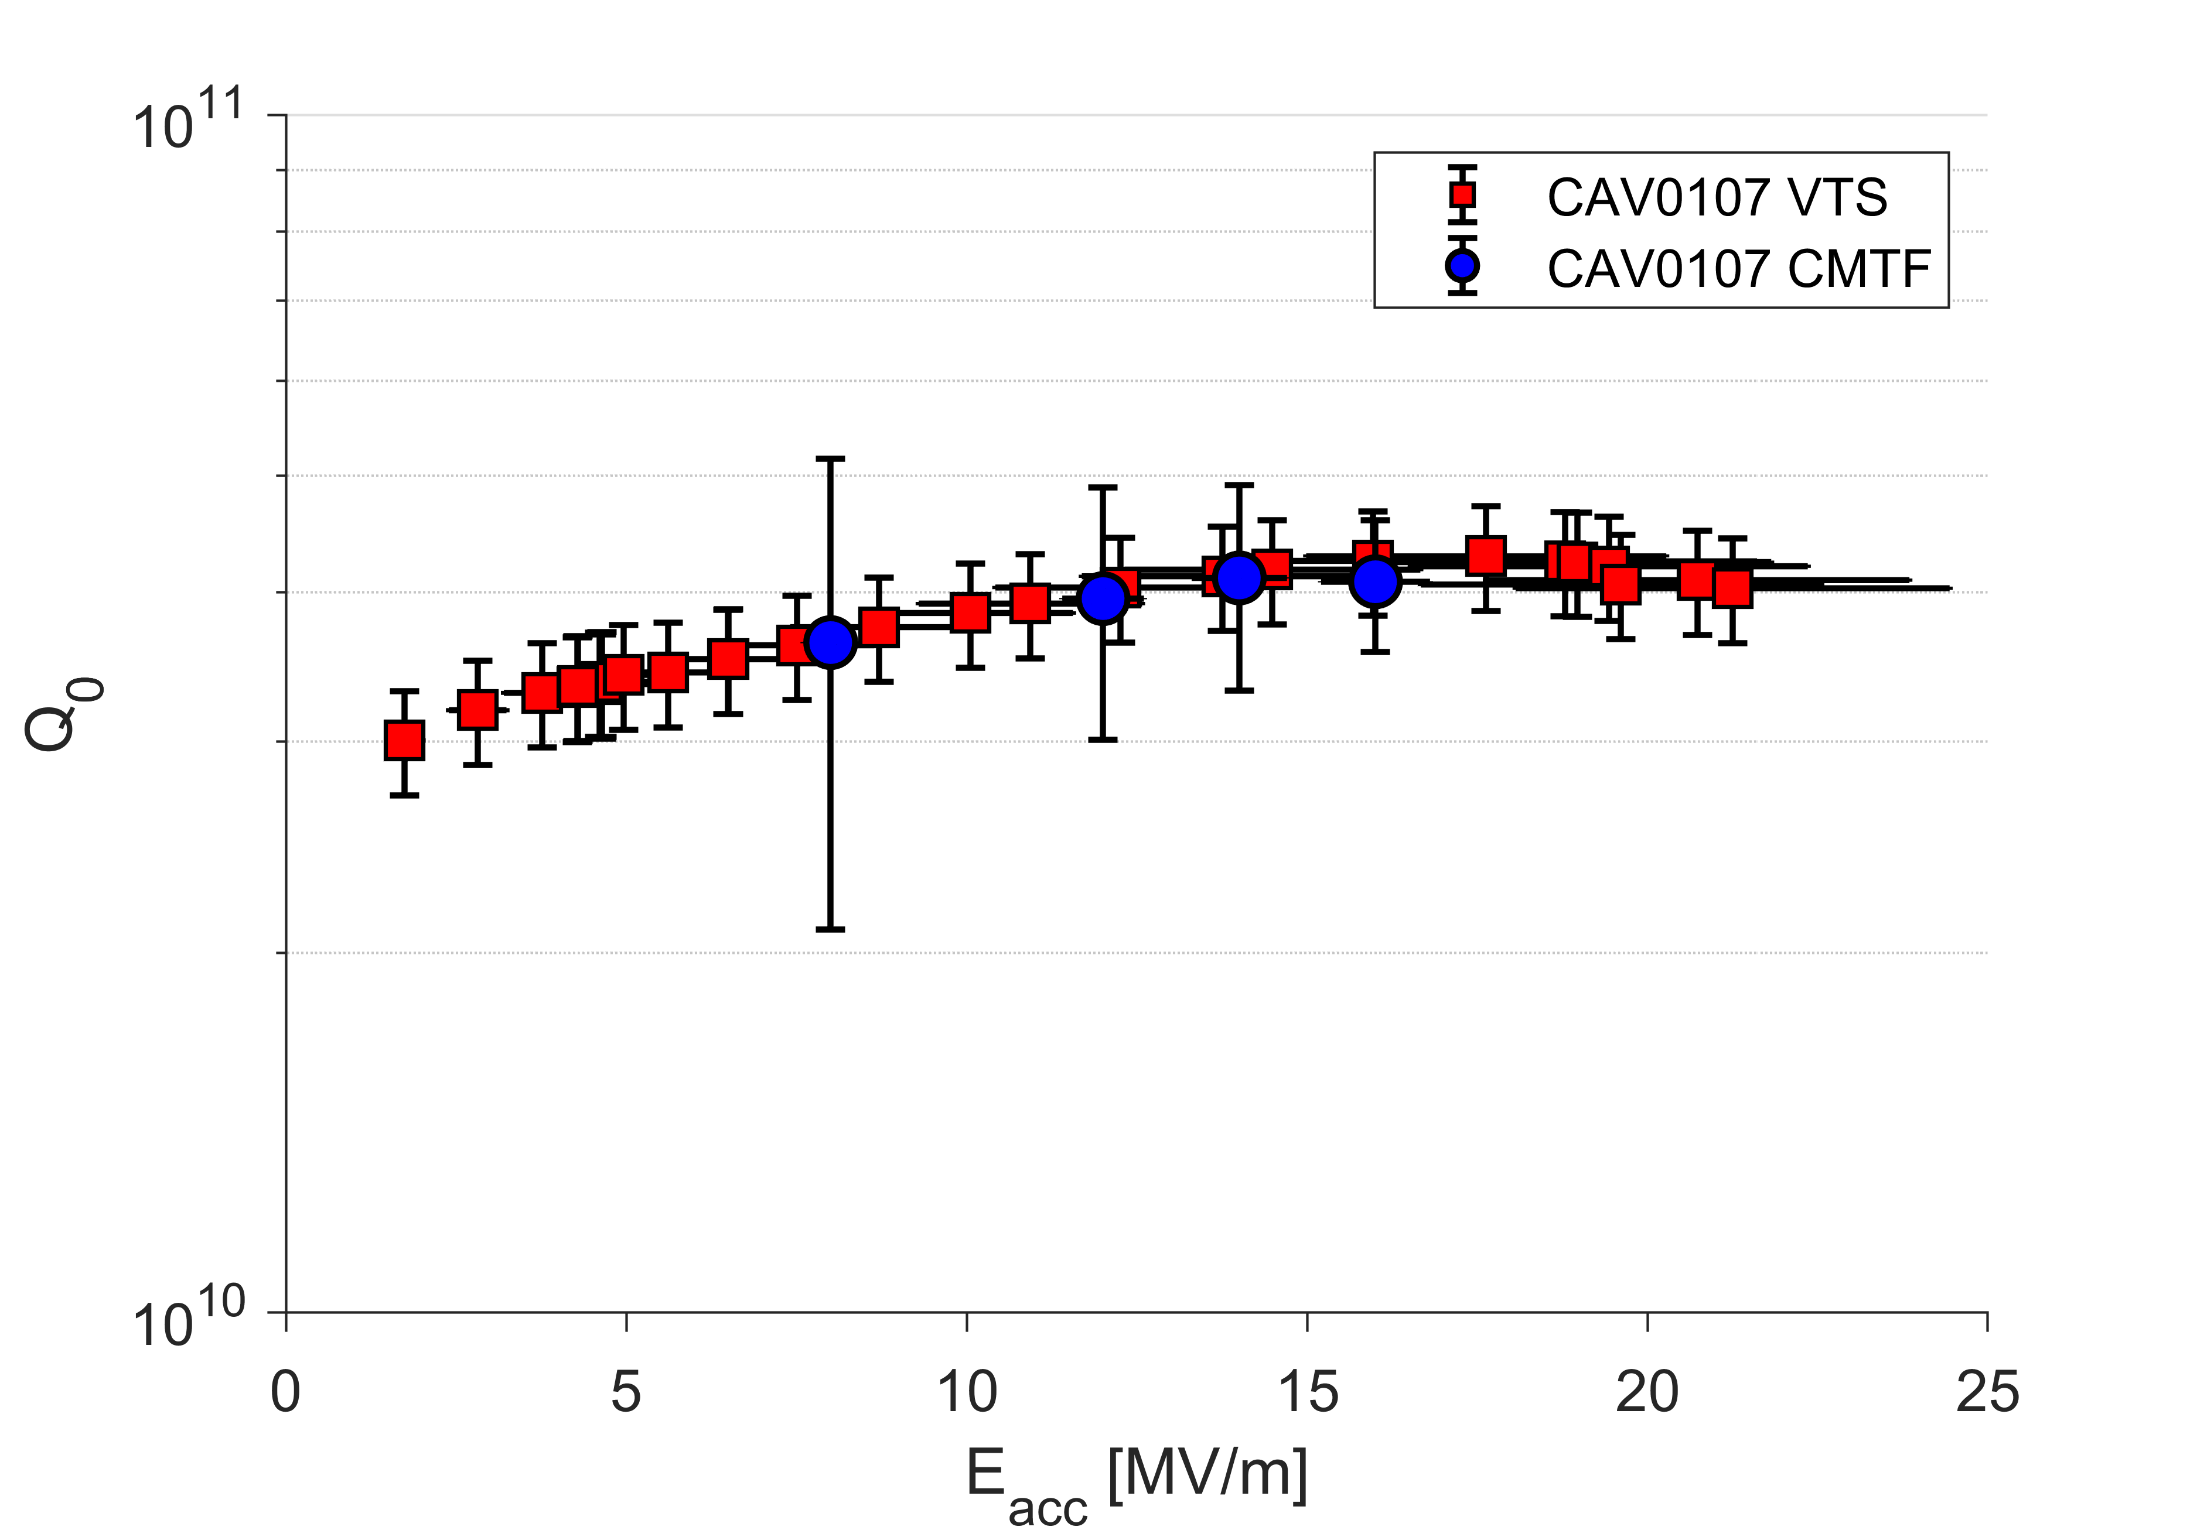
Anti-Q Slope in CM
Good agreement between Q in VT and CM test at all fields
Anti-Q slope clearly present even in the cryomodules
Nitrogen-doping has been successfully demonstrated in cryomodules production
NX/950
2 K

Slide 37
Outline
Introduction to LCLS-II
Cavity Preparation
Nitrogen-Doping in LCLS-II
Vertical Test Results by Material
Cryomodule Test Results by Material
Conclusions

Slide 38
Conclusions
LCLS-II production has been challenged by performance differences due to differently expelling flux material
The nitrogen-doping has worked as planned – Q₀ performance is significantly higher in cavities with good flux expulsion (TD/900, NX/950)
Nitrogen-doping has been successfully industrialized
Equivalent performance in doped cavities can be achieved, but with different heat treatments to account for differences in flux expulsion in the bulk niobium
There has been NO demonstrated difference in quench fields in cavities produced with different material
Until a new material specification is defined governing flux expulsion, flux expulsion must be verified for all niobium to be used in new cavities

