Slide 1
Motivation/Background for Flux Expulsion: Performance in LCLS-II CMs at Fermilab
Sam Posen, Fermilab SRF Team, LCLS-II Team
TTC Workshop Riken
26 June 2018
RIKEN Nishina Center, Saitama, Japan
Notes:
This is a talk about magnetic flux expulsion. In the last few years we have discovered how to manipulate this property of cavities in a practical way to minimize Q-degradation for machines where high Q0 is important.

Slide 2
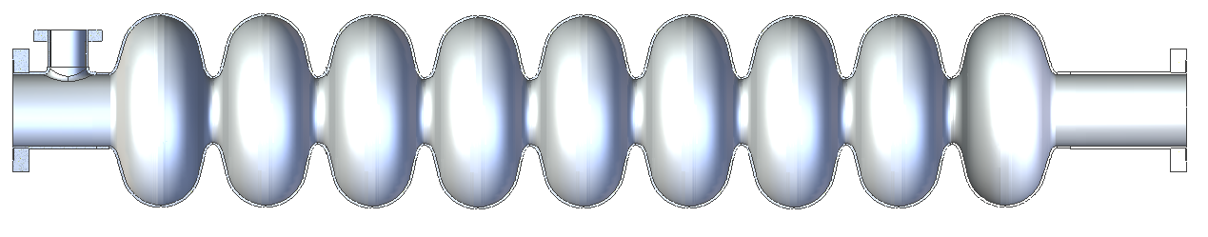
Why Flux Expulsion is Important
LCLS-II CAV0007 – fabricated and prepared by RI, TD material
LCLS-II CAV0019 – fabricated and prepared by RI, TD material
Notes:
Now what do I mean by flux expulsion? I mean that for practical magnetic shielding, we expect a background field of 5-10 mG, and when we cool down a cavity through Tc, two sort of extremes are possible

Slide 3
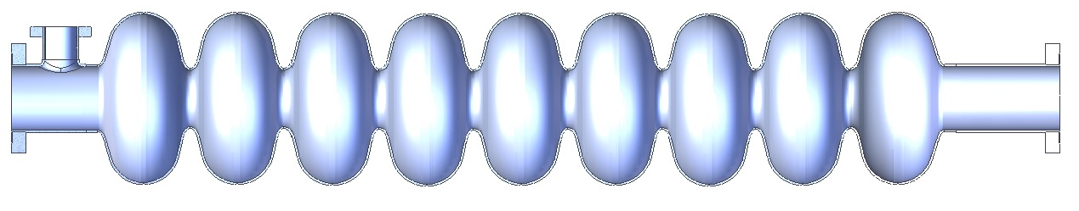
Why Flux Expulsion is Important
LCLS-II CAV0007 – fabricated and prepared by vendor B, TD material
LCLS-II CAV0019 – fabricated and prepared by vendor B, TD material
Notes:
In one extreme, ambient flux is fully trapped in the material, leading to increased residual resistance, and in the other, it is fully expelled, leading to much closer to the intrinsic cavity Q0. What we’ve found is that we can take the same vendor and the same material and by adjusting the treatment parameters come up with very different levels of flux expulsion. So why is this important?

Slide 4
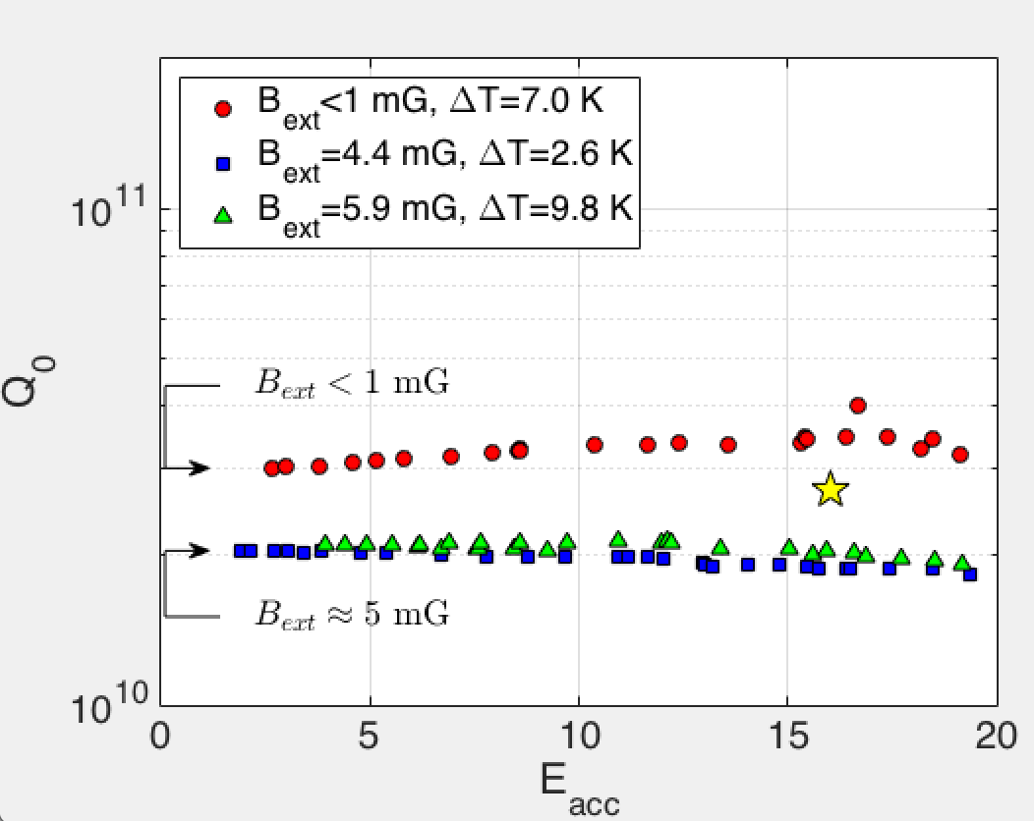
LCLS-II - Preproduction
Cooling in 5 mG applied field
(spec for background field in module)
1.3 GHz 1-cell cavities
Full expulsion
Data measured by Fermilab
As-received niobium material for LCLS-II production: very poor expulsion
Data measured by Jefferson Lab
B_{SC}/B_{NC}

Slide 5
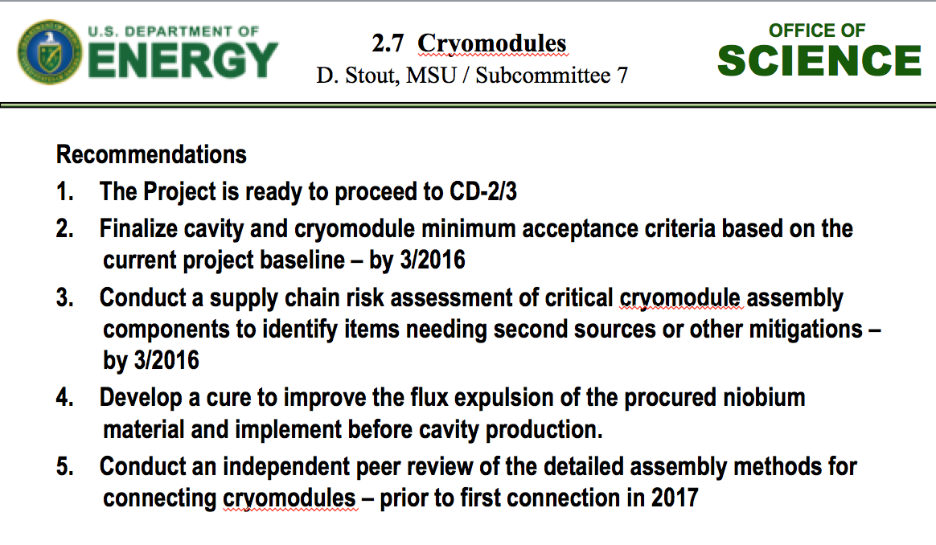
LCLS-II - Preproduction
Cooling in 5 mG applied field
(spec for background field in module)
1.3 GHz 1-cell cavities
Full expulsion
As-received niobium material for LCLS-II production: very poor expulsion
Data measured by Jefferson Lab
B_{SC}/B_{NC}
LCLS-II CD2/3 Review Closeout, Dec 2015

Slide 6
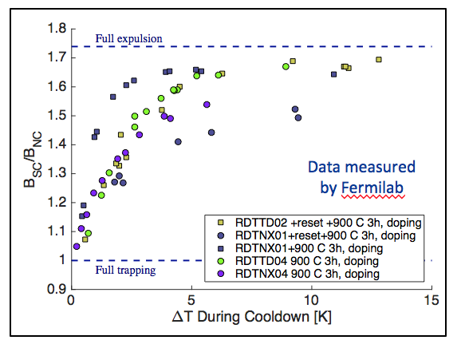
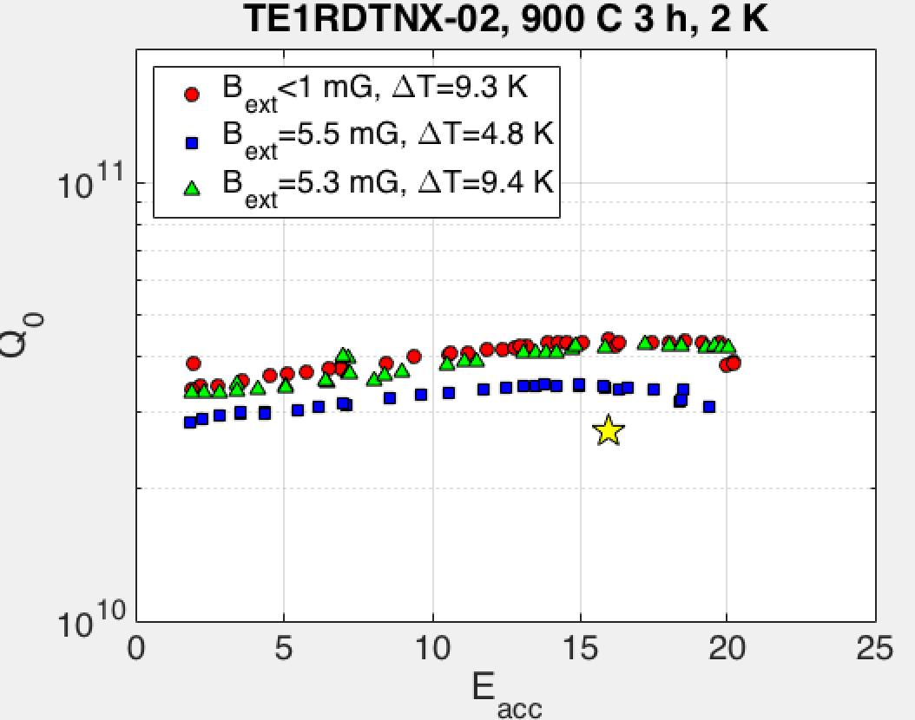
LCLS-II - Preproduction
Cooling in 5 mG applied field
(spec for background field in module)
1.3 GHz 1-cell cavities
Full expulsion
Data measured by Fermilab
As-received niobium material for LCLS-II production: very poor expulsion
Data measured by Jefferson Lab
B_{SC}/B_{NC}
After 900°C treatment: much improved
Data measured by Fermilab
Data measured by Fermilab

Slide 7
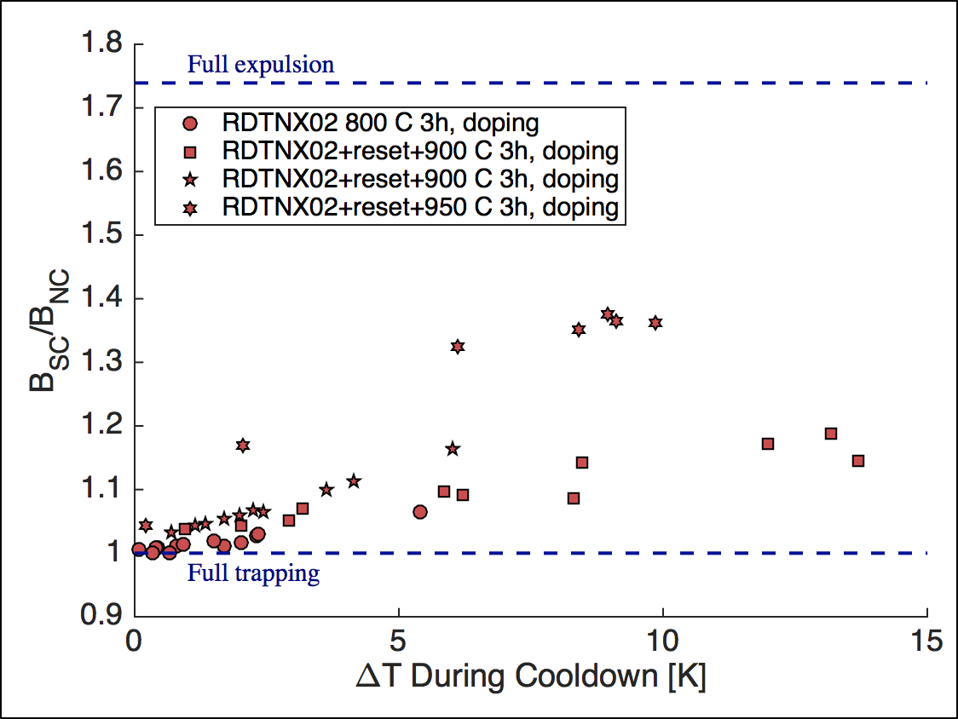
LCLS-II - Preproduction
Cooling in 5 mG applied field
(spec for background field in module)
1.3 GHz 1-cell cavities
Full expulsion
As-received niobium material for LCLS-II production: very poor expulsion
Data measured by Jefferson Lab
Data measured by Fermilab
B_{SC}/B_{NC}
After 900°C treatment: much improved
“Lot C” material – lower RRR, smaller grains

Slide 8
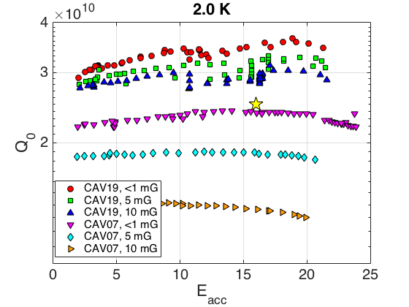
LCLS-II - Production
See below difference between flux trapping in baseline 800 C recipe compared to 900 C modification for TD material
These are production 9-cell cavities that are now in cryomodules for LCLS-II
After recipe modification
Before recipe modification
Data measured by Fermilab
Notes:
Meanwhile the very first batch of LCLS-II production cavities had been fabricated and tested.

Slide 9
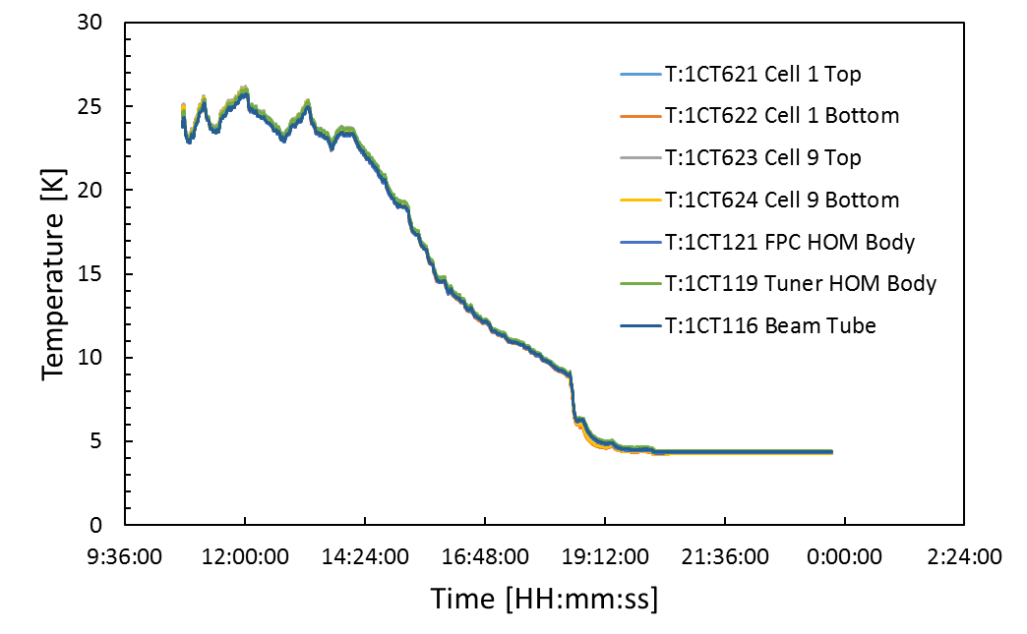
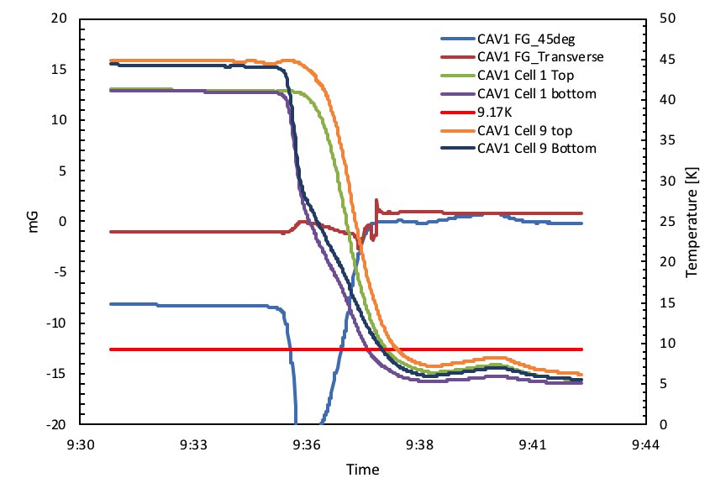
LCLS-II Production Data
See vertical test data in next talk by D. Gonnella which shows strong Q₀ dependence on material
I will show Cryomodule data from Fermilab
“Slow” cooldown
Mass flow ~a few g/s
“Fast” cooldown
Mass flow ~60-80 g/s
High mass flow during cooldown generates top-bottom ΔT at transition to expel flux

Slide 10
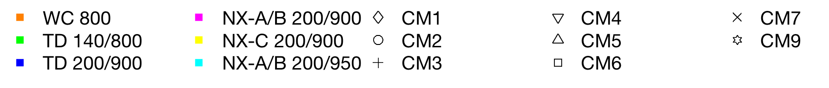
Cavities in Fermilab LCLS-II Cryomodules
⨉ 10¹⁰
At 16 MV/m (or max usable gradient)
All cavities of a given material in CM averaged. Spread goes into y-errorbars.
During cooldown through T_{c}

Slide 11
Cavities in Fermilab LCLS-II Cryomodules
⨉ 10¹⁰
⨉ 10¹⁰
At 16 MV/m (or max usable gradient)
All cavities of a given material in CM averaged. Spread goes into y-errorbars.
During cooldown through T_{c}

Slide 12
Cavities in Fermilab LCLS-II Cryomodules
⨉ 10¹⁰

Slide 13
Cavities in Fermilab LCLS-II Cryomodules
⨉ 10¹⁰

Slide 14
Cavities in Fermilab LCLS-II Cryomodules
⨉ 10¹⁰

Slide 15
Cavities in Fermilab LCLS-II Cryomodules
⨉ 10¹⁰

Slide 16
Cavities in Fermilab LCLS-II Cryomodules
⨉ 10¹⁰

Slide 17
Cavities in Fermilab LCLS-II Cryomodules
⨉ 10¹⁰

Slide 18
Crucial Questions
What makes different niobium production runs have such different flux expulsion behavior?
  Variation between TD and NX
  Variation within a given vendor (e.g. NX-A/B and NX-C)
Can we avoid producing NX-C type material which would have required extremely high heat treatment temperatures to improve?
Can we modify specifications to give predictable flux expulsion behavior for a given heat treatment?
How to do so without compromising mechanical properties?
How to perform QA/QC of flux expulsion in feasible manner?

Slide 19
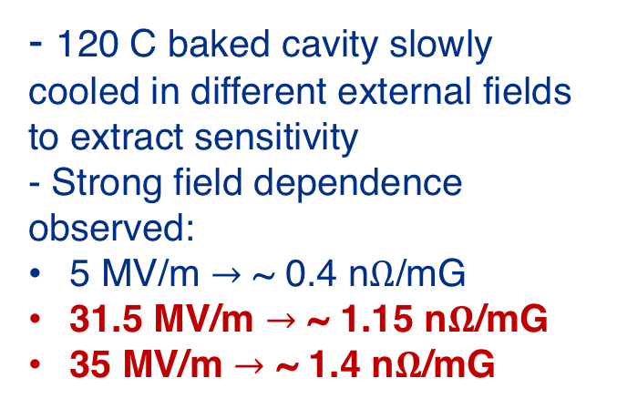
Non-Doped Cavities
Sensitivity even for standard treatment cavities increases at high gradients, comparable to mid-field of doped cavities – still a significant factor for high gradient machines
- 120 C baked cavity slowly cooled in different external fields to extract sensitivity
- Strong field dependence observed:
5 MV/m $→$ ~ 0.4 n$Ω$/mG
31.5 MV/m $→$ ~ 1.15 n$Ω$/mG
35 MV/m $→$ ~ 1.4 n$Ω$/mG
ILC
gradient
M. Checchin et al, FNAL, to be published

