Slide 1
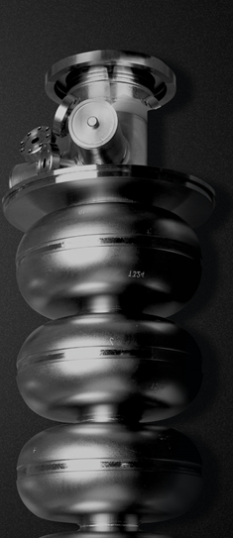
Update on N-infusion at JLab
TTC Meeting 2018
26-29 June 2018
RIKEN Nishina Center
Pashupati Dhakal
More details of the talk:
P. Dhakal et al., PRAB 21 032001 (2018)

Slide 2
Background
Work started ~2009 to understand the role of high field Q-slope with hydrogen (niobium hydrides) and passivation of Nb surface during heat treatment.
The improvement of Q has been observed following heat treatments with lower hydrogen concentrations.
Significant improvements of the RF cavity performance of several single cell cavities was obtained after the heat treatment at 800C and followed by120C with no post furnace chemical etching.
Surface nitridation for surface passivation (400C, ~10⁻⁵ mtorr N₂) was attempted and improvement on both Q and E_{acc} was observed.
New FNAL recipe for Low temperature “N-infusion” resulted in a significant increase in Q.

Slide 3
N-Infusion Update
Several single cell cavities were used for N-infusion study.
Cavities were HPR before loading to the furnace and Nb caps were assembled in clean room.
Before each heat treatments (with caps), a baseline measurement was done.
Rs vs T data were taken from 4.3-1.5K at B_{p}~10mT in order to extract the material parameters.
No post chemistry after the furnace treatment.

Slide 4
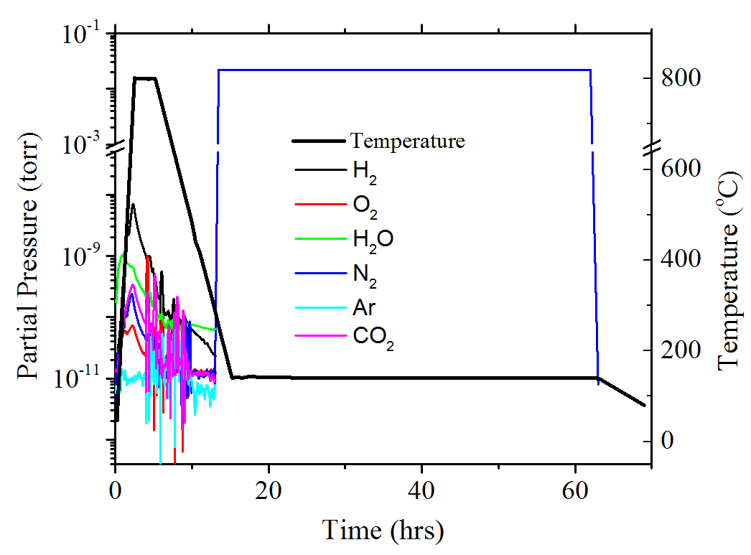
N-Infusion Update
Recipe
Cavity HT at 800C/3hrs.
Cooldown to ~290C, while heat and pump ON.
N2 partial pressure of ~25mTorr
into the furnace.
Pump valve CLOSED and hold at target temperature (120-160C) for 48 hours.
At the end of the process, pump ON and heater OFF.
Vent with nitrogen at room temperature
Cavity HPR and follow standard cavity assembly process.
P. Dhakal et al., PRAB 21 032001 (2018)

Slide 5
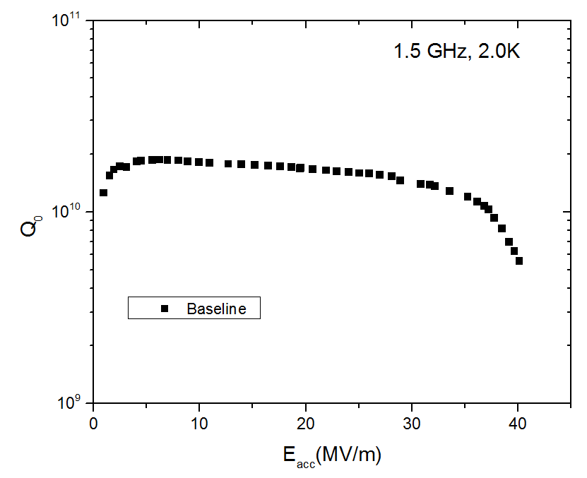
N-Infusion (RDL-02, 1.5 GHz, 2.0K)

Slide 6
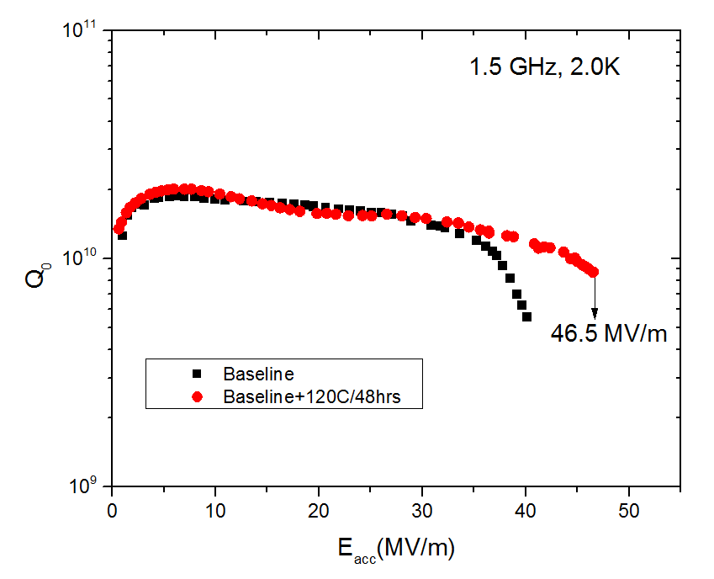
N-Infusion (RDL-02, 1.5 GHz, 2.0K)
Standard ILC EP recipe with Bake

Slide 7
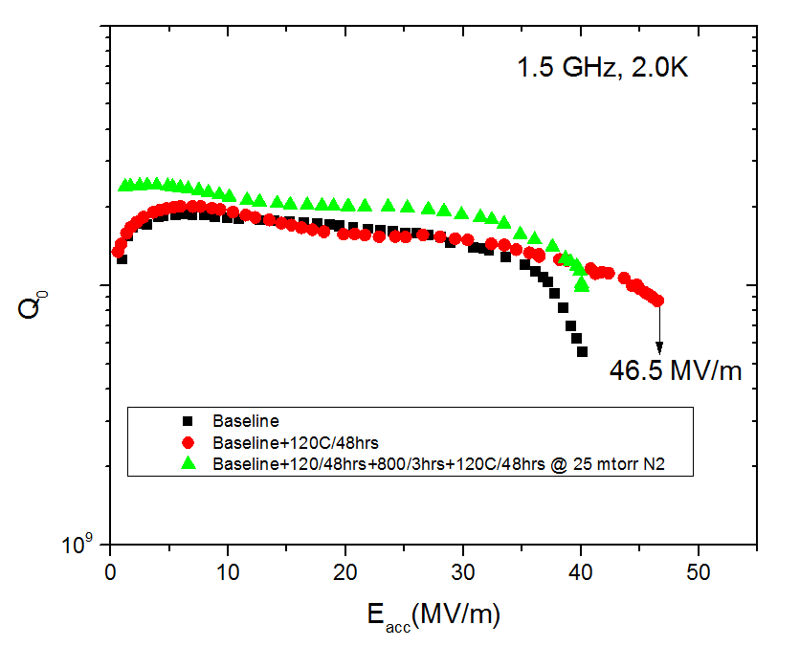
N-Infusion (RDL-02, 1.5 GHz, 2.0K)

Slide 8
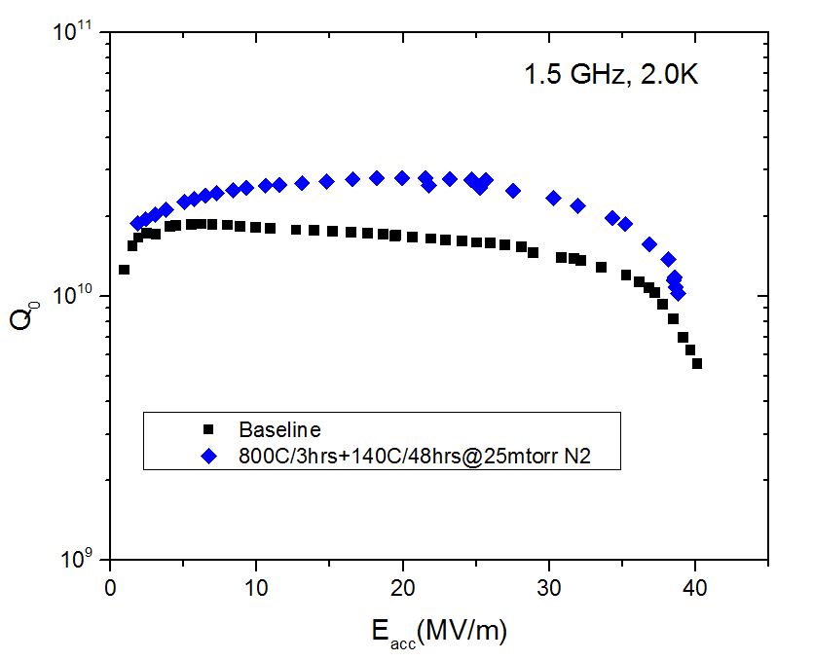
N-Infusion (RDL-02, 1.5 GHz, 2.0K)

Slide 9
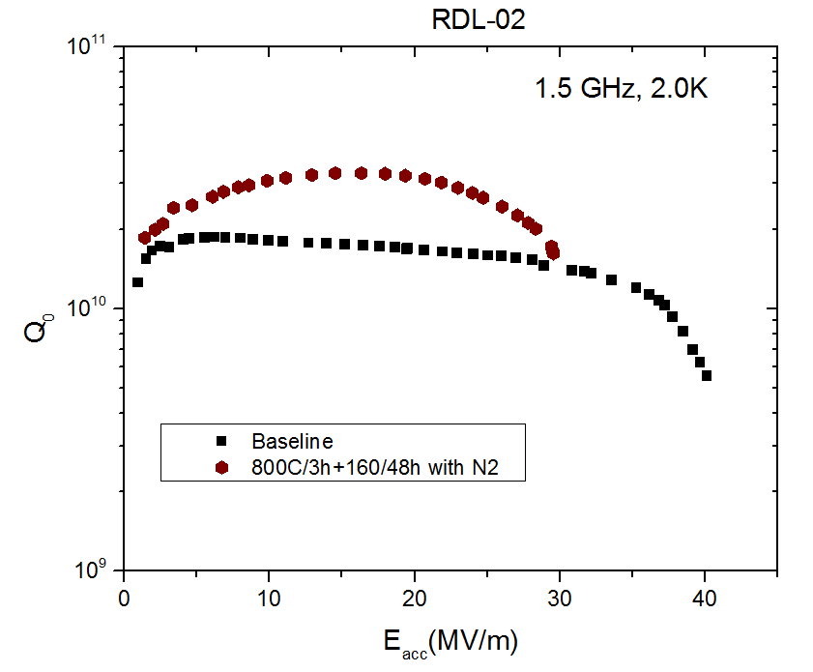
N-Infusion (RDL-02, 1.5 GHz, 2.0K)
Increasing temperature resulted in reduction in E_{acc}

Slide 10
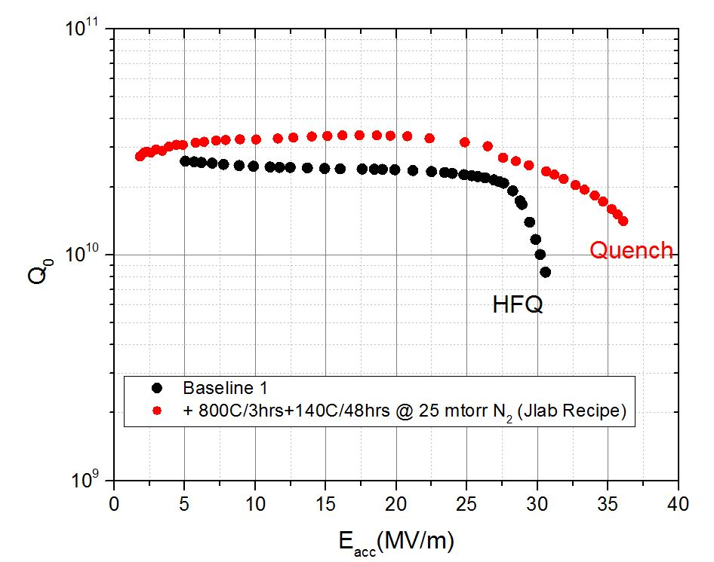
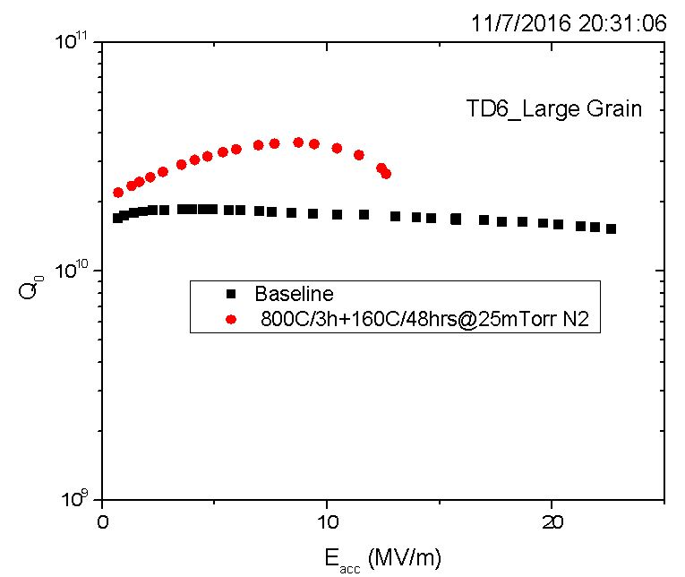
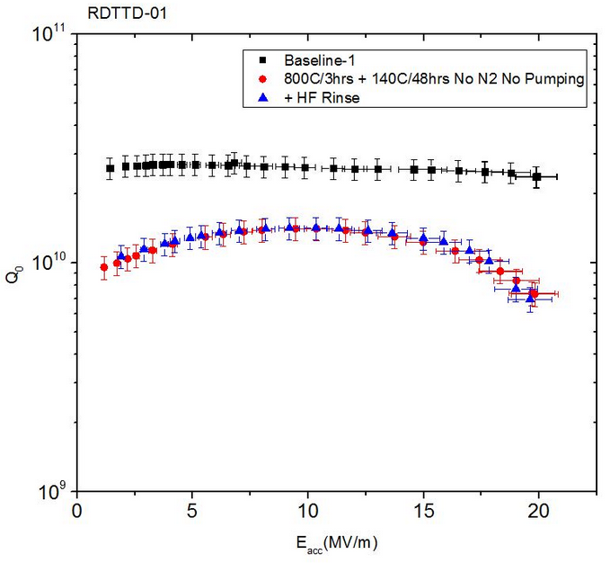
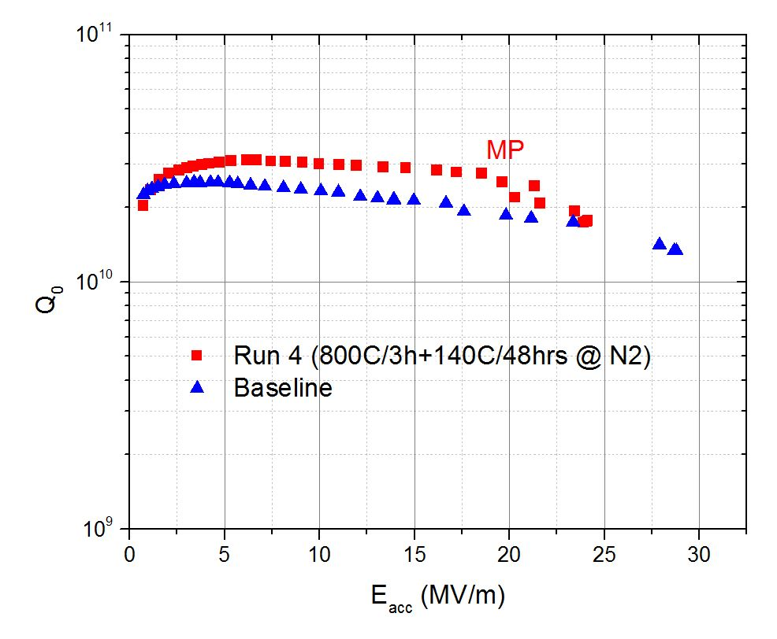
N-Infusion
1.3 GHz, 2.0 K
3.2x10¹⁰ @ 25 MV/m
RDT-14
TD5-LG
Decrease in Q observed with increase in residual resistance

Slide 11
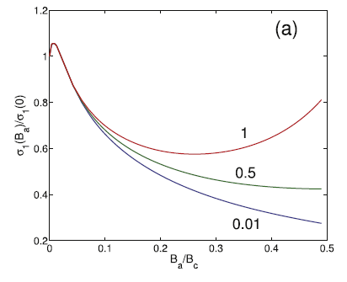
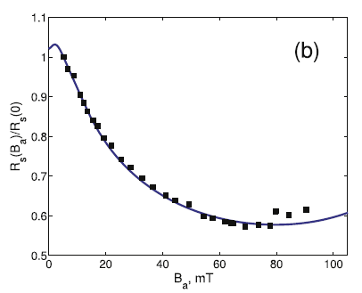
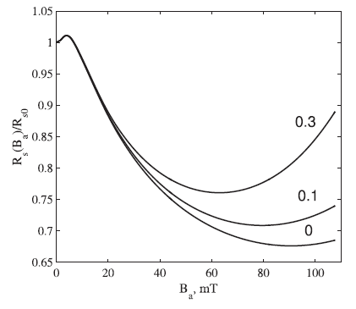
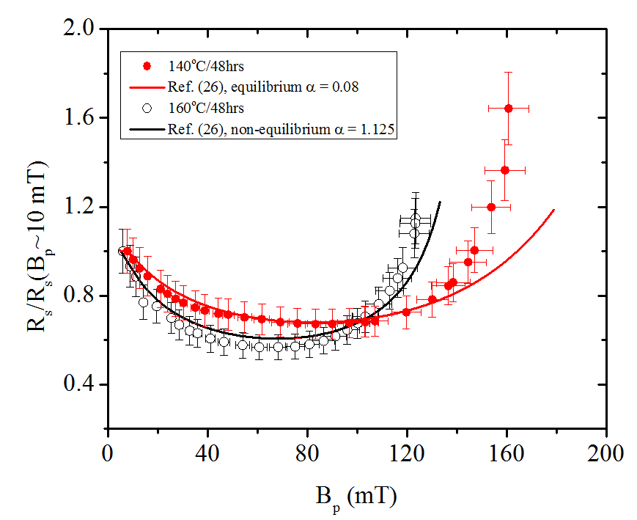
Compare with Theory
Non-equilibrium distribution function
Explain the Q-rise on Ti-doped cavities
Equilibrium distribution function
Distribution function depends on whether the
relaxation time of the quasi particle is greater or smaller than the rf period.
P. Dhakal et al., PRAB 21 032001 (2018)
Alex Gurevich 2017 Supercond. Sci. Technol. 30 034004

Slide 12
Summary
N-infusion: 800 °C/3h, N₂ at ~25 mTorr ~290°C, cooling to hold temperature maintained for 48 h.
R&D to understand the mechanism and depth of the N2 diffusion (if any) on going. Thursday 9:54 am
More single cells and multi cell are being prepared to validate the recipe.
Cleanliness of furnace and use of Nb-caps are necessary.

