Slide 1
Update on high Q/high G R&D @ FNAL
Anna Grassellino
Tesla Technology Collaboration Meeting
RIKEN, Japan, June 2018

Slide 2
Outline
Status and Progress in N infusion for high Q at high G
  24, 48, 60, 90 hours comparison Q vs E and Rbcs
  Comparison with new RI cavities results (60, 90 hours, new material, not-well annealed)
  Infusion on BCP cavity – comparative study
  Summary plot/table for Q/gradients
New finding with record tesla shape gradient – 49 MV/m –Peak magnetic field (CW) 210 mT
  All four cavities : 1de3, 1de20, aes9, pav5
  Rbcs of new treatment vs regular 120C
  1de3, 1de20 comparison modified 120C bake-infusion
Conclusions

Slide 3
Infusion – experience/history @ FNAL
N infusion is performed in our high T furnace @IB4 facility of FNAL, post 800C 3 hrs in HV, so far always @25 mTorr low T
2016 – full year of success, no variability
2017 – some variability starts to be observed, and some poor results (above 160C)
End of 2017 – oxygen leak found in the N2 injection line
After fixing it, zero variability observed – all infusions are successful (performed about ten since the fix)

Slide 4
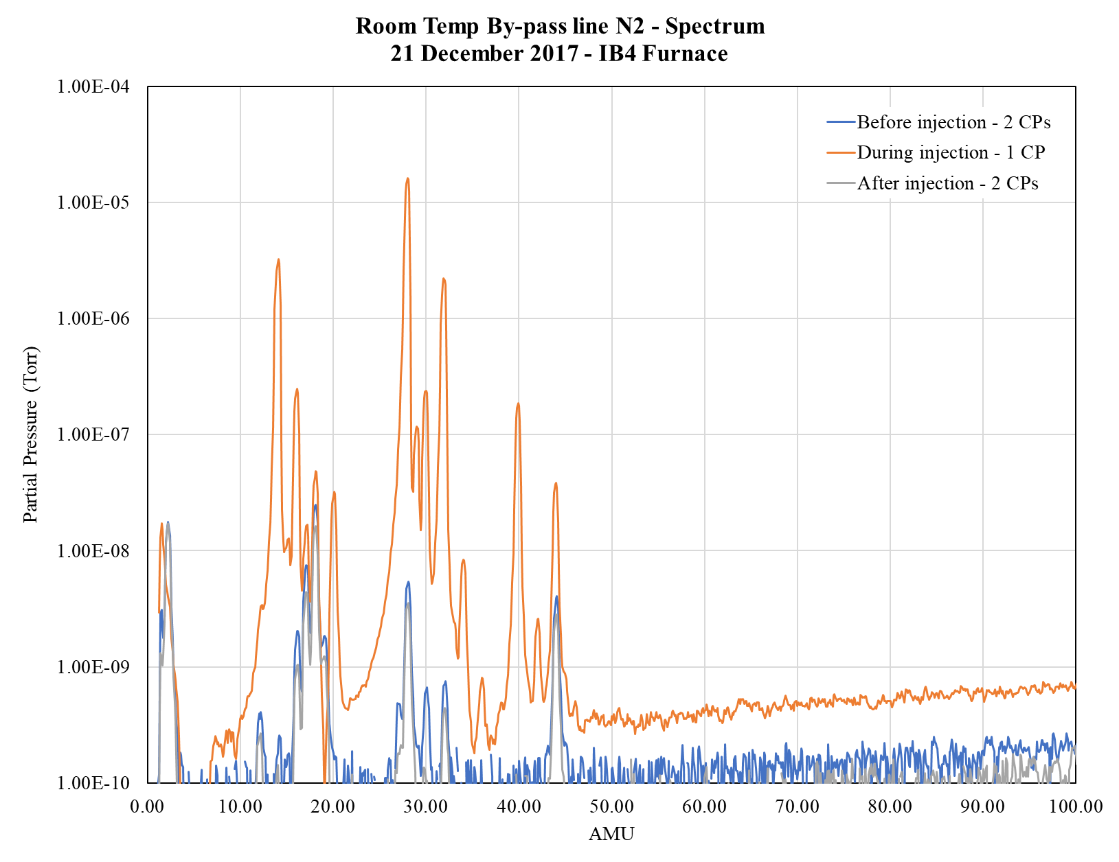
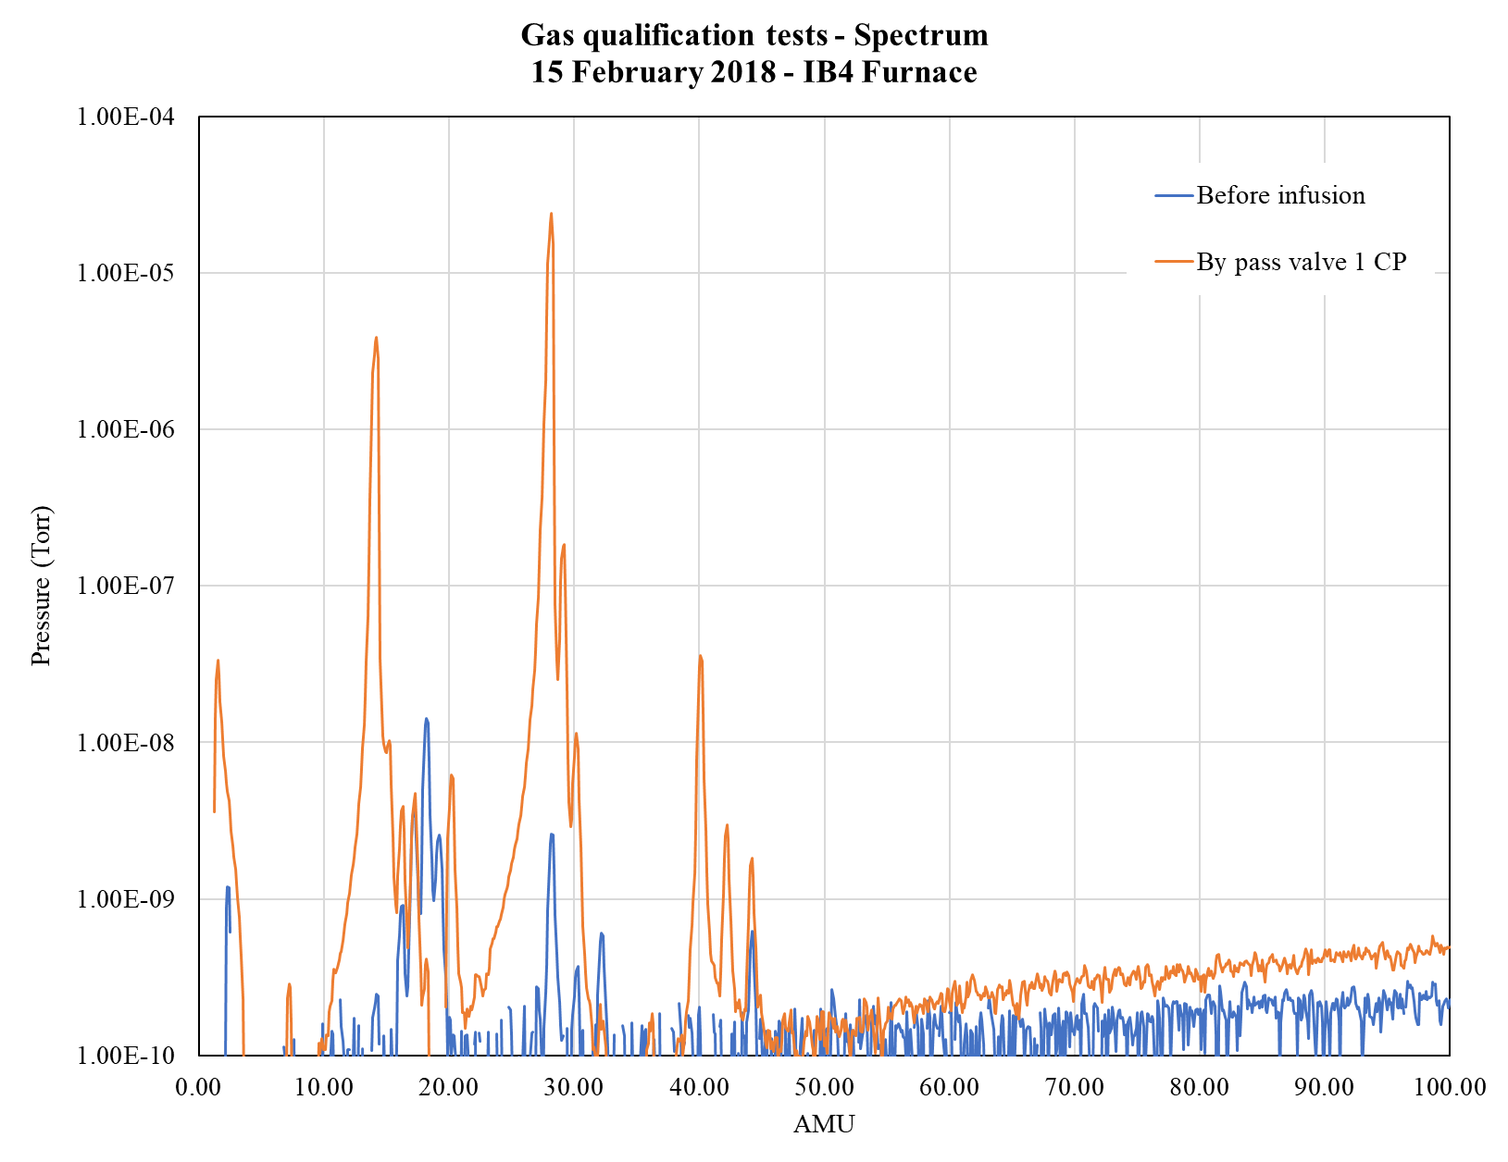
Degradation issue resolution
  2017 Q degradation observed
  Nov Extensive traditional leak checks performed
  Dec Innovative gas qualification method resulted in observing signs of air in infusion gas line
  Jan/Feb Further tests on the line revealed valve problematic
    Replaced valve & Initial cavity Q improved & per expectations
  Degradation attributed to excessive O₂
N₂
N₂
N
X
N
O₂
O₂
Q₀ → Bad
Q₀ → Good
X
O
Ar
O
CO₂
Ar
H₂
With gas
H₂
CO₂
Without gas

Slide 5
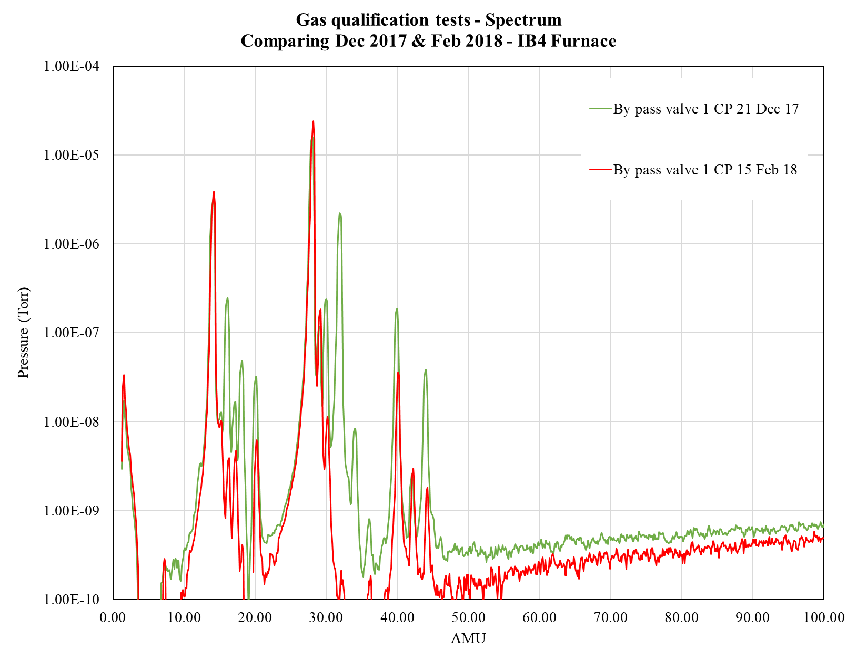
RGA scans – before & after

Slide 6
N Infusion (and going up to doping)– summary and update
Temperature | Duration of N₂ injection (@25 mTorr) | E_{acc} max, average | Q @ 21 MV/m -2K | Q@ 35 MV/m -2K | Limitation | Average on # single cell cavities
120°C | 24 hrs | 38 MV/m | 2.5e10 | 1.7e10 | Q slope @30 | 1
120°C | 48 hrs | 43 MV/m (max 45.6) | 2.5e10 | 2.3e10 | Quench | 6
120°C | 48 hrs w/o N₂ | 36 MV/m | 2.5e10 | 1e9 | Q slope @30 | 2
120°C | 60 hrs | 43 MV/m (max 44.5) | 3e10 | 2.5e10 | Quench | 3
120°C | 60 hours (BCP) | 33 MV/m | 2.7e10 | ~2e10 @30 | Q slope @28 | 1
120°C ** | 90 hrs | 42 MV/m | 2.3e10 | 2e10 | Quench/slope | 2 ** (non well annealed NX)
140°C | 48 hrs | 35 MV/m | 2.5e10 | 2.2e10 | Quench | 2
160°C | 48 hrs | 36 MV/m | 3e10 | 1e10 | Q slope@30 | 1
160°C | 48 hrs with N₂/48 wo | 35 MV/m | 4e10 | 2.5e10 | Q slope@25 | 1
160°C | 48 hrs with N₂/96 wo | 34 MV/m | 3e10 | 8e9 | Q slope@25 | 1
170°C | 48 hrs with N₂/48 wo | 27 MV/m | 4e10 | -- | Quench/Q slope @25 | 2
200°C | 48 hrs | 28 MV/m | 3.5e10 | -- | Q slope @15 | 1
300°C | 4 hrs with N₂/48 wo | 28 MV/m | 2e10 | -- | Quench, MFQS | 1
400°C | 30 mins | -- | 1e8 | -- | Nitrides | 1

Slide 7
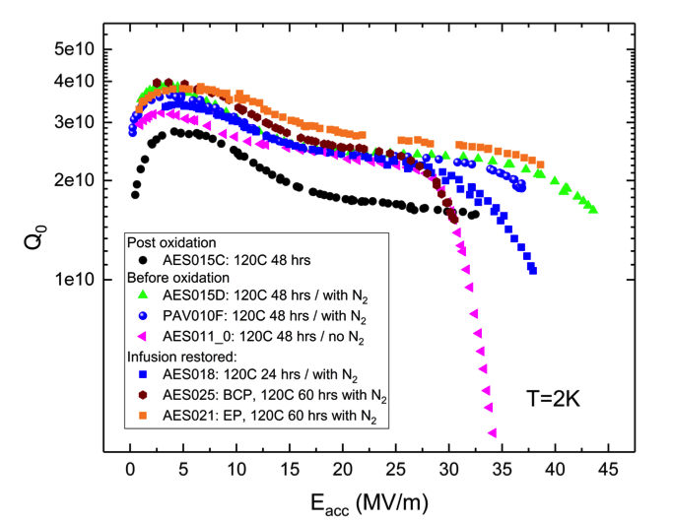
Q vs E @120°C
~3e10 @20MV/m
~2.5e10 @35MV/m
A. Grassellino et al, tbp

Slide 8
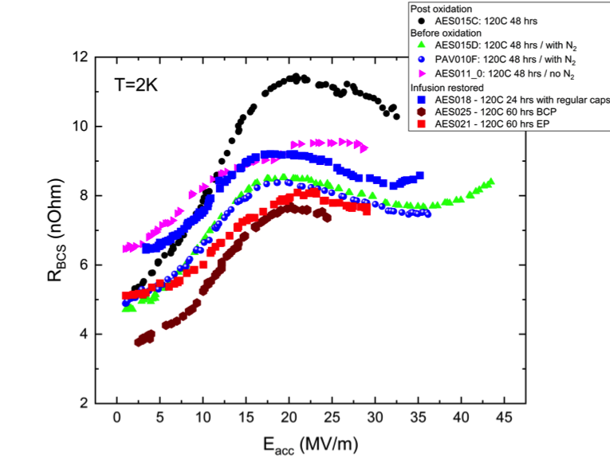
R_{bcs} (Eacc) trend @120C
A. Grassellino et al, tbp
Trend in BCS shows gradual decrease as nitrogen is injected for longer time
No reversal of BCS yet found at 120C

Slide 9
R_{bcs} (Eacc) trend higher T
120C 96 hours with N2
The reversal of BCS as per high T doping is observed for T> 160C

Slide 10
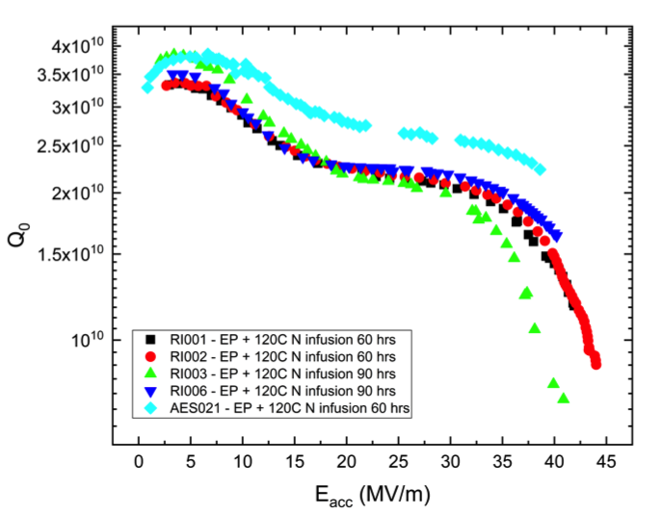
120C infusion on well annealed vs non well annealed material – cooled in zero field
Field emission
A. Grassellino et al, tbp
RI cavities made of new material annealed only one time at 800C, only 120 microns bulk removal

Slide 11
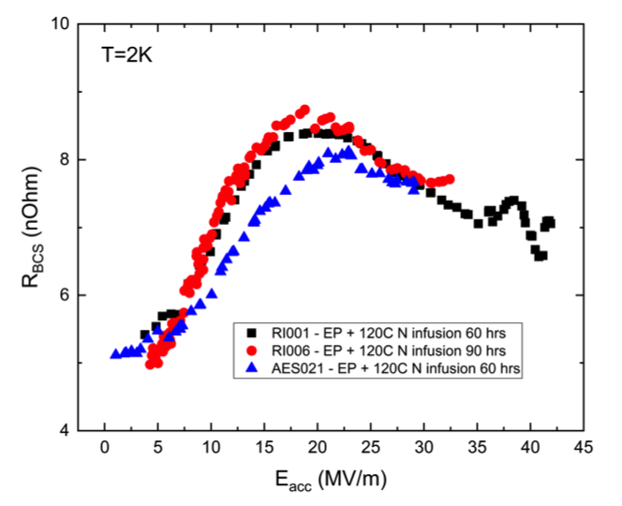
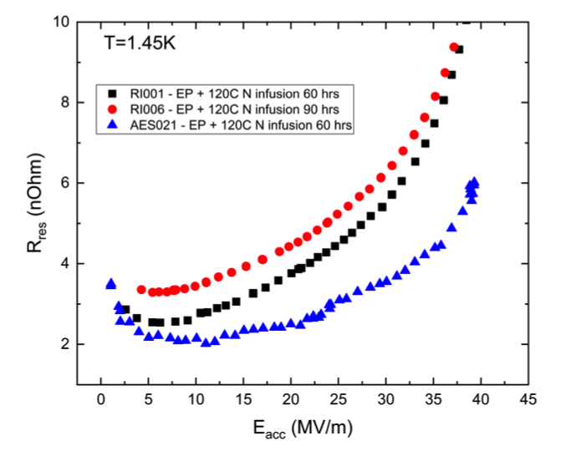
120C infusion on well annealed vs non well annealed material – BCS and residual
A. Grassellino et al, tbp
Residual resistance shows strong field dependence for non well annealed material
Deeper Bulk removal is a must for low Residual resistance
Perhaps also BCS resistance response different (see next)

Slide 12
Rbcs (Eacc) - ALL
A. Grassellino et al, tbp
Hint that non well annealed material may respond differently to infusion?

Slide 13
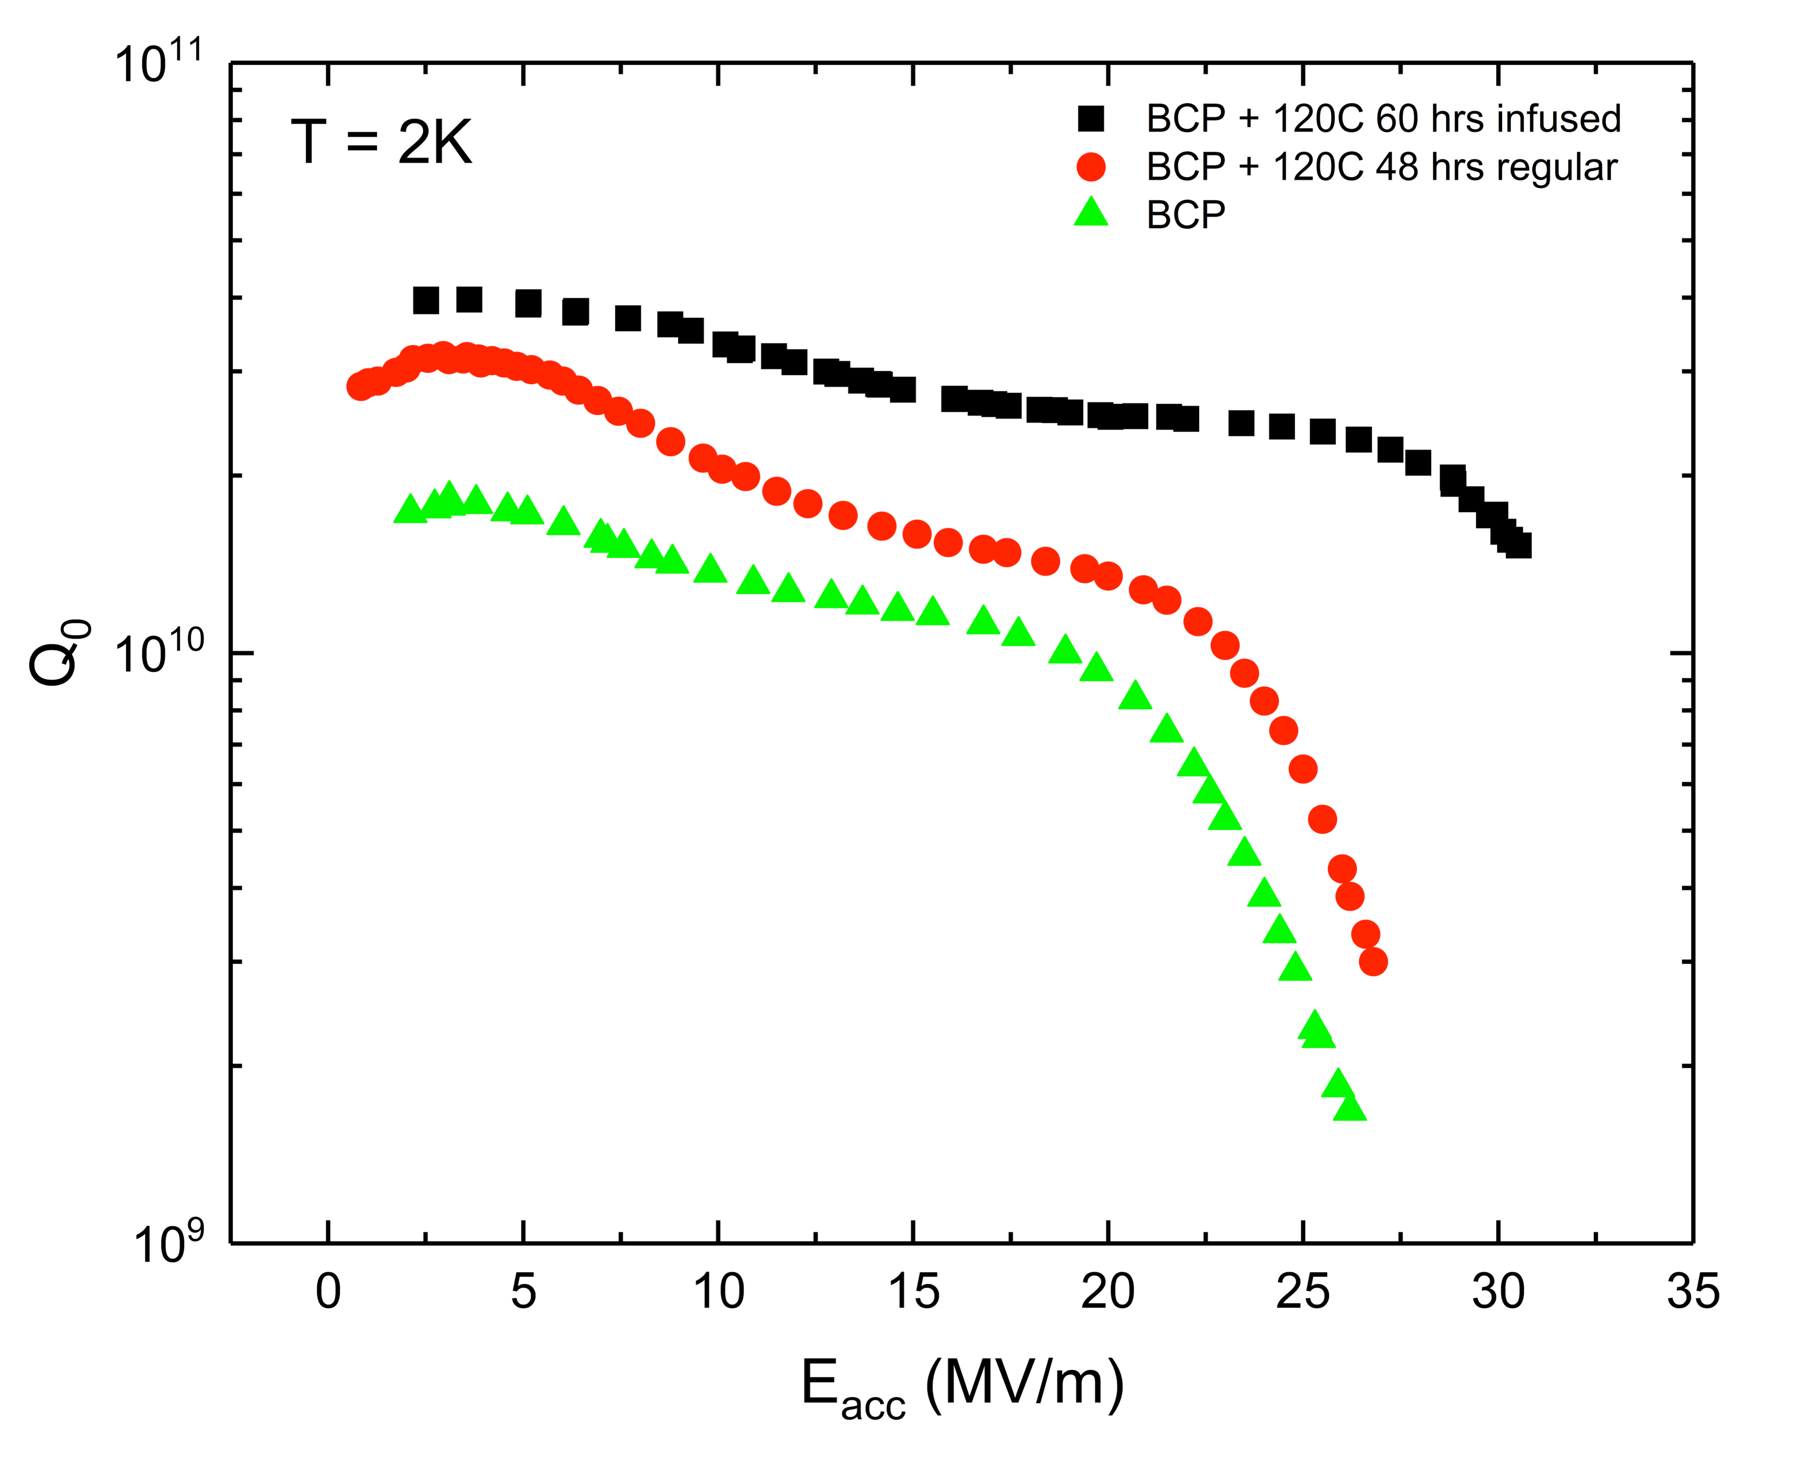
N infusion on BCP surface – record Q/grad values for BCP
A. Grassellino et al, tbp
A. Grassellino et al, tbp

Slide 14
BCP infusion studies -Comparison on same cavity
(low T oven, with oxide)
A. Grassellino et al, tbp

Slide 15
BCP infusion studies -Comparison on same cavity
1.4K
HFQS onset only slightly moved
A. Grassellino et al, tbp

Slide 16
BCP infusion studies -Comparison on same cavity
Plot 2 shifted to compare onset of HFQS, only slightly increased
A. Grassellino et al, tbp

Slide 17
BCP infusion studies -Comparison on same cavity
BCS resistance evolution – “modified” 120C bake to be discussed in next slides
A. Grassellino et al, tbp

Slide 18
New breakthrough – 210 mT, 49 MV/m Tesla shape aka “the magic 75C bake”
Surprise : no nitrogen involved
A. Grassellino et al, https://arxiv.org/abs/1806.09824

Slide 19
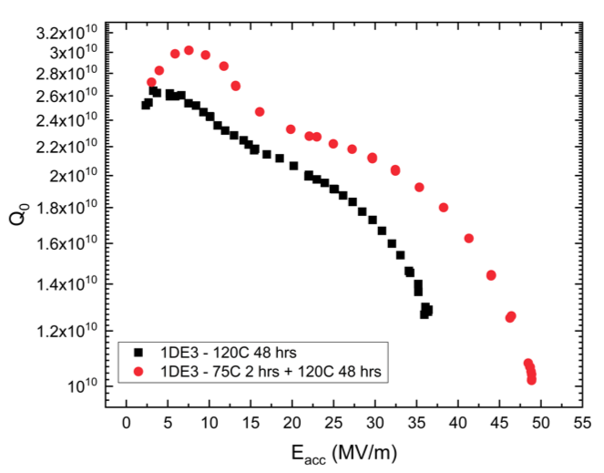
1DE3 – the first 49 MV/m cavity
Cavity (fine grain) from DESY colleagues was prepared for baseline test before infusion, EP 60 microns + regular 120C bake (no nitrogen, low T oven)
Results were pretty surprising/puzzling
A. Grassellino et al, https://arxiv.org/abs/1806.09824

Slide 20
Anomaly found during the low T bake
A thermocouple went faulty and oven went to standby
Cavity lingered around 75C for about 2 hours, then resumed the 120C 48 hours

Slide 21
Repeated on second cavity TE1AES009 (fine grain, AES, WC)
EP+ 75C 4 hrs+ 120C 48 hours
Regular 120C
A. Grassellino et al, https://arxiv.org/abs/1806.09824

Slide 22
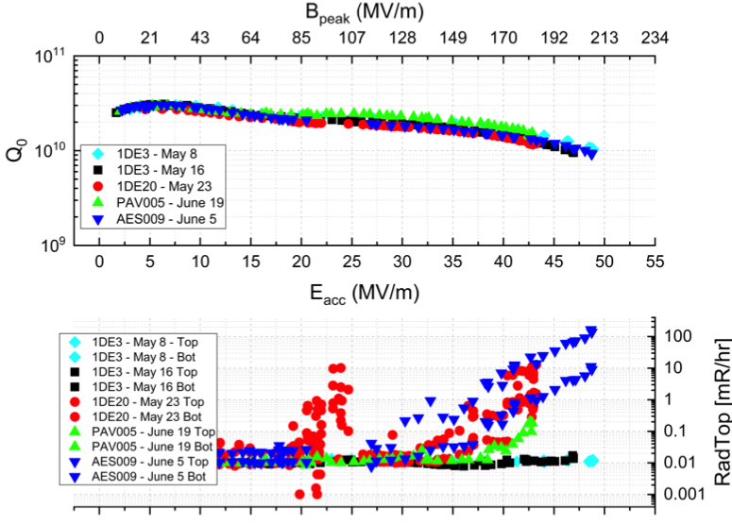
So far 4 cavities – 3 FG, one LG
A. Grassellino et al, https://arxiv.org/abs/1806.09824

Slide 23
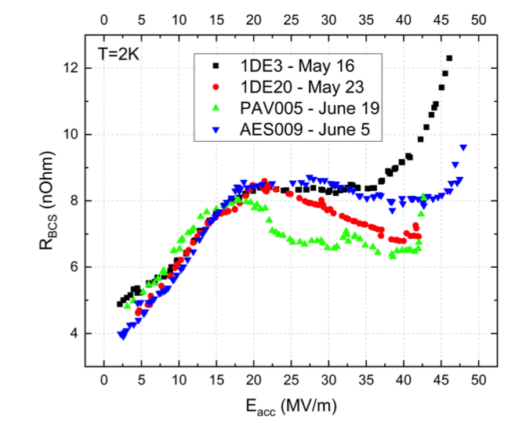
Next surprise: the BCS resistance is ~ as 120C N infused
A. Grassellino et al, https://arxiv.org/abs/1806.09824

Slide 24
Next surprise: the BCS resistance is ~ as 120C N infused

Slide 25
So, what is happening?
70C seems to be another magic temperature in niobium
1960-70s literature studies suggest that 70C is associated with changes in vacancies, while 120C changes in dislocations (Bordoni or Hasiguti type process)

Slide 26
So, what is happening?
These finding may be suggesting that quench in Nb is currently of extrinsic nature, likely nano-hydrides, and that changes in vacancies or dislocations happening at magic temperatures are helping suppressing their formation, or changing their phase and size (see Z. Sung studies, TTC Milan)

Slide 27
Positron Annihilation Studies on Nb sample
A. Romanenko Ph.D. Thesis,
Cornell University (2009)

Slide 28
Why is the BCS of 70/120 in oxide similar to that of N infused cavities at 120C?
Possible that it’s the other way around? N infusion at 120C in the furnace lingers during cooldown at 70C for quite some time
Can it be that 70C helps the BCS of 120C infused cavities, and that only deeper N contributes further
Maybe effect also on gradient?
What if we do 75/120 with nitrogen? Done – see next

Slide 29
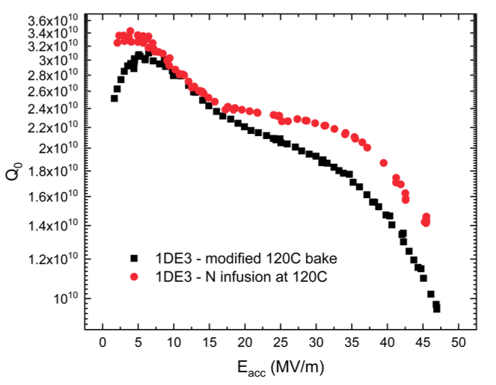
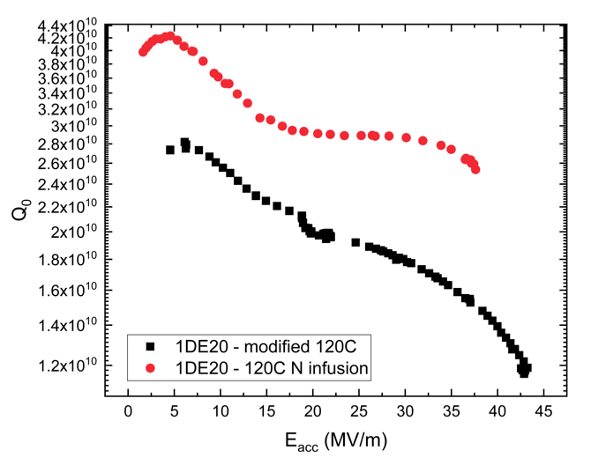
1DE3 and 1DE20
75C/120C with regular oxide (low T oven) versus with N infusion (high T furnace)
Fine grain improved little in Q, less gradient (however had FE)
Large grain improved substantially in Q, but decreased Eacc (which is typically seen for infusion on LG)

Slide 30
Combined with N infusion results, data so far suggest that the key to high gradients requires hitting magic temperatures
Temperature | Duration of N₂ injection (@25 mTorr) | E_{acc} max, average | Q @ 21 MV/m -2K | Q@ 35 MV/m -2K | Limitation | Average on # single cell cavities
120°C | 24 hrs | 38 MV/m | 2.5e10 | 1.7e10 | Q slope @30 | 1
120°C | 48 hrs | 43 MV/m (max 45.6) | 2.5e10 | 2.3e10 | Quench | 6
75/120°C | 4hrs/48 hrs | >46 MV/m (max 49 MV/m) | 2.3e10 | 2e10 | Quench | 4
120°C | 48 hrs w/o N₂ | 36 MV/m | 2.5e10 | 1e9 | Q slope @30 | 2
120°C | 60 hrs | 43 MV/m (max 44.5) | 3e10 | 2.5e10 | Quench | 3
120°C | 60 hours (BCP) | 33 MV/m | 2.7e10 | ~2e10 @30 | Q slope @28 | 1
120°C ** | 90 hrs | 42 MV/m | 2.3e10 | 2e10 | Quench/slope | 2 ** (non well annealed NX)
140°C | 48 hrs | 35 MV/m | 2.5e10 |  | Quench | 2
160°C | 48 hrs | 36 MV/m | 3e10 | 1e10 | Q slope@30 | 1
160°C | 48 hrs with N₂/48 wo | 35 MV/m | 4e10 | 2.5e10 | Q slope@25 | 1
160°C | 48 hrs with N₂/96 wo | 34 MV/m | 3e10 | 8e9 | Q slope@25 | 1
170°C | 48 hrs with N₂/48 wo | 27 MV/m | 4e10 | -- | Quench/Q slope @25 | 2
200°C | 48 hrs | 28 MV/m | 3.5e10 | -- | Q slope @15 | 1

Slide 31
Conclusions
Achieving the highest accelerating gradients in Nb cavities requires a very complex and delicate balance of vacancies/dislocations and impurities
  One more reason to NOT mess around with RRR
120C is a magic temperature, but requires either oxide or nitrogen to be present to lead to the highest accelerating fields
A new temperature has been found at 75C which in addition to 120C and in the presence of oxide during the bake produces the highest CW peak magnetic fields ever achieved, 210 mT
Q up to 3e10 at 35 MV/m have been demonstrated with N infusion
A new world to be explored with low T bake – towards 270 mT?

Slide 32
Acknowledgements
The awesome SRF research team @ FNAL
Our DESY colleagues for providing two cavities, and for all the discussion

