Slide 1
Infusion R&D at DESY
TTC Meeting at RIKEN – 27.6.2018
M. Wenskat – on behalf of SRF Team

Slide 2
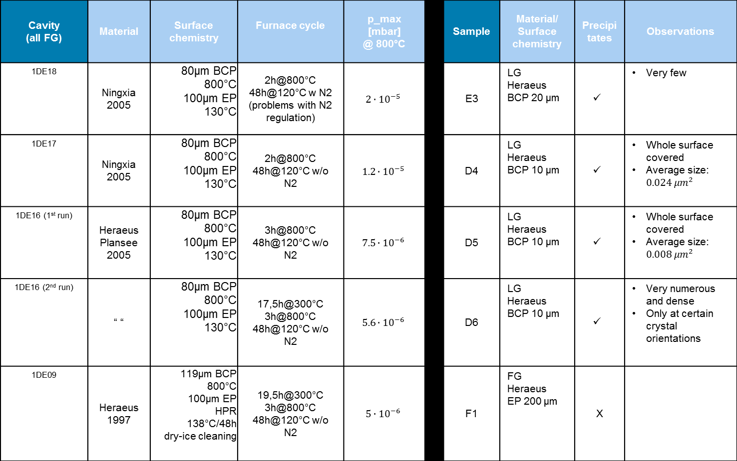
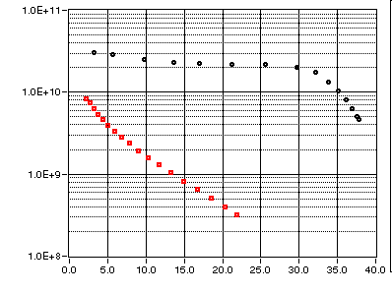
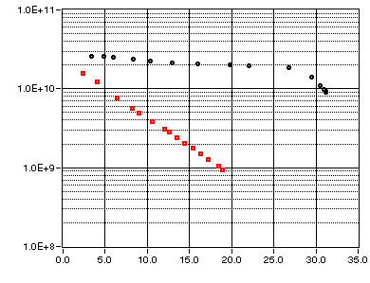
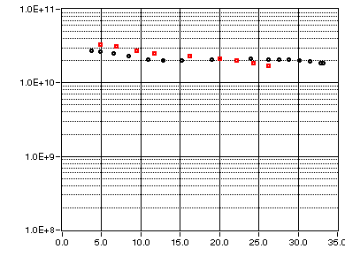
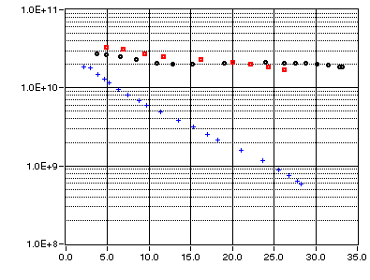
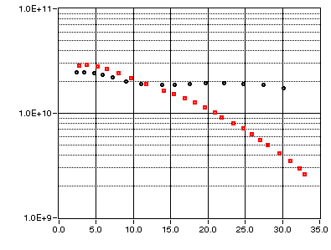
Overview: Runs so far at DESY

Slide 3
New Run – 1DE10 with Nitrogen @ 120°C
p_{max} = 5.5x10⁻⁶ mbar
Temperature
Pressure

Slide 4
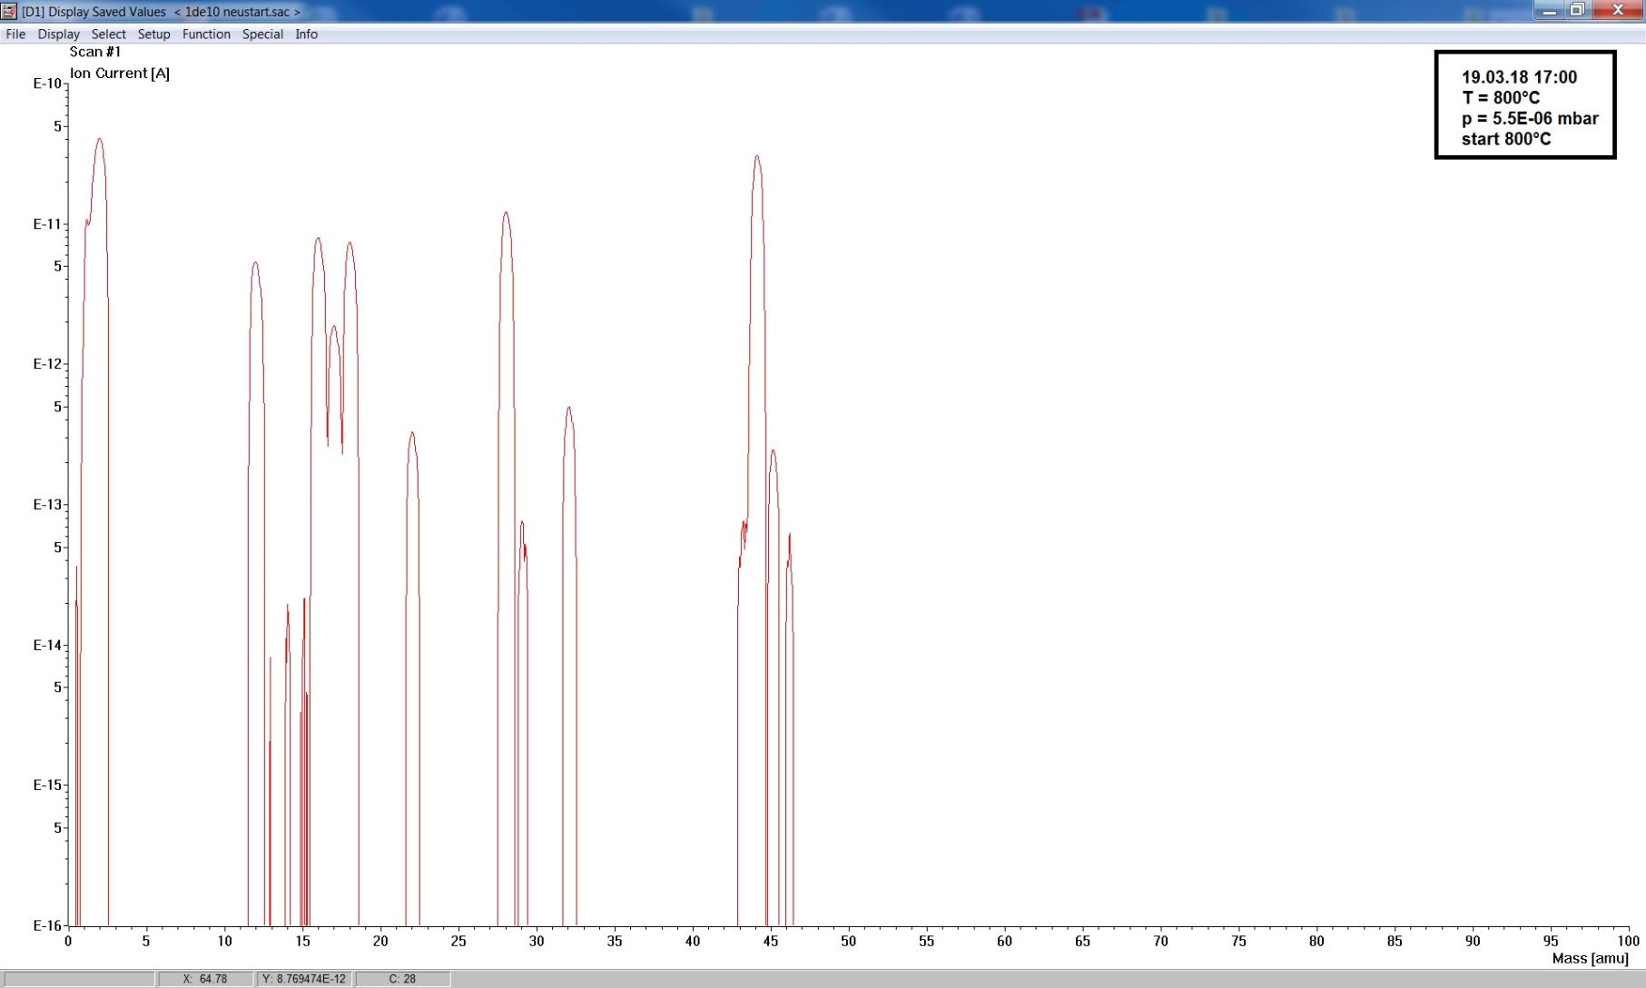
Partial Pressures during Run
RGA – 800°C beginning, p_{tot}=5.5x10⁻⁶ mbar
H
O
O₂
H₂0
Ne
N₂
CO
CO₂

Slide 5
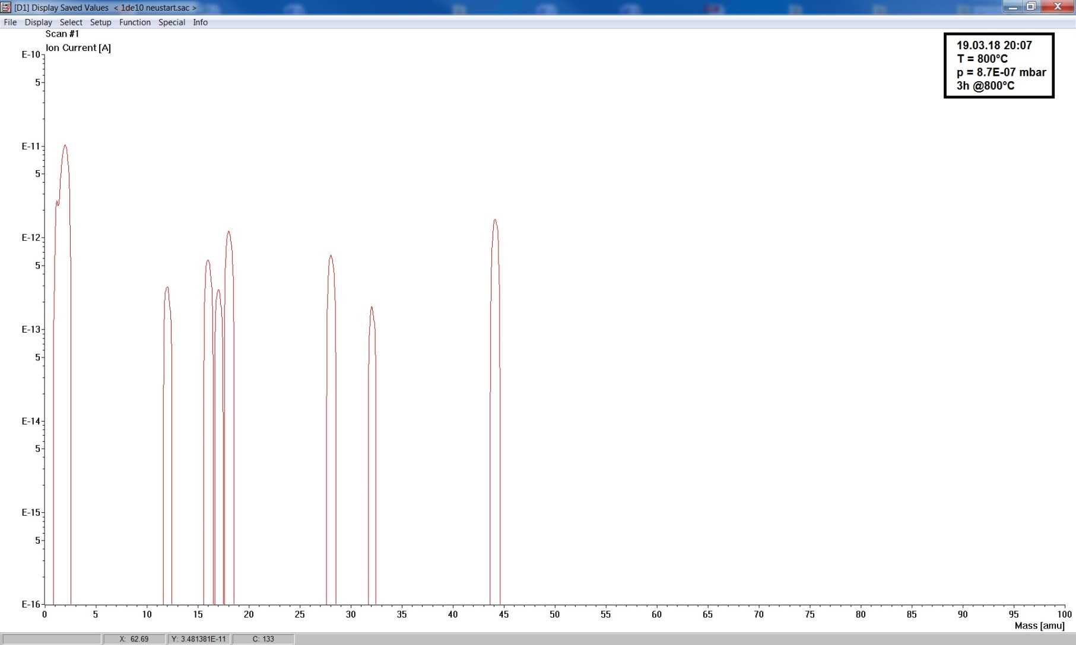
Partial Pressures during Run
RGA – 800°C after 3h, p_{tot}=8.7x10⁻⁷ mbar
H
O
O₂
H₂0
N₂
CO
CO₂

Slide 6
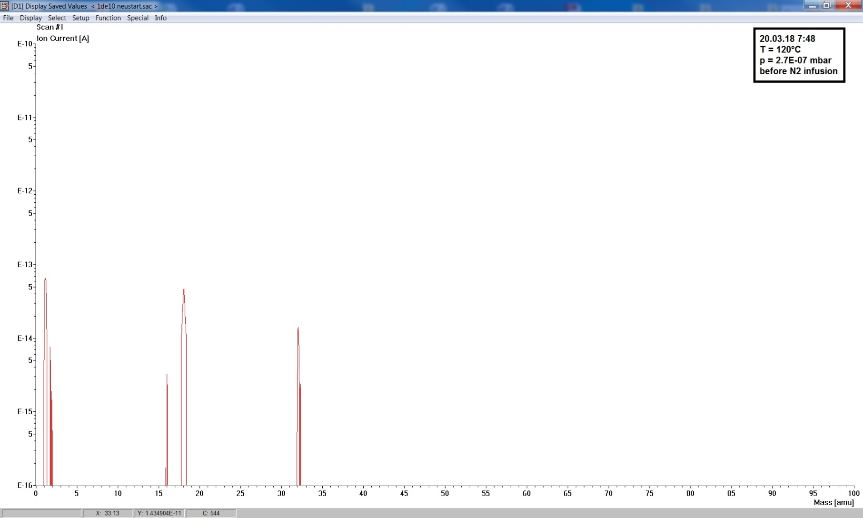
Partial Pressures during Run
RGA – 120°C before infusion, p_{tot}=2.7x10⁻⁷ mbar
H
H₂0
O₂

Slide 7
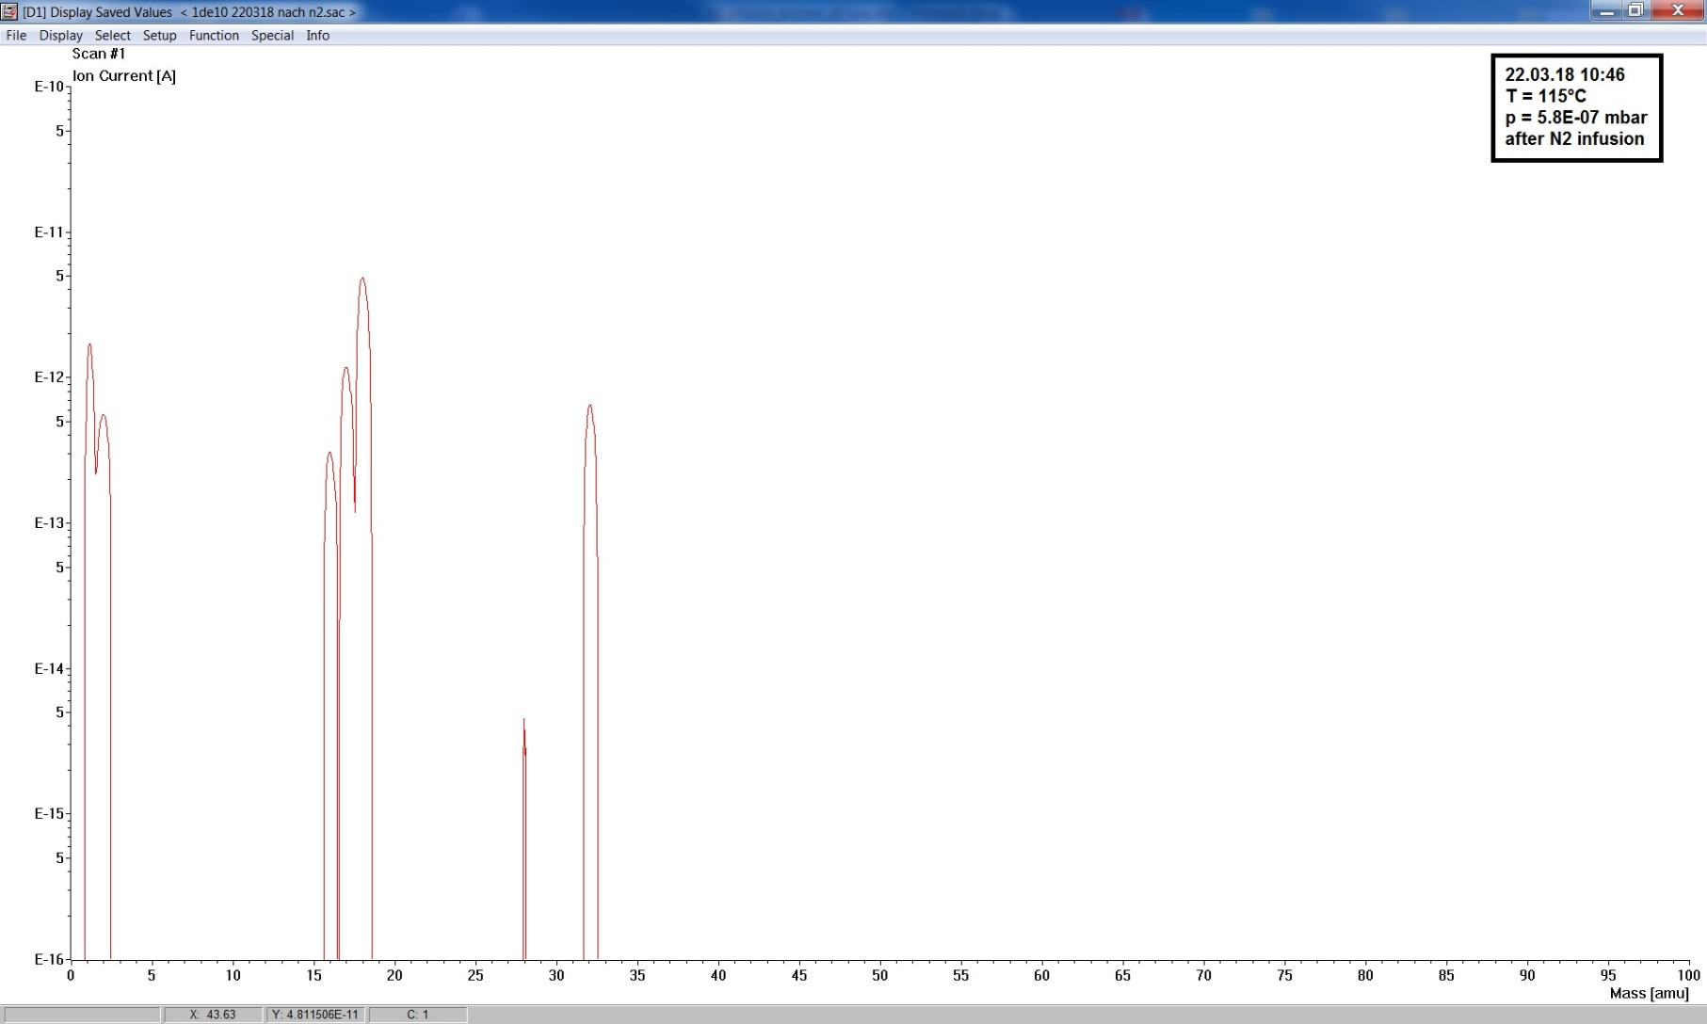
Partial Pressures during Run
RGA – 120°C after infusion, p_{tot}=5.8x10⁻⁷ mbar
In conclusion: as clean as we get (which is pretty clean)
H
H₂0
O₂
N₂

Slide 8
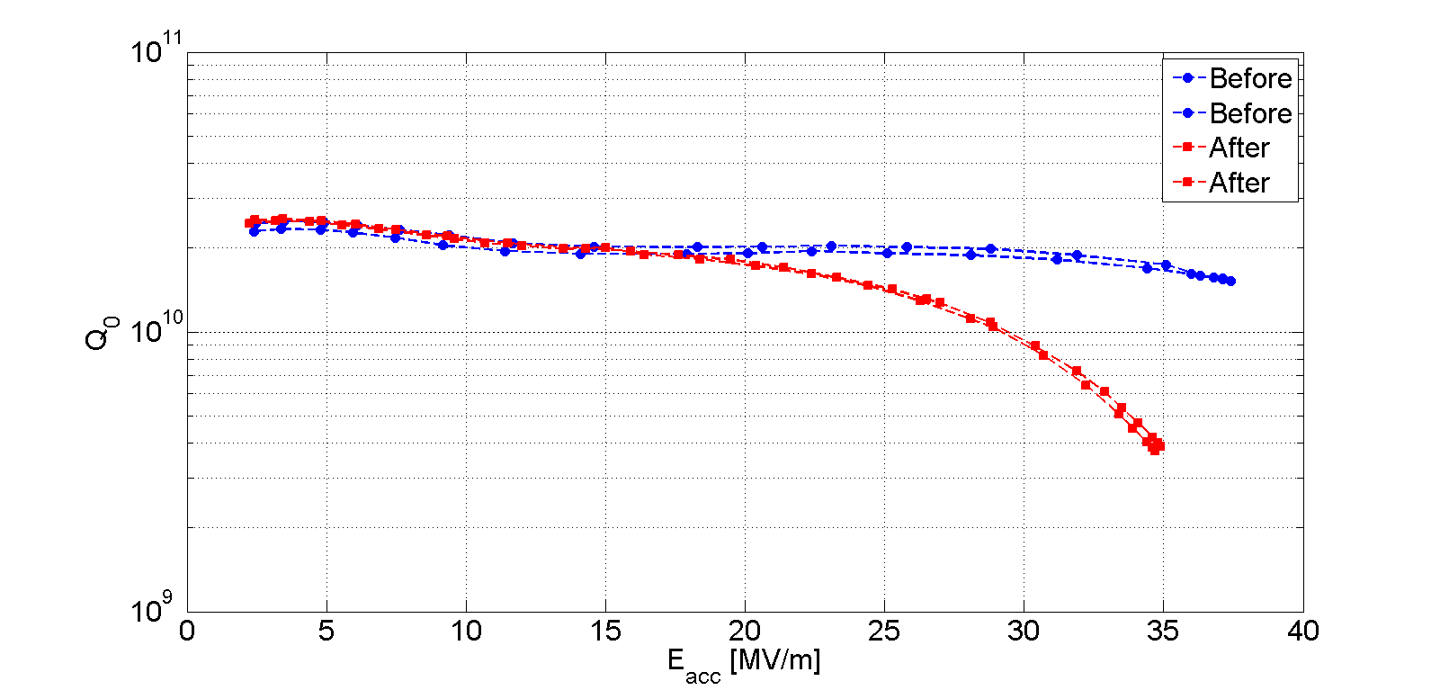
RF Test – 1DE10
@2K
no FE

Slide 9
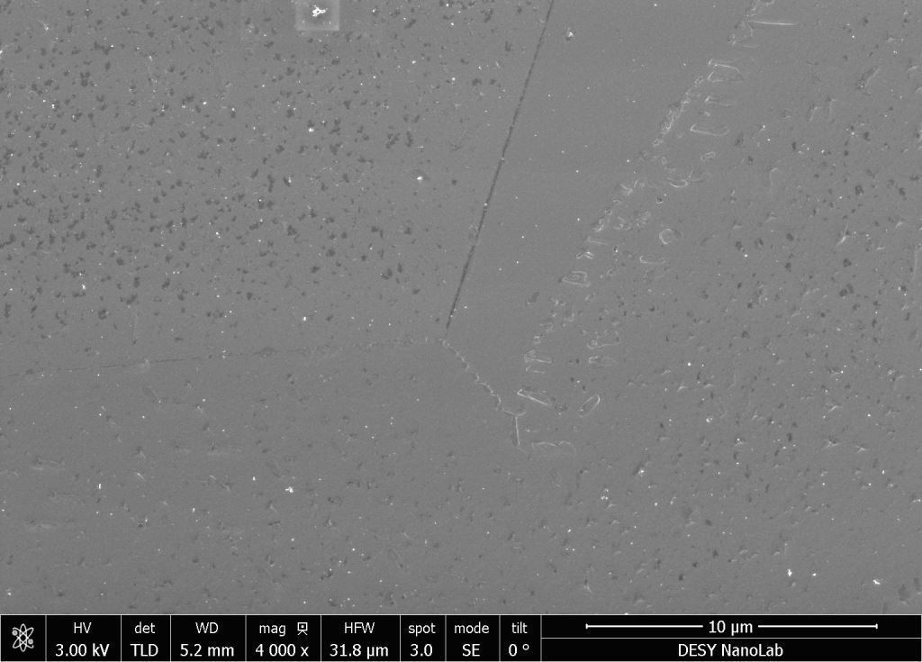
Samples 1DE10
Samples (2x3x FG):
-EP / BCP
-Tokyo Denkai / Ningxia / Heraeus
Treatment:
Chemistry (110 μm)
800°C@3h
Chemistry (40 μm)
120°C@48h
SEM before / after baking with cavity
Analysis ongoing
Preliminary results (only SEM/EDX):
Star-like precipitates and new black structures observable.
Both show a grain orientation dependency
No difference in BCP/EP or between Nb suppliers

Slide 10
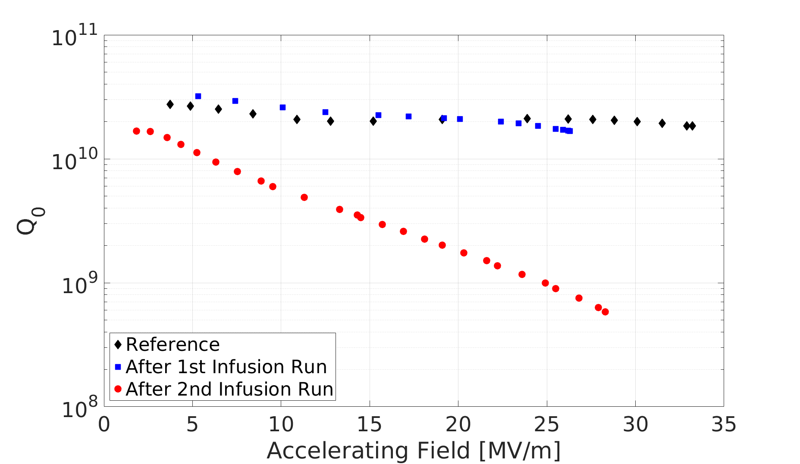
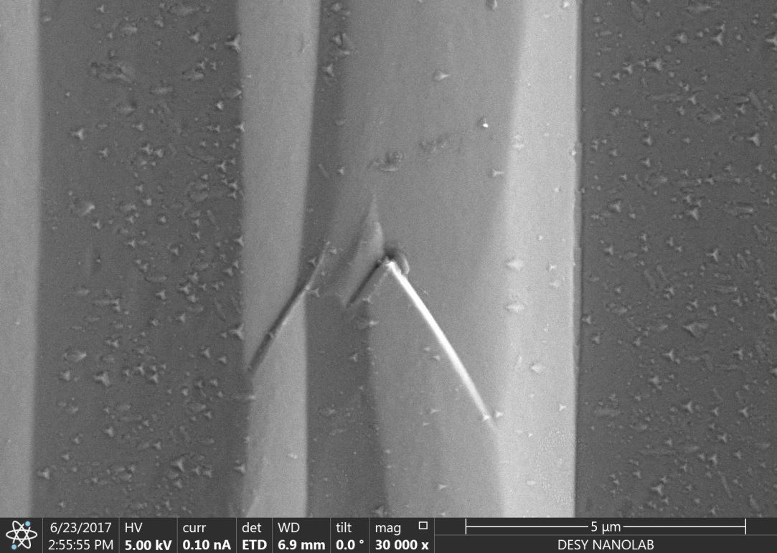
Origin of Deterioration I
1DE16 – RF Tests at 2K
@ 2K
Sample: 1DE16 – 1st Infusion Run

Slide 11
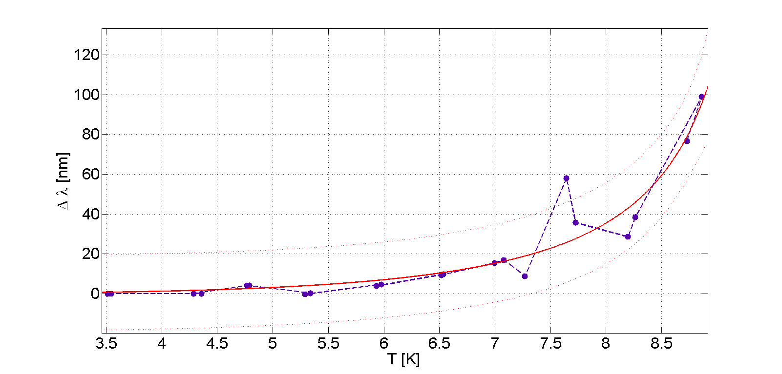

1DE16 – f vs. T aka Δλ vs. T
$$∆λ=λ\left(T\right)−λ_{0}=\frac{λ_{0}}{\sqrt{1−{\left(T/{T_{c}}\right)}^{4}}}−λ_{0}$$
$λ_{0}$= $λ_{L}\sqrt{1+\frac{ξ_{0}}{ℓ}}$
λ₀ = 74 nm
Mean free path: 14 nm → RRR: 51

Slide 12
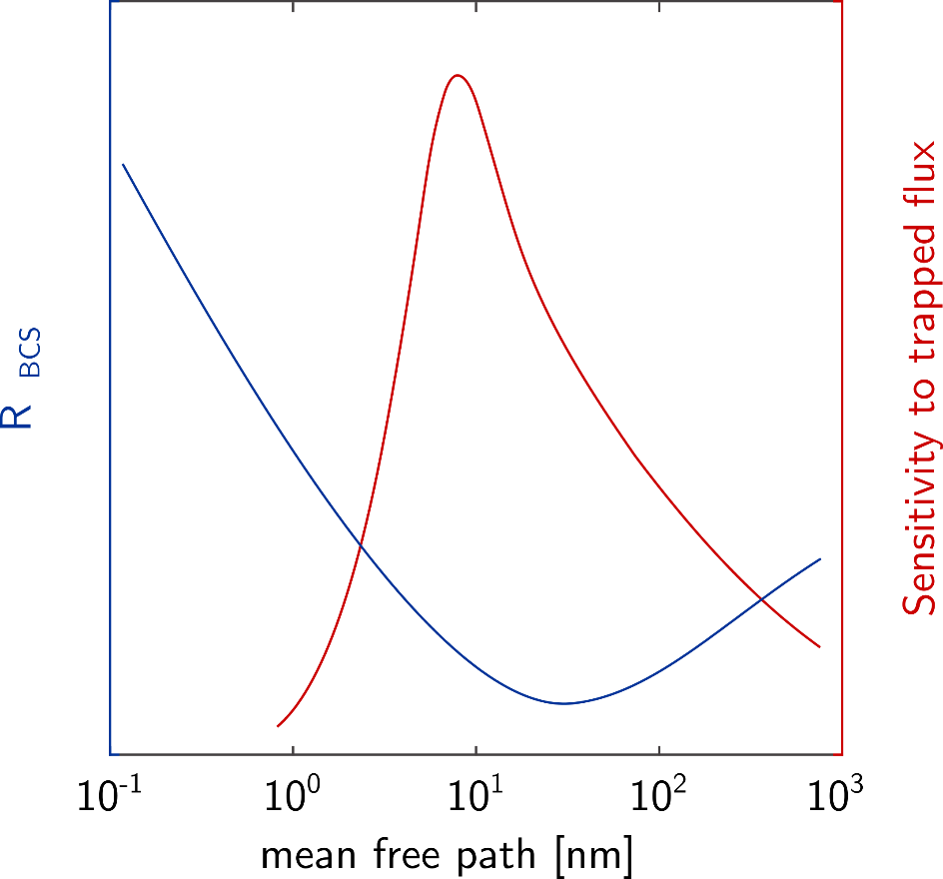
1DE16 – f vs. T aka Δλ vs. T
Interpretation
Sketch of dependencies on mean free path
[Kugeler - A Combined Temperature and Magnetic Field Mapping System for SRF Cavities – MT Meeting 2018]
1DE16
f vs. T in the range 3.5 - 10 K
Q vs. T in the range 1.5 - 4.2 K
→ 100 nm penetration depth
→ 40 nm penetration depth

Slide 13
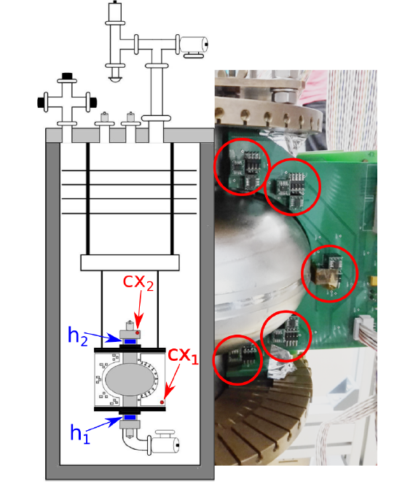
Origin of Deterioration II
T-Map & H-Map @ HZB
1DE16 – RF Tests at 2K
@ 2K
Use data from
  2nd Sound & T-Map & Optical inspection before 1st infusion run
  2nd Sound after 1st infusion run
  T-Map & H-Map after 2nd infusion run
And cut samples from cavity (hot- & cold- spots)

Slide 14
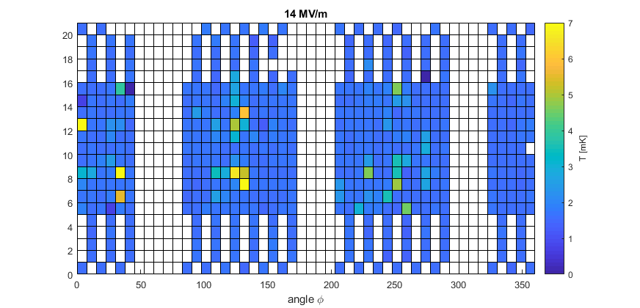
1DE16 – TMap @ HZB
First glance at measurements
Global increase of heating observed
No features observed in TMap data for previous quench spots

Slide 15
Summary
Intensive effort to improve furnace cleanliness & pressure
  ‘Saturation’ achieved – further improvements need hardware change
Latest infusion run
  Performance different to previous runs
  ‘Old’ and new precipitates
  Cavity/Samples analysis ongoing
Infusion run has been repeated with second cavity – rf test pending
  Do we really control the process and the resulting cavity performance?
Detailed analysis of cavity performances evolution and their causes
  Combine f vs. T & Q vs. T for better characterization of surface evolution
  TMap shows global heating – HMap still analyzed (HZB)
  Cavity cut outs for detailed surface analysis and correlation to rf performance

Slide 16
Thanks for Listening
Thanks to the complete DESY and Nanolab SRF team, I gave this talk on their behalf
Special thanks to Christopher Bate, Julia Köszegi, Oliver Kugeler and Jörn Schaffran for providing material
Only collaboration with many partners allows for complex R&D work

Slide 17
Back Up

Slide 18
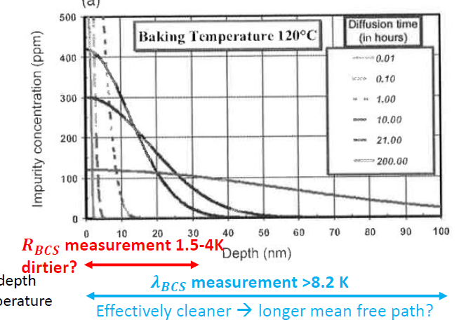
Penetration depth

Slide 19
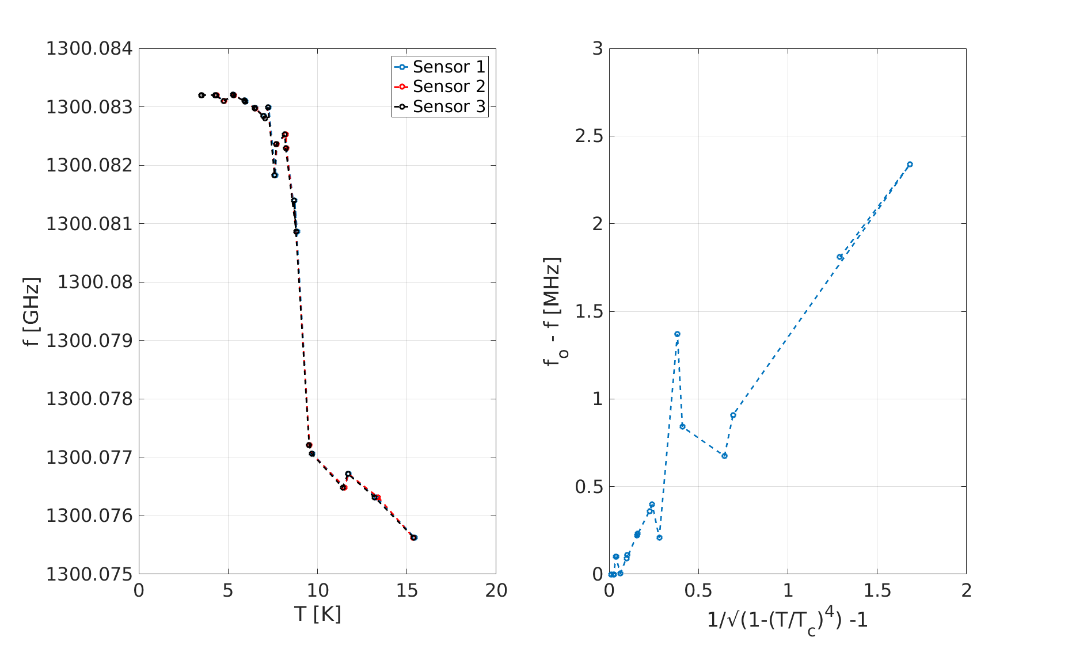
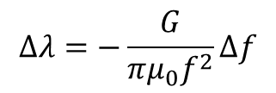
1DE16 – Frequency vs. Temperature
Determine mean free path
$$∆λ=−\frac{G}{πμ_{0}f^{2}}Δf$$

