Slide 1
Update on infusion studies at Cornell
P. N. Koufalis
Cornell University

Slide 2
Outline
PART I
Low temperature N-infusion at Cornell so far:
48 hr @ 160 ºC in N₂ gas
Various post-infusion vacuum anneal times
PART II
Low temperature C/O-infusion at Cornell so far:
48 hr @ 160 ºC in Ar+CO₂ gas
Various amounts of post-treatment etching
PART III
High frequency results with N-doping
Field dependence of surface resistance at 1.3 and 2.6 GHz
Clean niobium and N-doped

Slide 3
PART I:
N-Infusion

Slide 4
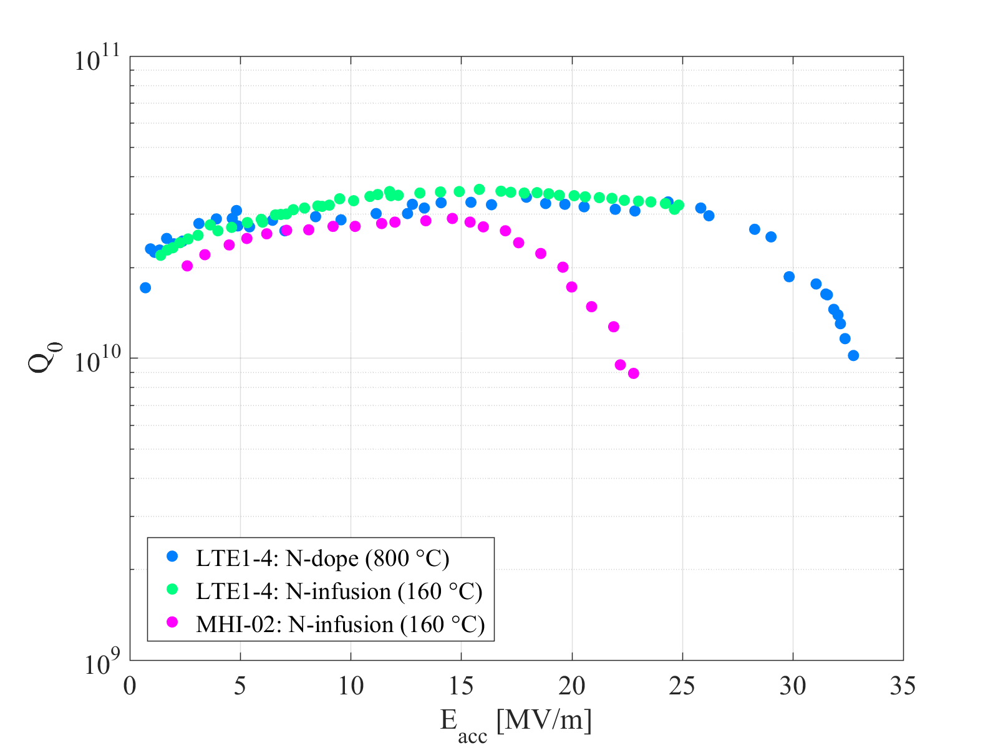
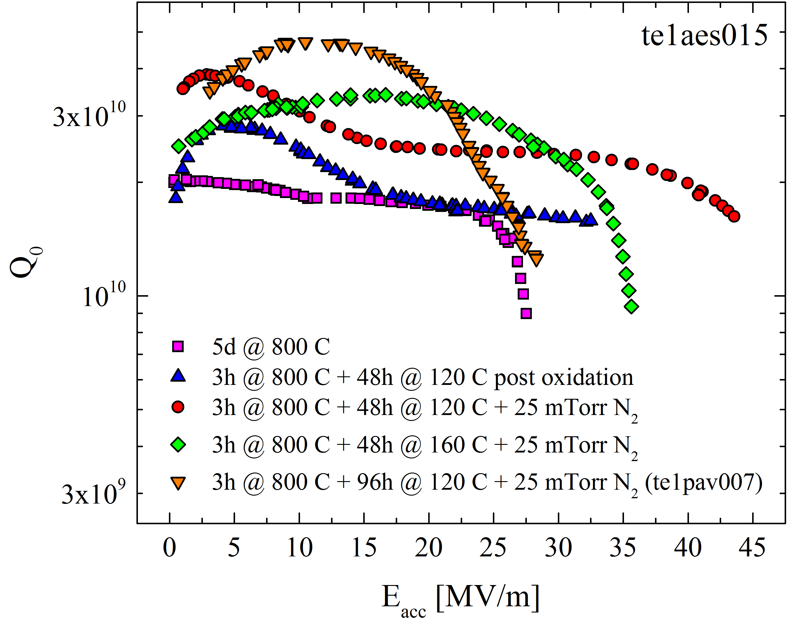
N-infusion
Low temperature baking (120 – 160 ºC) in a low pressure N₂ atmosphere results in ‘Q-rise’:
A. Grassellino and S. Aderhold, New Low T Nitrogen Treatments Cavity Results with Record Gradients and Q, TTC Saclay, 2016.
P. N. Koufalis, M. Liepe, J. T. Maniscalco. Low Temperature Doping of Niobium Cavities: What is really going on?, TUXBA01, SRF2017.

Slide 5
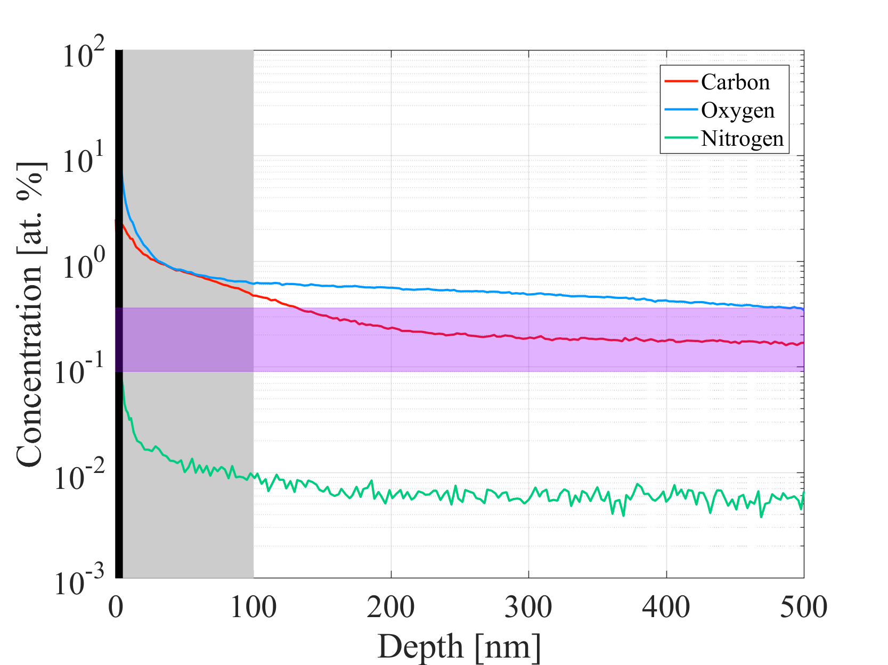
SIMS Analysis
EP + 800 °C (5 hr; UHV) + 160 °C (48 hr; N₂) + 160 °C (168 hr; UHV)
Oxide layer (~5 nm)
RF layer (~$λ_{L}$)
(0.09 – 0.36 at. % N) for N-doped cavities
Very high concentrations of impurities near the surface
surface roughness passivation by dirty surface layer that is superconducting by proximity effect?
quasiparticle overheating reduced in RF layer?
pinning sites for magnetic flux lines?
C and O concentrations TWO ORDERS OF MAGNITUDE HIGHER than N in RF layer

Slide 6
PART II:
C/O-Infusion

Slide 7
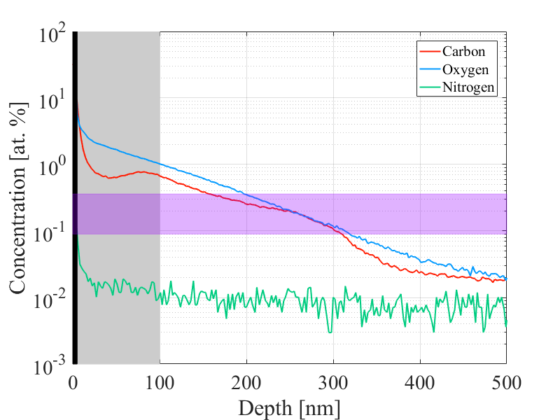
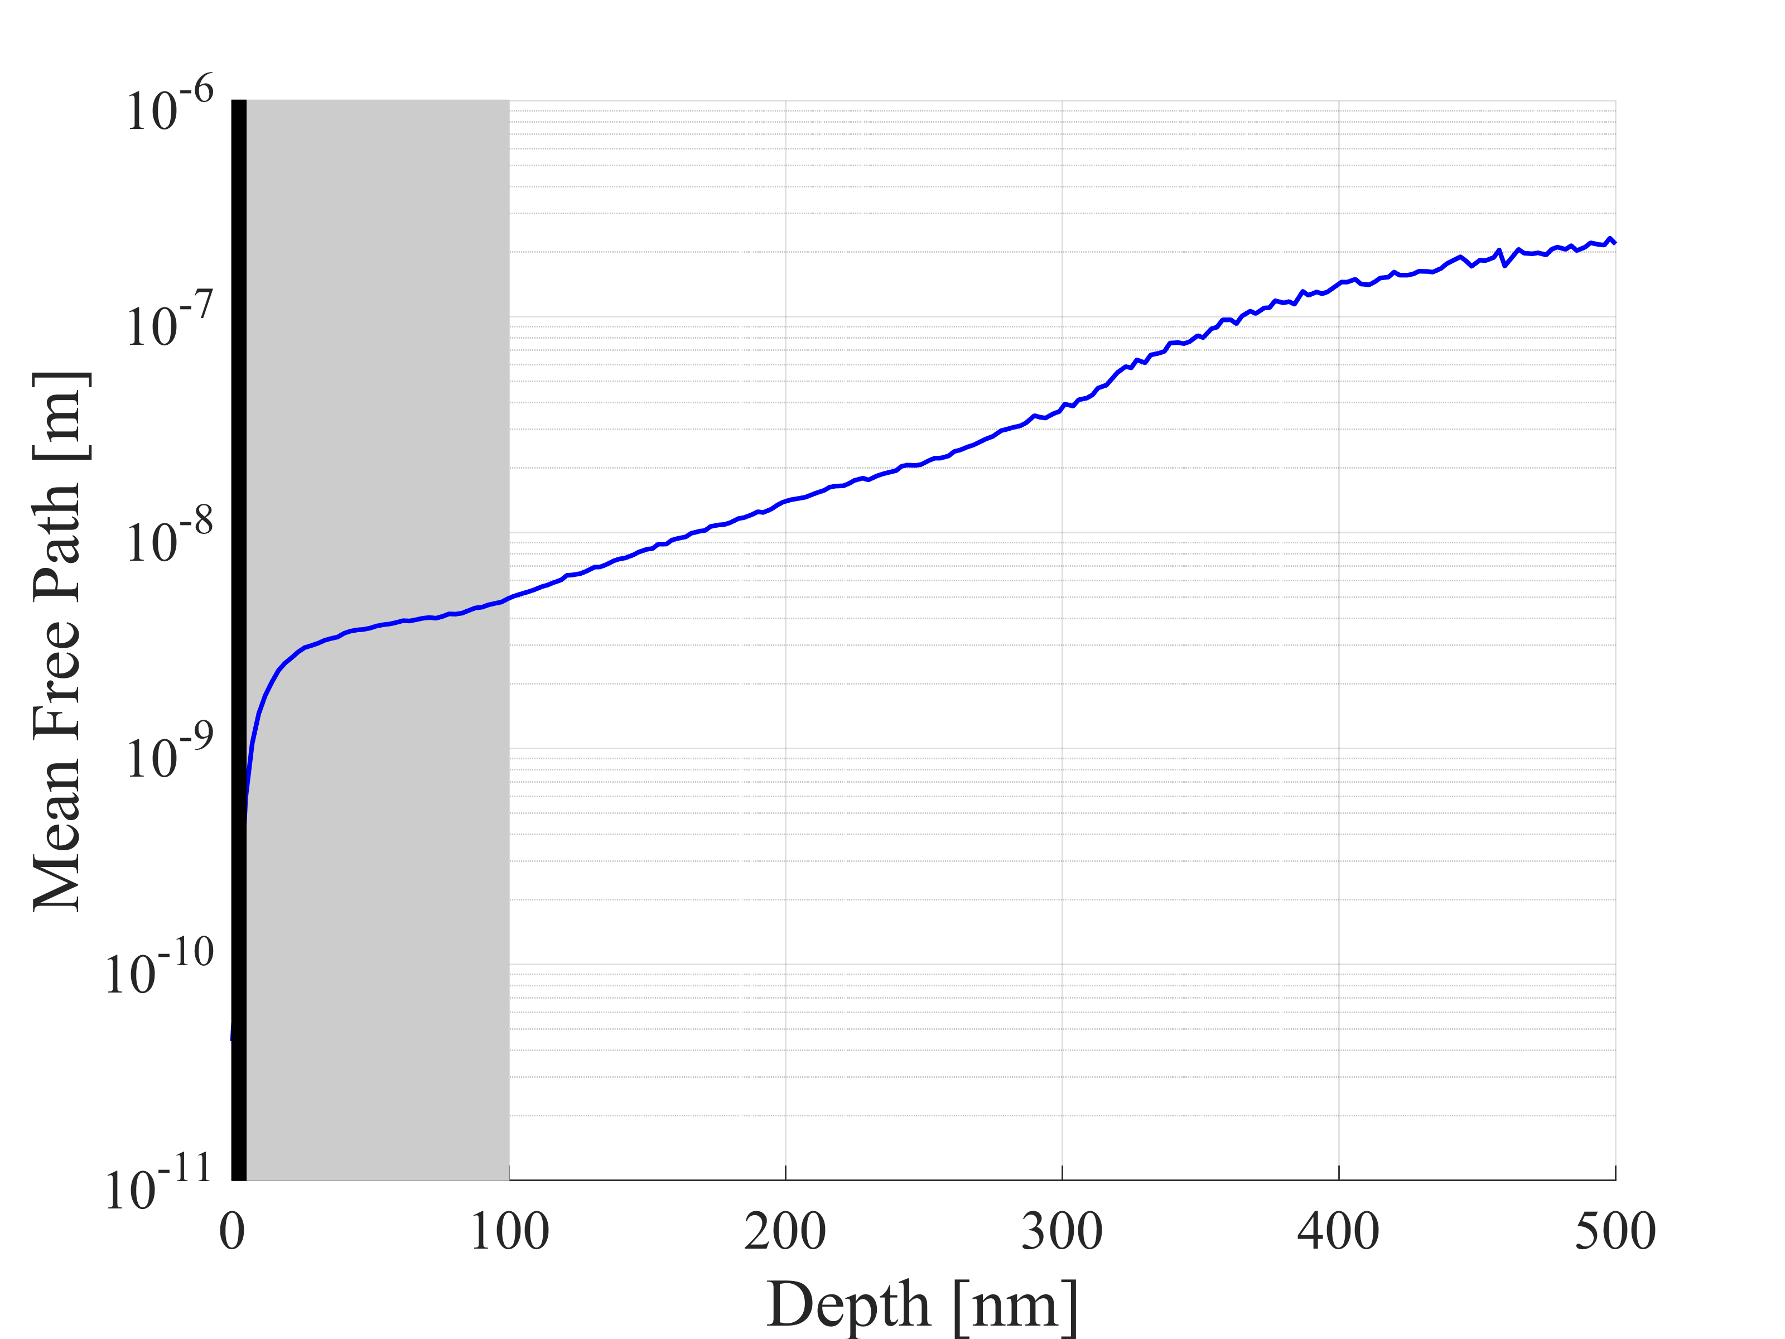
C/O Infusion Results
EP + 800 °C (5 hr; UHV) + 160 °C (48 hr; Ar+CO₂)
Very high concentrations of impurities near the surface
surface roughness passivation by dirty surface layer that is superconducting by proximity effect?
quasiparticle overheating reduced in RF layer?
pinning sites for magnetic flux lines?
C and O concentrations TWO ORDERS OF MAGNITUDE HIGHER than N in RF layer

Slide 8
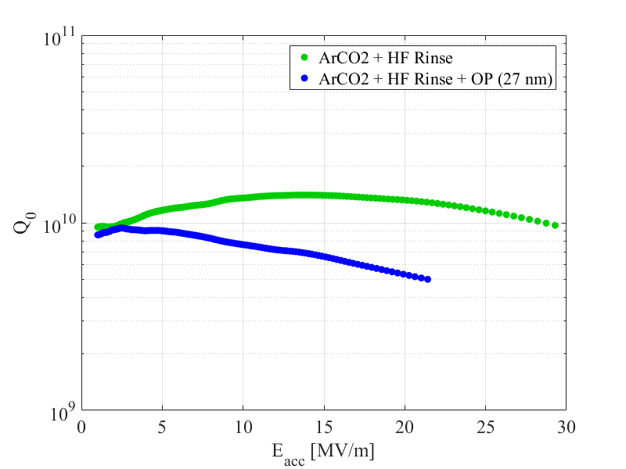
C/O Infusion Results
EP + 800 °C (5 hr; UHV) + 160 °C (48 hr; Ar+CO₂)
HF Rinse: ‘Q-rise’
HF Rinse + OP: ‘Q-drop’
The ‘Q-rise’ disappeared after oxypolishing. Why?
$$T=2.0 K$$
To better understand what is happening, we must look at the field dependence of the surface resistance
$$R_{S}=R_{BCS}+R_{res}$$

Slide 9
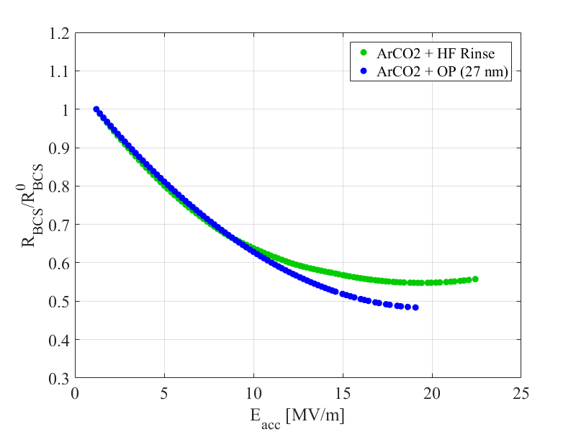
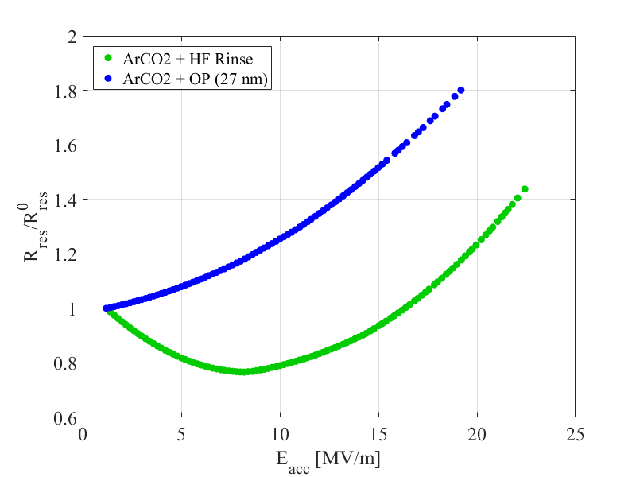
C/O Infusion Results
Strong reduction of $R_{BCS}$ with $E_{acc}$ in both cases; strong increase of $R_{res}$ with $E_{acc}$ in both cases
$R_{res}$ dominates behavior of cavity with HF + OP; In HF case, $R_{res}$ is lower in magnitude and decreases from its low field value up until $E_{acc}≈16 MV/m$
Presence of impurities lowers mean free path → increases electron-phonon coupling → lowers quasiparticle overheating → strong reduction in $R_{BCS}$

Slide 10
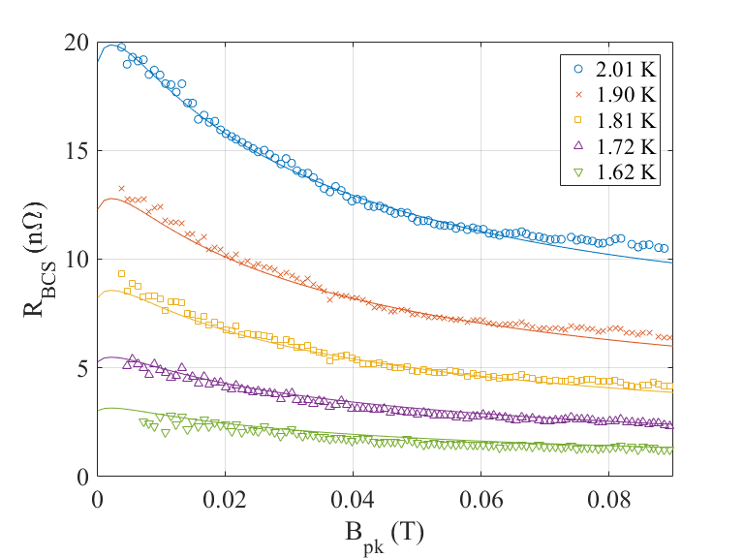
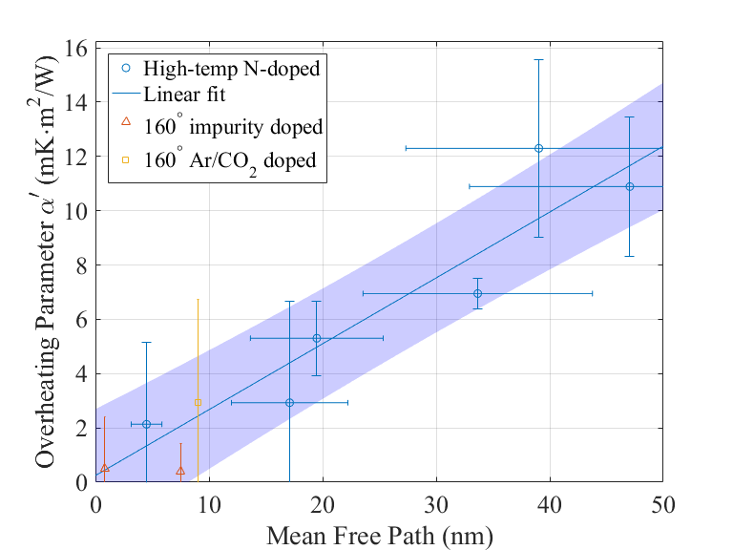
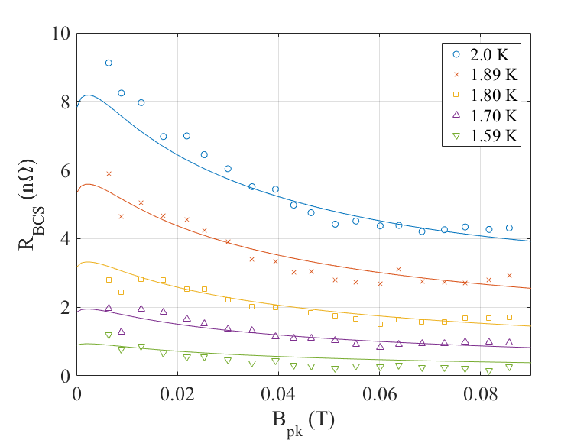
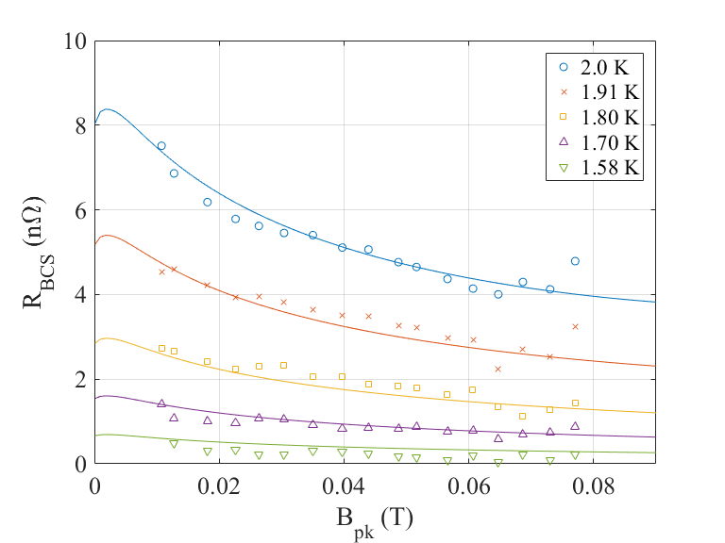
C/O Infusion Results
160 ºC ArCO₂ + HF
160 ºC N₂ (1-cell)
160 ºC N₂ (9-cell)

Slide 11
PART III:
High Frequency Results

Slide 12
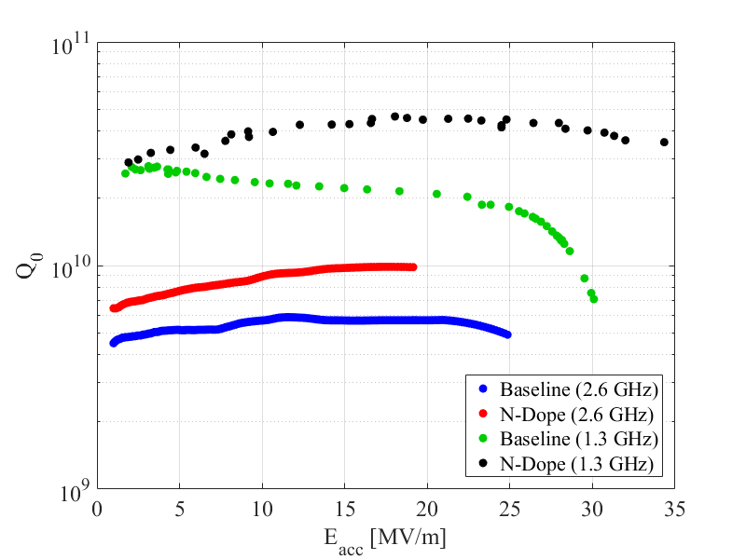
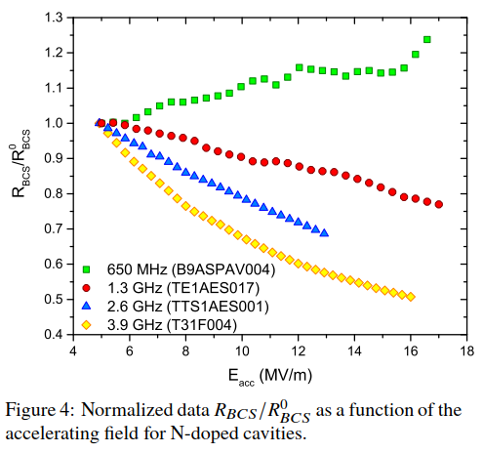
High Frequency Results
M. Martinello et al, “Advancement in the understanding of the field and frequency dependent microwave surface resistance of niobium,” in Proceedings of SRF2017, Lanzhou, China, 2017.
Baseline 2.6 GHz shows ‘Q-rise’ and after a 2/6 N-dope the Q increases and the ‘Q-rise’ gets even stronger
Breakdown surface resistance into BCS and residual components: $R_{S}=R_{BCS}+R_{res}$

Slide 13
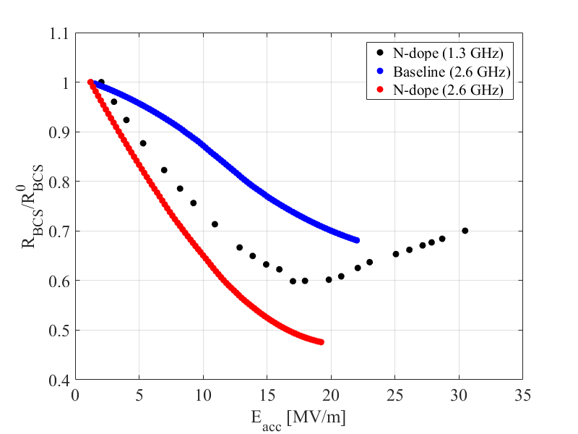
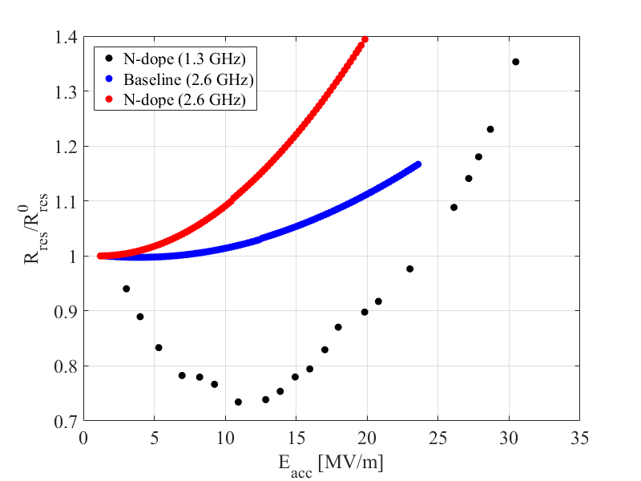
High Frequency Results
Baseline 2.6 GHz data showed a 30% reduction of $R_{BCS}$ and after 2/6 N-doping $R_{BCS}$ dropped by a little more than 50%
At 2.6 GHz you see ‘Q-rise’ even without doping; however, doping further enhances the ‘Q-rise’

Slide 14
THANK YOU FOR LISTENING

