Slide 1
Latest insight from high-frequency cavity experiments
Martina Martinello
TTC Meeting 2018

Slide 2
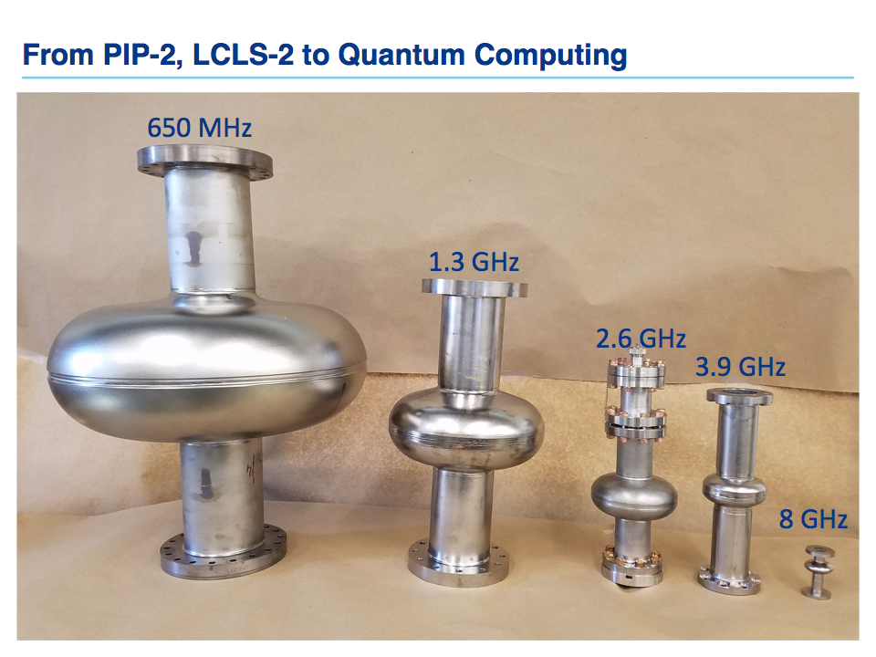

Analyzed Cavities
N-doping
120C baking
EP/BCP
1.3 GHz, 2 K
 | 650 MHz | 1.3 GHz | 2.6 GHz | 3.9 GHz
EP
BCP
120 C baking
2/6 N-doping

Slide 3
Field Dependence at Different Frequencies
Different thermal treatments were studied at different frequencies:
BCP and EP
120 ºC baking
Nitrogen doping (2/6 recipe)

Slide 4
Anti Q-slope in BCP’d 3.9 GHz Cavities
T=2.0 K
anti Q-slope
M. Martinello et al. SRF 2017 (TUYAA02), IPAC 2018 (WEPML013)

Slide 5
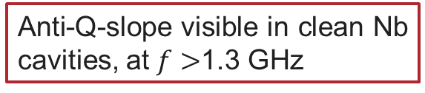
Anti Q-slope in BCP’d 3.9 GHz Cavities
T=2.0 K
anti Q-slope
Anti-Q-slope visible in clean Nb cavities, at $f>$1.3 GHz

Slide 6
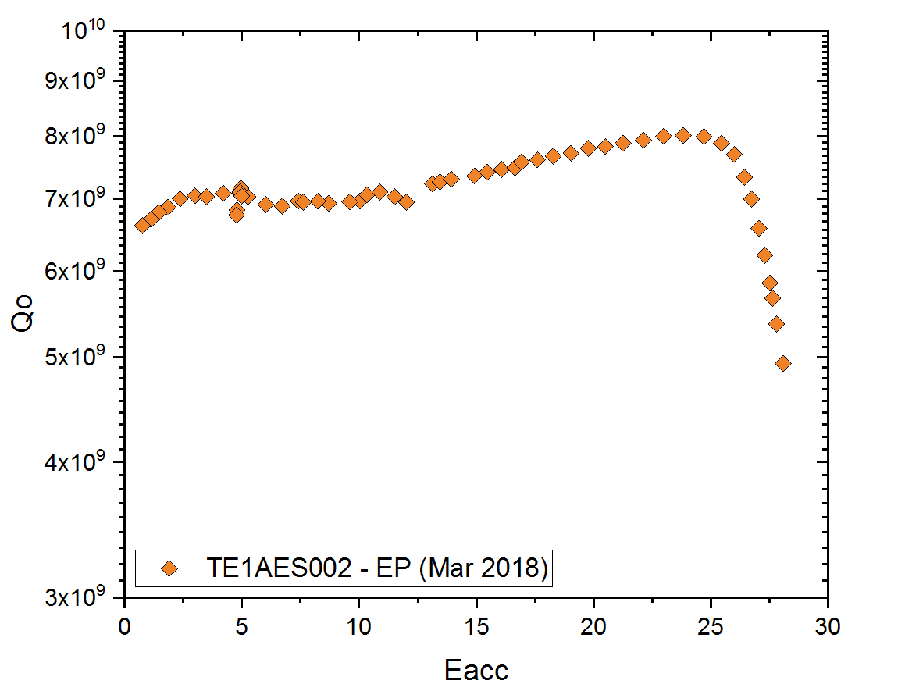
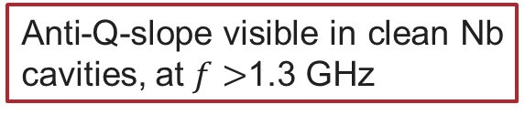
Anti Q-slope in EP’ed 2.6 GHz Cavities
T=2.0 K
anti Q-slope
Anti-Q-slope visible in clean Nb cavities, at $f>$1.3 GHz
M. Martinello et al., IPAC 2018 (WEPML013)

Slide 7
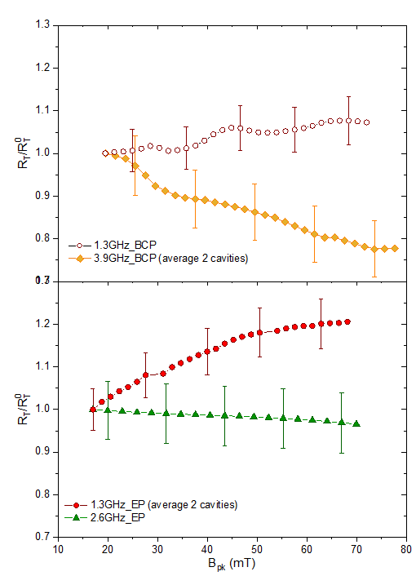
Anti Q-slope in EP’ed 2.6 GHz Cavities
As for N-doping, anti-Q-slope of these cavities is due to decreasing of the temperature-dependent surface resistance

Slide 8
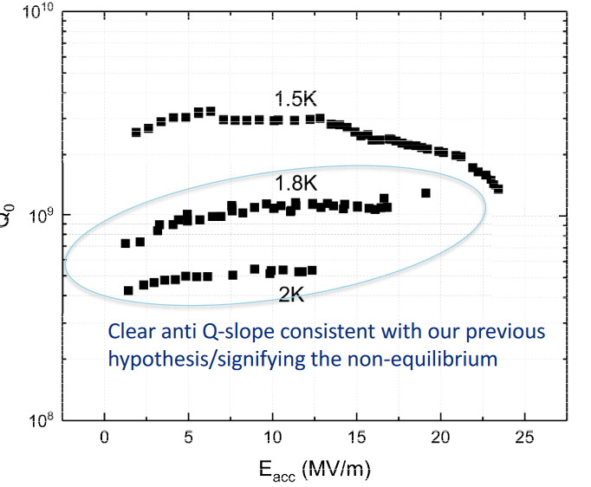
First 9 GHz EP Cavity
A. Romanenko et al., IPAC 2018

Slide 9
Field Dependence at Different Frequencies
Different thermal treatments were studied at different frequencies:
BCP and EP
120 ºC baking
Nitrogen doping (2/6 recipe)

Slide 10
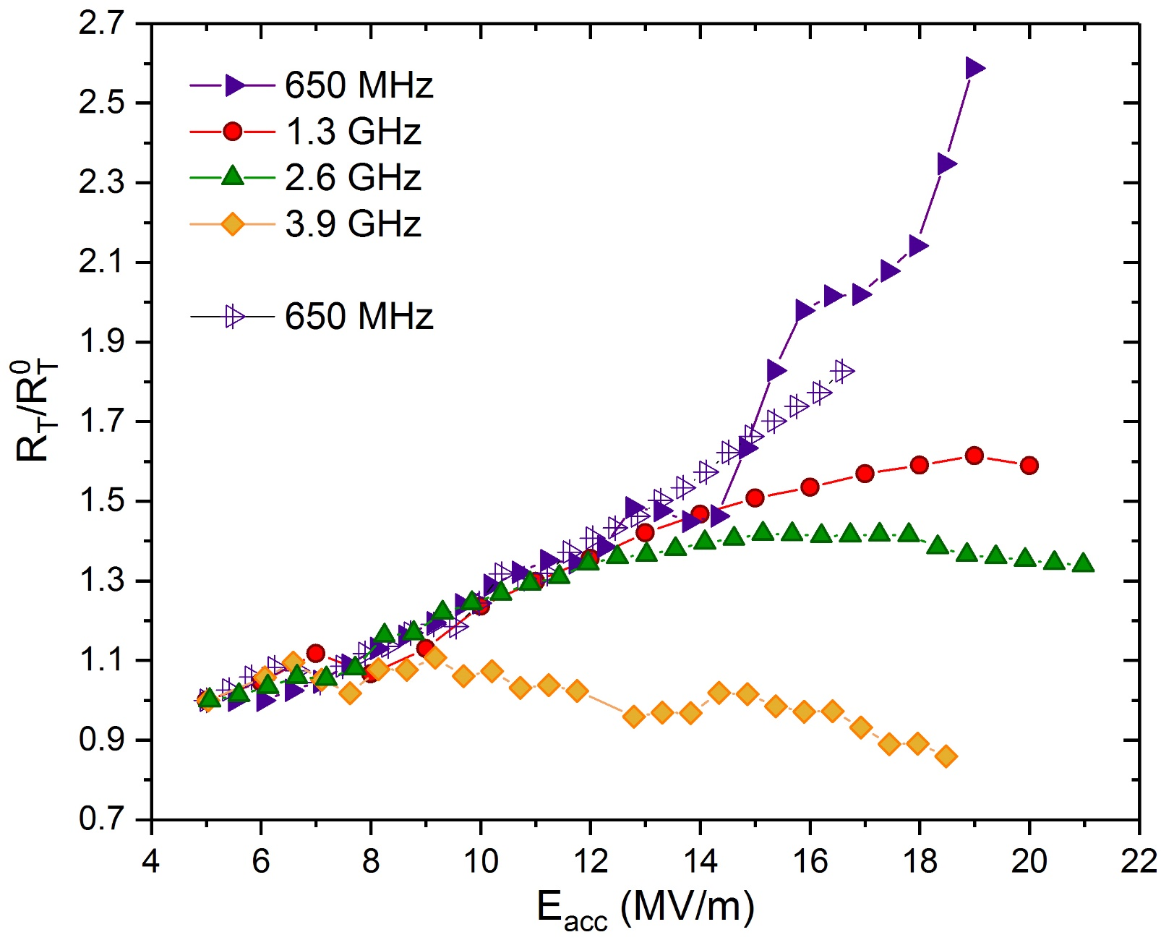
1. Normalized $R_{T}\left(2 K\right)$ for 120 C Baking
M. Martinello et al. SRF 2017 (TUYAA02), IPAC 2018 (WEPML013)

Slide 11
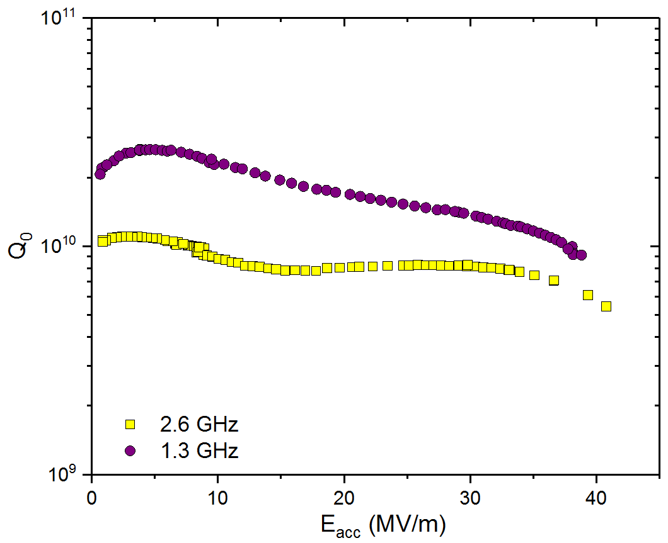
Q₀ of 2.6 GHz at high field tends to the one at 1.3 GHz
Q-factor of 2.6 GHz cavity converge to the one at 1.3 GHz at high gradients
T=2.0 K
120C baked cavities
M. Martinello et al. SRF 2017 (TUYAA02), IPAC 2018 (WEPML013)

Slide 12
Field Dependence at Different Frequencies
Different thermal treatments were studied at different frequencies:
BCP and EP
120 ºC baking
Nitrogen doping (2/6 recipe)

Slide 13
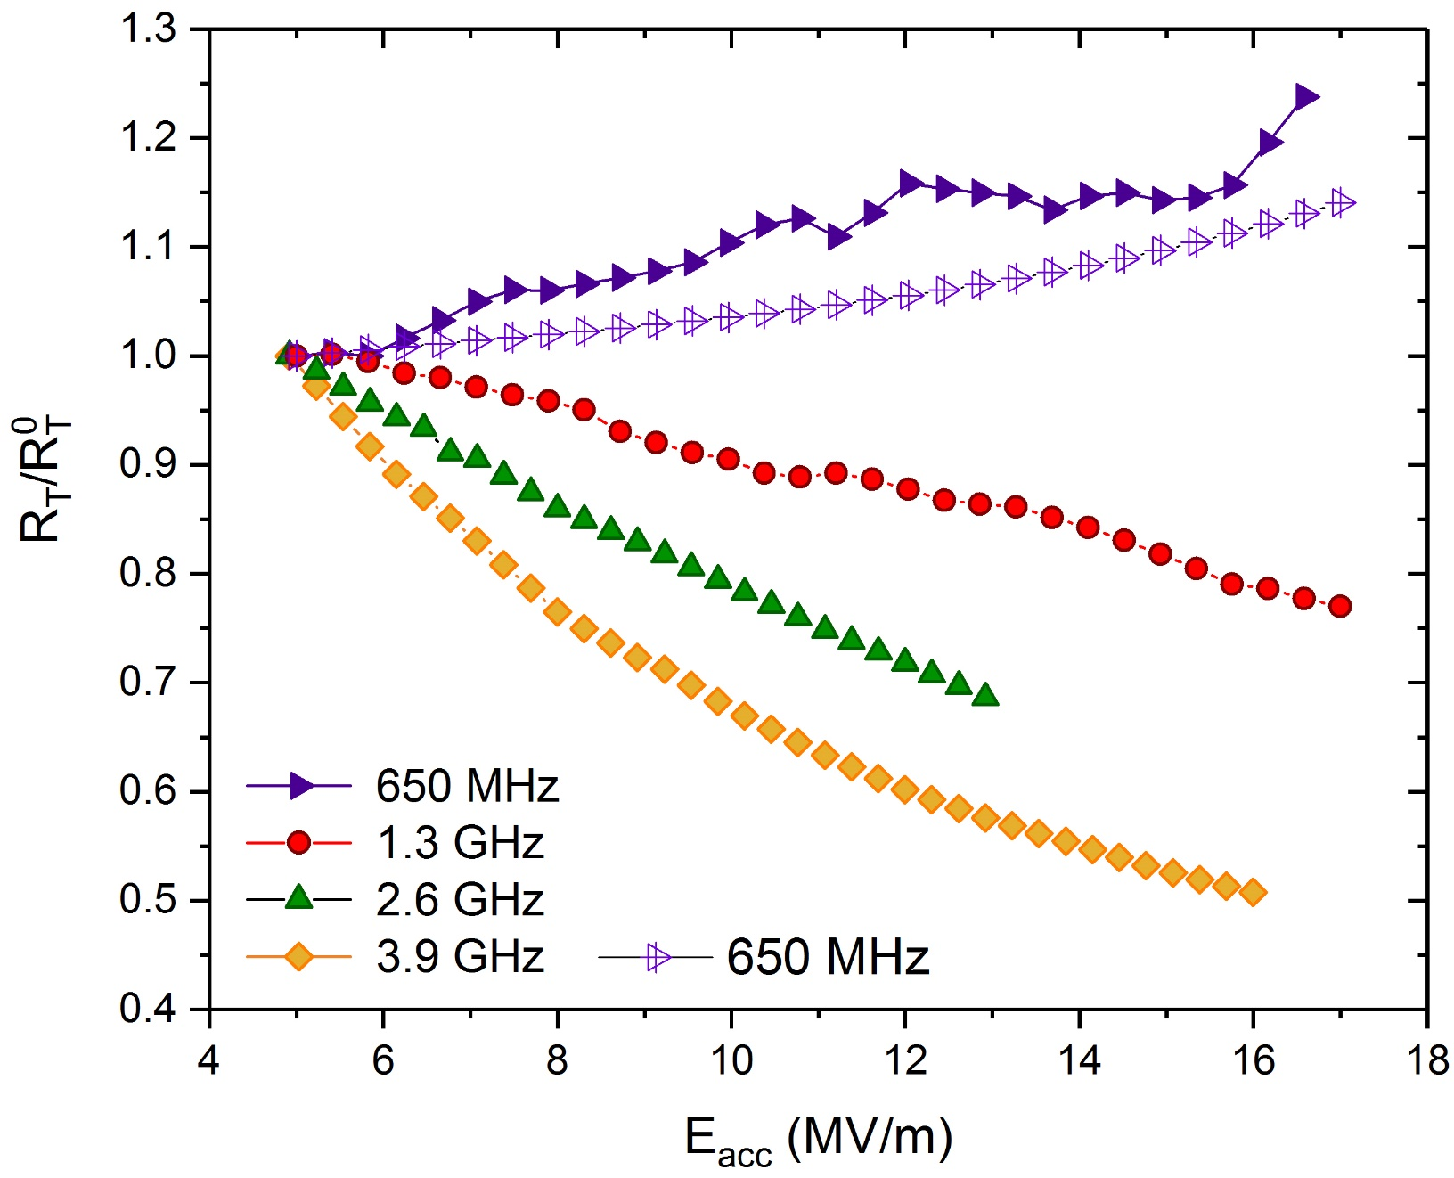
3. Normalized $R_{T}\left(2 K\right)$ for N-doping
N-doping effect (decreasing of R_{T}(Eacc)) more pronounced in cavities with f>1.3 GHz and absent in 650 MHz cavities
M. Martinello et al. SRF 2017 (TUYAA02), IPAC 2018 (WEPML013)

Slide 14
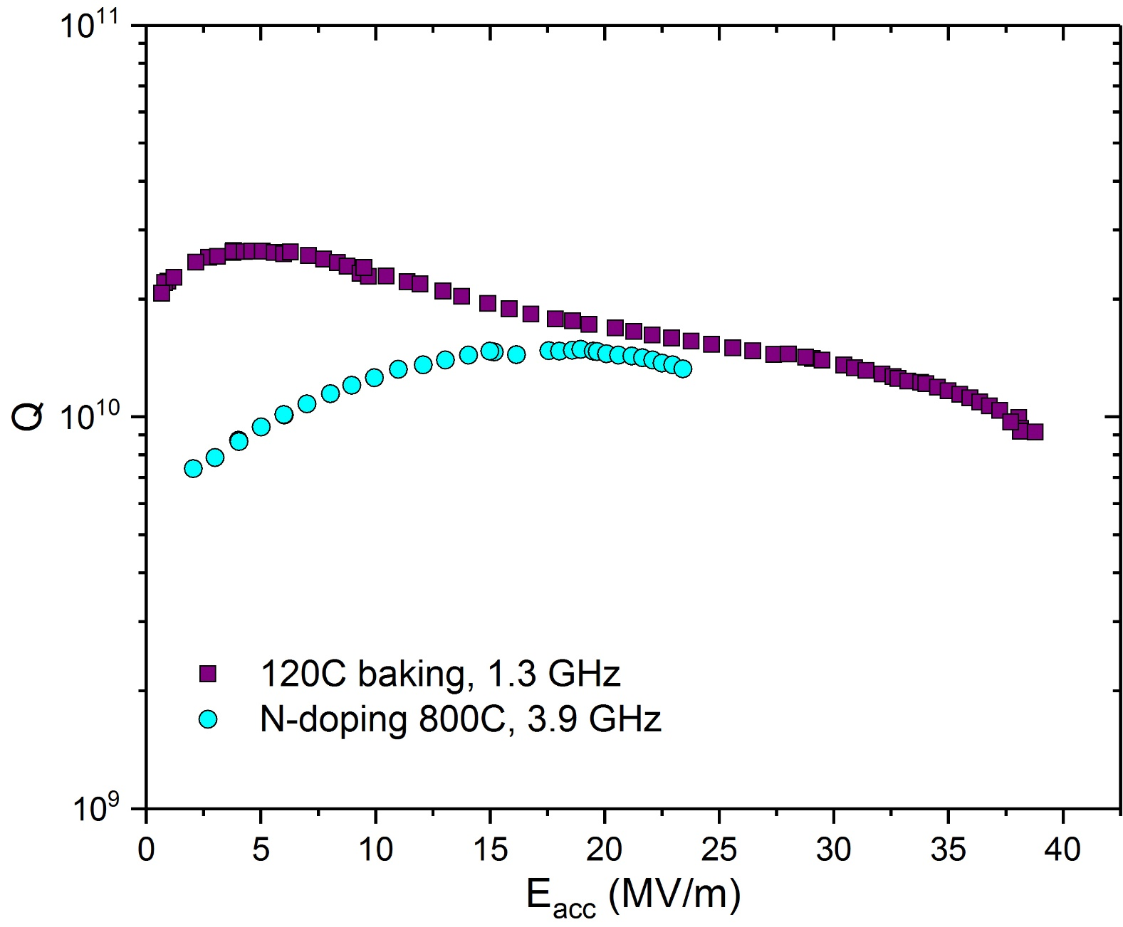

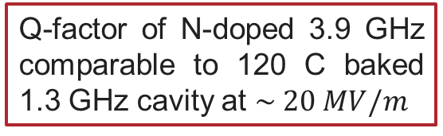
Unprecedented Medium Field Q₀ at 3.9 GHz
Q-factor of N-doped 3.9 GHz comparable to 120 C baked 1.3 GHz cavity at $\sim 20 MV/m$
$$Q_{0}\sim 1.5∙{10}^{10}$$
T=2 K
M. Martinello et al. SRF 2017 (TUYAA02),
IPAC 2018 (WEPML013)

Slide 15
Further Improvement in Q₀ at 3.9 GHz w 900C baking
T=2.0 K

Slide 16
Further Improvement in Q₀ at 3.9 GHz w 900C baking
T=2.0 K
Cavity needs to be re-measured because of wrong antennas mounted for this test

Slide 17
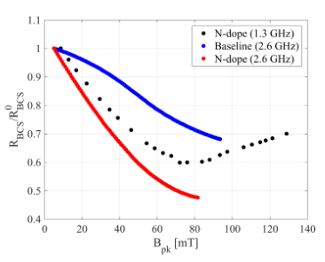
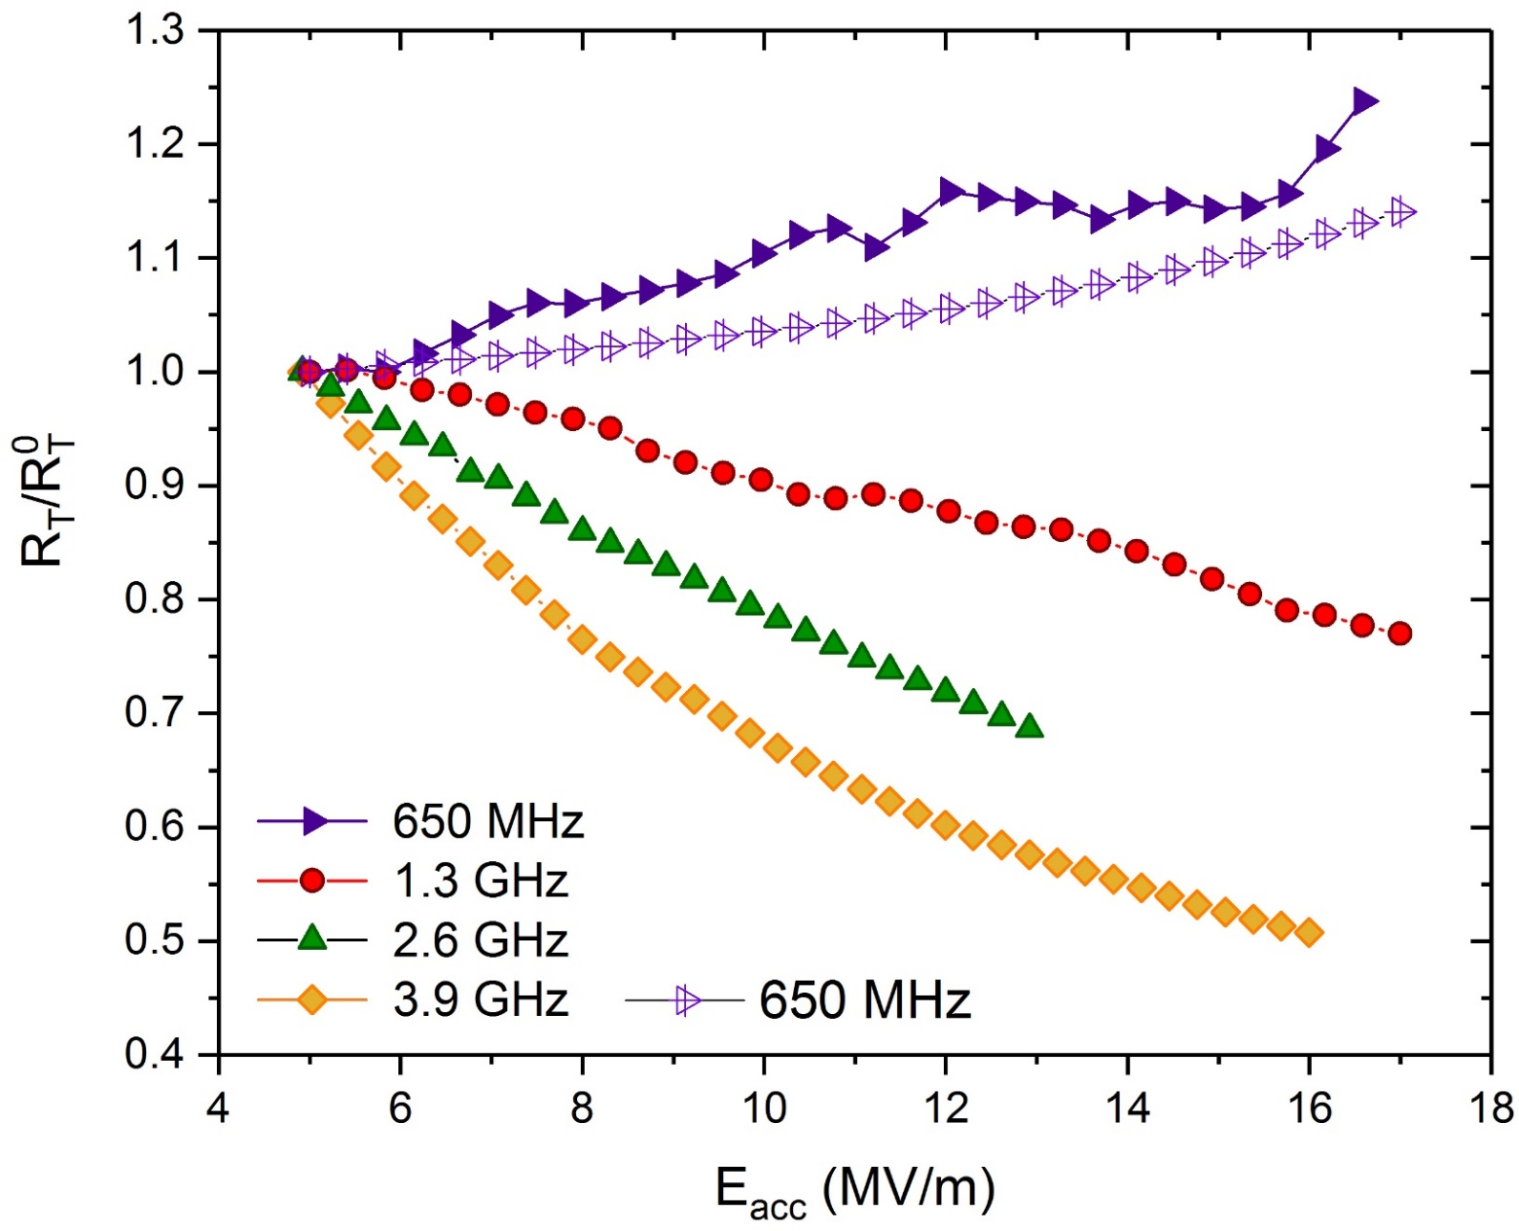
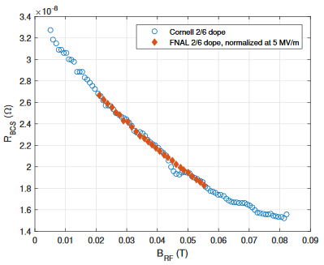
Recent results from Cornell agrees with this trend
P. Koufalis et Al., IPAC 2018
M. Martinello et al. SRF 2017 (TUYAA02), IPAC 2018 (WEPML013)
J. Maniscalco et Al., IPAC 2018

Slide 18
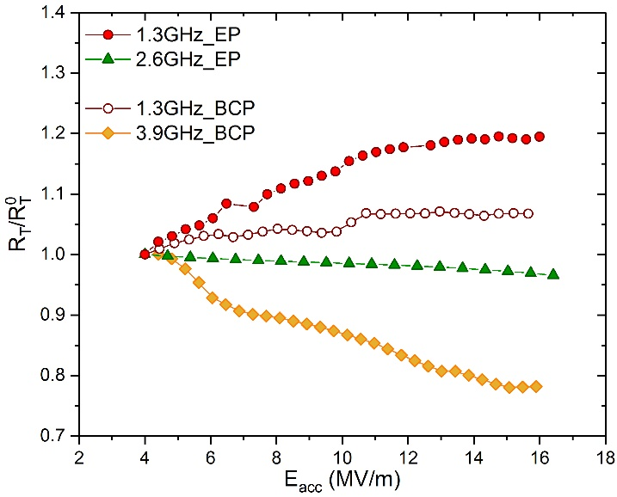
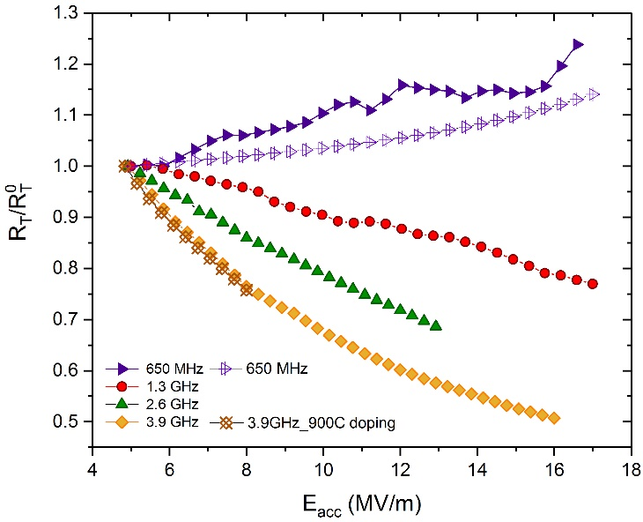
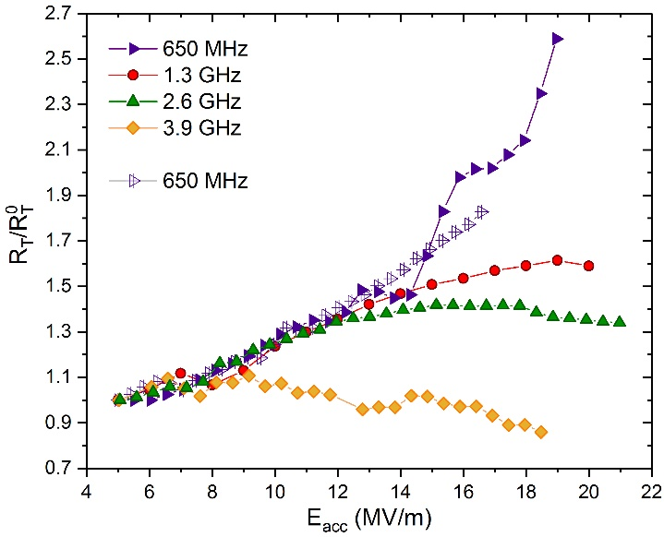
Summary on the frequency dependence of R_{BCS}(Eacc)
EP/BCP
N-doping
120C baking
The physical mechanism underneath the R_{T} reversal has a stronger effect at high frequencies
The R_{T} reversal, that has been considered the signature of the N-doped treatment, is actually visible also in clean Nb but at high frequency
On the other hand, N-doped cavities at low frequencies do not show the R_{T} reversal observed at 1.3 GHz
M. Martinello et al. SRF 2017 (TUYAA02), IPAC 2018 (WEPML013)

Slide 19
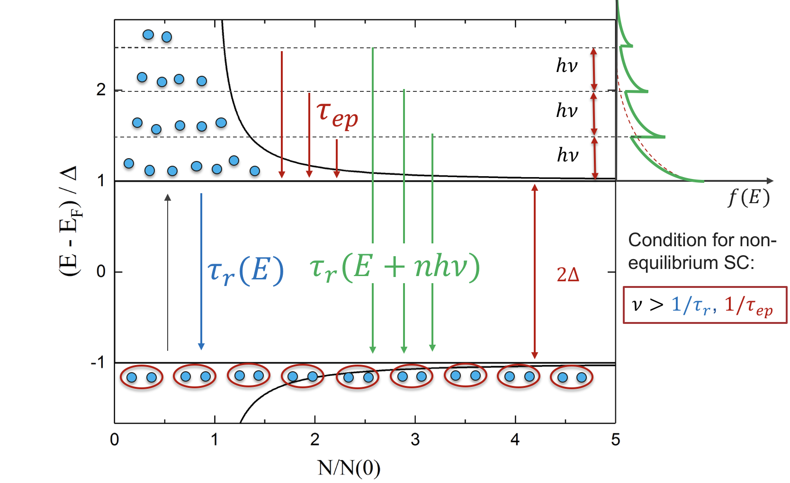
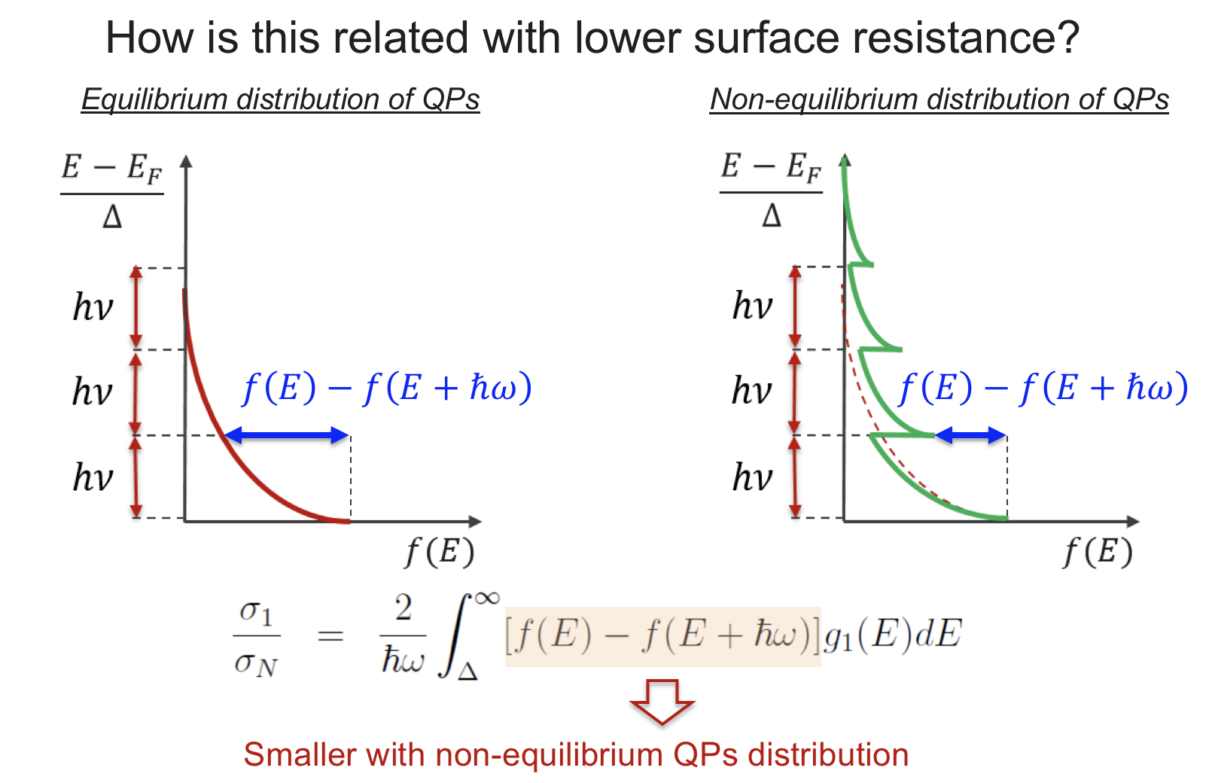
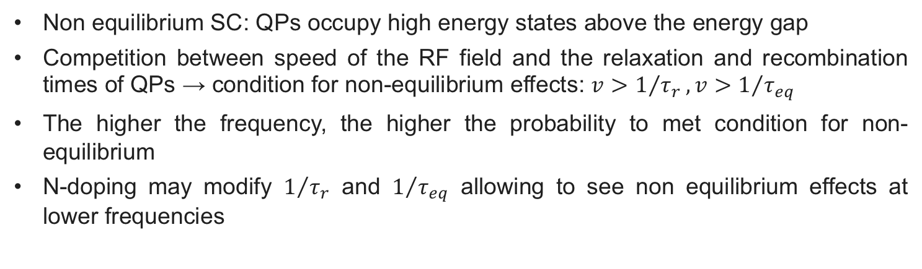
Non-equilibrium superconductivity
Non equilibrium SC: QPs occupy high energy states above the energy gap
Competition between speed of the RF field and the relaxation and recombination times of QPs → condition for non-equilibrium effects: $v>1/{τ_{r}}, v>1/{τ_{eq}}$
The higher the frequency, the higher the probability to met condition for non-equilibrium
N-doping may modify $1/{τ_{r}}$ and $1/{τ_{eq}}$ allowing to see non equilibrium effects at lower frequencies
Romanenko, LINAC 2014; M. Martinello et al. SRF 2017 (TUYAA02), IPAC 2018 (WEPML013)

Slide 20
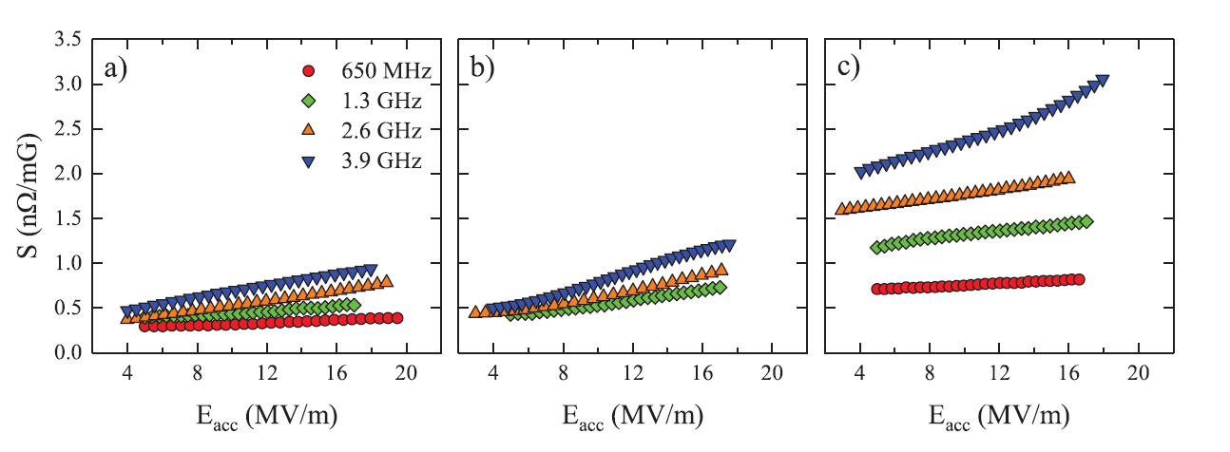
Sensitivity for different frequencies
120C baking
BCP/EP
N-doping
Trapped flux sensitivity increases with frequency
The increment strongly depends on the surface treatment, i.e. on the mean free path
Higher frequencies seem to have a larger field dependence
M. Checchin, M. Martinello et al., Appl. Phys. Lett. 112, 072601 (2018)
M. Checchin et al., Supercond. Sci. Technol. 30, 034003 (2017)

Slide 21
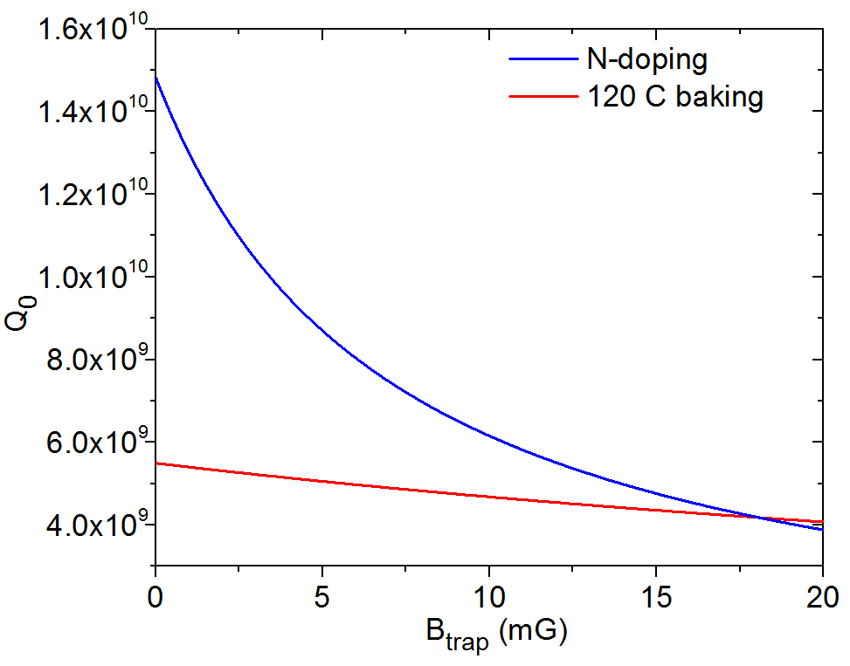

The advantage of N-doping at 3.9 GHz
N-doping wins over standard treatments as long as the field trapped is <17 mG
M. Martinello et al. SRF 2017 (TUYAA02), TTC Meeting Milan 2018

Slide 22
Conclusions
R_{T}(E_{acc}) shows a strong frequency dependence: high frequencies are favorable to lower R_{T} at high field
The decreasing of R_{T}(E_{acc}) can appear also in high-frequencies non-doped cavities and, vice versa, R_{T}(E_{acc}) increases in low frequencies N-doped cavities
High-Q in high-frequency cavity is possible, especially at medium field → new possibility for CW machine
Non-equilibrium SC may qualitatively explain the decreasing of the surface resistance as a function of the field and its enhancement at higher frequencies
Trapped flux sensitivity increases with frequency but depending on the treatment magnetic shielding may be more or less stringent

Slide 23
Thank you for your attention!

