Slide 1
TTC2018, RIKEN, June 26-29, 2018
  Nitrogen Doping Study at Peking University
Jiankui Hao
On behalf of SRF Laboratory
Institute of Heavy Ion Physics
Peking University

Slide 2
TTC2018, RIKEN, June 26-29, 2018
Outline
Motivation and background
N-doping researches of 1-cell cavities
  Sample analyses
  D-doping process
  Vertical test
Summary

Slide 3
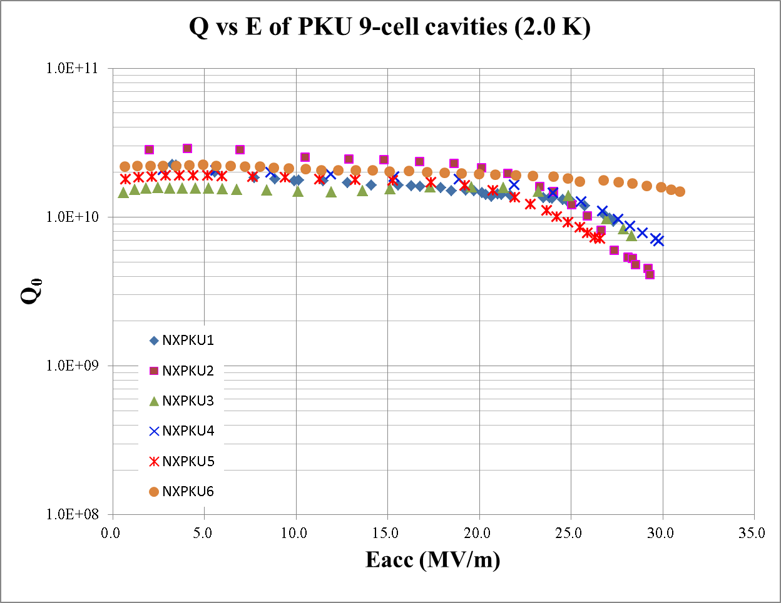
Motivation and background
N-doping Researches
  Driven by the needs of CW XFEL plans
    e. g. Shanghai XFEL, 8 GeV, 600 × 1.3 GHz 9-cell cavities, 16 MV/m, 2-3×10¹⁰
  Carried out with single cell cavities
  Large grain cavities adopted based on the previous researches
LG 9-cell cavities for XFEL
6 large grain 9-cell cavities were fabricated by PKU/OSTEC
BCP 180μm + 800°C 3h + BCP 30μm
no EP
E_{acc} of all 6 cavities larger than 25 MV/m
Q₀~1.6-2.4E10 @ 16 MV/m @ 2.0 K
high Q at vertical test

Slide 4
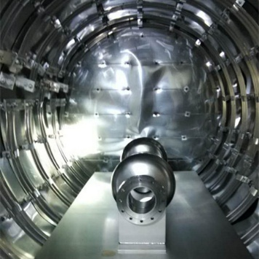
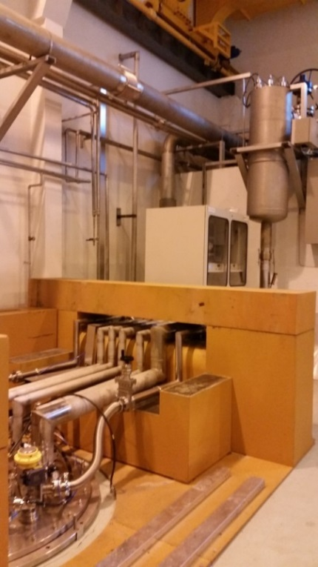
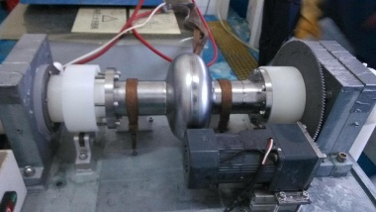
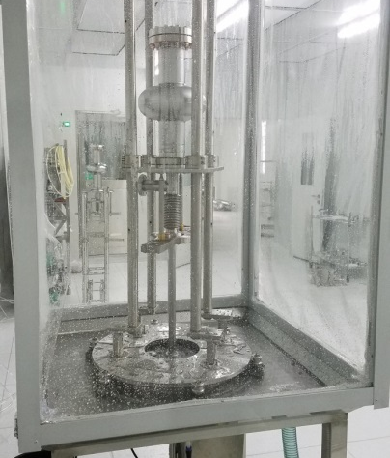
N-doping researches with single cell cavities
N-doping procedure
BCP
HPR
800°C annealing 3 hrs
Nitrogen doping
EP
Ethanol rinsing
Ultra sonic cleaning
HPR
Vertical Test
Furnace
VTS
Simple EP
HPR

Slide 5
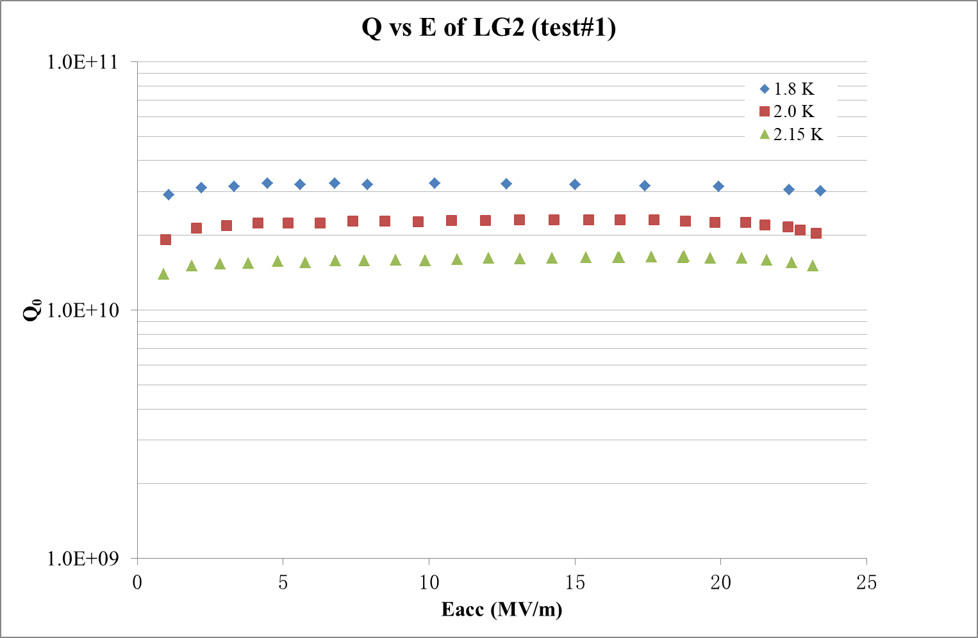
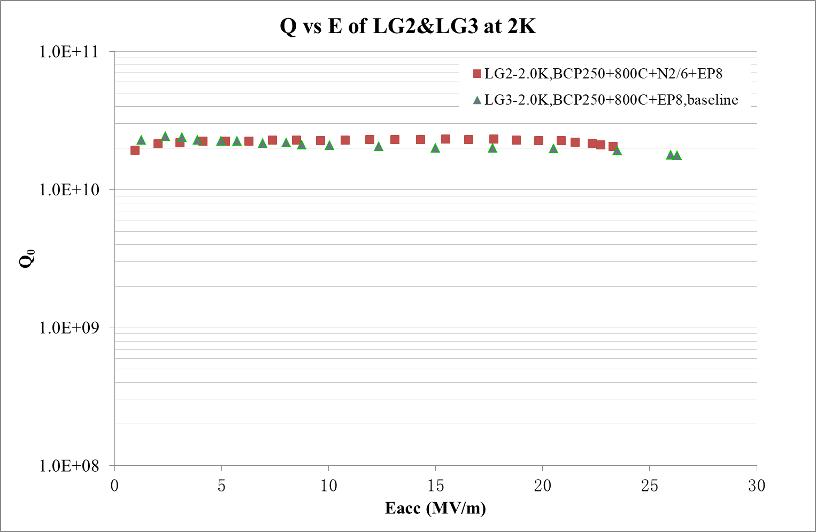
N-doping researches with single cell cavities
Light doping with large grain cavity LG2
BCP 250 μm + HPR
800°C 3 h
N-doping at 2.7-4.0 Pa for 2 min
Annealing 6 min
EP 6 μm, ethanol rinsing and HPR
Vertical test
  Eacc: 23.4 MV/m
  2.3×10¹⁰ @ 20 MV/m, 2K
  3.1×10¹⁰ @ 20 MV/m, 1.8K
Large grain cavity LG3
BCP 250μm + 800°C 3 h + EP 6μm
baseline
More work will be carried out

Slide 6
N-doping researches with single cell cavities
Heavy doping with cavity LG1
BCP 250 μm + HPR
800°C annealing 3 h
N-doping at 2.7-4.0 Pa (20-30 mTorr), 20 min
Annealing at 800°C, 30 min
Cooldown to 55°C in vacuum
EP 15 μm
Ethanol rinsing and HPR
Temperature and Pressure
Pressure in doping

Slide 7
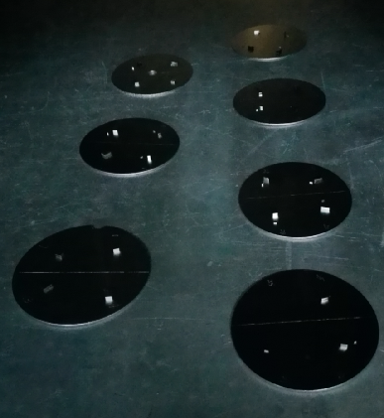
N-doping researches with single cell cavities
Nitrogen content of N-doped samples
（TOF-SIMS）
Nb samples are N-doped together with cavity
(Heavy doping, N20A30)
N contents measure by TOF-SIMS
  4 N-doped samples: EP 0, 7, 15, 25 μm
  1 non-doped sample
Samples
top1μm
different depth
EP 15 μm is enough to remove the bad NbN phase

Slide 8
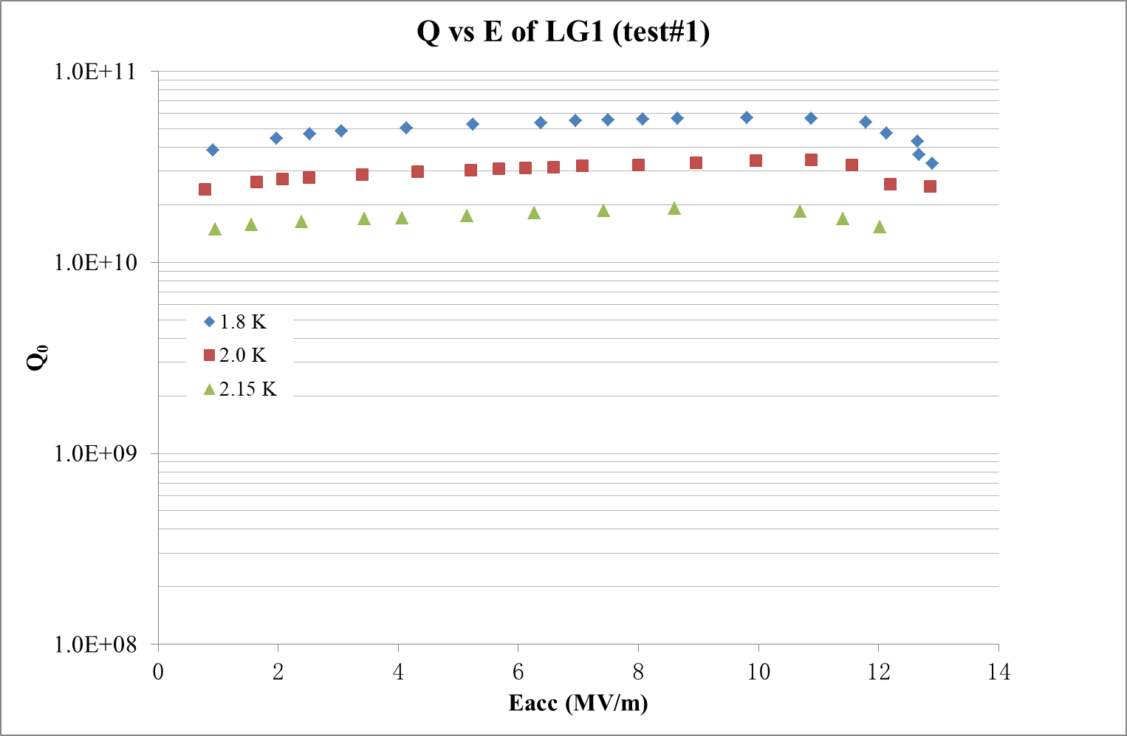
N-doping researches with single cell cavities
1st vertical test of N-doped cavity LG1
EP 15 μm
Ethanol rinsing and HPR
Vertical test
  3.4×10¹⁰ @ 11 MV/m, 2K
  5.6×10¹⁰ @ 11 MV/m, 1.8K
  Q-drop after 11 MV/m
  Minor field emission
  Q vs E at 2.15 K measured
  anti-Q-slope observed

Slide 9
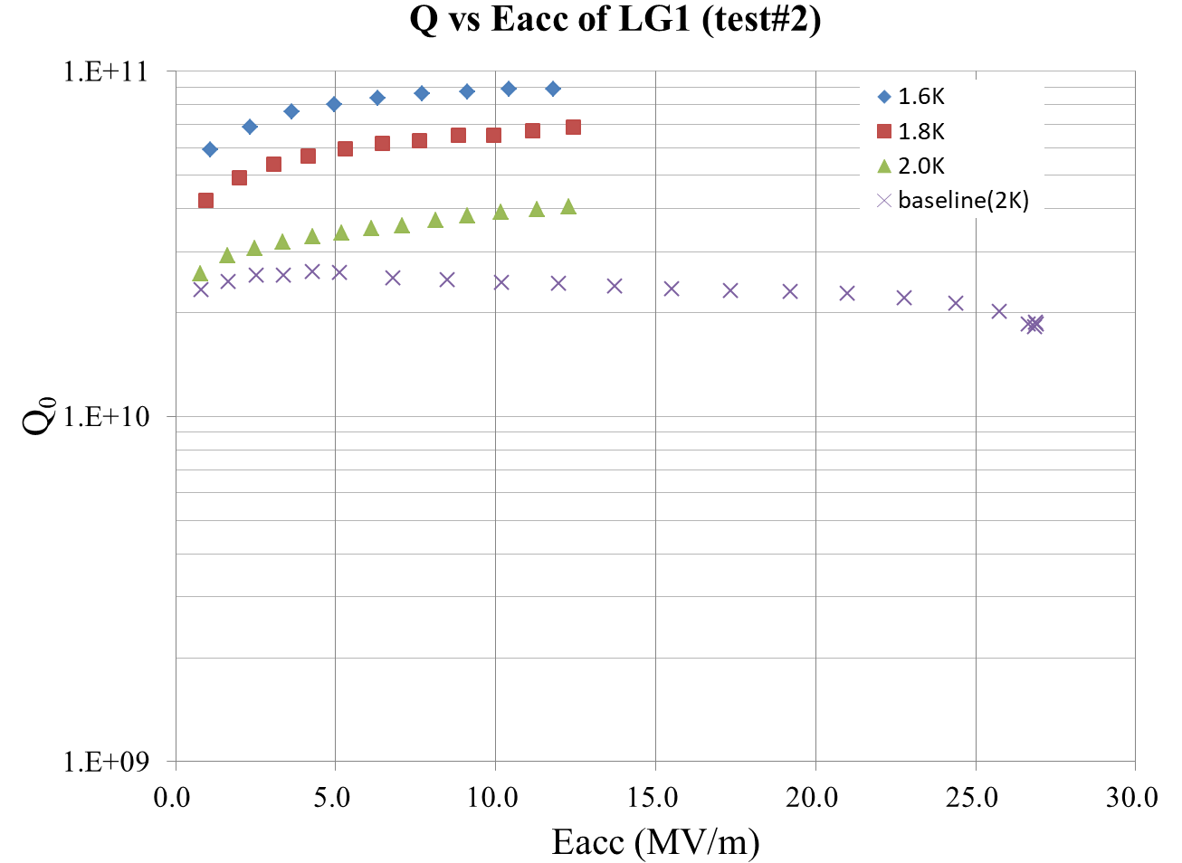
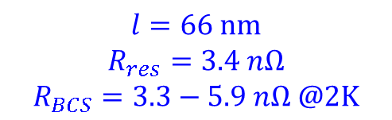
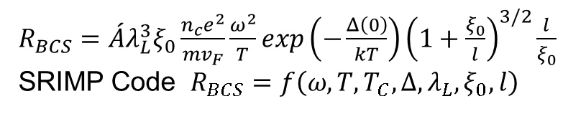
N-doping researches with single cell cavities
2nd test of LG1
Added HPR + Reassembly
4.0×10¹⁰ @ 12.3 MV/m, 2K
6.9×10¹⁰ @ 12.4 MV/m, 1.8K
Q vs E at 1.6K measured, Q₀~8.8×10¹⁰
obvious anti-Q-slope
low Eacc:
  Simple EP device
  EP parameters need to be optimized
$R_{BCS}=\acute{A}λ_{L}^{3}ξ_{0}\frac{n_{c}e^{2}}{mv_{F}}\frac{ω^{2}}{T}exp\left(−\frac{Δ\left(0\right)}{kT}\right){\left(1+\frac{ξ_{0}}{l}\right)}^{3/2}\frac{l}{ξ_{0}}$
SRIMP Code $R_{BCS}=f\left(ω,T,T_{C},Δ,λ_{L},ξ_{0},l\right)$
$$l=66 nm$$
$$R_{res}=3.4 nΩ$$
$$R_{BCS}=3.3−5.9 nΩ @2K$$

Slide 10
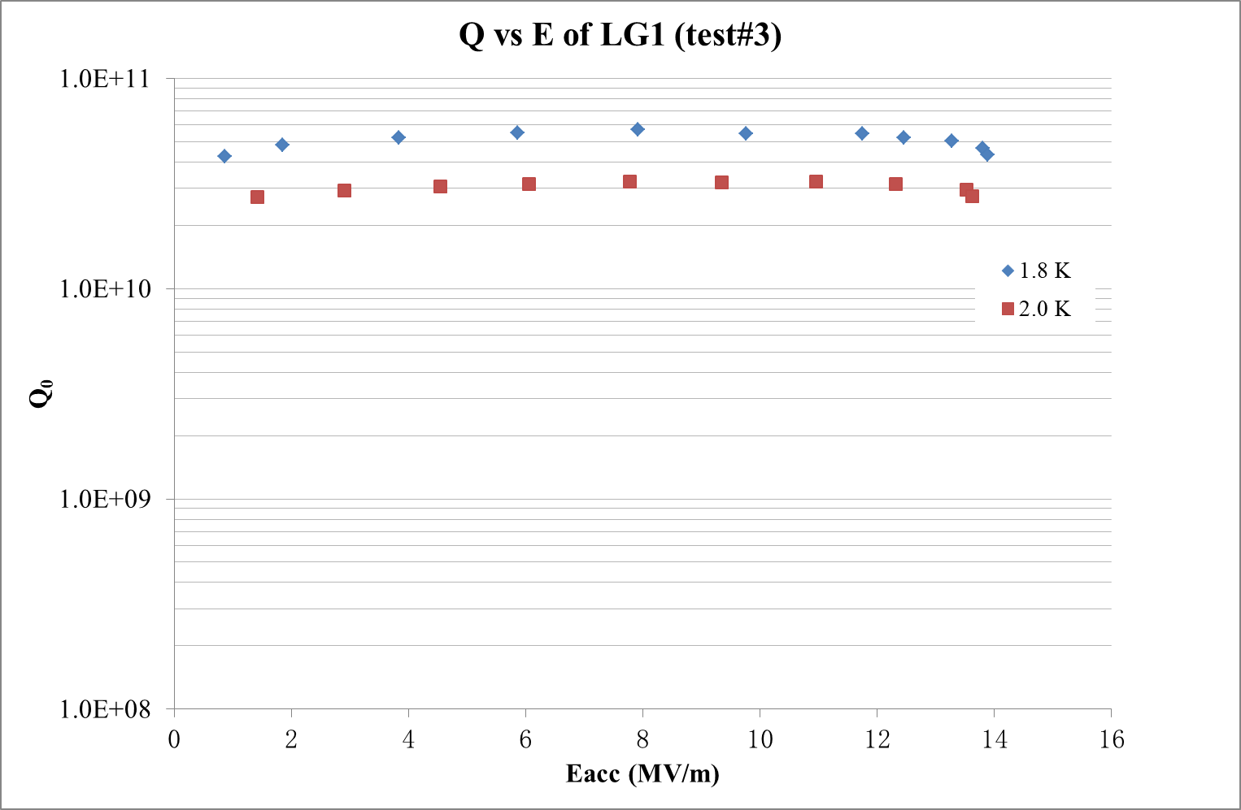
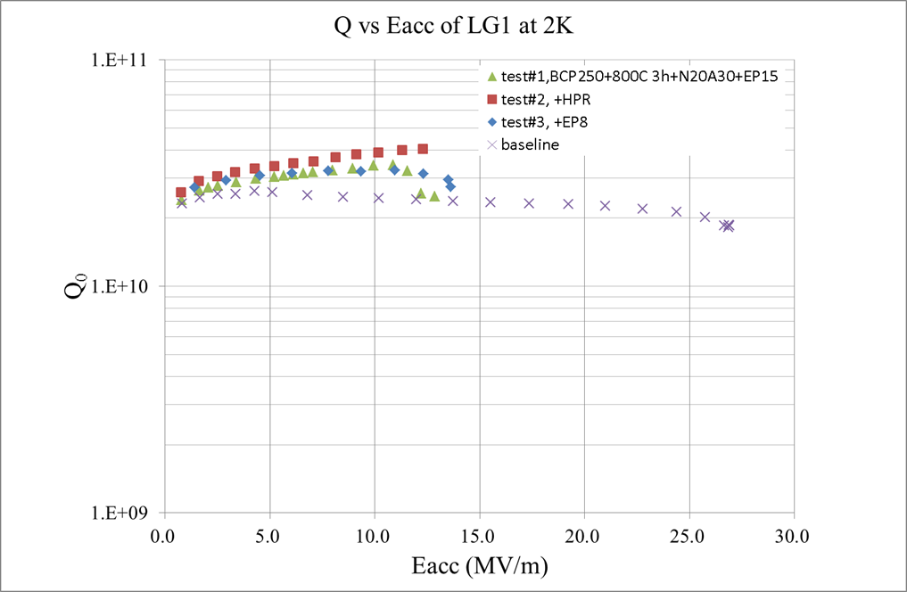
N-doping researches with single cell cavities
3rd test of LG1
+ EP 8 μm (total 23 μm after doping)
Ethanol rinsing and HPR
Q-drop after 12 MV/m ( 3.1×10¹⁰ @ 12.3 MV/m, 2K)
Eacc -> 13.8 MV/m

Slide 11
Summary
N-doping researches have been carried out with single cell large grain cavities.
With only BCP before N-doping, Q₀ of 4.0×10¹⁰ @ 12.3 MV/m @ 2K is obtained for heavy doping N20/A30.
Effect of light doping is not obvious. Improvement of Q is obvious for heavy doping, but Eacc is influenced.
More researches on N-doping and EP will be carried out.
Thank you for your attention！

