Slide 1
N-doping study at KEK
Temperature dependence of Nitrogen doping effects
Takafumi Okada (SOKENDAI),
Kensei Umemori, Yoichiro Hori, Eiji Kako, Taro Konomi, Hiroshi Sakai, Takeshi Dohmae (KEK),
Jyunichiro Kamiya, Shunta Kurosawa, Kenichi Takeishi (JAEA)
TTC meeting at RIKEN 2018/June/27

Slide 2
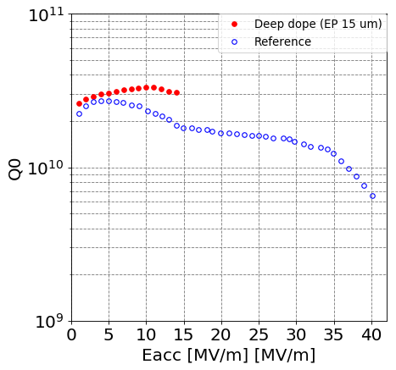
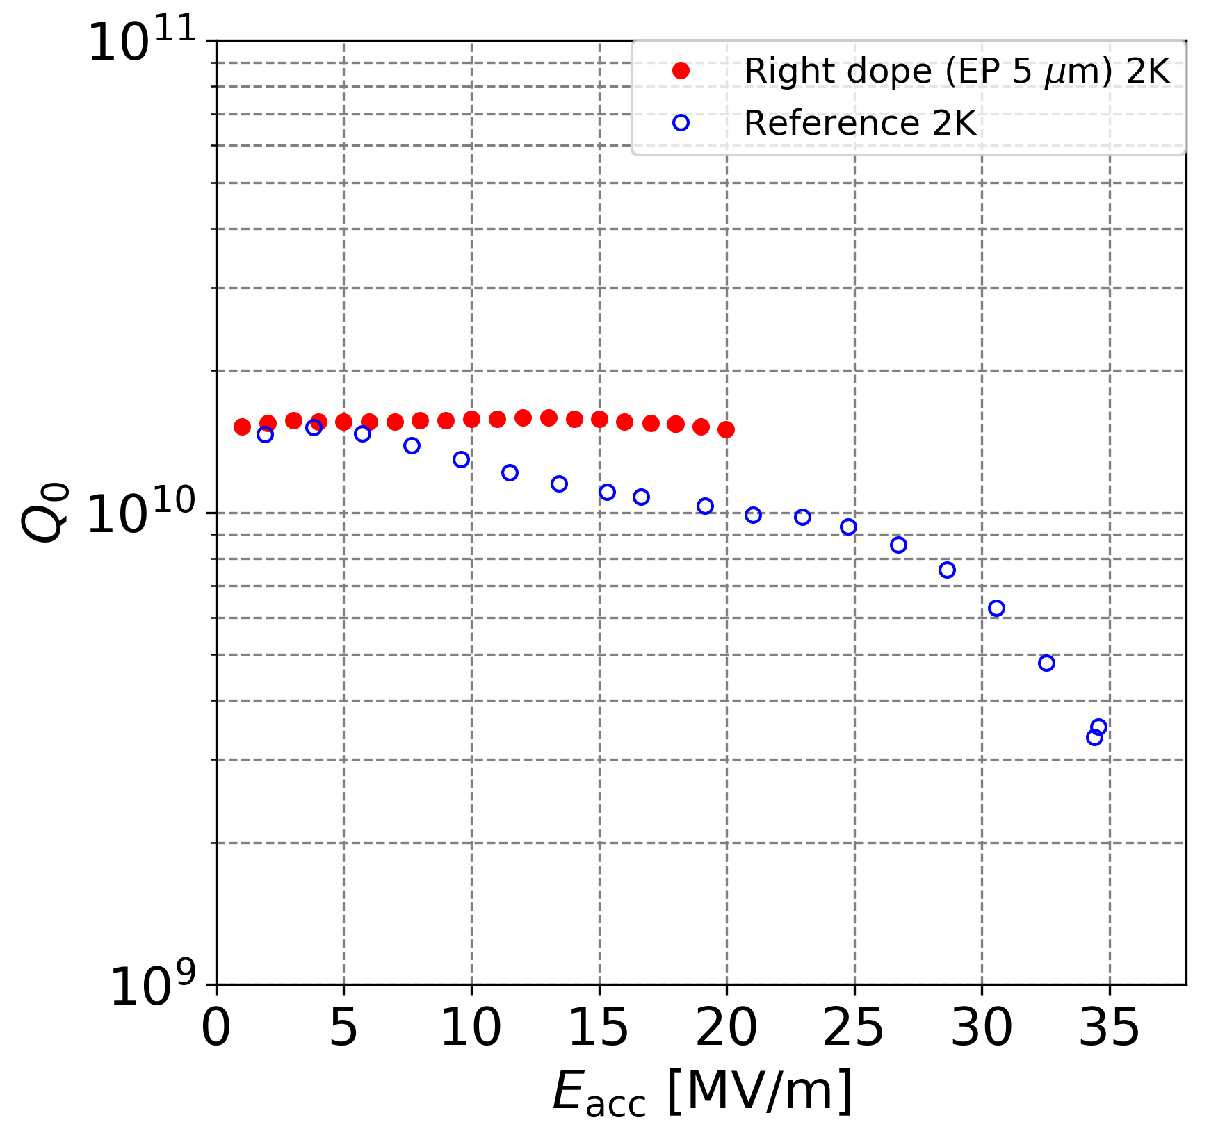
Motivation
Nitrogen doping improve the Q value of the SRF cavity.
At KEK, Nitrogen doping for 1.3 GHz single-cell and 3-cell cavities at J-PARC furnace is success.
We focus on
effects of Nitrogen doping
at other Temperature.
Deep doping for SIngle-cell cavity
1.5 times Q₀ at 14 MV/m, 2K
Light doping for 3-cell cavity
1.5 times Q₀ at 20 MV/m, 2K

Slide 3
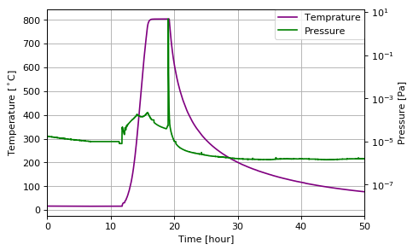
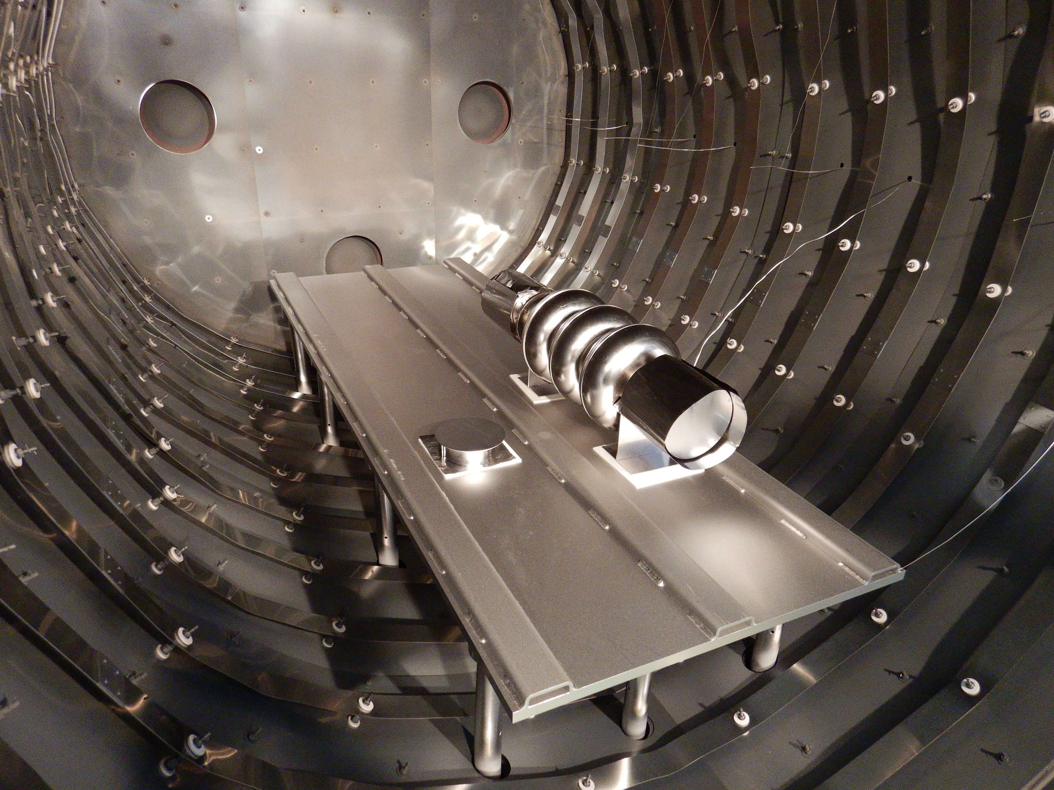
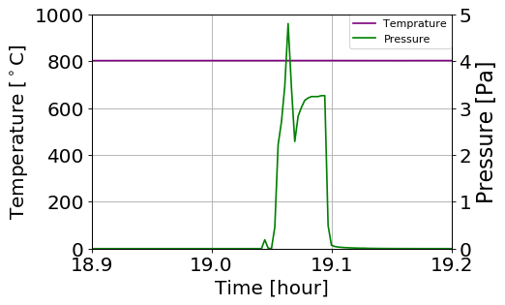
Nitrogen doping at KEK using furnace in J-PARC
Using oil-free furnace at J-PARC (cryo-pump and three TMP. ~1×10⁻⁶ Pa)
N doping for single cell and 3-cell Nb cavities.
  Single cell (deep N-dope) :
    800℃ 20 min with Nitrogen 2.7 Pa,
    800℃ 30 min, 15 μm EP
  3-cell (light N-dope) :
    800℃ 2 min with Nitrogen 3.3 Pa,
    800℃ 6 min, 5 μm EP

Slide 4
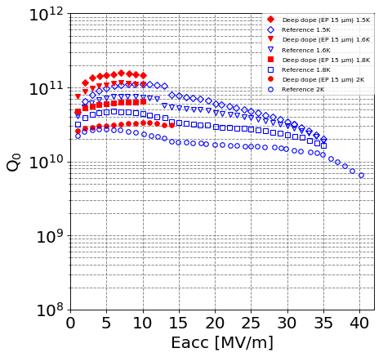
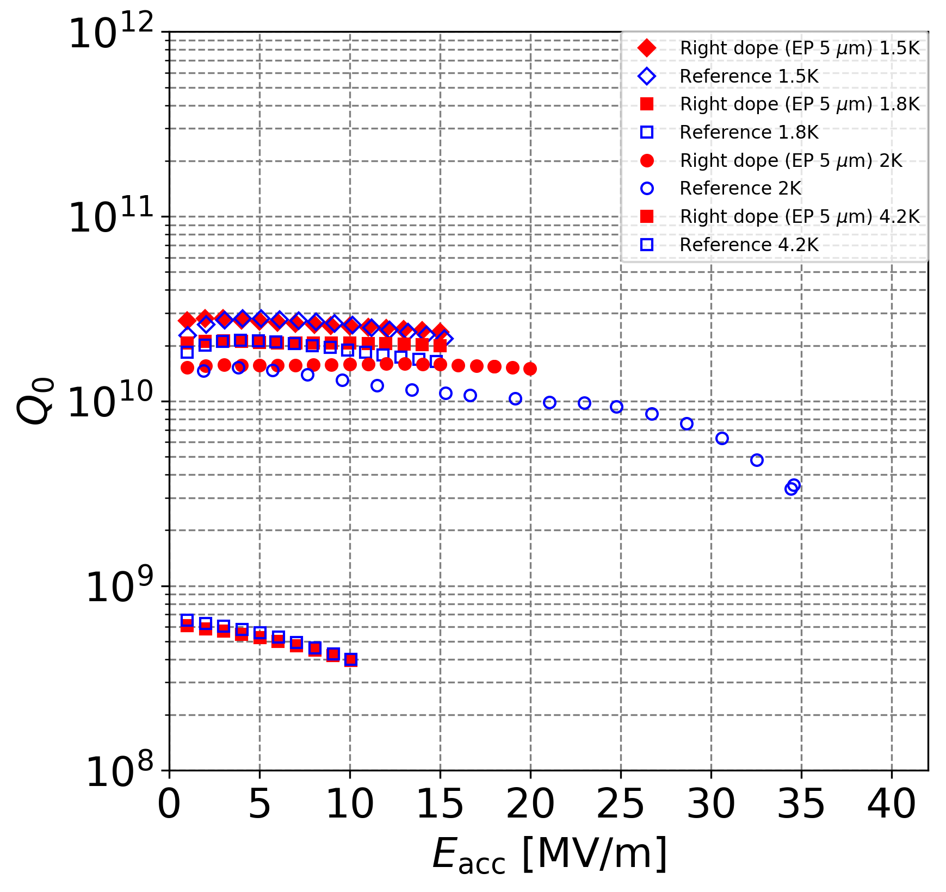
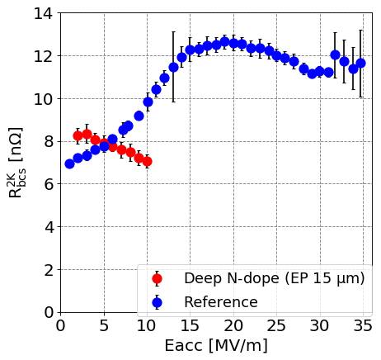
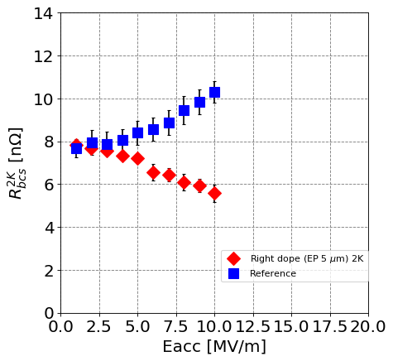
Test result of cavity performance
Deep doping for single-cell cavity
Light doping for 3-cell cavity
VT1, VT3
1.5K
1.6K
1.8K
1.5K
1.8K
2.0K
2.0K
BCS resistance
BCS resistance
4.2K
Cavity performance improve at under 2K.
However, unchanged Q₀ value for 3-cell results at 4.2K.

Slide 5
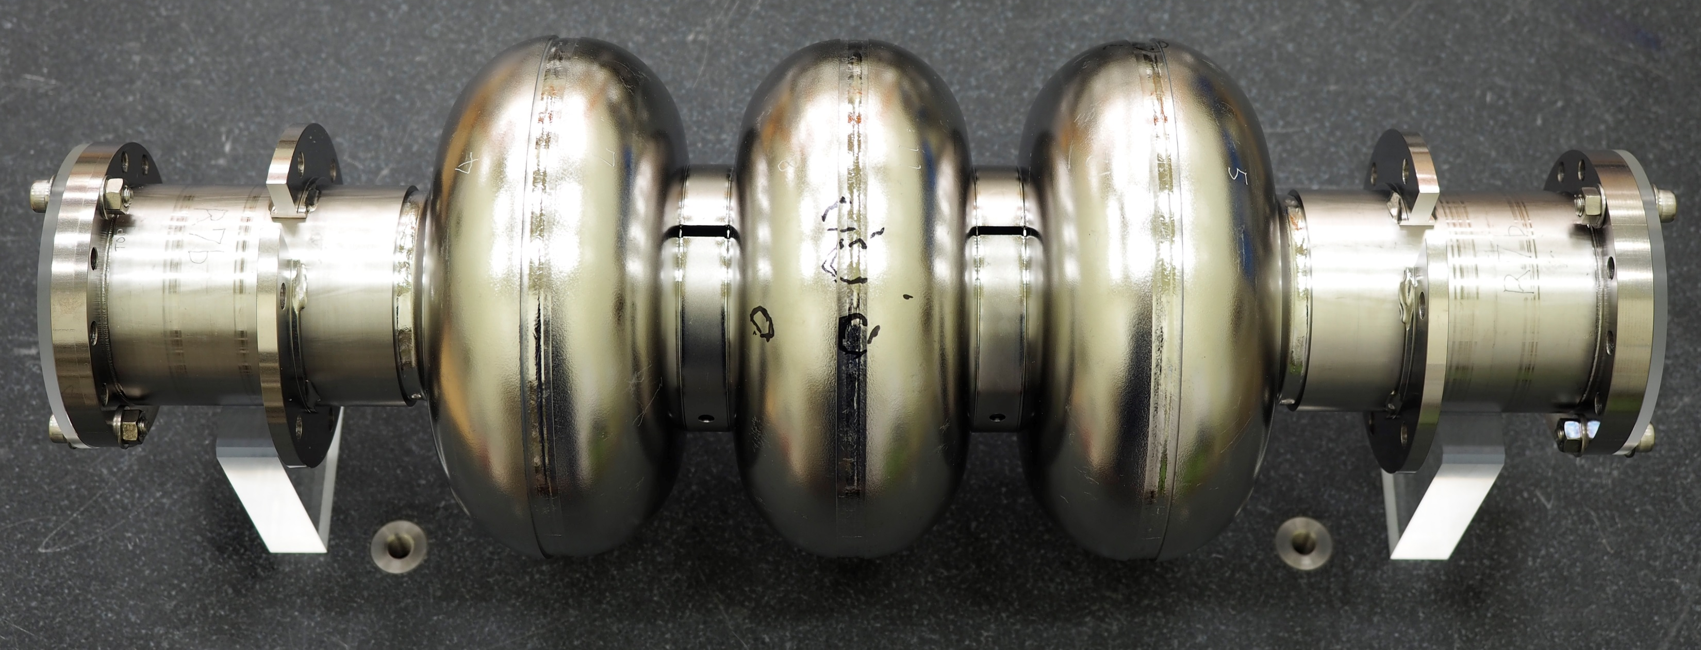
3-cell cavity parameter
We investigated the temperature dependence of the Nitrogen doping effect using 3-cell cavity
Tesla-like shape
Cell material is Nb from CBMM, high Ta, with 2 times melted (RRR 250-300)
Beam tube material is CBMM Nb without melting process
For 120℃ baking, EP 50 μm,
limited Eacc = 35 MV/m
VT1:Refence test limited Eacc = 35 MV/m
VT2, VT3:N-doping without magnetic field cancelling
VT4:Canceled magnetic field, with thermal gradient

Slide 6
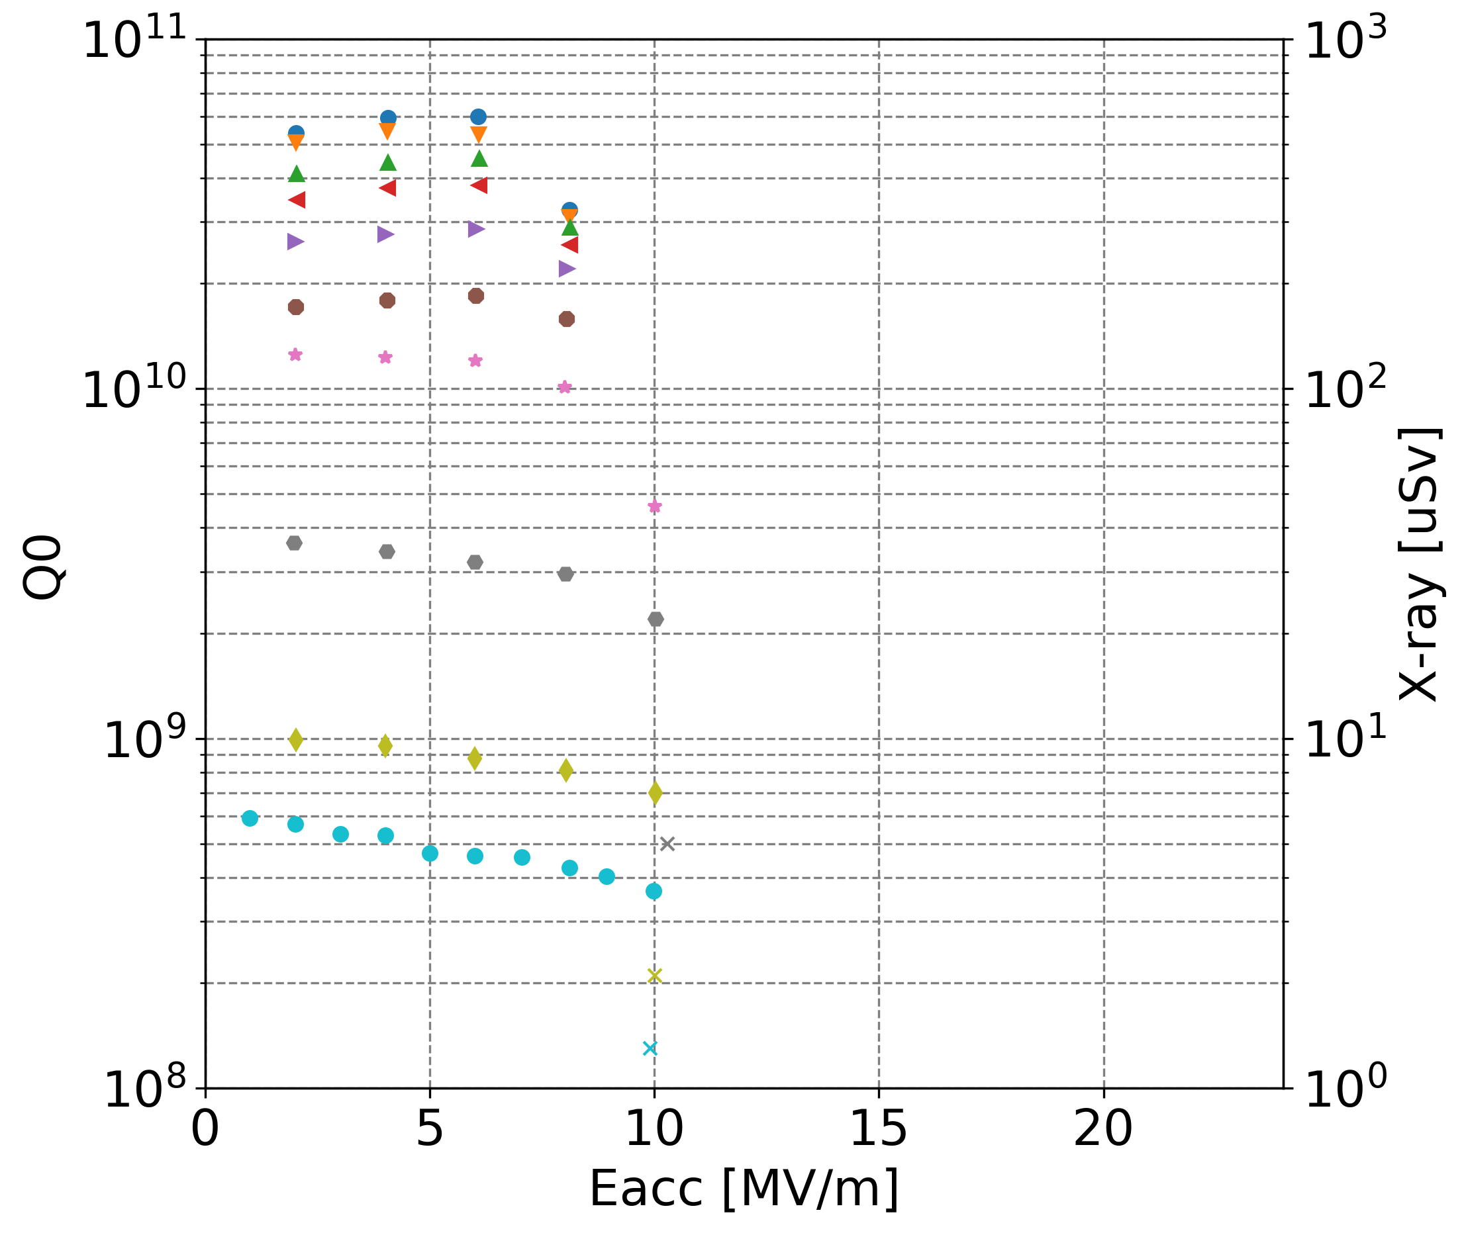
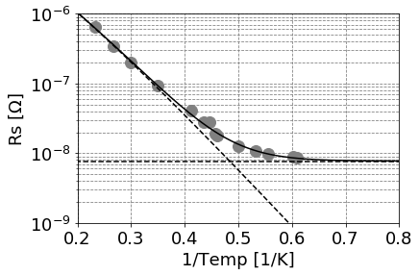
Test result of cavity performance at various Temperature
We tested 3-cell cavity performance at each temperature.
  Input coupler is variable
  Cancel magnetic field by solenoid coil
  Cooling with thermal gradient by heater
The Q₀ factor decrease with gradient at temperature from 4.2K to about 2.3K.
The BCS resistance obtained by Resistance-Temp fitting curve
1.5K
VT4
1.6K
1.7K
1.8K
1.9K
2.0K
2.3K
2.8K
3.6K
4.2K
Field emission

Slide 7
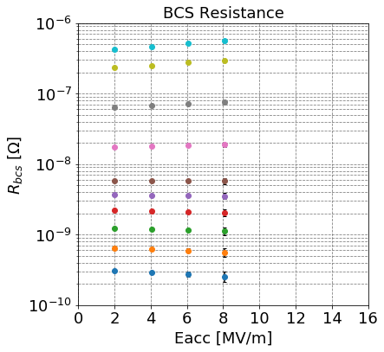
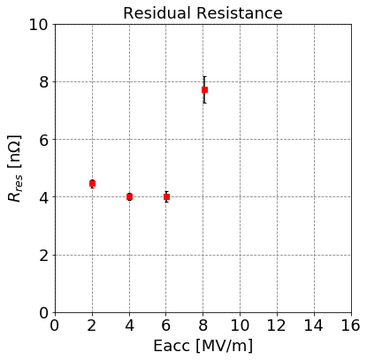

BCS resistance at various Temperature
Calculate the BCS resistance from
$$\frac{A}{T}e^{−\frac{B}{T}}+const.$$
The BCS resistance decrease with gradient at Temperature until about $λ$ point.
4.2K
3.6K
2.8K
preliminary
2.3K
2.0K
1.9K
1.8K
1.7K
1.6K
Anti Q-slope
1.5K

Slide 8
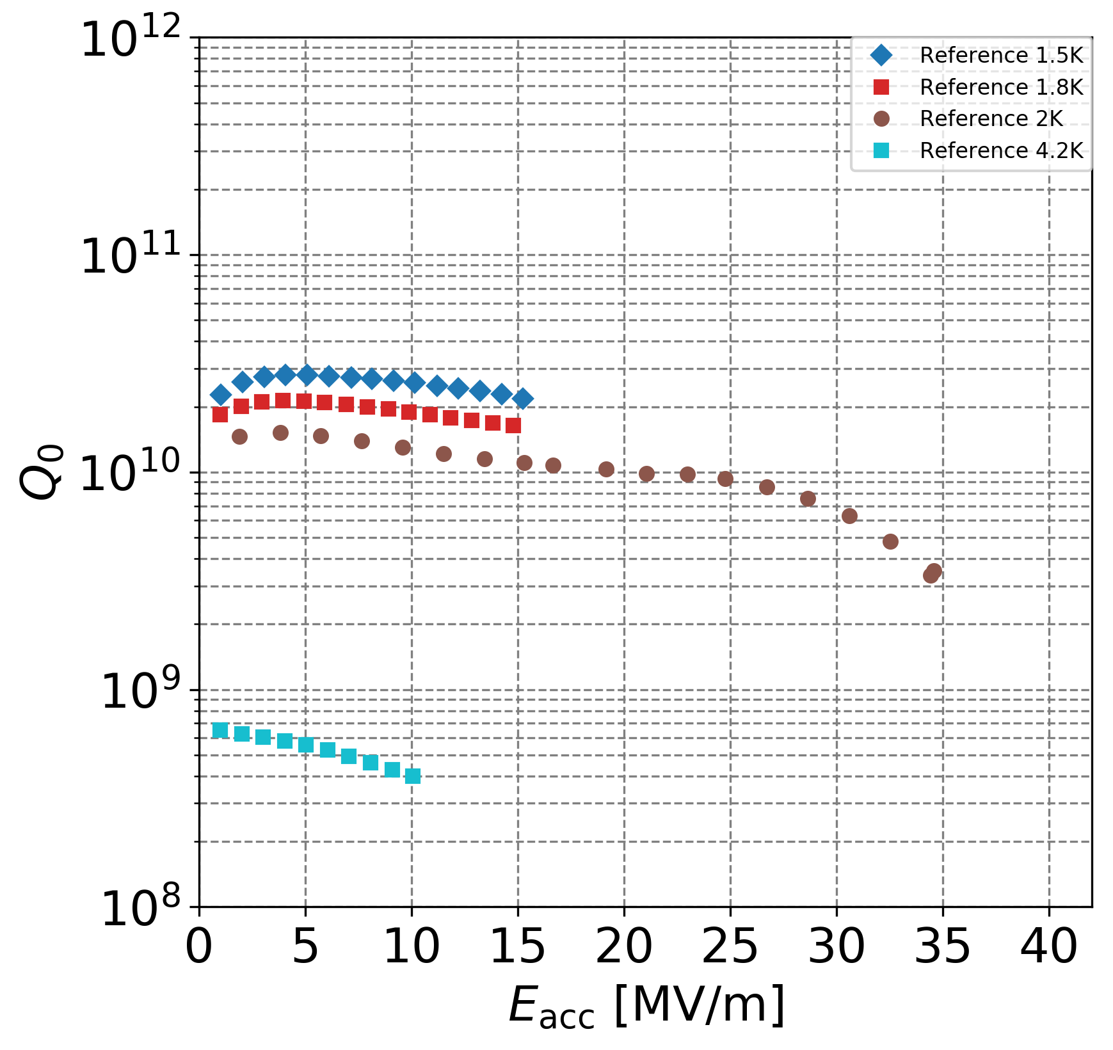
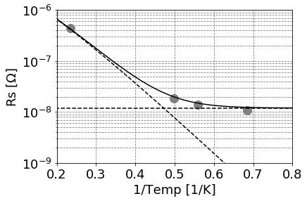
BCS resistance before Nitrogen doping
Before Nitrogen doping (Standard recipe)
We measured Q₀ data at only 4.2K, 2.0K, 1.8K, 1.5K
The BCS resistance at 4.2K to 1.5K calculate by fitting function
VT1
1.5K
1.8K
2.0K
4.2K

Slide 9
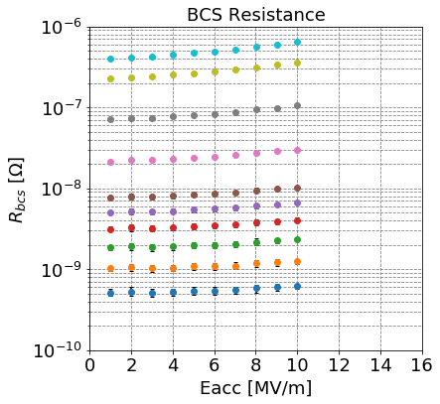
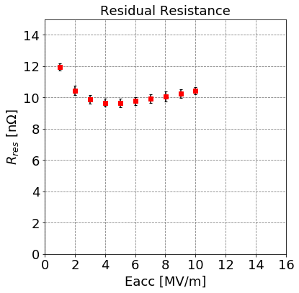
BCS resistance before Nitrogen doping
Before Nitrogen doping (Standard recipe)
We measured Q₀ data at only 4.2K, 2.0K, 1.8K, 1.5K
The BCS resistance at 4.2K to 1.5K calculate by fitting function
The decrease of BCS resistance was not observed.
4.2K
3.6K
2.8K
preliminary
2.3K
2.0K
1.9K
1.8K
1.7K
1.6K
1.5K

Slide 10
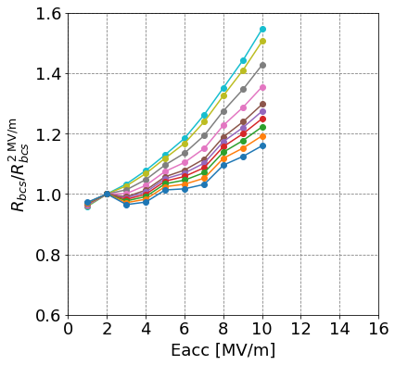
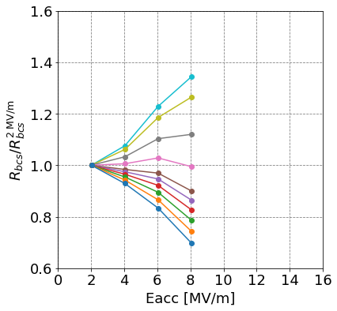
Temperature depence of BCS resistance
Normalized the BCS resistance by value at 2 MV/m
Before doping
Light doping for 3-cell cavity
4.2K
3.6K
2.8K
preliminary
preliminary
2.3K
2.0K
1.8K
1.9K
1.7K
1.6K
1.5K
The sign of slope is always positive
The sign of slope is negative under 2K

Slide 11
Summary
KEK studied Nitrogen doping for 1.3 GHz single-cell and 1.3 GHz 3-cell cavities using J-PARC furnace.
    The single-cell for deep doping, The 3-cell for light doping
Both cavities improved Q-factor at 2K. The BCS resistance decreasing with accelerating field
The effect of Nitrogen doping was not observed at 4.2K
The effect of Nitrogen doping to BCS resistance increase with decreasing temperature
Questions
Why is the Nitrogen doping effective at temperature under 2K?
Is it correct that nitrogen doping is not effective at 4.2K?
What is the behind physics of temperature dependence of Nitrogen doping?

Slide 12
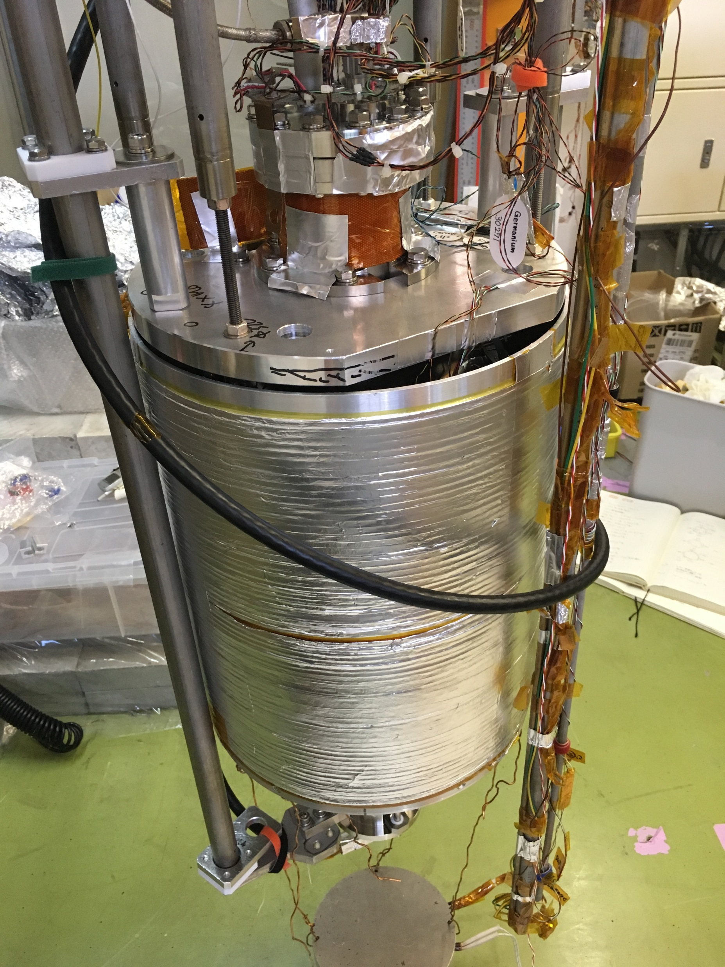
Cavity performance tests set up
Single-cell (long N-dope)
 | EP | Cancelling magnetic fied | Cooling with thermal gradient
First Vertical test | 15 μm | ○ | ○
Second vertical test | +10 μm (total 25 μm) | ○ | ○
3-cell (short N-dope)
 | EP | Cancelling magnetic fied | Cooling with thermal gradient
First Vertical test | 5 μm | × | ○
Second vertical test | 0 μm (total 5 μm) | × | ×
Third vertical test | 0 μm (total 5 μm) | ○ | ○
Reduced magnetic field using solenoid coil
Cooling with thermal gradient using heater on upper beam pipe
Heater
Solenoid coil

Slide 13
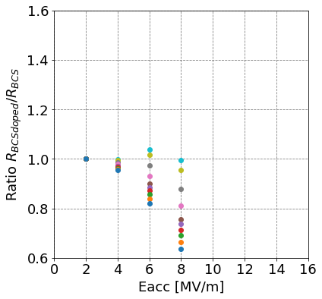
Temperature depence of BCS resistance
Normalized the BCS resistance by value at 2 MV/m
Ratio between Normalized the BCS resistance of N doped cavity and Normalized the BCS resistance of standard recipe cavity
preliminary
4.2K
3.6K
2.8K
2.3K
2.0K
1.9K
1.8K
1.5K
1.7K
1.6K

Slide 14
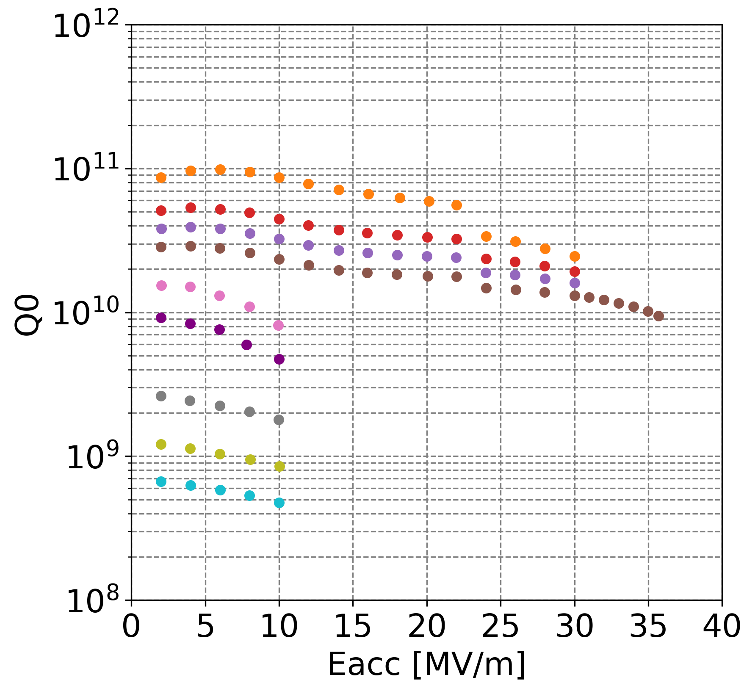
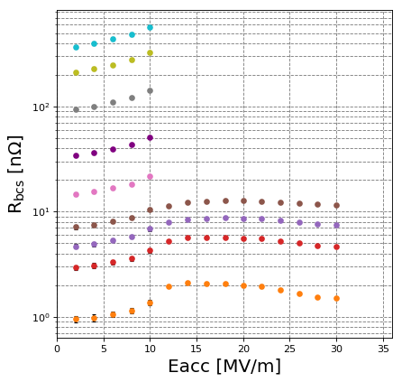
Temperature depence of BCS resistance for Nitrogen infusion
4.2K
3.6K
1.6K
3.0K
1.8K
2.5K
1.9K
2.2K
2.2K
2.0K
preliminary
2.5K
2.0K
1.9K
3.0K
1.8K
3.6K
4.2K
1.6K

Slide 15
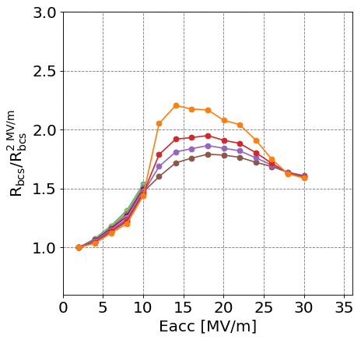
Temperature depence of BCS resistance for Nitrogen infusion
4.2K
3.6K
3.0K
2.5K
2.2K
preliminary
preliminary
2.0K
1.9K
1.8K
1.6K

Slide 16
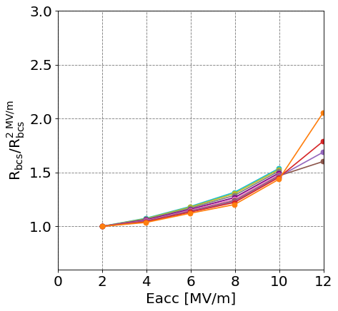
Temperature depence of BCS resistance for Nitrogen infusion
4.2K
3.6K
3.0K
2.5K
2.2K
preliminary
preliminary
2.0K
1.9K
1.8K
1.6K

Slide 17
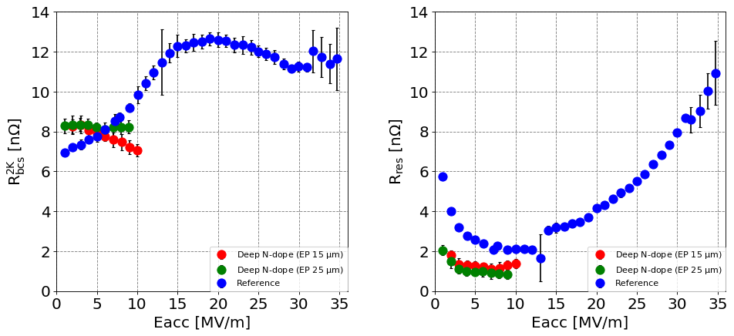
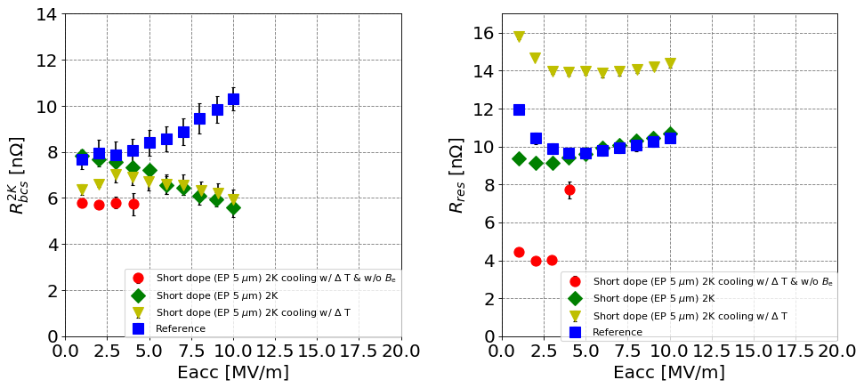
BCS resistance and Residual resistance at 2K
Single-cell (deep N-dope)
The BCS resistance decreasing with gradient
Reduced the residual resistance
3-cell (short N-dope)
The BCS resistance decreasing with gradient
Reduced the residual resistance
The BCS resistance of both cavities
decreasing with gradient (Anti Q-slope) at 2K

Slide 18
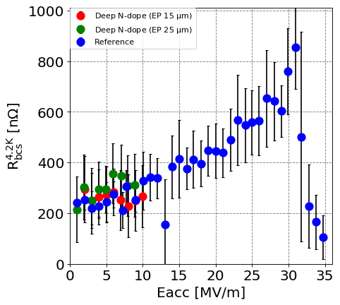
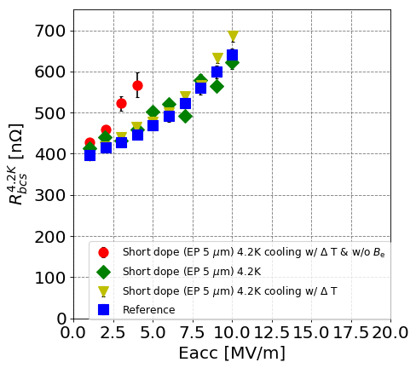
BCS resistance at 4.2K
Single-cell (deep N-dope)
3-cell (short N-dope)
Not decreasing BCS resistance with gradient (Anti Q-slope) at 4.2K

