Slide 1
Nb₃Sn Results from FNAL
Sam Posen, FNAL Nb₃Sn SRF Team
TTC Workshop Riken
27 June 2018
RIKEN Nishina Center, Saitama, Japan

Slide 2
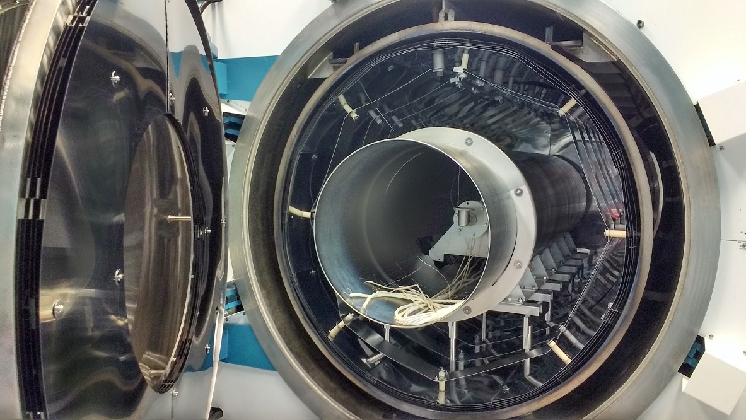
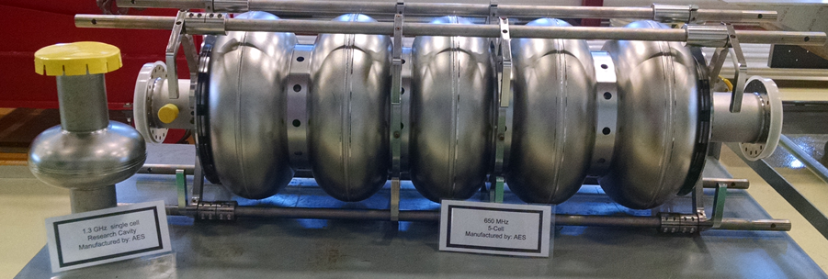
Nb₃Sn SRF Experimental Program at Fermilab
Goals: 1) further improvement to Q₀ and E_{acc} 2) scale up to production-style cavities
Large Nb₃Sn SRF coating apparatus commissioned
First samples coated Jan 30, 2017
1.3 GHz 1-cell (current state of Nb₃Sn R&D)
650 MHz 5-cell (future)
New Nb chamber, 20”diam, 82” long
New door and heat shields
Existing vacuum furnace

Slide 3
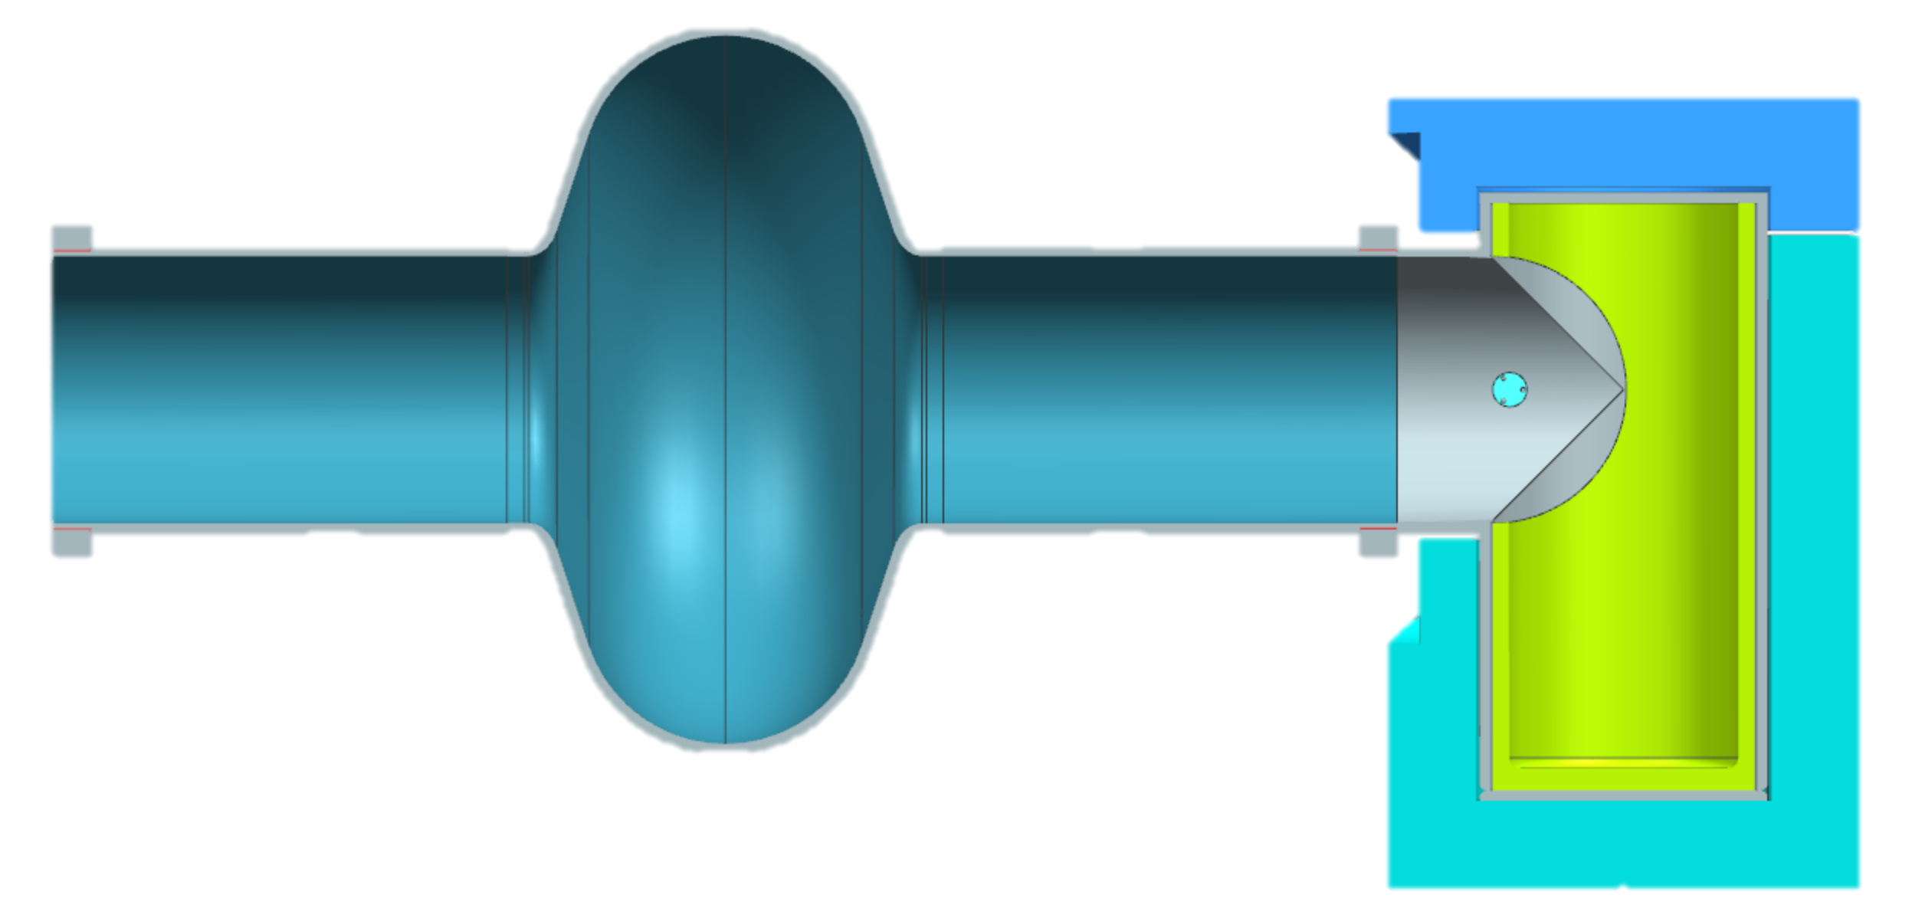
Coating Mechanism: Vapor Diffusion
By independently controlling Sn vapor abundance, it can balanced with Sn diffusion rate to achieve desired stoichiometry
Sn vapor arrives at surface
T_{f} = furnace temperature
=~1100 C
Nb
T_{s} = Sn source temperature
=~1200 C
Sn diffusion
Nb cavity substrate
Sn
Nb₃Sn
Sn Vapor
UHV furnace
Heater
Technique development: Saur and Wurm, Die Naturwissenchaften 1962, Hillenbrand et al. IEEE Transactions on Magnetics 1977, Peiniger et al, SRF’88.
3

Slide 4
Cavity Coatings

Slide 5
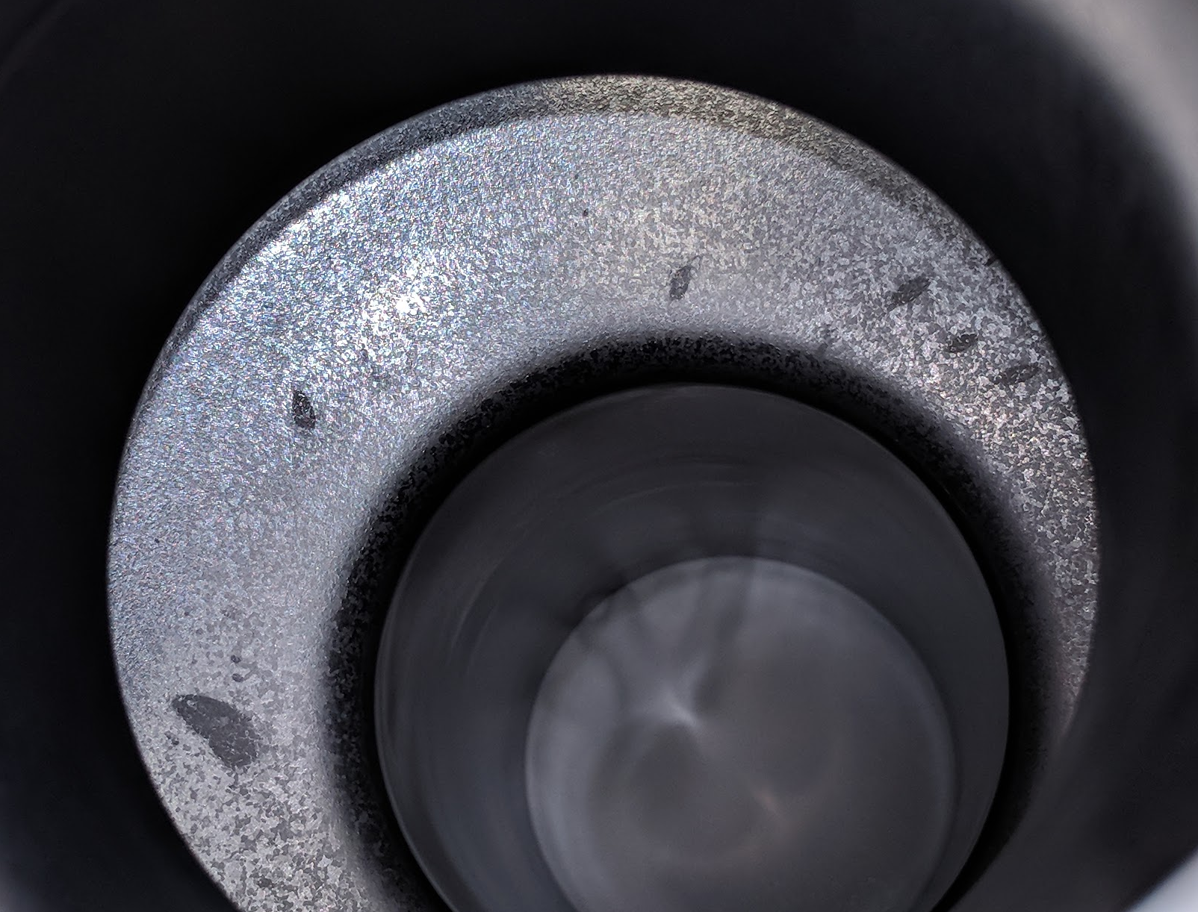
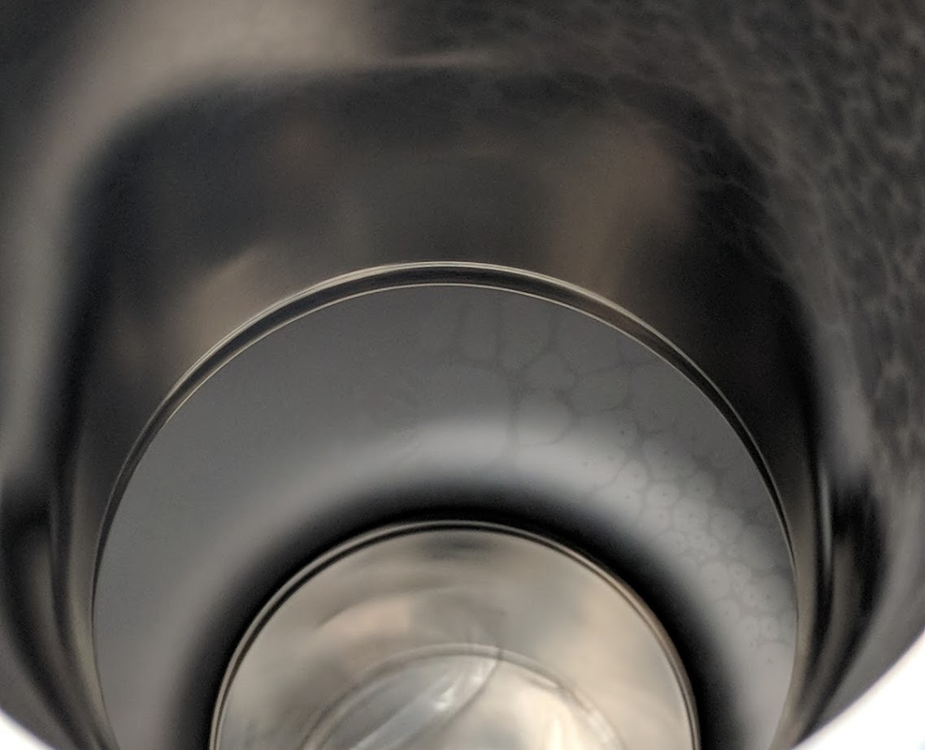
Recipe Development
0.4 g tin evaporated
1.5 g tin evaporated
Apparent Residual tin
Apparent thin or uncoated areas
Appearance appears to correlate with performance
Several parameters found to be important:
Crucible diameter
Heater power
Coating time
Annealing time

Slide 6
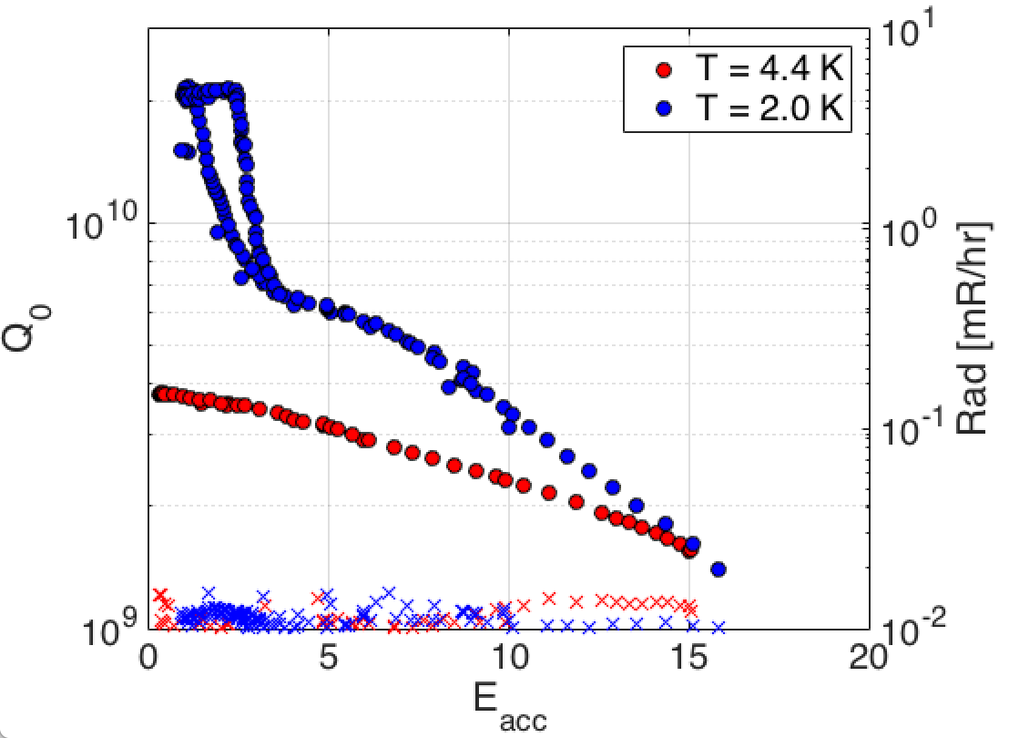
Recipe Development
0.4 g tin evaporated
1.5 g tin evaporated
Apparent Residual tin
Apparent thin or uncoated areas
For residual tin:
T_{c} ~ 3.7 K
H_{c} ~ 0.03 T

Slide 7
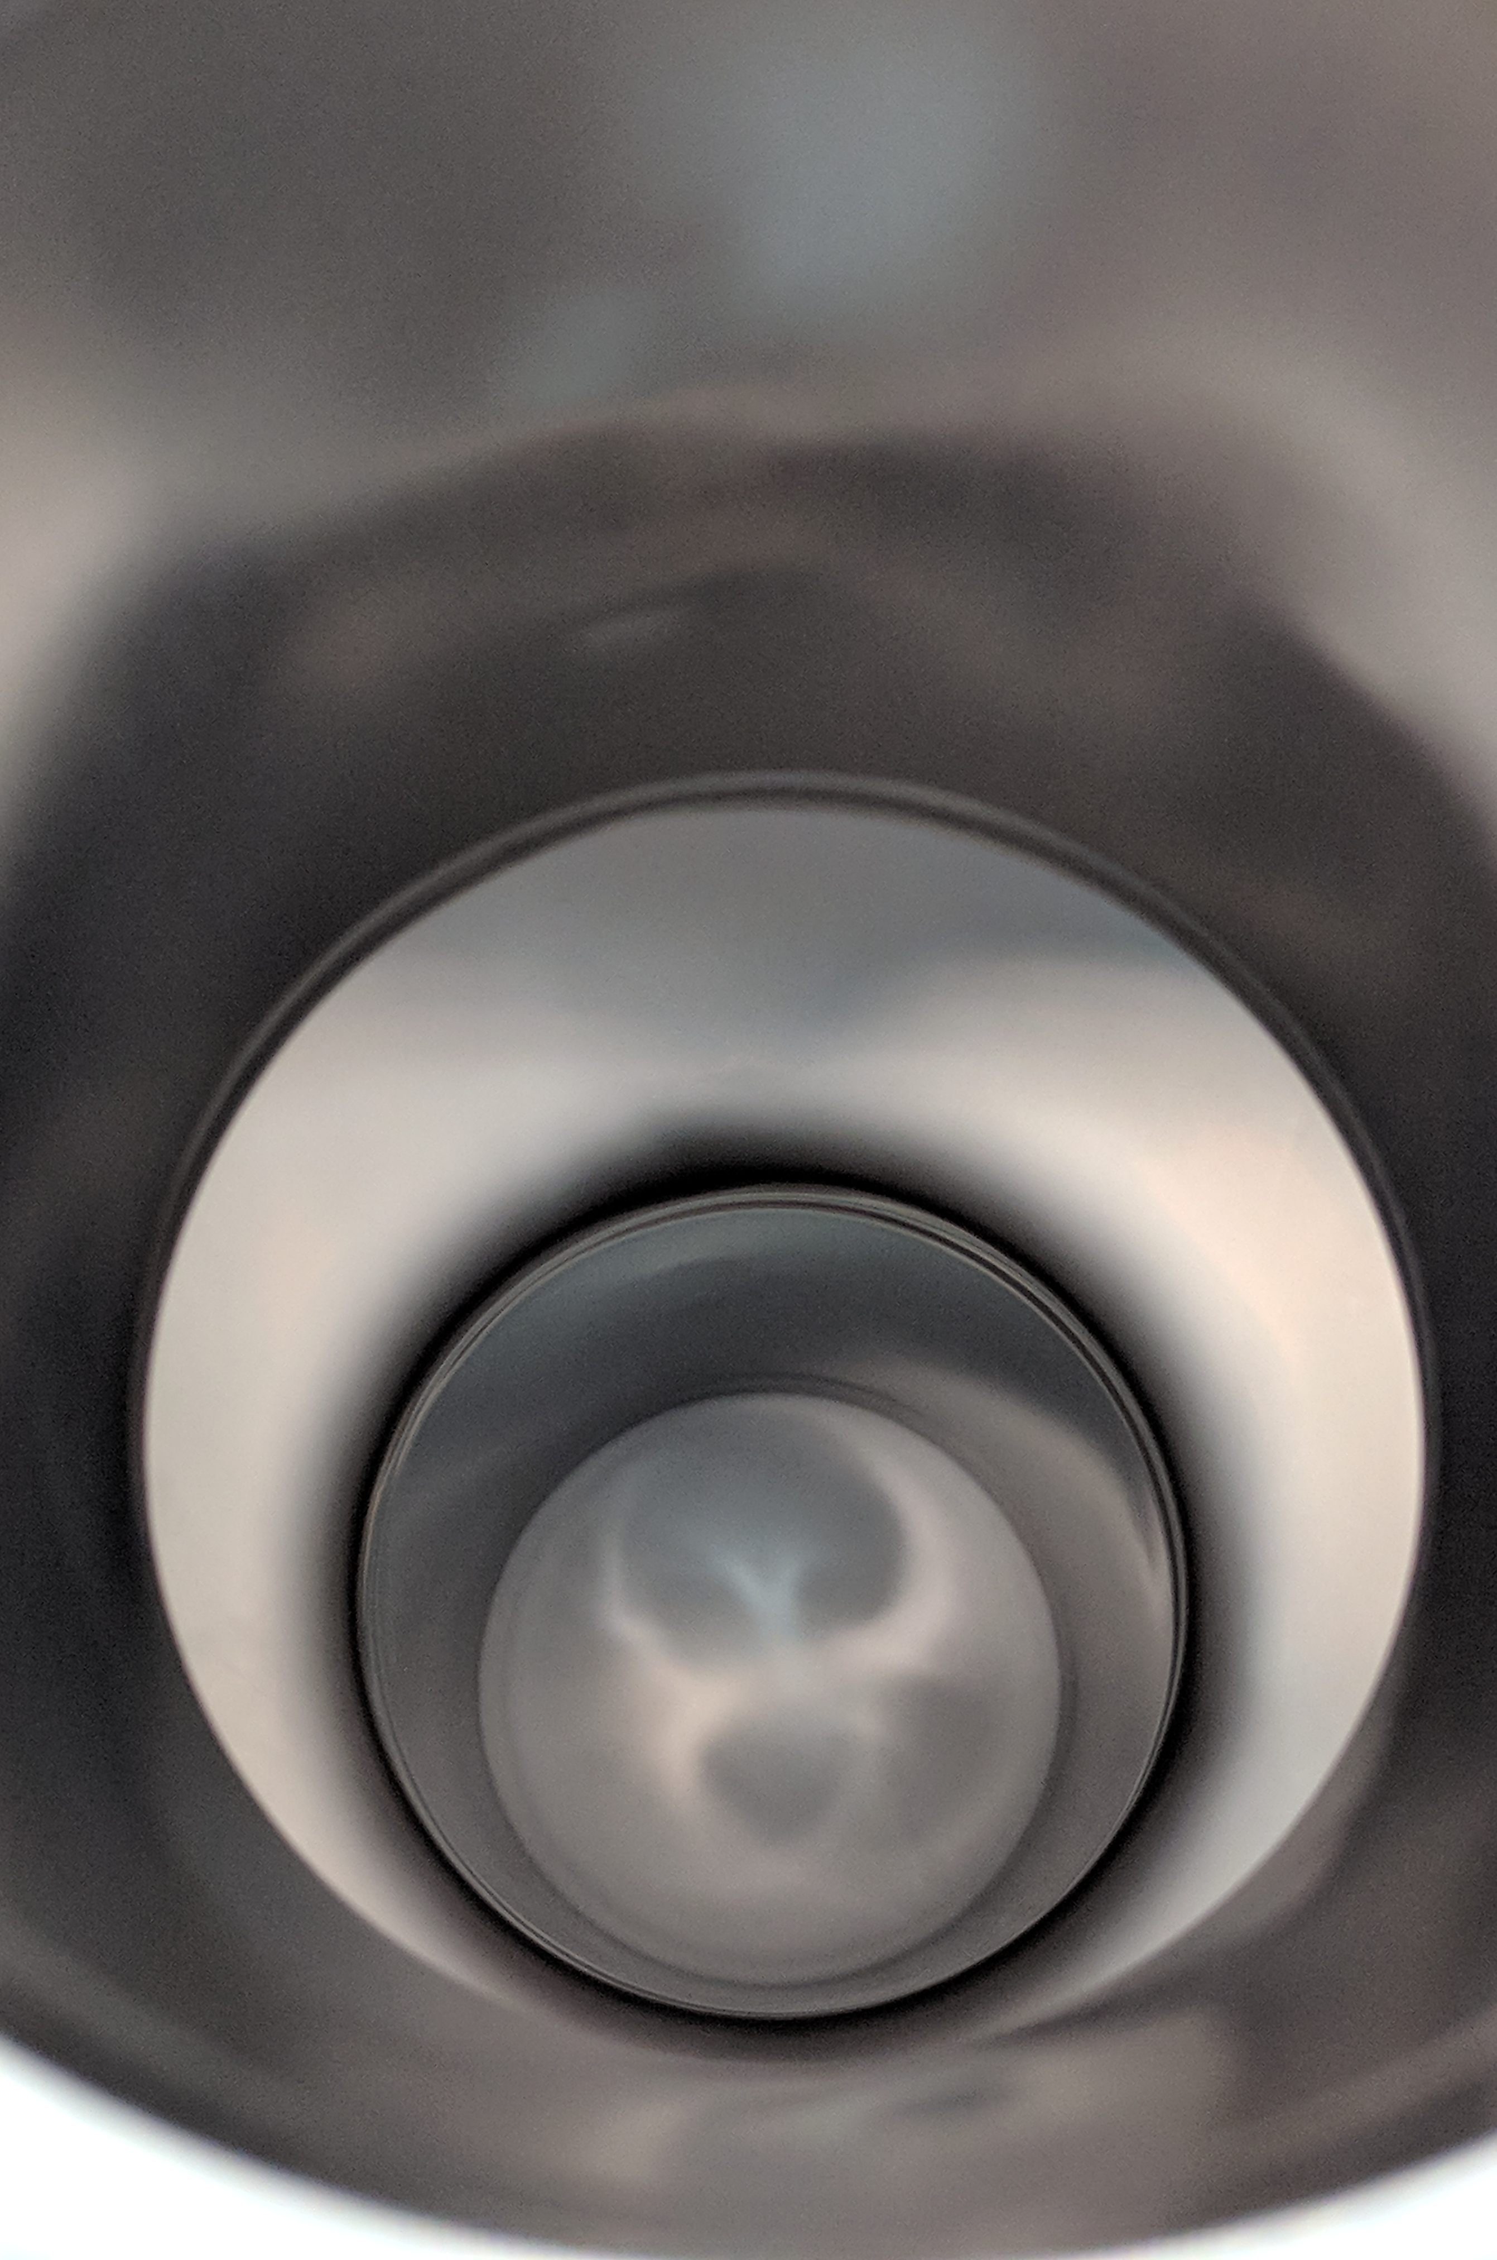
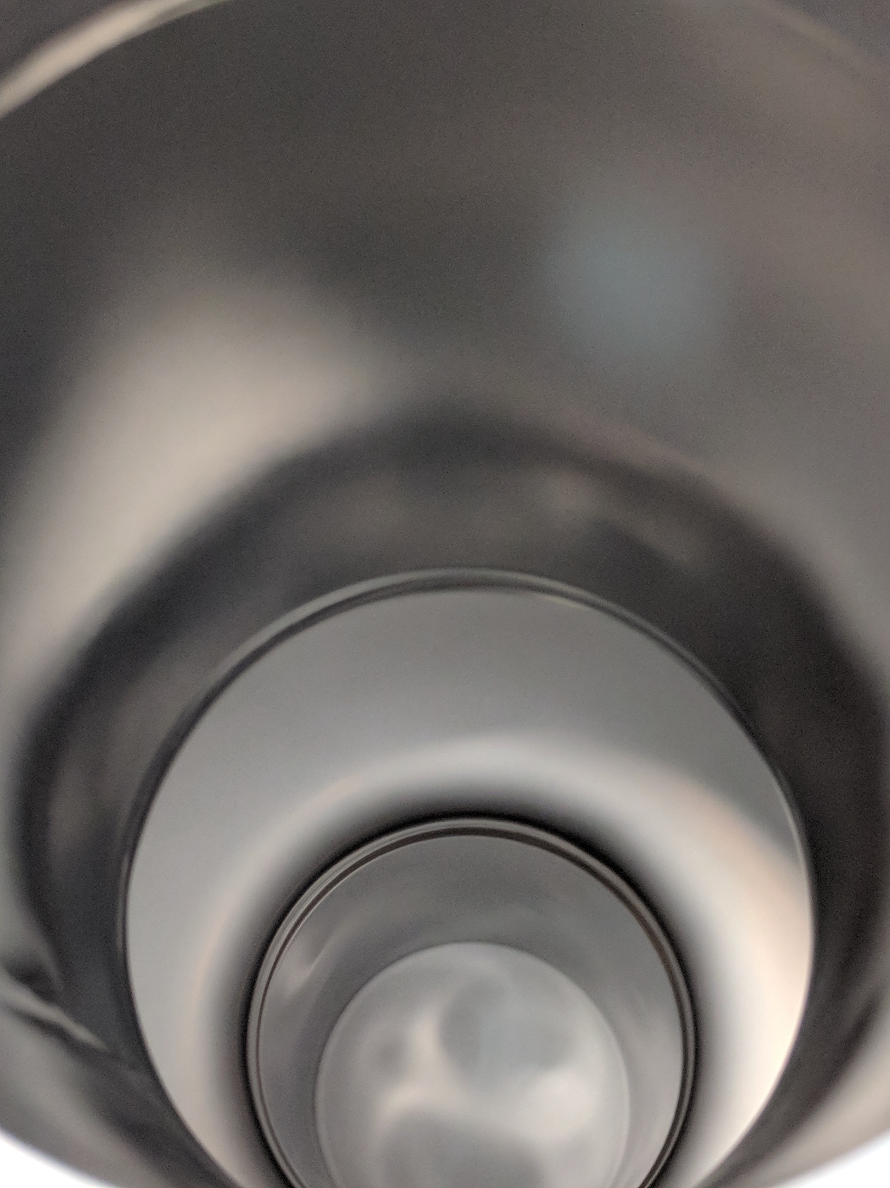
0.7 g tin evaporated

Slide 8
Recipe Development
To date, best appearance and performance at Fermilab achieved with:
Smallest diameter crucible tested
Heater at maximum power (crucible ~1200 C)
Large grain cavity anodized prior to coating (as advocated by Siemens in the 1970s and recently revived by Cornell)

Slide 9
D2 non-anodized
D3 non-anodized
Microscopy by J. Lee
Anodization helps! But “patchy” regions can persist
D1 anodized to 30 V
D6 anodized to 30 V

Slide 10
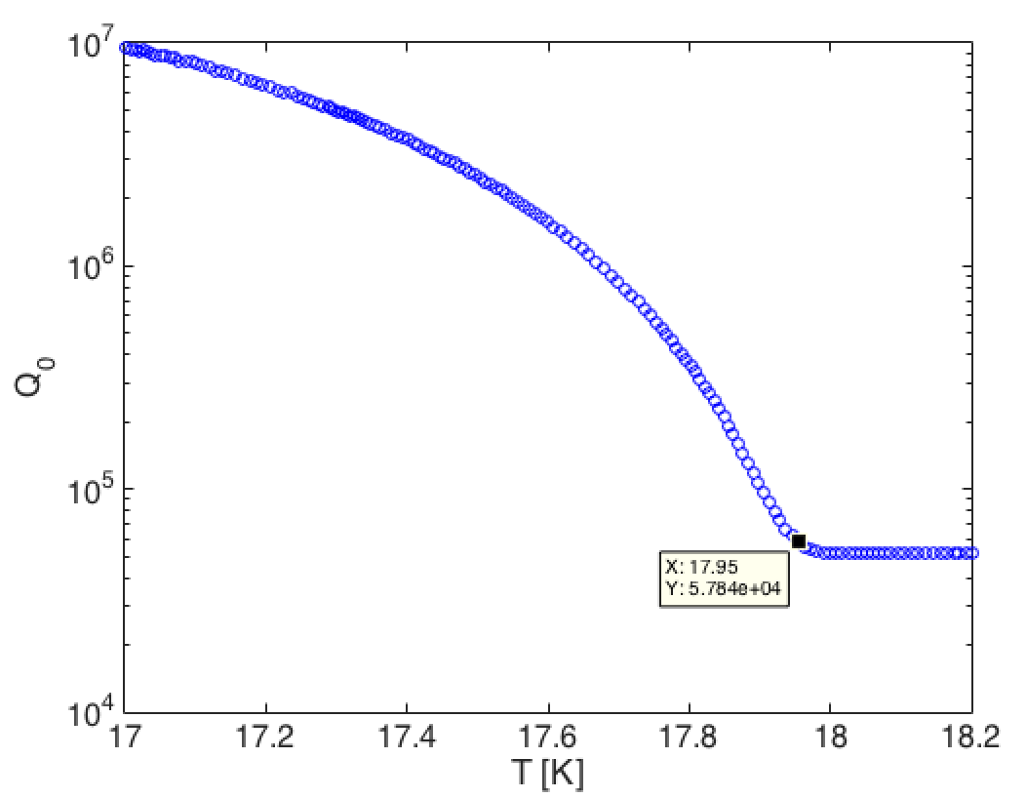
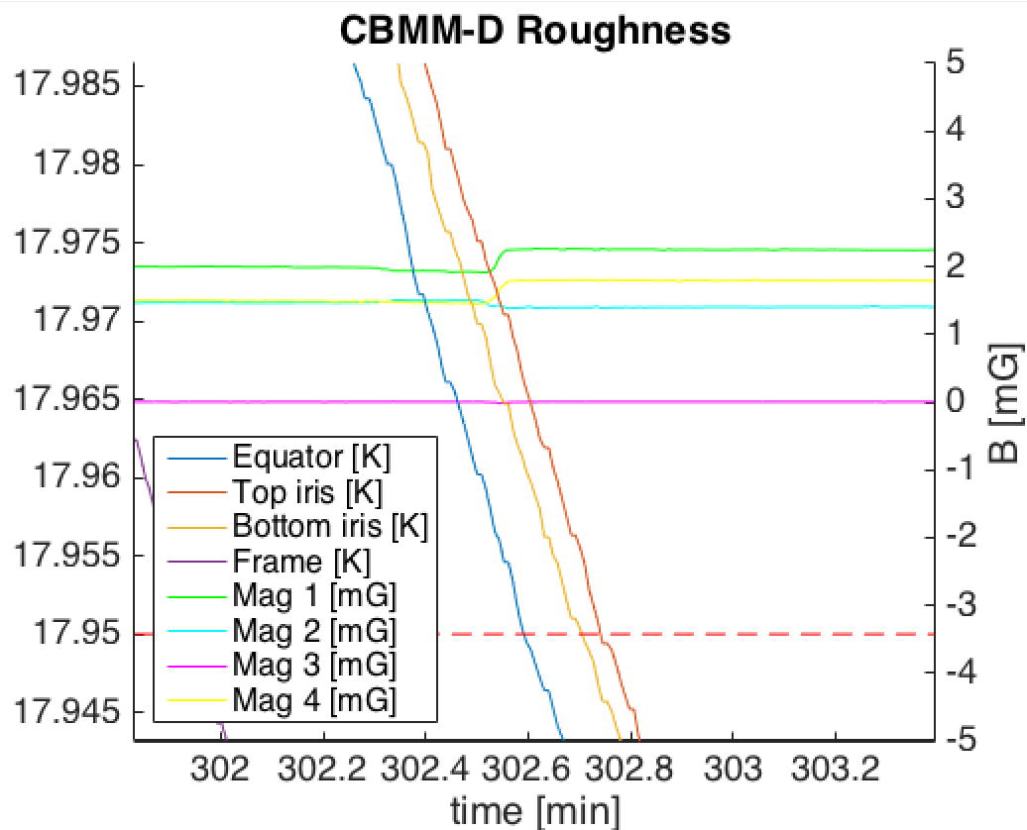
Cooldown

Slide 11
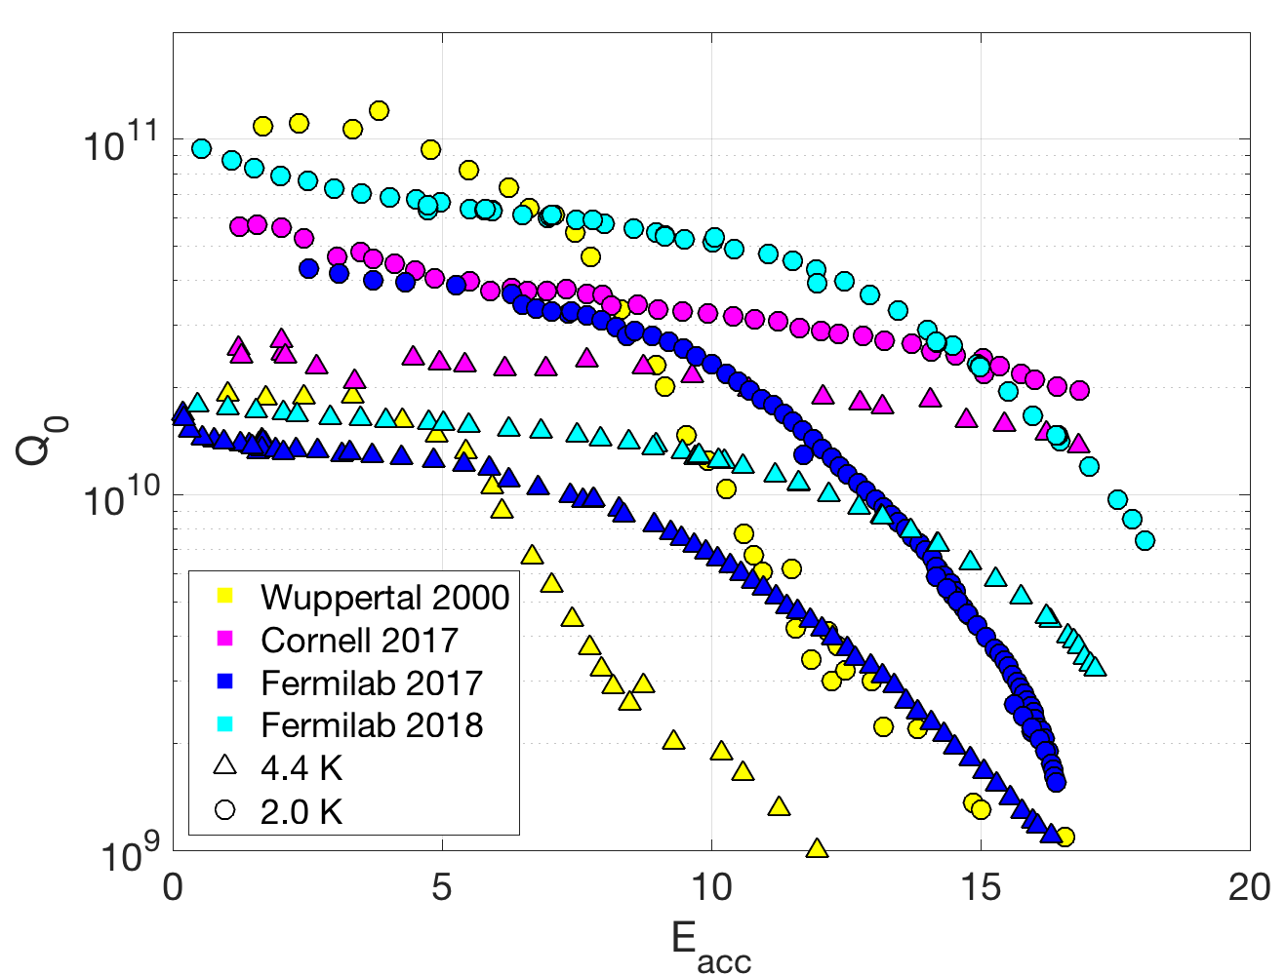
Q vs E
Substantial improvement in our second year of coating
Still some Q-slope, not yet flat Q₀ like Cornell
Very high Q₀ at 2.0 K, similar to Wuppertal

Slide 12
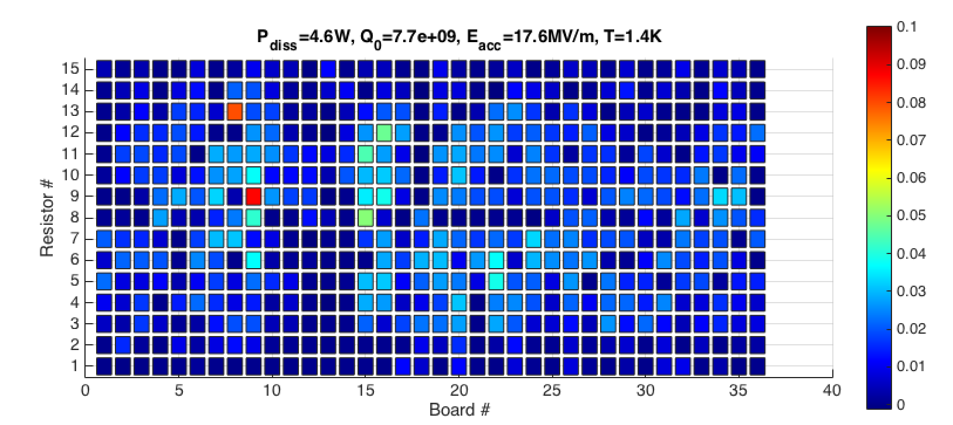
T-map at Highest Field Before Quench

Slide 13
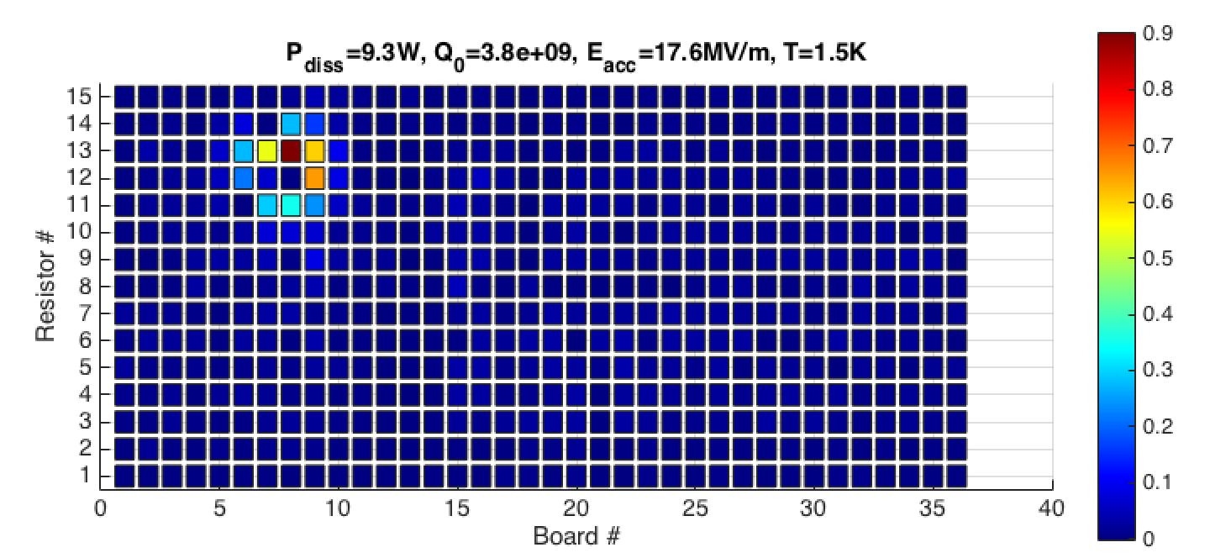
T-map After Quench

Slide 14
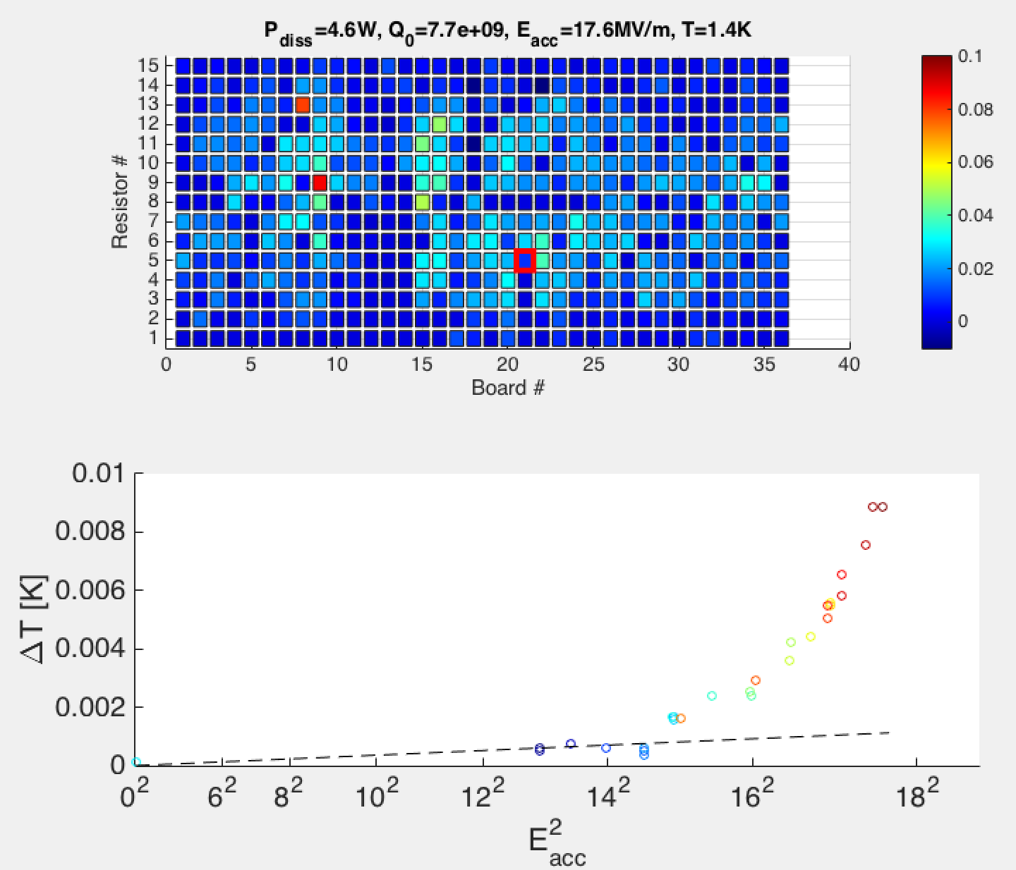
Both hot spots and cold spots show beyond Ohmic heating above ~15 MV/m

Slide 15
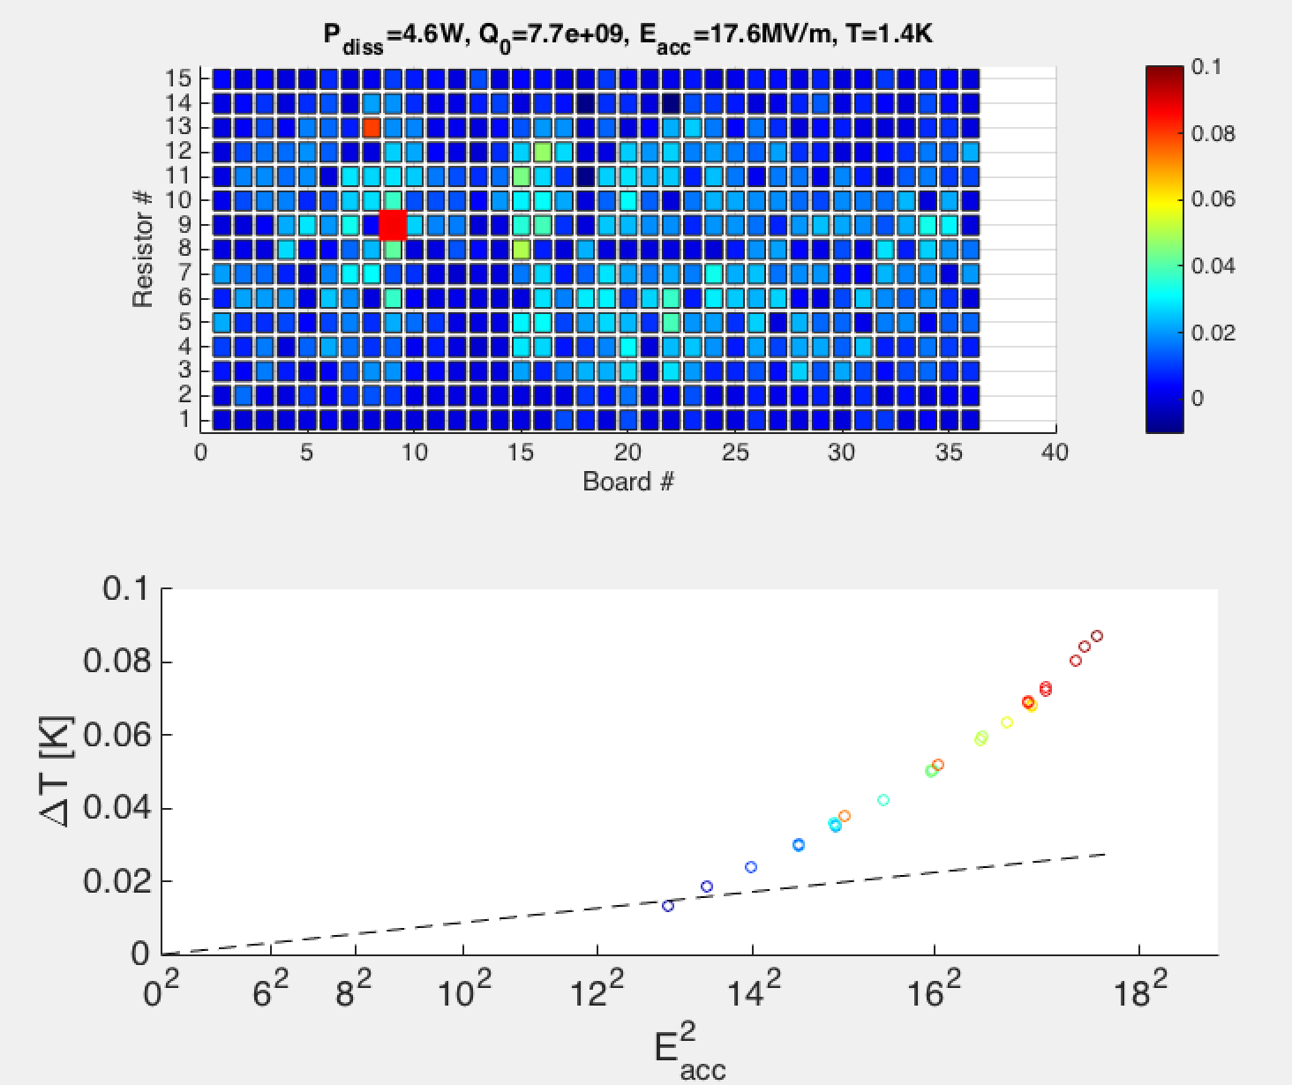

Slide 17
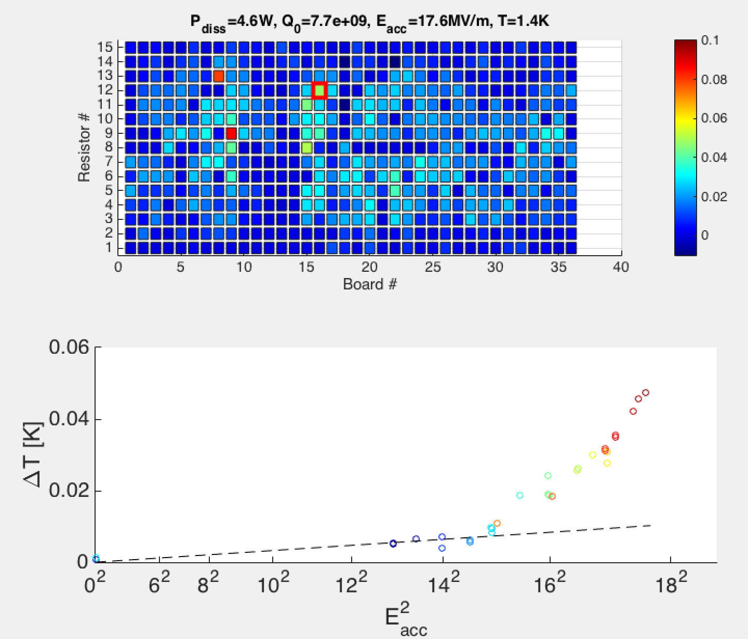

Slide 18
Development of Understanding

Slide 19
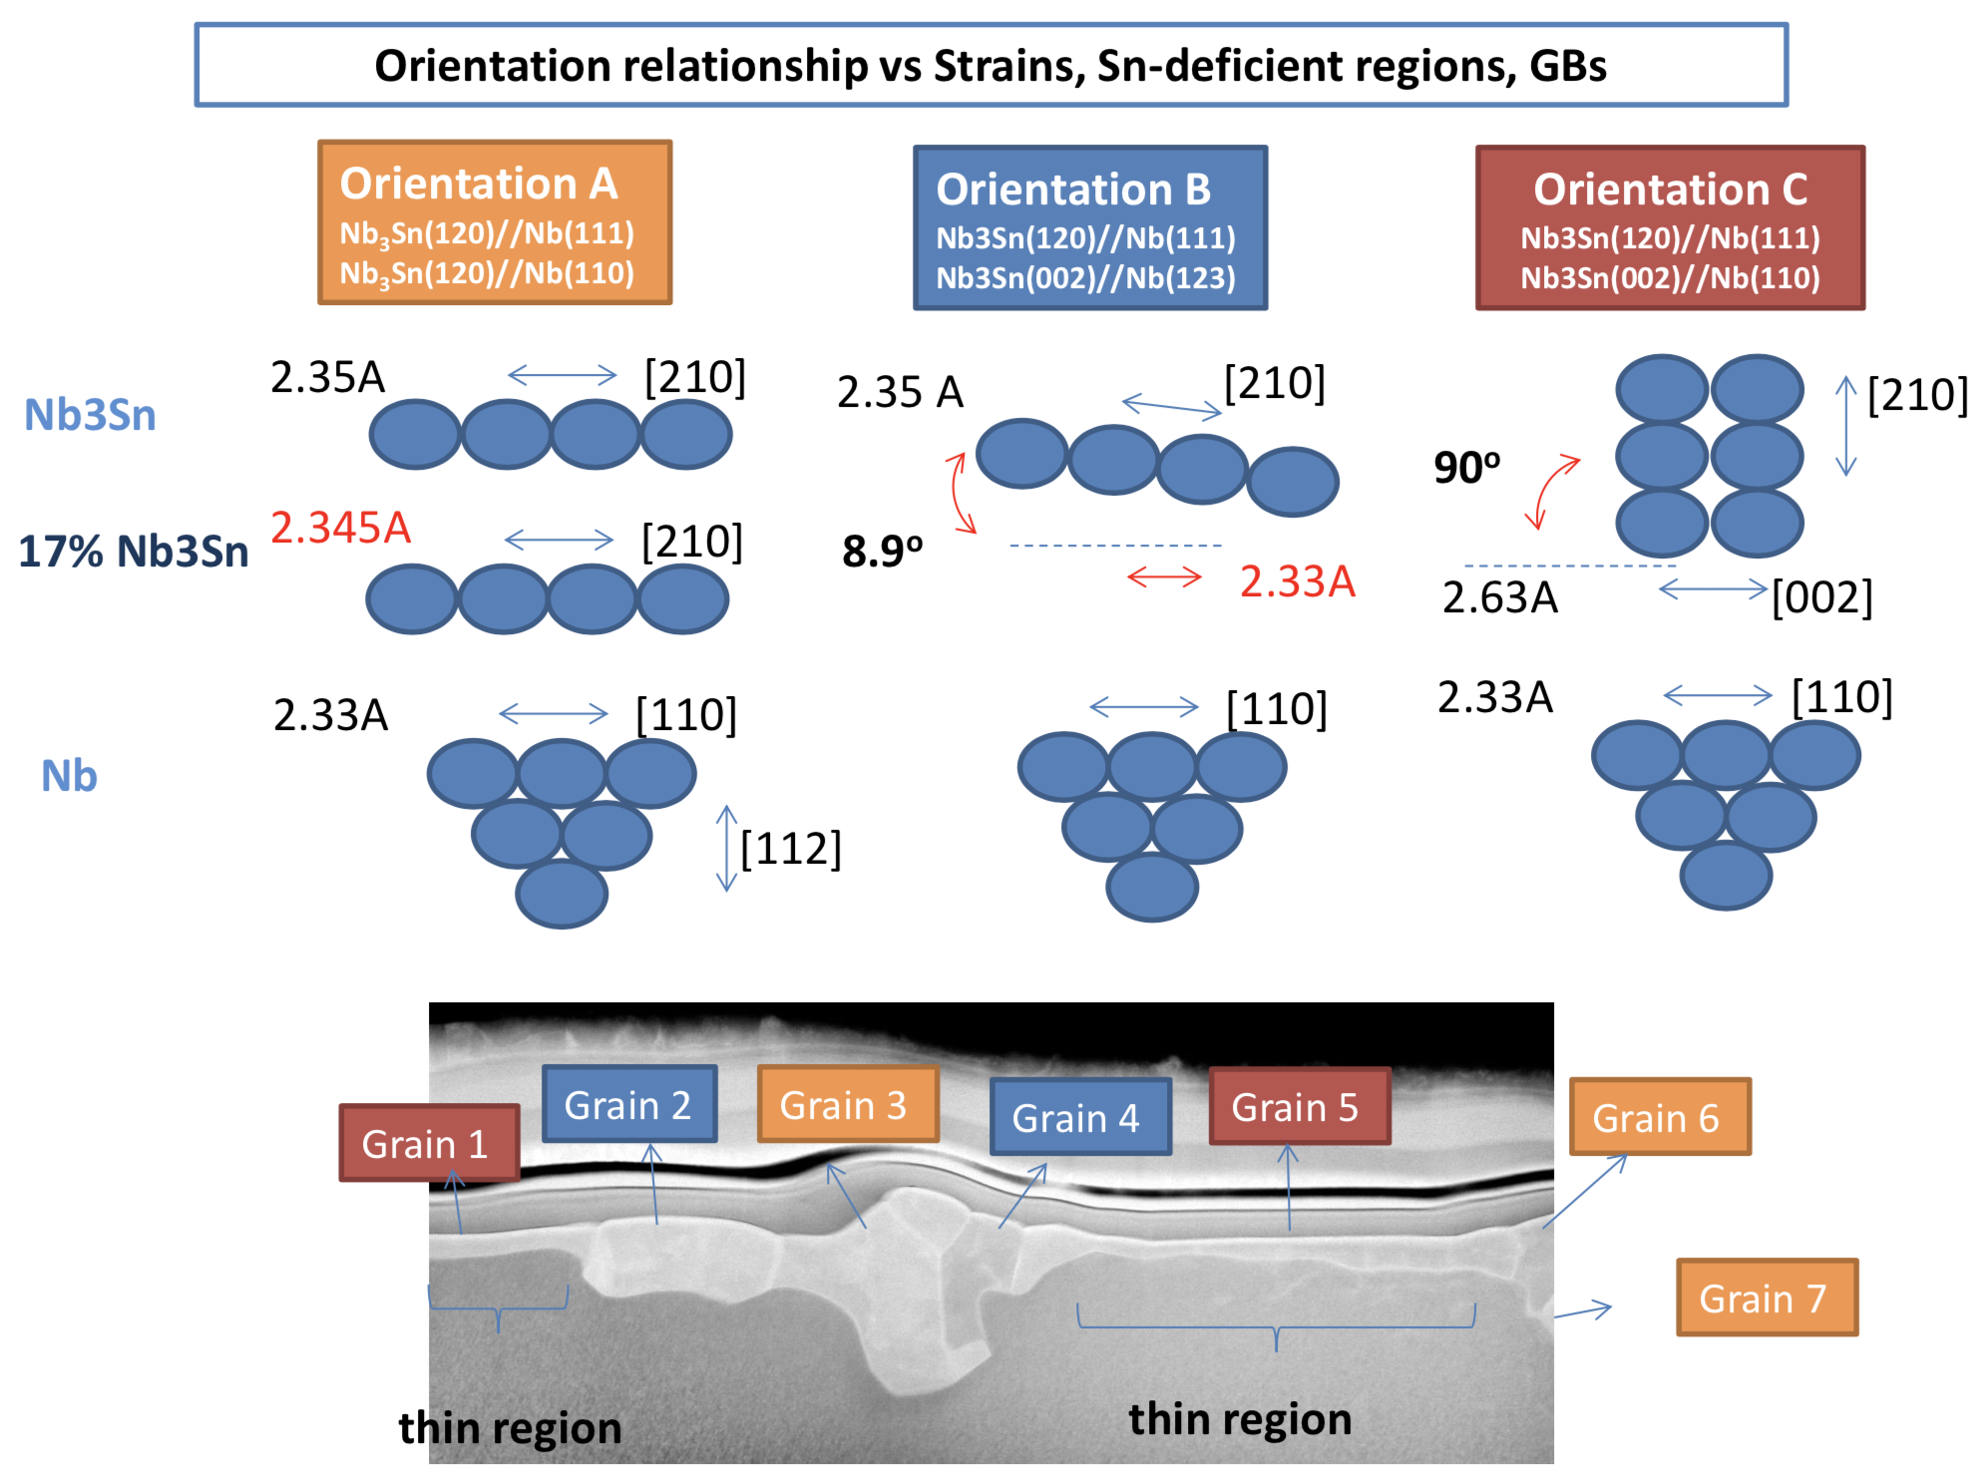
Epitaxial relationship observed between Nb₃Sn film and Nb bulk – appears to be key clue to understand formation of thin, lossy regions – arXiv preprint to be posted soon
13% lattice mismatch between Nb₃Sn film and Nb bulk for thin regions
Jae-Yel Lee, Northwestern University & Fermilab – presented at TTC 2018

Slide 20
Outlook

Slide 21
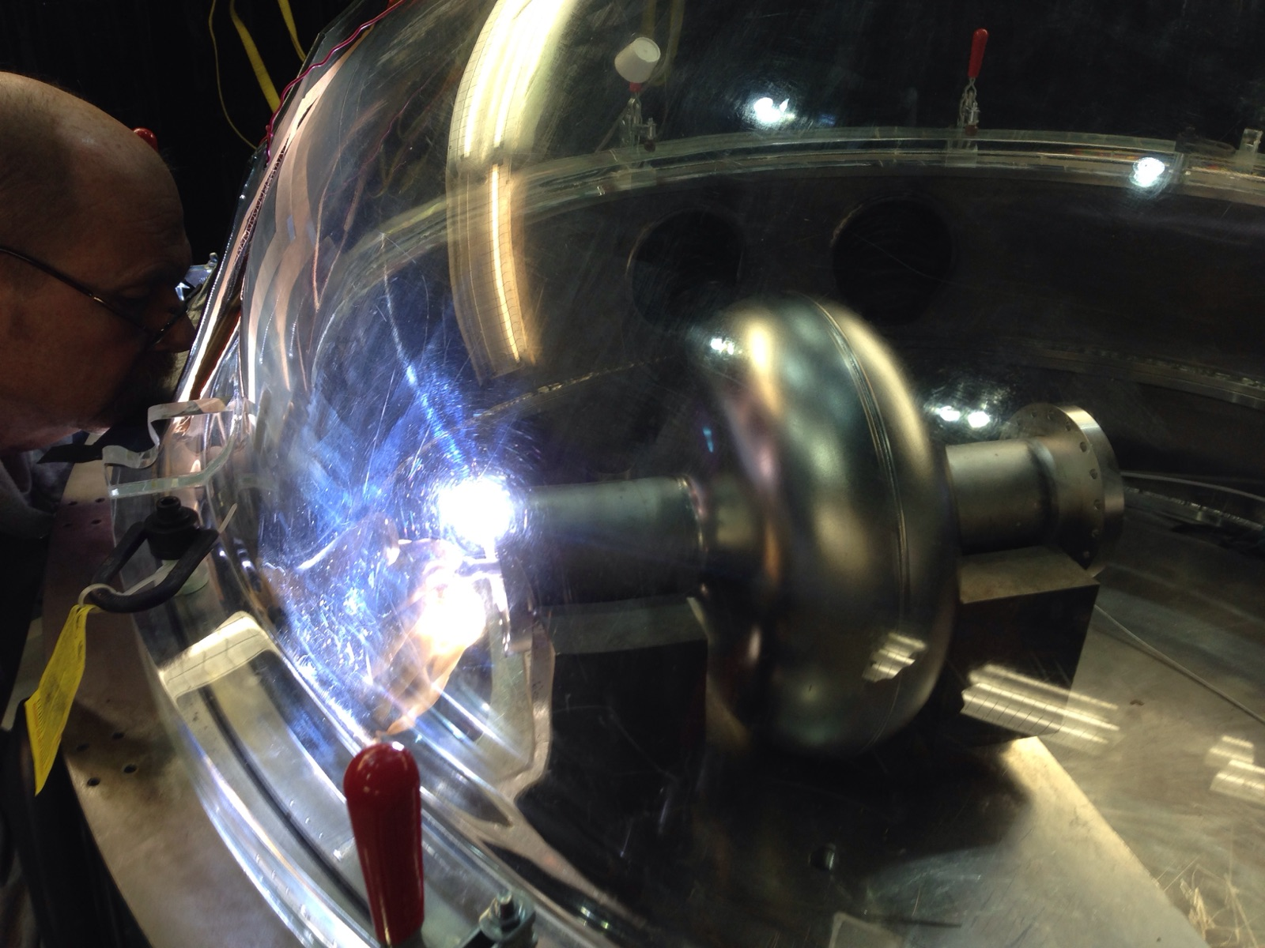
Outlook
Recipe development at Fermilab has led to nice performance on single cell cavity
Quench field 18 MV/m
Q₀ at 4.4 K >1e10 at 10 MV/m, Q₀ at 2.0 K >5e10 at 10 MV/m
Some Q-slope above 10 MV/m
Next steps:
Reproducibility on single cells
Push to remove Q-slope and increase maximum gradient
Move into other frequencies and into multicells
650 MHz 1-cell Nb flange welding

