Slide 1
First results of direct cutout studies of a nitrogen infused cavity
Alexander Romanenko
TTC Meeting’2018 – RIKEN, Japan
28 June 2018

Slide 2
Experiment summary
Bulk EP, fine grain 1.3 GHz cavity was prepared using 120C nitrogen infusion for 48 hours following the 800C 3 hrs vacuum bake
Temperature mapping followed by cutout and sample analysis

Slide 3
Characteristic Rbcs behavior

Slide 4
Temperature mapping
Some notable features:
Two halfs are not the same
More extended character of heating -> even close to iris

Slide 5
Characteristic individual thermometer readings

Slide 6
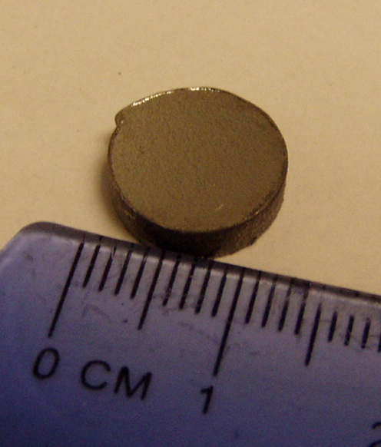
Cutout followed by surface analysis
Subject to state-of-the-art relevant analysis, e.g.:
TOF-SIMS
FIB-TEM
Cryo-AFM
…

Slide 7
TOF-SIMS – nitrogen depth profiles
Nb₂O₅
~15-20 nm N-rich layer
NbN⁻

Slide 8
TOF-SIMS – oxygen and carbon
O⁻
C⁻

Slide 9
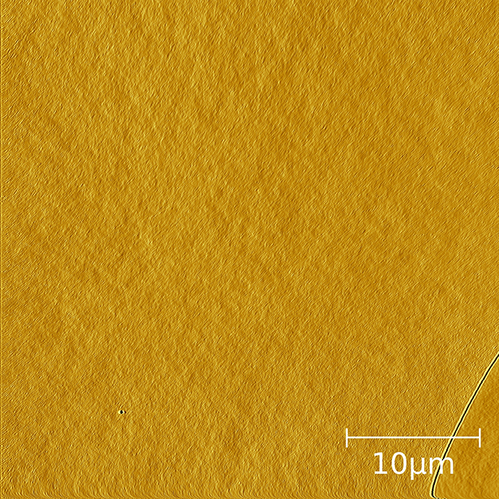
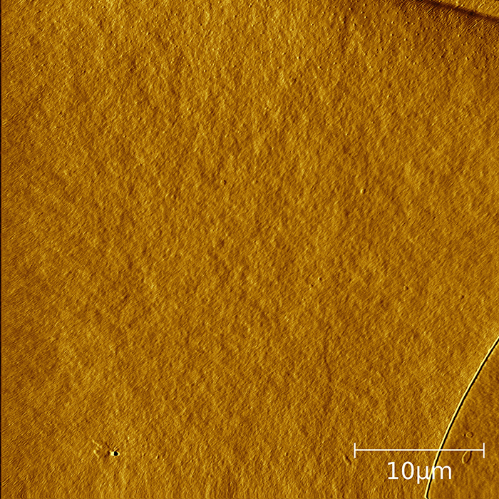
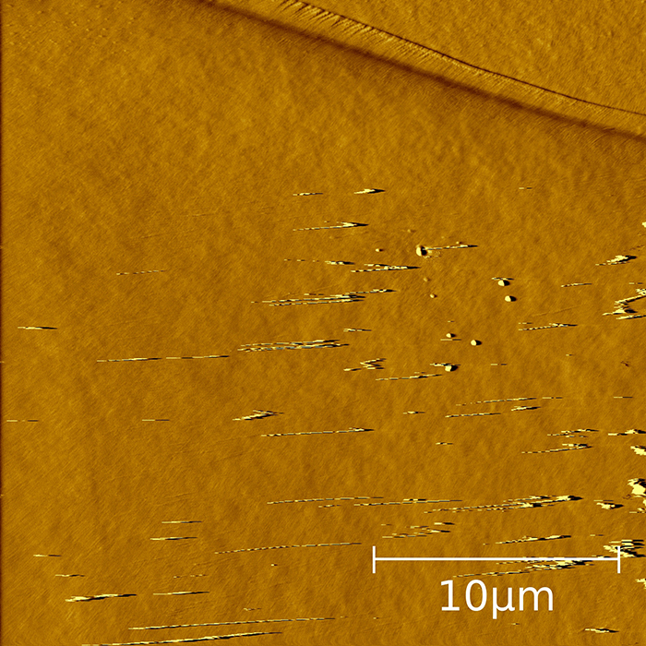
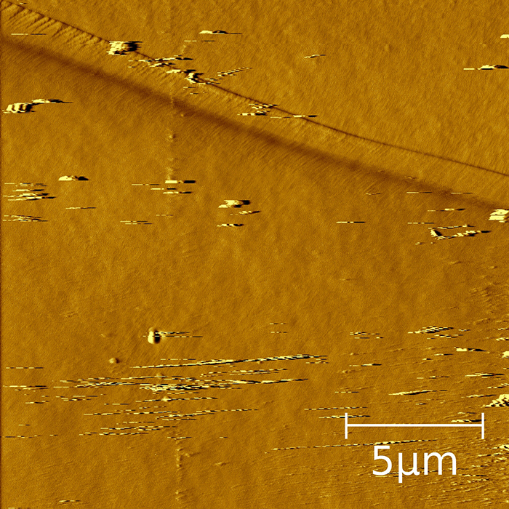
Cryo-AFM – directly seeing nanohydrides
300 K
150 K
Hydrides
Further study ongoing comparing with regular 120C baking cutouts (phase, size, temperature of formation)
Hydrides
Hydrides
10 K
50 K

Slide 10
TEM on FIB-prepared cutouts
No nitride inclusions are seen
Nothing special around grain boundaries

Slide 11
Summary
The first direct cutout studies of the nitrogen-infused cavity
Confirmed the presence of the thin (~20 nm) nitrogen-reach diffusion layer
Nanohydrides do form after nitrogen infused as well
No nitride inclusions or modifications of the grain boundaries found

