Slide 1




HOM-based Diagnostics
in SC Accelerating Cavities
at FLASH and the European XFEL
Nicoleta Baboi and Alexey Sulimov
DESY
on behalf of the international HOM-team
TTC Meeting, Japan, 26-29 June 2018

Slide 2
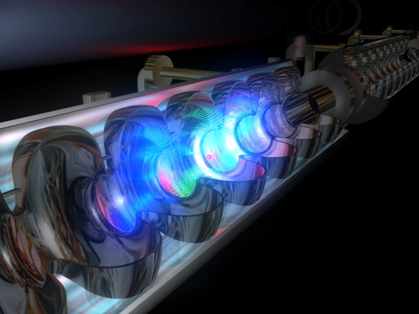
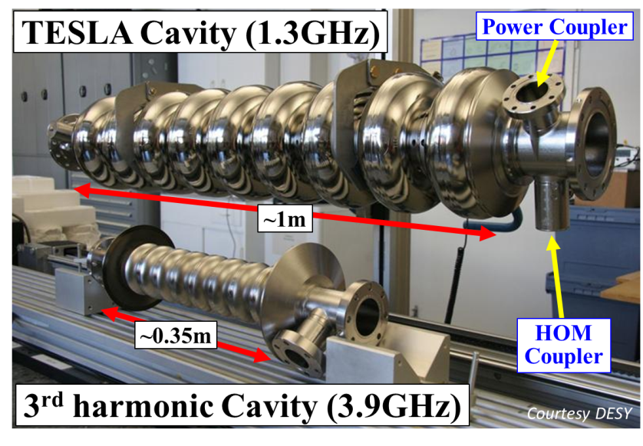
Outline
Motivation
HOM-BPM
(HOM-based Beam Position Monitoring)
  Beam alignment
  Beam position measurement
  in 1.3 and 3.9 GHz cavities
  Cavity alignment measurement
HOM-BPhM
(HOM-based Beam Phase Monitoring )
Summary

Slide 3
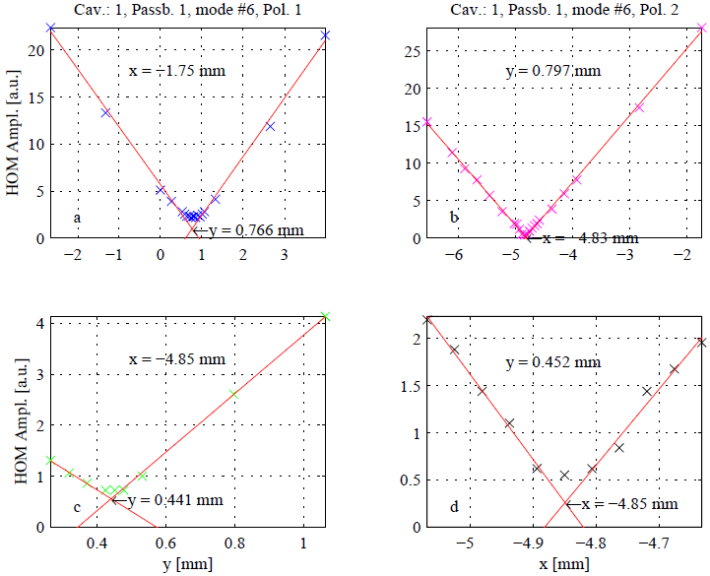
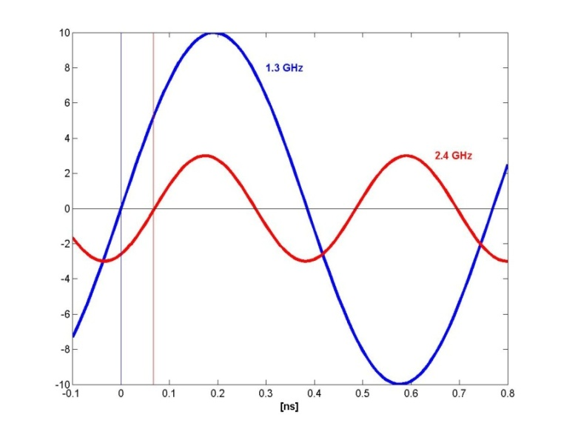
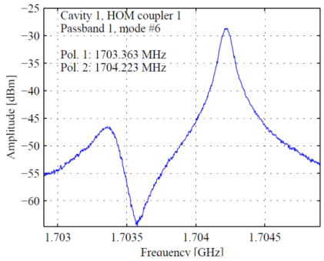
Motivation: Beam Diagnostics with HOMs
HOMs carry information about the beam properties
⇒ they can be used to monitor the beam
  The strength of the excited dipole modes depends linearly on the beam charge and transverse position: q∙r∙(R/Q)
  The timing of excited modes depend on beam arrival time (beam phase)
accelerating RF field
×
beam excited
HOM
Phase difference
Beam offset [mm]

Slide 4
Motivation: Benefits of HOM-based Diagnostics
HOM-BPM (HOM-based Beam Position Monitoring )
  Enable the alignment of the beam based on the signals which can damage beam quality, therefore reduce the wakefield effects
  Measure the transverse beam position
  Measure the transverse cavity alignment in the cryo-module
HOM-BPhM (HOM-based Beam Phase Monitoring )
  Direct, on-line measurement of beam phase wrt accelerating field phase
Does not require additional vacuum component, therefore relatively cheap

Slide 5
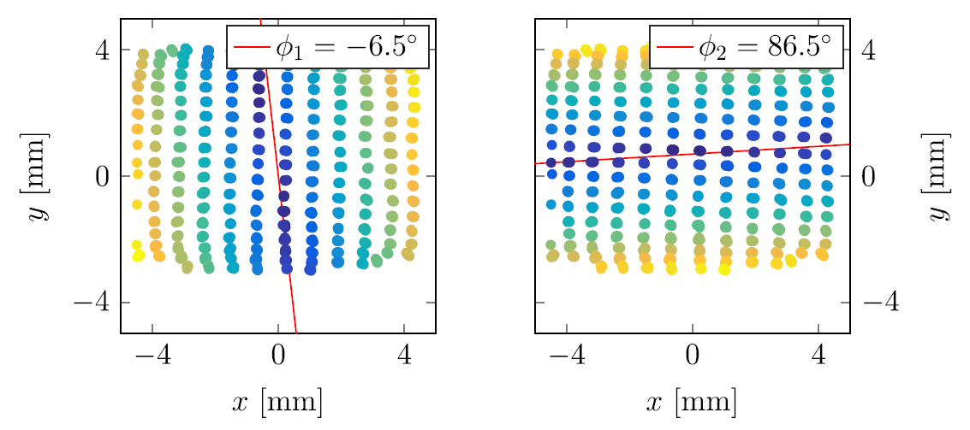
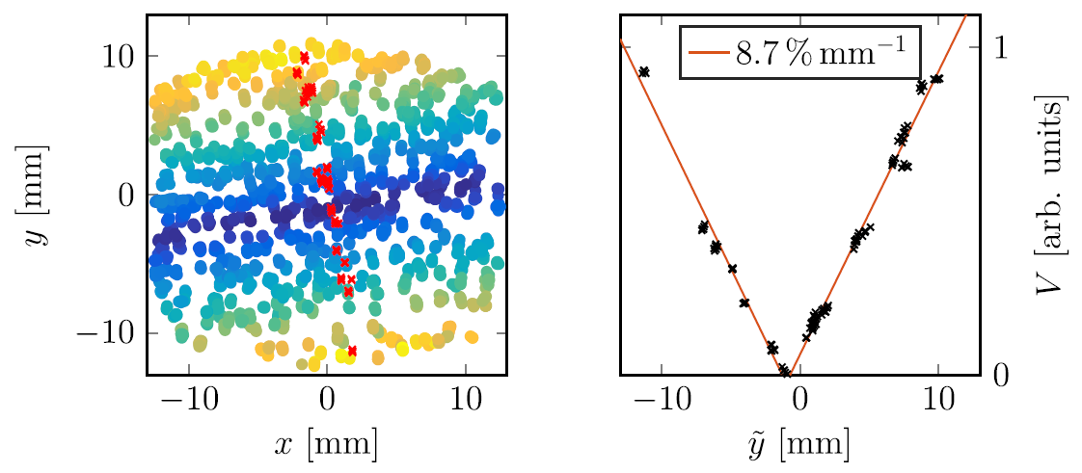
HOM-BPM: Dipole Modes
HOM amplitude vs. (x,y) (example)
  Rotated polarizations (different for each cavity)
    Often signal from one
    polarization dominates signal
    from one HOM coupler
  Linear dependence on beam
  offset (and charge)
Peak amplitude
Peak amplitude
Notes:
Upper plots: “Normalized amplitude of the first dipole mode at the upstream coupler (left) and of the second mode at the downstream coupler (right) at cavity two in ACC2 as a function of beam offset x and y. “
Lower plots: “Normalized amplitude V of the dipole mode at the downstream coupler of cavity eight in ACC2 as a function of beam offset x and y. The normalized amplitude of the highlighted points is plotted in the right graph as a function of the transformed vertical offset ~y, including a linear fit with a slope of 8.7%/mm.”

Slide 6
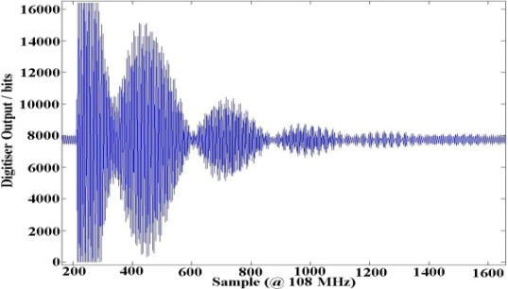
HOM-BPM: 1.3 GHz Cavities
HOMBPM-electronics installed in FLASH
  Use 1 dipole mode at 1.7 GHz, which has higher R/Q
  Used as operator tool for beam alignment (ACC1-5)
  Used for measurement of cavity alignment
Electronics under develop-ment for the E-XFEL
Bandpass
Filter
1.7 GHz
20 MHz BW
Mixer
Digitizer
Joe Frisch, SLAC
LO 1.68 GHz
Clock 108 MHz
Jablonski, Szymon, DESY
6

Slide 7
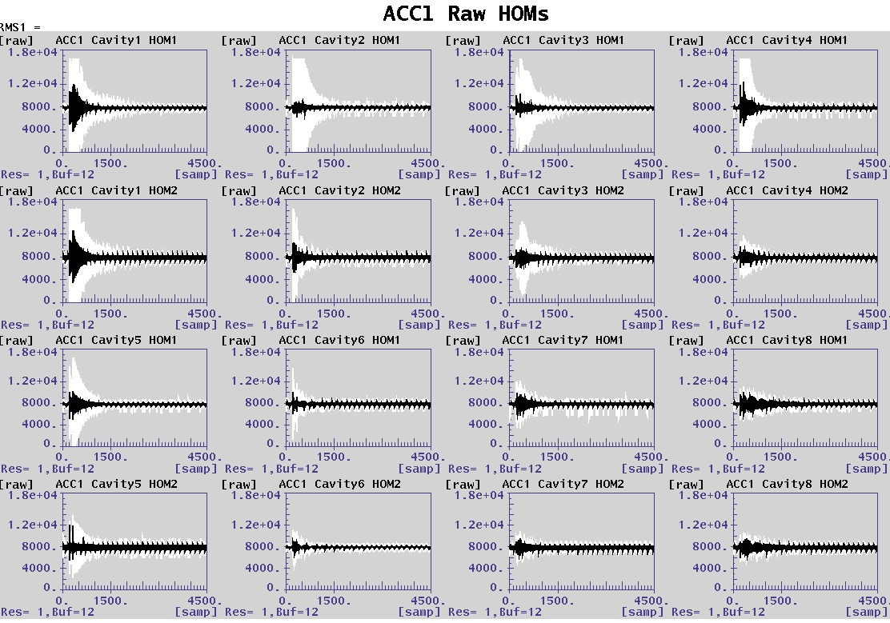
HOM-BPM: Beam Alignment
Used for beam alignment, mainly during commissioning

Slide 8
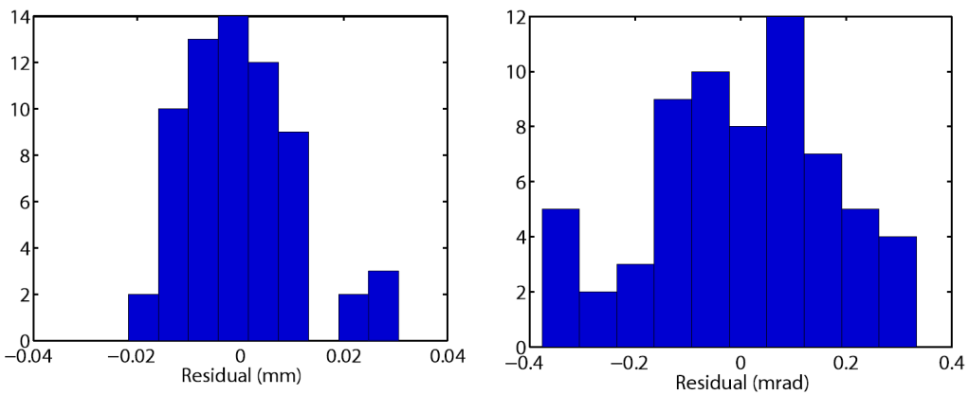
HOM-BPM: 1.3 GHz Cavities Calibration
Calibration more complicated than in standard cavity BPMs
  Split modes
  Polarization direction is usually
  not horizontal or vertical,
  and, generally unknown
  Different frequency in each cavity
  (1.7 GHz ± 10 MHz)
Demonstrated use as BPM
  10 μm rms resolution
Dimension
reduction
SVD
Linear regression
Calibration matrix
Resolution: 9μm
x
Stephen Molloy,
SLAC (now ESS)

Slide 9

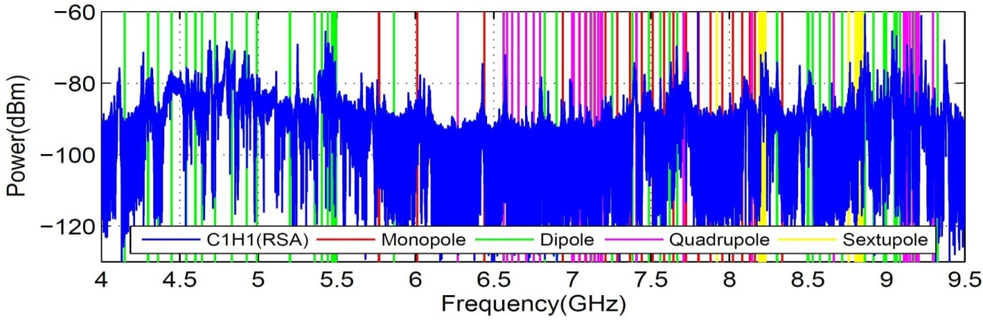
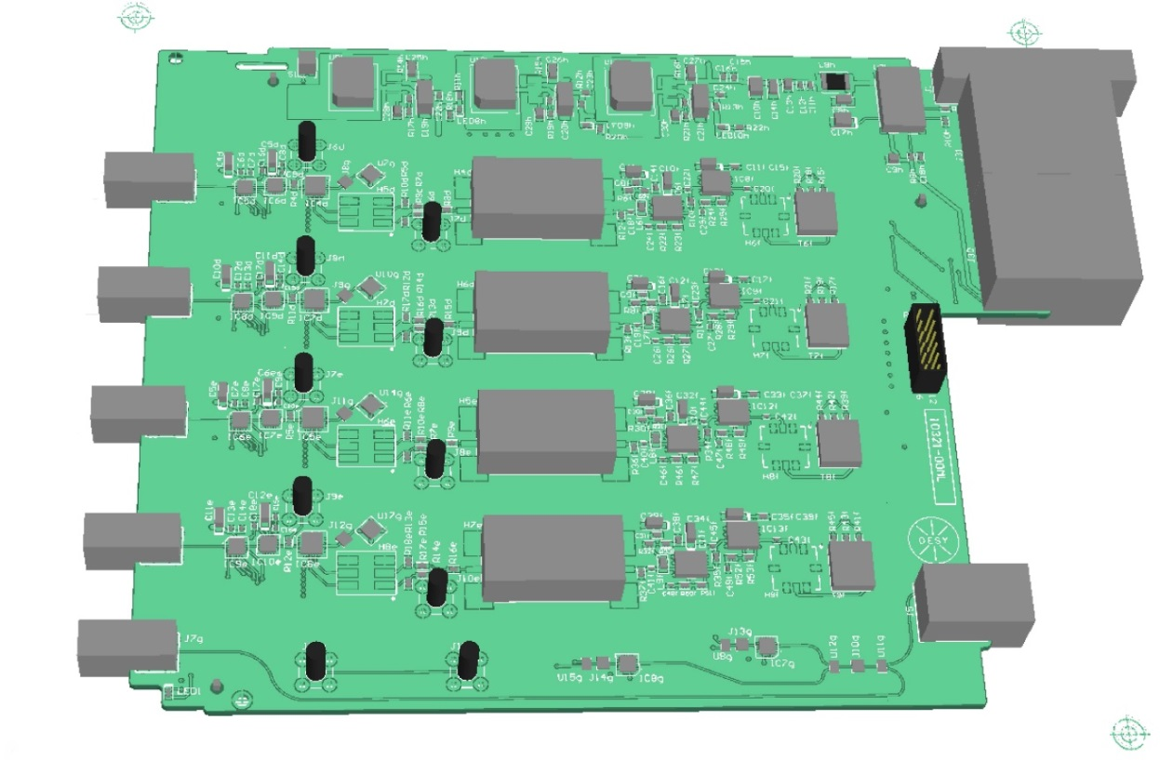
HOM-BPM: 3.9 GHz Cavities
HOMs in 3.9 GHz cavities have higher impact on the beam
No trivial copy of system for 1.3 GHz cavities, due to:
  Coupling of the cavities (4 at FLASH, 8 at the E-XFEL)
    Beam pipe cut-off: 4.39GHz → basically no local modes
  Use 2 bands:
  Electronics for FLASH and the E-XFEL
Dipole band | Beam Position meas. | Resol. (rms)
2nd, ~5.4GHz | Global position over the module length | ~20 μm
5th, ~9GHz | Local position in each cavity | ~50 μm
Pei Zhang, DESY
(now IHEP)
Bandpass
Filter
5.4 or 9 GHz
100 MHz BW
Mixer
Digitizer
Thomas Wamsat,
DESY
Nathan Eddy, FNAL
LO
Clock 108 MHz

Slide 10
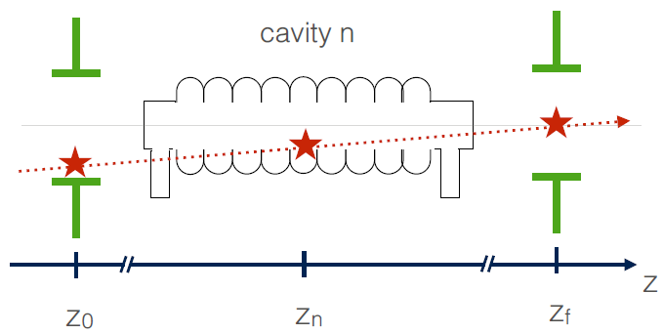
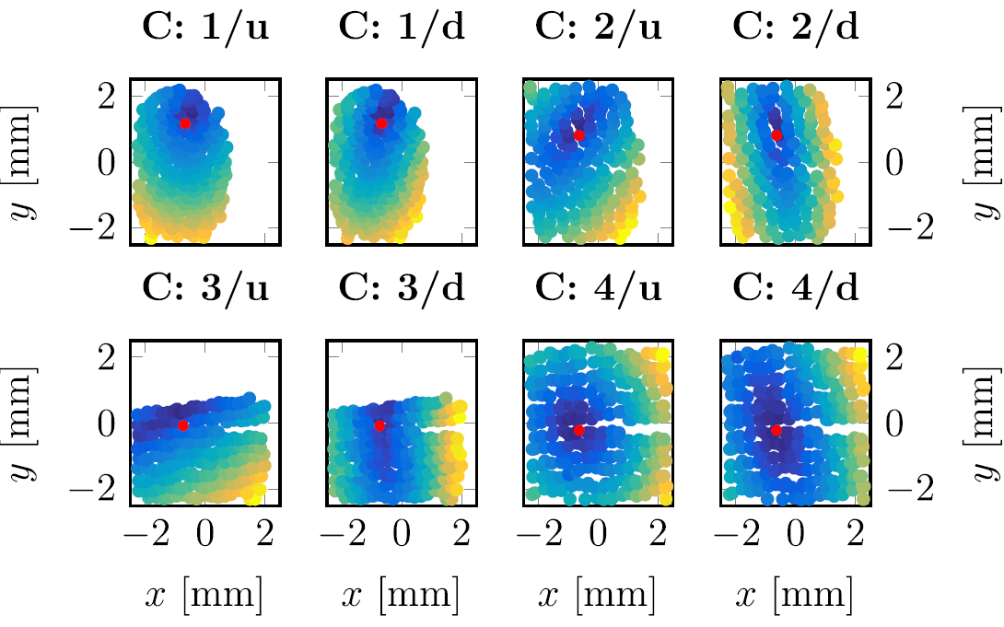
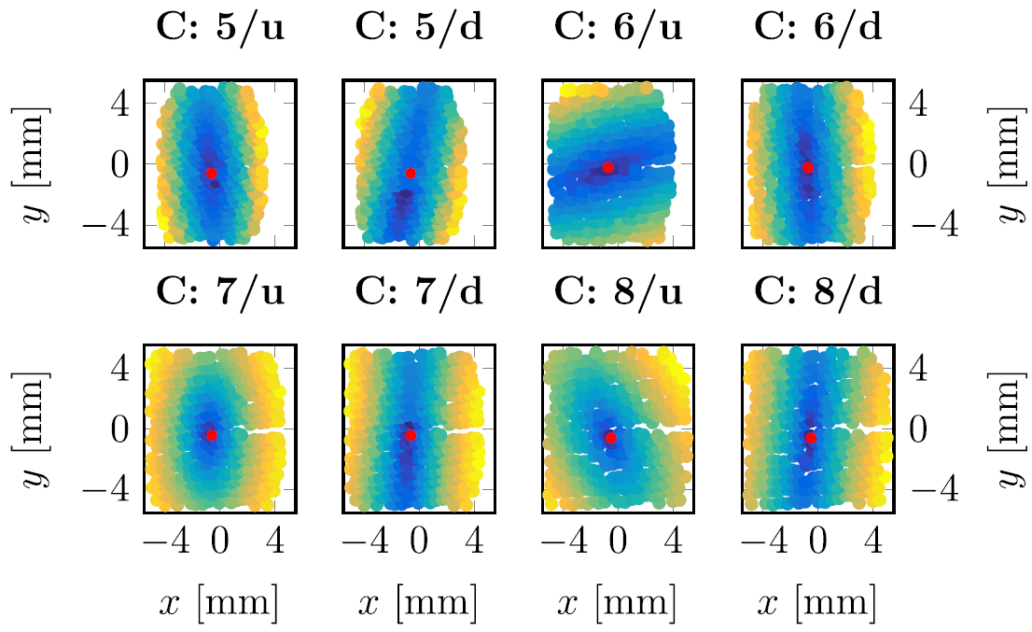
HOM-BPM: Cavity Alignment Measurement
Cavity offset
  HOM(offset) >> HOM(tilt)
    ca. 200 μm ⇔ 1 mrad (theor.)
    confirmed by one measurement
  Work ongoing to measure tilt of cavities in one module
Mode power
Notes:
The plots show the HOM power
The missing points at cavity three are caused by momentary problems of the readout electronics.

Slide 11
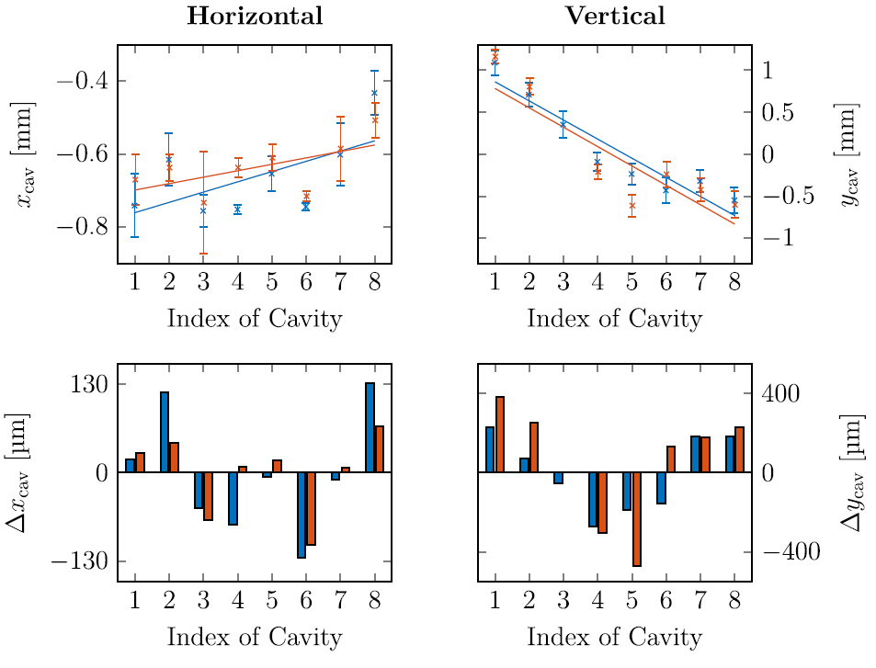
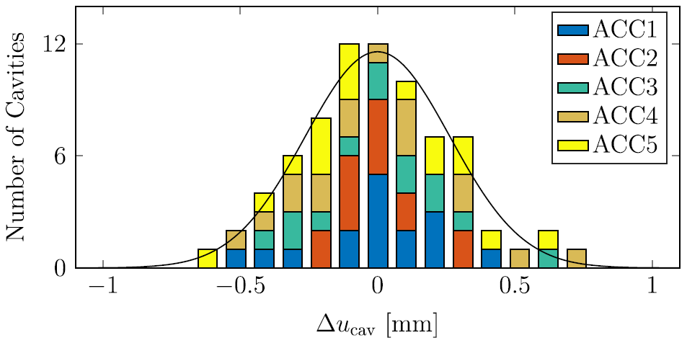
HOM-BPM: Cavity Alignment Measurement (2)
Results
  2 measurements are shown in
  the plot (ACC1)
ACC1-5
T. Hellert et al., Phys. Rev. Accel. Beams 20, 123501 (2017)
Notes:
The right plot shows the results from ca. 40 cavities, both transverse planes

Slide 12
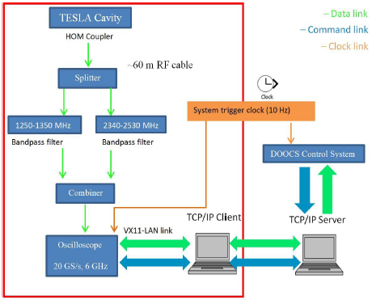
HOM-BPhM: Beam Phase Measurement
Experimental setup
  Can trace RF phase change of -5 and +5deg
  Resolution: 0.12deg rms
accelerating RF field
beam excited
HOM
Phase difference
Liangliang Shi, DESY

Slide 13
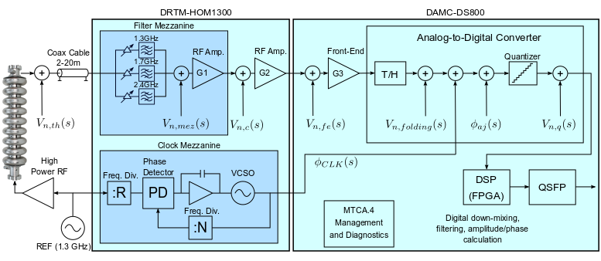
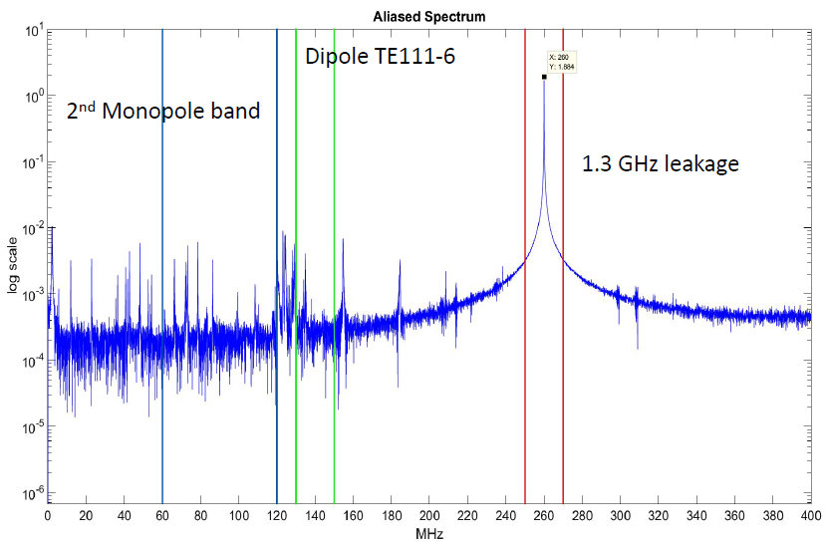
HOM-BPM+BPhM: Electronics for 1.3 GHz Cavities
Multiple filter
  Selects 1.3 and 2.4 GHz monopole
  modes from the HOM spectrum
  Also 1.7 GHz dipole mode for
  beam position monitoring
Direct sampling
Aliased spectrum
Szymon Jablonski,
DESY

Slide 14
Summary
Motivation
  HOMs contain information about the beam and cavity, low cost monitors.
  Monitors built or being built for FLASH and E-XFEL, for 1.3 and 3.9 GHz cavities
HOM-BPM
  Beam alignment → reduction of transverse wakefield effects
  Transverse beam position, like a cavity BPM
    1.3 GHz cavities:
    Resolution ca. 10 μm rms measured
    Currently work on stability in time
    3.9 GHz cavities:
    Resolution ca. 20 μm rms measured
    More challenging due to cavity coupling, higher frequency
    Extra challenges at the E-XFEL: longer cavity-chain, different cavity orientation
  Cavity alignment measurement
HOM-BPhM
  Experimental setup: Resolution of ca. 0.1 deg rms measured

Slide 15
Outlook
Current work:
  Long-term phase measurement
  Cavity tilt measurement
  Stability of beam position measurement in time
  Electronics for the E-XFEL being built
    For 1.3 GHz cavities: beam position and phase
    For 3.9 GHz cavities: beam position

Slide 16
Acknowledgements
Talk based on work of many people from several institutes
    (only main part of the work is mentioned)
  CEA: studies in TESLA cavities in FLASH
  SLAC: studies and electronics in TESLA cavities at FLASH
  FNAL: electronics for 3.9 GHz cavities in FLASH
  University of Rostock: measurements and simulations 3.9 GHz cavities
  University of Manchester/Cockcroft Institute: studies and simulations, 1.3 and 3.9 GHz cavities at FLASH
  TEMF: cavity simulations
  DESY
Part of the work has been made under EuCARD and EuCARD-2

Slide 17
Thank you for your attention!

Slide 18
More Info
https://indico.cern.ch/event/465683/contributions/2269313/attachments/1325170/1990289/HOM_WORKSHOP_2016.pdf
https://indico.cern.ch/event/465683/contributions/2269230/attachments/1325164/1992713/2016.08.22-24_HOMinXFEL_HOMSC16_Rostock.pdf
https://indico.cern.ch/event/465683/contributions/2269311/attachments/1325882/1990314/160823_HOMSC_thellert.pdf
e-mail: Nicoleta Baboi <nicoleta.baboi@desy.de>

