Slide 1
Design of a 9-cell SC cavity for EUV light source at KEK
Taro Konomi (KEK)

Slide 2
Outline
Cell design concept for HOMs
Center cell passband
Beam pipe diameter
End cell design
Optimization
Optimization for Dipole HOMs
Optimization for Monopole HOMs
Parameters of EUV cavity
Summary

Slide 3
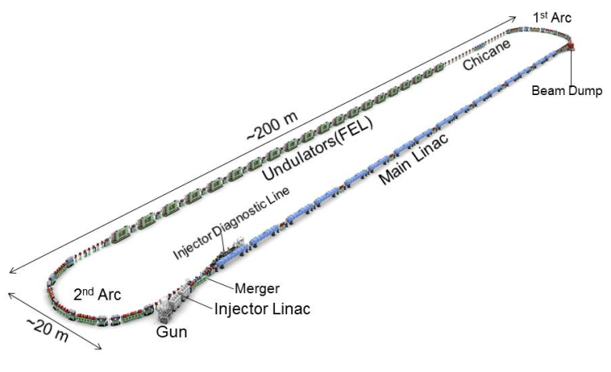
EUV Accelerator
KEK and Japanese industries organized EUV-FEL light source study group for industrialization since 2015.
Main linac has 64 units of 9-cell superconducting cavity.
We will design the EUV cavity using the experience of cERL
Ep/Eacc of cERL is 3.0 for 100mA BBU.
Redesign the cavity shape to realize stable 12.5 MV/m CW operation.
We focused on the monopole BBU.
KEK- EUV Accelerator Parameters
Parameters | Target value
Wavelength | 13.5 nm
EUV Power | 10 kW
Bunch charge | 60 pC
Beam energy | 800 MeV
Repetition frequency | 162.5 MHz
Average current | 9.75 mA
Accelerating gradient | 12.5 MV/m
Number of cavities | 64 units
Cavity Parameters | KEK-EUV | KEK-cERL | TESLA
Frequency (MHz) | 1300 | 1300 | 1300
Iris diameter (mm) | 70 | 80 | 70
R/Q (Ω) | 1009 | 897 | 1036
G (Ω) | 269 | 289 | 270
Ep/Eacc | 2.0 | 3.0 | 2.0
Hp/Eacc (mT/(MV/m)) | 4.23 | 4.25 | 4.26
BBU limit | >190 mA (EUV) | ~600 mA (3GeV ERL) | ~10 mA (3GeV ERL)

Slide 4
Cavity design concept for damping HOMs
EUV cavity was designed focusing on the low frequency HOMs.
HOMs are passed through the end cells and damped at beam line damper.
HOMs frequency of the end cells are adjusted to the center cells to make smooth RF flow.
Procedure of the EUV cavity design
Step3: Search best frequency of end cell
Tuning curve method can calculate only π mode frequency.
Passbands of the end cell are unknown.
π mode is not a high impedance mode. We have to sweep the end cell frequency.
End Cell
Center Cell
End Cell
HOM
Image of the end cell Passband sweep
HOM Damper
Cell design process
Step1: Calculate frequency
Center cell ⇒ Eigen mode solver
End cell ⇒ Tuning curve method
( this method can calculate only π mode)
Response matrix of end cell HOM frequency was created by this method.
Step2: Search Minimum Qext shape
End cell shapes were designed by using the matrix.
There are many shapes which agree with a target frequency
⇒ Select minimum Qext shape

Slide 5
Center cell Passband
Step 1
We selected TESLA shape for the center cell to set Ep/Eacc is to 2.
We will try to match end cell frequency to center cell passband.
End Cell
Center Cell
End Cell
Passband of TESLA center cell
HOM
HOM Damper
Notes:
I will talk about the cell design method from this slide.
EUV cavity was designed focusing on the low frequency HOMs.
This figure shows the passband of TESLA center cell.
R/Q and Rt/Q changes are small because the passband of 9-cell HOMs are ruled by the center cell.
Qext control the longitudinal and transverse impedance.
Frequency matching end cell and center cell is important to minimize the Qext because HOMs are pass through the end cells and damped at beam line damper..

Slide 6
Beam pipe diameter
φ100mm and φ110mm beam pipes are selected.
Beam pipe diameters are minimized to suppress leaking accelerating field.
Different diameters are selected to make the asymmetry actively and damp the high frequency HOMs.
TE11 cutoff frequencies of 100mm and 110mm beam pipe are 1600MHz and 1760MHz.
High impedance TE111 dipole HOM is damped by both beam line damper.
Monopole cutoff frequencies are lower than all monopole HOMs.
Passband of TESLA Center Cell
Beam pipe diameter | Φ110 | Φ100
Cutoff monopole (TM01) | 2086.4 | 2295.0
Cutoff Dipole (TE11) | 1597.1 | 1756.8
Formula of cutoff
Monopole TM01-mode
$f_{TM}=\frac{c}{2π}\left(\frac{j_{mn}}{a}\right)=\frac{229.50}{φ}[MHz]$
Dipole TE11-mode
$f_{TE}=\frac{c}{2π}\left(\frac{j_{mn}^{′}}{a}\right)\frac{175.68}{φ}[MHz]$
Notes:
We selected 100mm and 110mm beam pipe.
These are minimized to suppress leaking the accelerating field.
Different diameters are selected to make the asymmetry actively and damp the high frequency HOMs.
TE11 mode cutoff frequencies of 100 mm and 110 mm beam pipe are 1600 MHz and 1760 MHz each. High impedance HOM modes of TE111 is 1770 MHz.
Therefor high impedance Dipole HOMs are damped by both beam line damper.
Monopole mode cutoff frequencies are lower than all Monopole HOMs.

Slide 7
End Cell design
Step1
End cell frequency was calculated by tuning curve method because end cell and beam pipe have strong coupling.
Tuning curve method can separate cell and beam pipe frequency.
Therefor this method can calculate only π mode frequency because imaginary short plane is the magnetic boundary.
Imaginary short plane
Zoom
Magnetic
Boundary
Electric
boundary
Beam pipe resonance
Frequencies are calculated with various beam pipe length.
Cavity resonance
Red line is the cavity resonance
green curve is the beam pipe resonance.
Notes:
End cell frequency was calculated by tuning curve method because end cell and beam pipe have strong coupling.
This is the end cell model. CST eigne mode solver calculated frequencies with various beam pipe length.
This figure is an example. Red curve is the cavity resonance and green one is the beam pipe resonance.
The curvature shows the Qext of this model.
Imaginary short plane appears at the crossing point. This plane is the magnetic boundary.
Therefor we can calculate only pi mode frequency. From now, if I mentioned end cell frequency, it means end cell pi mode frequency.
We modify the end cell shape to match the center cell frequency.
There are many shape parameters in the elliptical cell.
Right figure shows the response of each shape parameters. Cell length and iris diameter have the major effect to HOM frequencies. R1 means iris diameter and Xlen means cell length.

Slide 8
End Cell design
Step 1
Frequency and Qext response of TM010,TE111,TM110,TM011 were calculated.
⇒ Response matrix was created
Cell length (A2,xlne) and iris diameter (R1) can change the frequency effectively.
We tried to found the best end shape by using the response matrix
End cell frequency was swept from the matching point because other end cell passband are unknown.
There is no solution which matches more than 3 HOMs at once by this matrix method.
Matching HOMs were divided into each end cell.
⇒ Φ100mm BP cell adjust to Acc., TE111 and TM011.
⇒ Φ110mm BP cell adjust to Acc., TM110 and TM011.
Φ110 BP side cell
B2
Cavity side circle
B1
A2
A1
R1
xlen
B3
R2
A3
Beam pipe side circle

Slide 9
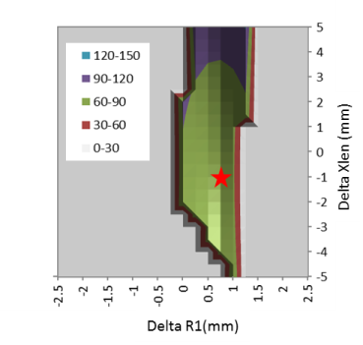
End cell design
Step 2 Example (Φ110mm BP cell )
TE111 and TM011 end cell frequency adjust to center cell π mode.
⇒ Delta means the difference from center cell π mode frequency
Gray color area is constrained condition.
Re-entrant shape is not better for HPR or other water cleaning.
Pressing can be possible.
If change amount is higher than 20mm, the shape become triangle shape.
The star shows the minimum Qext shape. This is a candidate.
TE111 Qext of Φ110 BP cell
Condition Δf (TE111)=0MHz, Δf(TM011)=0MHz
Qext
B2
Cavity side circle
Constrained conditions
Not re-entrant shape：
Xlen-A1-A2>0mm
Pressing is possible :
Absolute value>5mm
Feasible shape：
Change amount <20mm
B1
Minimum Qext.
This is a candidate.
A2
A1
R1
xlen
B3
R2
A3
Beam pipe side circle
Notes:
We tried to found the best shape which matches TM010, TE111, TM110 and TM011 mode frequency. But there is no shape matching more than 3 HOMs at once.
Matching HOMs are divided into each side cell. 100mm BP side cell adjust TE111 and TM011, the other side cell adjust TM110 and TM011.
This figure is an example of matching. Horizontal axis is the delta R1 and right axis is delta xlen. Collor gradation shows the TE111 Qext. Gray Area is constrained condition.
Constrained conditions are three.
First, xlen-a1-a2 is more than zero because the re-entrant shape is not better for HPR or other water cleaning.
Second one is absolute value more than 5mm, because the pressing can be possible.
Last one is changing amount less than 20 mm, because if it higher than 20mm, the shape become triangle shape.
The star shows the minimum Qext shape. We selected this as the best shape.
From next slide delta frequency is changed from the target center cell frequency. The shapes are selected by this method.

Slide 10
Optimization for Dipole HOMs
The end cell frequency was swept to match the high impedance passband mode.
Target impedance is 5.5x10⁴ which corresponds ~200mA BBU threshold.
Legend shows the delta frequency from center cell π mode.
All Shapes satisfy dipole mode target.
We focused on monopole HOMs.
φ110BP cell tuning for TE111
φ100BP cell tuning for TM110
Δf(TE111)
Δf(TM110)
Notes:
Here shows the optimization for 9-cell TE111 and TM110 dipole modes.
Target impedance is 5.5x10 4th which BBU threshold is 200mA. This value is based on analogy.
Left figure is 110 BP side cell tuned for TE111. Legend shows the delta frequency of 110 BP side cell. The unit is MHz.
All dots are lower than target value.
Right figure is 100 BP side cell tuned for TM110. Legend also shows the delta frequency of 100 BP side cell.
All dots are also lower than target value.
We focus on the Monopole HOMs because any shape satisfies the target value.

Slide 11
Optimization for Monopole HOMs
Highest impedance of monopole HOM is the TM110-π/9 mode.
Both end cells were tuned to minimize the highest impedance mode.
Minimum value of R/Q*Qext is 5x10⁴ Ohm. Both delta frequencies are about +5MHz
⇒ Heating Power is 20W if the beam repletion hits the HOM frequency.
Δf(TM011)
TM011-π/9
Monopole HOM Power
$$P_{b}=\left(\frac{R}{Q}\right)Q_{ext} I_{0}^{2}$$
$$=5×{10}^{4}×{\left(0.02A\right)}^{2}=20 W$$
Final Shape
Notes:
Here shows the optimization for TM011 monopole HOMs.
Left figure shows impedance of 9-cell TM011 HOMs. Legend is TM011 delta frequency of the 100mm and 110mm BP side cell.
Red circle is the TM011 pi/9 mode. This mode has the highest impedance.
Right figure shows the detail. Horizontal axis is the TM011 delta frequency of 100 BP side cell.
Vertical axis is the impedance of 9-cell cavity. Legend is the delta frequency of 110 BP side cell.
Both cell have the minimum value at about +5MHz.
The minimum value is 5x104 th .
HOM power of this mode is estimated lower than 20W. This HOM frequency is far from repetition frequency.
Total loss calculated from the wake field is lower than 20W.
So the damper will be operate lower than 100W

Slide 12
Parameters of EUV cavity
Ep/Eacc is 2.0 because the center cell is TESLA shape.
EUV monopole HOM is lower than cERL because the cERL was optimized for dipole HOMs
Acc.
Cavity Parameters | KEK-EUV | KEK-cERL | TESLA
Frequency (MHz) | 1300 | 1300 | 1300
Iris diameter (mm) | 70 | 80 | 70
R/Q (Ω) | 1009 | 897 | 1036
G (Ω) | 269 | 289 | 270
Ep/Eacc | 2.0 | 3.0 | 2.0
Hp/Eacc (mT/(MV/m)) | 4.23 | 4.25 | 4.26
BBU limit | >190 mA (EUV) | ~600 mA (3GeV ERL) | ~10 mA (3GeV ERL)
Monopole HOM
Dipole HOM
Notes:
Here shows summary of EUV cavity parameters.
Ep/Eacc is 2.0 because the center cell is TESLA shape.
Bottom figures show the comparison of EUV cavity and ERL cavity.
Monopole HOM impedance of EUV cavity is lower than that of ERL cavity because the ERL cavity is optimized to the dipole modes.
There are may dots of EUV HOMs. The reason is beam pipe length was changed to search the maximum Impedance.

Slide 13
Summary
EUV cavity has been designing for EUV-ERL/FEL accelerator.
Cavity designed based on KEK-cERL +TESLA cavity.
⇒TESLA center cell + beam line damper
Maximum impedance of Dipole HOM is 3x10⁴ Ohm/cm²/GHz.
⇒ BBU limit is more than 190 mA.
Maximum impedance of Monopole HOM is 5x10⁴ Ohm.
⇒ This HOM power is lower than 20 W
Notes:
This is the summary of my talk
EUV cavity has been designing for EUV-ERL/FEL accelerator.
Cryomodule has been designing based on ILC cryomodule. Detail design will be started because the cavity and damper parameters are decided.
EUV cavity design is based on ERL cavity. It consists of TESLA shape center cell and beam line damper.
Maximum impedance of Dipole HOM is 3x104. BBU limit is 10times higher than EUV operation current.
And Maximum impedance of Monopole HOMs is 5x10 4th. This HOM power is lower than 20W and Total loss will be lower than 100W.
That’s all
Thank you.

