Slide 1
Electro-hydraulic Forming for CERN Applications
Marco Garlaschè
… on behalf of the CERN / Bmax collaboration
TTC 2018 – RIKEN Nishina Center, Tokyo – 26th ÷ 29th June

Slide 2
SRF Cavity Forming: State of Art

Slide 3
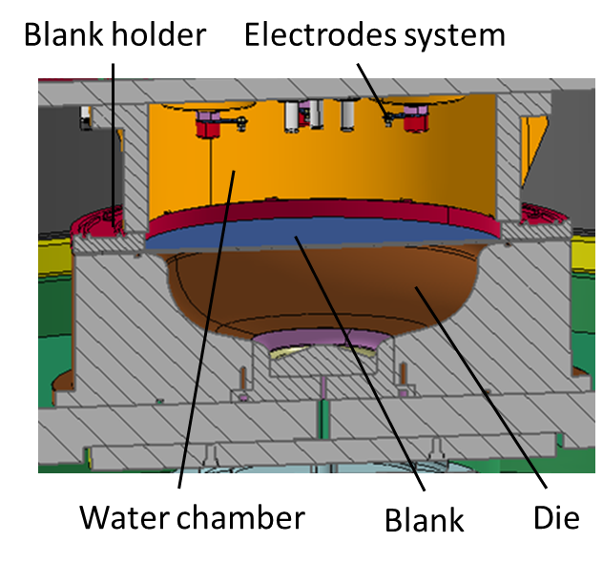
Electro-Hydro Forming: Introduction
Electro-Hydraulic Forming (EHF) :
alternative method to conventional shaping methods of cavity fabrication (..spinning, deep drawing..)
High speed
Contactless
How..
an electric arc is generated in water between electrodes
shockwaves in water (10³÷10⁵ s⁻¹) produce high speed deformation of metal
Strain rate for cavity forming in the order 10³ s⁻¹
Blank
Non-thermal plasma
Courtesy Bmax

Slide 4
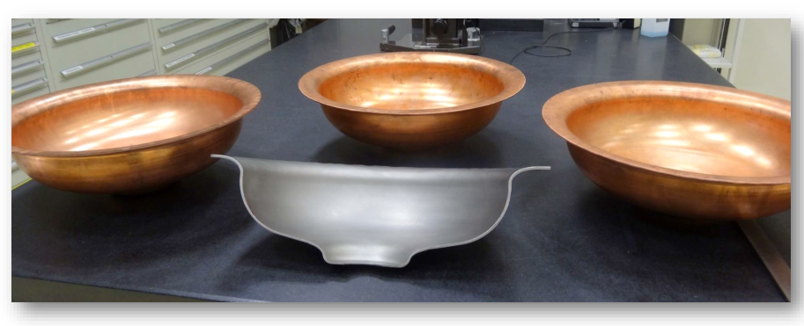
EHF: Advantages & Activities
Advantages:
High strain rate *:
increased metal formability
reduced springback
lower occurrence of defects (wrinkling, puckering)
Contactless forming:
Cleanliness of RF surfaces
Process reproducibility and scalability (time, cost)
Collaboration
Current activities for SRF Cavities:
LHC 400 MHz in copper substrate
FCC 800 MHz bulk Niobium
Ongoing characterizations:
RF surface : roughness, inclusions
Shape accuracy
Thickness
RRR
Strain, dislocations, hardening…
Non-thermal plasma
Non-thermal plasma
(*) both FCC & BCC materials

Slide 5
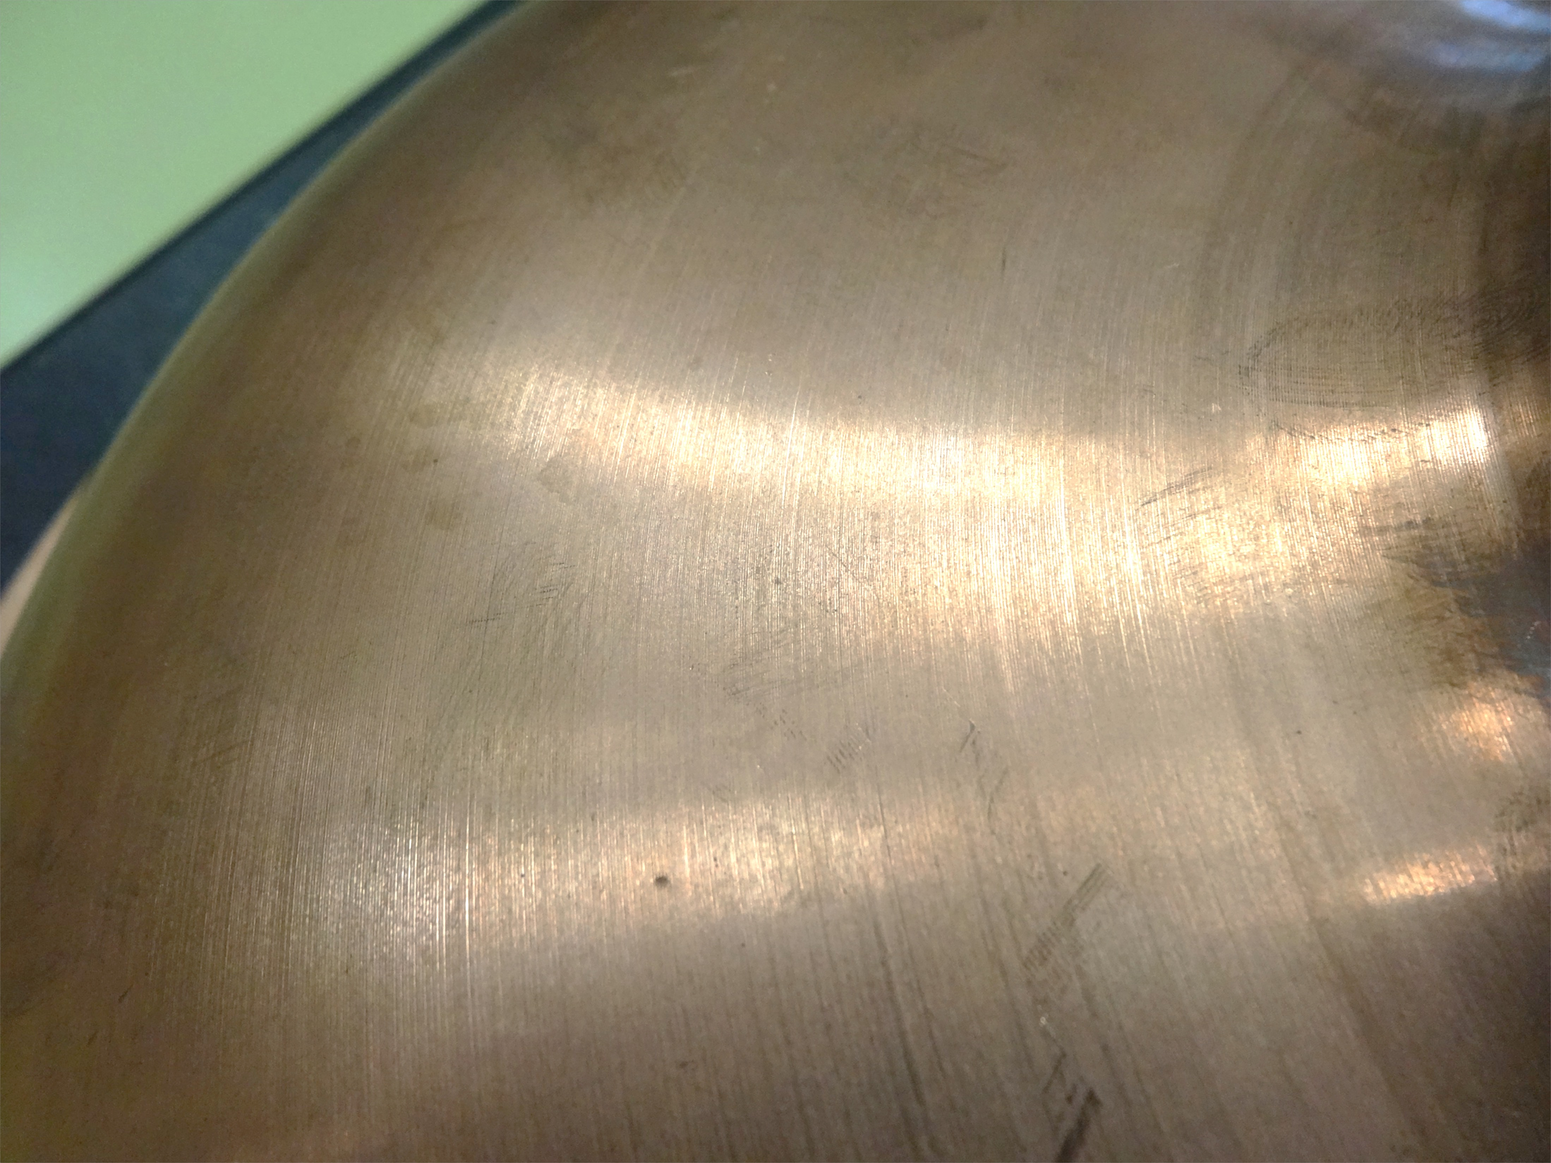
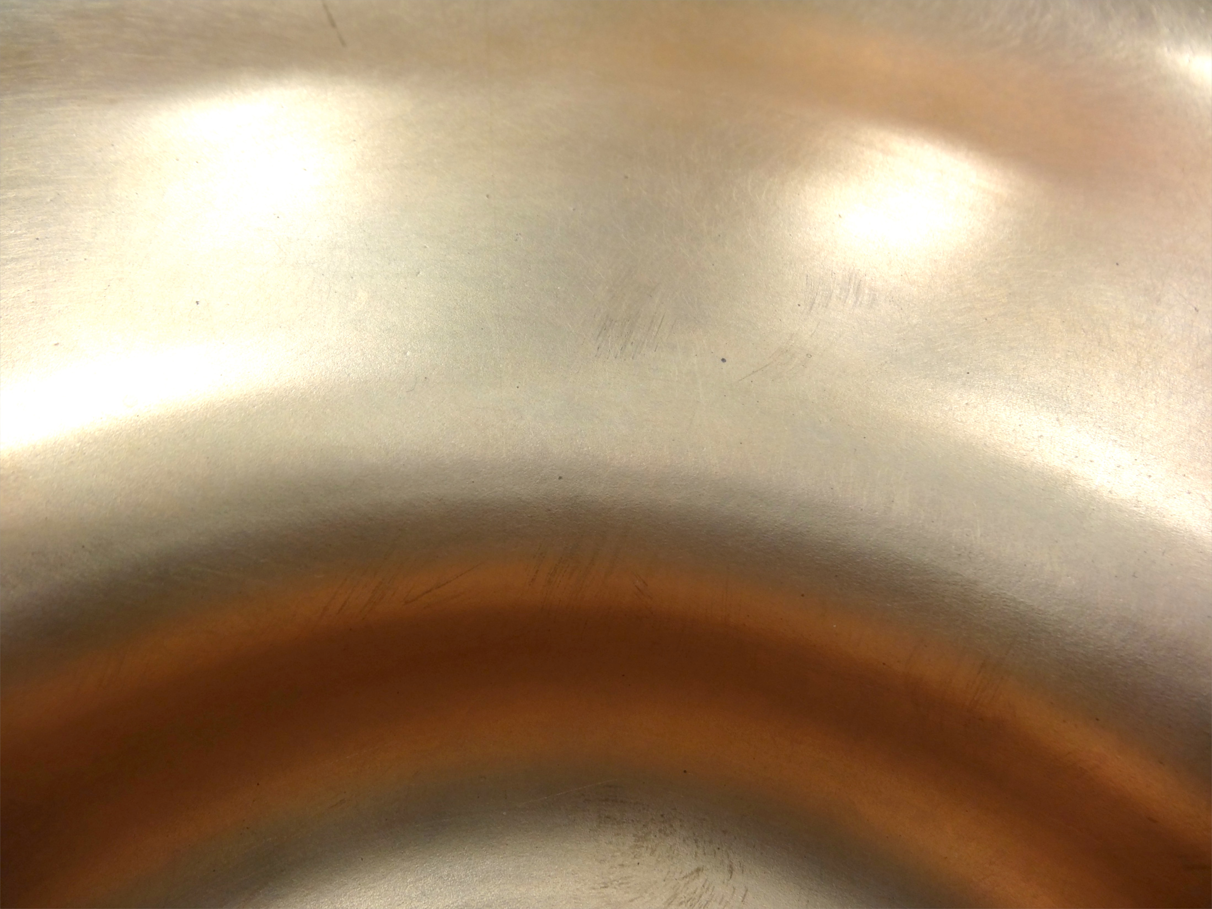
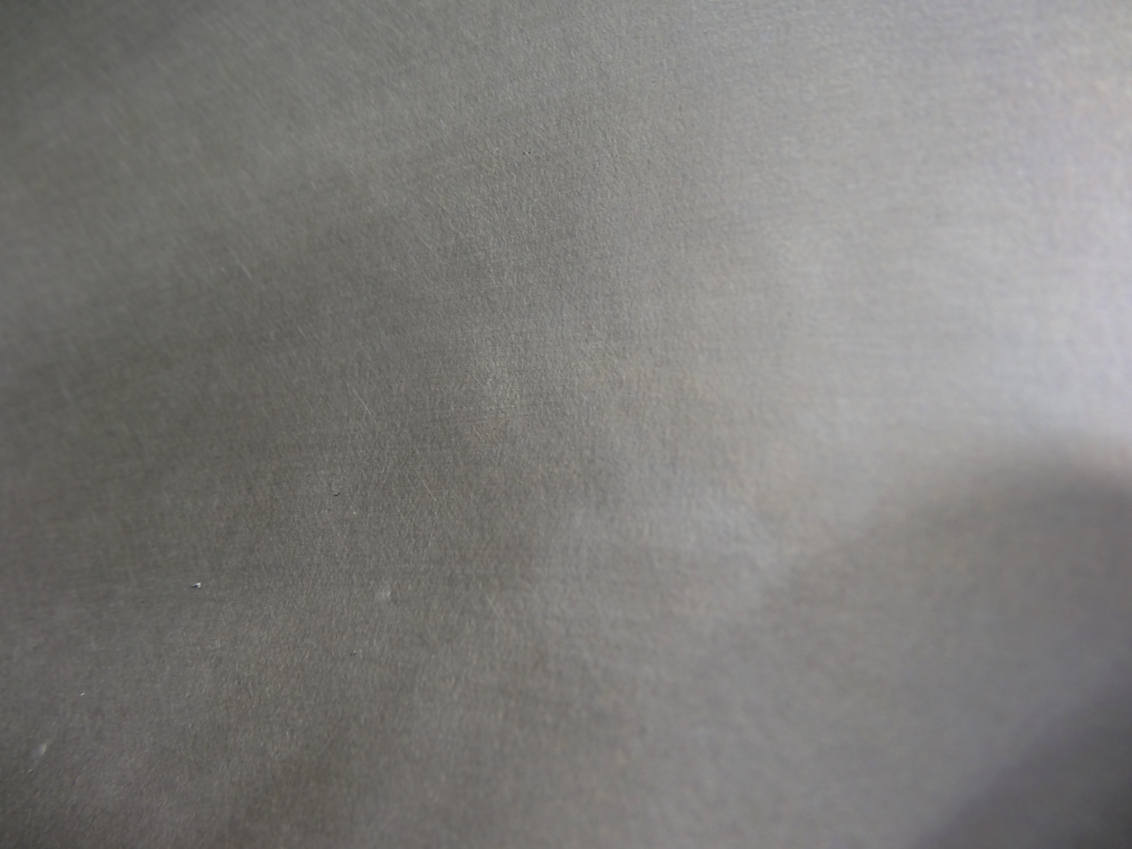
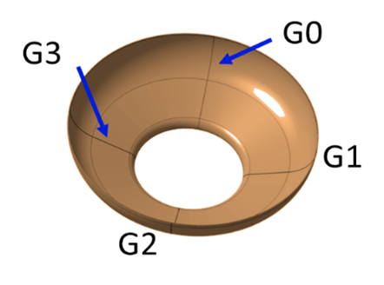
EHF & SRF: Some Results
OFE Cu outer surface
OFE Cu RF surface
Nb RF surface
Roughness
Id | Ra sheet (µm) | Rt sheet (µm) | Ra EHF (µm) | Rt EHF (µm)
OFE | 0.2 | 3.5-5.8 | 0.2 | 2-12
Nb | 0.8-0.9 | 7-11 | 0.9-1 | 8-11
300 mm
200 mm
Thickness : amply constant along profile
Shape accuracy : ± 200µm
Wall Thickness (mm)
Iris
Equator
Distance from the equator along the profile (mm)
[initial sheet thickness = 3mm]

Slide 6
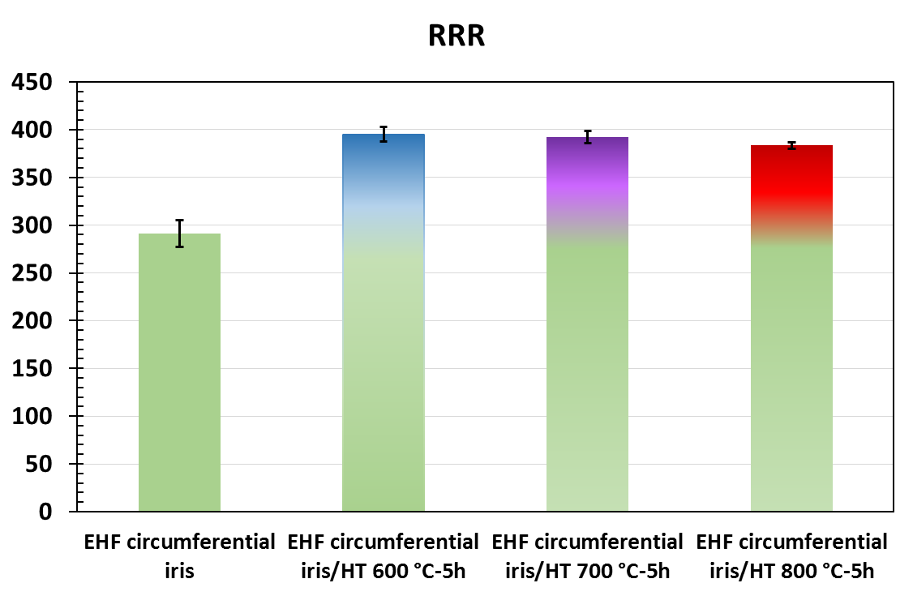
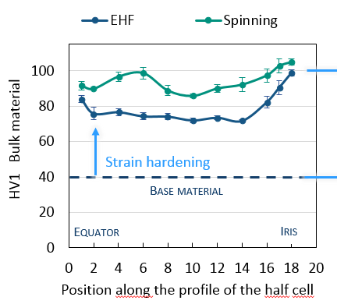
EHF & SRF: Some Results
Process does not affect RRR values
Strain:
less extreme than in other processes
Uniform distribution on the through-thickness
Electron back scatter diffraction
Base material
Formed material by EHF

Slide 7
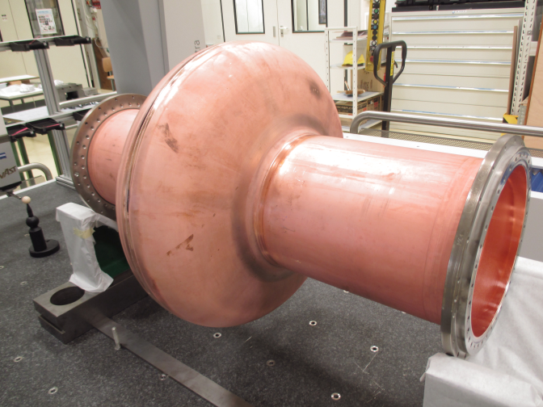
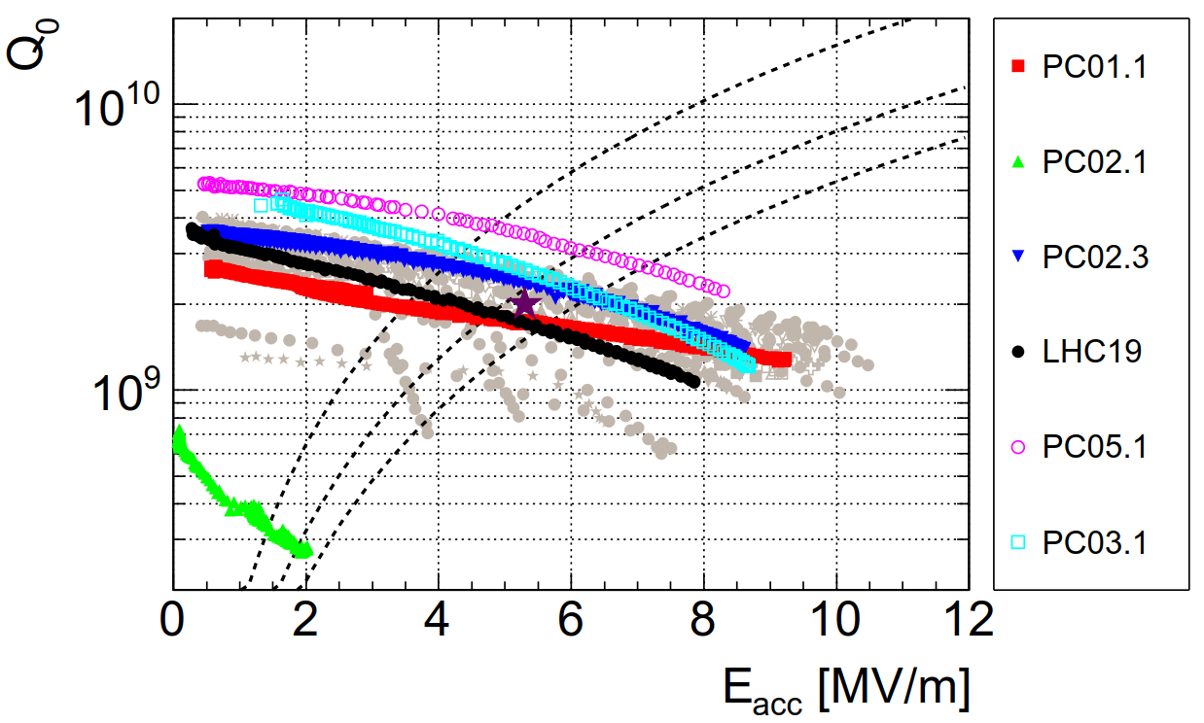
Conclusions
Contactless forming → RF surface cleanliness
Good results in terms of thickness and shape accuracy (easier assembly and post fabrication steps)
Promising results in terms of cavity RF performance
Good potential for process scalability (time, costs)
Potentially higher formability
Ongoing work:
Process optimization (tools, parameters..)
400 MHz: validating initial results on 2nd cavity
800 MHz: New bulk Nb cavity under production
Contact @ CERN: Carolina Abajo

Slide 8
Thank you
References and Slide Contributions:
S. Atieh, “First Results of SRF Cavity Fabrication..”, SRF, Whistler (Canada), 2015
E. Cantergiani, “SRF Cavity Fabrication by Electro-Hydraulic Forming”, FCC Week, Rome (Italy), 2016
C. Abajo, “Surface quality and improvements on the SRF cavity …”, FCC Week, Amsterdam (Netherlands), 2018

Slide 9
SPARE

