Slide 1
Summary of WG1 conveners: Han Li (UU), Kazutaka Ozeki (RIKEN), Bob Laxdal (TRIUMF)
There are a variety of significant low to medium beta projects being pursued using non-elliptical TEM mode cavities (QWR, HWR, single and multiple spokes). Projects include FRIB, ESS, RISP, C-ADS and RIKEN. In principal the performance limits for non-elliptical cavities should be similar to elliptical cavities but the cavities typically operate in a lower frequency range and with unique geometries. Comparing performance across the variants is not as evolved as with 1.3GHz elliptical cavities. The scope of this working group is to discuss the known limitations of TEM mode accelerating cavities.
The range of discussion should include:
Performance results Q,Rs(B) vs Ea,B from various labs
Experience with heat treatments including doping
Role of rf frequency
Multipacting issues
4K vs 2K operation

Slide 2
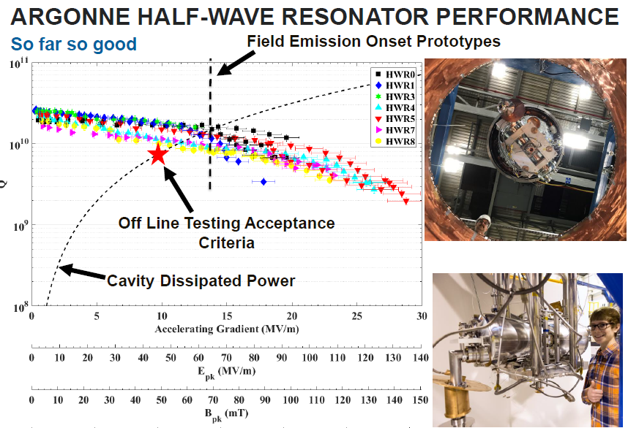
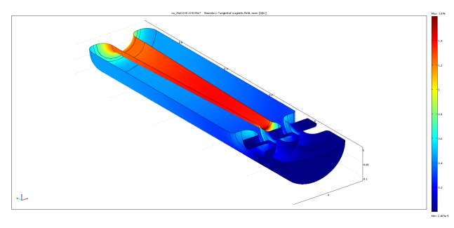
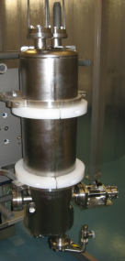
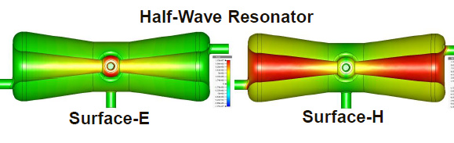
(1) Performance results Q,Rs(B) vs Ea,B from various labs
Performances are continuing to improve – latest results from ANL and TRIUMF (RISP) indicate cavities operating at up to Bp~143mT for both EP and BCP cavities respectively with ANL at Ep=135MV/m! (well above beta=1 cavity)
RISP QWR Tested at TRIUMF
EP
BCP
0
20
40
60
80
100
120
140
160
Bp (mT)

Slide 3
1) Performance - FRIB
largest low beta linac ever built
~ X-FEL in terms of complexity due to design using four cavity families, 6 CM variants (340 SRF cavities)
Great opportunity to extract excellent data with high statistics
FRIB certified cavities so far:
  16 β=0.041 QWRs, 96 β=0.085 QWRs, 72 β=0.29 HWRs, and 81 β=0.53 HWRs
  So far 268/322 (81%) have been tested in VTA.
These statistics give valuable information about cavity performance limitations in production mode, which suggests needed R&D for future high gradient (Ep>40MV/m, Bp>80mT) low/medium beta cavities.
FRIB cavity basic processing:
  Nb @ RRR > 250, Bulk BCP (> 120μm), 600^{O}C - 10 hrs, BCP( ~10μm), HPR
  No 120 Bake, test at 2K.

Slide 4
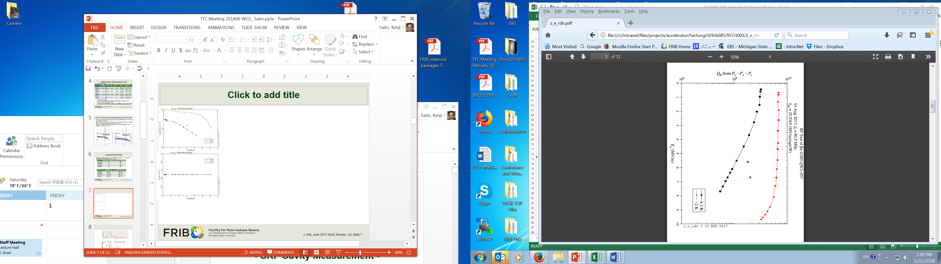
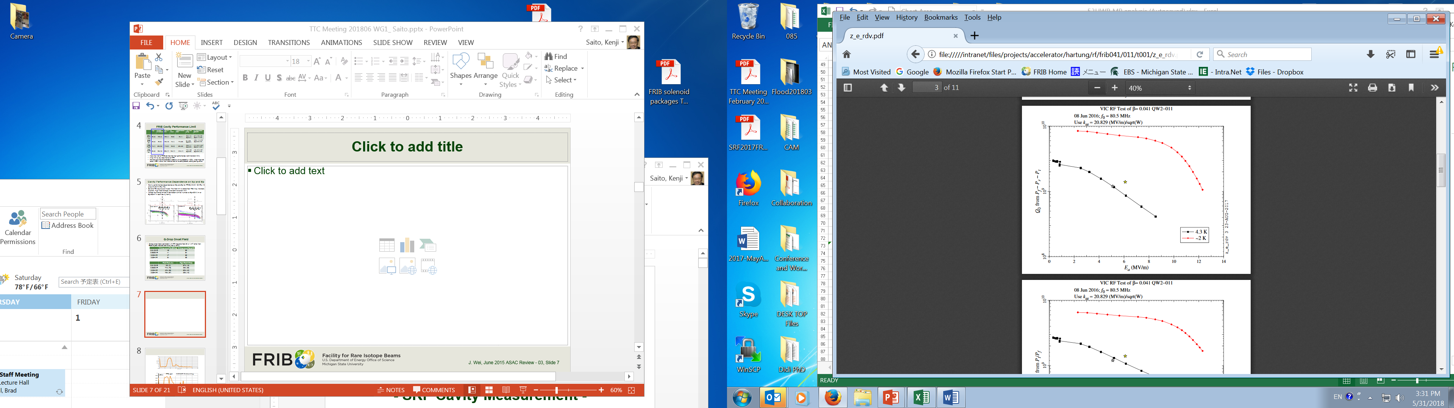
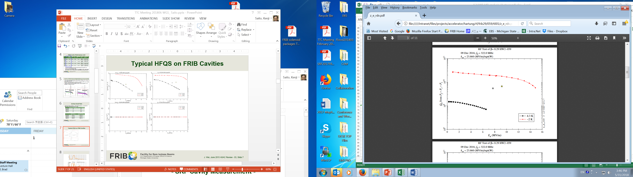
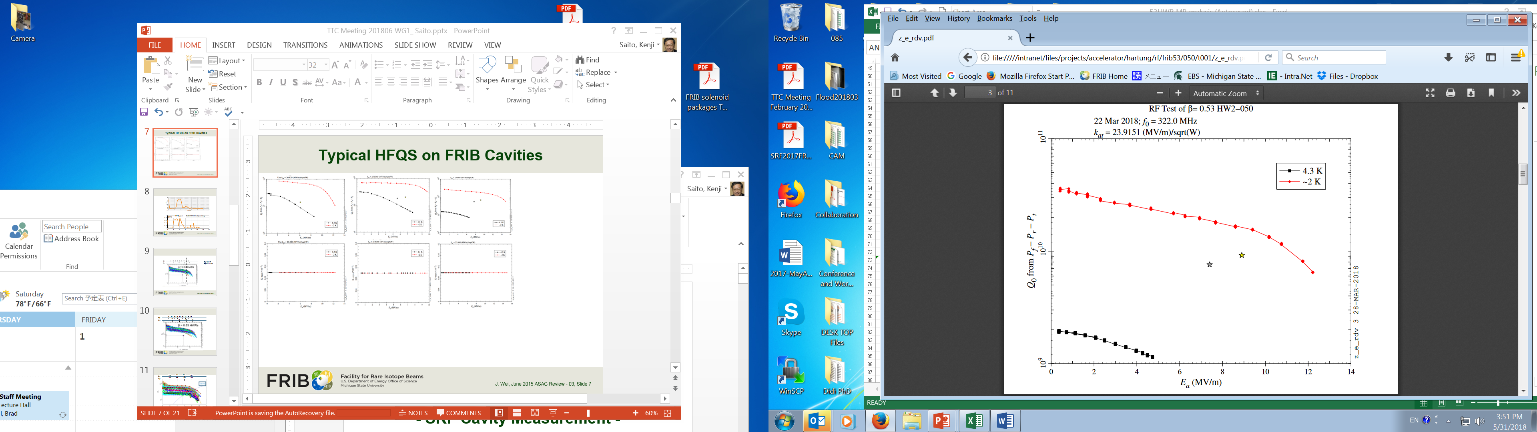

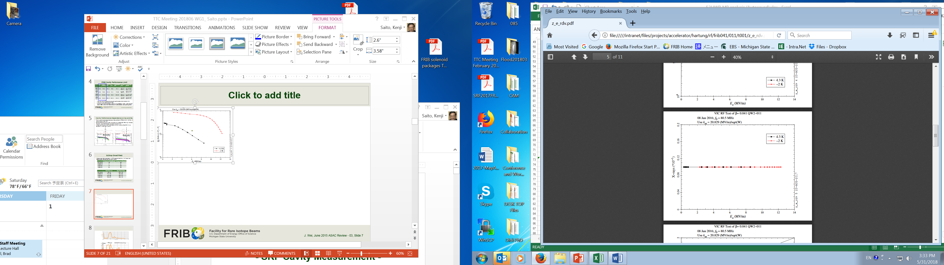


High Field Q-Slope
Pure high field Q-slope (HFQS) without X-ray is often observed in every FRIB cavity family.
The average onset field is coincident at a Bp ~ 84 mT in every cavity family, which corresponds to Eacc=20MV/m for ILC cavity – similar to the onset field of HFQS with BCP’ed cavities.
HFQS
HFQS
HFQS
HFQS
Eacc ~ 8 MV/m
Eacc ~ 7 MV/m
Eacc ~ 11 MV/m
Eacc ~ 9.5 MV/m
0.041QWR
0.085QWR
0.29HWR
0.53HWR
No X-ray
No X-ray
No X-ray
No X-ray
0.041QWR-Xray
0.085QWR-Xray
0.29HWR-Xray
0.53HWR-Xray

Slide 5
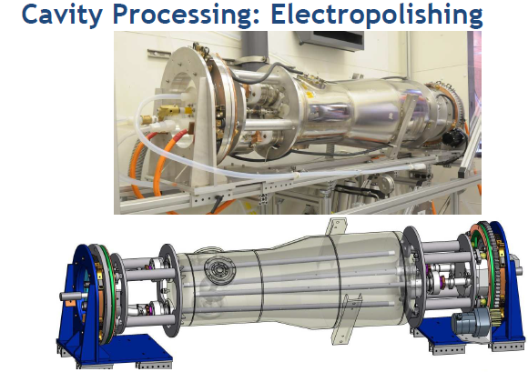
EP ANL
Thinking about the future is EP required to push out HFQS?
Presently both BCP and EP providing good performance at specified gradients.

Slide 6

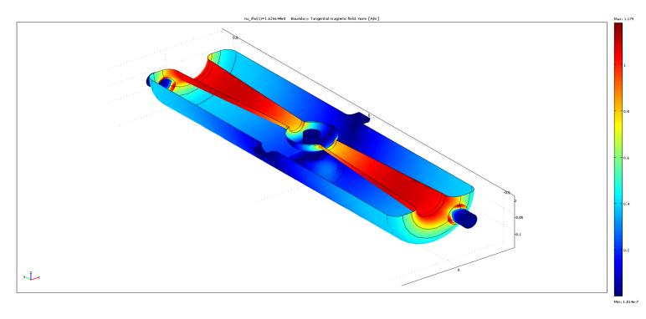
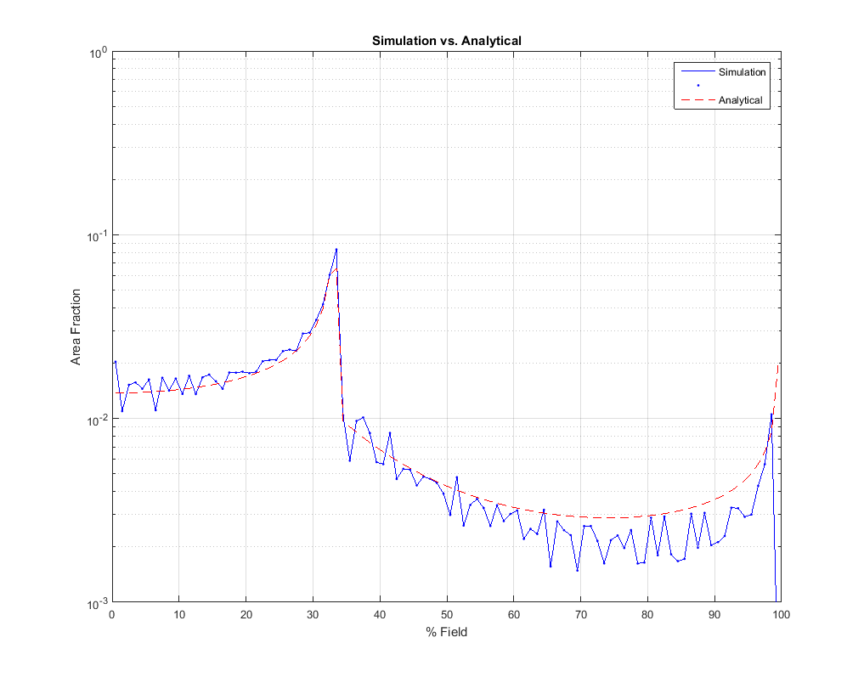

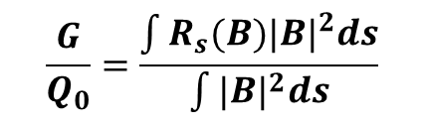
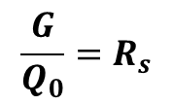
Geometry Factor and Extracting Rs(B)
TEM cavities have a significant portion of the power loss below the peak magnetic field compared to elliptical.
Comparing performances of field dependent Rs across different TEM cavities requires more than Q₀(B)=G/R_{s}(B) since G is dependent on R_{s}(B)
$$\frac{G}{Q_{0}}=R_{s}$$
$$\frac{G}{Q_{0}}=\frac{\int{{R_{s}(B)|B|}^{2}ds}}{\int{{|B|}^{2}ds}}$$
Distribution function
$$R_{s}\left(B\right)=R_{s0}+α_{1}|B|+α_{2}{\left|B\right|}^{2}$$
Bsurface

Slide 7
Multipacting Issues

Slide 8
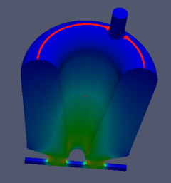
Multipacting
Experience/Issues
  IMP
    MP simulations are quite accurate at predicting levels
  RISP – HWR
    Changed design from `flat top’ to `dome top’ to reduce MP issues
  FNAL SSR1
    Reported that MP conditioning can take several hours to up to 2 days or more to condition the PIP-II SSR1 spoke
Mitigations
  Modifying the geometry
    Small changes in local geometry can help in design stage
    New geometry – Balloon SSR - TRIUMF – proposed, designed, built and tested first Balloon SSR cavity - very effective at decreasing negative impact of MP
      1.5 hours to get through all barriers – no barriers above 1.8MV/m
  Heat treatment is effective at reducing MP conditioning time
    Either a 120C bake (48 hours) if that is part of the process
    Or <100C for 48 hours (magic?)
    Also can install heaters in on-line cavities – TRIUMF (80C pre-cooldown)

Slide 9
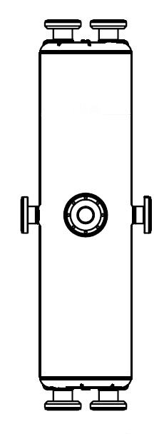
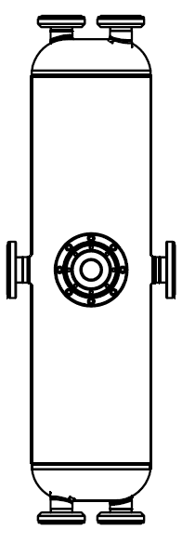
the prototype cavities of QWRs & HWRs
Stage | QWR prototype | HWR prototype
Performance Test (Bare cavity) | #2-2 (RI) #3-1 (VZ) #3-2 (VZ) | #1-1 (RI) #3-1 (VZ) #3-2 (VZ)
Performance Test (Jacketed cavity) | - | #3-1 Round type VZ) #3-2 Round type (VZ) #3-3 Flat type (VZ) #3-4 Flat type(VZ) to be tested
Total | One 2nd (RI) Two Bare Cavity 3rd (VZ) | One 1st (RI) Three 3rd Bare & Dressed(VZ)
Flat type
Round type
Vendor : RI: Research Instruments, VZ: Vitzro Tech

Slide 10
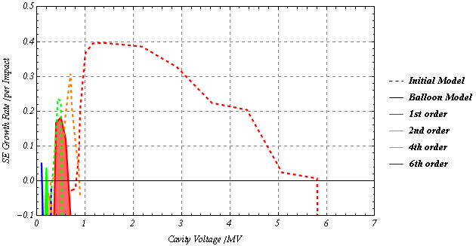
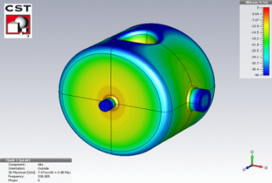
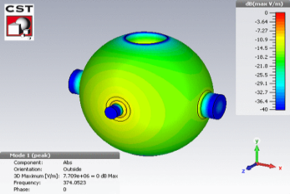
Comparing MP in Traditional SSR and Balloon SSR - TRIUMF

Slide 11
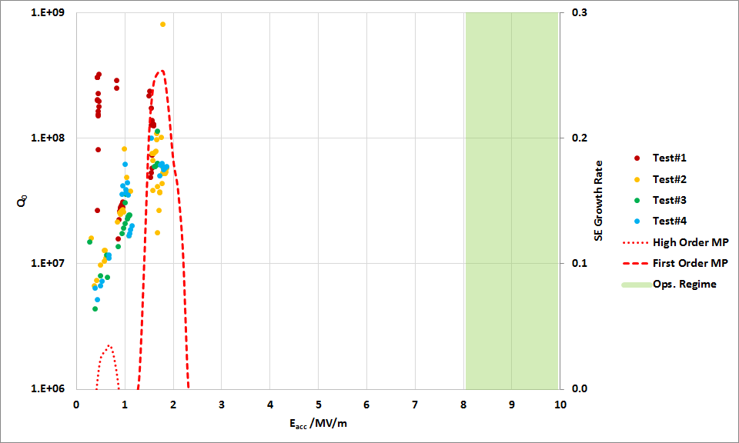
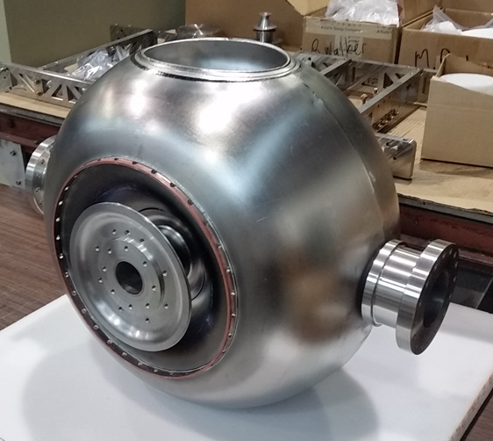
Multipacting simulations confirmed in First Balloon Cold Test
There is excellent agreement between MP simulations and cold test data
No multipacting barriers near the operational gradient or below 0.1 MV/m.
The barriers only exist between 0.2 MV/m and 1.8 MV/m.
TRIUMF: First demonstration of Balloon geometry

Slide 12
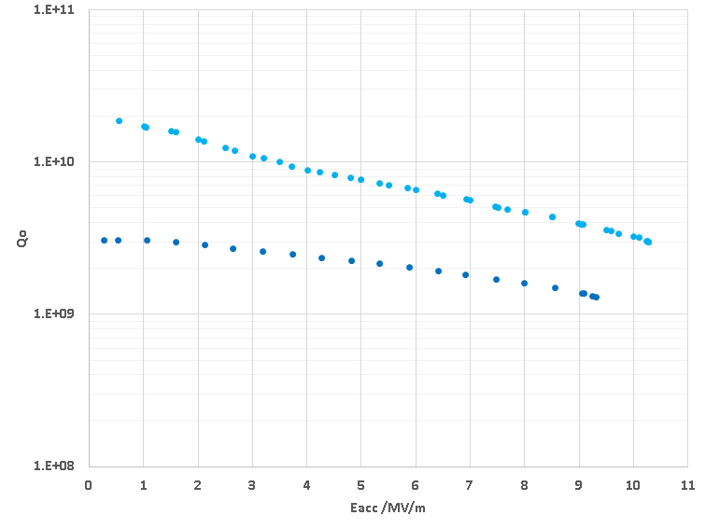
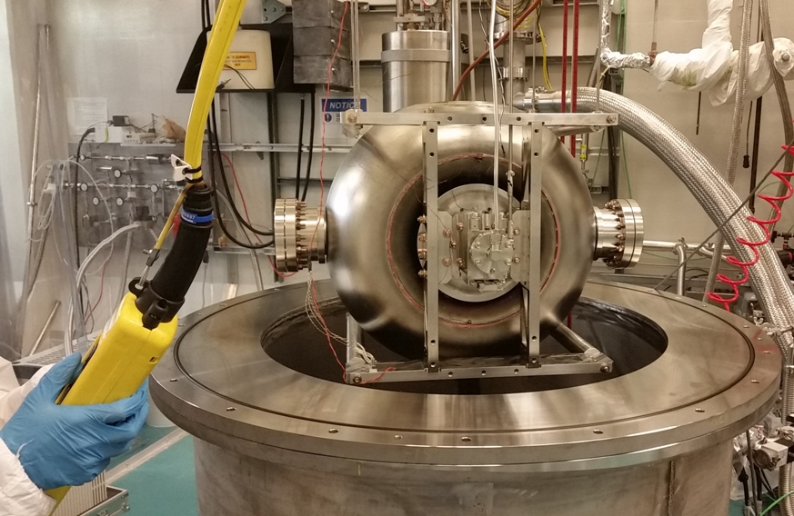
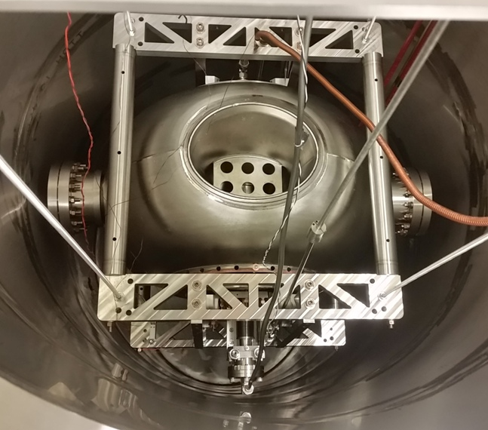
Cold test – Jan. 12, 2018 TRIUMF
2K Result
4.2K Result
New SSR variant prototype successfully completed by TRIUMF - RISP adopts balloon for SSR1 and SSR2.

Slide 13
Role of Frequency

Slide 14
ODU Coaxial Test Cavities for fundamental study
Surface Electric Field
Surface Magnetic Field
325 MHz
650 MHz
325 MHz
650 MHz
975 MHz
1300 MHz
975 MHz
1300 MHz

Slide 15
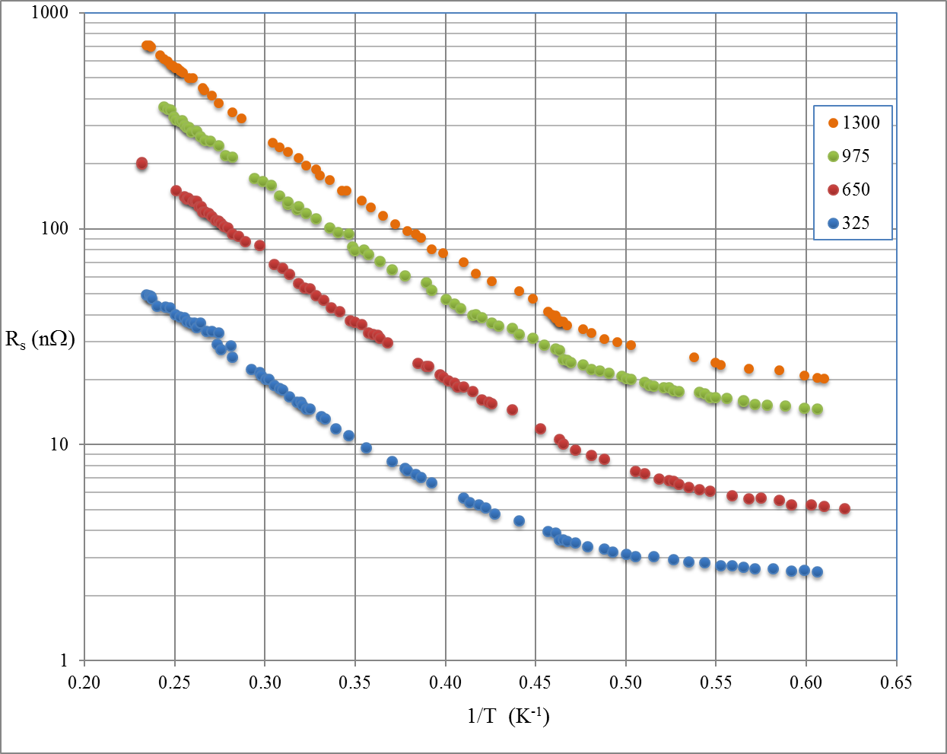
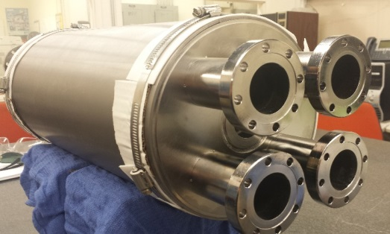
Low Field Frequency Dependence
Initial tests (ODU) – more to come!
No low-T baking
ODU

Slide 16
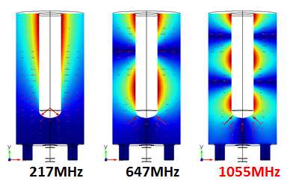
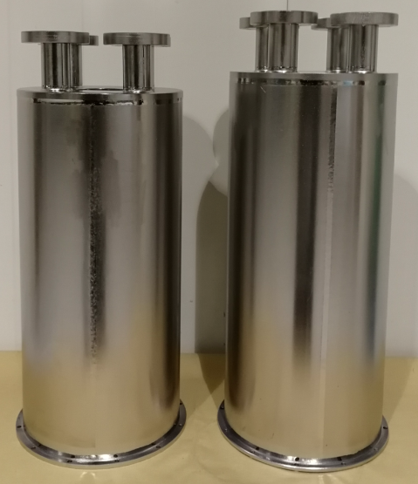
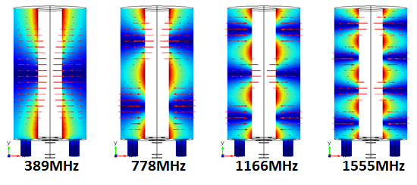
TRIUMF Coaxial Test Cavities for fundamental study – soon to test!
Lowest Modes
The cavities are designed as the coaxial equivalent of a 1.3GHz single cell cavity for TEM R&D

Slide 17
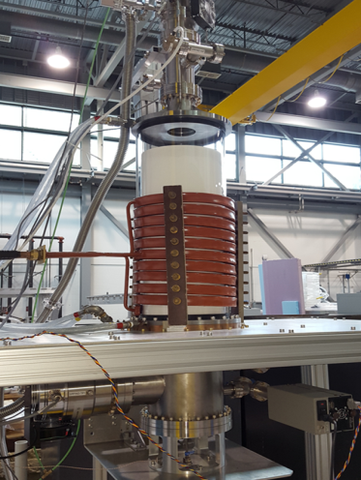

Summary
New Developments – TRIUMF - heat treatments
Coaxial cavities have been fabricated and our being prepared for first cold test next month
Goal is to test the cavities at the fundamental and higher harmonics to characterize field dependent rf losses as a function of rf frequency
A UHV rf induction oven is now available for heat treatment studies – ie doping

Slide 18
Experience with heat treatments

Slide 19
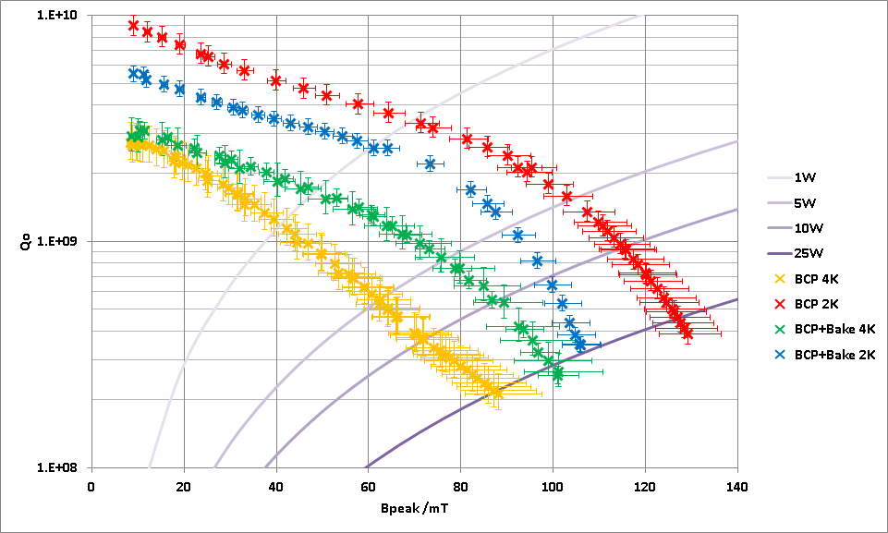
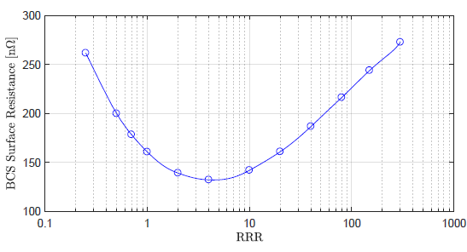
QWR 120C Bake
120C Bake applied for 48 hours
The bake modifies the MFP within the surface layer and improves R_{BCS} at the expense of increasing the residual R_{res}
120micron BCP
120C bake lowers BCS but increases residual so 4K performance improved but 2K performance reduced

Slide 20
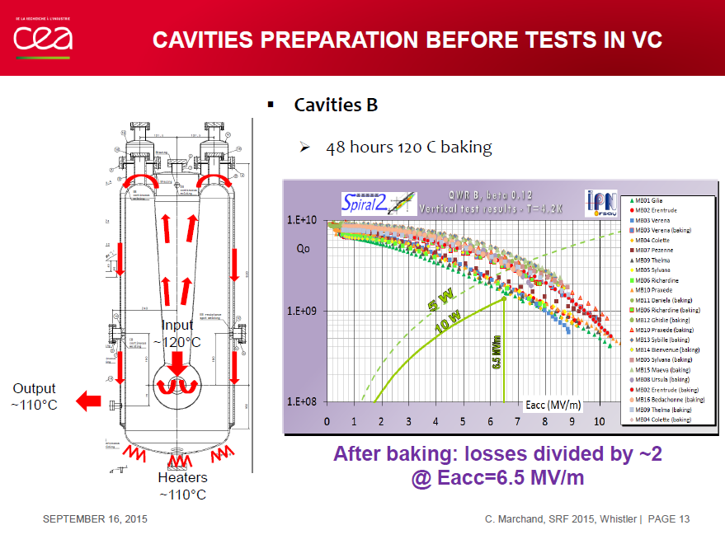
Nice benefit for Spiral-II at 4K

Slide 21
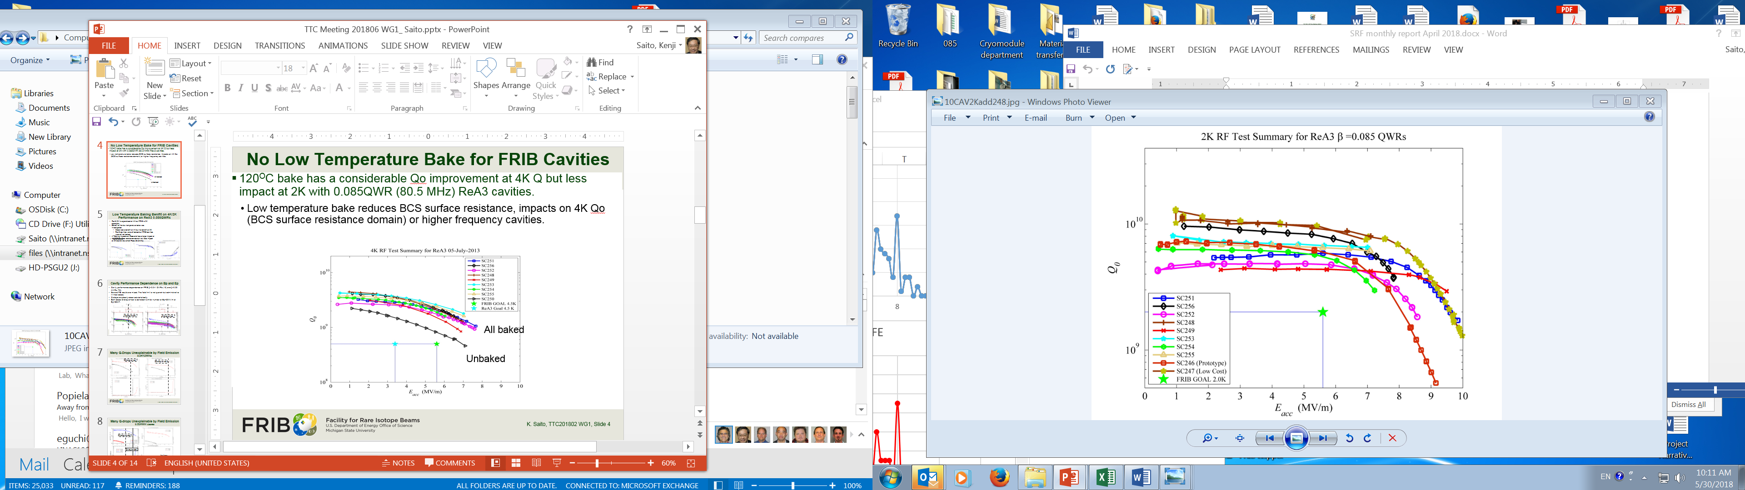
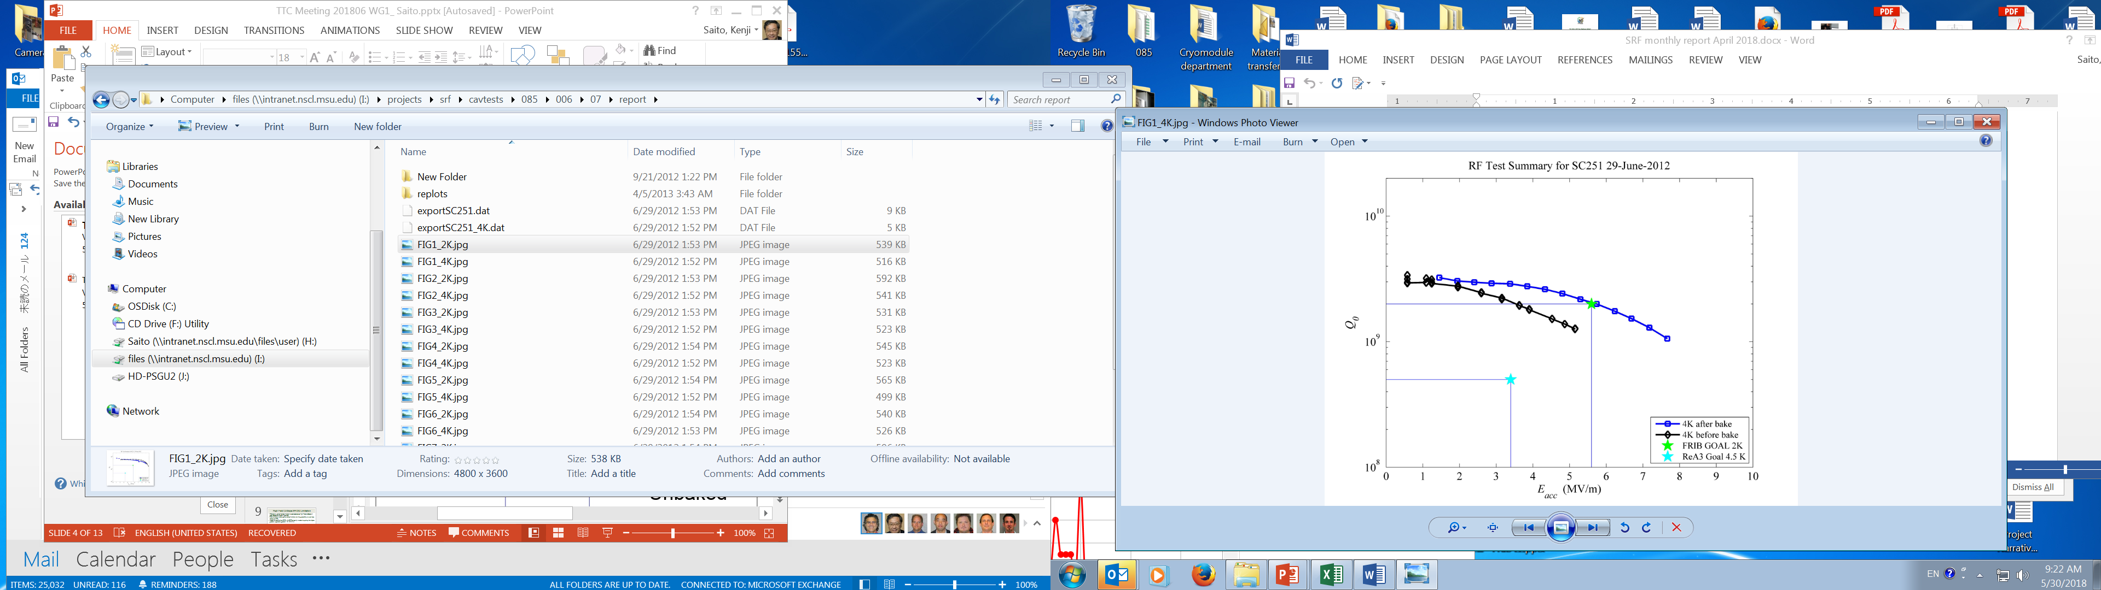
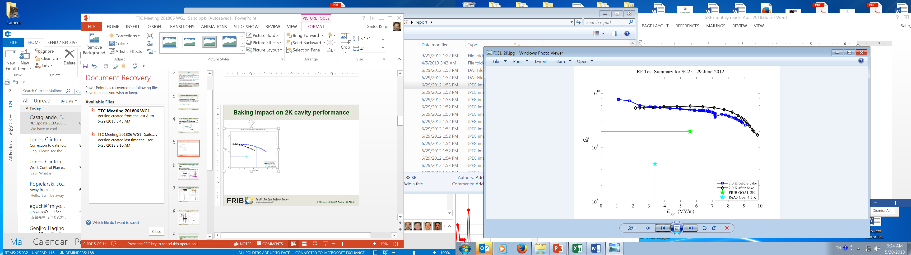
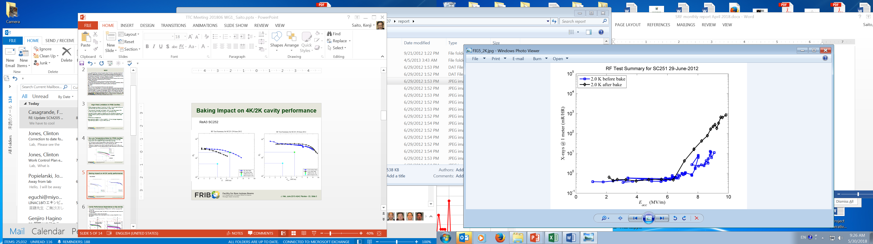
Low Temperature Baking Benefit on 4K/2K Performance on ReA3 0.085QWRs
120C bake for ReA3 0.085QWRs
  benefit at 4K but no benefit at 2K
ReA3 is operated at 4K and employed LT bake.
FRIB is operated at 2K, LT bake was not employed to save time.
ReA3 cavities 4K
ReA3 SC252
4K
2K
X-ray at 2K

Slide 22
4K vs 2K – Data extraction

Slide 23
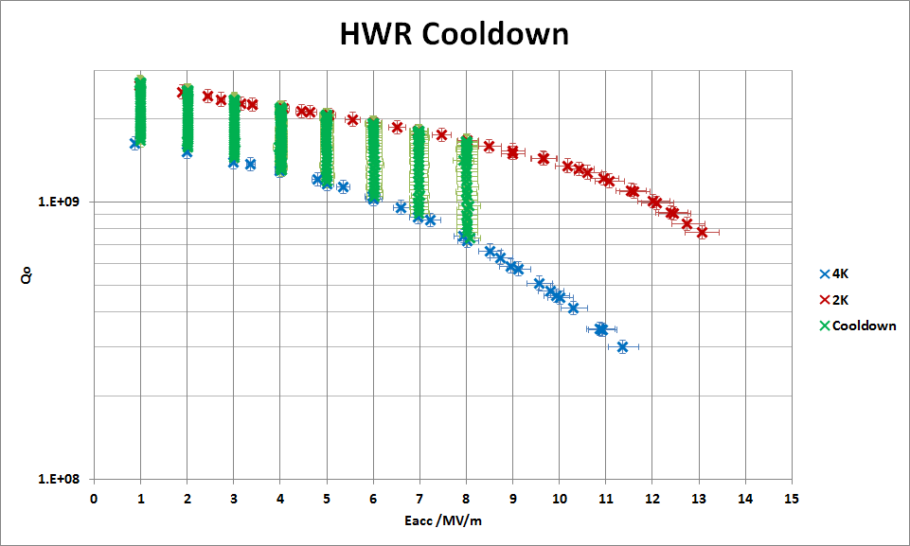
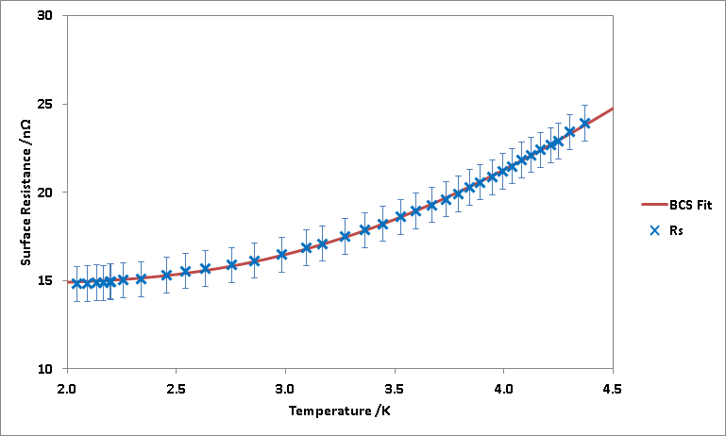


4K to 2K Data to Extract R_{BCS} and R_{res}
Informative to separate R_{BCS} and R_{res} components, Q measurements are taken at various field levels and temperatures as the cavity is cooled down
R_{BCS} follows an exponential dependence with temperature
$$R_{s}=R_{res}+R_{BCS}$$
$$=R_{res}+A\frac{f^{2}}{T}e^{−\frac{∆}{k_{B}T}}$$

Slide 24
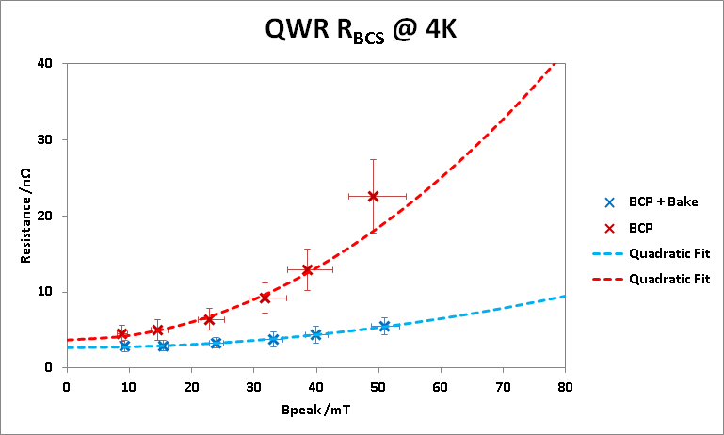
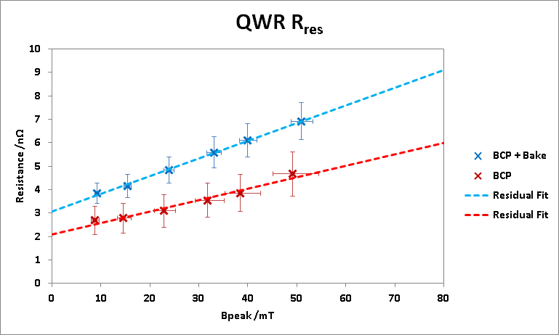
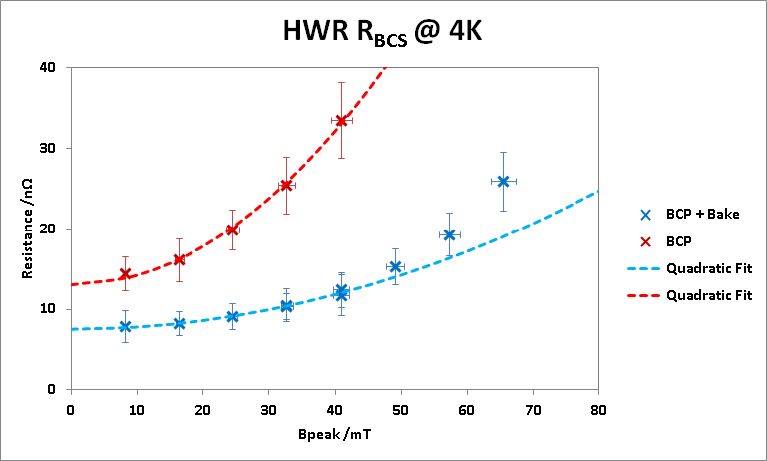
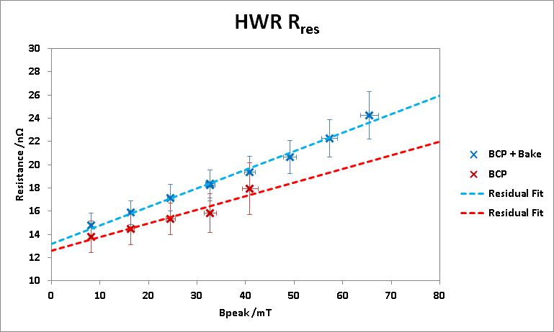
Separation into R_{bcs} and R_{res} - TRUMF
No bake
120C
QWR
No bake
120C
No bake
120C
HWR
120C
No bake

Slide 25
Advancing technologies

Slide 26
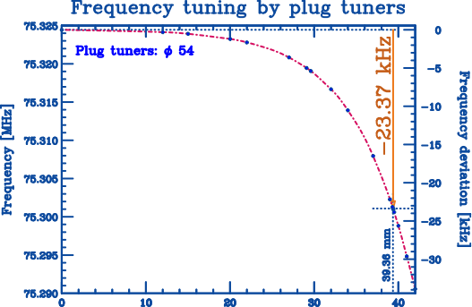
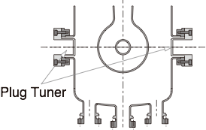
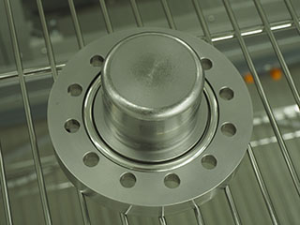
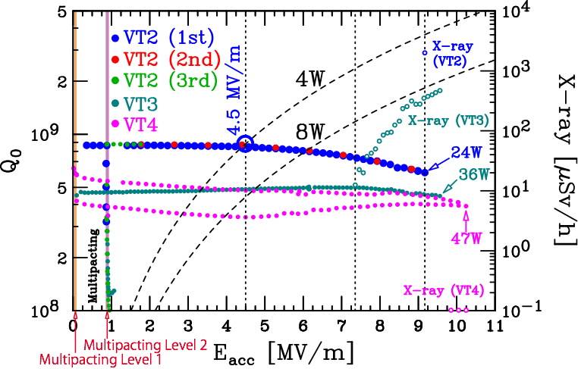
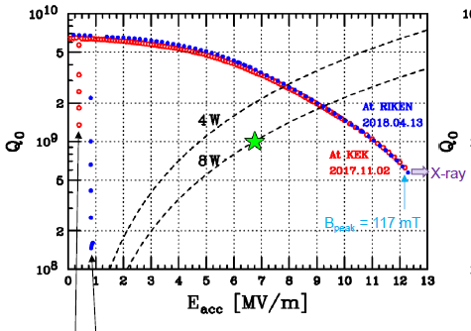
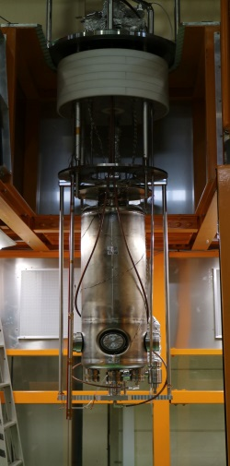

Plug tuner Riken
Hight of the Plug Tuner
Photo of a plug made of pure Nb
Hight of the Plug Tuner

Slide 27



Plasma cleaning on SC cavity - IMP
RF plasma cleaning on room temperature
Plasma cleaning processing completed after the cavity deposited with carbon by PECVD
A quadrupole mass spectrometer was installed for residual gas monitor, the production of the plasma interaction with niobium surface
Discharge parameters, such as pressure, oxygen volume ratio and RF power, were optimized for the uniform distribution inside cavity
Plasma discharge of Ar/O2 inside SC HWR cavity
Fig. Plasma cleaning setup for HWR (left) and picture of discharge on the cavity (right)
*A.D. Wu et al., In-situ plasma cleaning to decrease the field emission effect of half-wave SRF cavities, submitted to NIMA.
antonwoo@impcas.ac.cn

Slide 28
Plasma cleaning on SC cavity
Performance recovery results
Max Epeaks increased from 57MV/m to 70MV/m (23%) after plasma cleaning
Set on point of the FE increased from 32MV/m to 58MV/m (43%), and max x-ray radiation dose decreased from 200 to 4.5 uSv/h
MP effect was removed around the Epeak of 16MV/m by the plasma cleaning
MP region

Slide 29


FNAL 120C with IR heating panels

Slide 30
Summary of WG1
A lot of progress in TEM mode cavities – new structures, new treatments, new projects
FRIB is bringing a lot of statistics to the community
Common analysis and data taking will help us compare across cavity variants
New tools are emerging to shed light on fundamental issues of rf frequency, field dependence
Thanks to all participants for their input and good discussions
And thanks to our hosts!

