Slide 1
WG3 Summary
’High Q and high gradient performance’
Alex Romanenko (FNAL)
Kensei Umemori (KEK)
Marc Wenskat (DESY)

Slide 2
Some Numbers…
4 Sessions
  2 Cavity related / 1 Sample related / 1 Theory related
18 Contributions
Europe
Asia
North America

Slide 3


…and some kind of „Magic“

Slide 4
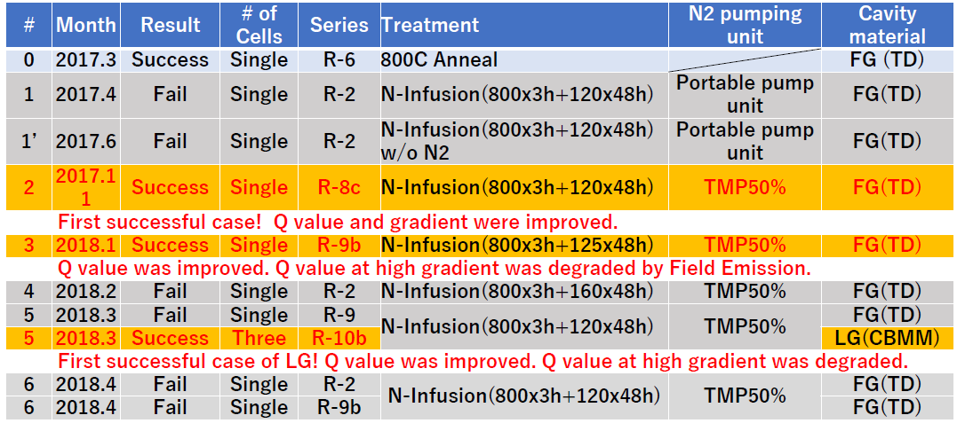
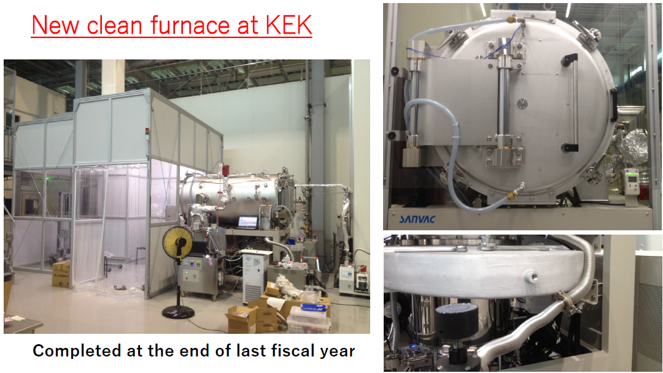
Status Update KEK on Infusion
Intensive Effort
Failed & successfull runs @ JParc Furnace
New furnace at KEK

Slide 5
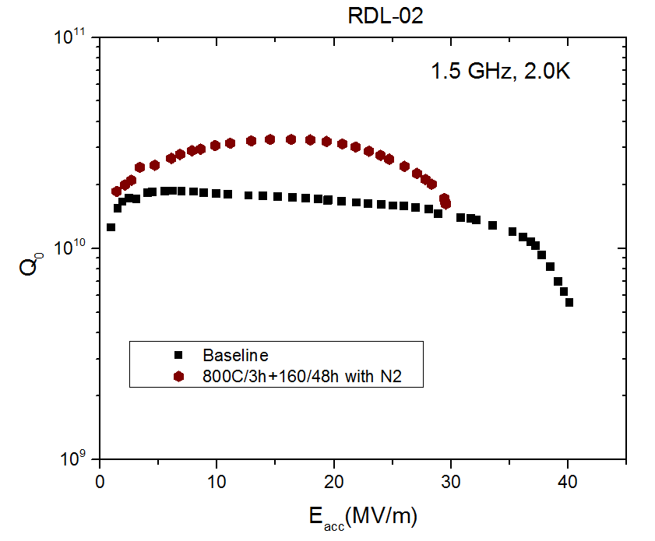
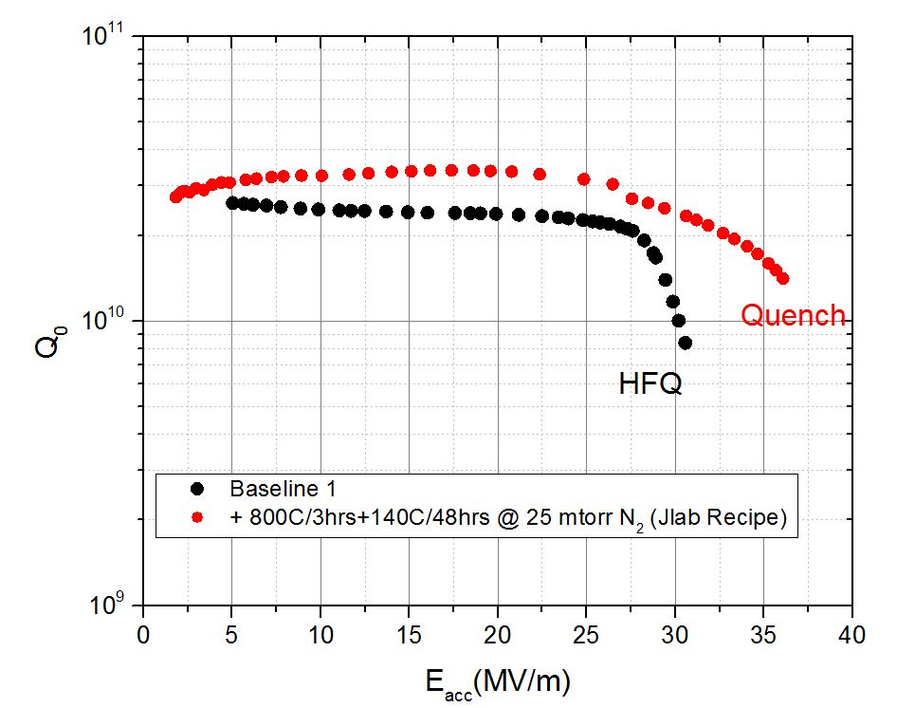
Update on N-infusion at JLab
Successful infusion runs at multiple temperatures
Need to inject at higher T to succeed
Upgrade of furnace diagnostics &

Slide 6
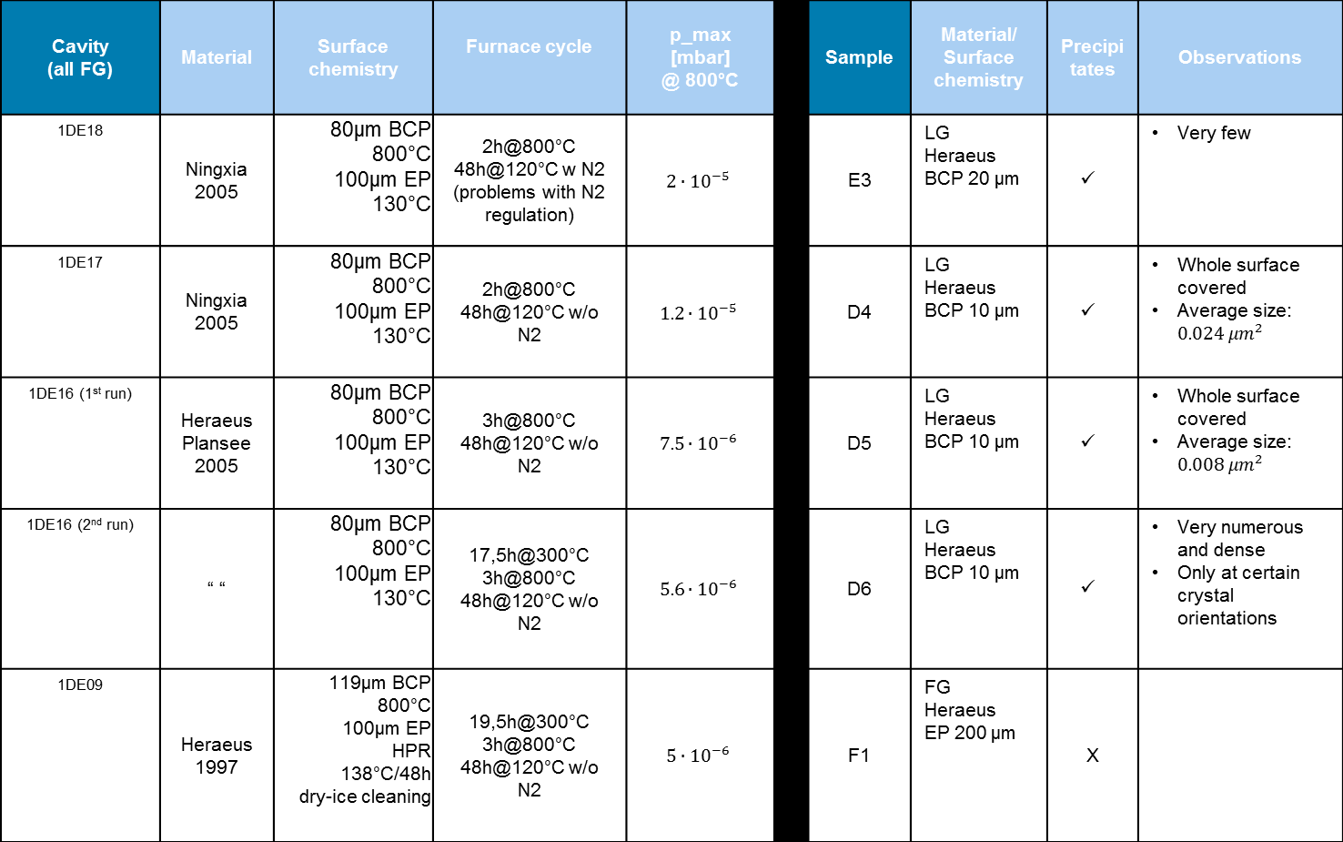
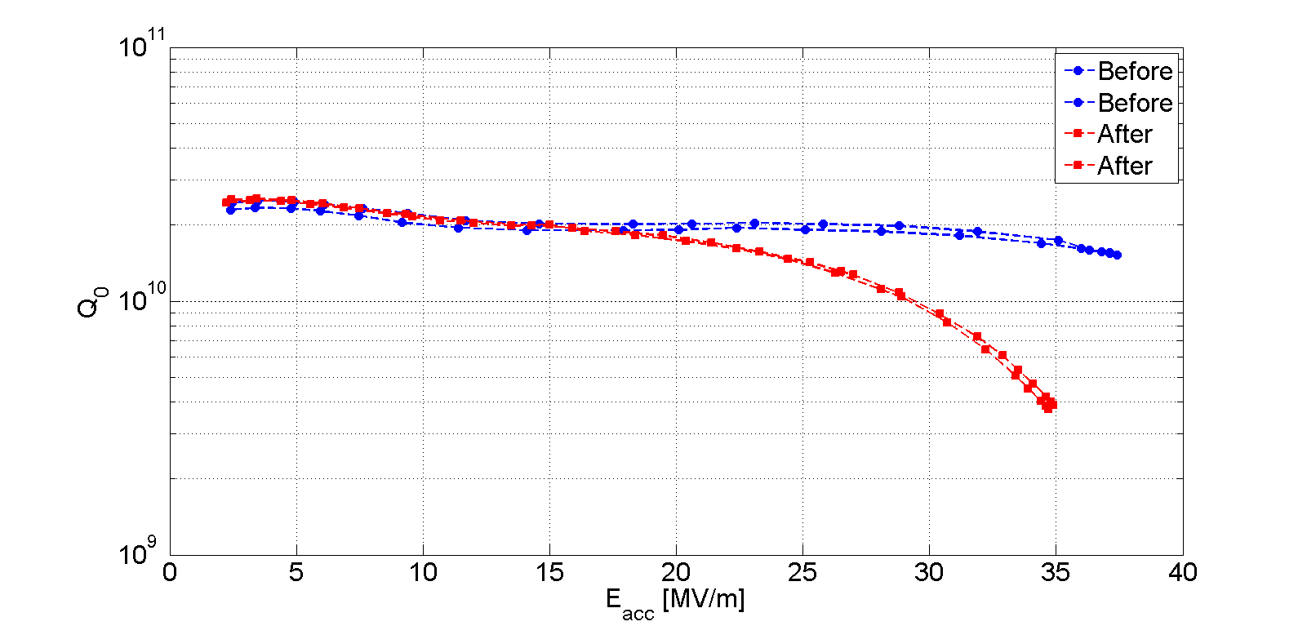
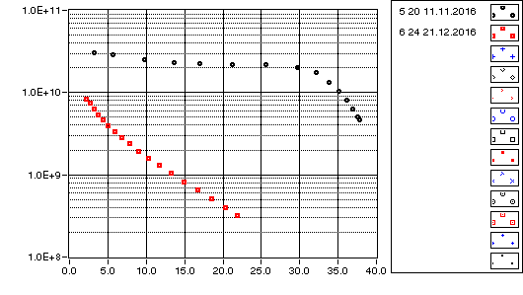

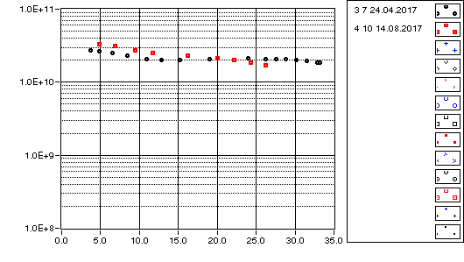
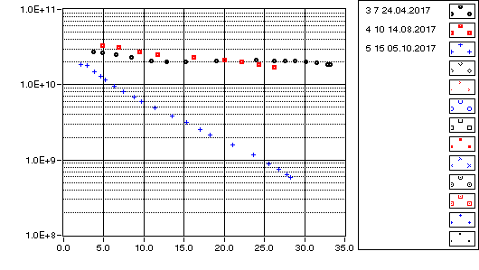

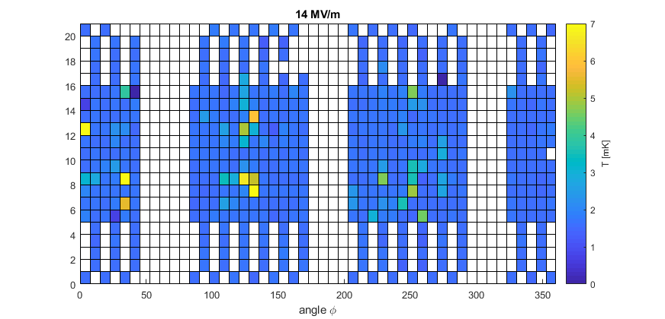
Infusion R&D at DESY
No successfull infusion yet – extensive R&D on necessary furnace conditions
Collaboration with several labs

Slide 7
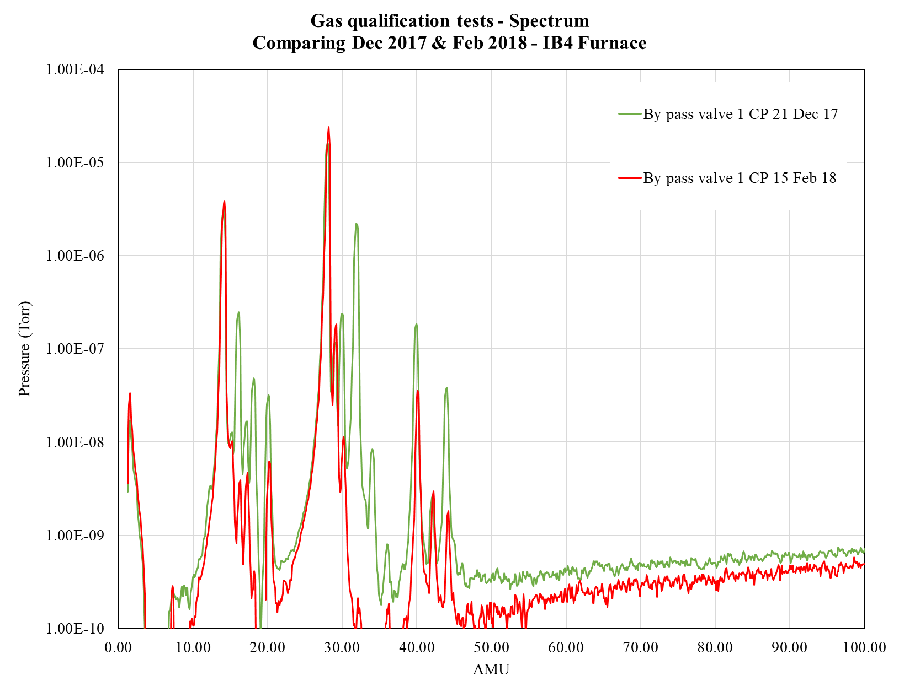
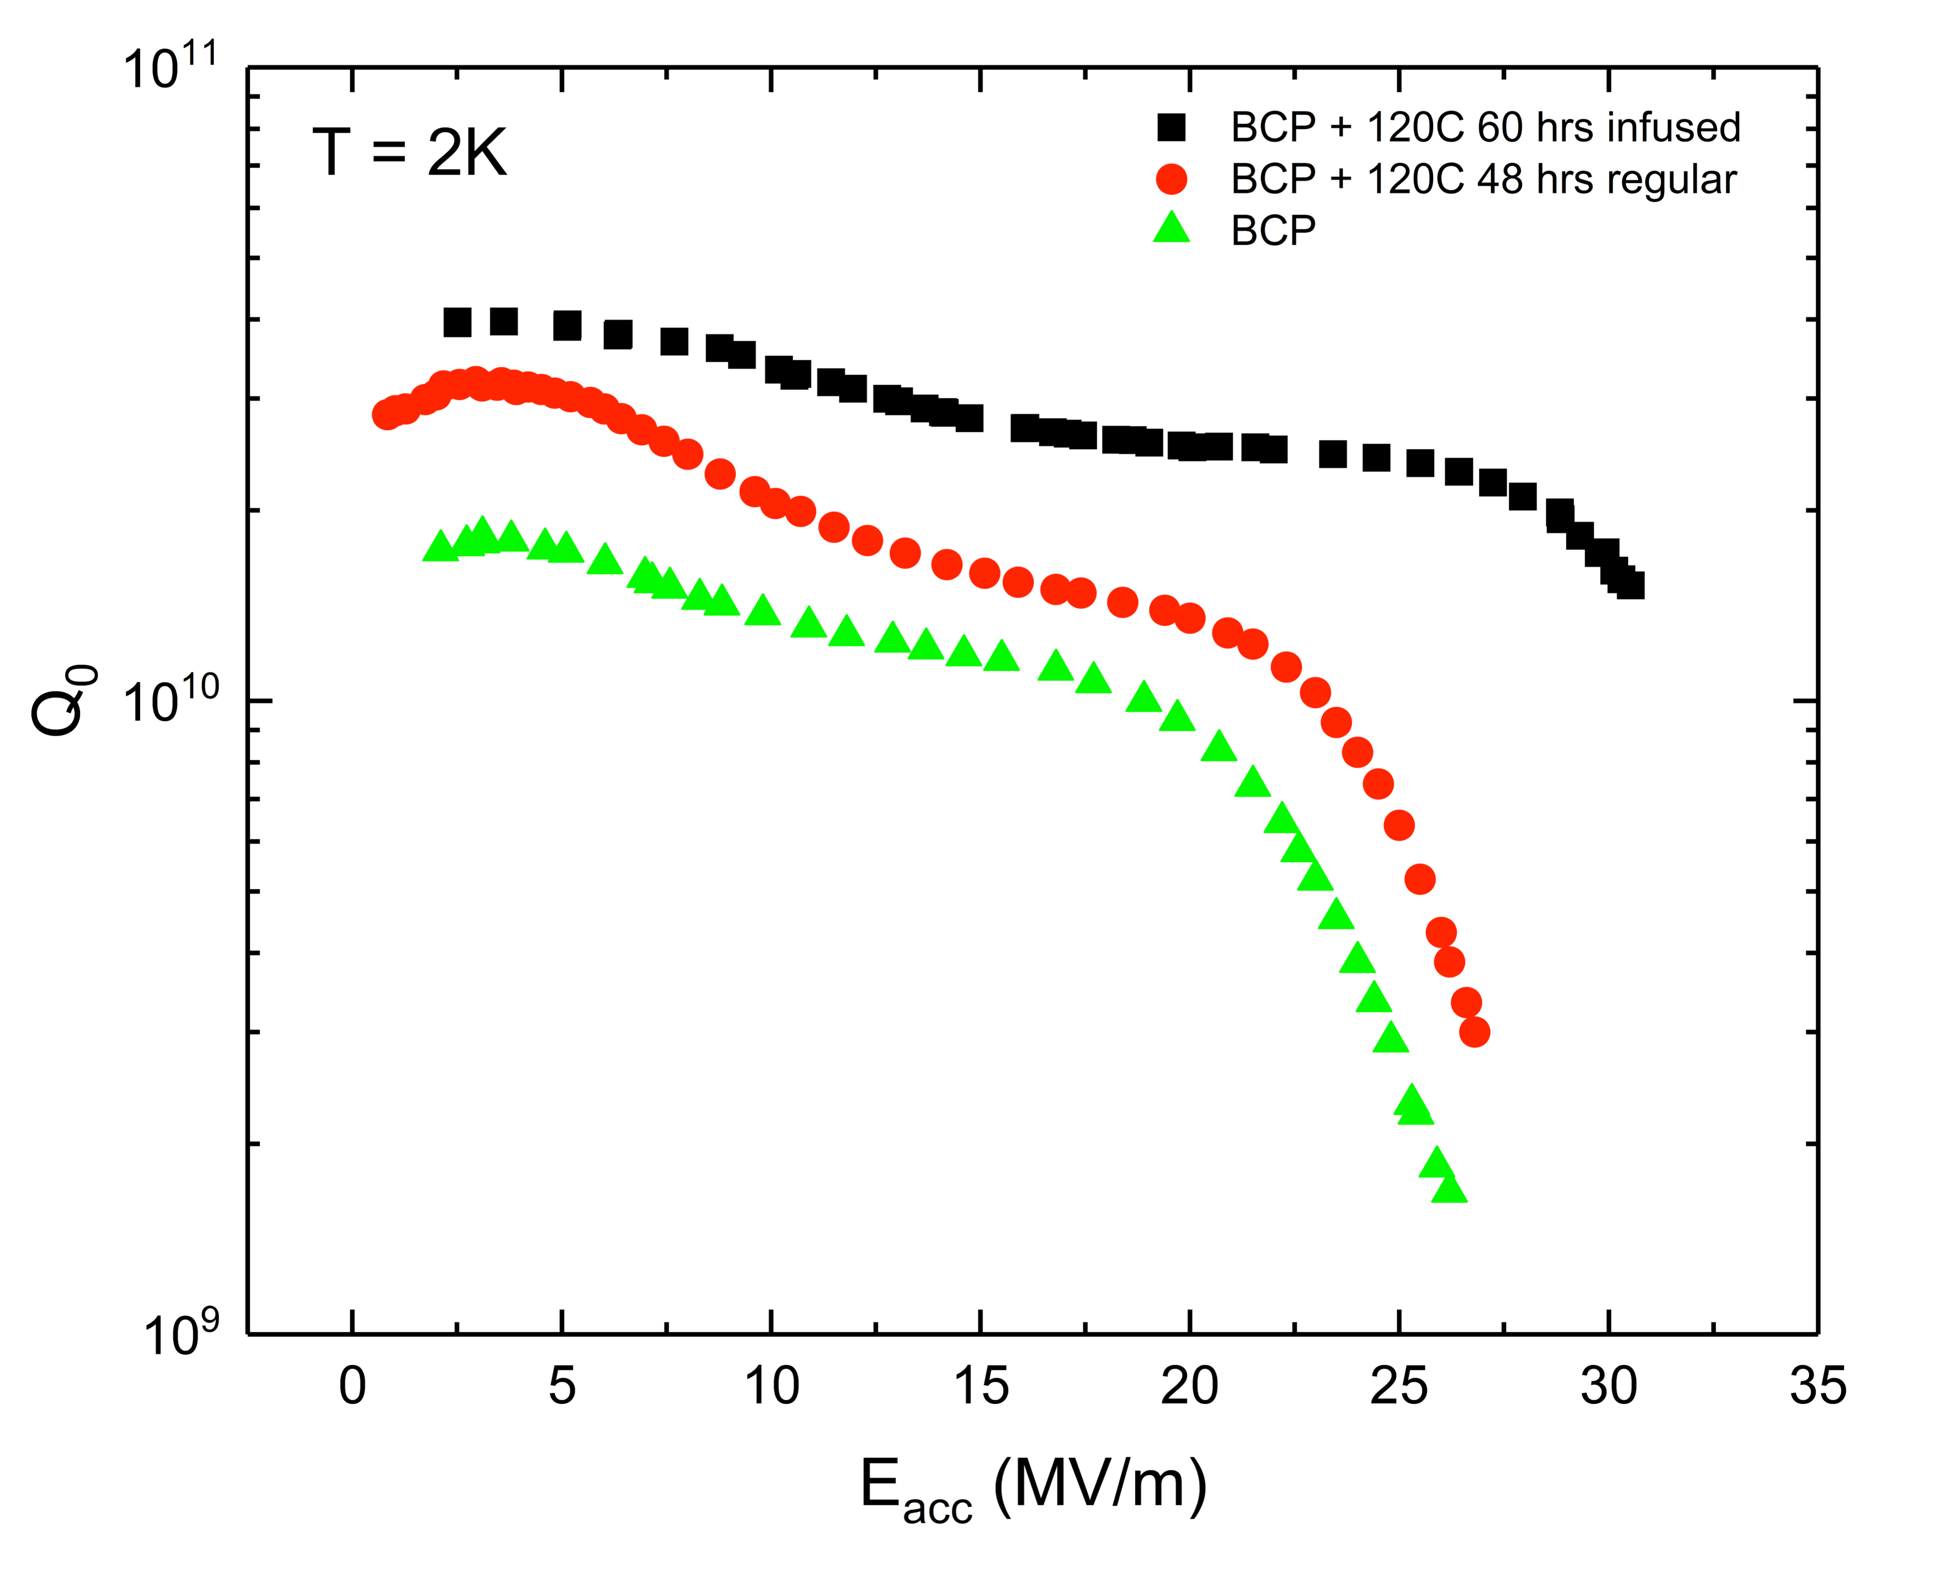
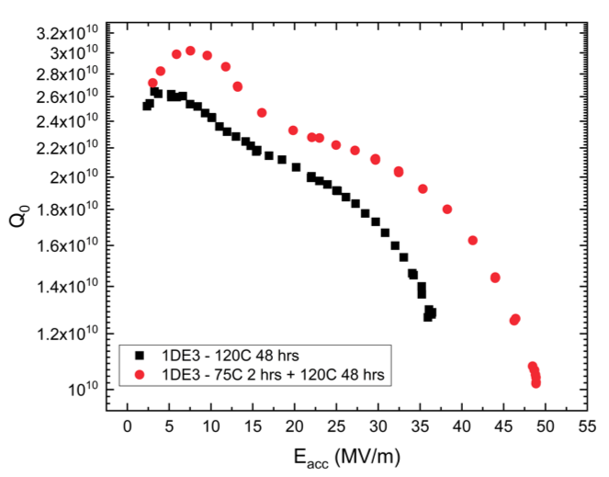
Update on high Q/high G R&D @ FNAL
Air leak in injection valve fixed
Showed that infusion works on BCP cavities as well
„Magic low T bake“
  Luck favors the prepared

Slide 8
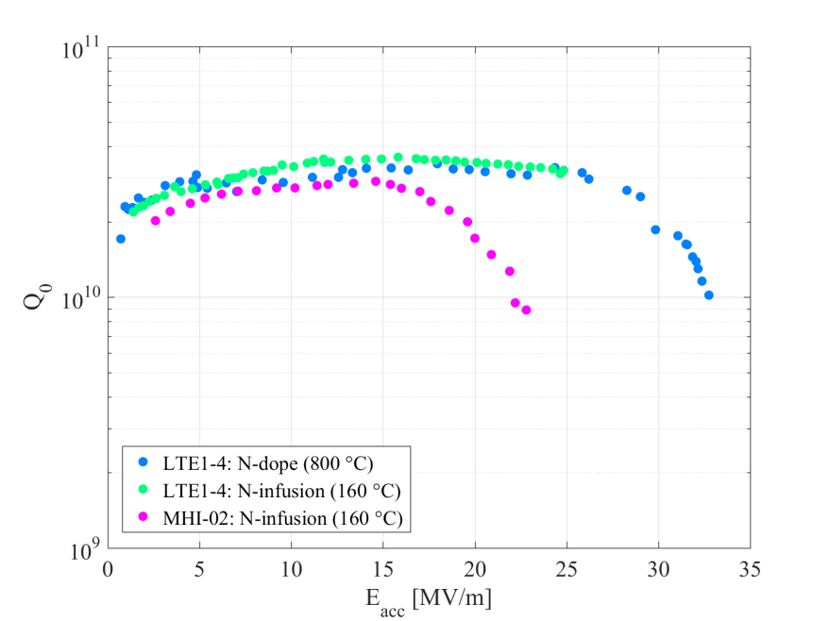
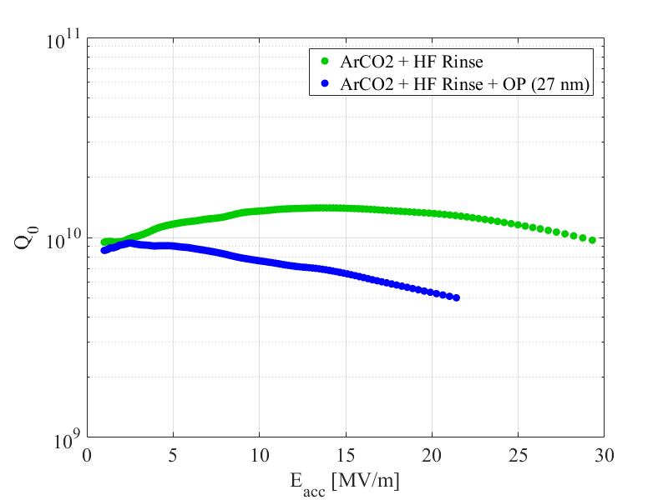
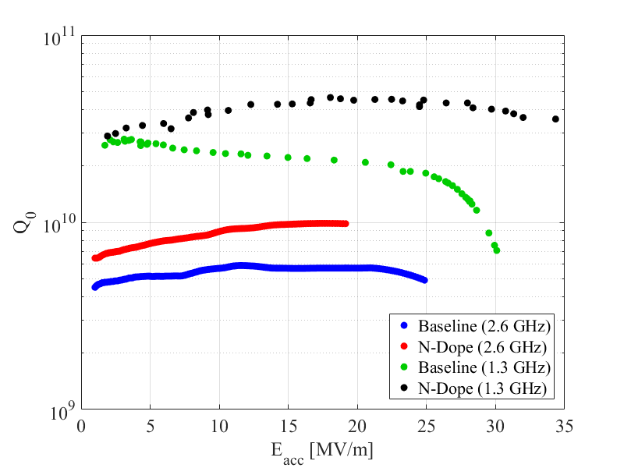
Update on infusion studies at Cornell
Successful Infusion run with N
Showed that Anti-Q-Slope possible with ArCO₂ infusion
Extend the R&D towards different frequencies

Slide 9

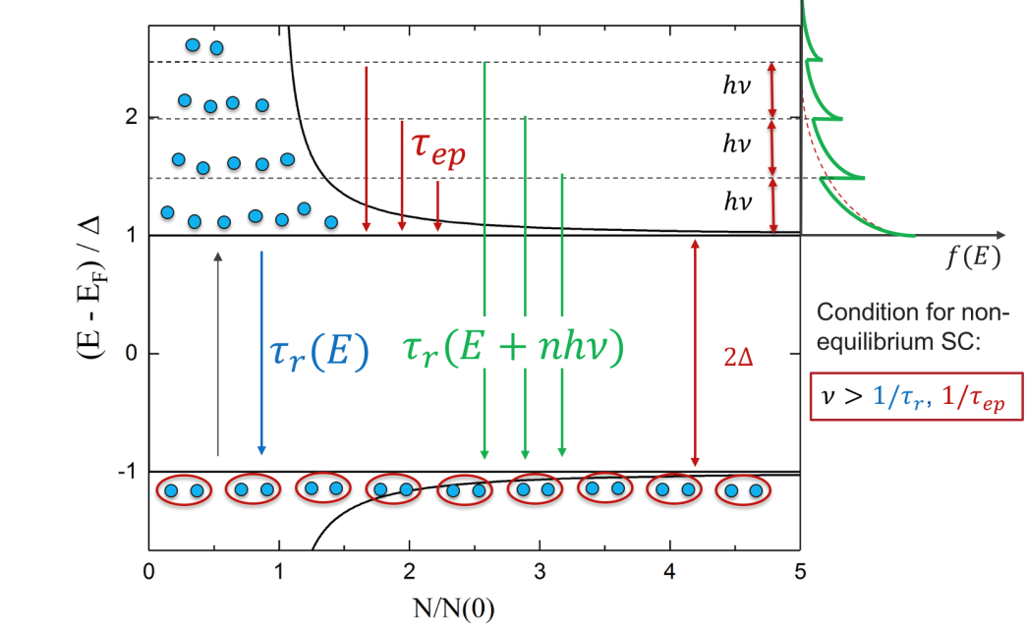
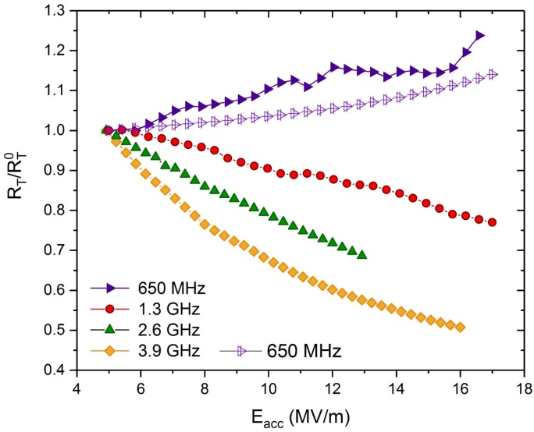
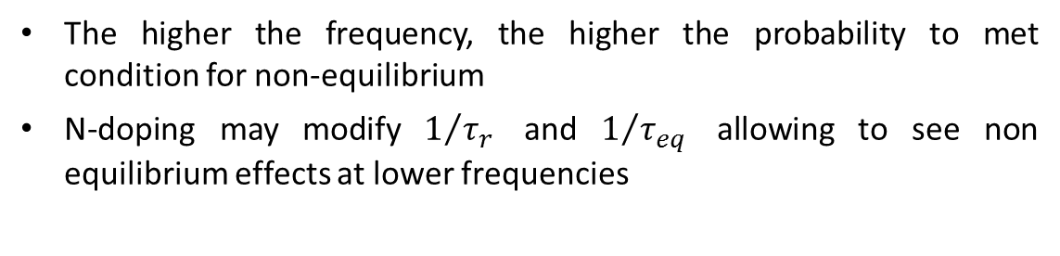
Latest insight from high-frequency cavity experiments
 | 650 MHz | 1.3 GHz | 2.6 GHz | 3.9 GHz
EP
BCP
120 C baking
2/6 N-doping
s
The higher the frequency, the higher the probability to met condition for non-equilibrium
N-doping may modify $1/{τ_{r}}$ and $1/{τ_{eq}}$ allowing to see non equilibrium effects at lower frequencies

Slide 10
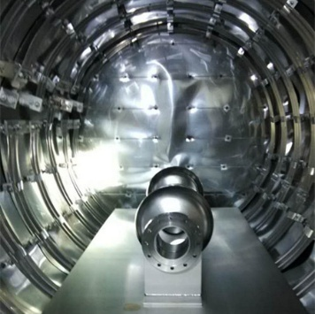
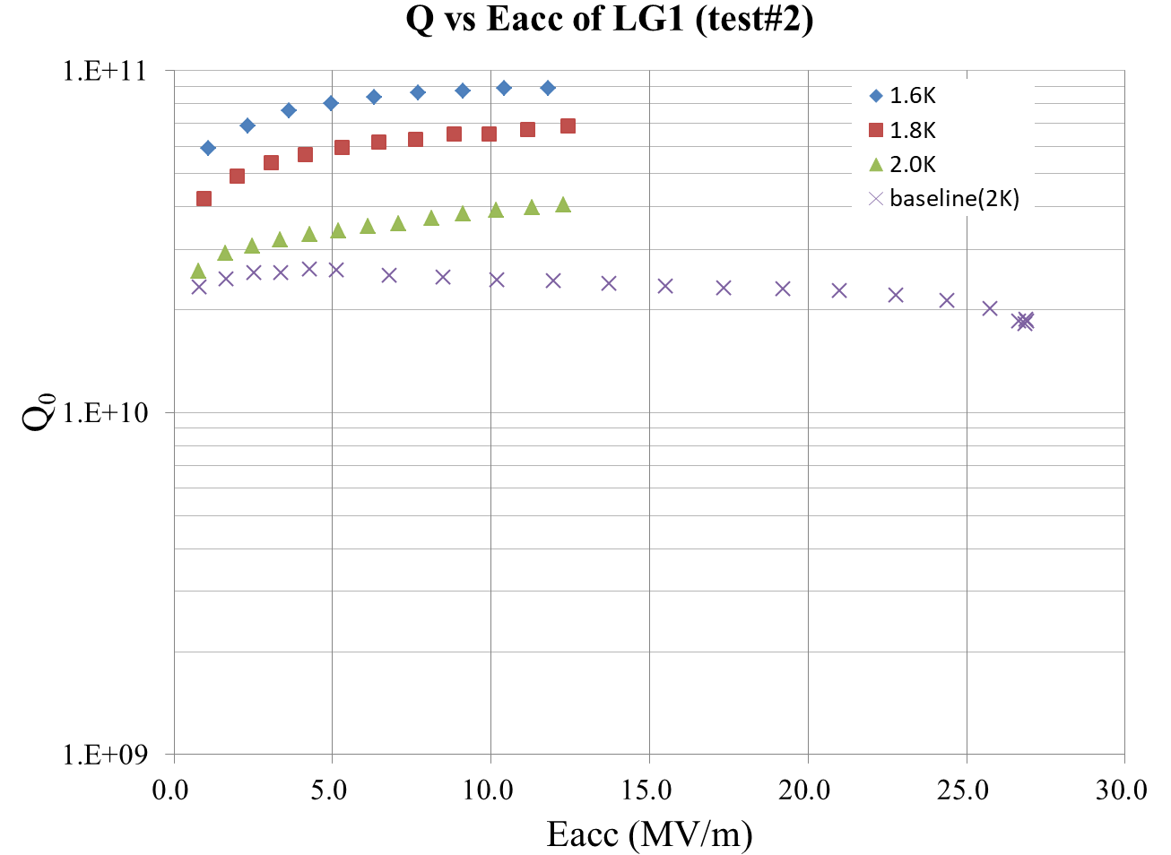
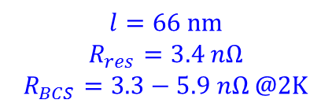
Nitrogen Doping Study at Peking University
$$l=66 nm$$
$$R_{res}=3.4 nΩ$$
$$R_{BCS}=3.3−5.9 nΩ @2K$$
Furnace
Heavy / light N-doping R&D on large grain cavities.
Successful run on LG1
Might be problems with EP

Slide 11
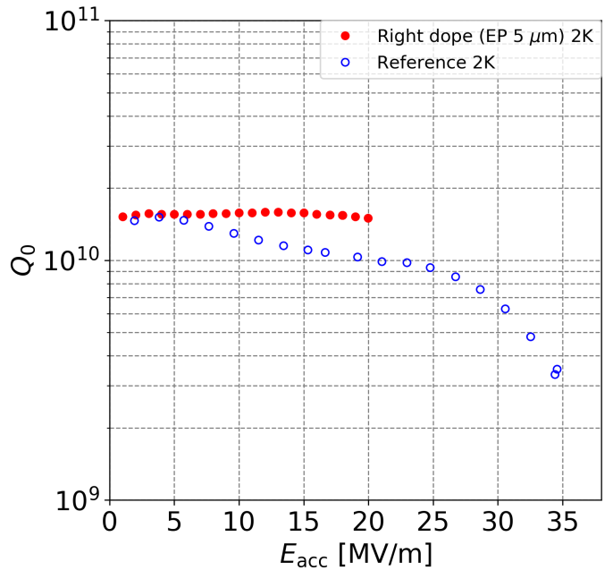
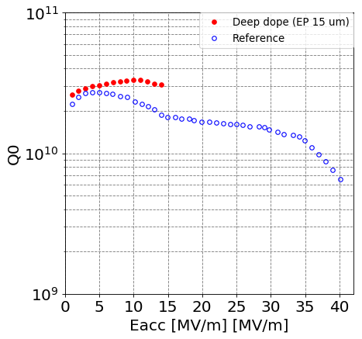
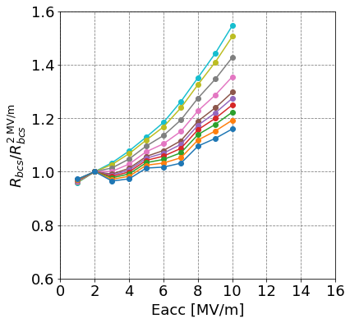
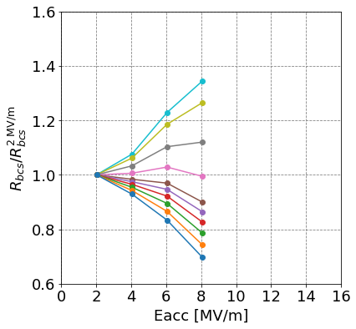
N-doping study at KEK
Doping using J-PARC furnace
Temperature dependency of doping effect under investigation
Before doping
Light doping for 3-cell cavity
preliminary
preliminary

Slide 12
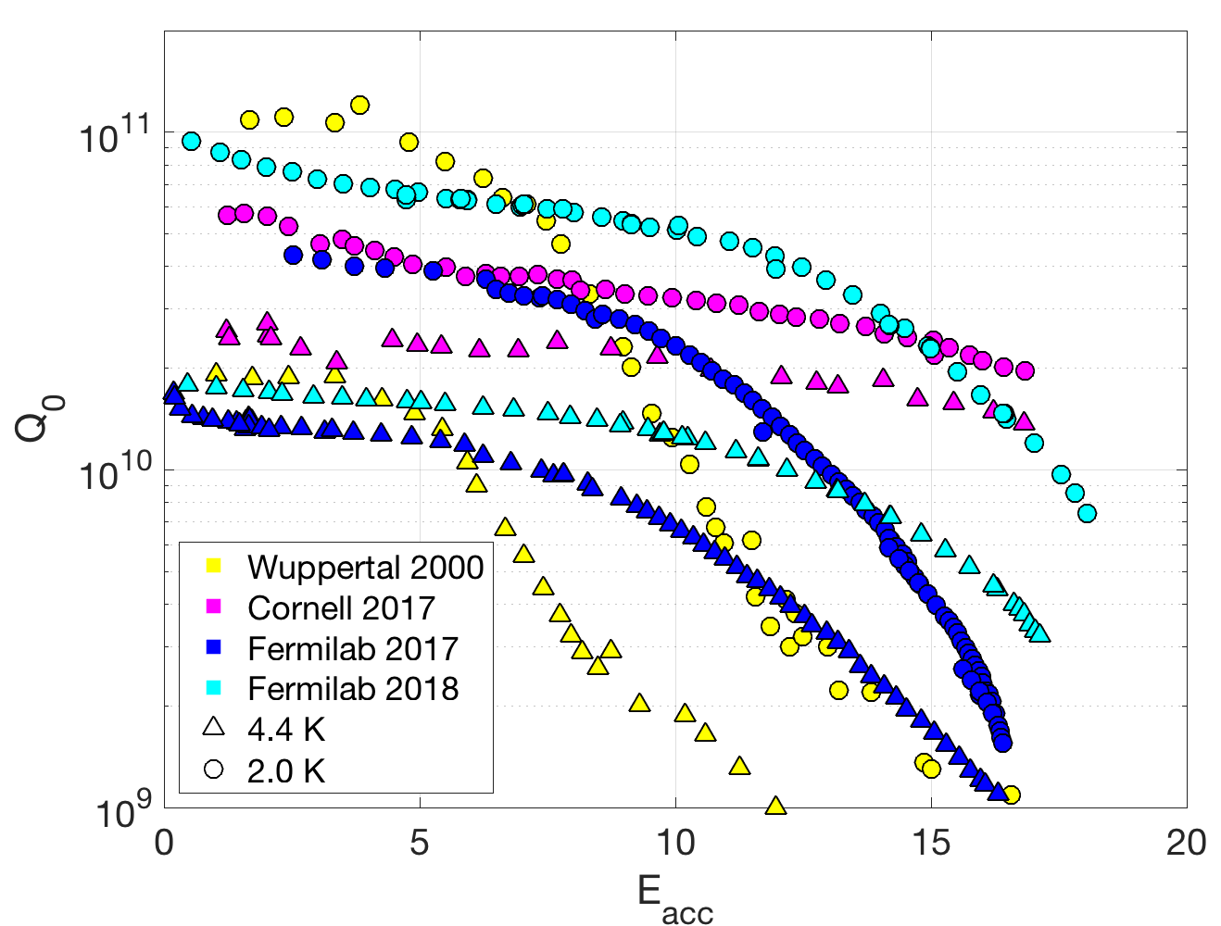
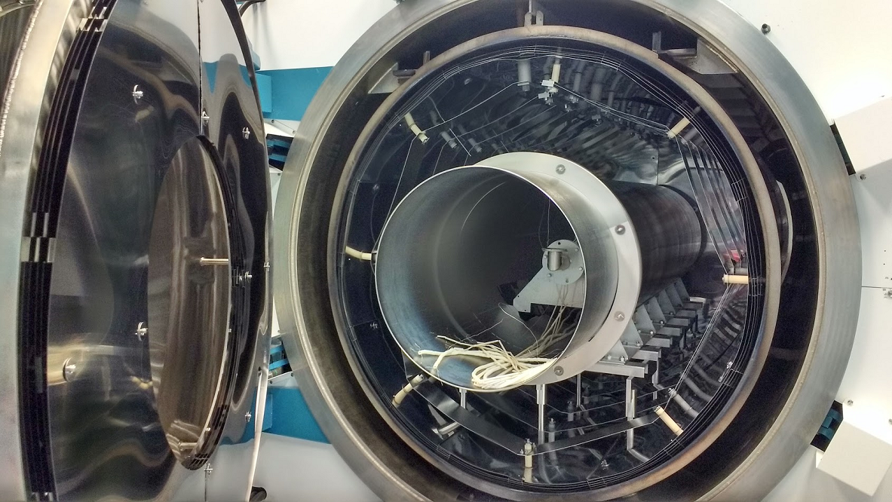
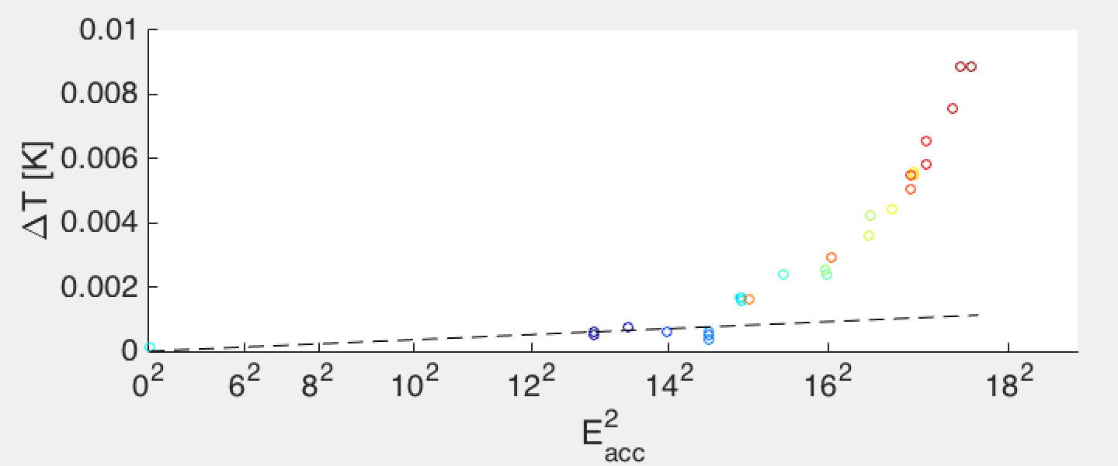
Nb₃Sn Results from FNAL
New Nb chamber, 20”diam, 82” long
New door and heat shields
Existing vacuum furnace
Epitaxial relationship observed between Nb₃Sn film and Nb bulk – appears to be key clue to understand formation of thin, lossy regions – arXiv preprint to be posted soon

Slide 13
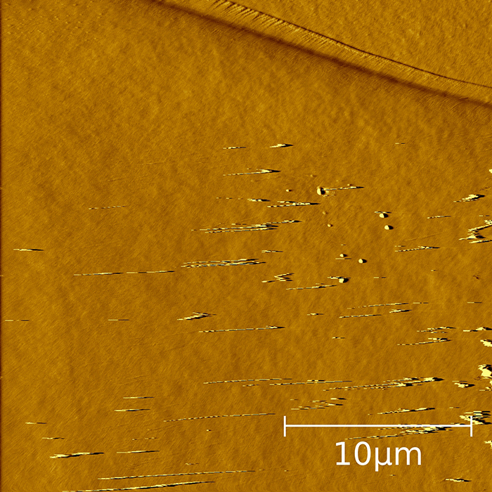
Results of the direct cutout studies of a N-infused cavity
Nb₂O₅
~15-20 nm N-rich layer
NbN⁻
Hydrides
50 K

Slide 14
Sample analysis at KEK
800℃ Annealing
1st N-infusion
(Failure)
2nd N-infusion
(Success)
Depth (nm)
Depth (nm)
Depth (nm)
Sample for QA of furnace runs (D- & TOF-SIMS and XPS)
Carbon and Oxygen signal maybe key to distinguish success/failure
NbN signal under investigation
H_{c1} measurements with 2mm sphere sample by SQUID MPMS (N-dope < Anneal < N-infusion)

Slide 15
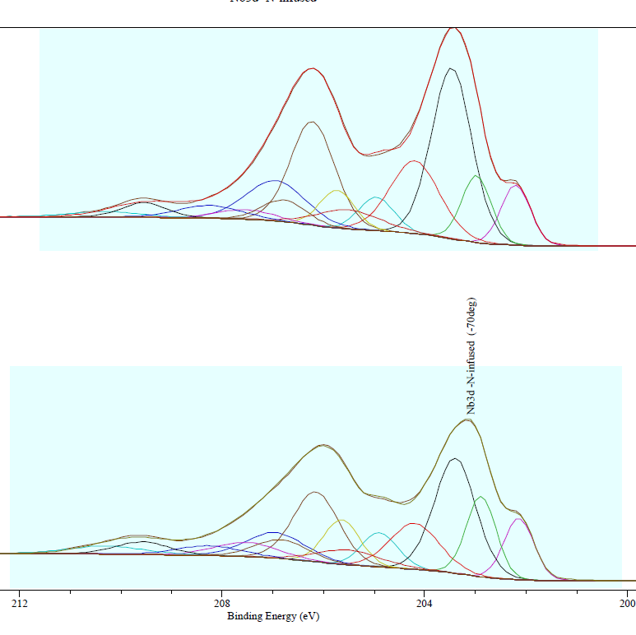

Surface study of nitrogen-infused Nb samples
Nb₂O₅
Nb_{x}C_{y} / Nb₂X_{y}O_{5-y}/NbO₂
NbO
Nb
Nb
0°
Normal-exit XPS
Nb_{x}O
Nb
Nb₂X_{y}O_{5-y}
Nb_{x}O
Interstitial -rich Nb
Nb-C
Systematic XPS studies
TEM investigatons confirmes
carbon-rich layer below the
surface oxide
Nb₂O₅
NbO₂
NbO
70°

Slide 16
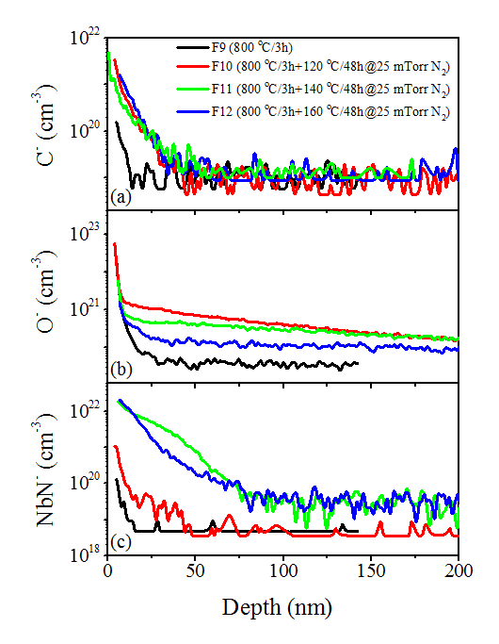
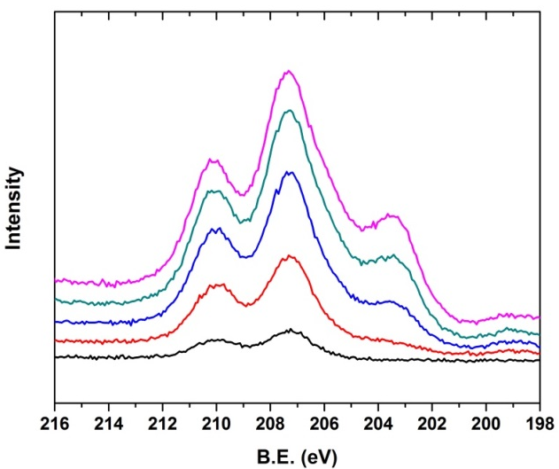
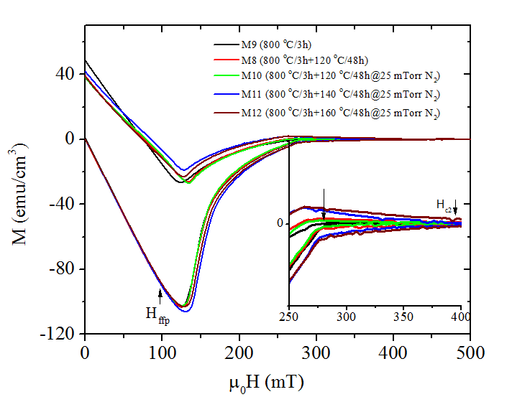
Sample Analysis: Understanding the RF performance of SRF cavities
NbN_{1-x}O_{x} is found on Nb baked at 140-160 °C in N atmosphere
Bulk H_{c2} is increased in case of N-infusion at 140 °C and 160 °C
Higher N concentration for 140 and 160C/48hrs treatments.

Slide 17
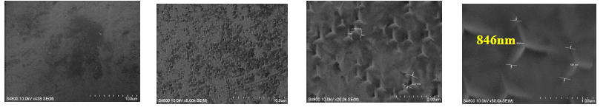
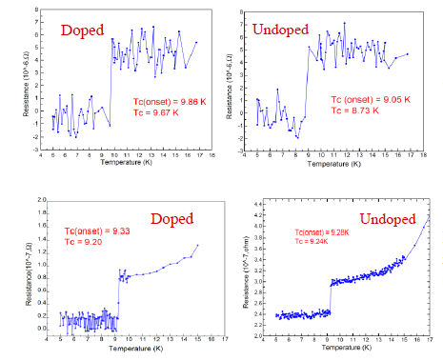
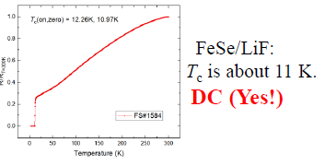
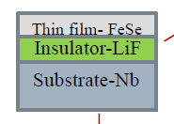
Nb Sample analysis at IHEP
TOF-SIMS / SEM / PPMS & MPMS
Doped samples (OTIC furnace)
SS/SIS samples

Slide 18
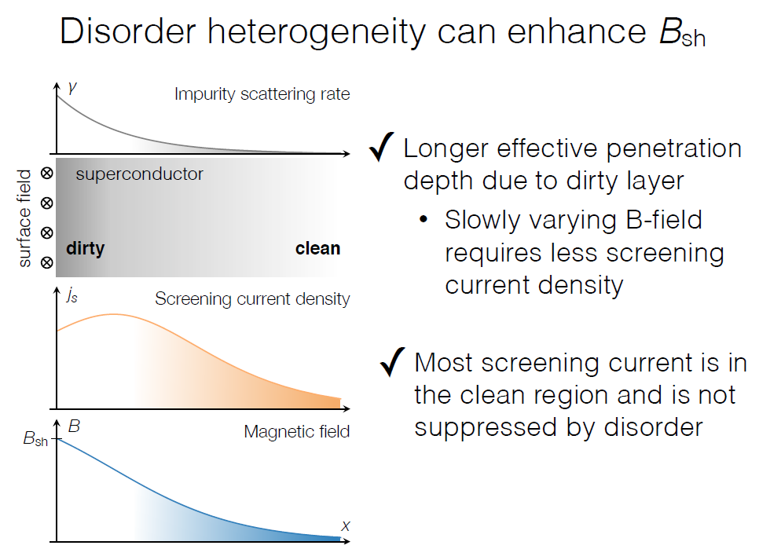
Theoretical insight on the roles of disorder heterogeneity in enhancing the maximum gradients

Slide 19
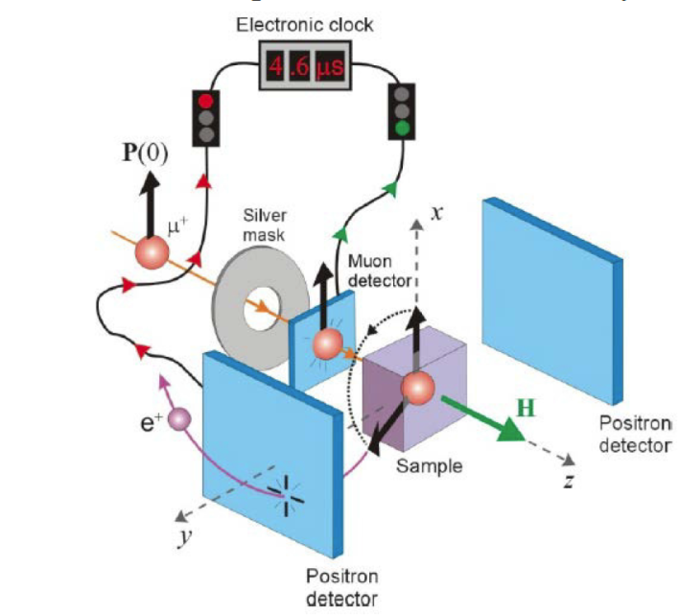
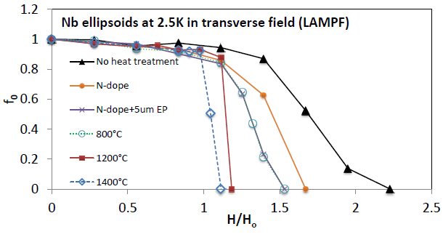
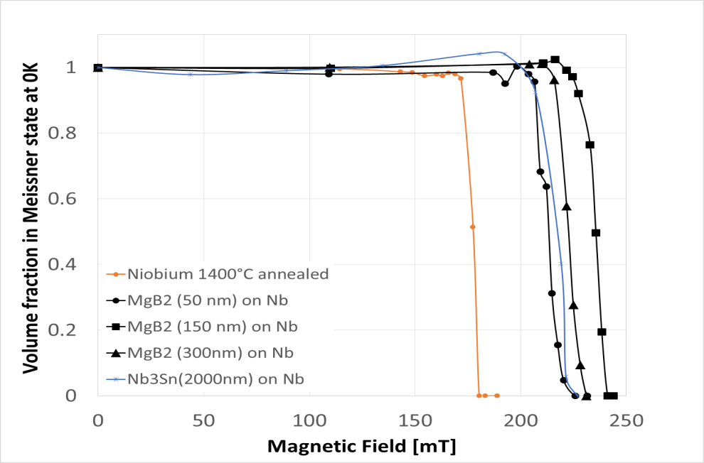
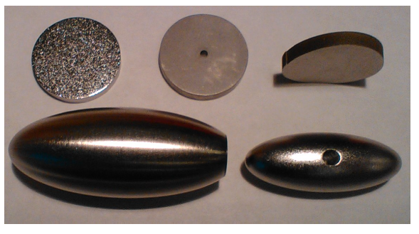
Insights from muSR
s
Recently MgB₂ and Nb₃Sn on niobium samples of different thickness have been tested.
Findings: A layer of a higher T_{c} material on niobium can enhance the field of first entry by about 40% from a field consistent with H_{c1} to a field consistent with H_{sh}.
This enhancement does not depend on material or thickness suggesting that superheating is indeed induced in niobium by the overlayer
Theoretical B_{c1}
Theoretical B_{sh}

Slide 20
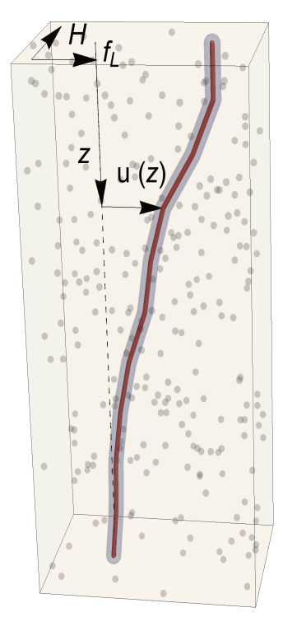
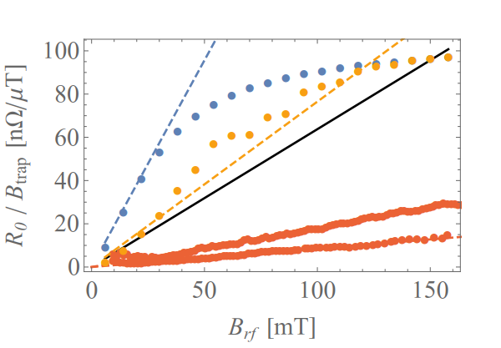
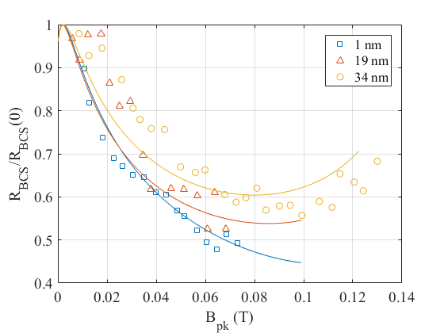
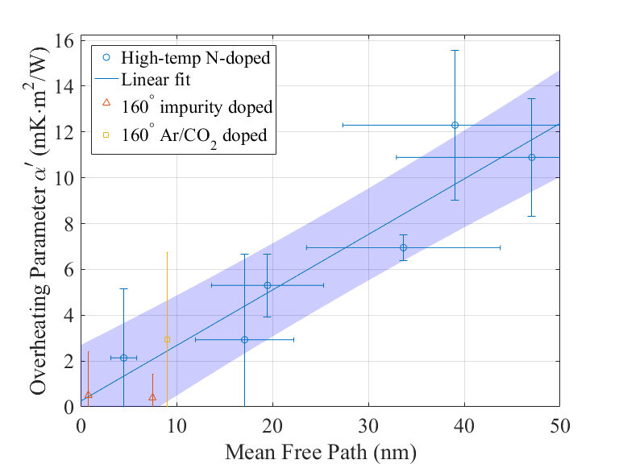
Cornell Theory
vortex line
impurities (point defects)
Model flux pinning dynamics in Nb with random impurity distribution
Apply Gurevich QP-Heating and relation of heating parameter with mfp
Investigate f-dependency in the model
CO-Infusion
(1.3 GHz)

Slide 21
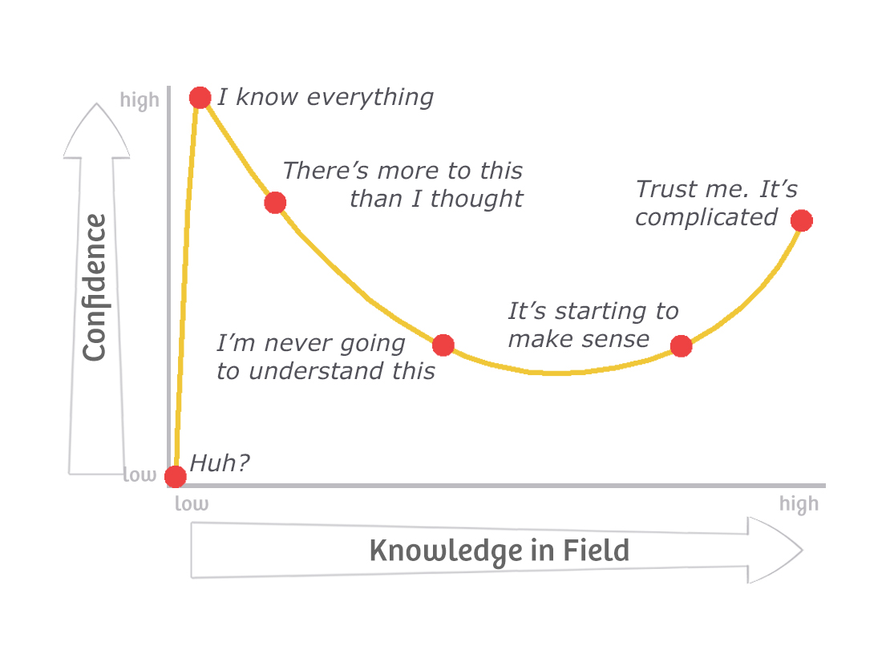
Dunning-Kruger Effect
We are here(?)
Makes sense to merge efforts for „High Q“ and for „High G“ to „High Q at High G“?
Current results showed a strong entanglement of both topics

