Slide 1




HWR/QWR Test Data
Bob Laxdal, Zhongyuan Yao
TRIUMF
June 26, 2018

Slide 2
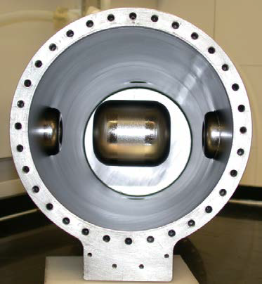
Outline
Introduction
Separation of Rs and Rbcs
QWR and HWR for RISP
Comparing Rs (B) across different geometries
High performance – a data point

Slide 3
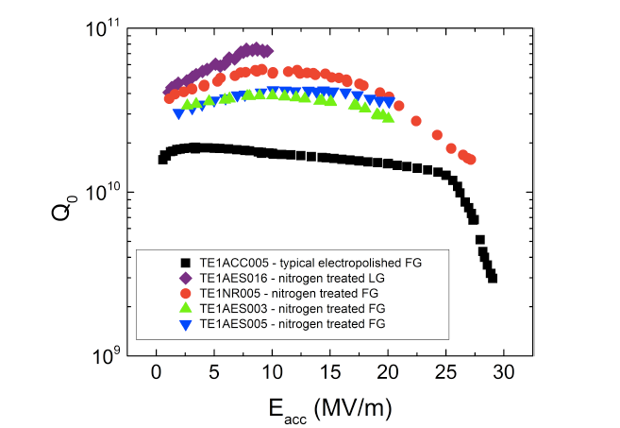
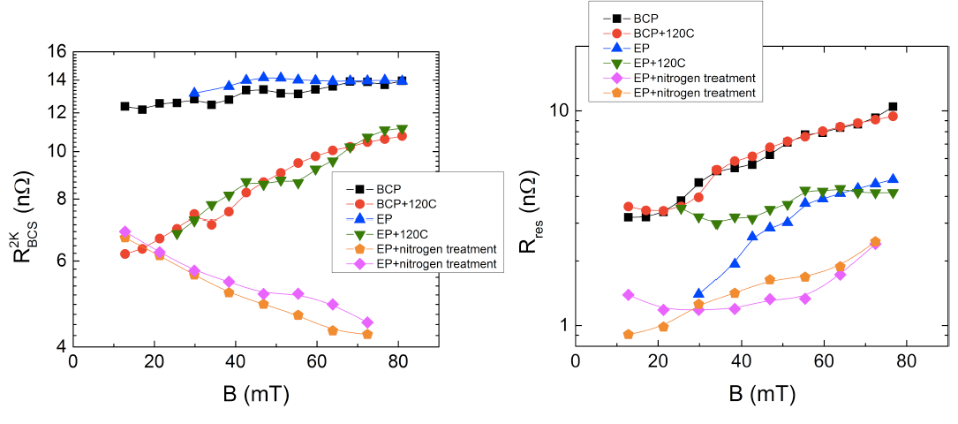
1.3GHz Development
  Optimizing and understanding RF performance has focused primarily on 1.3GHz cavities.
  High gradient studies for ILC
  High Q studies for LCLS-II.
    N doping enhanced low field Q-slop, and increased Q in medium field.
    Recipe is being optimized for higher quench field
  Separating R_{res} and R_{BCS} is also instructive in low beta (low frequency) cavities to provide an insight to the mechanisms at play.
Medium Field Q-slope
High Field Q-slope
120°C Bake
120°C Bake
A. Grassellino, et al., ‘Nitrogen and Argon Doping of Niobium for Superconducting Radioactive Cavities: a Pathway to Highly Efficient Accelerating Structures’, arXiv:1306.0288, July 2013.
N doping

Slide 4
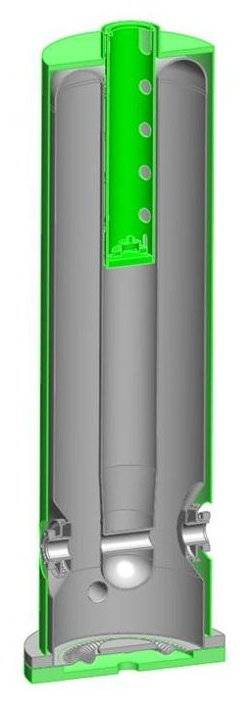
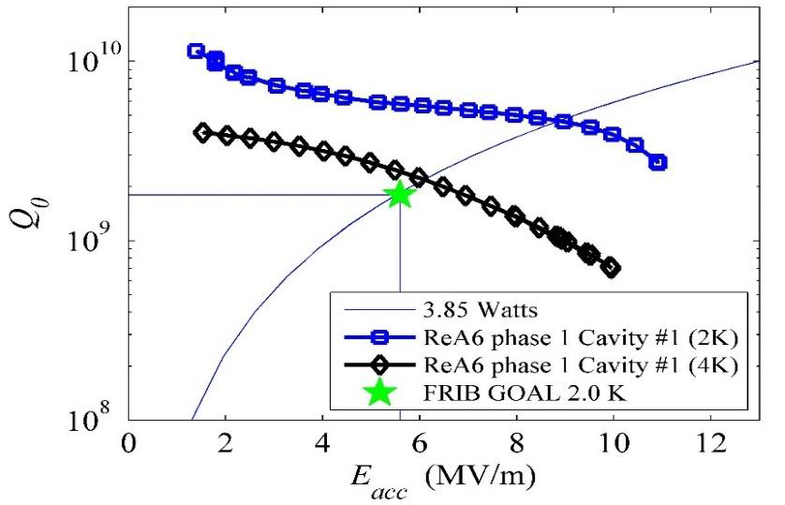
Low Beta Resonators
  Due to R_{BCS} frequency dependence low frequency resonators can operate at 4K - reduce cryogenics system cost
  Strong Medium Field Q-Slop (MFQS) is observed at 4K in low frequency and low β resonators.
  Presently facilities are choosing to operate at 2K even at low frequency to avoid MFQS (ie FRIB and RISP).
  MFQS and improving 4K performance need to be further understood.
  Example: 120˚C bake improves 4K Q in medium field.
FRIB 80.5MHz β=0.085 QWR
K. Saito, ‘FRIB Project: Moving to Production Phase’, SRF2015

Slide 5
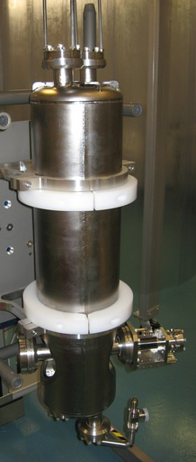
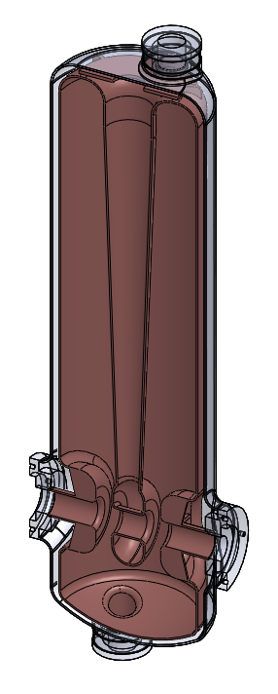
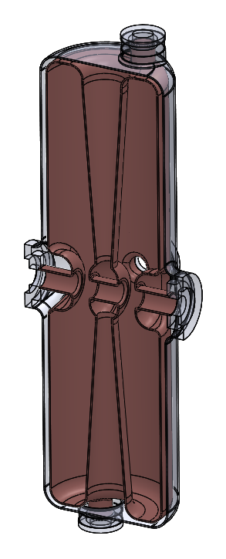
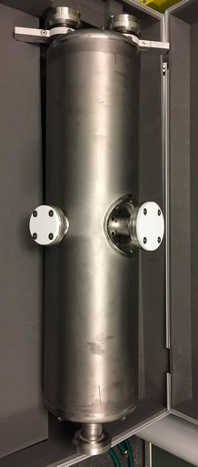
Study: RISP QWR and HWR Cavities
  81.25MHz QWR and 162.5MHz HWR designed by RISP
Cavity treatments
    120μm BCP (+15μm for HWR)
    HPR
    48hr 120°C bake
  Cavities were tested at TRIUMF before and after bake and after multiple etches
 | QWR | HWR | Unit
Frequency | 81.25 | 162.5 | MHz
β | 0.047 | 0.12 | 1
L_{eff}=βλ | 0.173 | 0.221 | m
E_{peak}/E_{acc} | 5.3 | 5.6 | 1
B_{peak}/E_{acc} | 9.5 | 8.2 | mT/MV/m
G | 21 | 40 | Ω
U/E_{acc}² | 0.126 | 0.159 | J/(MV/m)²

Slide 6
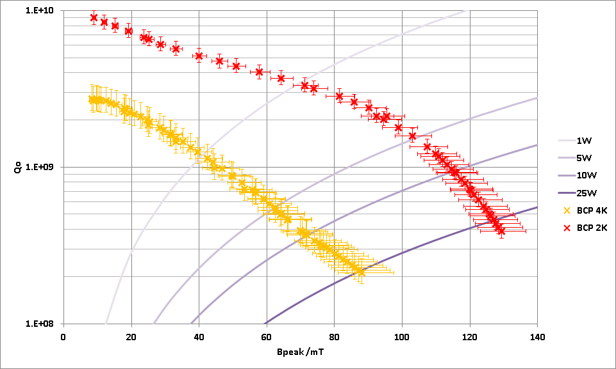
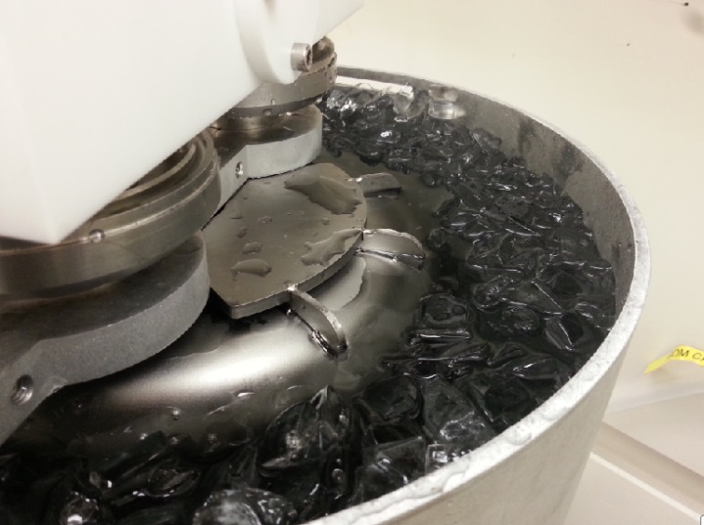
QWR BCP Result
QWR was etched 120microns
Tested at 4.2K and 2K
Significant Q-slope at 4K – less slope at 2K
120micron BCP
129mT

Slide 7
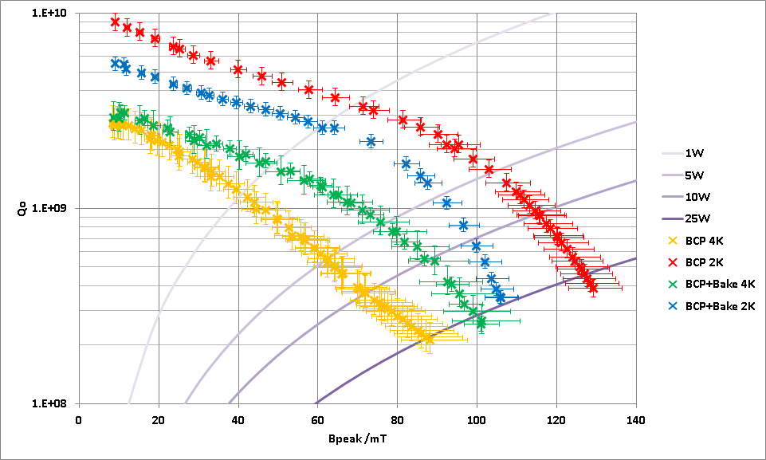
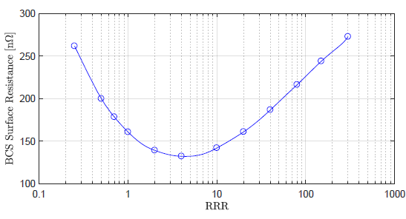
QWR 120C Bake
120C Bake applied for 48 hours
The bake modifies the MFP within the surface layer and improves R_{BCS} at the expense of increasing the residual R_{res}
120micron BCP
120C bake lowers BCS but increases residual so 4K performance improved but 2K performance reduced

Slide 8
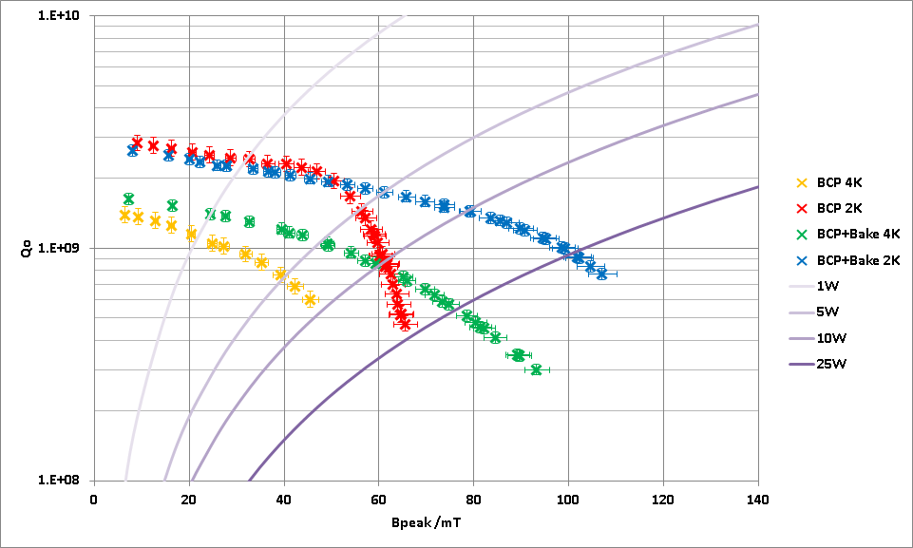
HWR Before and After 120C Bake
The same measurement sequence was done with the HWR cavity
BCP 2K result impacted by FE near 55mT
135micron BCP
107mT
120C bake lowers BCS but increases residual so 4K performance improved but 2K performance reduced

Slide 9
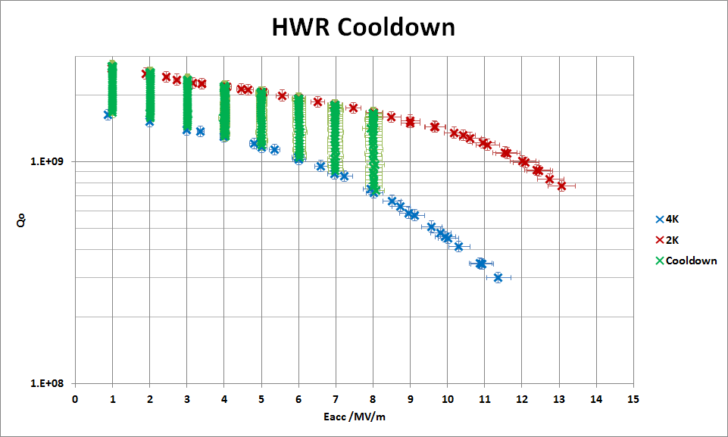
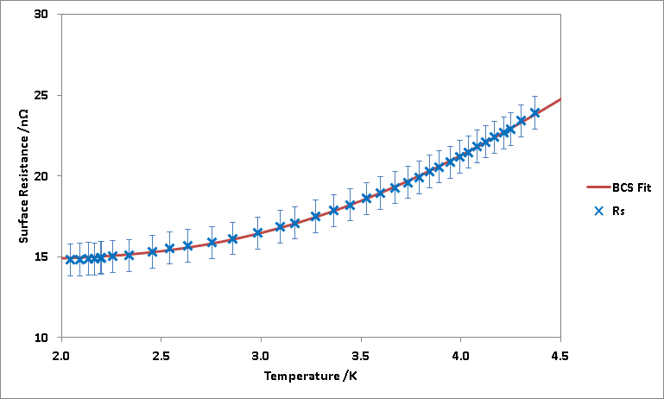


4K to 2K Data to Extract R_{BCS} and R_{res}
To separate R_{BCS} and R_{res} components, Q measurements are taken at various field levels and temperatures as the cavity is cooled down
R_{BCS} is expected to follow a exponential dependence with temperature
$$R_{s}=R_{res}+R_{BCS}$$
$$=R_{res}+A\frac{f^{2}}{T}e^{−\frac{∆}{k_{B}T}}$$
λ

Slide 10
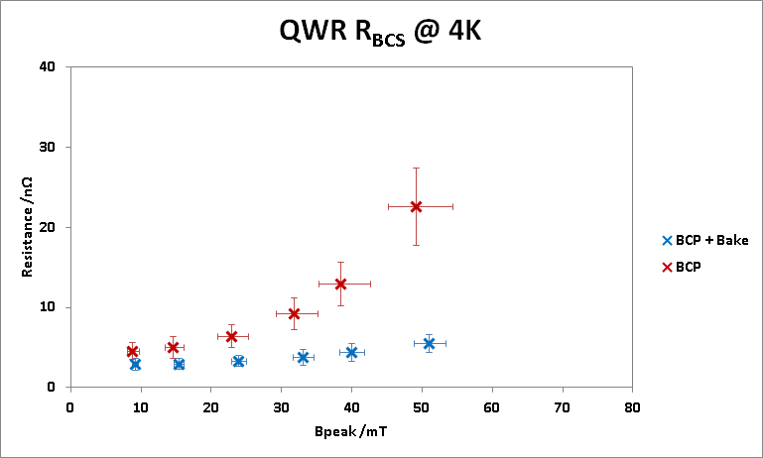
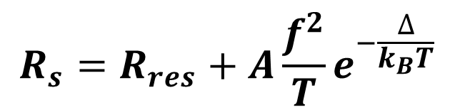
QWR BCS Resistance
Manipulation of the data can be done to extract R_{BCS} as a function of field
Note how the 120C bake has lowered the base R_{BCS} and significantly decreased the field dependence
$$R_{s}=R_{res}+A\frac{f^{2}}{T}e^{−\frac{∆}{k_{B}T}}$$

Slide 11
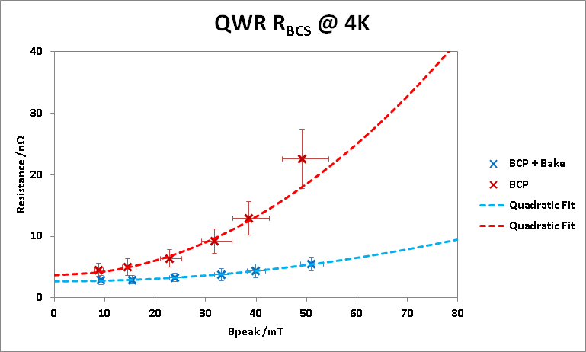
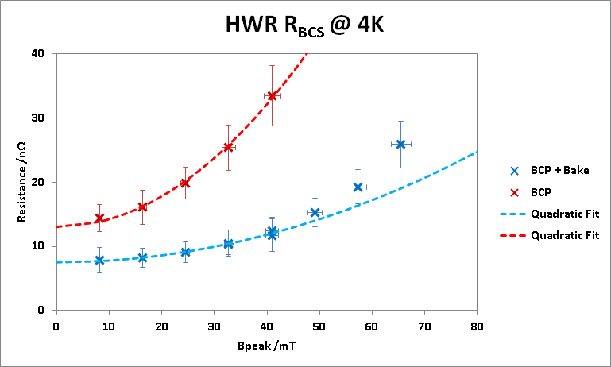
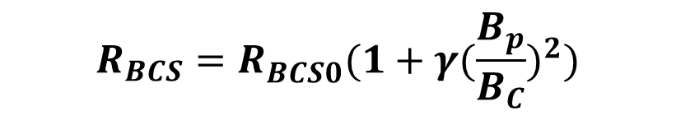
Quadratic Dependent R_{BCS}
  120C Bake reduced R_{BCS0} and field dependent coefficient.
  Field dependence is quadratic for B_{peak}<40mT.
  Slope is stronger than quadratic at the field of >60mT.
$$R_{BCS}=R_{BCS0}^{}(1+γ{(\frac{B_{p}}{B_{C}})}^{2})$$
 | R_{BCS0} @ 4K | γ
 | nΩ
QWR BCP | 3.70 | 64.2
QWR Bake | 2.69 | 15.8
HWR BCP | 13.03 | 36.7
HWR Bake | 7.53 | 14.3

Slide 12
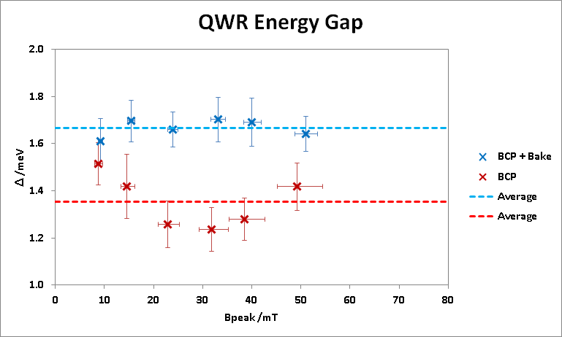
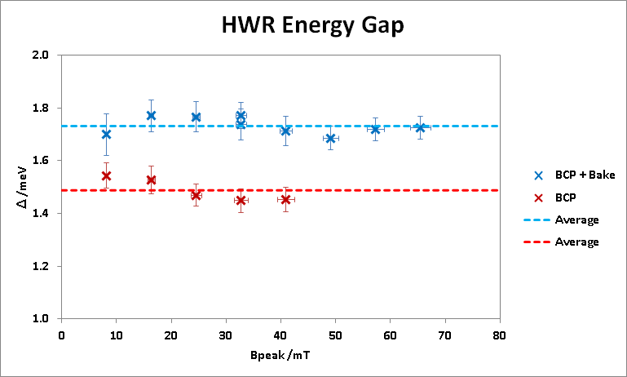
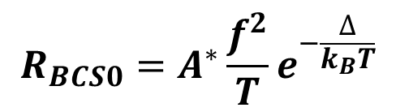
Energy Gap
  Field dependence of energy gap is not obvious in low and medium field.
  Bake increased average value of energy gap by about 20%.
$$R_{BCS0}=A^{∗}\frac{f^{2}}{T}e^{−\frac{∆}{k_{B}T}}$$
Δ | QWR | HWR
meV
BCP | 1.35 | 1.49
Bake | 1.67 | 1.73

Slide 13
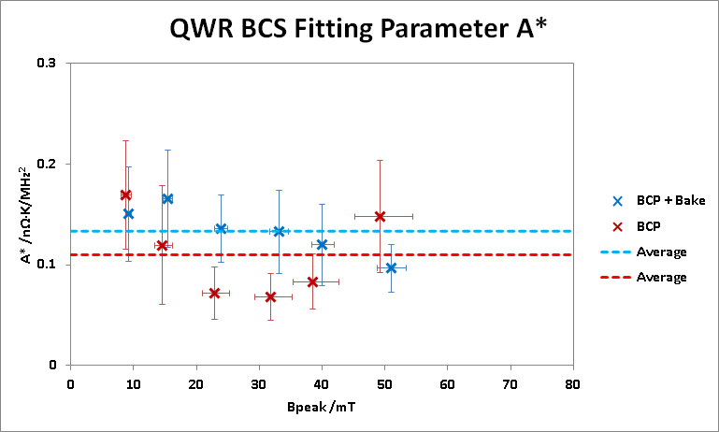
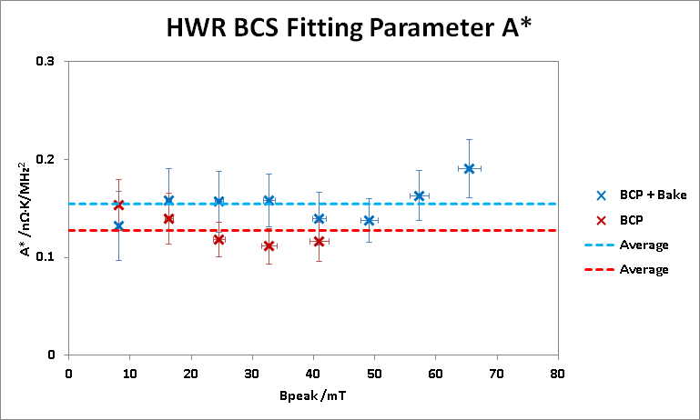
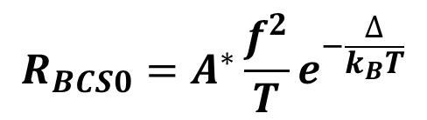
Fitting Parameter A*
  Bake effect for A* is not obvious with these two data set. The differences are within error bars.
$$R_{BCS0}=A^{∗}\frac{f^{2}}{T}e^{−\frac{∆}{k_{B}T}}$$
A* | QWR | HWR
nΩ∙K/MHz²
BCP | 0.110 | 0.128
Bake | 0.133 | 0.155

Slide 14
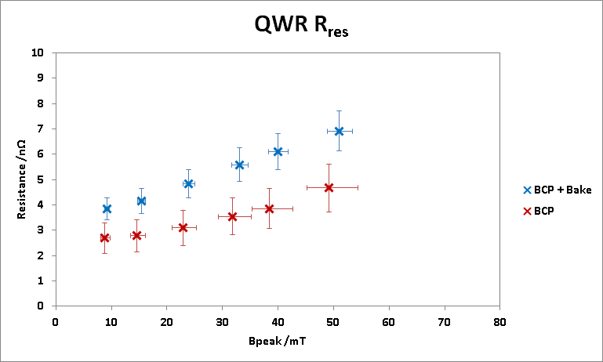
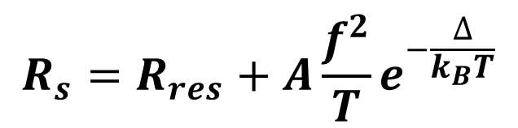
QWR Residual Resistance
R_{res} corresponds to the non exponential term
Also responsible for Q-slope but this looks more linear
$$R_{s}=R_{res}+A\frac{f^{2}}{T}e^{−\frac{∆}{k_{B}T}}$$

Slide 15
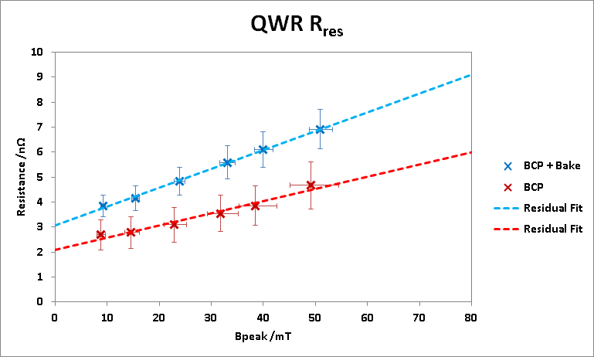
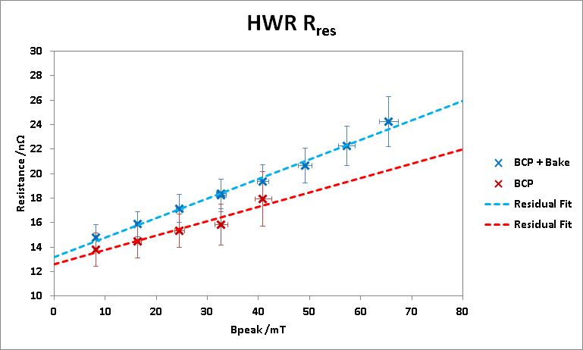
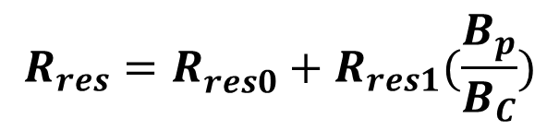
Linear Dependence of R_{res}
  Bake increased R_{res0} and field dependent slope.
  High R_{res} of HWR is suspected due to cool down procedure and trapped flux.
  R_{res1} is proportional to frequency within error bar.
$$R_{res}=R_{res0}^{}+R_{res1}(\frac{B_{p}}{B_{C}})$$
 | R_{res0} | R_{res1}
 | nΩ | nΩ
QWR BCP | 2.09 | 9.76
QWR Bake | 3.07 | 15.1
HWR BCP | 12.6 | 23.5
HWR Bake | 13.2 | 31.9

Slide 16
QWR Residual Resistance
R_{res} corresponds to the non exponential term
Also responsible for Q-slope but this looks more linear
$$R_{s}=R_{res}+A\frac{f^{2}}{T}e^{−\frac{∆}{k_{B}T}}$$

Slide 17
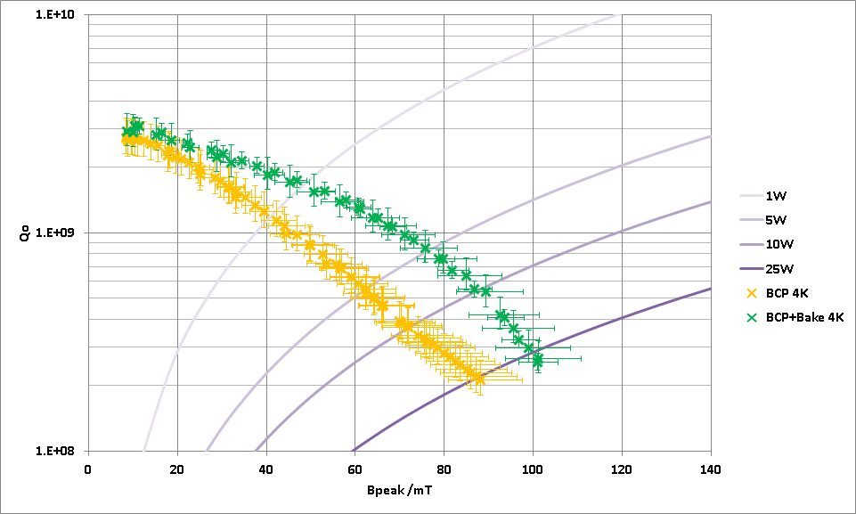
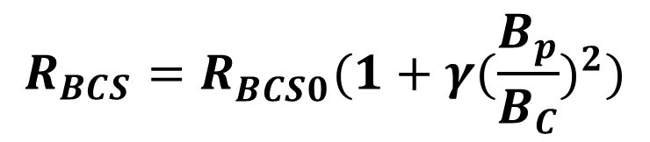
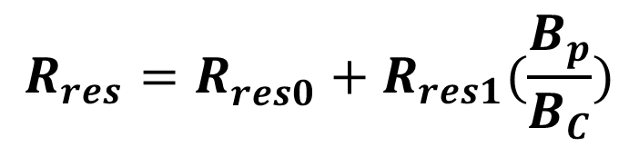
QWR 4K Q-slope
The Q-slope is a combination of R_{BCS}(B) and R_{res} (B)
Both linear and quadratic terms are identified
$$R_{res}=R_{res0}^{}+R_{res1}(\frac{B_{p}}{B_{C}})$$
$$R_{BCS}=R_{BCS0}^{}(1+γ{(\frac{B_{p}}{B_{C}})}^{2})$$

Slide 18
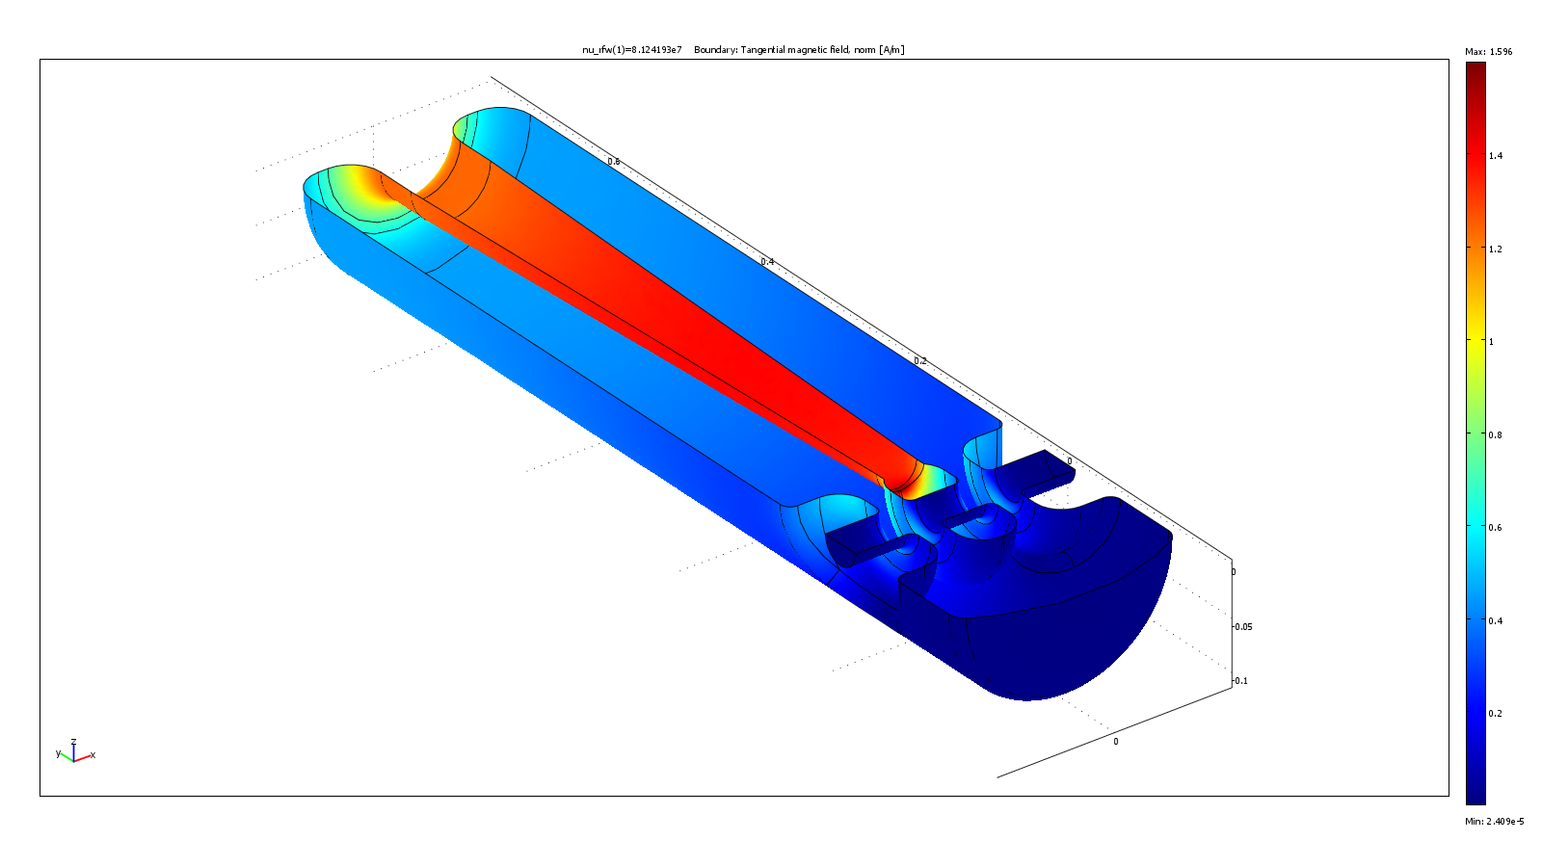
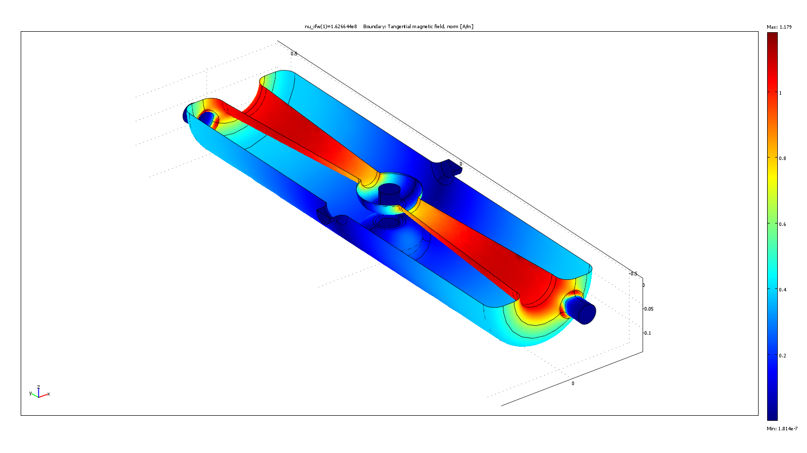
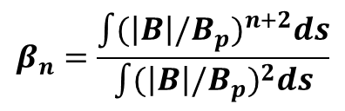
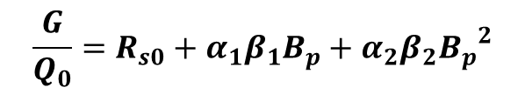

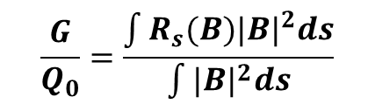
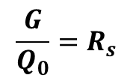
Geometry Factor
Comparing performances of field dependent Rs across different cavities requires more than Q₀(B)=G/R_{s}(B) since G is dependent on R_{s}(B)
Extracting accurately the surface resistance from experimental data requires to take into account the field distribution over the accelerating structure
$$\frac{G}{Q_{0}}=R_{s}$$
$$\frac{G}{Q_{0}}=\frac{\int{{R_{s}(B)|B|}^{2}ds}}{\int{{|B|}^{2}ds}}$$
$$R_{s}\left(B\right)=R_{s0}+α_{1}|B|+α_{2}{\left|B\right|}^{2}$$
$$\frac{G}{Q_{0}}=R_{s0}+α_{1}β_{1}B_{p}+α_{2}β_{2}{B_{p}^{}}_{}^{2}$$
 | QWR | HWR
β₁ | 0.68 | 0.71
β₂ | 0.53 | 0.58
$$β_{n}=\frac{\int{{(\left|B\right|/B_{p}^{})}^{n+2}ds}}{\int{{(\left|B\right|/B_{p}^{})}^{2}ds}}$$

Slide 19
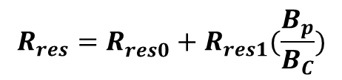
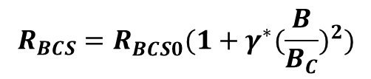
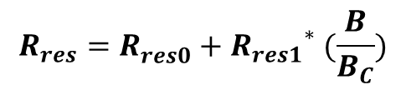
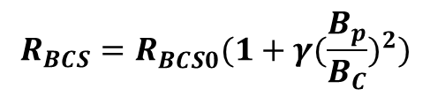
From R_{s}(B_{p}) to R_{s}(B)
$$R_{res}=R_{res0}^{}+R_{res1}(\frac{B_{p}}{B_{C}})$$
$$R_{res}=R_{res0}^{}+{R_{res1}}^{∗} (\frac{B}{B_{C}})$$
$$R_{BCS}=R_{BCS0}^{}(1+γ{(\frac{B_{p}}{B_{C}})}^{2})$$
$$R_{BCS}=R_{BCS0}^{}(1+γ^{∗}{(\frac{B}{B_{C}})}^{2})$$
After corrections the true linear and quadratic R_{s}(B) field dependence can be determined
 | R_{res1} | R_{res1}* | γ | γ*
 | nΩ | nΩ
QWR BCP | 9.76 | 14.4 | 64.2 | 121.6
QWR Bake | 15.1 | 22.2 | 15.8 | 29.9
HWR BCP | 23.5 | 32.9 | 36.7 | 63.6
HWR Bake | 31.9 | 44.7 | 14.3 | 24.8

Slide 20
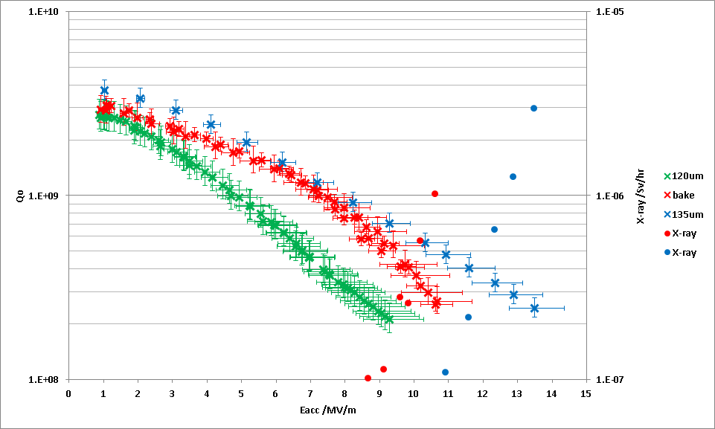
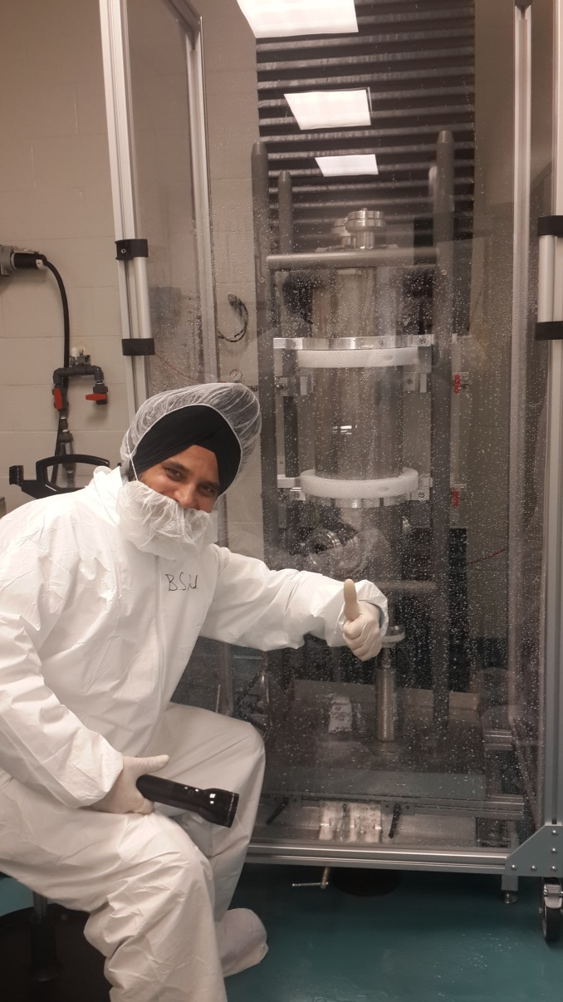
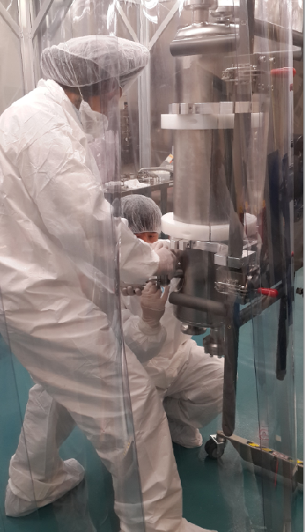
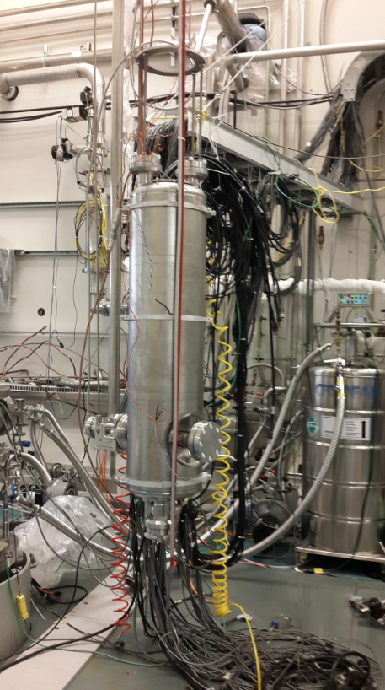
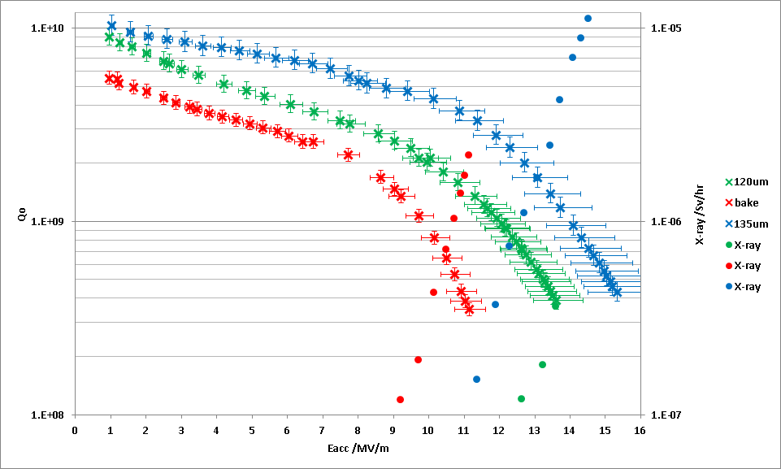
QWR - 135μm BCP
After the first round of tests the cavity was given a further 15microns etch and the performance improved.
The etch destroys the previous R_{BCS} improvement from the 120C bake but reduces the residual and the residual slope

Slide 21

QWR – High performance
Note that the cavity pushes out to high field with some FE but no quench to Bp=143mT or Ep=80MV/m
Corresponds to Ea~33MV/m for an elliptical cavity
Excellent performance for a BCP cavity
Bp=143mT
Ep=80MV/m
0
20
40
60
80
100
120
140
160
Bp (mT)

Slide 22





ANL (EP) vs RISP QWR (BCP)
Elliptical cavities typically choose EP for high gradient performance – Low beta typically chooses BCP
Here’s a comparison of Rs for ANL QWR (EP) and RISP QWR (BCP) both at 4K and 2K. ANL cavity has a slightly better residual resistance at 2K but Q-slope is actually slightly better in RISP case with higher final Bp.
Bottom line is that both BCP and EP can deliver great performance. The heat treatment after processing can play a significant role.
Cavity type | QWR
Freq. (MHz) | 81.25
β | 0.047
Leff (cm, βλ) | 17.3
Ep/Ea | 5.3
Bp/Ea | 9.5
QRs (Ohm) | 21
Rs/Q (ohm) | 470

Slide 23
Summary
MFQS study was performed on two low β resonators by measuring cool down Q data at various field levels.
120˚C bake improved 4K performance in medium field for both RISP QWR and HWR by reducing R_{BCS0} and field dependent coefficient. The 120C bake increased R_{res}.
With our data, the field dependent component of BCS resistance is shown to be quadratic, and the residual part is linearly field dependent.
More systematic tests and data from the community can give an insight of MFQS for low β resonators.
To compare the field dependent surface resistance of different structures the distribution of the field on the surface has to be taken into account.

Slide 24
Thank You
Merci
ありがとうございました

