Slide 1
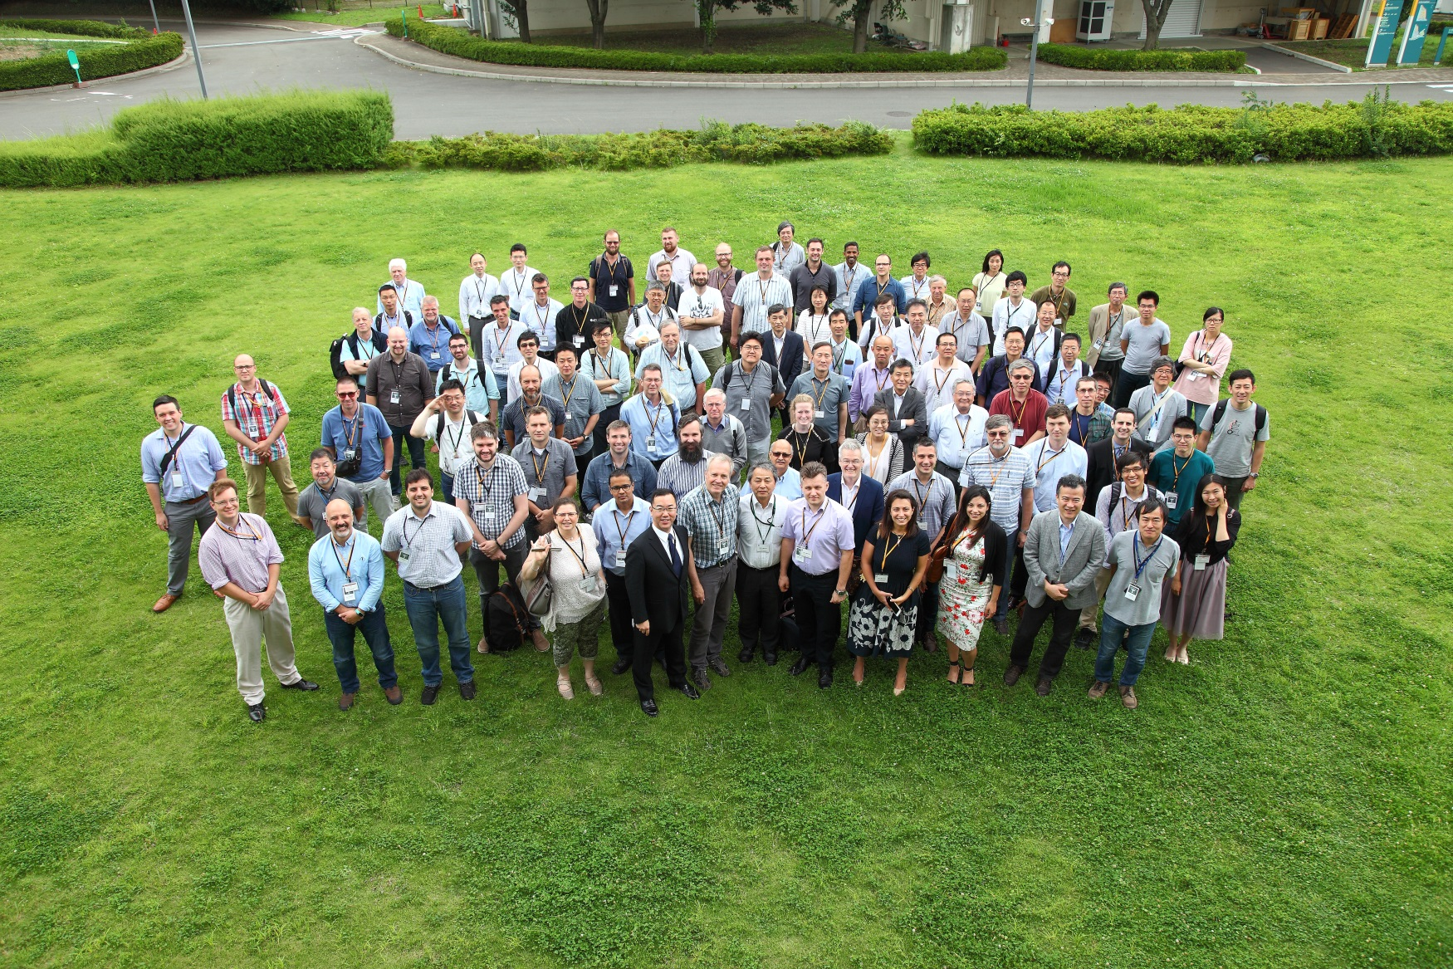
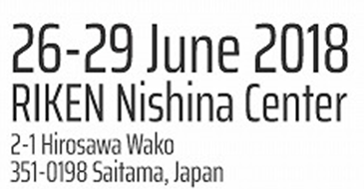
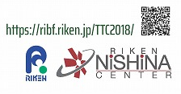
TTC Collaboration Board Summary Hans Weise / DESY, June 29th, 2018
Notes:
How to edit the title slide
Upper area: Title of your talk, max. 2 rows of the defined size (55 pt)
Lower area (subtitle): Conference/meeting/workshop, location, date, your name and affiliation, max. 4 rows of the defined size (32 pt)
Change the partner logos or add others in the last row.

Slide 2
The mission of the TESLA Technology Collaboration
The mission of the TESLA Technology Collaboration is
to advance SRF technology R&D and related accelerator studies across the broad diversity of scientific applications, and
to keep open and provide a bridge for communication and sharing of ideas, developments, and testing across associated projects.
To this end the Collaboration supports and encourages free and open exchange of scientific and technical knowledge, expertise, engineering designs, and equipment.
The TTC organizes regular collaboration meetings where new developments are reported, recent findings are discussed and technical issues are concluded. This time, TTC meeting is hosted by RIKEN Nishina Center on 26-29 June 2018.
discussion

Slide 3
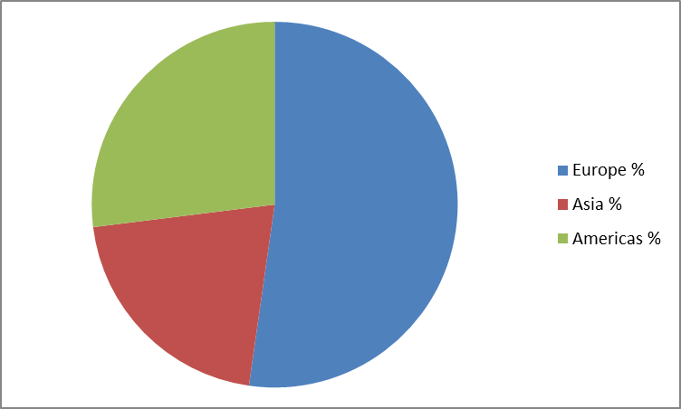
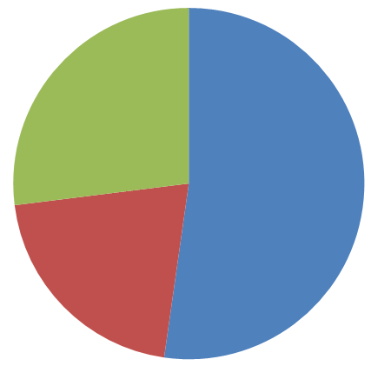
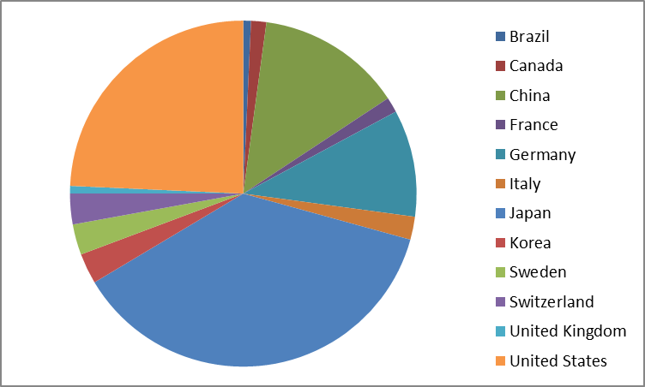
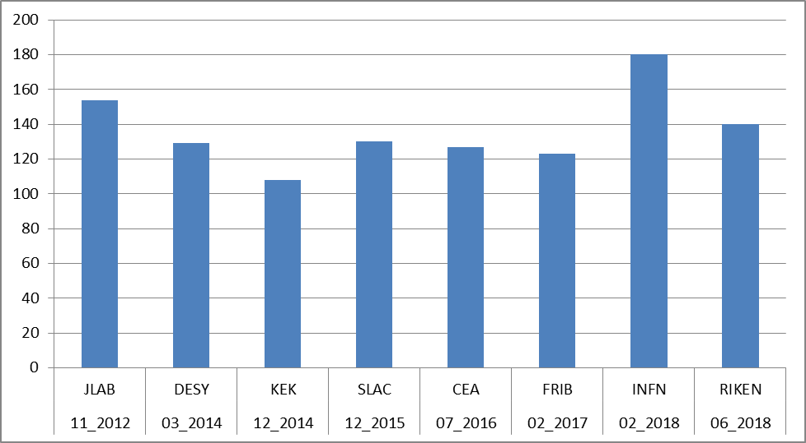
Number of TTC Meeting Participants
RIKEN
MILANO
143 participants
22% from industry
very limited diversity
av. 136

Slide 4
Collaboration Board Agenda
Approval of the minutes
Discussion about TTC WGs
Thin Films
High Q
High Gradient
TTC Web Page
Rules / possible modifications
New TTC Membership
Location and timing of next the TTC meeting to be organized around end of 2018.

Slide 5
Discussion about TTC WGs
At present we have the following active TTC WGs
Thin Films
High Q & High Gradient (possibly combined)
Others required? -> Technical Board
Activities are clearly beneficial to the community.
So far reports given at every CB meeting; in future in the TTC plenary.
Combination of High Q & Gradient under discussion with actual WG chairs.
"High performance bulk Nb"
modified Charter required; under discussion / preparation…
TTC TB could / should provide additional input.
In order to improve visibility and give better access to material and discussions, the TTC web page will link to the WGs. Teaser for the upcoming report at the next meeting will also help.
Updated WG Charter will be discussed at next CB meeting. CB supports rotation of group leadership to give opportunities to younger researchers.

Slide 6
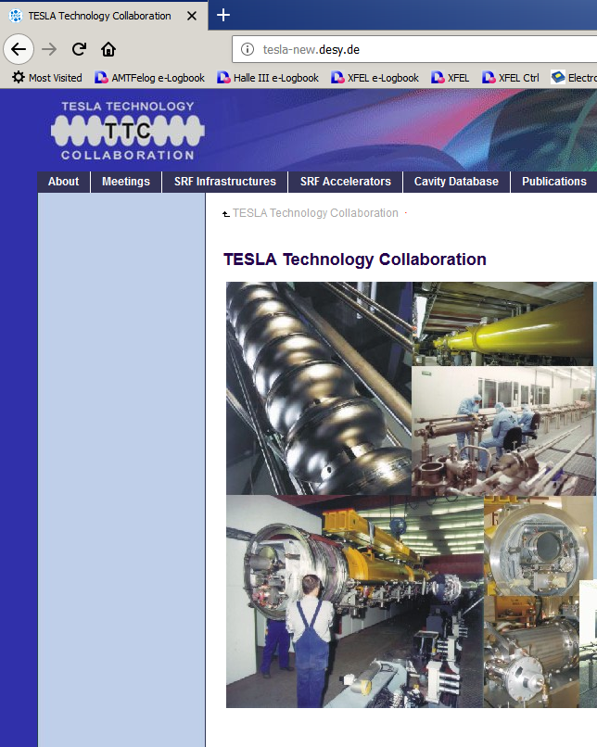
TTC Webpage
TTC Web Page
Rules / possible modifications / others?
Need to take care of more strict EU data protection rules (GDPR May 25th, 2018)
Urgently need some updates
Should link to entry pages of SRF labs
access to lab info
higher visibility
Example:
http://eu-amici.eu/technology_infrastructure
Small CB sub-panel plus WEB enthusiasts in all labs; volunteers required

Slide 7
No application for new TTC Membership
but we again welcome SINAP, RIKEN and Uppsala

Slide 8
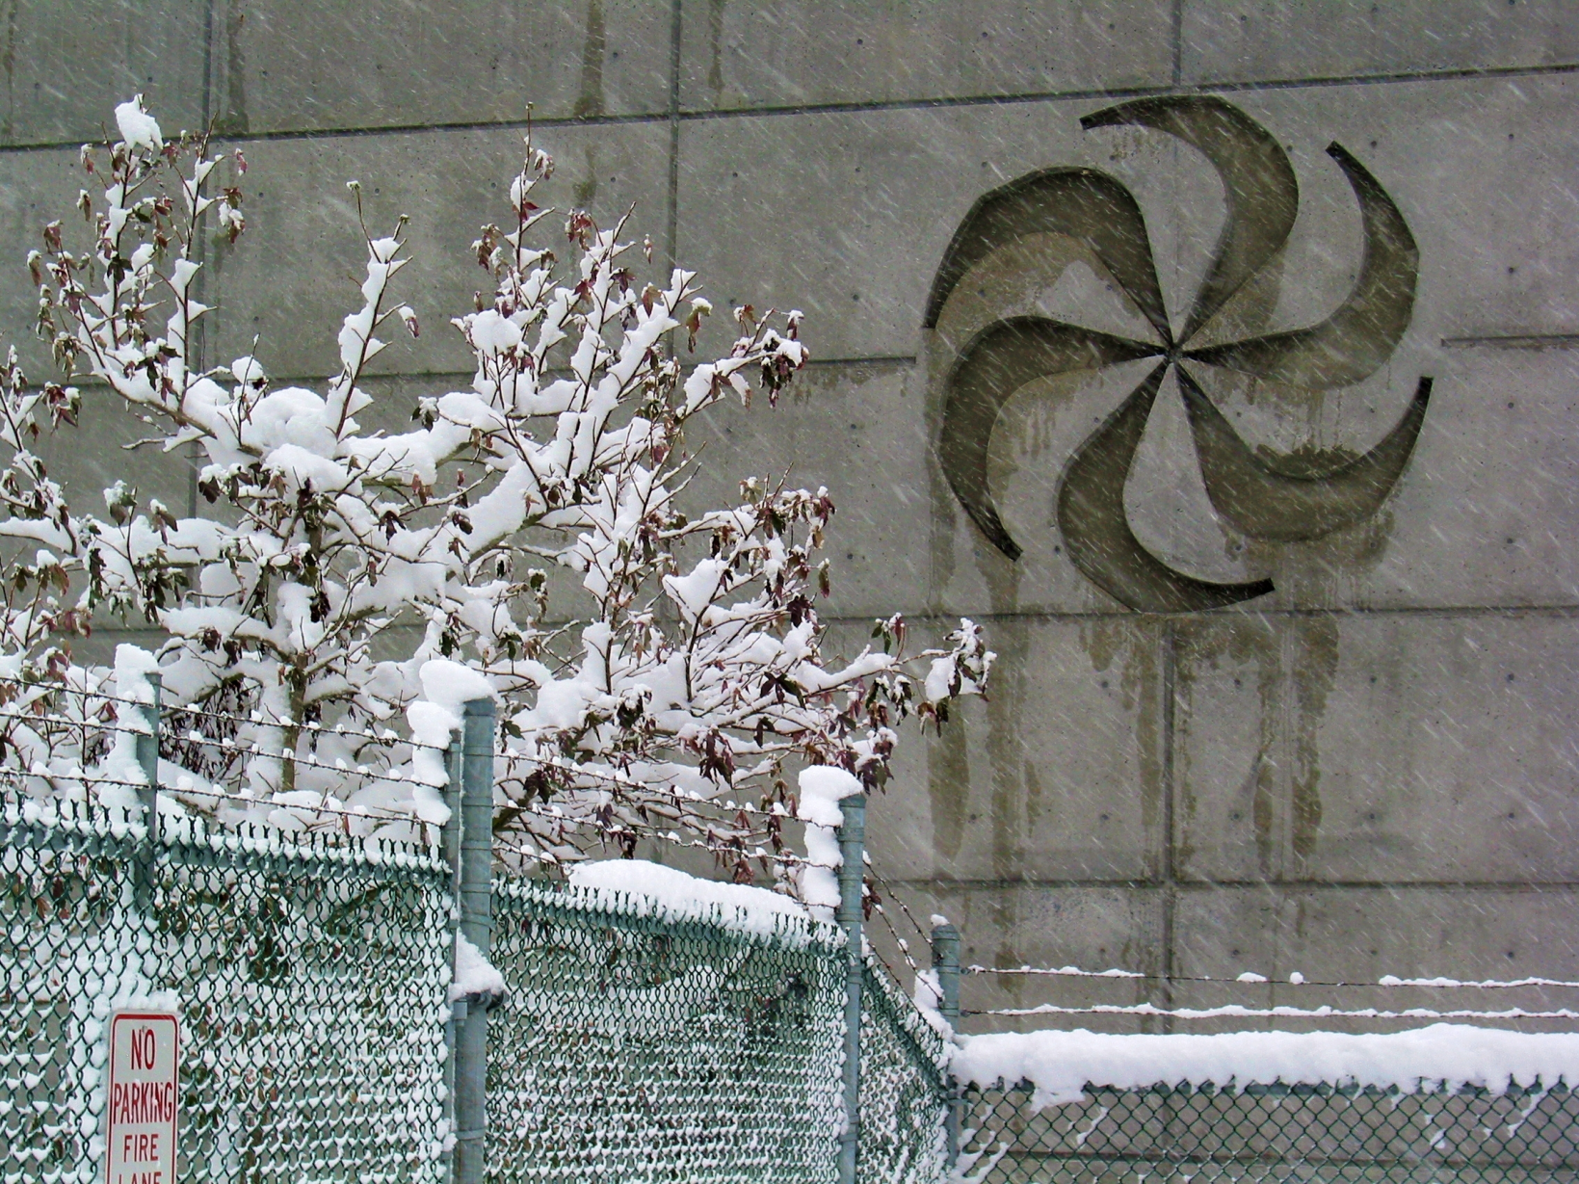
Location and timing of next the TTC meeting to be organized around end of 2018
Feb 5-8, 2019 (tbc)
Picture courtesy of TRIUMF

Slide 9
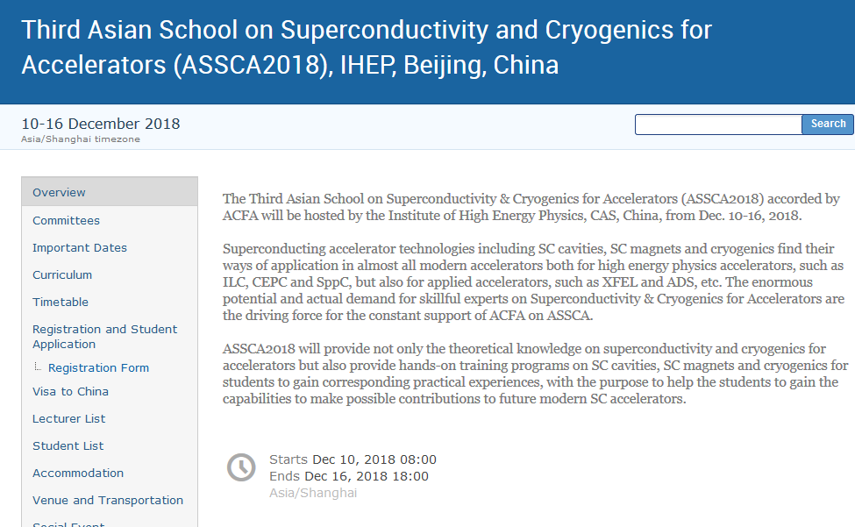
Announcement of TTC related Meetings
TTC Topical Workshop
„Flux trapping and magnetic shielding"
November 8/9 2018 at CERN

Slide 10
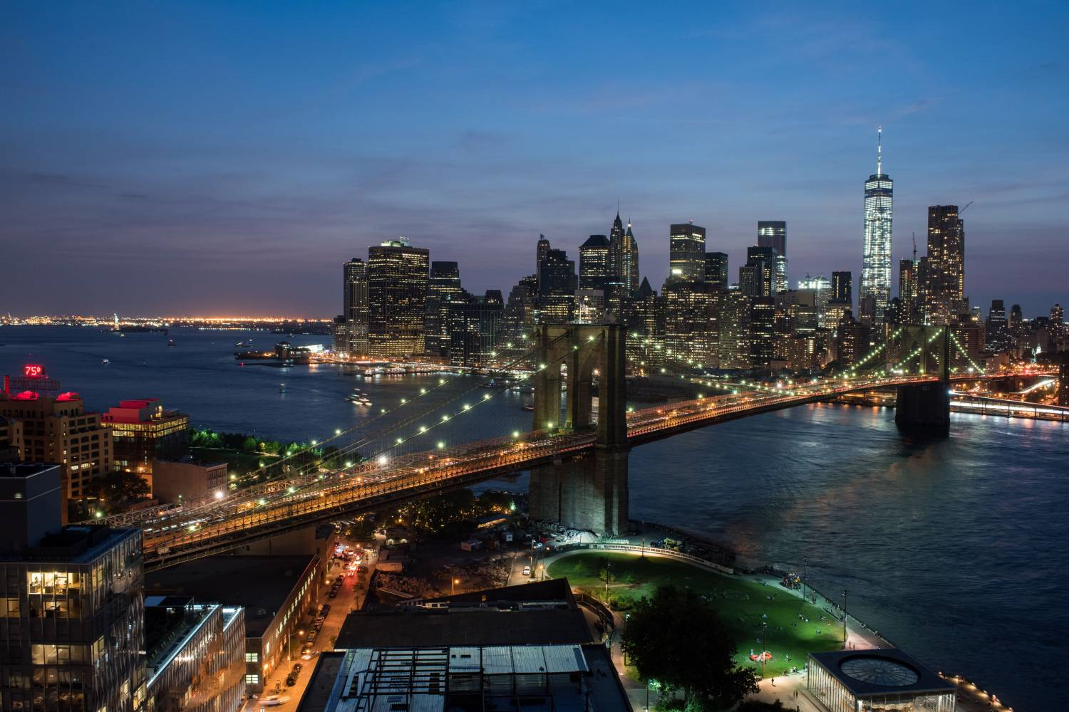
Bring together a diverse group of experts spanning the key disciplines (LLRF, Mechanical, and Cryogenic engineering) critical to the design and operation of SRF cavities and cryomodules, in particular those operated with high Q/narrow bandwidth and pulsed conditions.
Identify the key microphonic and detuning (Lorentz) issues experienced in facilities currently operating, and lessons learned which can inform the design and installation of those under construction and being proposed.
Present the latest developments in each discipline with the overall goal of producing quiet cryomodules, and addressing noise via both simple passive methods, and advanced active compensation techniques.
October 25 and 26, 2018
Hotel/Conference Center: New York Marriott at the Brooklyn Bridge, Brooklyn, NY
Contact: Kevin Smith ksmith@bnl.gov or Curt Hovater hovater@jlab.org
2nd Workshop on Cryomodule Microphonics & Resonance Control
October 25 and 26, 2018

Slide 11
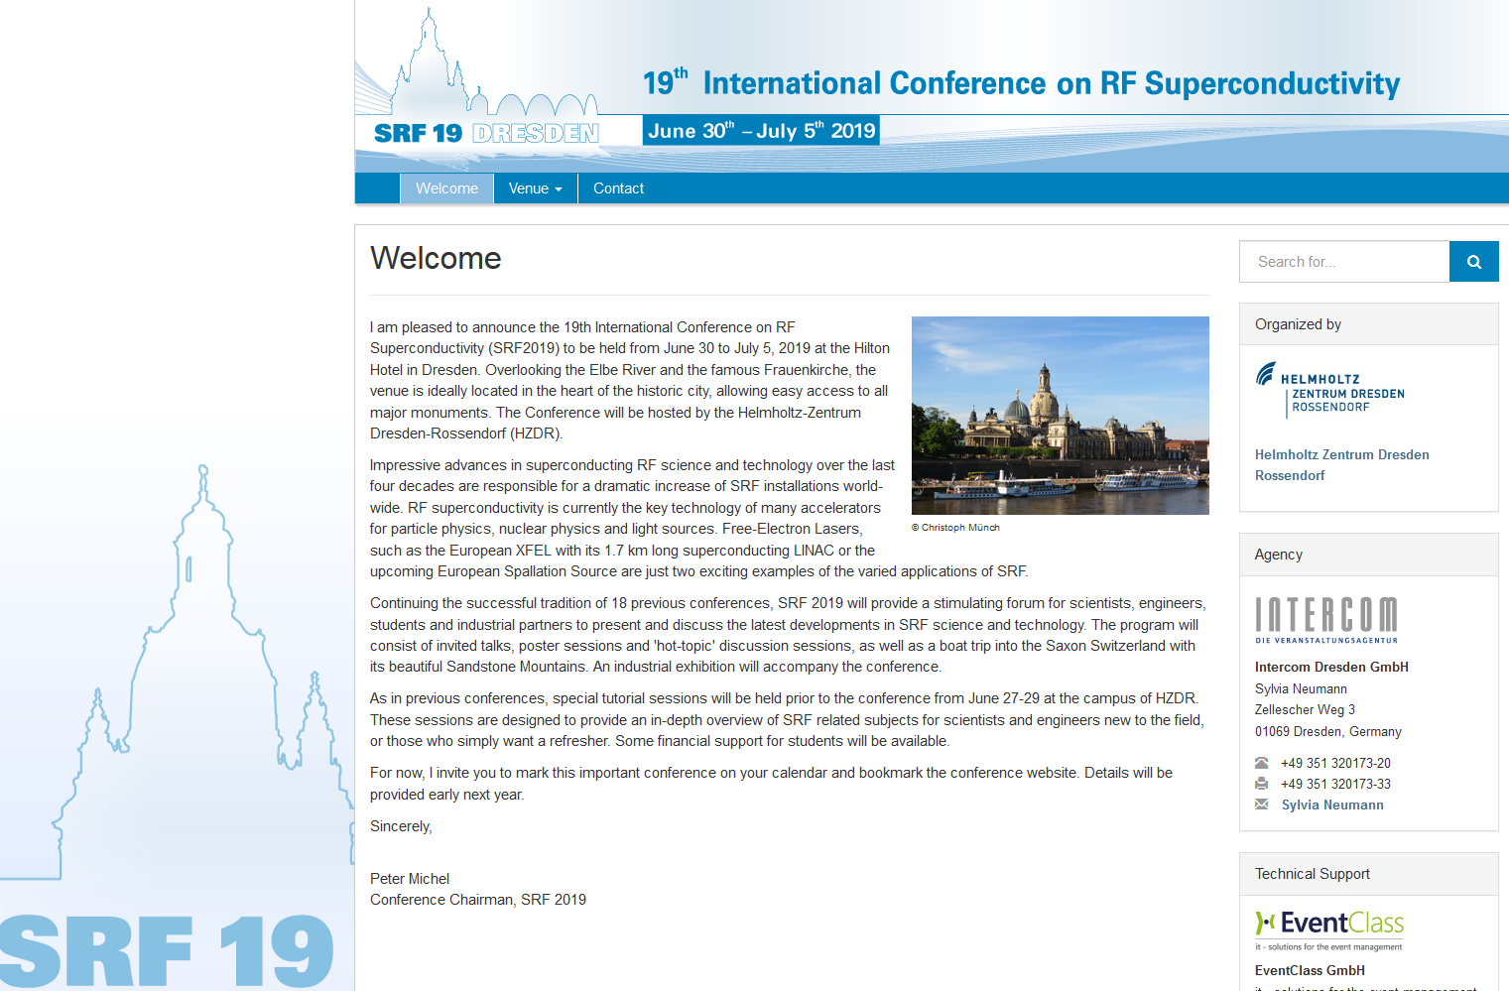
Announcement of TTC related Meetings

Slide 12
Overview TTC related Meetings
8th Workshop on Thin Films and new ideas for pushing the limits of RF Superconductivity | INFN Legnaro | October 8 – 10, 2018
TTC Topical Workshop Flux trapping and magnetic shielding | CERN | November 8-9, 2018
Cryomodule Microphonics and Resonance Control | Co-hosted by BNL and JLAB in New York City | October 17 – 28, 2018
Third Asian School on Superconductivity and Cryogenics for Accelerators (ASSCA2018) | IHEP Beijing | December 10 – 16, 2018
TESLA Technology Collaboration Meeting | TRIUMF | February 5-8, 2019 (tbc)
19th International Conference on RF Superconductivity (SRF2019) | Helmholtz Zentrum Rossendorf Dresden | June 30 to July 5, 2019

Slide 13
The actual TTC Meeting was conducted in an enthusiastic way and with great care…
Naruhiko Sakamoto (RIKEN), LOC-chair, and his team
and the
TTC Meeting Scientific Program Committee chaired by Eiji Kako (KEK) & Wolf-Dietrich Moeller (DESY)
SPC | WP Leaders
Hans Weise (DESY), TTC-chair Bob Laxdal (TRIUMF) Eiji Kako (KEK) Wolf-Dietrich Moeller (DESY) Naruhiko Sakamoto (RIKEN) Sergey Belomestnykh (FNAL) Akira Yamamoto (KEK/CERN) Paolo Pierini (ESS) | Bob Laxdal (TRIUMF) Han Li (Uppsala University) Kazutaka Ozeki (RIKEN) Sam Posen (FNAL) Claire Antoine (CEA) Akira Yamamoto (CERN/KEK) Alex Romanenko (FNAL) Marc Wenskat (DESY) Kensei Umemori (KEK) | Jacek Sekutowicz (DESY) Ben Hall (HZB) Rama Calaga (CERN) Hiroyuki Ao (FRIB) Marcelo Juni Ferreira (ESS) Hiroshi Imao (RIKEN)
THANK YOU!!!
お疲れ様です (​otsukare-sama desu)

Slide 14
The actual TTC Meeting was conducted in an enthusiastic way and with great care…
Naruhiko Sakamoto (RIKEN), LOC-chair, and his team
and the
TTC Meeting Scientific Program Committee chaired by Eiji Kako (KEK) & Wolf-Dietrich Moeller (DESY)
SPC | WP Leaders
Hans Weise (DESY), TTC-chair Bob Laxdal (TRIUMF) Eiji Kako (KEK) Wolf-Dietrich Moeller (DESY) Naruhiko Sakamoto (RIKEN) Sergey Belomestnykh (FNAL) Akira Yamamoto (KEK/CERN) Paolo Pierini (ESS) | Bob Laxdal (TRIUMF) Han Li (Uppsala University) Kazutaka Ozeki (RIKEN) Sam Posen (FNAL) Claire Antoine (CEA) Akira Yamamoto (CERN/KEK) Alex Romanenko (FNAL) Marc Wenskat (DESY) Kensei Umemori (KEK) | Jacek Sekutowicz (DESY) Ben Hall (HZB) Rama Calaga (CERN) Hiroyuki Ao (FRIB) Marcelo Juni Ferreira (ESS) Hiroshi Imao (RIKEN)
THANK YOU!!!
お疲れ様 でした (​otsukare-sama deshita)

