Slide 1
WG4
Developments Requested for Future Heavy Ion SRF LINACs from FRIB Experience
K. Saito
MSU/FRIB SRF Development Manager

Slide 2
R&Ds for Future Heavy Ion SRF LINACs
FRIB produces cavities of 19 β=0.041 QWRs, 100 β=0.085 QWRs, 80 β=0.29 HWRs, and 160 β=0.53 HWRs, in total ~360.
The production has been completed ~ 90%. All cavities except 0.53 HWRs has been finished including VTA certification test.
Good chance to discover hidden issue and resolve
Discovered and and not enough resolved in the FRIB cavity production
  RF contact issue at demountable bottom flange with QWRs
  Bolt gnawing issue on the NbTi flange screws
  High field Q-slope on BCP’ed low/medium beta cavities

Slide 3
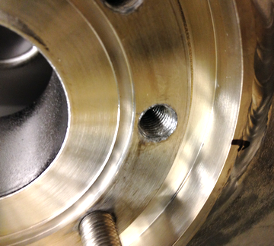
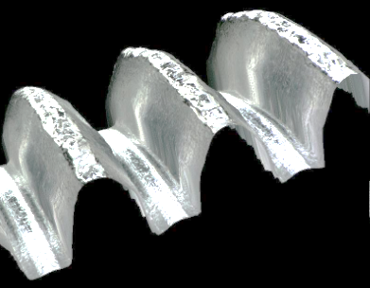
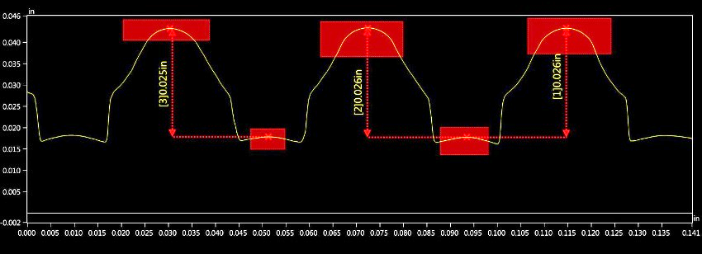
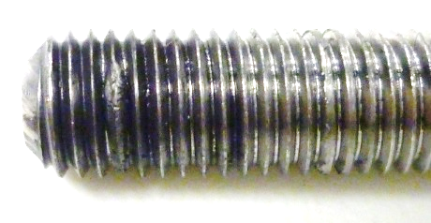
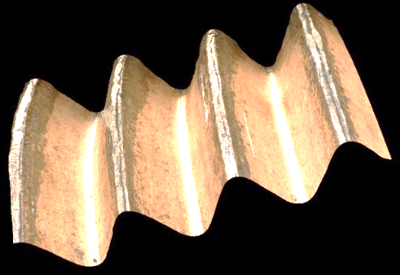
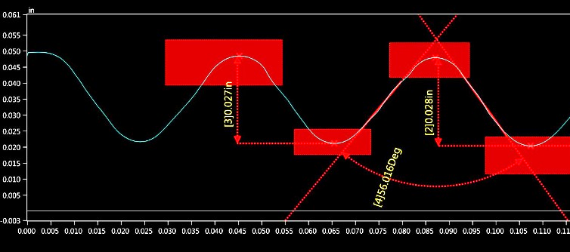
Issue of SS316L Bolts with NbTi Flange Screw
Gnawing on the NbTi screws
  SS316L bolt often gnaws the NbTi flange screw
  Needs electropolishing
  The fabrication quality is not good off center for example if get from cheaper market
Magnetized easily
  Even SS316L bolt is often magnetized 1 – 10 G during tightening work, or welding.
  Risk of increase residual magnet field around cavities
Particle production
  Produces particle during tightening
  Needs electropolishing but loos the tightness
SS316L
NC25
NC25 hard copper is a good candidate
  Very smooth surface, no need EP
  Suitable feature for bolt material at low temperature

Slide 4
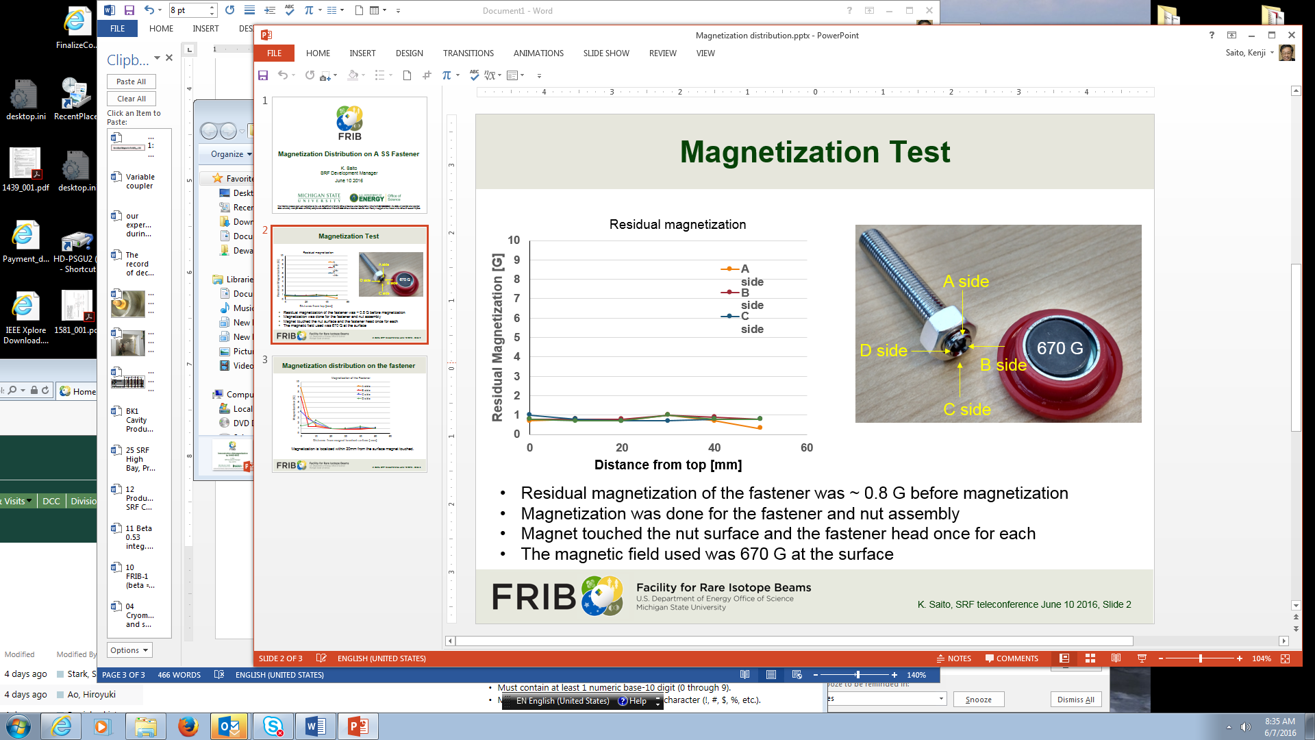
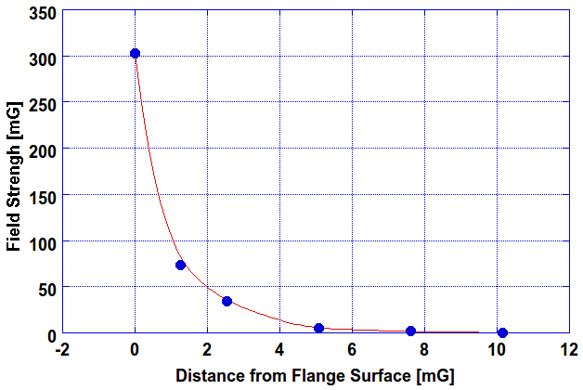
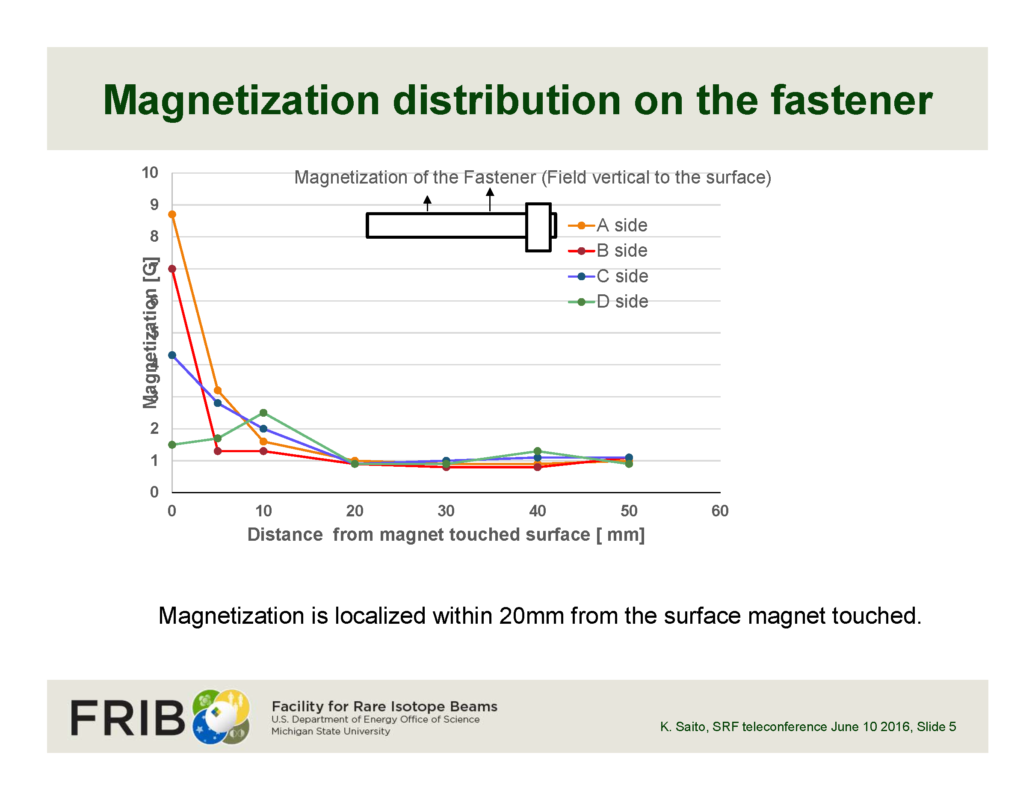
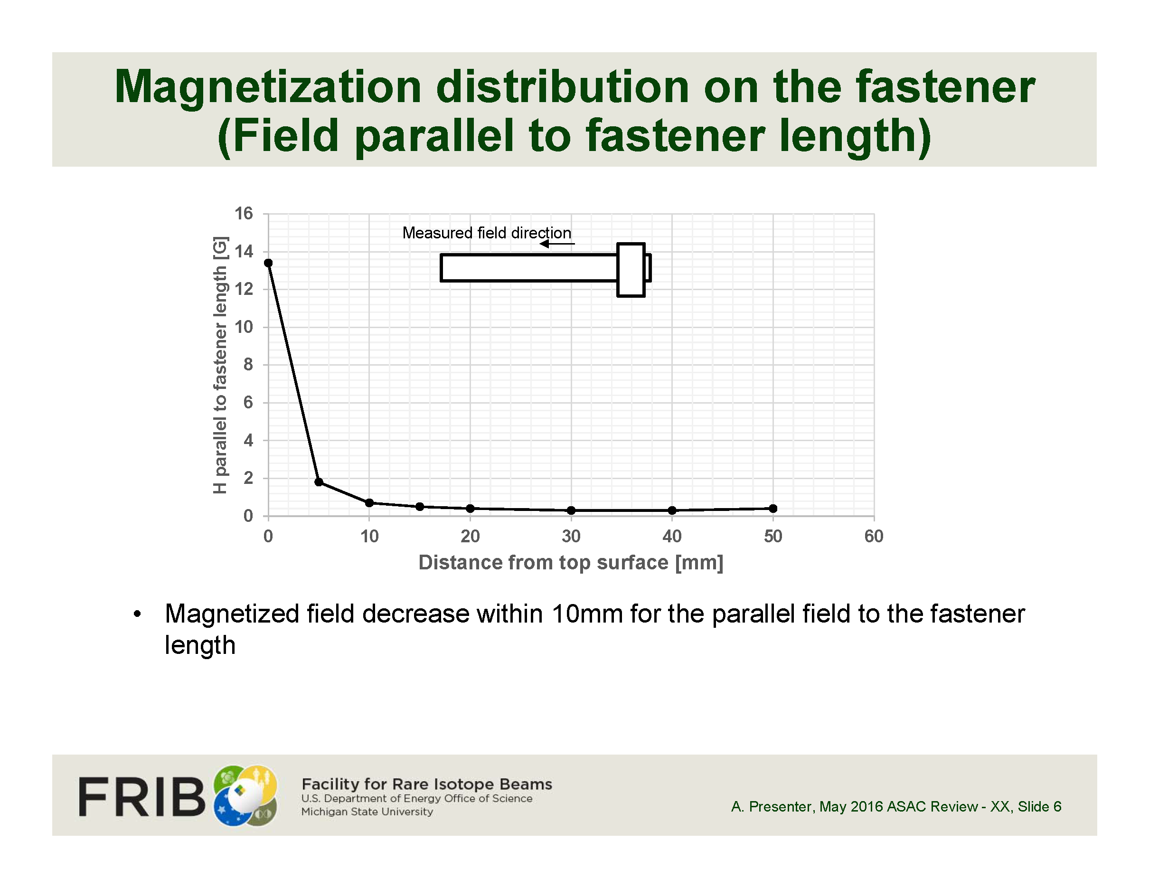
Magnetization Test of SS316L Fastener
Easily magnetized > 10 G at the surface
Magnetized field attenuation by space distance from the surface
Magnetization results
In the world of the 5 mG remnant field control like high Q cavities
1) Material of bolts must be chosen with great care.
2) Perfectly none magnetic materials should be used for fasteners and nuts, for instance hard copper (NC25) instead of stainless.
Transvers
Longitudinal

Slide 5
Required Material Feature Martial
Required material feature for bolts
  Harder material
  Less elongation
  Very hard and no low-temperature brittleness
  High thermal contraction coefficient
  Less particle contamination
  None margination
  High workability
Feature | NC25 | SS316L
Hardness [Hv] | 285 | 200
Elongation [%] | 13 | 50
0.2% Yield strength [MPa] | 700 | 280
Tensile strength [MPa] | 850 | 620
Sharpie at 4K [J] | 102(NC50) | 77
Thermal contraction [10⁻⁴ %/K] | 18 | 17
Parties (0.3μm) during tightening | 11 | 17 (EPed)
Magnetization on the surface after attached 670G magnet [G] | None | ~ 10
High workability | SS level
NC25 hard copper (Cu-Ni alloy) is recommended
  Perfectly none magnetic
  Very hard
  No gnawing (proofed)
  Less particle contaminant as same as EPed SS316L bolts (proofed)
Cold brittleness won Ti 5-grade
  Low-temperature brittleness is concerned (Sharpie at 4K 28 J).

Slide 6
Low Q Issue on 0.085QWRs

Slide 7
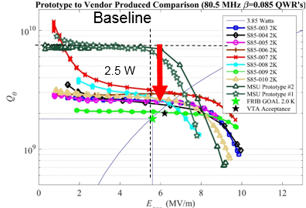
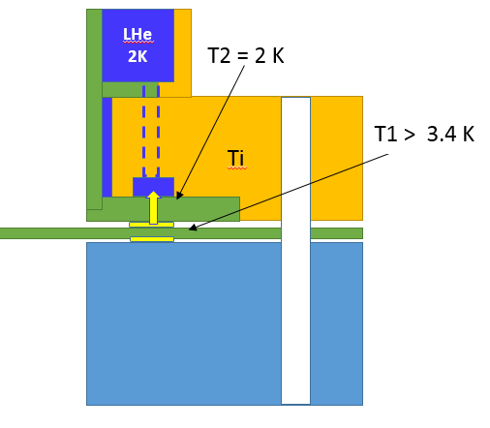
Low Q Issue in 0.085QWRs continued
Developed mitigation but not yet understand perfectly the mechanism
Production 0.085QWRs indicated low Q behavior against the in-house development cavities.
An additional heating of a 2.5 W happens in this issue.
Various potential cures were attempted
Re-torqueing mitigates remarkably with reproducibility, Maybe Indium flow and poor RF contact
Not yet fully understood the low-Q mechanism
Tuning plate
Indium shield

Slide 8
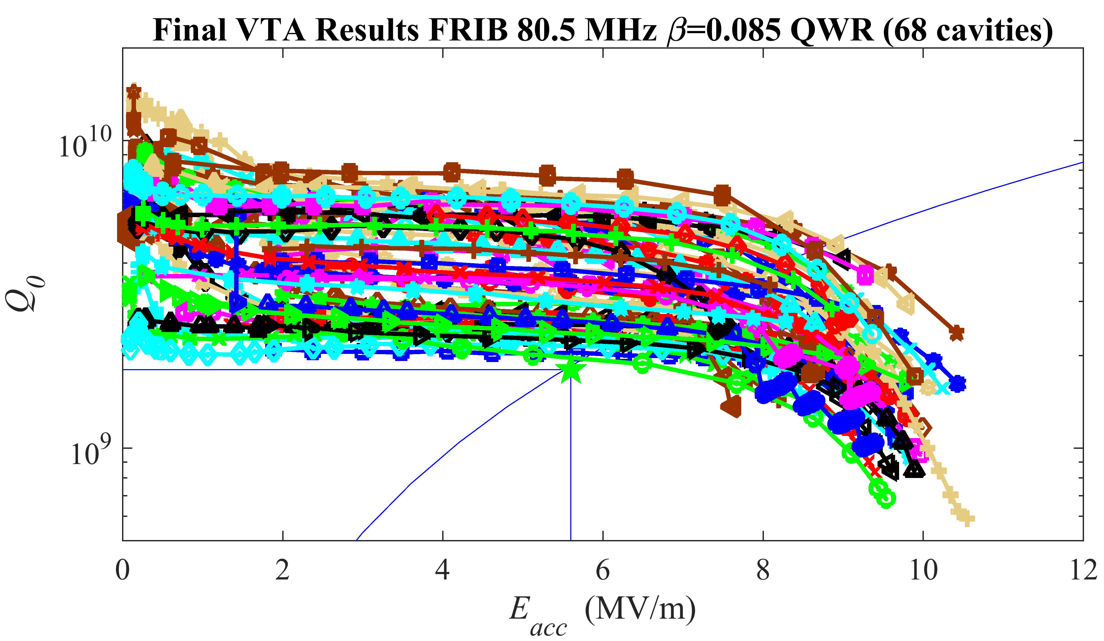
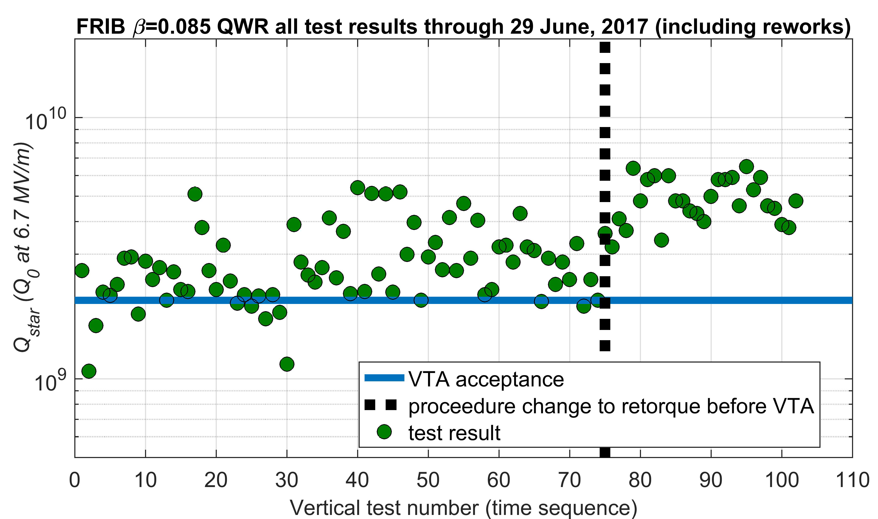
Not Yet Fully Understanding the Low-Q Mechanism
Re-torqueing resolved this issue practically
The bottom flanges have been always re-torqued before installing VTA.
Thermal cycle test up to room temperature was reaped several times with one cavity and the high Q performance was confirmed to be kept.
Indium RF contact is the cause
  Continues investigation
  Indium RF contact resistance happened about ~ 30μΩ at Qo = 2x10⁹ (2.5W additional heating).
Not yet full understanding, needs further R&D

Slide 9
High Field Q-Slope with BCP:ed Cavities
HFQS
HFQS
HFQS
HFQS

Slide 10
High Field Q-Slope (HFQS) Limitation
High Field Q-Slope Limits FRIB cavity performance
FRIB used BCP, 600^{O}C hydrogen degassing, HPR but no 120^{O}C baking
120^{O}C baking was effective on Q_{O} enhancement at 4K but impact on HFQS at 2K
Gradient is often limited by HFQS, which starts at ~ 84 mT for every beta family.
Needs to resolve the HFQS with BCP’ed cavity in order to pushup the higher gradient
Cavity | Eacc [MV/m] Ep [MVm] / Bp [mT] | Q_{O} at operation gradient (spec) | Highest Eacc and Limitation
β=0.041 QWR | 5.1 30.8 / 54.6 | 1.4 x 10⁹ | ~11 MV/m, HighQ slope (> 8 MV/m, 84 mT)
β=0.085 QWR | 5.6 33.4 / 68.9 | 2.0 x 10⁹ | ~9.5 MV/m, High Q slope (> 7 MV/m, 84 mT)
β=0.29 HWR | 7.7 33.3 / 59.6 | 6.7 x 10⁹ | ~15 MV/m, High Q slope (>11 MV/m, 84 mT)
β=0.53 HWR | 7.4 26.5 / 63.2 | 9.2 x 10⁹ | ~ 14 MV/m, High Q slope ( > 10 MV/m, 84 mT)

