Slide 1
TTC WG-2 focusing on Nb Material - Properties and Specifications – Respond from OTIC
Hongyun ZHAO
Ningxia Orient Tantalum Industry Co.,Ltd
TTC (at RIKEN, 26-29 June, ‘18), WG2 Co-Conveners
2018-6-26

Slide 2
Q1: General advices on specifications and/or any specific comments on items causing difficulties?
Advice/Comment/Infromation:
For EXFEL/007, every items of the specification could be meet by Ningxia OTIC without difficulties.
10 years RRR niobium production.
Served project of EXFEL, FRIB, LCLSII, China ADS, ESS with RRR niobium.
Completed production facilities in house from mineral process to niobium sheet.
Chemical, metallurgical and mechanical property analysis lab in house.
Experienced engineer and technician team.
Quality control system ISO9001.

Slide 3
Q2: Would there be cost-saving for: - Accepting higher impurity content in the specifications (e.g. loosen tantalum allowance) or for accepting lower RRR? - Cutting-out Large Grain disks/sheets from the Nb ingot vs Producing fine grain sheets after forging/rolling/polishing? What is the maximum diameter available?
Advice/Comment/Information:
The higher impurity content and lower RRR is not cost-saving way for Ningxia OTIC.
Tantalum is valuable element for OTIC.
We separate tantalum from niobium at hydrometallurgy process, low tantalum content is the normal result of the process.
Multi remelting is the key process for RRR niobium ingot. Less remelting times may cause lower RRR for niobium ingot, but the risk of less than low limit of RRR rise.
Cutting –out Large Grain disk is similar cost from fine grain sheet by the way of forging, rolling, polishing.
The maximum diameter of niobium ingot is 480mm.

Slide 4
Q3: What is the maximum recrystallized fraction possible and how measured/ensured? Would it be helpful to relax any other specifications, to help maximize recrystallized fraction? e.g. grain size? Hardness? Impurity content? Annealing temperature?
Advice/Comment/Information:
>95% recrystallized fraction could be got. The way to measure it is metallographic analysis.
It could help maximize recrystallized fraction by the bigger grain size, the lower hardness, the lower impurity content, the higher annealing temperature.

Slide 5
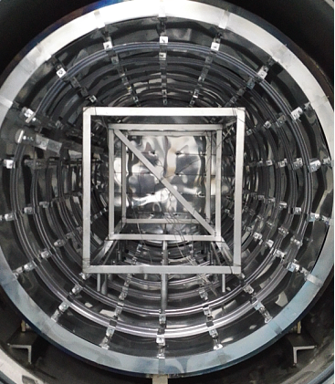
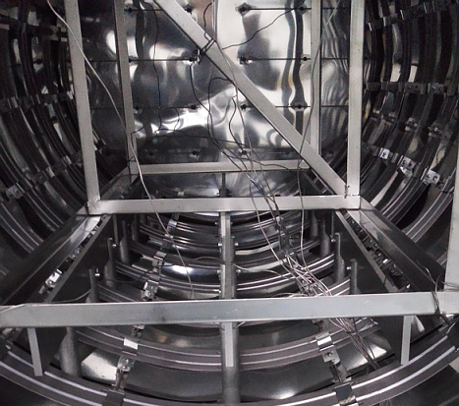
Q4: What is the temperature uniformity of sheets in the furnace during heat treatment after rolling in case of Fine Grain sheets (from a view point of QA/QC)?
Advice/Comment/Information:
The temperature uniformity of the furnace is ±3℃ by the way of 9-point temperature monitoring.

Slide 6
Q5: Would it be possible to determine the damage-layer thickness of completed rolled sheets or sliced disks? If yes, What is the reproducibility of damage-layer thickness?
Advice/Comment/Information:
We kept limited experience on the damage-layer thickness of the rolled sheets.

Slide 7
Q6: Any other specific advices?
Advice/Comment/Information:
250-350 is a RRR item on a new niobium specification. How to control the RRR more than 250 is experienced, but control RRR less than a up limit is a challenge.

Slide 8
Thank you

