Slide 1
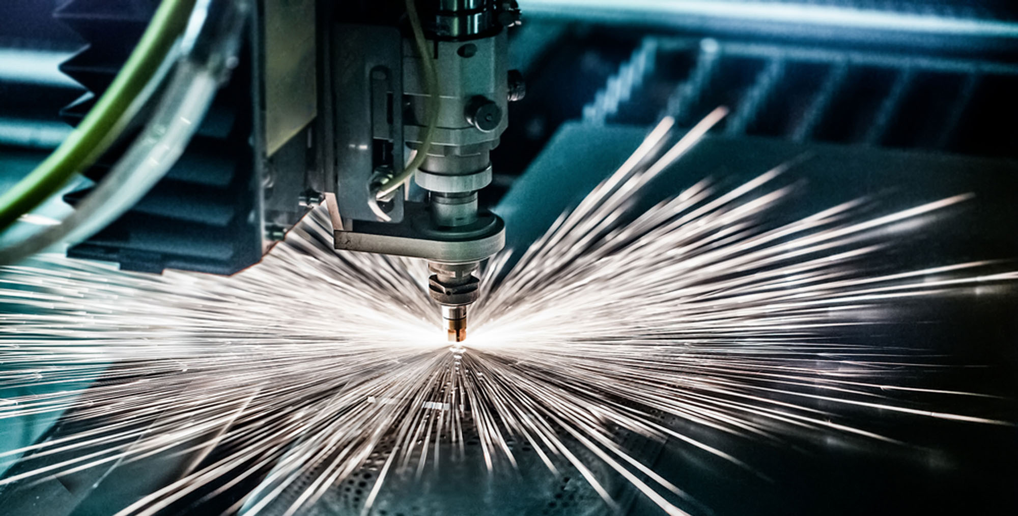

TTC WG-2 focusing on Nb Material – Properties and Specifications
Hanau, 18.06.2018, Bernd Spaniol

Slide 2
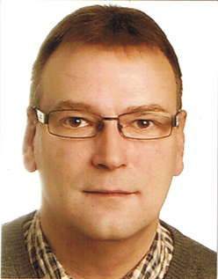
Hello to the TTC Meeting at Riken
As I could not join the meeting, please let me give you a warm Hello by this way.
I asked Akira Yamamoto to present our comments.
Thank you and I wish you fruitful discussions.
Best regards
Bernd Spaniol

Slide 3
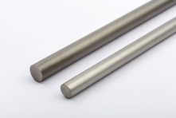
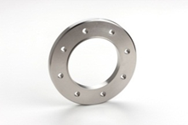
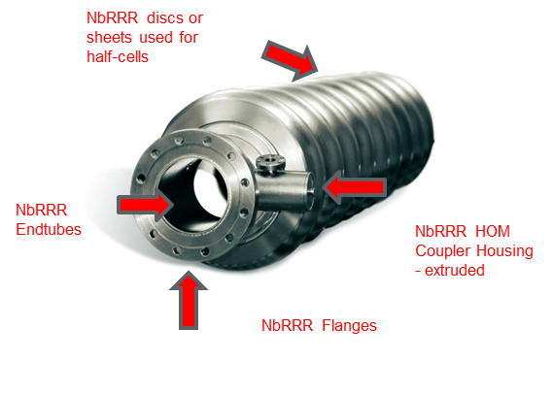
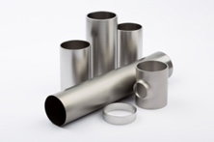
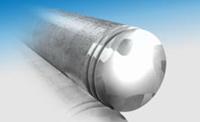
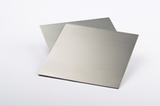
Tesla shape cavities - material and components
Products:

Slide 4
RF SC Landscape
The Nb RF SC Landscape:
- a quite small number of players
- best prediction for Standardization
and well agreed Specifications
6
~ 10
Nb RRR material
Producer
~ 50
RF SC manufaturer
Industry
High Energy Physik
Institutes

Slide 5
Heraeus comments to the questionnaire of the TTC Chairs
RRR smaller than 300?
- a high RRR is the assurance for material failures and process failures
- the RRR is a reference for the thermal conductivity at low temperatures
- a high thermal conductivity is leading the heat, caused by smaller imperfections, fast into the He
- all the efforts by improved cleaning, EP, BCP, N treading has been resulting in less need of extreme
high RRR values
This is describing the trend, but what is the right RRR level?

Slide 6
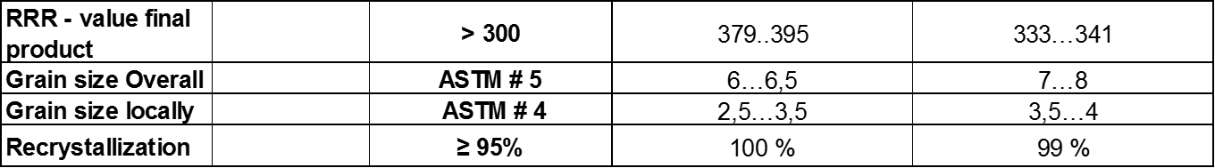
Heraeus comments to the questionnaire of the TTC Chairs
Grain size:
High purity to get high RRR values vs fine grains after recrystallization
  - RRR 300 + is predicting a minimum of Interstitials and metallic impurities
  - The Interstitials and metallic impurities are acting as growing-cells for new grains during the recrystallization
  - the absence of that impurities will end in a grain growth during the recrystallization
  - We have to do a bad compromise of not fully annealing and degradation of the RRR to find the “working window” to meet
  the specifications ( RRR vs grain size vs mechanical properties)
  - Here some figures from the same Nb material with different recrystallization rate.
  - we have to decide between best RRR values vs finest grain size

Slide 7
Heraeus comments to the questionnaire of the TTC Chairs
FG vs LG:

Slide 8
Heraeus comments to the questionnaire of the TTC Chairs
Mechanical properties / Impurities / RRR
- the table is showing the interactions between impurities, mechanical properties and RRR value
as a result or as a prediction

Slide 9
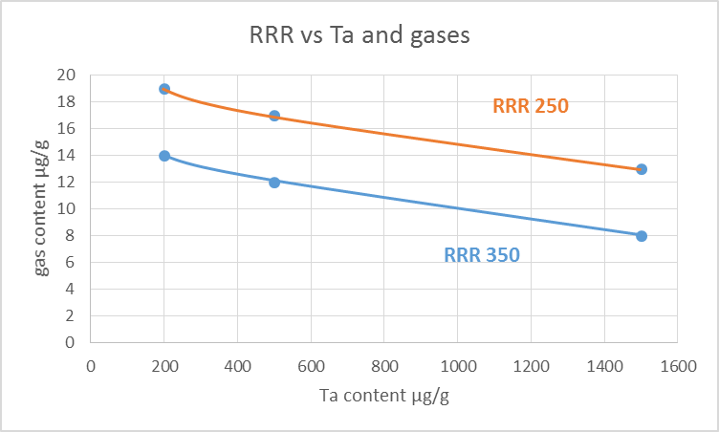
Heraeus comments to the questionnaire of the TTC Chairs
Impurities Ta Content:
- practically as well from the cost side, the Ta content is limited by the chosen RRR value
- the table is showing some samples how we have to reduce the Interstitials by increased Ta content to get the
same RRR result.
- calculation done for RRR 350 and for RRR 250
- a significant higher Ta content is feasible for RRR values of 250 and less, but costs will increase by additional
remelts to reduce the gases
- a significant higher Ta content for RRR > 300 will increase the cost as the No. of remelts has be increased to get
the low Interstitials level
- the higher the RRR value the more critical is the Ta content, as the gases has to reduced dramatically

Slide 10
Heraeus comments to the questionnaire of the TTC Chairs
Cost savings:
- Ta content:
- a higher Ta content will not end in a significant cost saving, to get the same RRR value, the Interstitials has to be
reduced by additional remelts.
- a higher Ta content can ensure the stable availability of large quantities of Nb pre-material for large projects,
such as ILC
- Interstitials:
- higher content of Interstitials are ending in a cost saving, as the No. of remelts can be reduced, but the RRR
value will also be reduced
- LG:
- LG discs can be produced with a cost saving potential of about 20% compared to rolled sheets

Slide 11
Heraeus comments to the questionnaire of the TTC Chairs
Other questions:
Temperature uniformity during the annealing process
- resistant furnaces has a typically temperature uniformity of better than 10 K in the heating zone
- inductive furnaces has a typically temperature uniformity of better than 25 K in the heating zone
The temperature uniformity in the annealed Nb parts is depending
- on the furnace load
- on the dimension of the parts
- on the heating speed from RT to the annealing temperature
- to minimize the temperature ununiformity it is usual to have a holding point before reaching the
annealing temperature to get a more homogeneous temperature distribution in the parts.

Slide 12
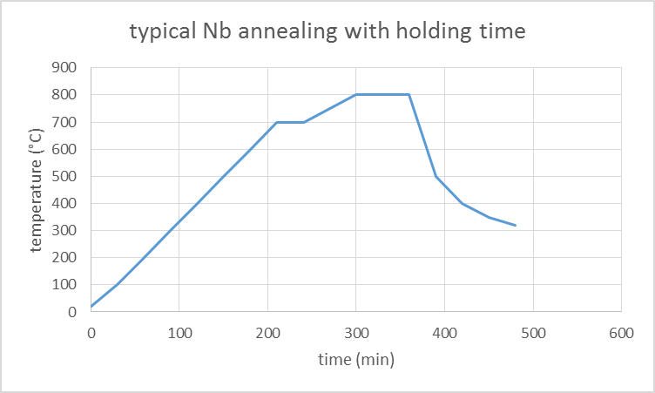
Heraeus comments to the questionnaire of the TTC Chairs
Other questions:
Temperature uniformity during the annealing process
- typically annealing curve with a holding time of 30 min at 700°C to get homogeneous temperature
distribution in the Nb parts

Slide 13
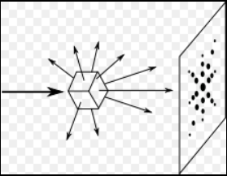
Heraeus comments to the questionnaire of the TTC Chairs
Other questions:
Damage layer:
- the thickness of a damage layer on fully annealed material could be determined by X-ray investigations
- using the “Laue” X-ray investigation, you will get a clear “Laue” picture only for
undamaged crystals
- the thickness of an damage layer could be determined by
gradually etching of the sample, as long till you find a clear “Laue” picture
- we found that effect by investigations of grain orientation on Nb RRR
but we never determined the thickness of the damage layer of sheet,
discs or tubes

Slide 14
Heraeus comments to the questionnaire of the TTC Chairs
Thank you and
best regards
Bernd Spaniol

Slide 15
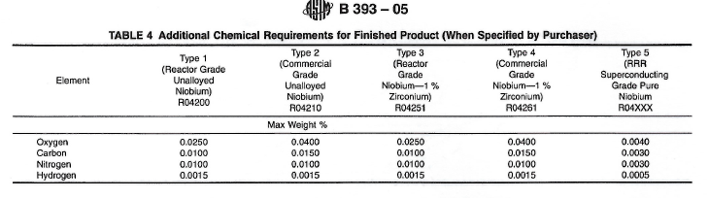
Harmonization - Material and component reference
The influence of unusable standards:
- how wrong HARMONIZATION is opening the way to diversification
- O < 40 µg/g - C < 30 µg/g - N < 30 µg/g - H < 5 µg/g → RRR 25

Slide 16
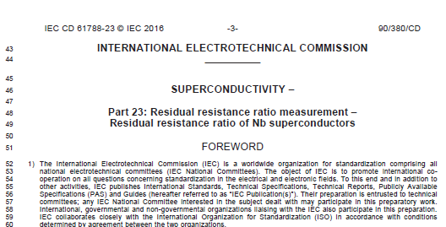
Harmonization - Material and component reference
The influence of usable standards:
- less discussions, less interpretation, a signpost

Slide 17
Harmonization - Material and component reference
The influence of usable standards:
- less discussions, less interpretation, a signpost
The IEC Standard 61788-23
Will describe an international Standard on measurement of the RRR value of Nb superconductors
- measurement at 9,2 K
- measurement U vs time
- measurement with external magnetic field
- extrapolation to 4,2 K

Slide 18
Harmonization - Material and component reference
 |  | DESY |  | Heraeus |  | KEK | FNAL |  |  | Summary 9,2 K |  |  | Summary 4,2 K
Lot 3253 |  | RRR (9.2K) | RRR (4.2K) | RRR (9.2K) | RRR (4.2K) | RRR (9,2K) | RRR (9.2K) | RRR (9.2K) | RRR (4.2K) | min (9,2K) | max (9,2K) | range (9,2K) | min (4,2K) | max (4,2K) | range (4,2K)
sample 1 |  | 367 | 399 | 370 | 402 |  |  | 365 |  | 365 | 370 | 5 | 399 | 402 | 3
sample 2 |  | 347 | 375 | 348 | 376 |  | 345 | 343 | 371 | 343 | 348 | 5 | 371 | 376 | 5
Lot 3244 |  | RRR (9.2K) | RRR (4.2K) | RRR (9.2K) | RRR (4.2K) | RRR (9.2K) | RRR (9.2K) | RRR (9.2K) | RRR (4.2K)
sample 1 |  | 391 | 427 | 390 | 426 |  |  |  |  | 390 | 391 | 1 | 426 | 427 | 1
sample 2 |  | 379 | 413 | 378 | 411 |  |  |  |  | 378 | 379 | 1 | 411 | 413 | 2
Lot 3247 |  | RRR (9.2K) | RRR (4.2K) | RRR (9.2K) | RRR (4.2K) | RRR (9.2K) | RRR (9.2K) | RRR (9.2K) | RRR (4.2K)
sample 1 |  | 417 | 458 | 418 | 460 | 417 |  |  |  | 417 | 418 | 1 | 458 | 460 | 2
sample 2 |  | 408 | 448 | 395 | 431 |  |  |  |  | 395 | 408 | 13 | 431 | 448 | 17
Lot 3259 (No 149) |  | RRR (9.2K) | RRR (4.2K) | RRR (9.2K) | RRR (4.2K) | RRR (9.2K) | RRR (9.2K) | RRR (9.2K) | RRR (4.2K)
sample 1 |  | 382 | 416 | 377 | 411 |  |  |  |  | 377 | 382 | 5 | 411 | 416 | 5
sample 2 |  | 383 | 417 | 370 | 403 |  |  |  |  | 370 | 383 | 13 | 403 | 417 | 14
Lot 3259 (No 150) |  | RRR (9.2K) | RRR (4.2K) | RRR (9.2K) | RRR (4.2K) | RRR (9.2K) | RRR (9.2K) | RRR (9.2K) | RRR (4.2K)
sample 1 |  | 344 | 372 | 328 | 354 |  |  |  |  | 328 | 344 | 16 | 354 | 372 | 18
sample 2 |  | 332 | 358 | 332 | 358 | 336 |  |  |  | 332 | 336 | 4 | 358 | 358 | 0
FNAL sample R2 |  | 376 | 409 | 355 | 385 |  |  | 375 |  | 355 | 376 | 21 | 385 | 409 | 24
FNAL sample R3 |  | 310 | 332 | 302 | 323 |  |  | 293 |  | 293 | 310 | 17 | 323 | 332 | 9
FNAL sample R4 |  | 334 | 360 | 346 | 374 |  |  | 320 |  | 320 | 346 | 26 | 360 | 374 | 14
FNAL sample R6 |  | 319 | 343 | 318 | 341 |  |  | 313 |  | 313 | 319 | 6 | 341 | 343 | 2
 |  | I) messured R vs Temperature @ 9,2 K | II) calculated from I) using TTC-Report 2010-02 | III) messured R vs time @ TC | IV) calculated from III) using TTC-Report 2010-02 | V) messured R vs Temperature @ 9,2 K | VI) messured R vs time @ TC | VII) messured R vs Temperature @ 9,2 K | VIII) messsured R vs Temperature @4,2 K using outer magnetic field

Slide 19

Harmonization - Material and component reference
The influence of the tendering process:
- national law is applicable
- only a reduced influence on the specifications during the tendering process
- example: ESS, high beta ASTeC
- at the end the tendering was stopped and postponed

Slide 20
Harmonization - Material and component reference
The AMICI conference, more than giving proposals:
- Questions:
how are the results of the AMICI conference being implemented in the future ?
shall there be a HARMONIZATION based on international Standards ?
IEC, CEN, CENELEC, ….. ?
- Motivation:
let´s work together to end up
with much more than a proposal

Slide 21
Harmonization - Material and component reference
Thank You !

