Slide 1

Answering to your questions
Hiroaki Umezawa
CTO
Tokyo Denkai Co., Ltd.

Slide 2
Q1: General advices on specifications and/or any specific comments on items causing difficulties?
Advice/Comment/Infromation:
LG disc does not meet specification of EXFEL, especially in mechanical properties.
If mechanical properties of LG is not so tight, the one for FG should be loosened as well as LG.
Some of the spec of FG is hard to fulfill.
For example, “The difference in mechanical properties (Rm, Rp0.2, AL30) measured perpendicular and parallel to the main rolling direction should not exceed 20%”.

Slide 3
Tensile Strength
FG
LG
Ts > 140MPa

Slide 4
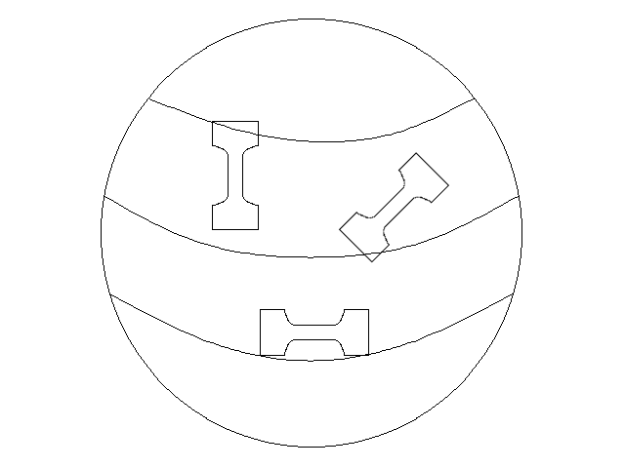
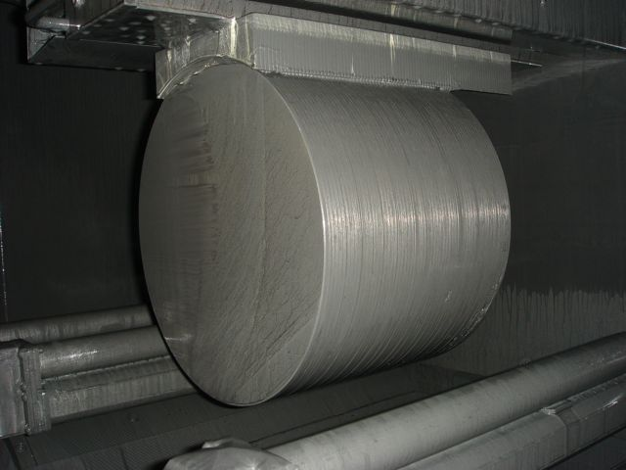
Sampling Direction
Vertical
Horizontal

Slide 5
0.2% Yield Strength
FG
LG
50MPa < Ys < 100MPa

Slide 6
Elongation
FG
LG
Elongation > 30%

Slide 7
Q2: Would there be cost-saving for:
- Accepting higher impurity content in the specifications (e.g. loosen tantalum allowance) or for accepting lower RRR?
- Cutting-out Large Grain disks/sheets from the Nb ingot vs Producing fine grain sheets after forging/rolling/polishing? What is the maximum diameter available?
Advice/Comment/Information:
Loosening specification in Ta contamination has no effect in cost cutting. Even if the specification is loosened as such, we are purchasing Nb with low Ta contamination as a raw material because RRR does not increase if Ta is too high in raw material.
Lowering RRR will lead to cost-saving.
Large Grain discs are cheaper than Fine Grain sheets.
The available maximum diameter is 300mm at our machine.

Slide 8
Q3: What is the maximum recrystallized fraction possible and how measured/ensured?
Would it be helpful to relax any other specifications, to help maximize recrystallized fraction? e.g. grain size? Hardness? Impurity content? Annealing temperature?
Advice/Comment/Information:
The recrystallize ratio is evaluated by optical microscopy.

Slide 9
Q4: What is the temperature uniformity of sheets in the furnace during heat treatment after rolling in case of Fine Grain sheets (from a view point of QA/QC)?
Advice/Comment/Information:
This subject is deeply connected to our know-how.
We would like to discuss individually not publicly, and only when there is a problem with our products relating to this issue.

Slide 10
Q5: Would it be possible to determine the damage-layer thickness of completed rolled sheets or sliced disks? If yes, What is the reproducibility of damage-layer thickness?
Advice/Comment/Information:
We do not know if it is possible to determine.
We have not measured the damage-layer thickness, nor have not tried to measure it.

Slide 11
Q6: Any other specific advices?
Advice/Comment/Information:
LG or FG? Cavity vendor knows very well about the difference between LG/FG in usage-wise.
Also, Low RRR will influence to production yield of cavity.

Slide 12
Summary
We, Tokyo Denkai can provide both FG and LG.
We have installed multi-wire-saw in our facility with capital investment of 1 million dollars.
We are capable in EB-melting & multi-wire-saw cutting.
Increasing LG disc demand is welcome with us.
We will do our best whatever ILC choose LG or FG.

Slide 13
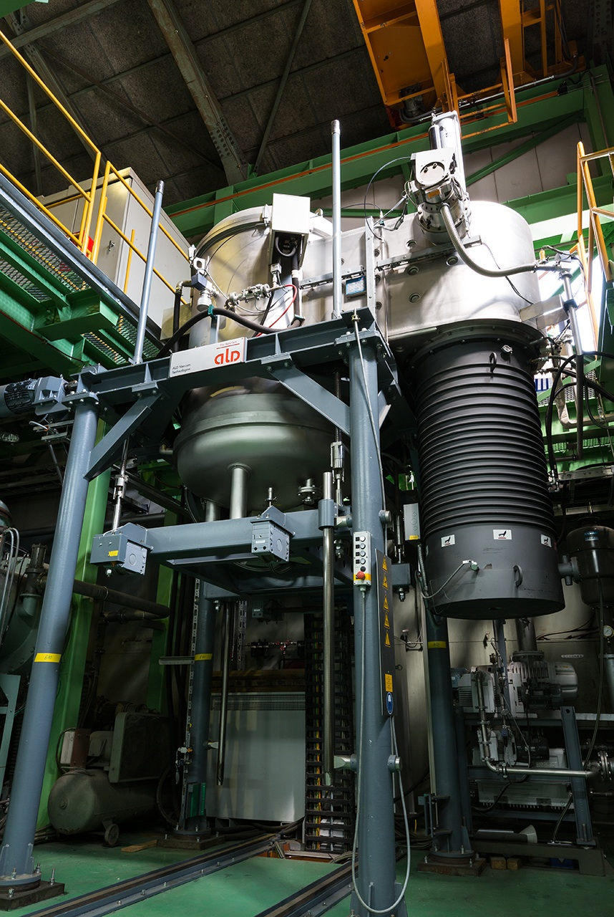
Thank you for your attention.

Slide 14
Back Up Slides

Slide 15
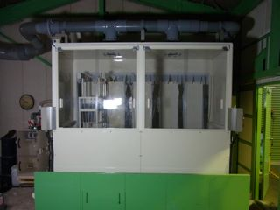
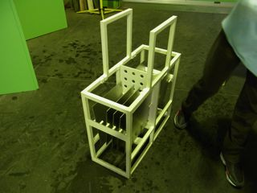
Automatic Etching Machine

Slide 16
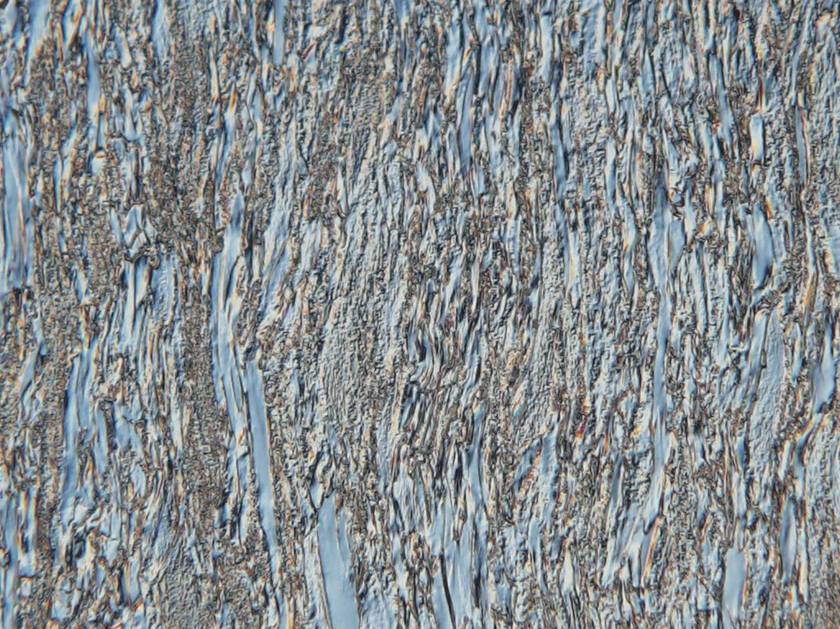
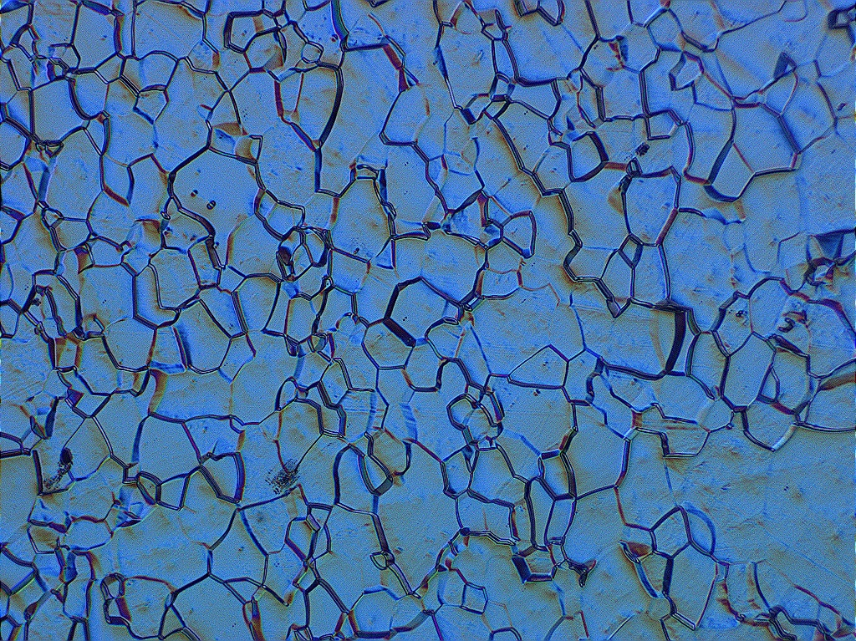
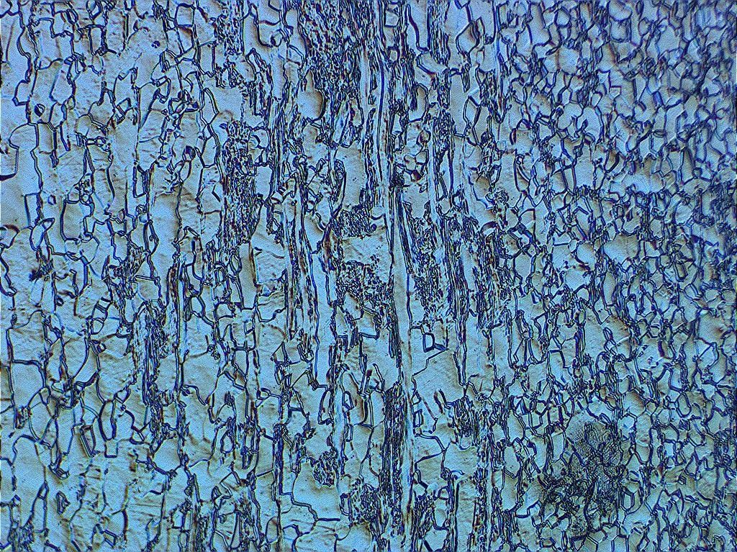
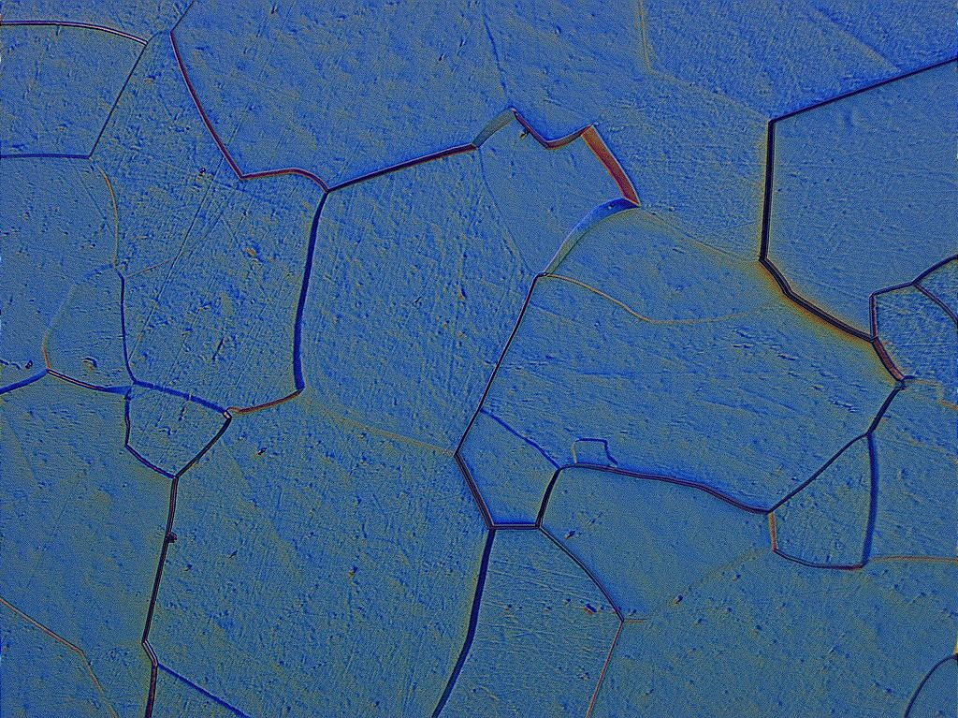
Micrographs
Before Annealing
ASTM #6
Not fully recrystallized
ASTM #2

Slide 17
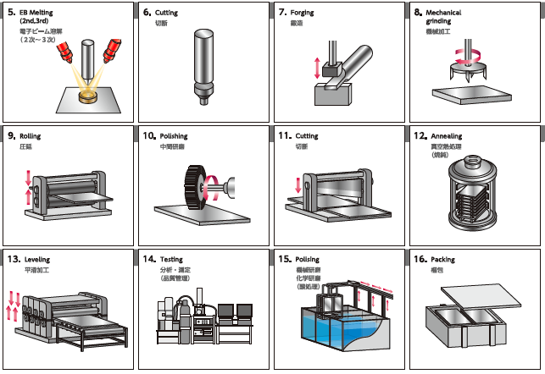
Fabrication process of Nb

