Slide 1
WG2
Experience with LG Niobium SRF Cavities
K. Saito and H. Umezawa*
MSU/FRIB SRF Development Manager
* Tokyo Denkai, Co. Ltd, Japan

Slide 2
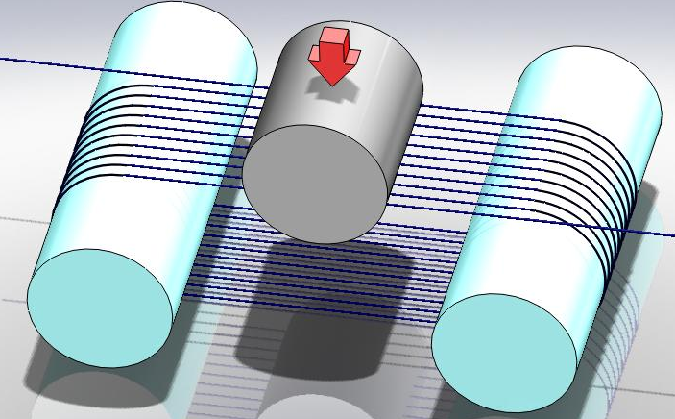
Multi-Wire Slicing Method
Apply silicon wafer slicing technology for Nb Ingot
“Multi-wire slicing of Nb ingot”
K. Saito, Single Crystal-Large Grain Niobium Technology Workshop in Brazil 2006
Splay liquid abrasives
Pressing
Nb

Slide 3
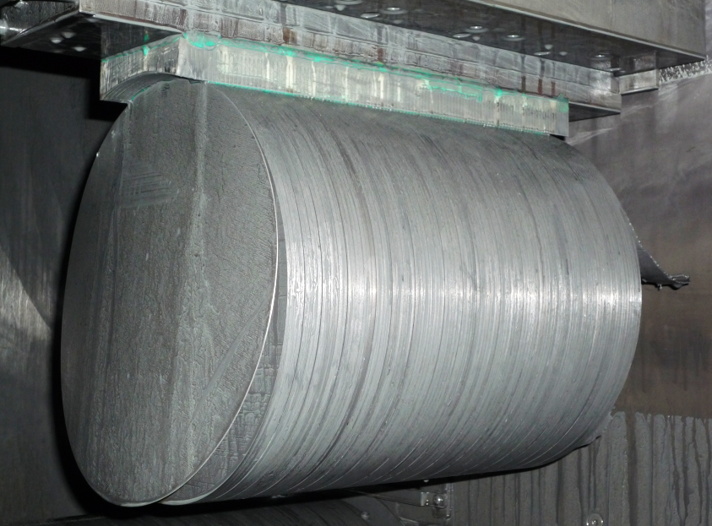
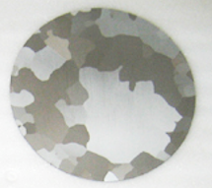
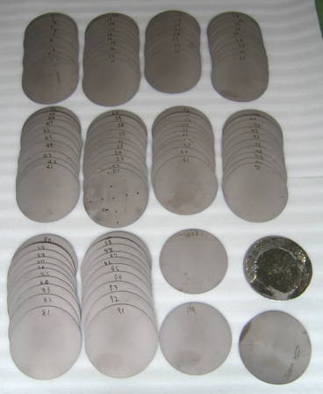
Wire Sliced Niobium Sheets from Ingot (TD)
RRR reduction by this slicing
is small, within the material
variation.
480 → 430
Degradation of RRR by this slicing is
about 10% . but it is within the location
variation of the Nb ingot.
102 sheets from 265φ x 307mm long Ingot
11-13/May/2011/ K.Saito

Slide 4
Feature of Sliced Nb Sheets from Ingot
Very Uniform
Feature of sliced sheet material:
Very uniform
~ 0.1% deviation in thickness
Very smooth
Rz ~ 5μm
Needless of mechanical finishing
Very fast sheet production
102 sheets within 48 hr
KEK 19 sheets
Weight of individual sheet
Thickness of individual sheet
2.906 ± 0.038 mm
Scatter 0.13%
1387 ± 1.2 g
Scatter 0.09%
Very Smooth
KEK 102 sheets
Surface roughness of individual sheet

Slide 5
Sheet Cleaning after Slicing
BCP and Annealing
Ultrasonic rinsing
BCP
Annealing @ 750^{O}C
Ti box

Slide 6
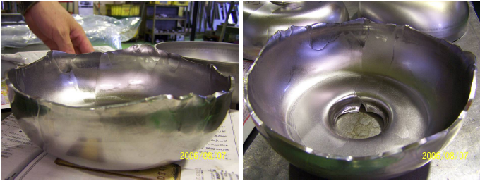
Half-Cell Deep Drawing
Crack
but no issue
for fabrication
11-13/May/2011 K.Saito

Slide 7
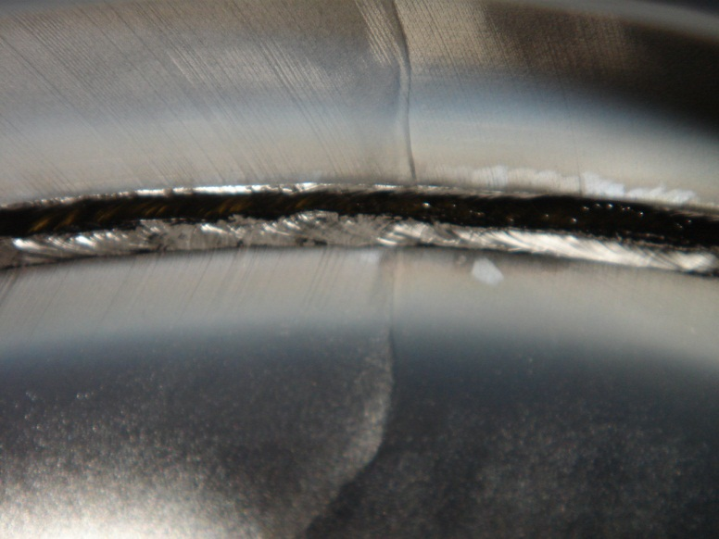
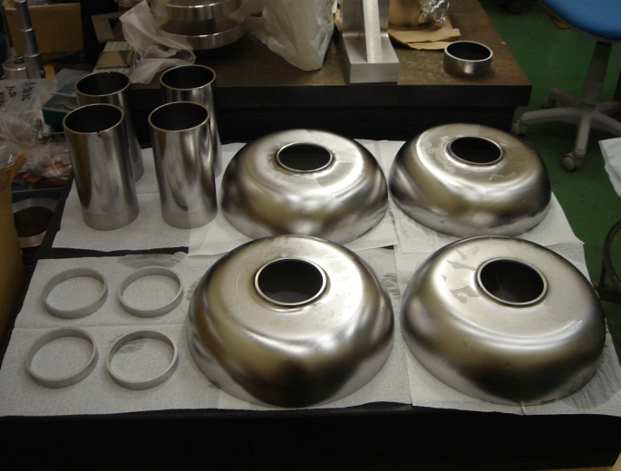
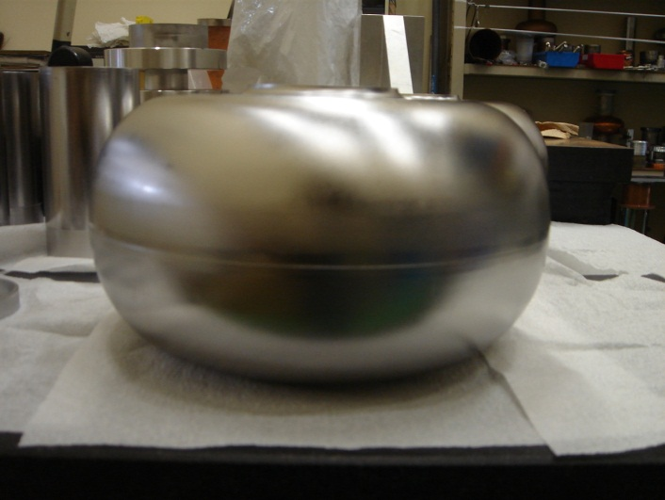
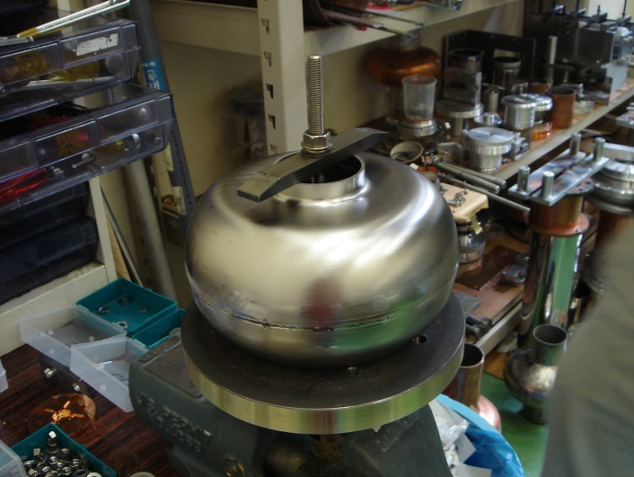
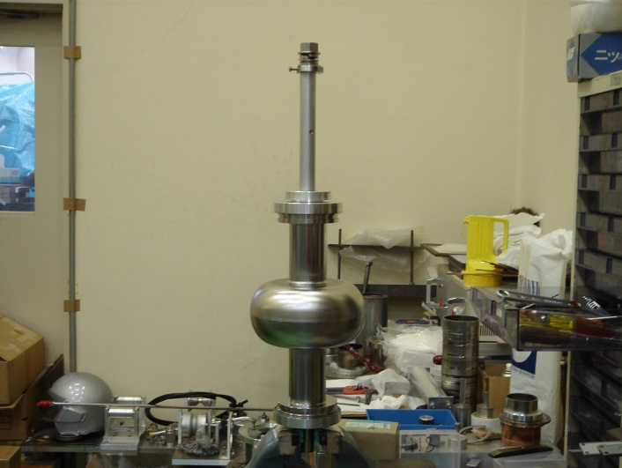
Fabrication @ KEK Machine Shop
Inside equator
Trimming EBW
EBW
Welding parts were trimmed fitting structure

Slide 8
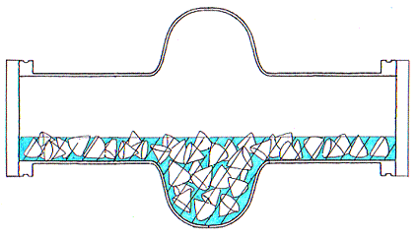

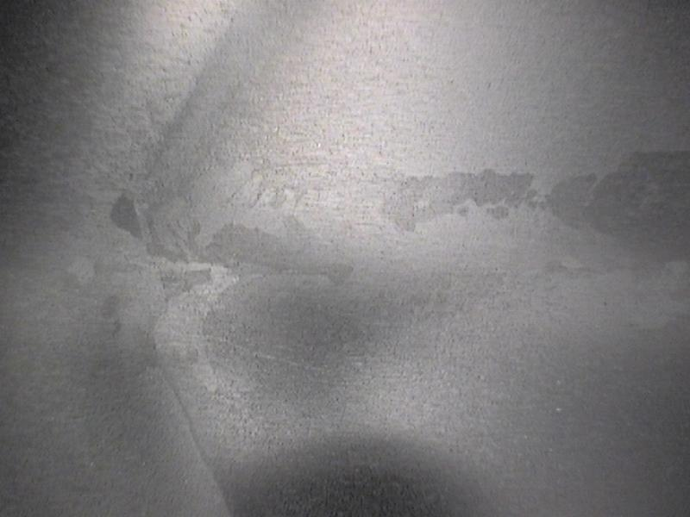
CBP at KEK
Rotated ~100rpm on a oppositely rotating table
Rough stone : 5 times
Green stone : Once
Brown stone : Once
White stone : Once
Totally ~ 200 μm removed @ equator
Water
stone
equator
equator
Equator EBW after CBP
Equator light BCP after CBP

Slide 9
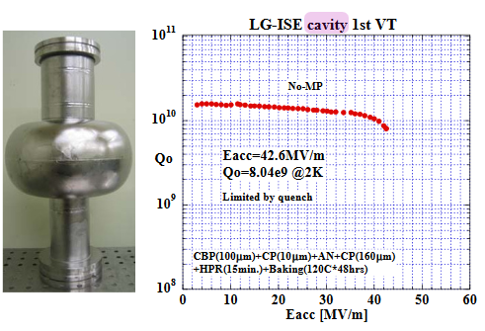
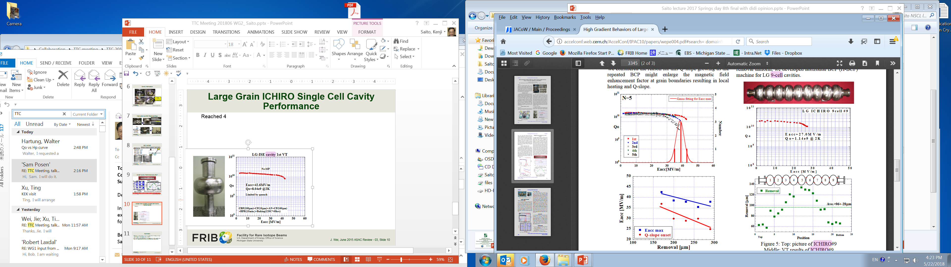
Large Grain ICHIRO Single Cell Cavity (End-Cell) Performance
Process:
  CBP ~ 80μm, light BCP ~ 10μm, Annealing 750^{O}C 3 hr, BCP 160μm, HPR (55 kg/cm²for 15 min), Baking 120^{O}C for 48 hr
Reached 42.6 MV/m by BCP at the first test.
High field Q-slop (HFQS) limits the performance.
Additional BCP produces more serious HFQS.

Slide 10
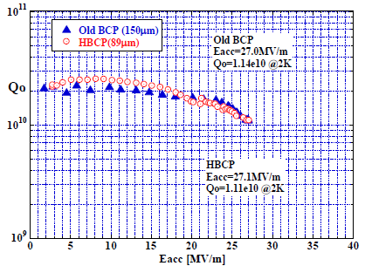
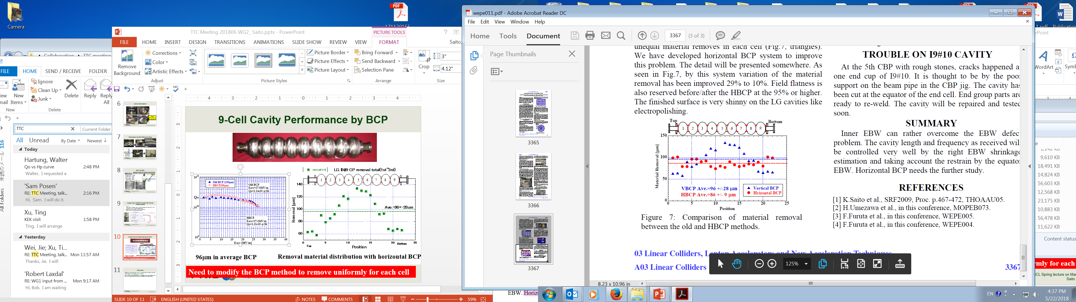
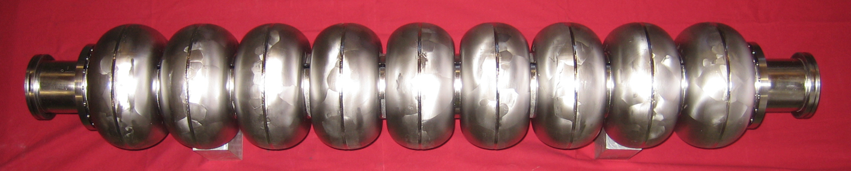
9-Cell Cavity Performance by BCP
96μm in average BCP after CBP
Removal material distribution with vertical and horizontal BCP
Cavity performance is limited by HFQS !
DESY has a similar result with BCP.
Expected to mprove the gradient > 40 MV/m, DESY result (next slide).

Slide 11
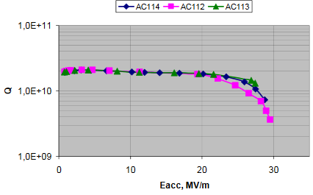
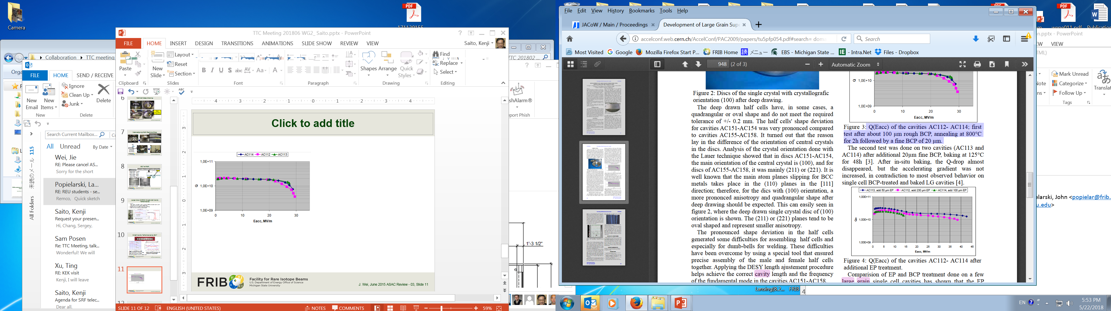
DESY Large Grain 9-Cell Cavity Results
BCP
EP
Q(Eacc) of the cavities AC112-AC114: first test after about 100 μm bulk etching with BCP, annealing 800^{O}C 2 hrs followed by light BCP of 20 μm. AC113 was quenched.
Q(Eacc) of the cavities AC112-AC114: after additional EP.

Slide 12
Merit for Large Grain for Nitrogen Doping or Infusion
Less vendor material dependence for N-doping or N-infusion cavity performance
  Nb material dependence was observed with N-doping with LCLS-II cavity performance.
  Nb material production has two category: High purity ingot production and sheet material production.
  The final material property is very sensitive to the sheet production, which is in vendor know-how.
  Slicing sheet production can ship the sheet production, as the result the vendor material dependence will be less than fine grain cavity.
Less sensitive the flux trapping during cooldown
  Large grain has less flux trapping, as the result can be expected high Qo.
  High Q quality will be controlled more easily than fine grain cavity.

Slide 13
Summary
Cavity fabrication is no problem if use fitting structure for EBW welding parts.
The performance of the large grain cavity is limited by high field Q slop below 30 MV/m with BCP’ed 9-cell cavity, even taking 120^{O}C baking.
However, DESY experience shows the high gradient performance > 40MV/m with EP’ed 9-cell.
Slicing technology have advantages in sheet production speed and cost, in addition with the N-doping or N-infusion cavity performance.

