Slide 1
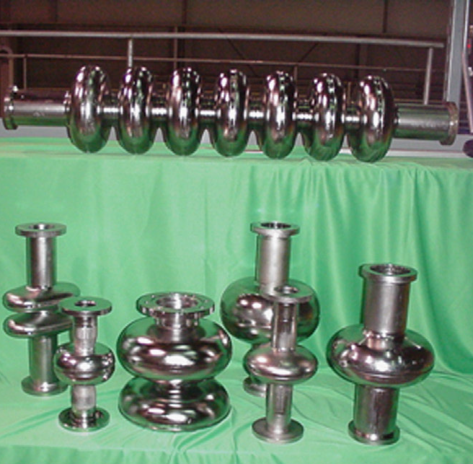
Ingot Niobium for Efficient and Potentially Low Cost SRF Cavities
TTC Meeting 2018
26-29 June 2018
RIKEN Nishina Center
Pashupati Dhakal

Slide 2
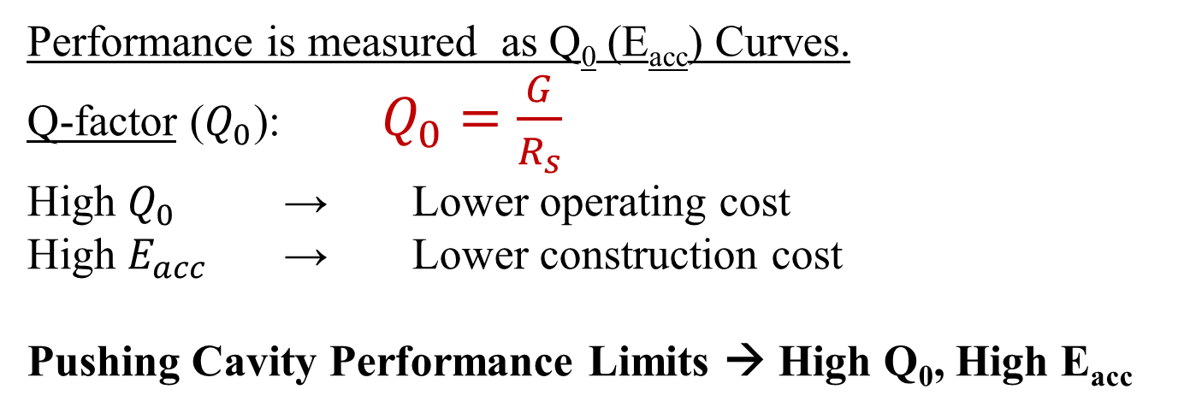
SRF Cavities
Performance is measured as Q₀ (E_{acc}) Curves.
Q-factor ($Q_{0}$):$Q_{0}=\frac{G}{R_{s}}$
High $Q_{0}$ → Lower operating cost
High $E_{acc}$ → Lower construction cost
Pushing Cavity Performance Limits → High Q₀, High E_{acc}
Gradient limitations
Critical field
Field emission
Multipacting
Q₀ limitations
R_{s}
Process, Metallurgy and
Superconductivity

Slide 3

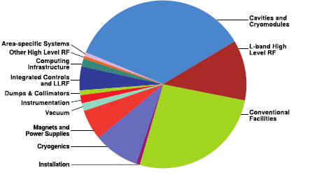
SRF Cavities
SRF Cryomodule
EXFEL ~ 100 (~800 cavities) LCLS-II ~ 40 (~300 cavities) ILC ~ 1000 (~8000 cavities)
ILC TDR
Keys for Cost reductions
Lower manufacturing/processing cost
Lower material cost
High Q and high gradient

Slide 4
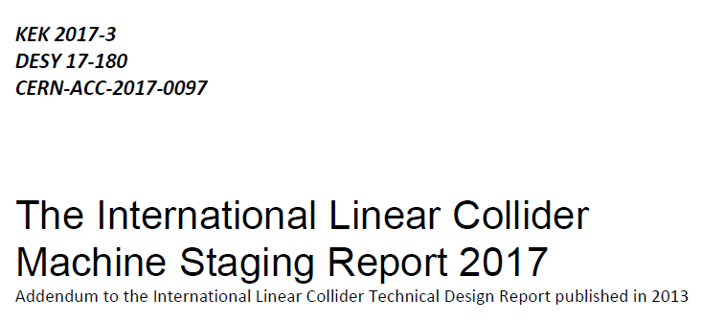
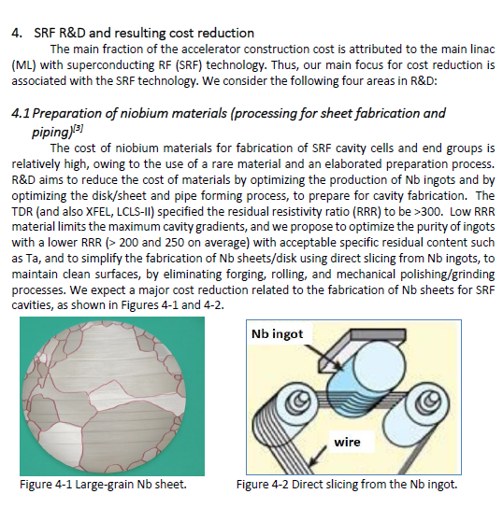
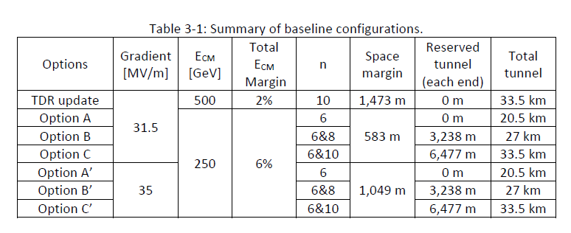
ILC Machine Staging Report 2017
Work on Ingot Niobium started in 2004 at Jefferson Lab and was quickly adopted in several lab around the world.
Ingot niobium cavities have been successfully produced by industry.
Eight 9-cell cavities were installed in one X-FEL cryomodule.

Slide 5
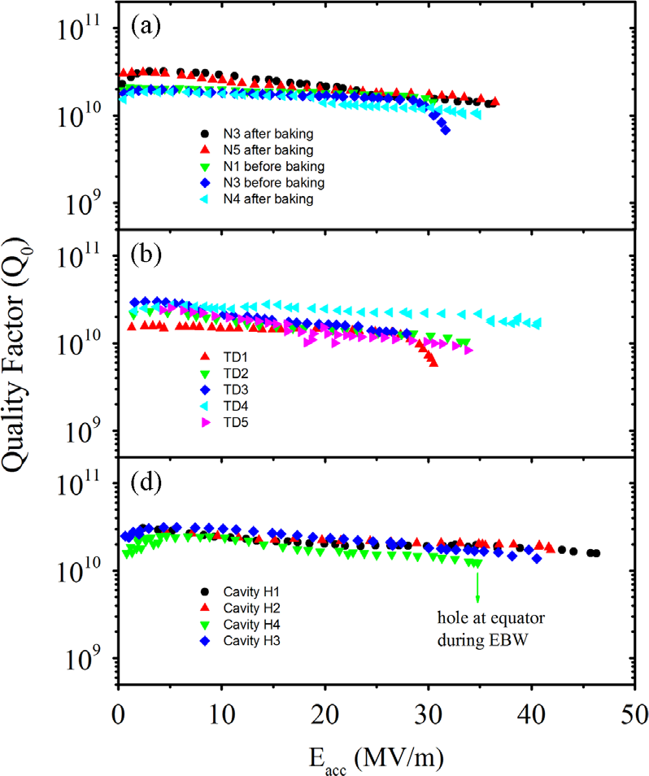
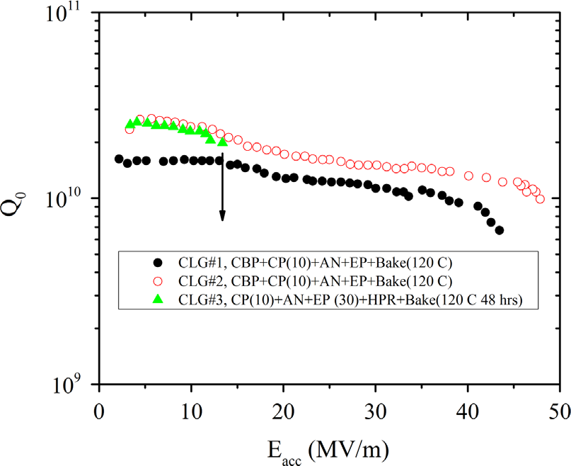
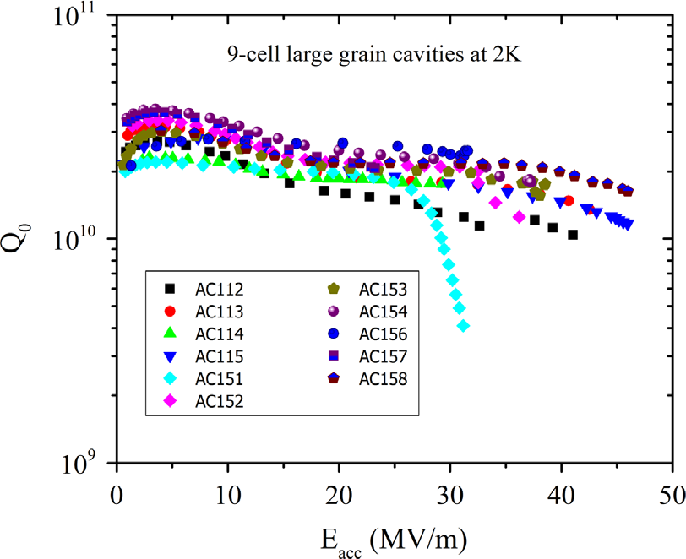
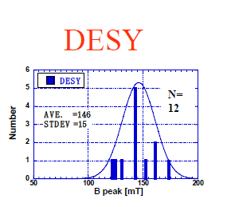
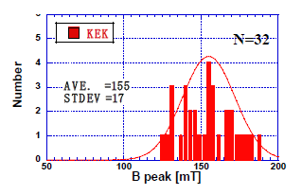
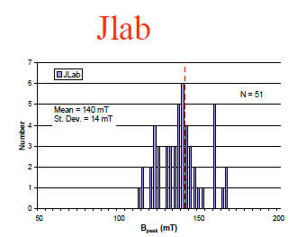
Ingot Niobium Cavities
Performance of SRF cavities built from ingot materials is comparable to that achieved using standard fine grain materials.
JLAB Single cells
KEK Single cells
DESY 9-cell
37 MV/m
35 MV/m
33 MV/m
Kneisel et al., NIMA 774, 133 (2015)
Kneisel, SRF 2007

Slide 6
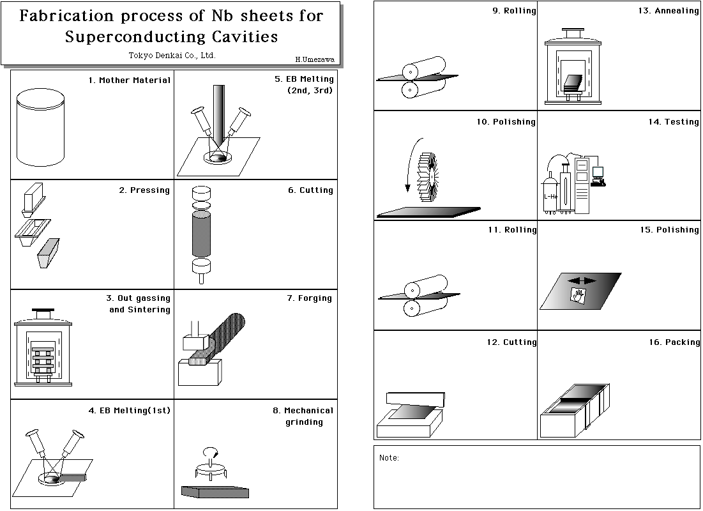

Processing Steps (FG vs Ingot)
Less steps → Lower manufacturing cost
→ Low material cost

Slide 7
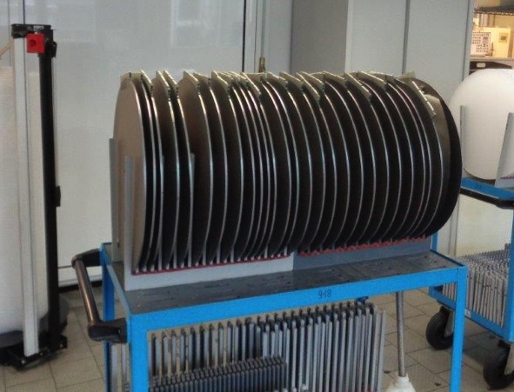
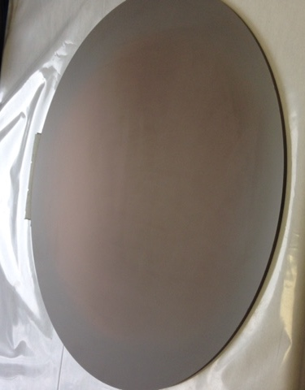
Cost Comparison for Niobium Discs
  Fine grain low tantalum discs $1,400 from vendor A
  High tantalum ingot discs with slicing from
  vendor B: $310
Multi wire slicing
Cut into slices in one of two ways
  Electronic Discharge Machining (EDM) with single wire
    Expensive
    Affects niobium surface quality
  Multi-wire slurry slicing
    Cost effective
    Produces the best results
    Production steps are reduced
Surface finishing
Photos: courtesy Ursula Weitzel-Hoefler, Heraeus

Slide 8
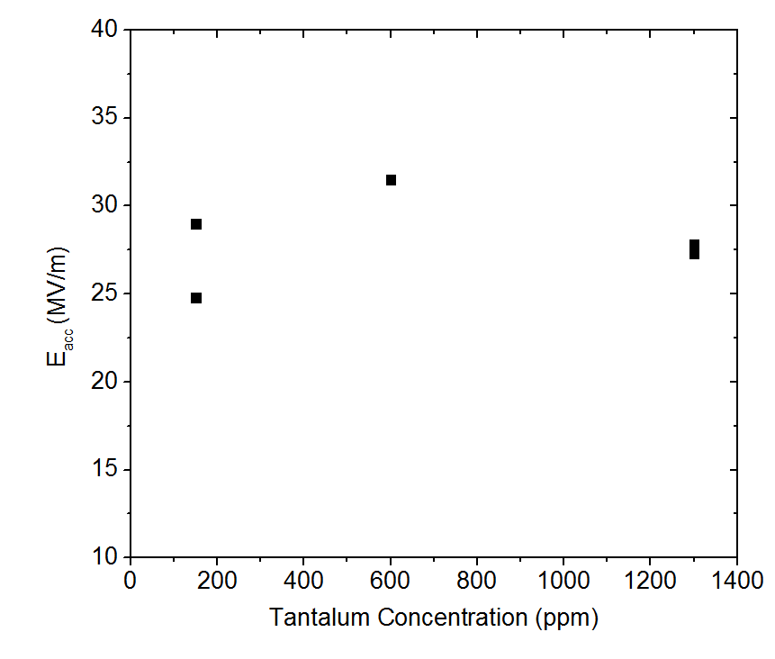
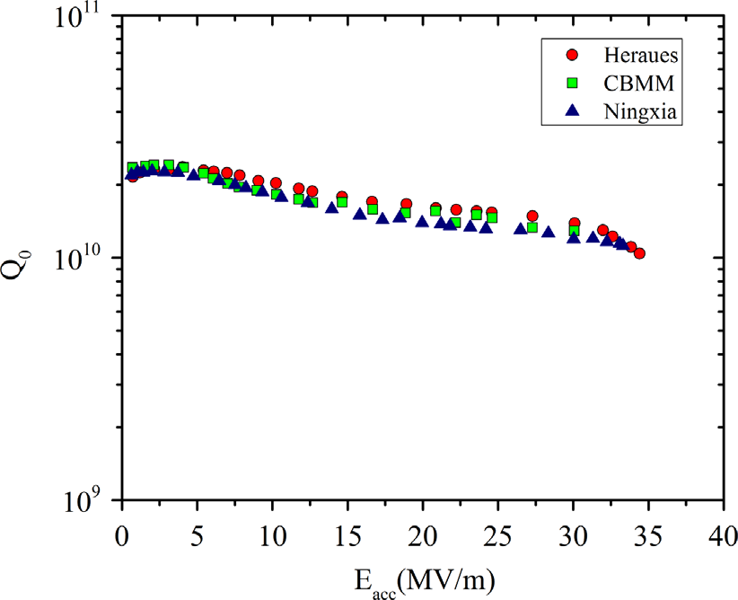

Tantalum Effect on SRF Cavity Performance
Performance of cavities is unaffected by tantalum content up to ~1300 wt. ppm
P. Kneisel, G. Myneni, G. Ciovati, D. Proch, W. Singer, T. Carneiro et al in Proceedings of PAC 2005
8

Slide 9
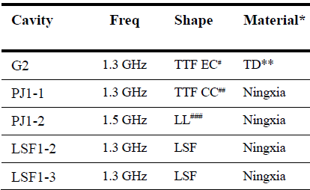
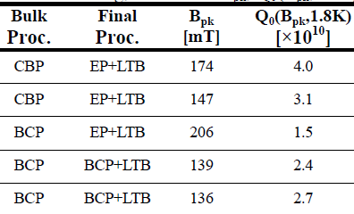
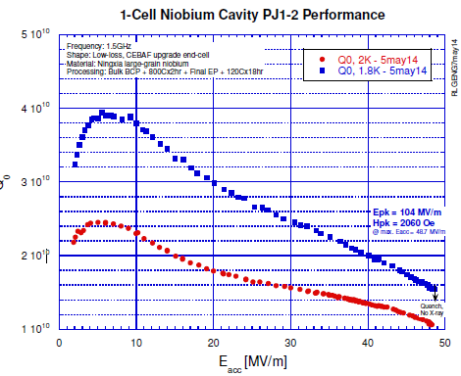
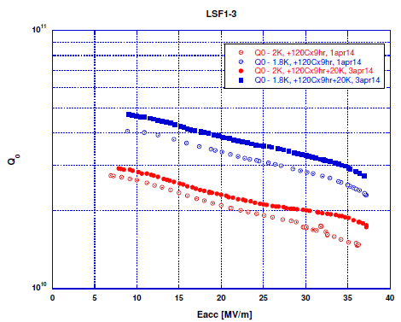
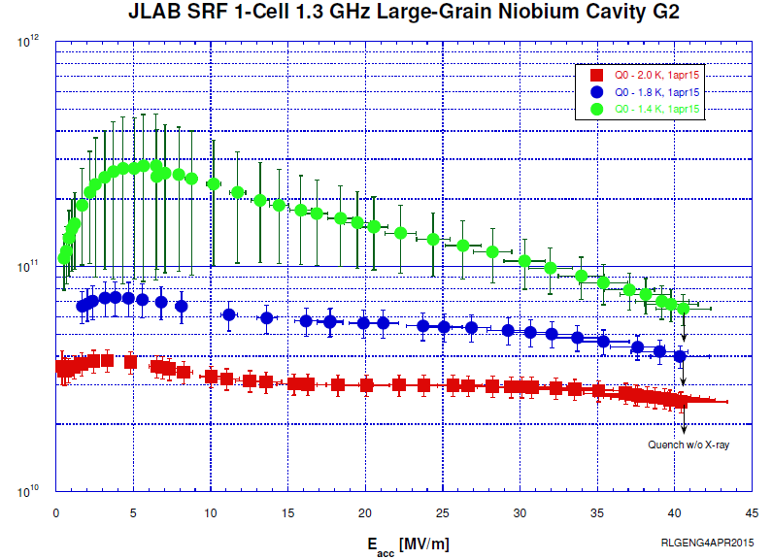
Ingot Cavities with different shapes
E_{acc} (MV/m)
41
35
49
33
32
R. Geng et al., IPAC 15

Slide 10
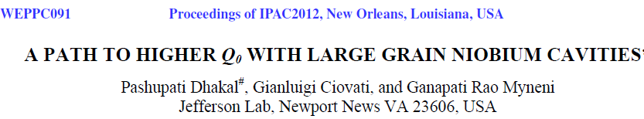
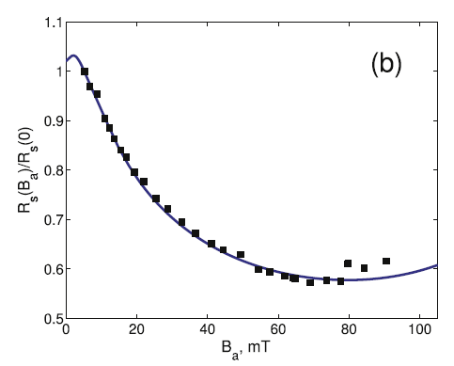
Ti/N2 Doping
T = 2K, 1.5 GHz
First observation of Q-rise in medium purty (RRR ~106) ingot Nb, high Ta cavity
T = 2K, 1.3 GHz
B_{p}/E_{acc} = 4.2
Reduced dissipation due to the current-induced broadening of the quasiparticle density of states in dirty limit.
Gurevich, PRL (2014)
N-Doping with successive EP removal

Slide 11
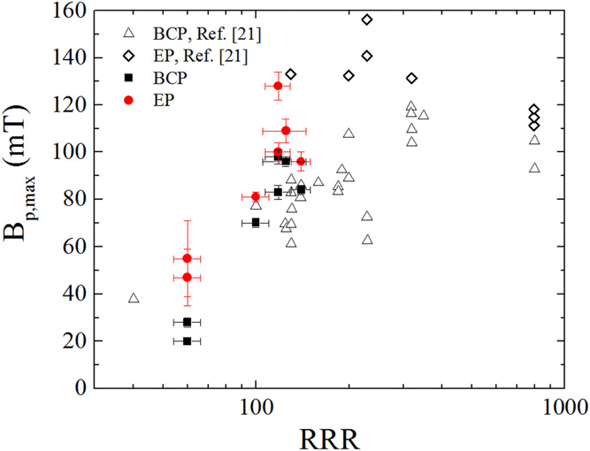
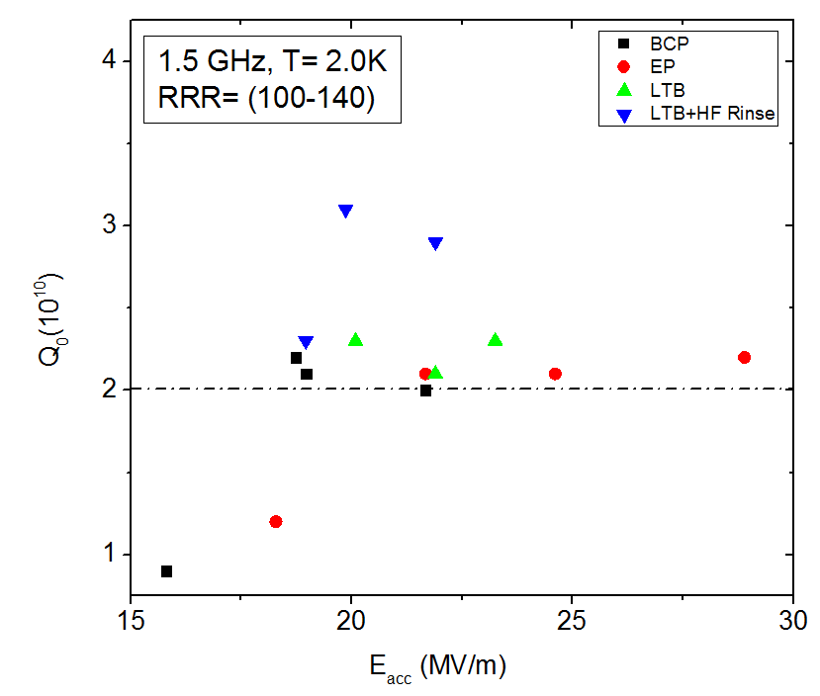
Cavity Performance Vs RRR
Ciovati et al., Supercond. Sci. Technol. 29 (2016) 064002
FG
LG
For TESLA Cavity, B_{p}/E_{acc} = 4.2 mT/(MV/m)
An average quench field of ∼100 mT has been obtained in medium-purity (RRR =100–140) ingot Nb cavities at 2.0 K.
Q0-value of 2×10¹⁰ at 2 K has been obtained in medium-purity, 1.3–1.5 GHz ingot Nb cavities

Slide 12
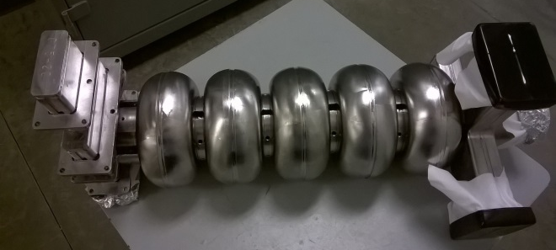
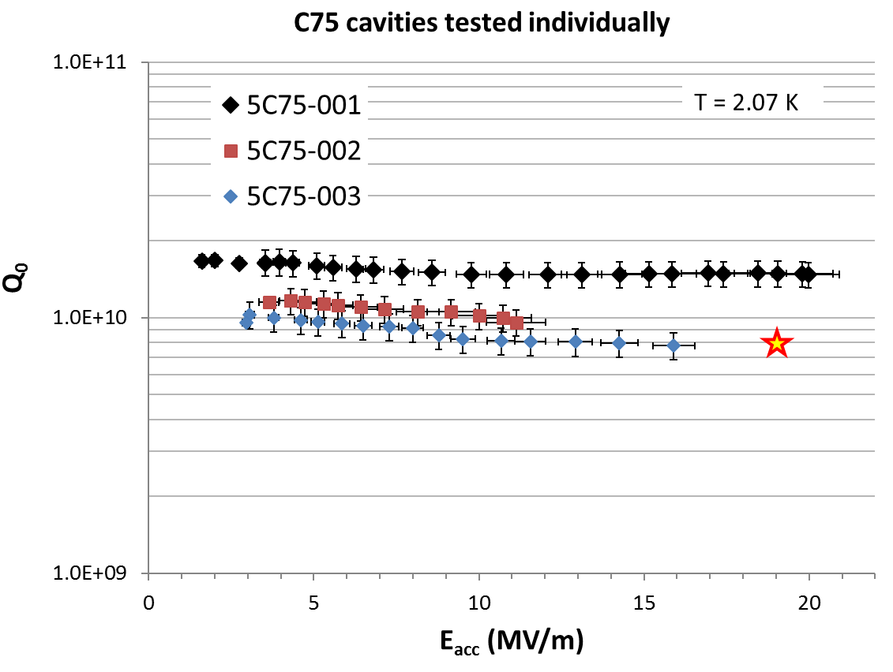
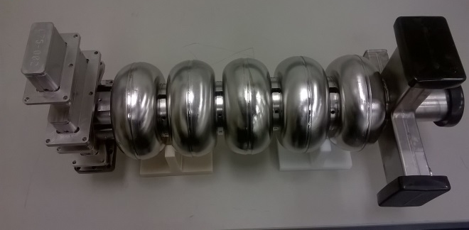
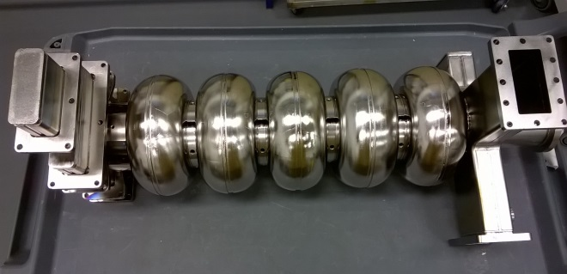
Prototype 5-cell Ingot Cavities
Three prototype cavities built, processed and tested “in house” (Sep. 2016 – Jan. 2017)
Two cavities (5C75-001 and 5C75-002) made from large-grain Nb discs multi-wire sliced from CBMM ingot (RRR~120, Ta = 670-1350 wt.ppm)
One cavity (5C75-003) made from large-grain Nb discs from Tokyo-Denkai (RRR = 496, Ta = 29 wt. ppm)
5C75-001
5C75-002
G. Ciovati, TTC Milan 2018
The limitation is fabrication/processing issues
Q₀ in cryomodule is better than C50 (FG) cavities
5C75-003

Slide 13
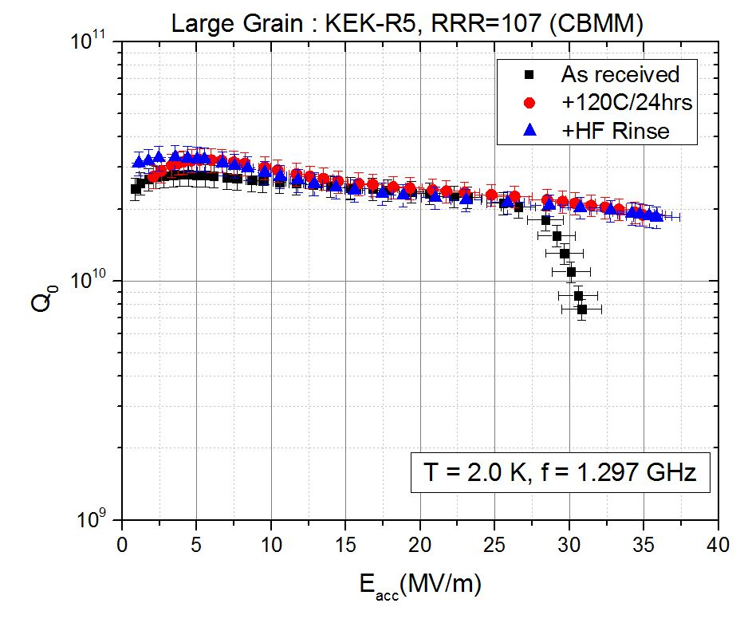
Medium-purity large-grain single-cell from KEK
Q= 2x10¹⁰ @
36 MV/m
Ta concentration = 1034 ppm

Slide 14
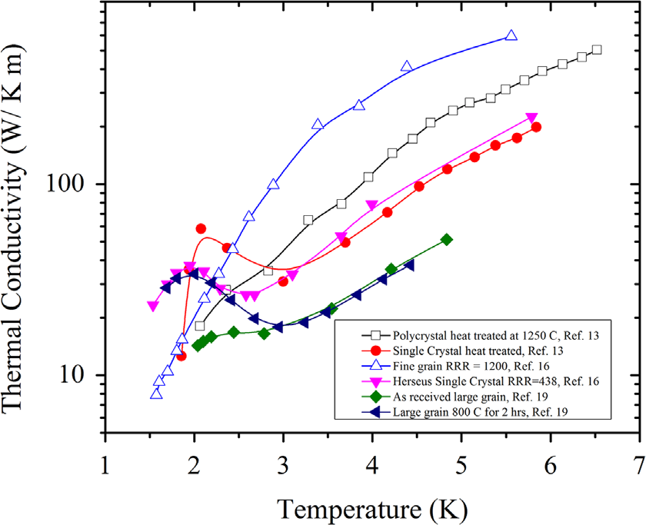
RRR vs Thermal Conductivity (FG vs Ingot)
Enhanced phonon peak
For better thermal stability
Kneisel et al., NIMA 774, 133 (2015)

Slide 15
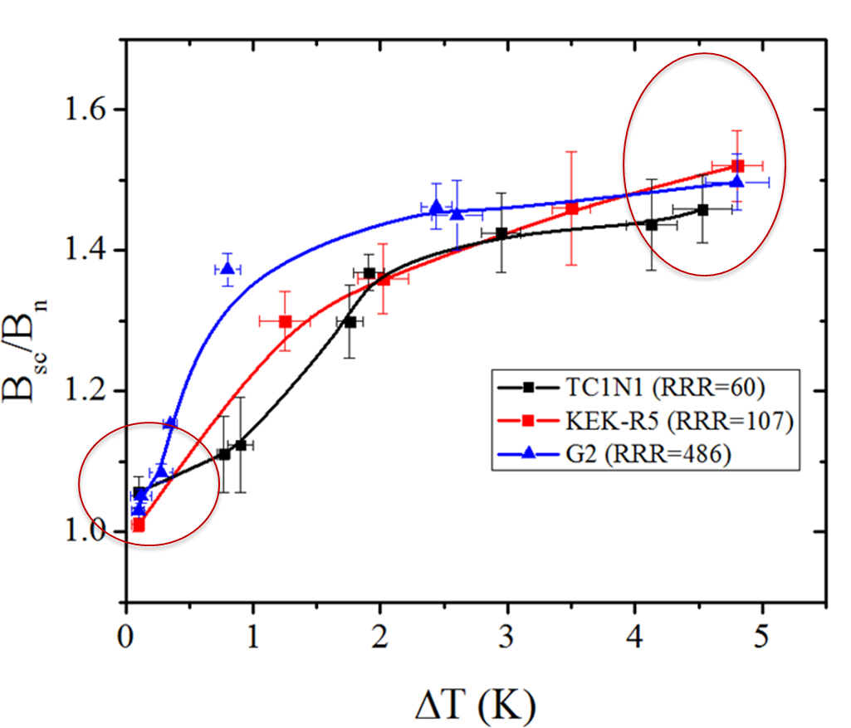
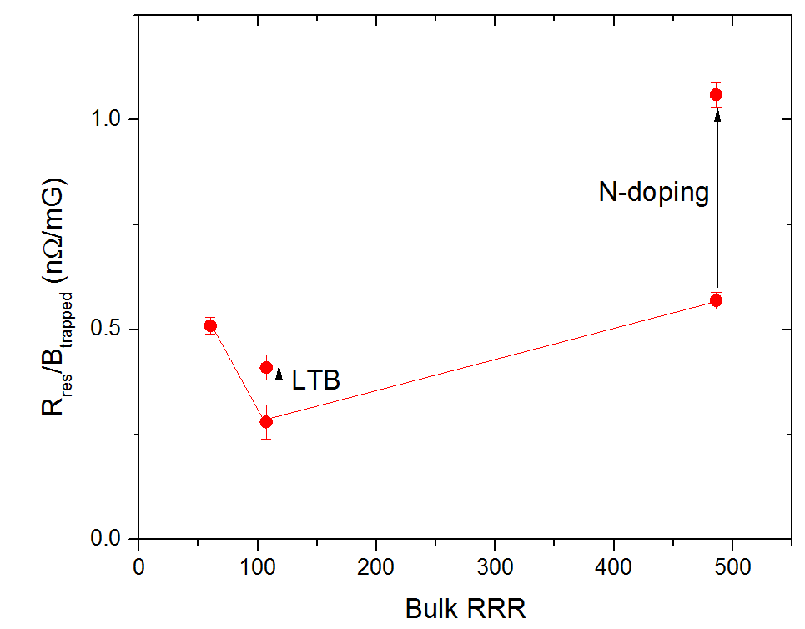
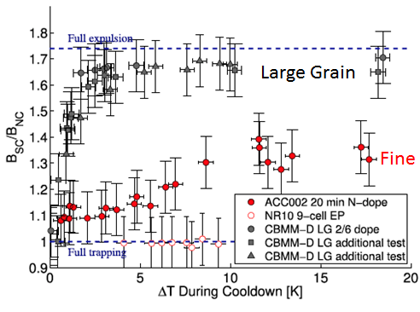
Flux Expulsion/Trapping (LG vs FG)
Haung and Geng Phys. Rev. Accel. Beams 19, 082001
Trapped flux sensitivity vs RRR (Ingot)
ΔT<0.1K
Posen et al., APL 119, 213903 (2016)
Flux expulsion
Magnetic flux trapped in superconducting niobium increases RF losses, decreasing the Q₀
Nitrogen doping exacerbates this problem
Ingot material is less susceptible to this effect regardless of the RRR of Ingot materials
P. Dhakal, “Flux trapping in Large Grain Nb cavities”, TTC Topical Workshop, FNAL, 2017. To be published

Slide 16
Summary
Ingot Nb Cavities:
Material cost is ~1/4 for “TESLA spec”.
Ingot niobium can be the material of choice for high-field cavities.
Cavities made from medium purities consistently achieved > 20 MV/m with Q₀ > 2x10¹⁰.
Q₀ is statistically 30-40% higher than fine grain material processed with similar recipe.
Still need to focus on optimizing processing technique.
Acknowledgements
G. Ciovati, P. Kneisel, G. R. Myneni, R. Geng
and all Jefferson Lab Scientific/technical staff

Slide 17


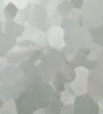
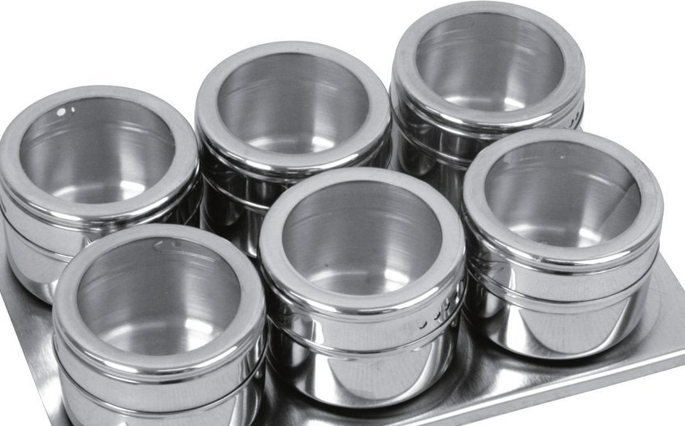
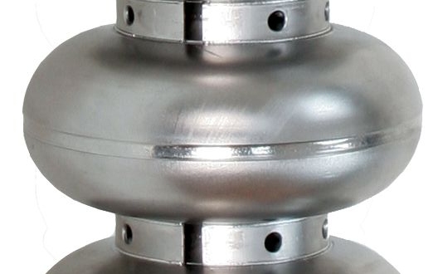
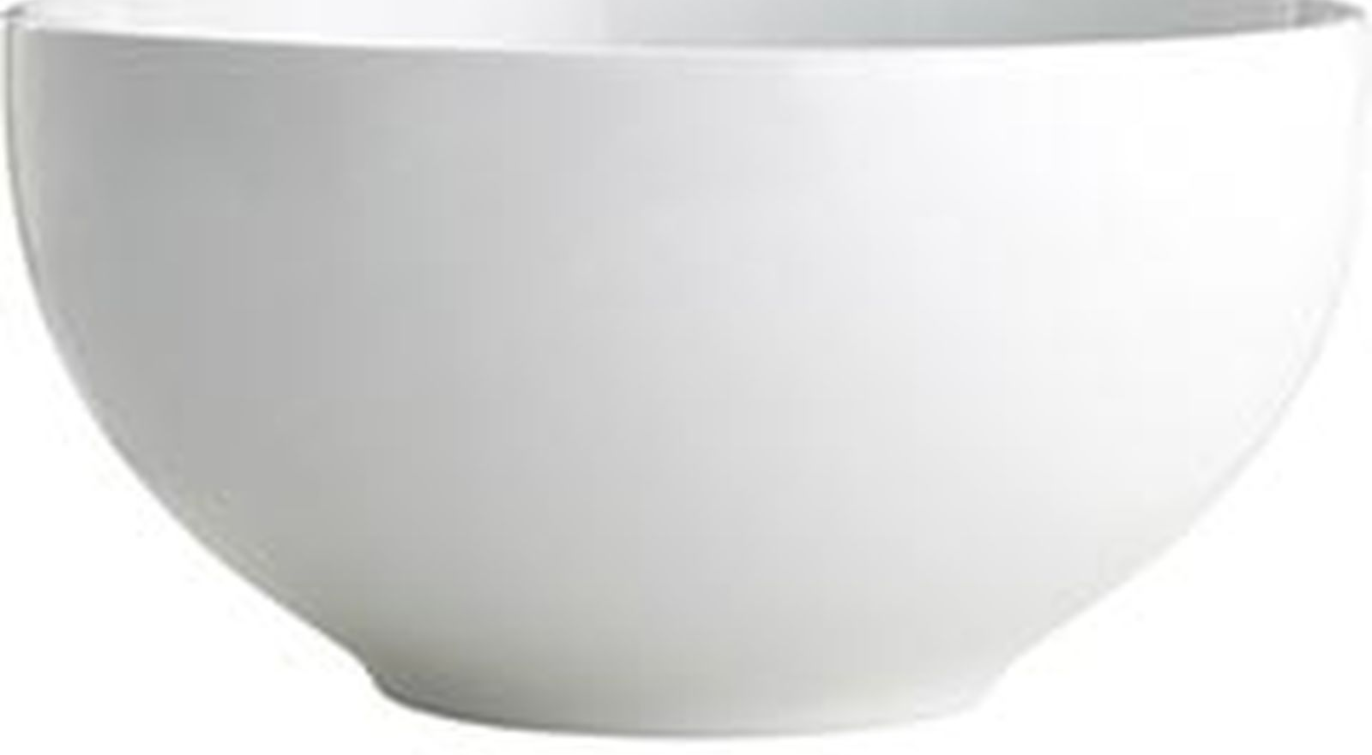

Recipe for high Q and high gradient
Nb
N₂
Ti
Thank you !!

