Slide 1
The importance of recrystallization
How it explains Pinning, Q-disease, variability of N doping….
TTC Meeting Riken 2018 june
C.Z. Antoine

Slide 2
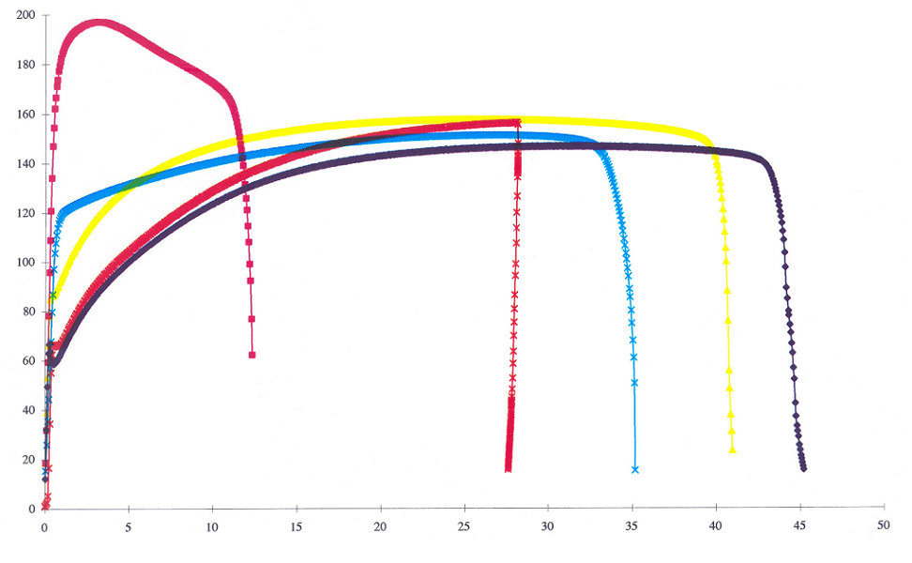

Recrystallization: macroscopic level*
* Also industrial level
  For RRR 250- 300, full recrystallization occur above 800 C, 2 h (or 600 C, 7,5 h)
  Formability : you need recrystallized material !
  Forming => strain hardening / welding => partial recovery but thermal stress / heat treatment => recovery/ frequency tuning => strain hardening…
  Mechanical resistance : you also need recrystallized material ! (it is the only way to know which are the minimum mechanical properties !)
Rolled (73%)
Stress (MPa)
600° C, 2h
700° C, 2h
900° C, 2h
800° C, 2h
20 µm
As received
[Curtesy W.& X. Singer Desy]
Strain/Deformation (%)

Slide 3
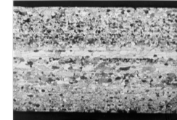
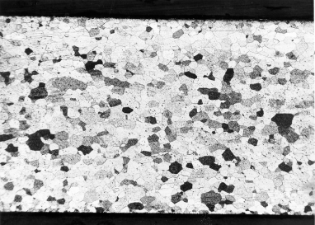
Traction curves & formability
σ
High failure rate
Good forming
Good forming
Mechanical properties \Batch | A | B
RRR | ~ 310 | ~ 320
Yield Strength σ_{0.2}(MPa) | 66 | 150
Tensile Strength σ_{m}(MPa) | 180 | 183
Elongation A (%) | 59 | 40
Strain Hardening Coef. n | 0.31 | 0.10
Hardness Hv | 56 | 65
Grain size (ASTM) - core - surface | 4 4 | 5 6
Forming Aptitude | GOOD | BAD
Δl
  Plastic deformation @ mono axial deformation
  Not very accurate for elastic data (estimation only)
  Not very accurate for bi-axial deformation (see next slide)
ASTM #6 : 45 µm
ASTM #5 : 64 µm
ASTM #4 : 90 µm
ASTM #3 : 125 µm

Slide 4
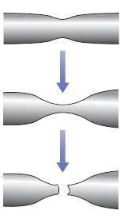
Specification for good forming
  YS and UYS depend on grain ∅ => one has to define a range rather than absolute value
  Strain hardening parameter n more reliable than YS, UTS
stress
Small grains
UTS
Uniform elongation stops there !
Necking starts there
Total elongation not very relevant !
Poor forming
σ ∼ Kε^{n}
YS
Larger grains
strain
Strain hardening coefficient : formability ↑ if n ↑
Bi axial deformation :ε_{max} varies like 4/11(2n+1)
Trade-off: ASTM #5 (64 µm) or ASTM #4 (90 µm) (uniform grain size is more important than the actual size)
  Metallurgical point of view : smaller grains are better
  SC point of view : larger grains are better
Notes:
Purely metallurgical point of view : smaller grains are better : more uniform deformation (but ask for more forming effort), no risk of orange peel, better mechanical resistance.
From SC point of view, large grains are better : better crystal quality, baking more efficient, more rapidly…
Tradeoff : ASTM #5 : 64 µm or ASTM #4 : 90 µm (uniform grain size is more important than the actual size)
At higher diameter orange peel becomes sensible.

Slide 5

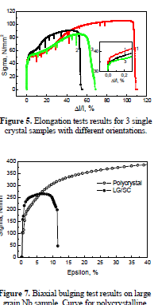
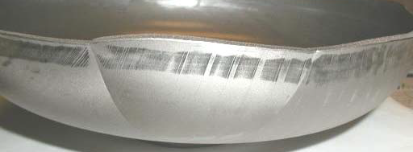
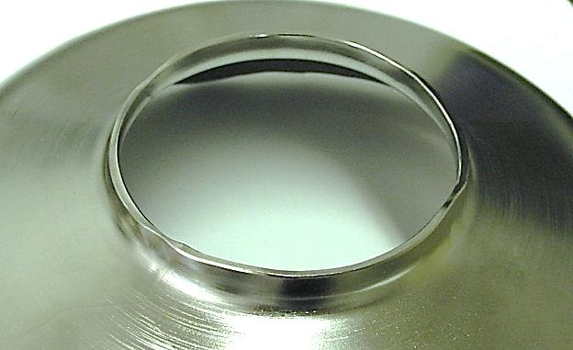
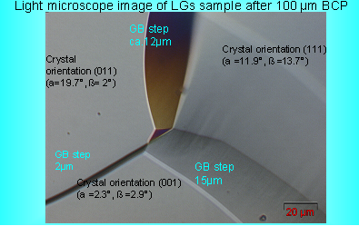
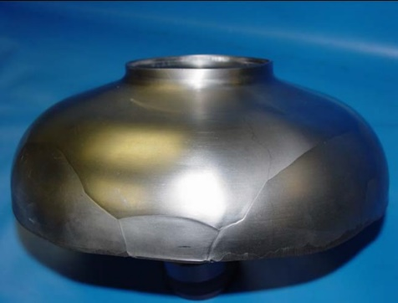

Large grain forming
  Better crystalline quality
  Cost saving
  Sheet fabrication: less steps
  Weight saving (sheet corners)
But….
  Non uniform forming
  Asymmetric deformation
  Risk of tearing (irises)
  Risk of holes during welding
  Larges steps @ GB
[Singer, 2008]
=> A whole new industrial process needs to be developed
=> More steps at cavity fabrication, more risks, fabrication cost not fully assessed at the industrial level

Slide 6
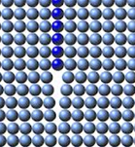
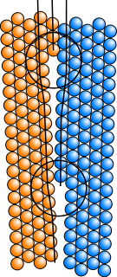
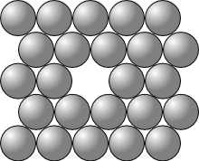
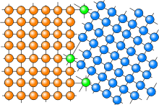
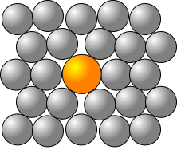
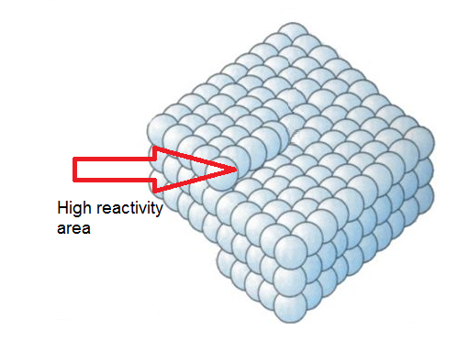
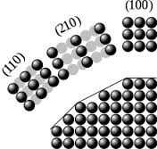
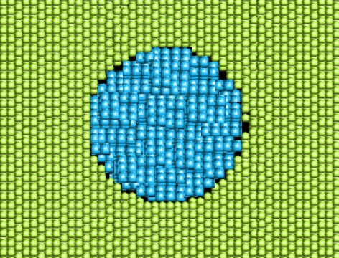
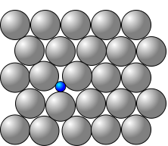
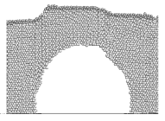
Examples of Crystalline defects
Punctual:
1D:
2D :
Vacancy
Edge dislocation
Surfaces, interfaces
Substitutional atom
Screw dislocation
3D :
Surface faceting
Interstitial atom
Inclusions
Voids

Slide 7
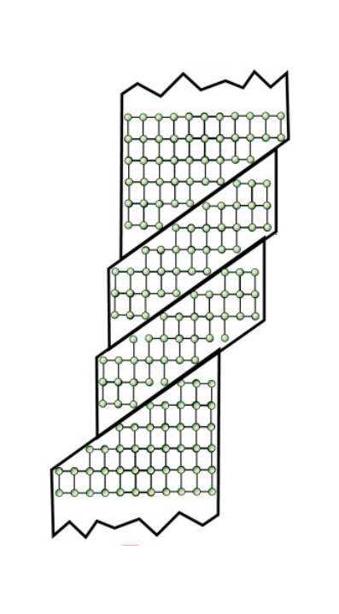
Deformation At the microscopic level
  Well recrystallized material :
      ∃ Still defects : vacancies interstitial or substitutional atoms, dislocations, sub grain boundaries (dislocation walls)…
      Defects concentration = f (Tp°) at a given purity
  Upon deformation :
      Dislocation loops are emitted from existing dislocations segments
      Not all directions are equivalent : some grains deform more/less
      Dislocations interact with other defects (other dislocations, interstitials, GB….) => dislocations entanglement, “ forest”, => dislocation « cells » + segregation of interstitiels (H, O, C….)
Low density of defects
High density of defects
~ 100 nm
Notes:
dislocation cell : in the center quite perfect crystal all defects are « entangled » together
diffusing species can be gathered around dislocation (elastic interaction)
Interaction between interstitials and dislocations : depending on temperature when a dislocation moves, it can be draged by or drag the interstitials with….

Slide 8
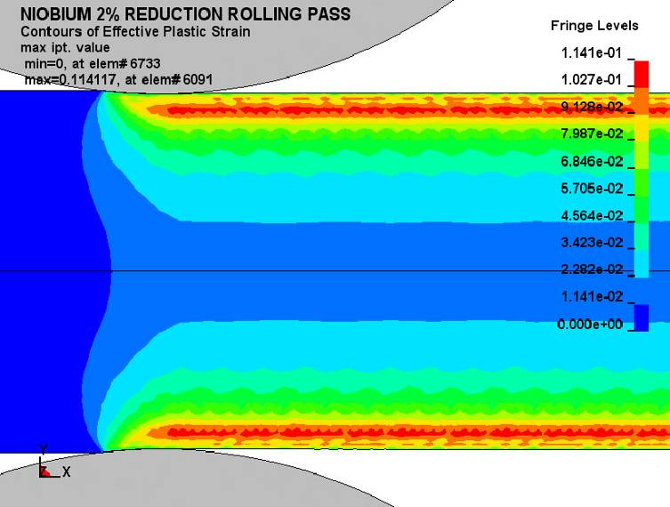
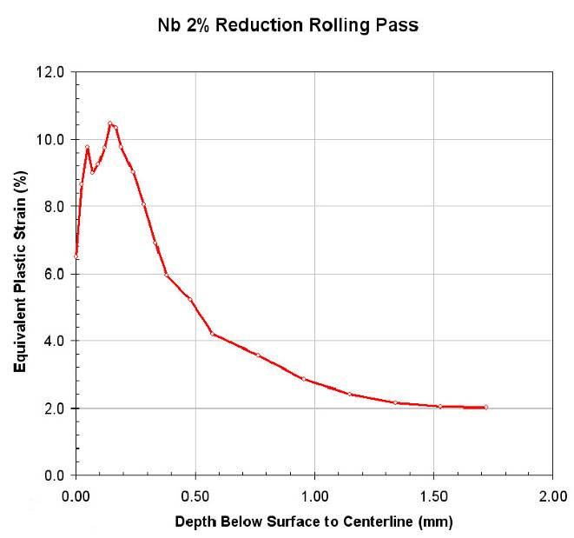
Main Origin of dislocations
Damage layer/ rolling
Finite element simulation of 2% reduction of 3.5 mm sheet with 1 cm diameter rolls (Courtesy Non-Linear Engineering, L.L.C.).
[R. Crook et al, Black Laboratory] &
http://accelconf.web.cern.ch/AccelConf/srf2009/posters/tuppo071_poster.pdf
  Damage layer seems to essentially originate from rolling
      Because of their orientation some grains accumulate more dislocations
      Surface texture is resistant to recrystallization
      Not fully eliminated after 150 µm removal (patchy nature)
Oxide-metal interface
  Large strain in the first 10 nm
      High dislocation density to accommodate the difference in lattice parameter
      Surface segregation (mainly H, O, C… but also F and other chemicals…)
  Deformation from deep drawing (~30%) :mostly recovered by recrystallization

Slide 9
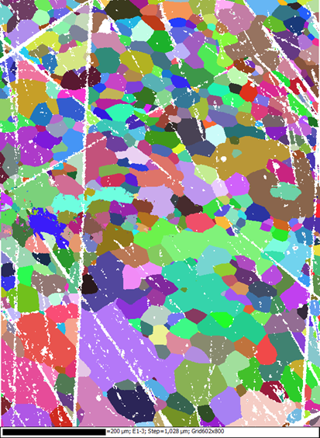
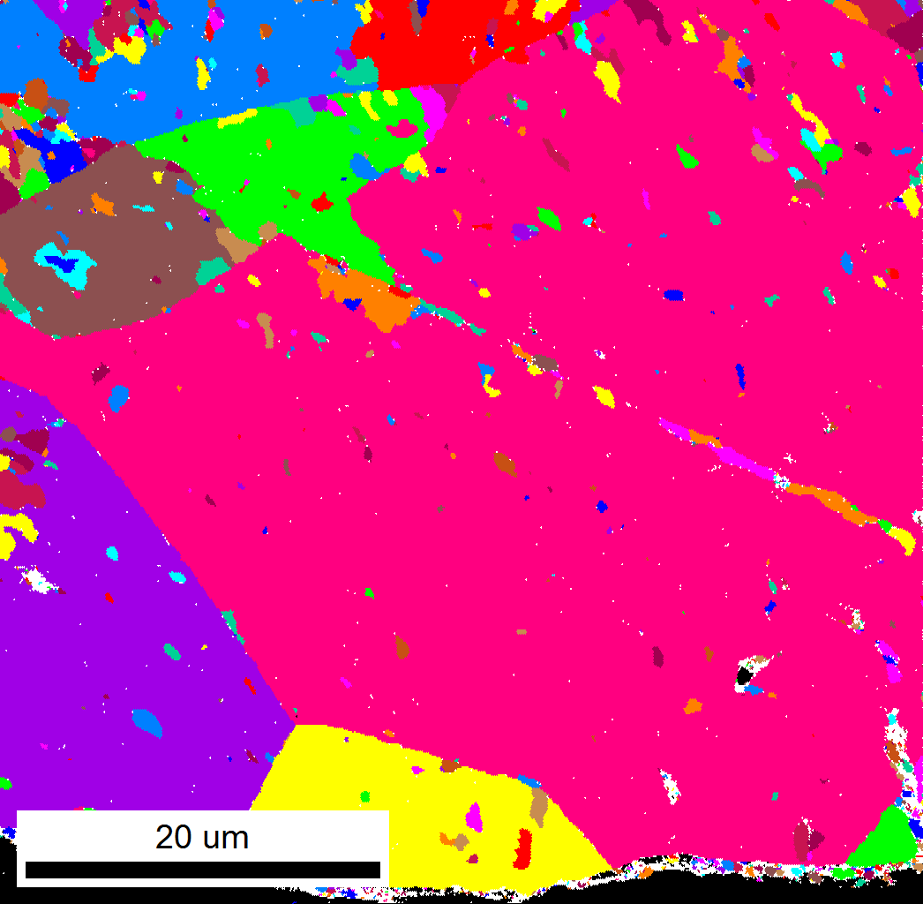
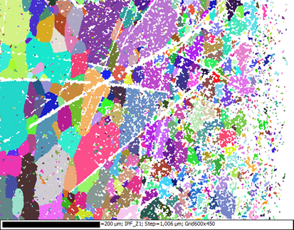
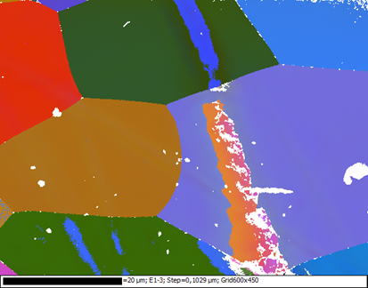
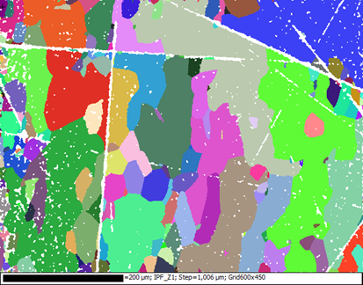
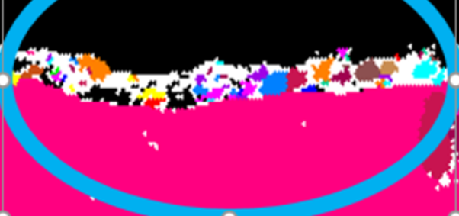
Damage as seen by electron diffraction
Surface of the sheet
New damage layer ~ 1 µm
c) After forming
20 µm
200 µm
UGC
a) As received
b) After 2 steps polishing 20 + 25 min
(300 µm removed)
10 µm
Core of the sheet
Polishing on flat surface is quick and easy. Mechanical chemical preparation inspired from metallographic polishing can produce damage layer ≤100 nm
Notes:
Sheet cuts , prepared with metallographic polishing (5 steps, ⊥ damage <<100 nm)

Slide 10
Important defects in SC Nb ?
Morphologic defects (pores, steps, facets…): field enhancement
  Site with depressed superconductivity: NC, SC but local change of κ, ξ...)
  NB. Same defects can => early penetration of Vx (surface) and/or pinning of Vx (bulk) !
Elastic strain also favors light elements (H, C, N ,O…) segregation !!!!!
~1 µm
~1 nm
Micro- to nano-roughness
(go to fractal approach ?)
.
⊥
⊥
⊥
°
⊥
⊥
Crystalline defects :
Interfaces (oxide layer, inclusions) > GB >⊥ cells > ⊥(=dislocations) > vacancies or interstitials
Plays on SC parameters: l, κ...
3D
2D
1D
0D
Strain on the crystalline lattice
Notes:
Elastic interaction and segregation:
Atmosphere example : air molecules are free, but atmosphere = denser @see level (interaction with gravity)
Same with H @ T >150 K => Cottrell clouds around dislocations !!!
Elastic strain also affects SC and pinning !!!

Slide 11
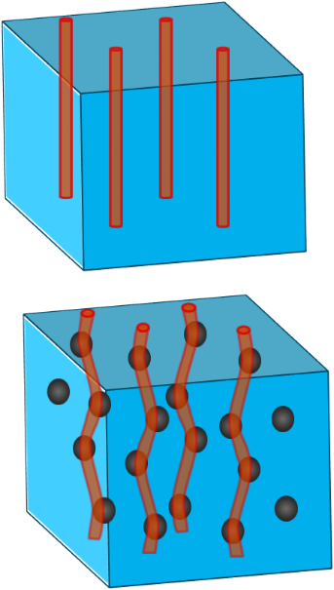

More details on pinning mechanisms
Matsushita : 4 mechanisms from the SC point of view
  A- Condensation energy variation (one saves condensation energy if ⱻ already a normal zone)
  B- Elastic interactions (lattice elastic moduli in SC state < elastic Mod. In normal state , NB => interacts strongly with lattice elastic deformation due to crystalline defects-see below)
  C-Magnetic interaction (if defects >>λ, you can treat it like an interface: image vortex + surface barrier => very strong effect)
  D- Kinetic interaction (areas with ≠ξ => ≠ in Vx velocities ?)
IN BRIEF : local effects !!!! (=>2 fluids model not fully OK)
∃ 2 kinds of pinning :
  Strong pinning (surface magnetic pinning) : twinning, voids, non SC aggregates, irradiation defects (columnar), nano-indentations : Dominant mechanism: A then C
  Weak pinning centers but many of them: «volume core pinning»
      Dominant mechanism: B ; B less efficient than C but if they are many pinning centers => results into strong pinning
      Mechanism efficiency B  Interface (G.B) → dislocation → punctual defects
Notes:
if V pinning potential and ρ Vx density:
$E_{pinning}\sim \int{V\left(r\right)ρ\left(r\right)d^{3}r}$
Generally λ >a₀ (a₀ ~ ∅ pinning center)
So one can work with mean values over λ (continuum model/ Larkin volume)

Slide 12
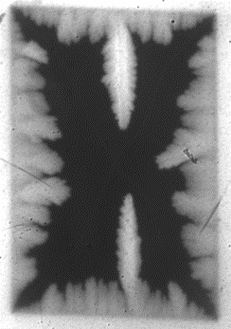
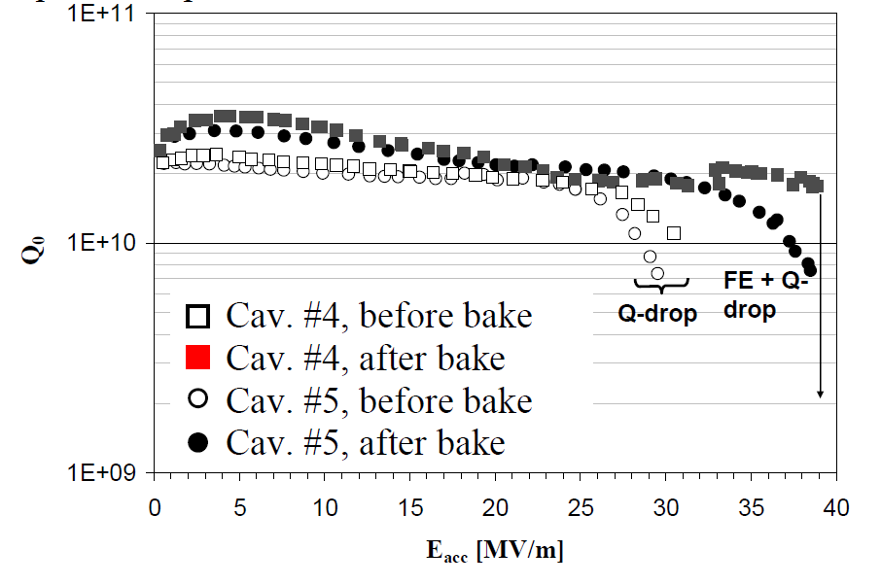
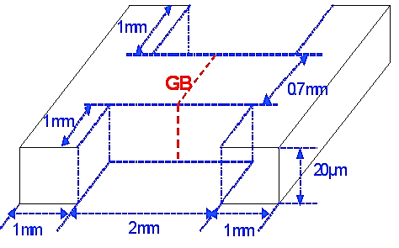
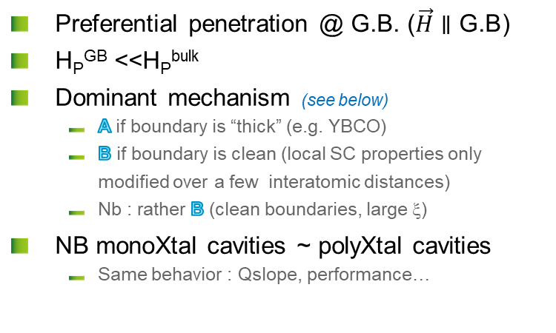
Grain boundaries in Nb
[A. Polyanskii,. H. Sung et al, FNAL/FSU]
  Preferential penetration @ G.B. ($\vec{H}∥\text{G}\text{.}\text{B}$)
  H_{P}^{GB} <<H_{P}^{bulk}
  Dominant mechanism (see below)
      A if boundary is “thick” (e.g. YBCO)
      B if boundary is clean (local SC properties only modified over a few interatomic distances)
      Nb : rather B (clean boundaries, large ξ)
  NB monoXtal cavities ~ polyXtal cavities
      Same behavior : Qslope, performance…
H
    On GB: Josephson Vx
    Interface pinned (GB)
    Current lines are distorted
Monocrystalline cavities
H
    @ 4.5 K
    H_{P}^{GB} ~ 32 mT
    H_{P}^{bulk} ~ 150 mT
GB : not dominant pinning mechanism in Nb !!!
Notes:
Preferential penetration in GB when GB alignes with field (very few chances to, occur in cavities)
SRF 2017 ‘retrouver qui ?) => some GB show easy way in, easy way out for the field, and for others have pinning behavior. NB some GB can be considered as array of dislocations, depends on relative orientations
GB indeed exhibit degraded SC properties, but it does not seem to affect RF behavior.
Since Xi is much larger than disordered volume around GB => not main pinning behavior

Slide 13
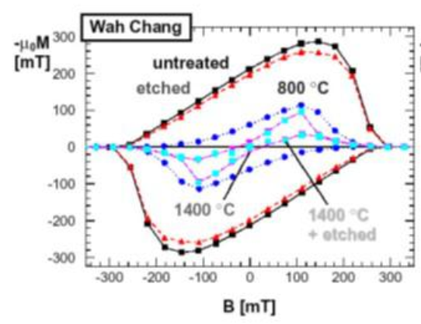
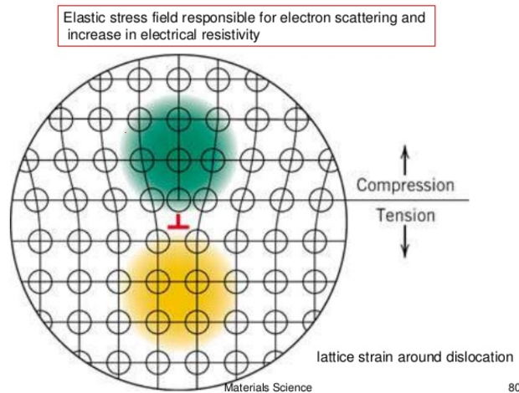
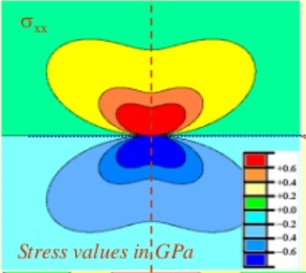
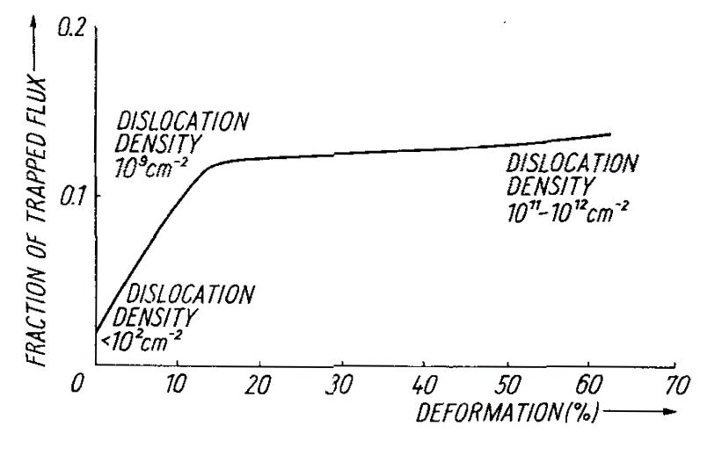
Individual Dislocations
[Bahte et al PAC 98]
  Source of the hysteresis in DC magnetometry
  Local elastic distortion of the lattice
+ 1 GPa
  Dominant mechanism 1! Disloc = B (effect < GB)
  but…
0
- 1 GPa
[Narlikar A, Dew‐Hughes D 1964 #1542]
Stress map around an edge dislocation
http://www.slideshare.net/vamsikrishna393950/stress-fields-around-dislocation/
  They are many dislocations inside Nb, even if well recrystallized
  Non linear behavior => Dislocation repartition is not uniform
  (not 1D anymore)
Notes:
See also Ulmaier # 1549. DY/Y (relative elasticity difference between SC and NC state depends on:
# defects=Z in volume ξ^3 (Z = nξ^3)
DY/Y  when ℓ and ξ
https://en.wikipedia.org/wiki/Dislocation :
The interface between a metal and an oxide can greatly increase the number of dislocations created. The oxide layer puts the surface of the metal in tension because the oxygen atoms squeeze into the lattice, and the oxygen atoms are under compression. This greatly increases the stress on the surface of the metal and consequently the amount of dislocations formed at the surface. The increased amount of stress on the surface steps results in an increase in dislocations.
In single crystals, the majority of dislocations are formed at the surface. The dislocation density 200 micrometres into the surface of a material has been shown to be six times higher than the density in the bulk
After chemical etching, small pits are formed where the etching solution preferentially attacks the sample surface around the dislocations intercepting this surface, due to the more highly strained state of the material . Thus, the image features indicate points at which dislocations intercept the sample surface. In this way, dislocations in silicon, for example, can be observed indirectly using an interference microscope. Crystal orientation can be determined by the shape of the etch pits associated with the dislocations

Slide 14
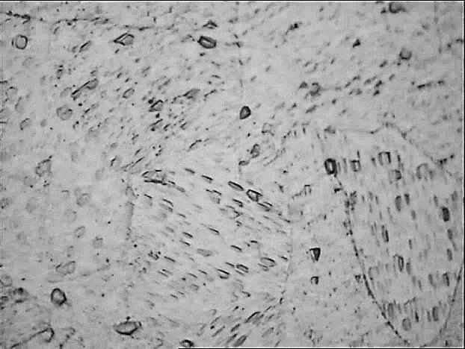
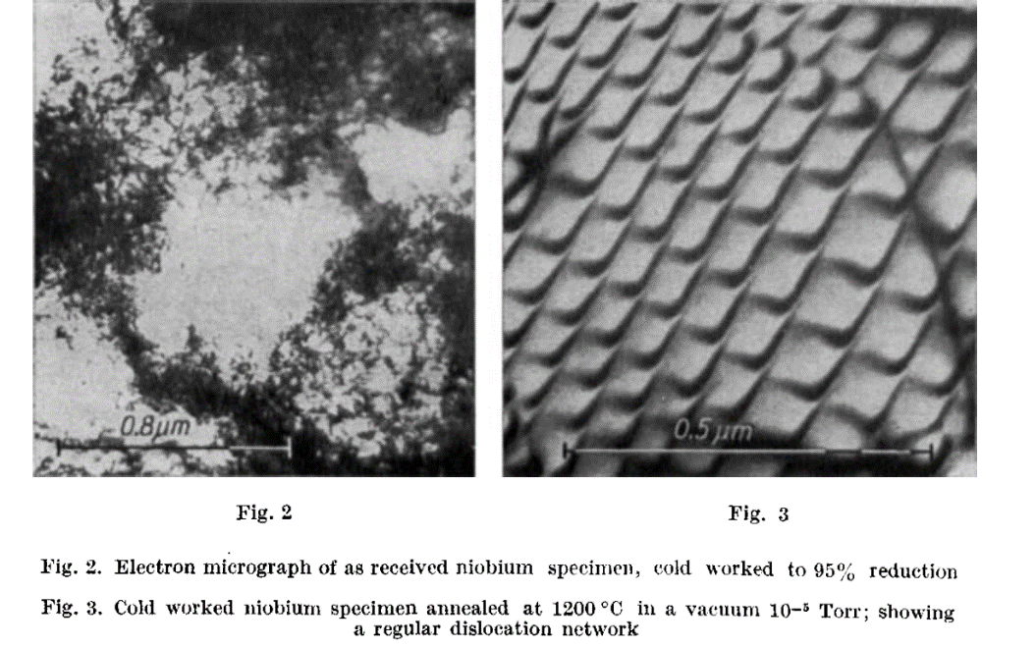
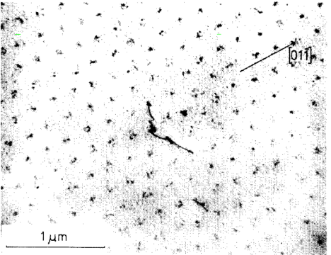
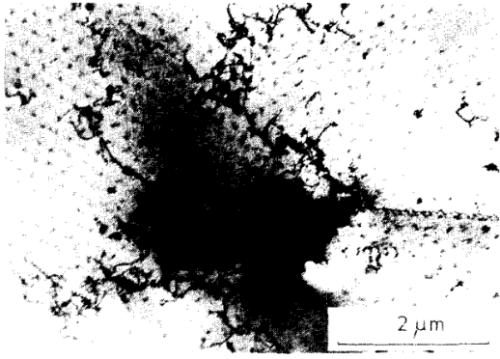
dislocation CELLS in Nb
  Dislocations gather in “cells” (as soon as 3-5% strain)
  Stress on dislocation pill-up = stress on 1! Disloc^{n} x 20 !!!
  => 2D defects, analogous to G.B. (ⱻ many more dislocations than GB)
  Expend over a distance larger than G.B. (~ to ξ,=> stronger pinning)
Etching figures revealing dislocation arrays on as received Nb sheet after light etch
Monocrystal, RRR = 5000
[Narlikar, 1964, #1542]
  « Bitter decoration » (Abrikosov lattice visualization)
      In well recrystallized: Abrikosov Lattice everywhere
      In deformed Nb: Abrikosov Lattice only in the core of D. cells, but all Vx close to dislocations cells are attracted and pinned there )
[Herring, 1974, #1544]
Notes:
Typically, for Nb the pinning force per unit length F_{p} is about 2.10⁻⁶ N/m for an isolated dislocation (to be compared to 9.1 10⁻⁴ N/m for a normal conducting precipitate [31]).
They are many more dislocations than grain boundaries in typical Nb used for SRF applications. Moreover, most of the time dislocations are gathered into dislocation cells where dislocations tangle and pill up into “walls” with high stress concentration and high stress gradients whereas the inner cell are nearly defect less. For heavily deformed material they prefigure future grain or sub-grain boundaries that will appear upon recrystallization. Those dislocation cells are clearly 2D defects similar to GB, rather than linear. Dislocation structure becomes non uniform in Nb for very small amounts of deformation (3-5 %, equivalent to a density of dislocation ~10⁸-10⁹ cm²) [30]. In heavily deformed metals dislocation density can reach 10¹¹-10¹² cm², but even a very carefully recrystallized material still hold dislocations even at temperatures close to the melting point. Examples of the effect of recrystallization on density of dislocation can be found e.g. in [57, 58].

Slide 15
hydrides
Hydrogen in Nb and annealing
  Slow cool down => Hydrides => Q-disease (~100K)
  Bulk ~ 0, 01 At%, Surface ~some 0.1 to 1% ! => enough for hydride precipitation
  Worsened by polishing either mechanical or (electro)-chemical (mechanical: creates dislocation + removes the surface barrier => H_{ads})
  Annealing 600°C, 10h or 800°C, 2h => Q-disease cured
  After annealing one is less sensitive to Q-disease
  Even after fast cooldown or annealing, ∃ still hydrides (but less: no Q-Disease)
Baking effect, N infusion
  Initially : high H concentration: Dislocations (Cotrell clouds), Vacancies (up to 6 H / vacancy, + H_{iinterst} around)
  Oxide decomposition + O (/N) diffusion (as interstitials and in vacancies)
  O in vacancy (also C, N) fix H (1! H for 1! O/N/C)
  Prevents hydride precipitation (see e.g. [Wipf])
  [Trenikhina Y, et al,. JAP. 2015;117(15):154507]
  See also D. Ford, 2013 and S. Balachandran SRF 2017
Notes:
#1557 Knobloch 2002
Q-disease : uniform heating of cavities
Observed only if cooldown ragte < 1K/min
Not observed on RRR 40
Danger = 75-150 K, max @ 100K ; saturation after 3h @ 100 K
Affects both BCS and Residual resistances @ T<Tc (within penetration depth ~50-100 nm), Does not affect RS @ T> TC (penetration depth~1µm) => surface phenomenon
Something about polarization see>Higuchi SRF 2001
Kneisel @ Snowmass 2001 : change of mean free path alone cannot explain the effect of baking (annealing)
Recuit 1400 ° helps a lot
H –Nb Interaction energy: more favorable for H to go on a vacancy rather than an Td interstitial site (and even more for Oh sites)
But O (C,N) stronger interaction with V or Td interstitials than H=> once there not so much H anymore => hydride nucleation = more difficult.
# 1798-Steinbinder-Wipf
The trapping of H in Nb by O (or N), impurity atoms, and thus the formation of O-H pairs, provides a unique possibility of investigating transport processes of H interstitials down to temperatures where, in the absence of traps, the H becomes immobile because of precipitation into an ordered hydride phase [9-11].
# 1799-Hempelmann
« Wipf et al. [25] investigated the locally restricted hydrogen motion around oxygen impurities in Nb00.013H0.016 b y means of inelastic neutron scattering. Owing to the trapping effect hydride precipitation is prohibited in this system, and the motional behaviour of single hydrogen atoms can be studied at very low temperatures. »
“In nitrogen-doped niobium, for example, the local lattice expansion around the nitrogen impurities results in interstitial sites with a higher hydrogen affinity than the normal sites which thus act as hydrogen traps.”
“The QNS studies of hydrogen diffusion in NbN,H, performed by Richter and Springer [ 541 were the first microscopic investigation of a trapping process. Some relevant results are shown in Fig. 13. A comparison of the activation energy of roe1 with the activation energy of hydrogen diffusion in pure niobium [ 3, 20] enables a binding energy of approximately 100 meV to be deduced for the N-H pair.”

Slide 16

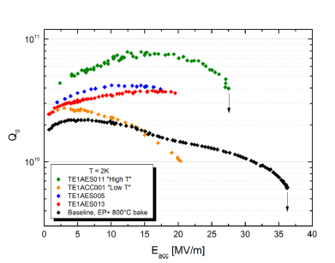
Doping: a new SRF behavior
High duty cycle applications
  Cryogenic losses are dominant; even increasing x2 is good (even if detrimental to Eacc)
  N doping: empirical recipe, but ℓ_{surface} is modified
  Bulk ℓ not affected : still high thermal conductivity
  Flux trapping sensitivity higher than for bulk Nb
  Results vary from lab to lab for the same « recipe »
[Grassellino et al., SST, 2013;26(10):102001].
4,5 K
~100 nm => dislocation cells
~10 nm => interstitials
Nb/Cu
Bulk Nb
Martinello et al, FNAL
Gonella et al, CORNELL U.
Local modification of SC parameters !!!
(l ∝ RRR)
Notes:
# 1546
We see that nitrogen-doping gives significantly smaller mean free paths than the undoped EP preparation. It is important to note that in the case of the EP +120 C cavity, the mean free path extracted will not be accurate. This is due to the 120 C baking only affecting a small fraction of the RF penetration layer. Our method for extracting mean free path effectively averages over the whole penetration depth. This issue is not present in the nitrogen-doped cavities since their surface layer is very uniform over several microns.
For the same amount of trapped flux, a nitrogen-doped cavity will have a higher residual resistance and thus a lower Q0 at low temperatures
Stronger doping leads to larger Rres,B/Btrapped to a certain point, after which Rres,B/Btrapped begins to decrease with even stronger doping
# 1321
Density of states and distribution function with moving cooper pairs becomes angle-dependent
angle between V_{F} (any direction) and V_{S} cause energy split with angle dependence. • Consequence: While the energy relaxation happens from high energy to low energy in Mattis-Bardeen theory, it is possible this process also happens from low energy to high energy. While this procedure “borrows” energy from those from high energy to low energy, the net effect still obey the 2nd law of thermodynamics.

Slide 17
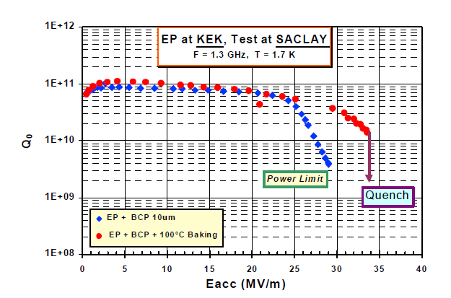
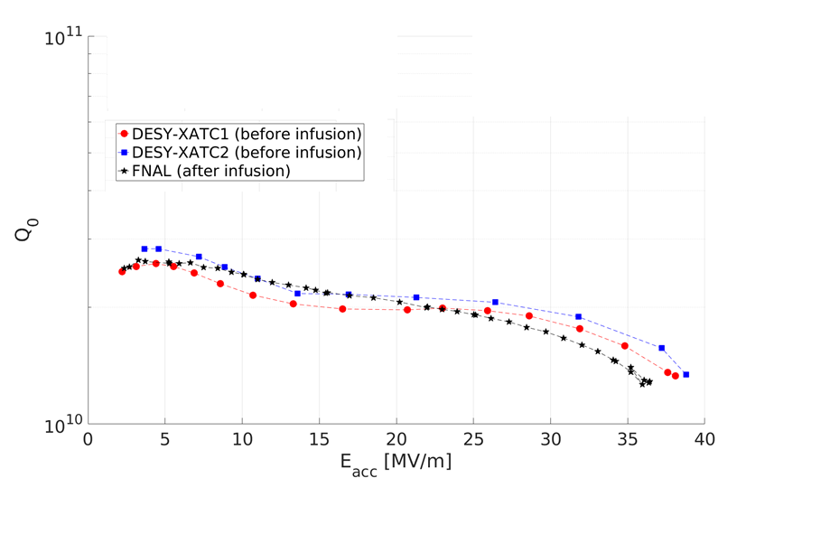
Baking/infusion what is the difference?
  Baking
  120 °C, 48 h => oxide degrades, O_{i} diffuses ~100 nm
  Change in mean free path => better R_{S}
  prevents hydride precipitation
  N infusion
  800°C annealing (oxide disappears)
  120 °C, 48 h in presence of N₂ => N_{i} diffuses ~10 nm
  Change in mean free path => better R_{S}
  prevents hydride precipitation
≡ ~ 4 x10¹⁰ @ 2 K
2 K
[Kako, E., et al. (1999). Improvement of cavity performance in the Saclay/Cornell/DESY's SC cavities. In SRF 99]
5.10¹⁰ < Q₀ < 10¹¹ @ 1,5 K
  Nb : here high RRR, well recrystallized (Ti annealing)
  Is it N, or recrystallization + interstitial ?
[Curtesy M. Wenskat, Desy]

Slide 18
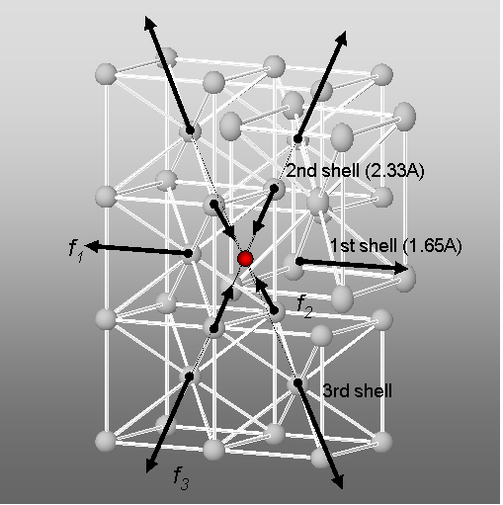
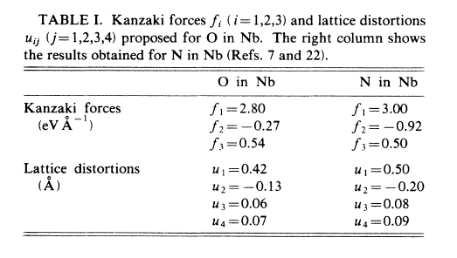
Maybe optimum treatment is not found yet
  O vs N
      ~ same effect on conductivity, Tc
      ~ same distortion on the lattice
DOSCH H., V., SCHWERIN A. and PEISL J., Phys. Rev. B 34 (1986)
  Differences ?
      Oxygen = main impurity in Nb
      Oxygen diffuses ~x100 faster than N, (~x 300 for C) at a given T
      Oxide layer is thinner in presence of N (N blocks diffusion of O and H)
      Pauling electronegativity: C=2,55; N=3,04; O=3,44; F=3,98 (NB no data on Fluor diffusion in literature, but certainly present @ surface)
      Atomic radius in pm: C= 67; N= 56; O= 48; F= 42 (NB some indication that C not stable in time => forms carbides)
      Effective charge  from O to C to N (electromigration @ high temperature)

Slide 19
Conclusion
  Recrystallization is mandatory (strain hardening coef. n > 0.3)
    Helps to get rid of crystalline defects
    Prevents pinning in non doped Nb
    Reduces the number of hydride precipitation site
    Gives a high “phonon peak” (reason for high medium Q₀ ?)
  Damage layer is a source of variability on the surface
    Needs to be documented and monitored
    Systematic Cross-section of the sheet (optical or EBSD), statistics on reproducibility
  Doping introduces weak pinning centers…
    … even in a well recrystallized material, but at least it should be reproducible
    Trade-off needs to be determined
  N infusion
    … gives similar results as well recrystallized material + baking
    compare the flux trapping sensitivity
    compare the repartition of the interstitials atoms at atomic scale => optimum ?

Slide 20
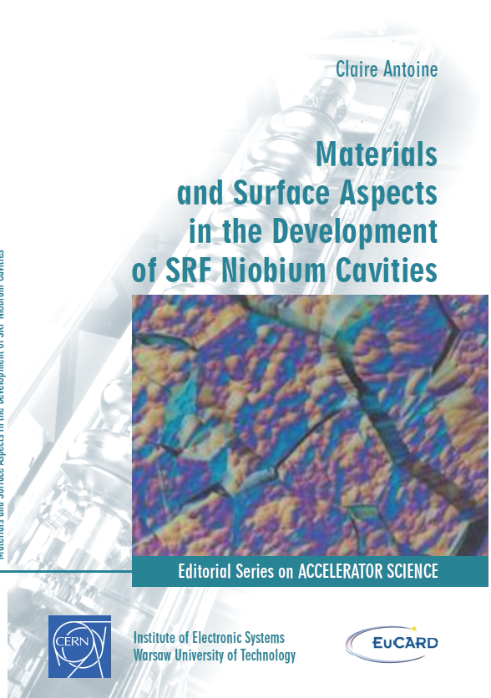
  See also :
      Singer, W. (2009). SC Cavities: Material, Fabrication and QA. SRF 2009 Tutorials.
      Singer, W. (2015). "SRF Cavity Fabrication and Materials." arXiv preprint arXiv:1501.07142.
      Antoine, C.Z,, et al. (2011). “Physical Properties of Niobium and Specifications for Fabrication of Superconducting Cavities” Fermilab Technical Division Note TD-06-048
      Antoine, C.Z. Material and surface aspect in SRF technology , SRF2011 tutorial + T_2013_04 _Erice tutorial.pptx + T_2013_04 _Tutorial ess.pptx
      general see e,g,: http://slideplayer.com/slide/4969419/
  Recent advanced papers:
      Srinivasan, R., et al. (2009). "Orientation effect on recovery and recrystallization of cold rolled niobium single crystals." Materials Science and Engineering: A 507(1): 179-189.
      Bieler, T., et al. (2010). "Physical and mechanical metallurgy of high purity Nb for accelerator cavities." Physical Review Special Topics-Accelerators and Beams 13(3): 031002.
      Sung, Z.-H., et al. (2017). "Development of low angle grain boundaries in lightly deformed superconducting niobium and their influence on hydride distribution and flux perturbation." Journal of Applied Physics 121(19): 193903.
Tutorials in metallurgy
EUCARD-CERN Monographs
Volume # 12, pdf version:
http://cds.cern.ch/record/1472363/files/?ln=fr

Slide 21
Thank you for your attention

Slide 22
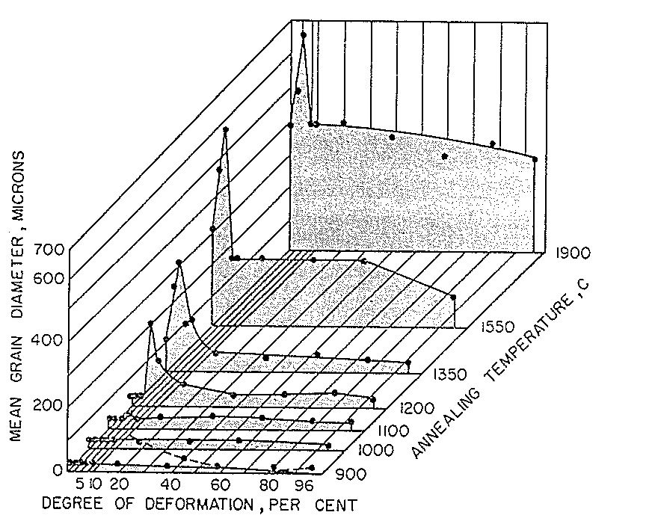
Recrystallization
  Deformation > 65% =>
  uniform nucleation
  small grains
  if purity ↑, T_{recryst} ↓
      RRR ≤ 100 => T_{recryst} ≥ 900 C
      RRR 300 => T_{recryst} ~ 800 C
      RRR 400 => T_{recryst} ~ 750 C ?
  Large grain material
      Recrystal^{n} into smaller grains
  Recommended : 2h, 800 C :
  Removes cold work
  Also removes H
Critical deformation: only high deformation leads to small grain recrystallization
Commercial Nb
RRR ~ 50-100
N.B. careful monitoring of furnace temp.!

Slide 23
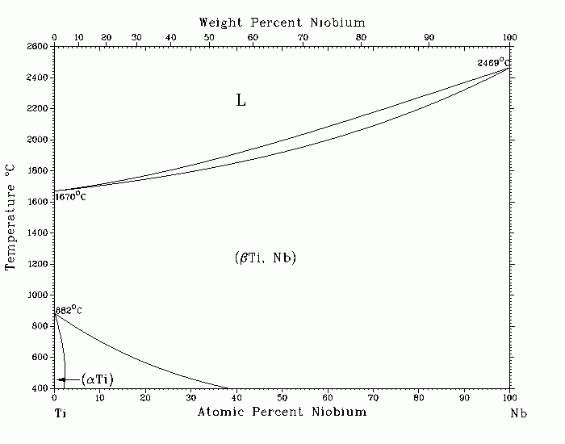
Titanium in Niobium
  Titanium = substitutional impurity
  Titanium has the same ∅ as Nb
      No lattice distortion => no strong pinning behavior if no inclusion
      Titanium is fully miscible inside Nb (as shown by the phase diagram)
  RRR issue
      RRR mainly influenced by light elements below RRR 600-800
      Light elements act as scattering centers for conduction electrons => affect thermal conductivity
      RRR is a convenient way to predict thermal conductivity ~ 4 K
      Titanium does not affect thermal conductivity but affects RRR
      RRR requirement has to be adapted to the Ti content

Slide 24
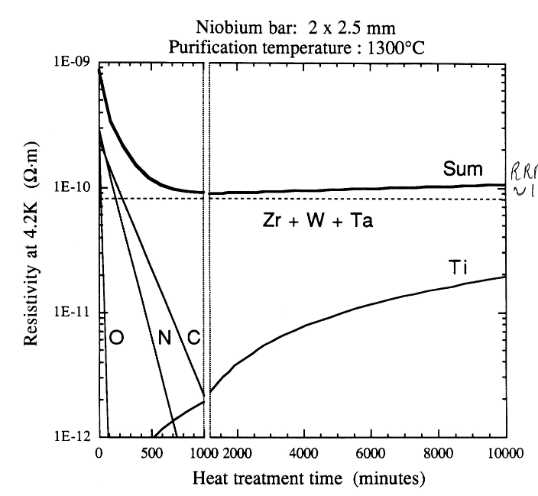
Niobium purification: λ_{T} ∝ RRR ∝ purity
  Purification annealing with a getter (Ti)
  ΔG° (TiO₂) < ΔG° (Nb₂O₅)
  Moderate vacuum, temperature
  Diffusion limited ⇒ Issues for macroscopic objects :
RRR ~1600
  Only light elements contribute to thermal behavior (e⁻ scattering) up to RRR ~800
  metallic impurities : homogeneous after EB melting
  Inclusions appear during manipulation (e.g. dust embedded in soft Nb)
  Ta content : plays on RRR, not on thermal behavior
Impurity | Δρ/ΔC (nΩ.m/At ppm)
N | 0.52
O | 0.45
C | 0.43
H | 0.08
Ti | 0.096
Ta | 0.025
light impurities
metallic impurities, lattice defects
Notes:
Only light elements play in thermal behavior (electron scattering).
Heat treatment are very expensive, alternatively:
Buy high purity Nb (very expensive)
Buy large grain (ingot) material :
ingot are more pure than sheets (no forging)
less processing steps : should be far less expensive !
Prepare cavities without surface defects : no thermal dissipation => no need for nice heat transfer !

Slide 25
Baking vs Doping
  Oxygen and Nitrogen (or Carbon!) tend to play a similar role in Nb
      Sit on interstitial Oh sites
      Interact with Hydrogen (slightly ≠ interaction energy)
      Interact with dislocations
      Similar influence on resistivity
  So what’s the difference ?
      Oxygen = main impurity in Nb
      Oxygen diffuses ~x100 faster than N, (~x 300 for C) at a given T
      Oxide layer is thinner in presence of N (N blocks diffusion of O… and H ?)
      Pauling electronegativity: C=2,55; N=3,04; O=3,44; F=3,98 (NB no data on Fluor diffusion in literature, but certainly present @ surface)
      Atomic radius in pm: C= 67; N= 56; O= 48; F= 42 (NB some indication that C not stable in time => forms carbides)
      Effective charge  from O to C to N (electromigration @ high temperature)
      …?

Slide 26




Etching figures & damage
  Typical etching figures (dislocations emerging at the surface)
  As received Nb Sheet,
  optical microscope, w. surface etching →
SEM, cross section, transverse to rolling direction ↓
  Existence of etching figures provide a coarse but very quick estimation of the presence of remaining stress inside the material
Depth (µm)
Silver epoxy
Distorted grains
(mottled contrast)
100
Etch pits
200
300
optical microscope, surface etching on low damage Nb surface →
S
Cross-section, ST plane
T

Slide 27
























After (poor) welding :
  Optical observation of a cavity cut-out after 20 µm BCP
Welding seam
2 mm
  Deep etching pits (aligned with crystallographic direction) are found in the heat affected area.
  Similar feature is expected (and observed !) on the RF surface
  Careful exploration of the remaining stress due to welding is necessary (i.e. with orientation imaging)

Slide 28


Deep drawing : additional strain
Half cell cutout
(just after deep drawing, before welding)
1500
1000
500
300
100
equator
μm from surface
~ 5 mm
cavity
interior
surface
Local Average Misorientation
1 μm spatial
resolution
High friction area
NB, Average deformation ~30%
Easily recovered w. 800°C, 2 h annealing
Inverse Pole Figure
(poles normal to cavity surface)
[courtesy : R. Crook et al, Black Laboratory]

Slide 29
HOT spots:
Trapped flux vs local low H_{C1} ?
Hots spots attributed to vortices, 2 possibilities:
  Flux trapped upon cooldown, then de-trapped from pinning centers by the RF field
  Flux entering at H>H_{C1} (possibly lower local H_{C1})
  IT IS NOT EXACTLY THE SAME THING !!!
  Flux trapped (frozen) upon cooling down is not necessarily the origin of the quench
Trapped vortices | Early penetration
µSR : without mask, threshold @ 40 mT but inner volume is essentially non magnetic: could be related to weak pinning on edges, surface. | µSR: before 100 mT « volume magnetic fraction » is ~0% for masked samples (ie without edge effect) : no flux line originally present at H> 100 mT, lines jump directly to the center of the samples
Irreversibility observed in DC magnetization curve Flux jumps on some DC magnetization curves (NB. Flux jumps are more often observed on damaged or polluted surfaces). ~ 0 magnetic moment on field cooled DC experiments: if there is flux, then it is trapped. | Point contact Tunneling shows degraded SC properties in hot spot (inelastic quasiparticle scattering: broadened DOS, a finite zero bias conductance and/or zero bias peak, lower gap…) : it could promote early penetration.
Depining frequency is very low for bulk Nb (104 Hz) : trapped flux is expected to be mobile in RF field and produce dissipation | Morphologic defects are often found at the quench site (steps, pits): in this case the local field is higher than the applied field. It can also be considered as a defect with locally lower penetration field. In some other cases, MO experiment show that GB are an easy way in AND out when field is parallel to them; in this case, it is not pinning, just degraded superconductivity.
Some hot spots can be moved around with thermal activation In some case MO experiments show actual pinning on defects like GB (after field has been decreased).
  Probably both occur altogether….

Slide 30
Niobium
Not only a superconductor…
  Refractory : high melting temp 2786 K
      Difficult to manipulate (e.g. EB melting only)
  Valve metal : ⱻ a thin oxide layer ≡ diffusion barrier
      Makes Nb very inert at room temp
  Getter: reacts with H, C, O, N… A.S.A. T > 200 °*C
      No hot forming
      EB welding w. good vacuum (TIG welding possible w. UHPurity Ar=> prohibitive)
  Very sensitive to deformation => importance of recrystallization !!!
      Dislocation cells appear A.S.A 3-5% deformation (uncommon for BCC metals)
      « phonon peak » in thermal conductivity disappears for the same strain (can be used as a diagnostic)

