Slide 1
Superconducting CH Structure Development in
Mainz, Frankfurt, Darmstadt
F. Dziuba¹
K. Aulenbacher^{1,4}, W. Barth^{1,2}, M. Basten³, M. Busch³,
V. Gettmann¹, M. Heilmann², J. List¹ , T. Kürzeder¹,
M. Miski-Oglu¹, H. Podlech³, A. Rubin², A. Schnase²,
M. Schwarz³, S.Yaramyshev²
¹HIM, Helmholtz Institute Mainz, Mainz, Germany
²GSI Helmholtzzentrum, Darmstadt, Germany
³IAP, Goethe Univ. Frankfurt, Frankfurt, Germany
⁴KPH, Johannes Gutenberg Univ., Mainz, Germany

Slide 2
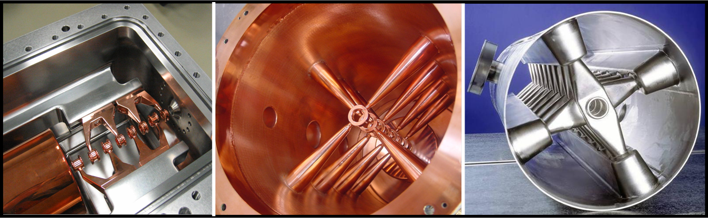
The Family of H-mode DTL Cavities
CNAO Italy
217 MHz
p-Linac prototype for GSI
340 MHz
1st superconducting CH prototype
360 MHz
H₁₁₁
H₂₁₁
H₂₁₁
r.t. IH-DTL
r.t. CH-DTL
s.c. CH-DTL

Slide 3
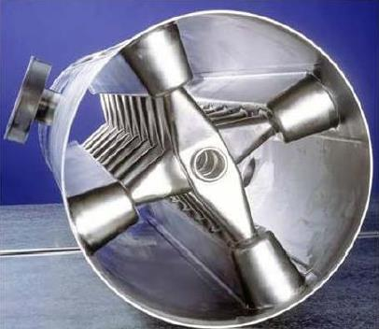
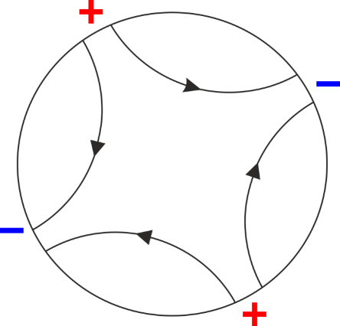
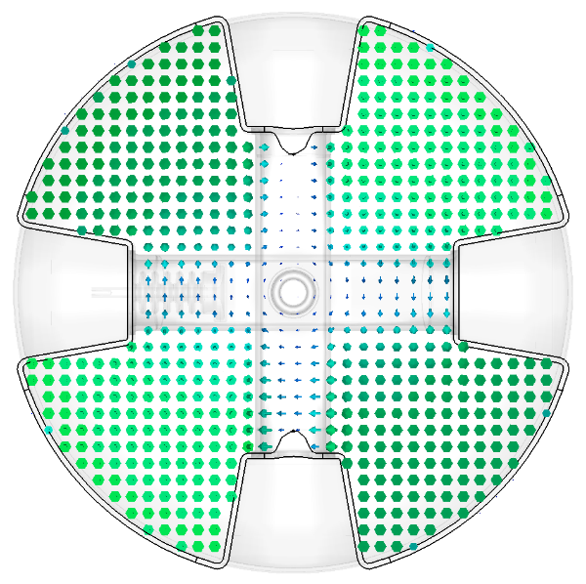
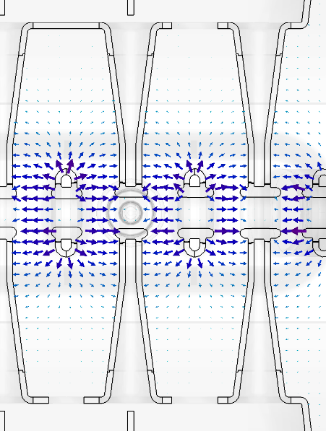
The CH Cavity
H₂₁₁ mode of ”pillbox“ cavity
H field
E field
E field
E field along beam axis
Multigap drift tube cavity for the acceleration of protons and ions in the low energy range
Drift tubes are alternating connected to “+” and “-” potential
Cross-bar-H-mode cavity → CH cavity

Slide 4
Superconducting cw-LINAC
Recent Layout of the superconducting cw-LINAC
Layout properties
Multigap CH cavities
Cavities with short lengths (<1 m) and small transverse dimensions (<0.5 m)
Modular construction with 4 cryo modules
Each containing 3 CH cavities, 1 buncher, 2 solenoids
E_{a}= 5.5 MV/m enables compact linac design
First step Demonstrator project

Slide 5
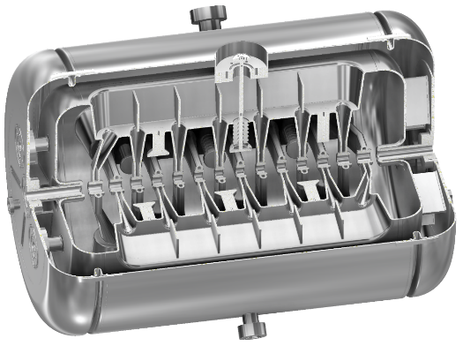
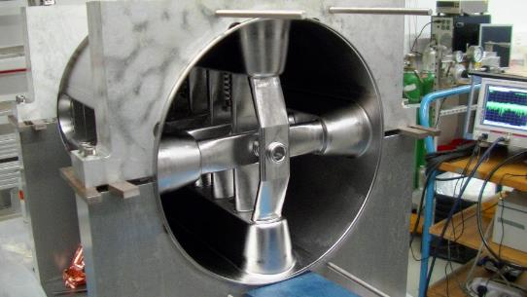
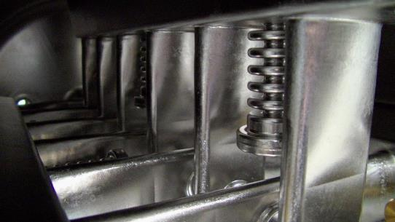
RF Design of the Demonstrator Cavity CH0
(based on beam dynamic design by S. Mineav 2009)
Inclined stem
Dynamic tuner
Static tuner
Preparation
ports
Helium vessel
3rd superconducting CH cavity developed at IAP
Manufacturered at Research Instruments
Most complex superconducting cavity ever been built
Bulk Niobium (RRR 300) from Tokyo Denkai

Slide 6
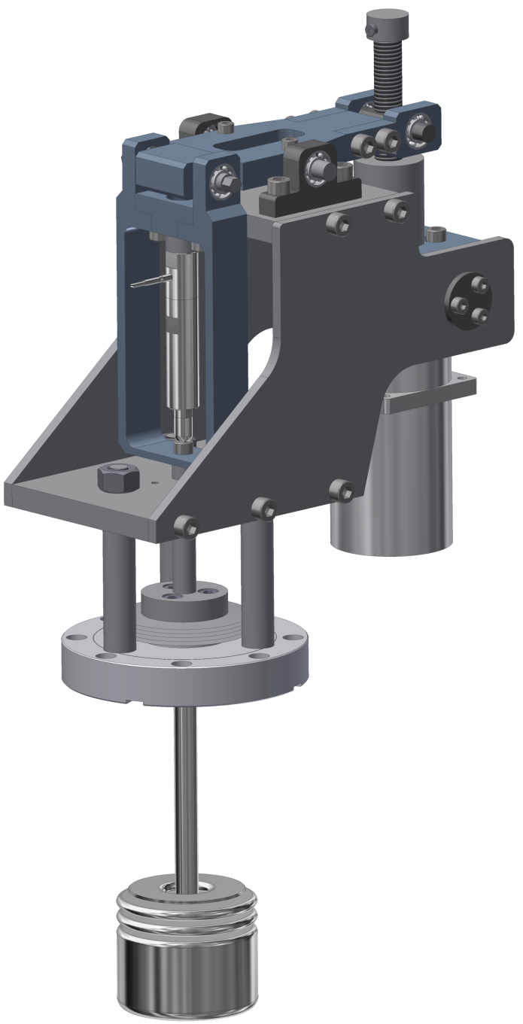
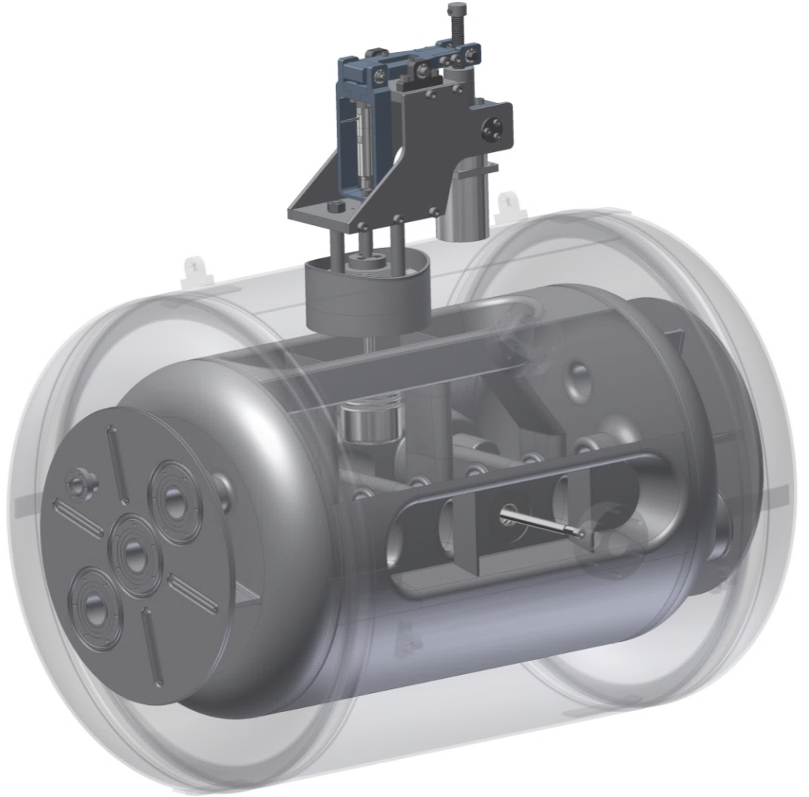
Cavity Tuning
Rotation axis
Spindle
Lever
Main properties of the tuning system:
Enables slow & fast frequency adjustment
Capacitive bellow tuner
Max. mechanical displacement ±1 mm (≈ ±60 kHz)
Required force < 800 N
Lever with pivot point ratio ≈ 2:1
Gear reduction ratio 50:1
Piezo actuator ‚connected in series‘ with slow tuning unit
Required displacement of piezo ±6 µm (≈ ±360 Hz)
Piezo
actuator
Stepping motor
Bellow tuner
50 mm

Slide 7
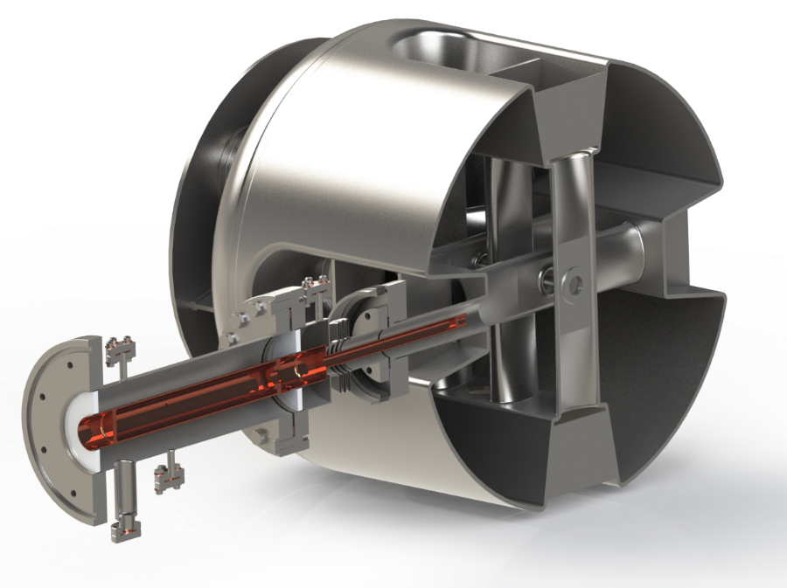
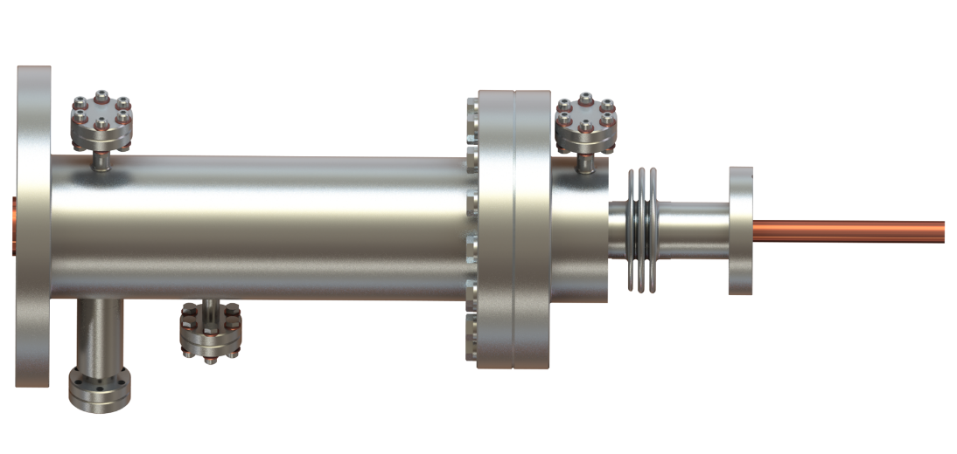
High Power Coupler
502.6 mm
Diagnosis port
Outer conductor
3 1/8‘‘
Outer conductor
Inner
conductor
Bellow
Warm part
Cold part
Coupler design based on the work of S. Kazakov, Fermilab
300 K
Warm window
70 K
Cold window
4 K
Coaxial antenna setup (inner conductor made from copper)
Capacitive coupling of RF power
Devided into cold & warm part by 2 ceramic windows (Al₂O₃), TiN coated
5 kW cw operation, cold window connected to LN₂ supply
216.816 MHz operation frequency with 33 MHz bandwidth

Slide 8
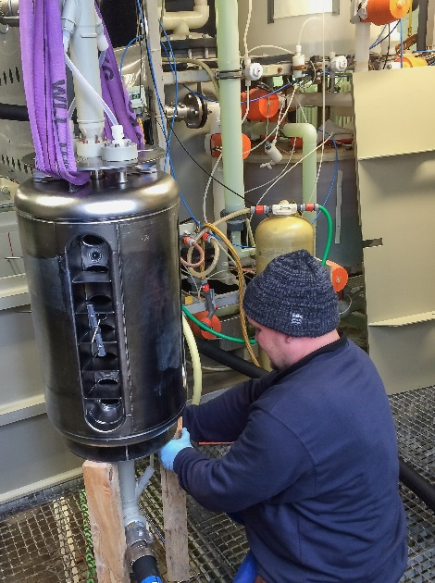
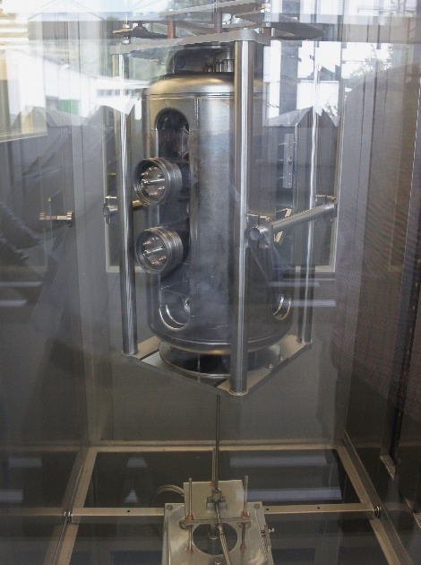
Surface Preparation at Research Instruments
Before assembly of He vessel (before 1st cold test):
1. BCP - 50 µm
2. BCP - 25 µm (after welding of static tuners)
3. BCP - 3 µm
HPR for 2 h, 12 h drying, assembly of antennas
HPR for 12 h (from both sides repectively), 12 h drying
After 1st cold test:
HPR for 12 h (from both sides repectively), 12 h drying
Final welding of He vessel
HPR only along beam axis!
No Baking!

Slide 9
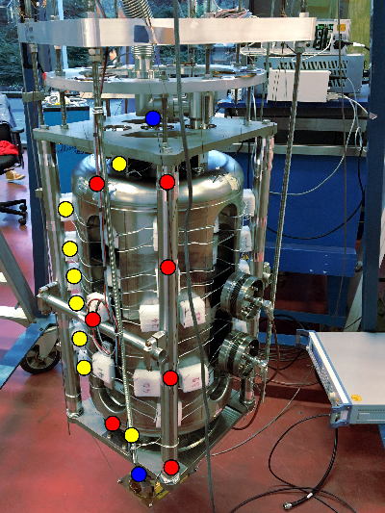
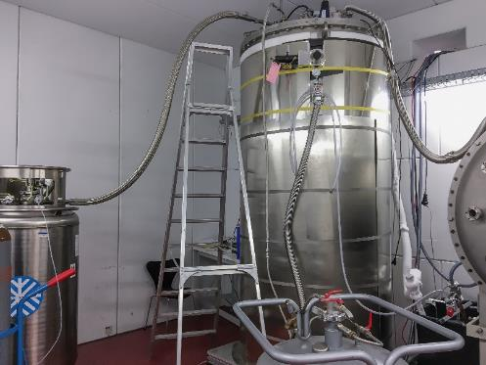
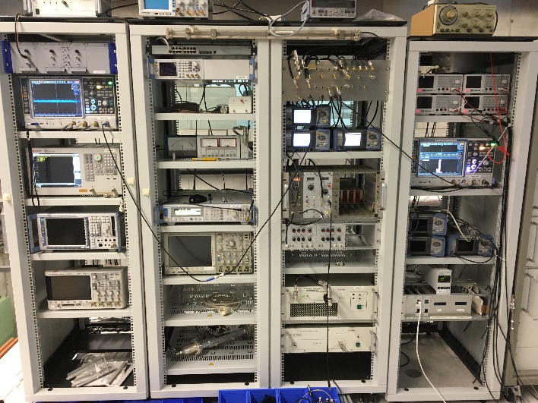
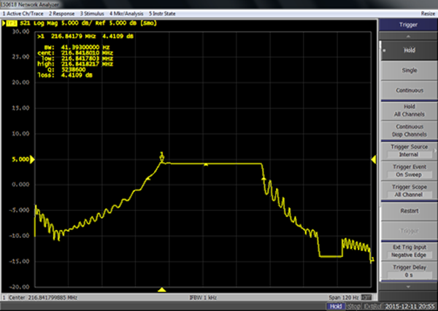
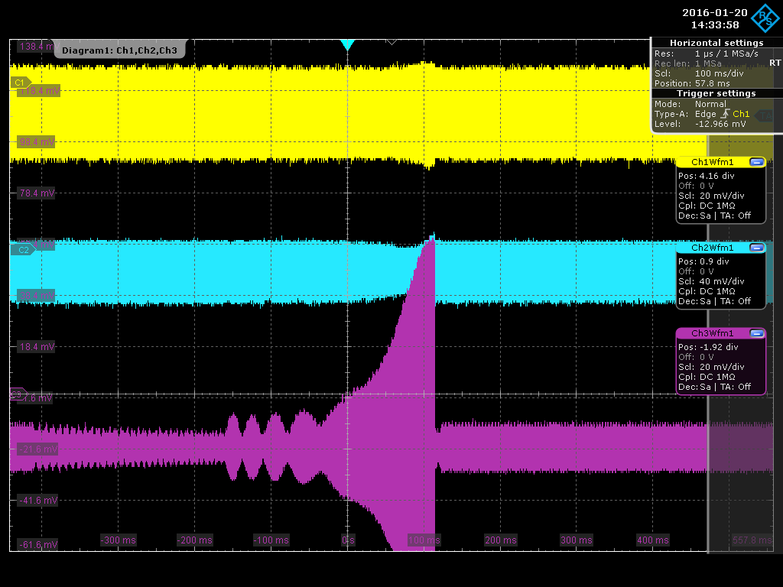
RF Conditioning of the Cavity
1. Low level RF test in vertical orientation w/o He vessel at 4 K (01/2016) - Experimental setup at IAP
TLD
Temperature probes
Piezo elements
strong barrier remained for 12 h
conditioning of whole cavity took 2 days
RF conditioning using VNA (sweep of frequency and variation of forward power)
U_{f}
U_{r}
U_{t}

Slide 10
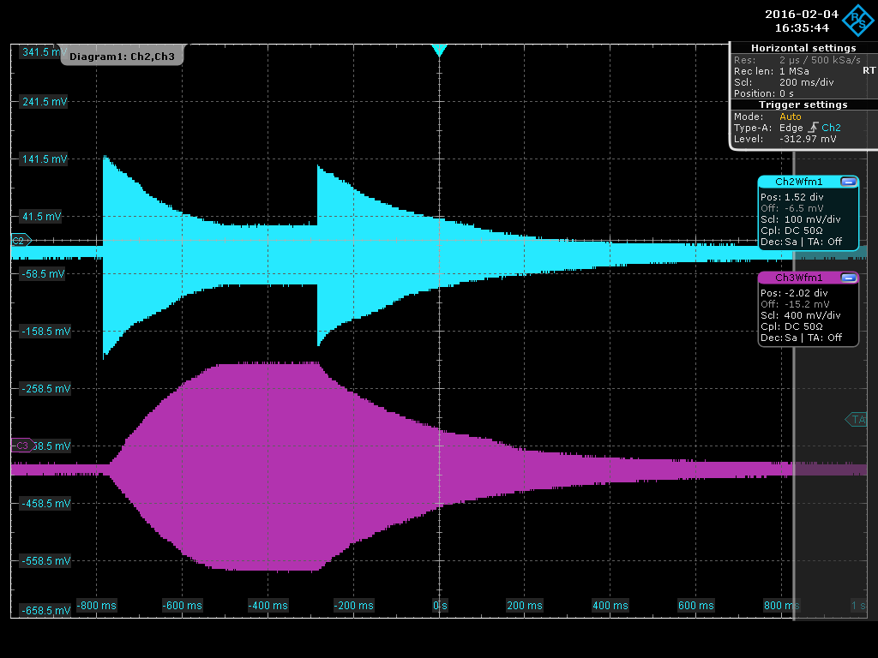
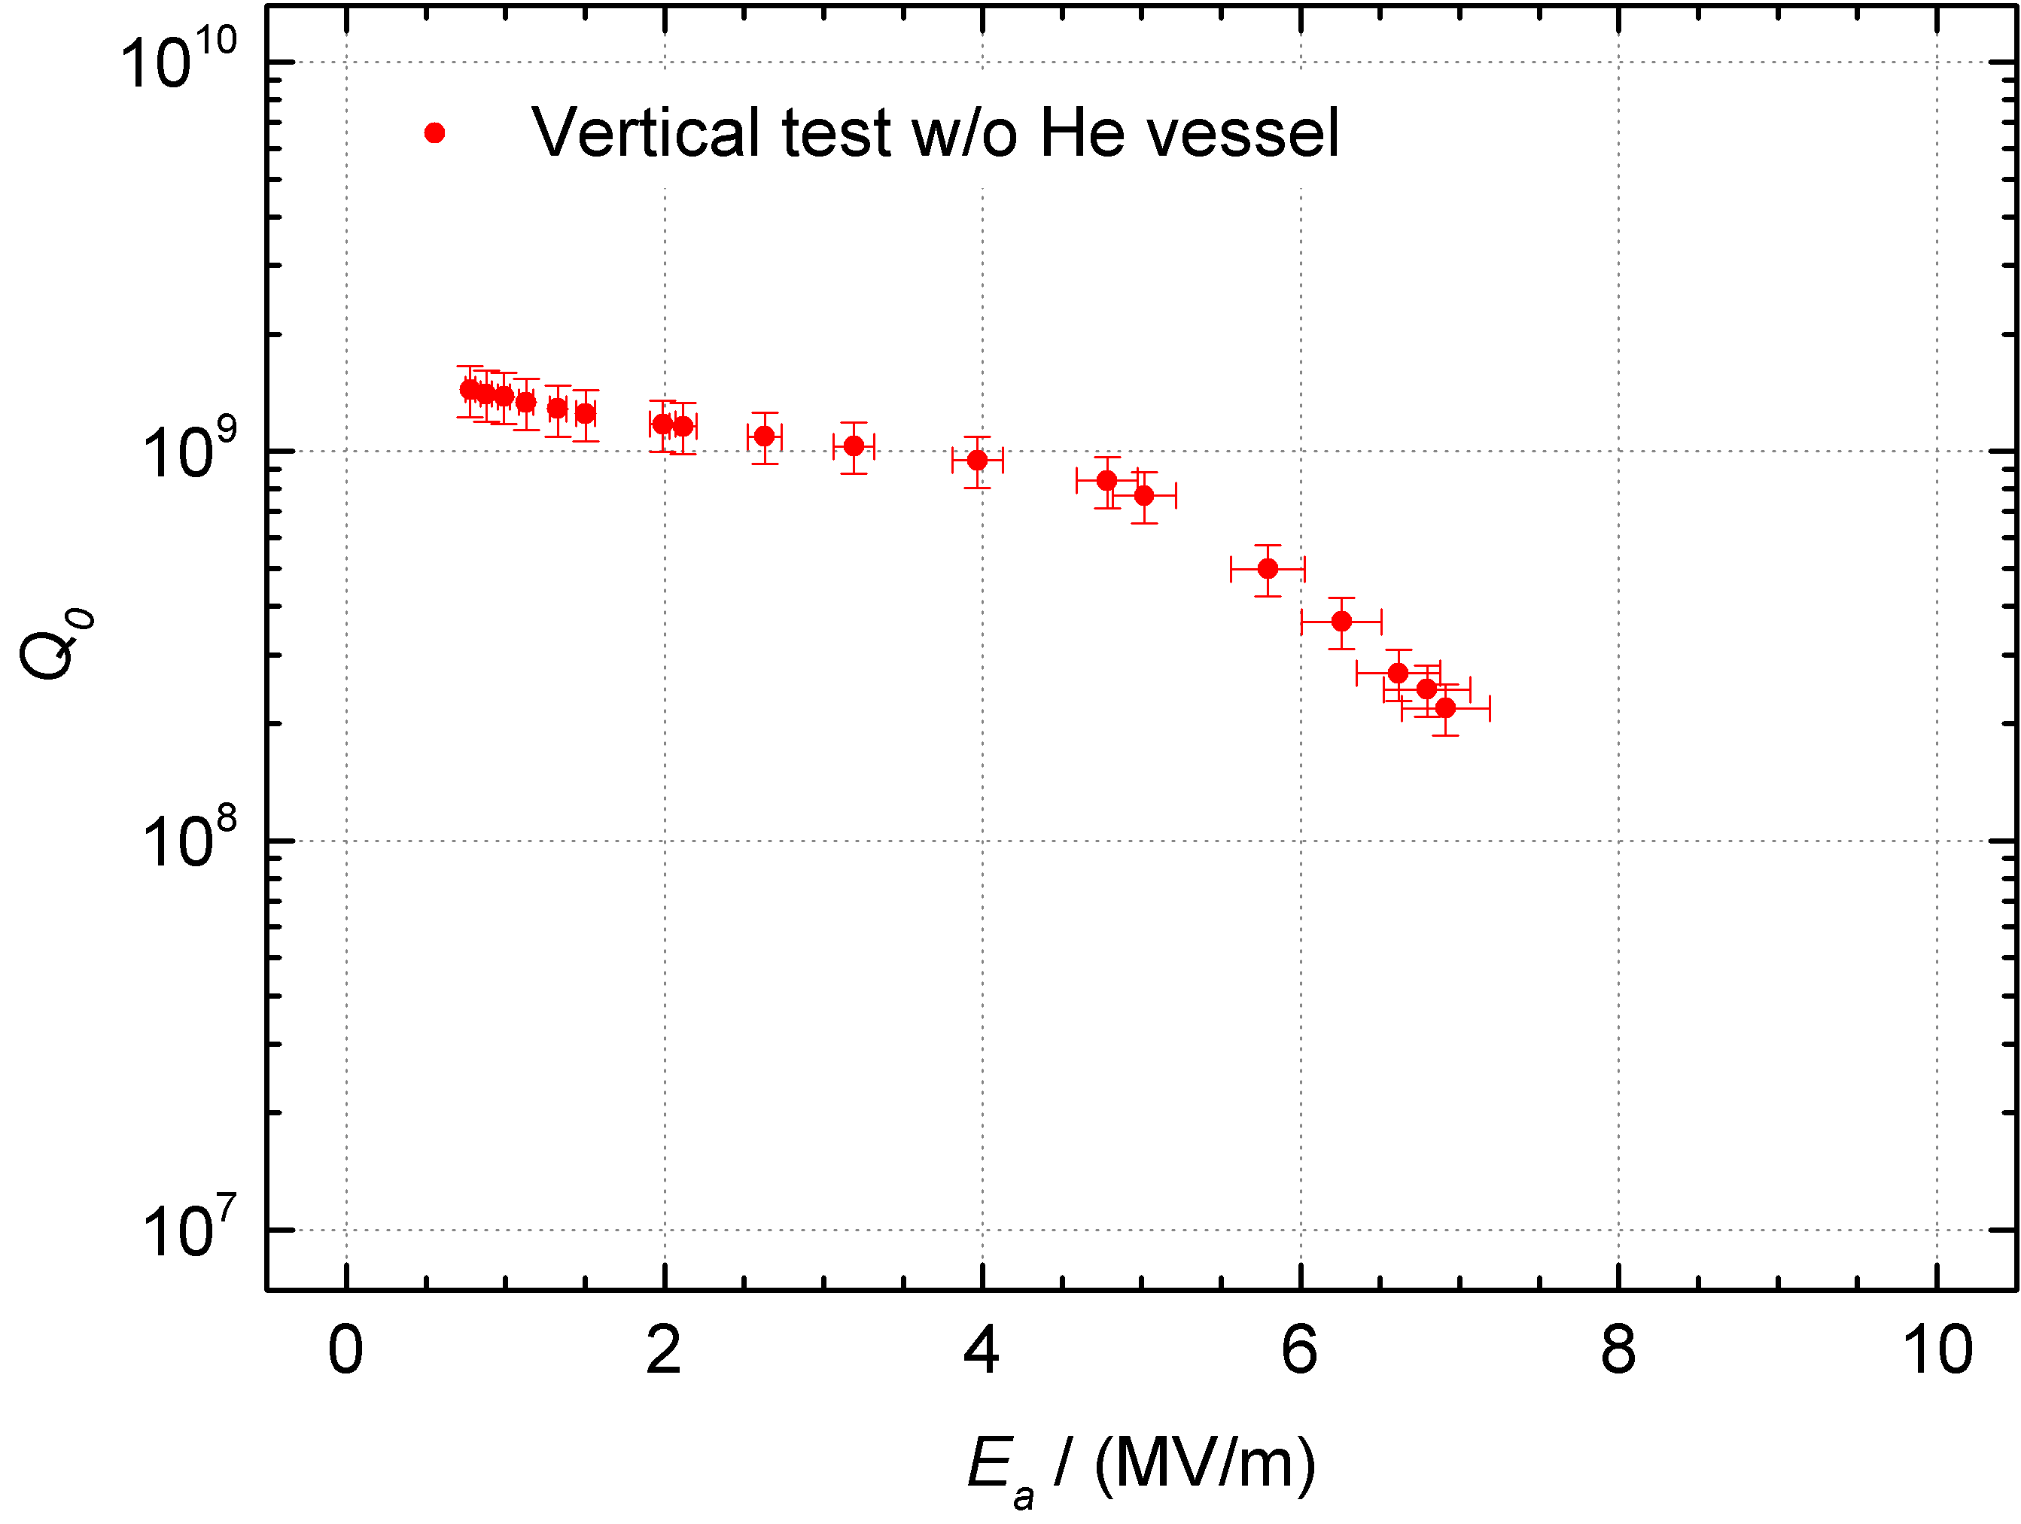



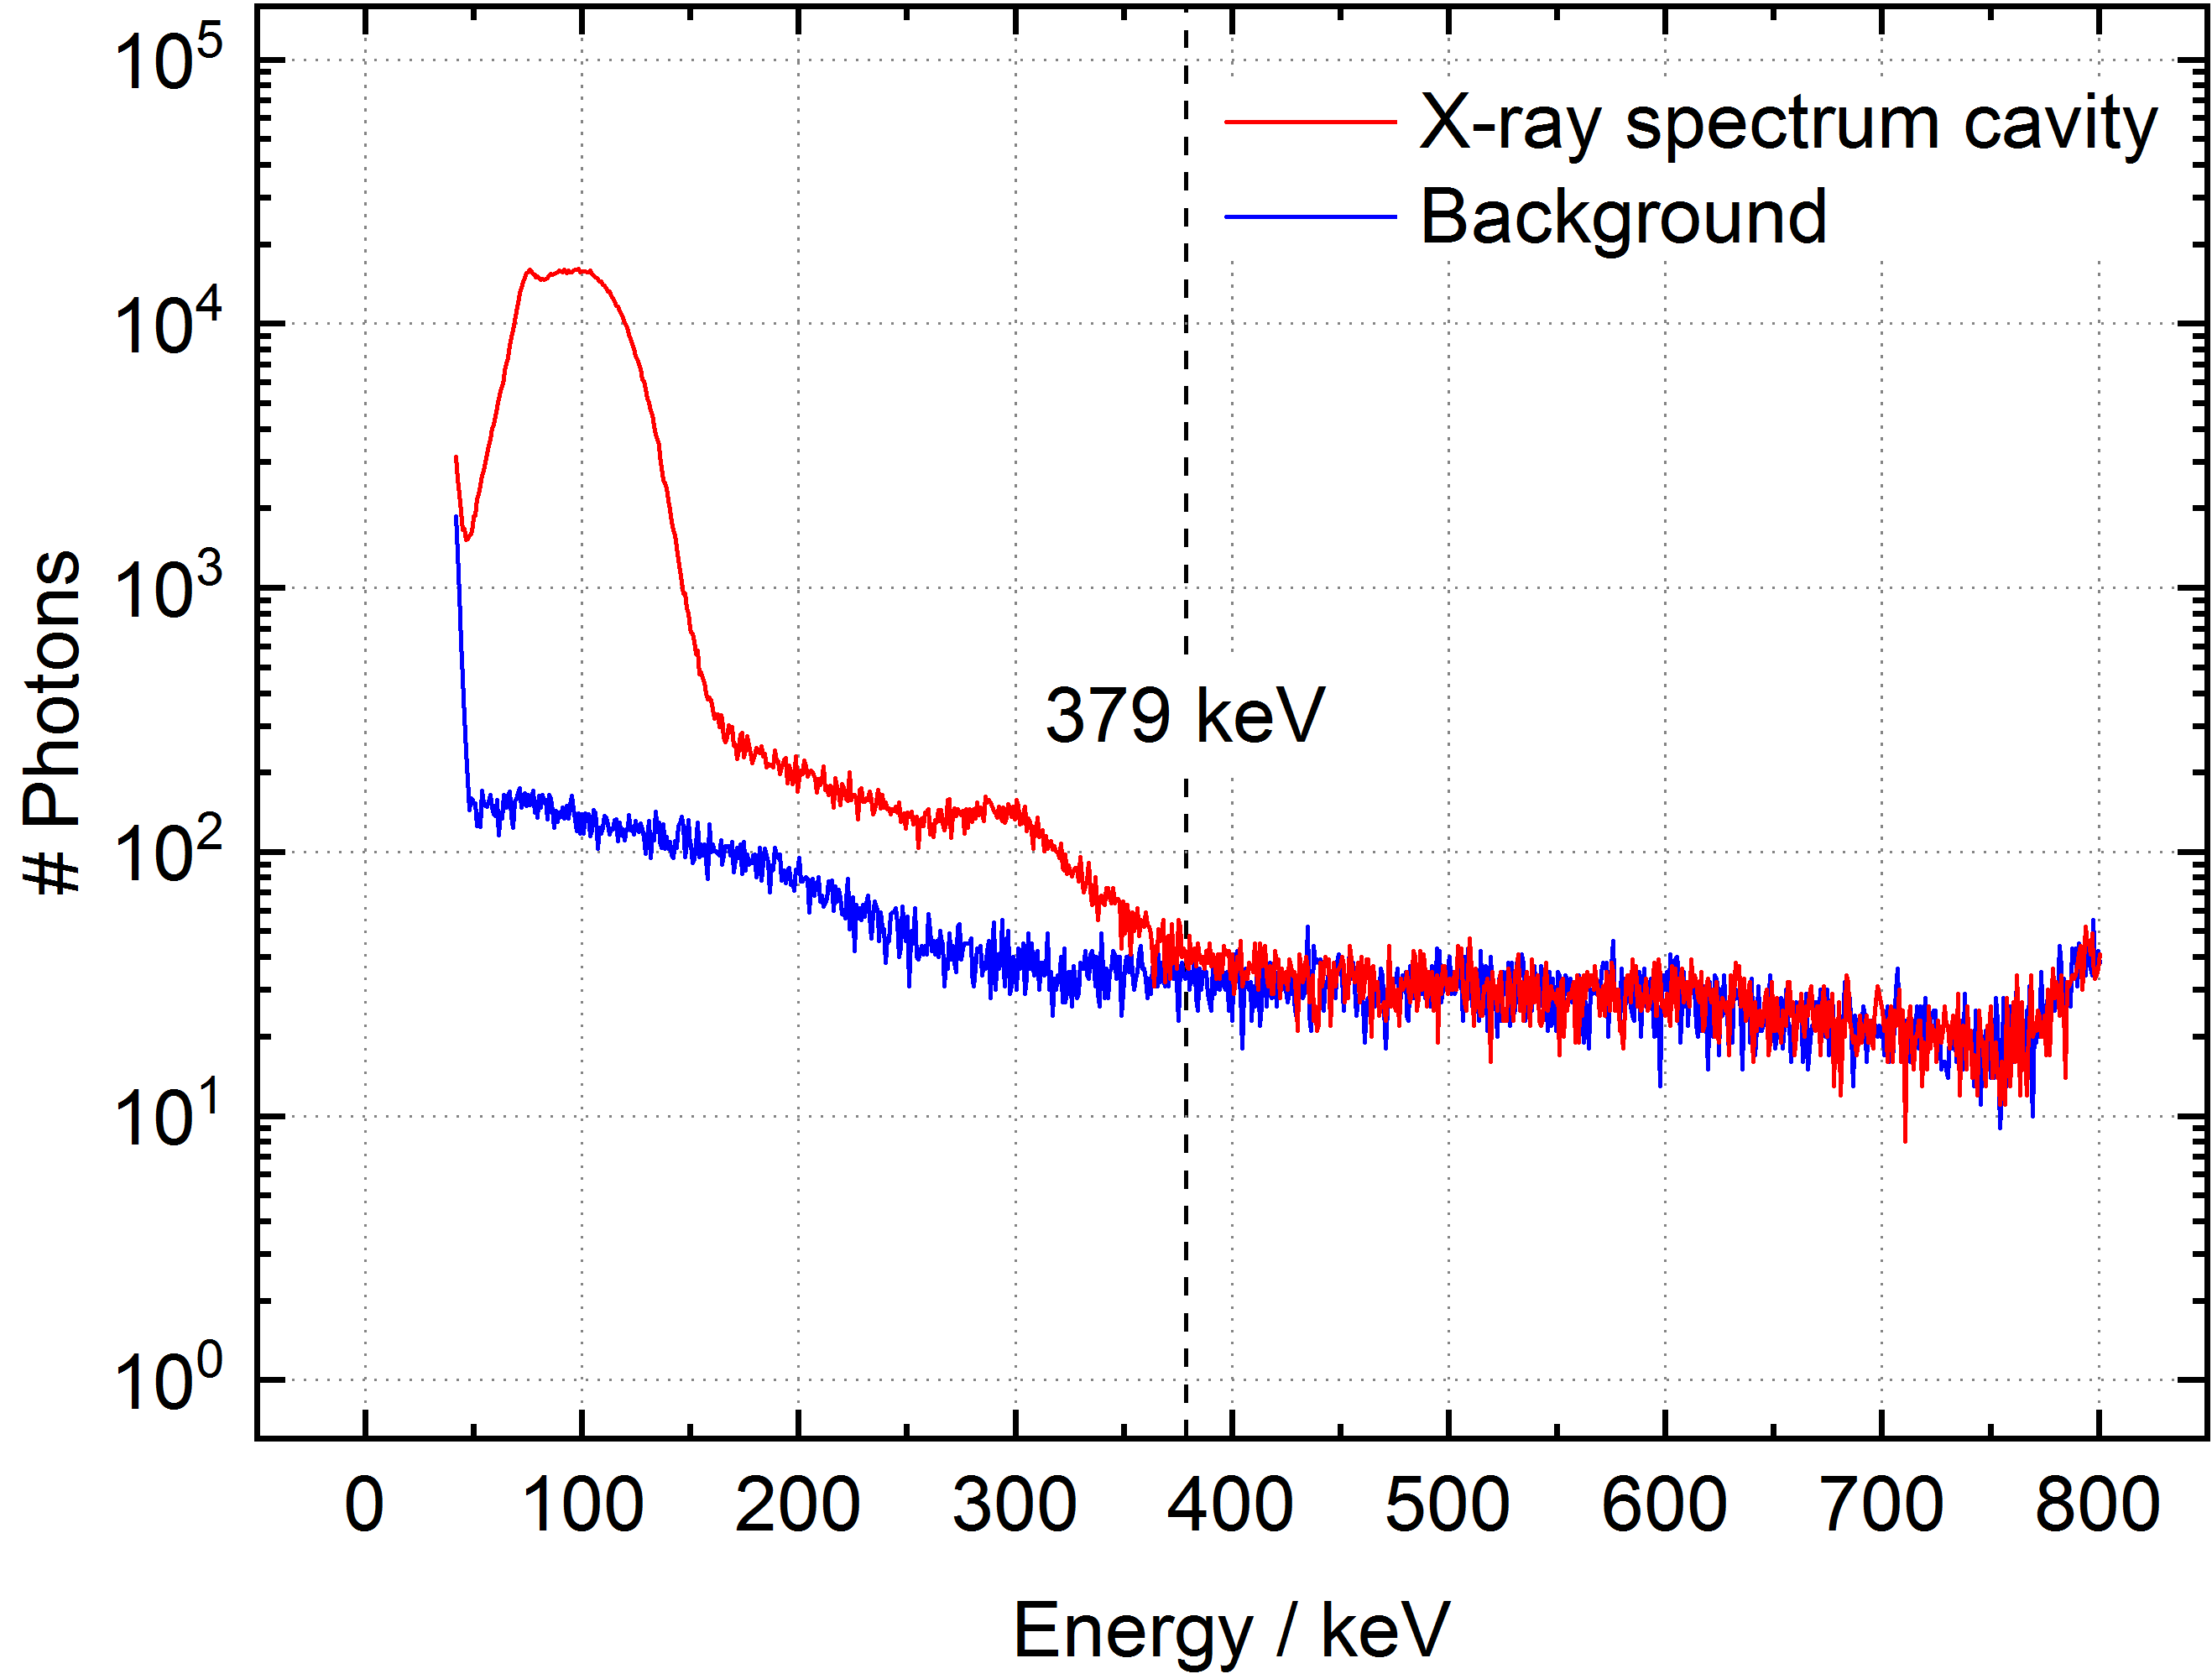
Cavity Performace at 4 K
1. RF test in vertical orientation
w/o He vessel at IAP (01/2016)
Beginn field emission
Cross check of RF power meters with
cavity x-ray spectrum
Cavity was limited by field emission due to
insufficient surface preparation
HPR was not possible inside each quadrant

Slide 11
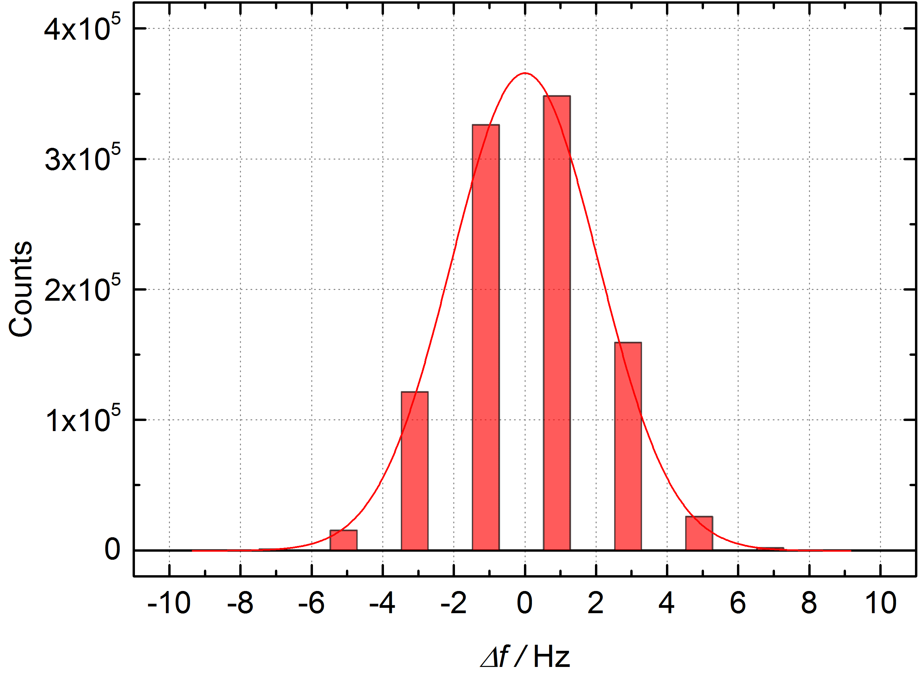
Frequency Sensitivity
(Cavity without He vessel)
Analysis of dynamic frequency variations
Operated as generator driven resonator,
directed by rf control system, no tuning
Recording of VCO signal over 10 h
Very stable operation of the cavity
Max. frequency shift of ±7 Hz
Mechanical modes and corresponding VCO signal due to an excitation with a harmonic ac voltage at 4.2 K

Slide 12
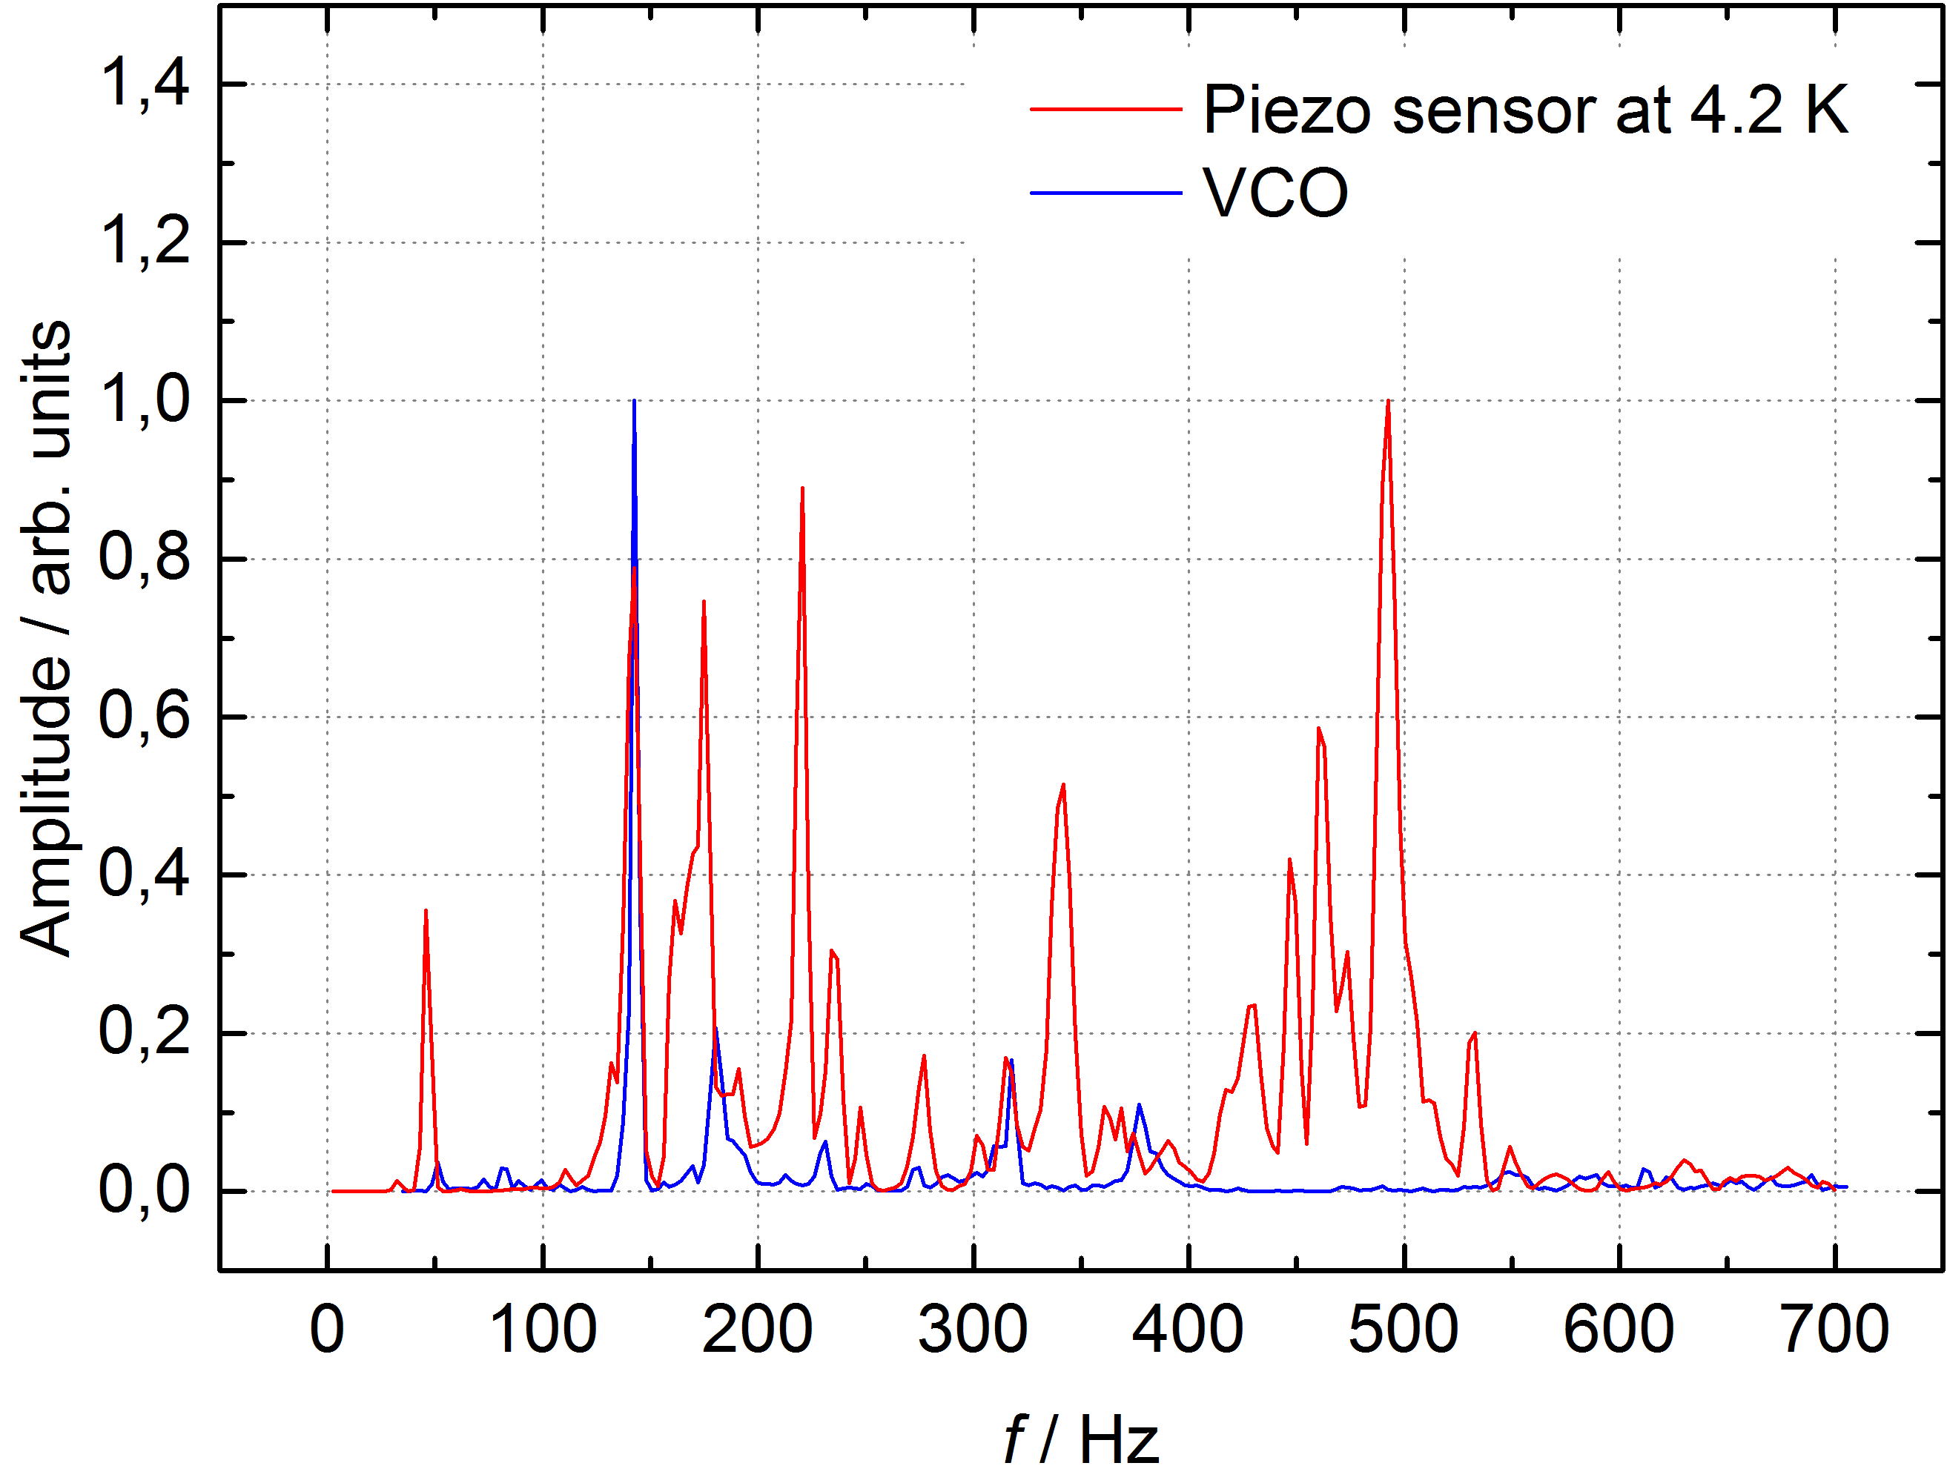
Microphonics
(Cavity without He vessel)
Analysis of mechanical resonances
143 Hz
180 Hz
318 Hz
Piezo actuator to excite the cavitiy, piezo sensor to recorded mechanical amplitudes
No microphonics up to 100 Hz in VCO signal
Compensation of frequency shifts caused by higher resonances by rf control system
Not all mechanical resonances causing frequency changes
Mechanical modes and corresponding VCO signal due to an excitation with a harmonic ac voltage at 4.2 K

Slide 13
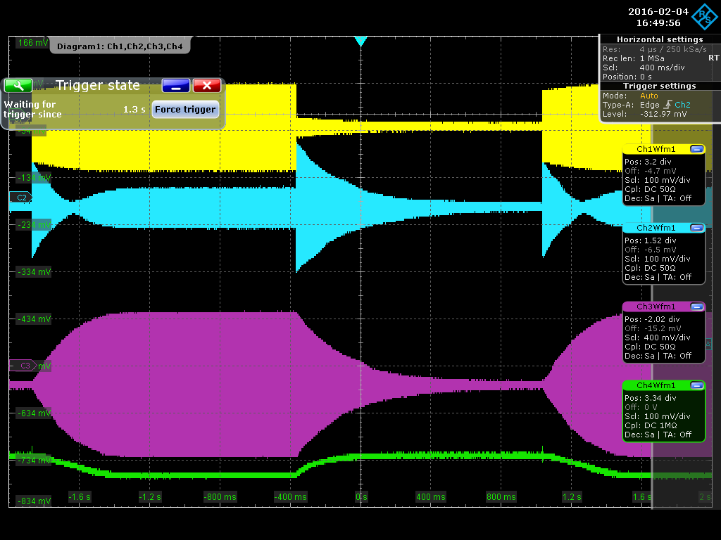
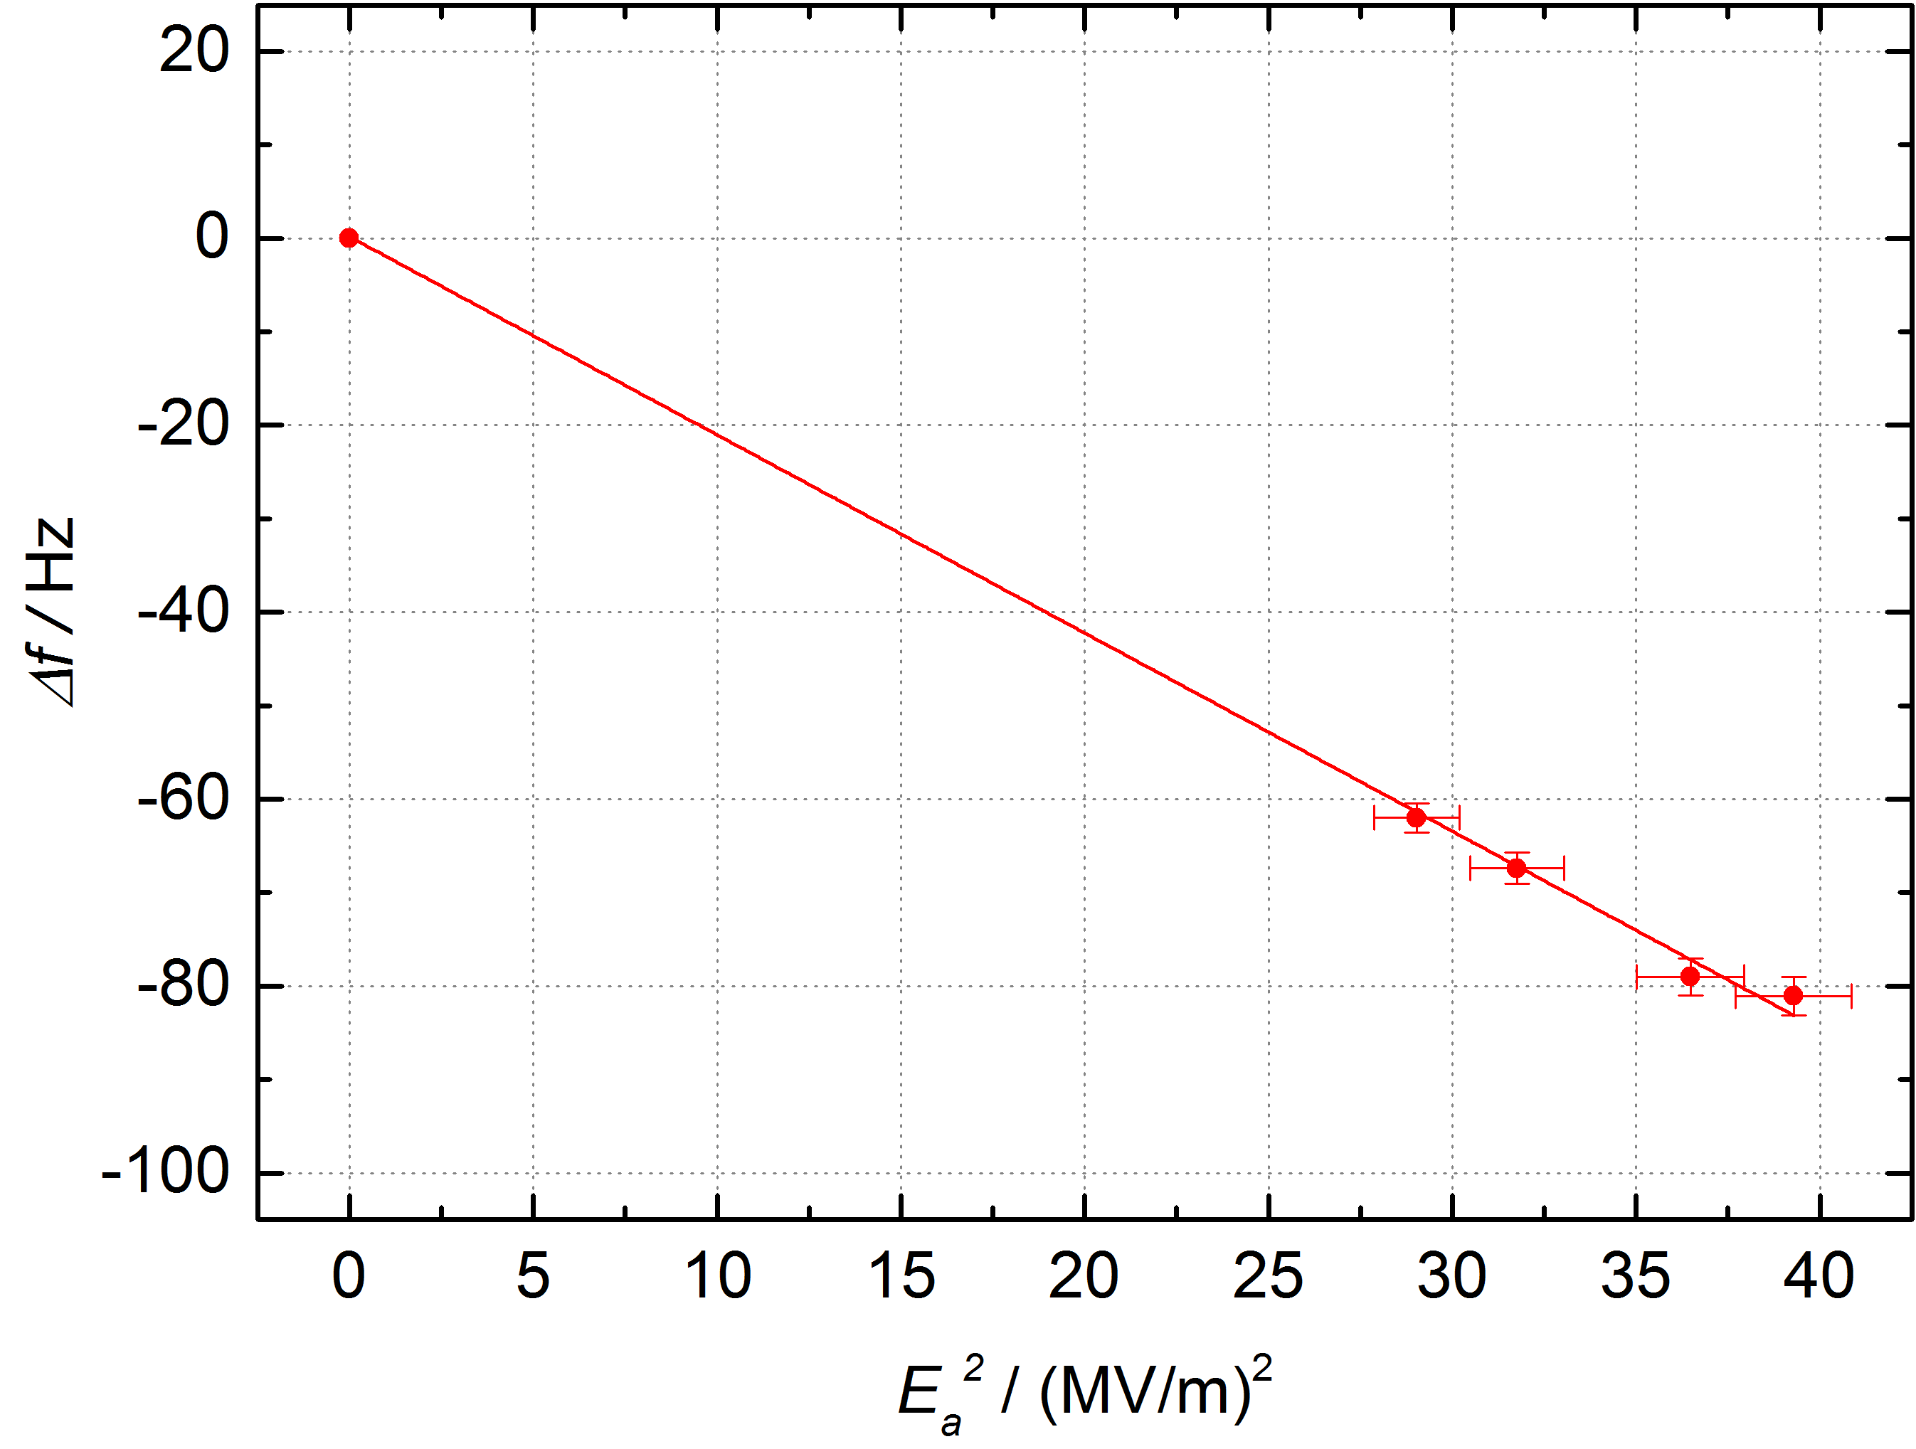

Lorence Force Detuning
(Cavity without He vessel)
Pulsed operation - 800 ms RF pulses at various field levels
E_{a} = 5.5 MV/m
Forward power
Transmitted power
Reflected power
VCO signal
Measurement of corresponding VCO signal (green curve)
K factor of -2.1 Hz/(MV/m)²
∆f = -64 Hz at 5.5 MV/m

Slide 14
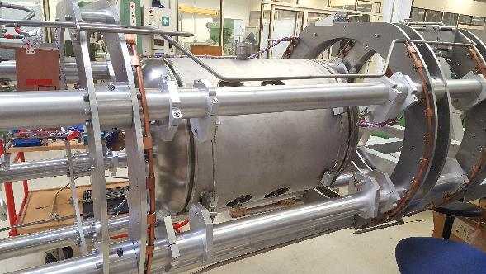
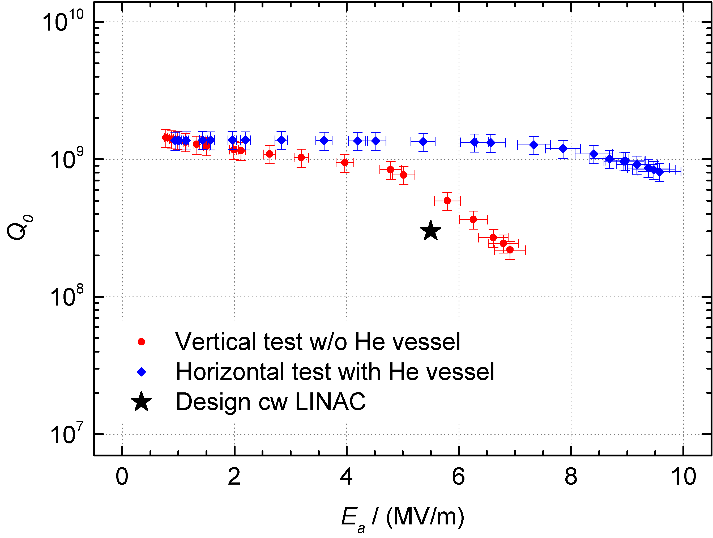


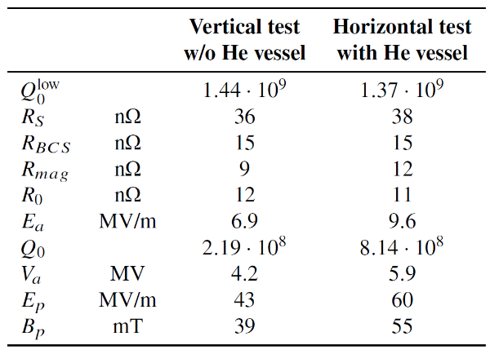
Cavity Performace at 4 K
2. RF test in horizontal orientation with He vessel
at GSI (10/2016)
Improved performance due to second HPR
No field emission activity
High gradient
Thermal quenching above 9.6 MV/m
@ E_{a}^{max}

Slide 15
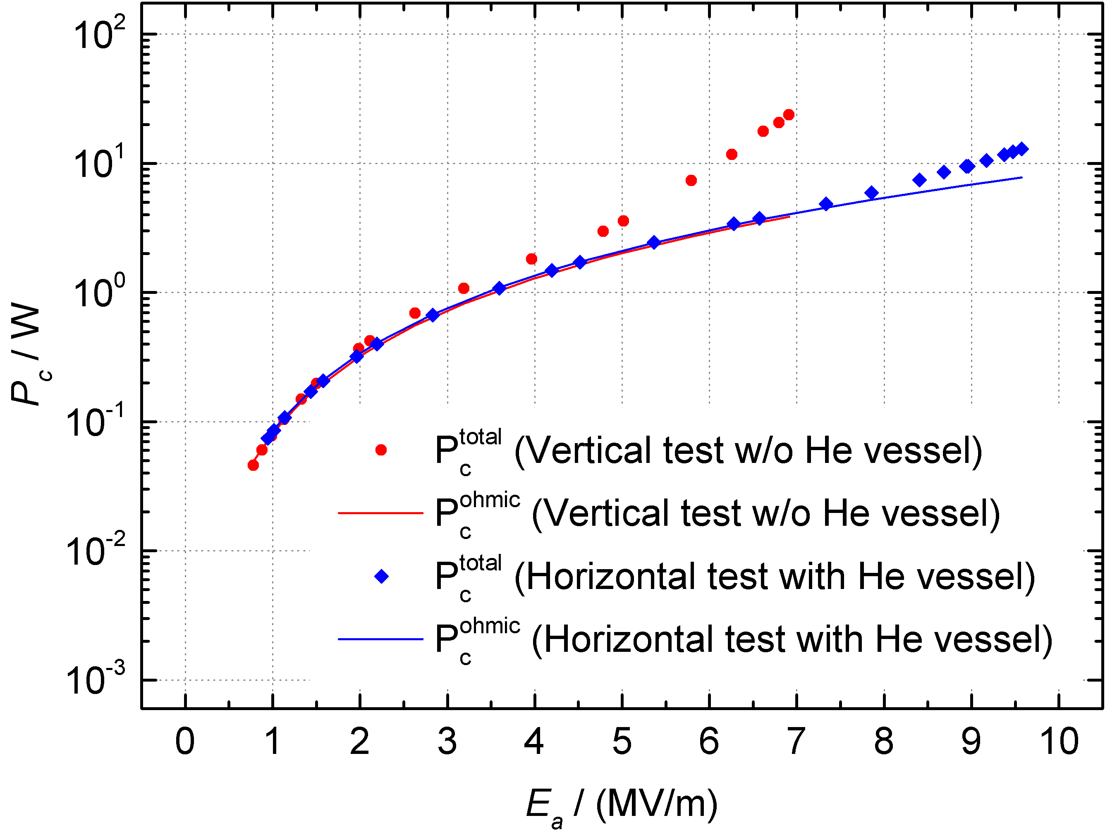
Power Consumption
Total losses inside the cavity
1. RF test
2. RF test (after second HPR)
Rapidly increase of total losses
at E_{a} = 5 MV/m (E_{p} = 32 MV/m)
Indication for field emitter activation
Extremely reduced total losses
Minor increase of total losses
at E_{a} = 7.8 MV/m (E_{p} = 49 MV/m)

Slide 16
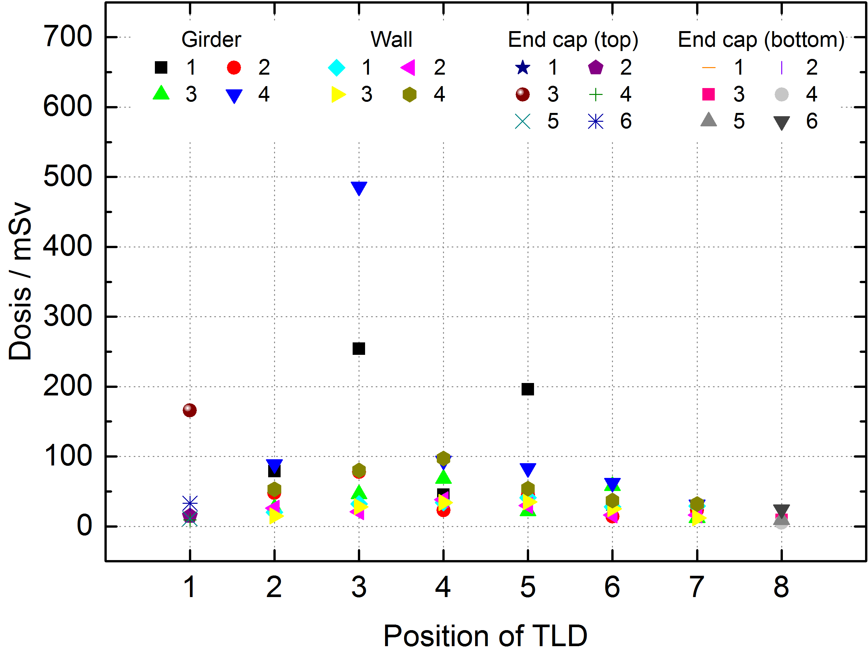
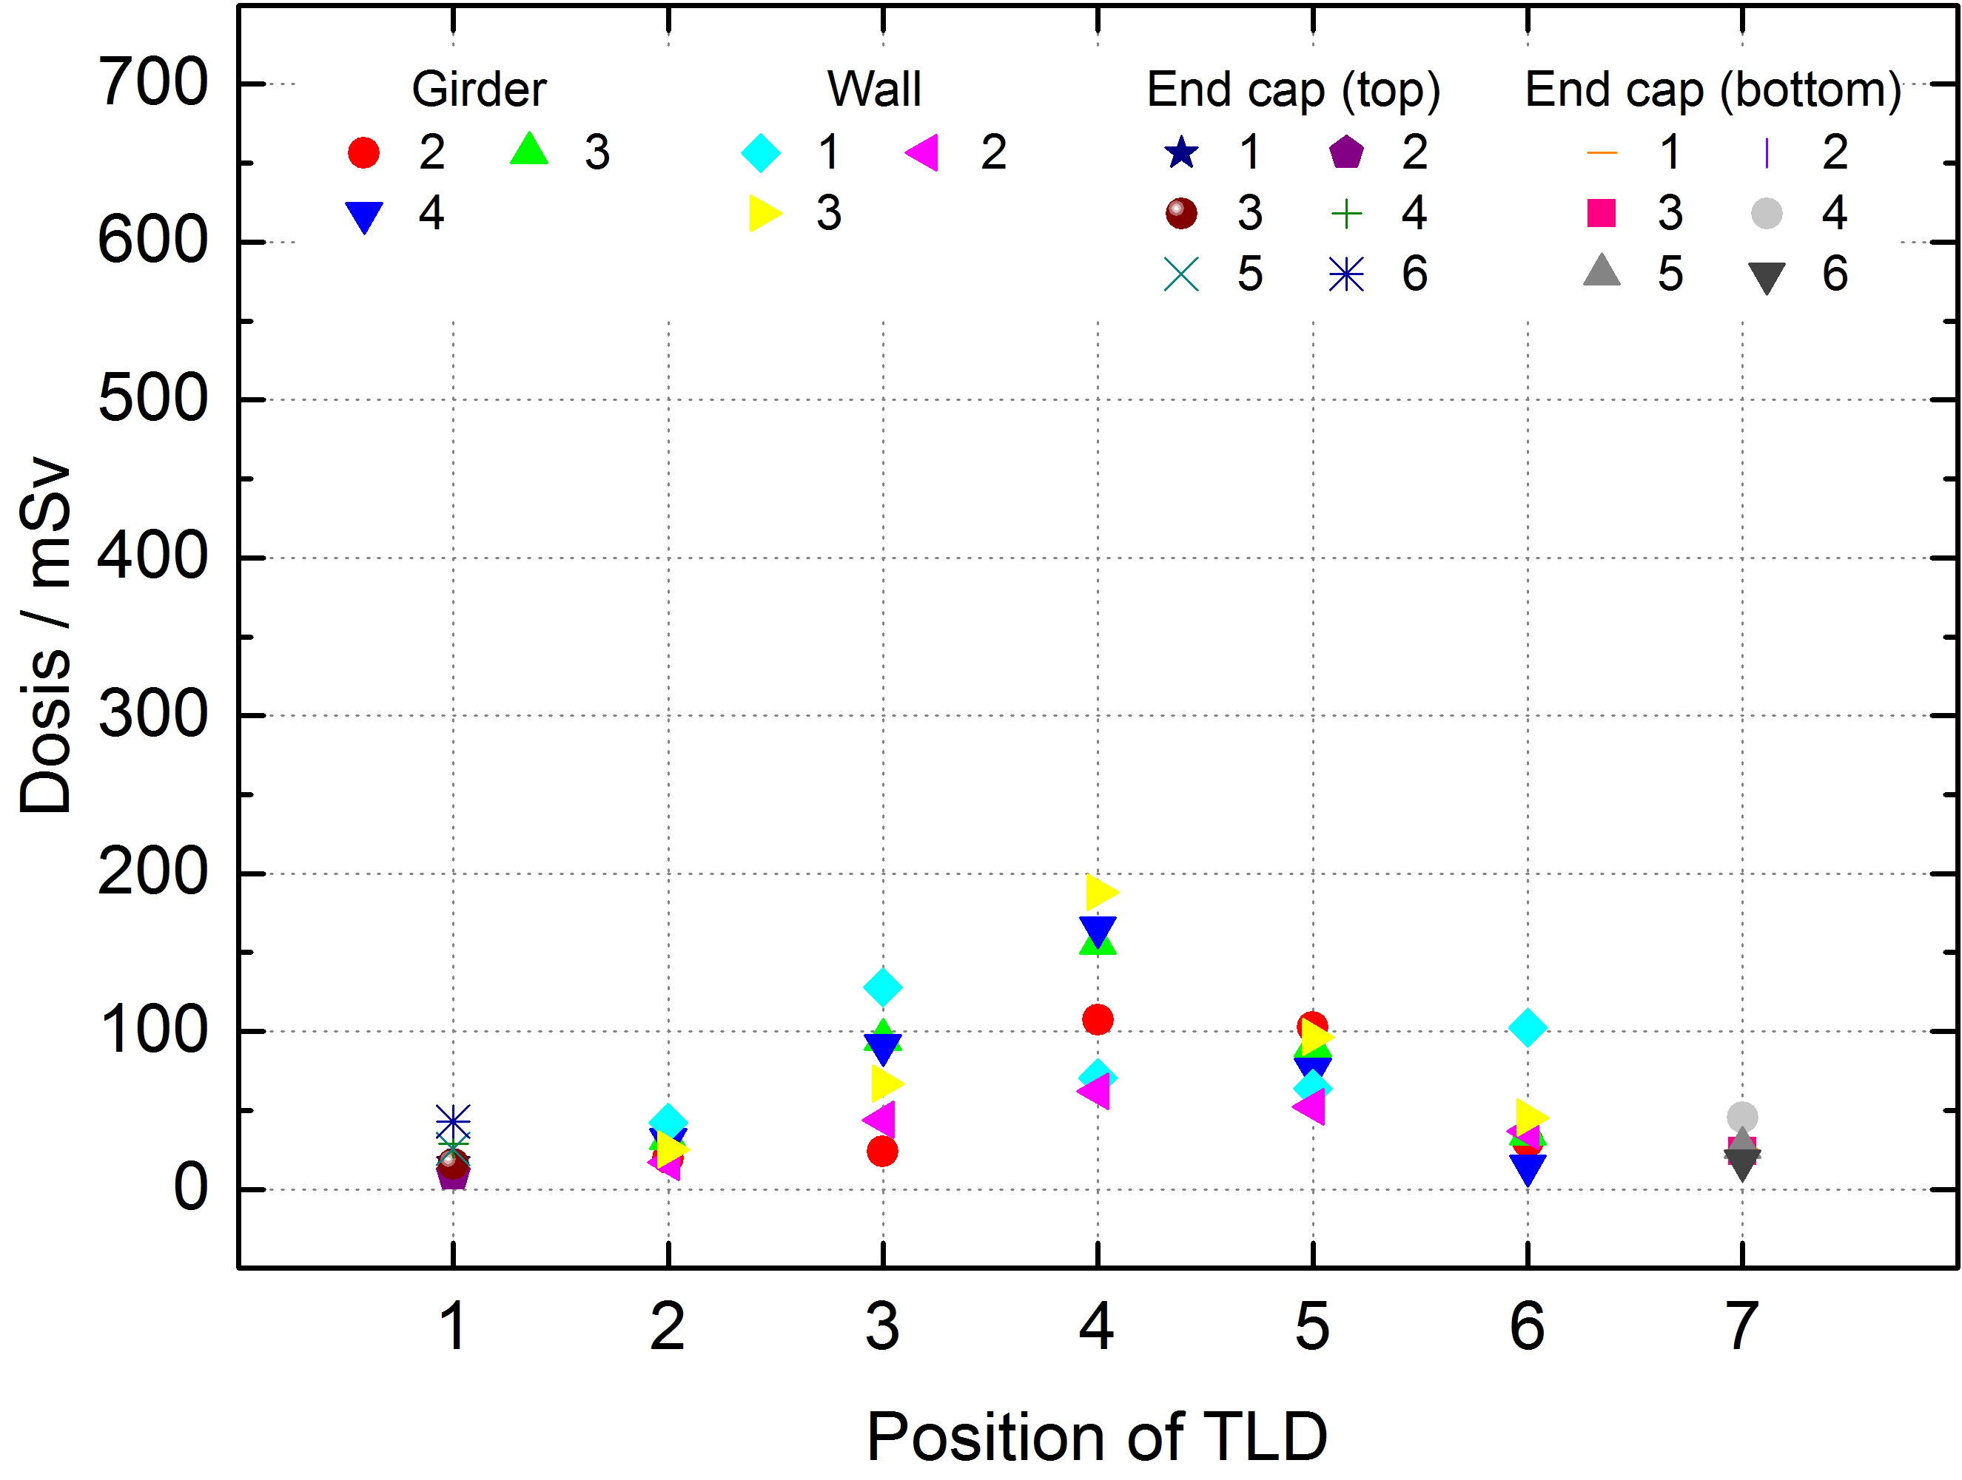
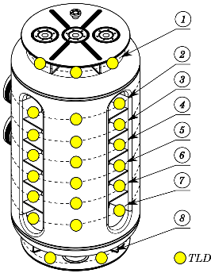
Detection of Field Emitters
1. RF test
(vertical test, without He vessel)
2. RF test
(horizontal test, second HPR, with He vessel)
Dose
Dose
Integrated radiation dose after 9 h of operation at high field levels
measured with thermoluminescent detectors (TLD)

Slide 17
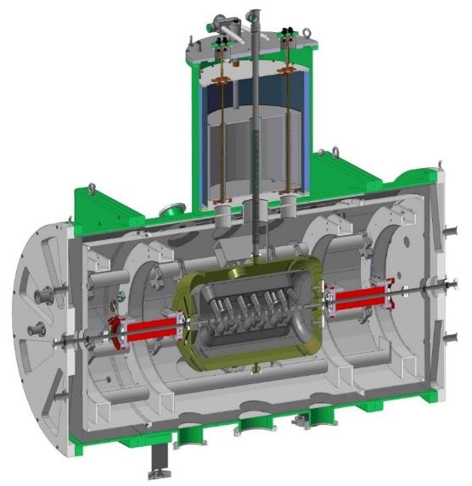
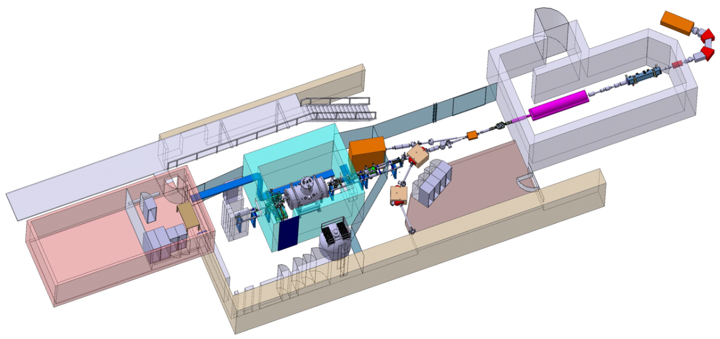
Demonstrator Beam Commissioning Environment
The High Charge State Injector (HLI) at GSI served as an injector for the demonstrator
Superconducting
9.3 T solenoids
Superconducting
217 MHz CH cavity
ECR
HLI-IH
Demonstrator
Support frame
Control room
HLI-RFQ
UNILAC
15 m
LHe reservoir (3000 l)
2.2 m
Layout of the horizontal cryo module
Experimental setup of the demonstrator at GSI

Slide 18
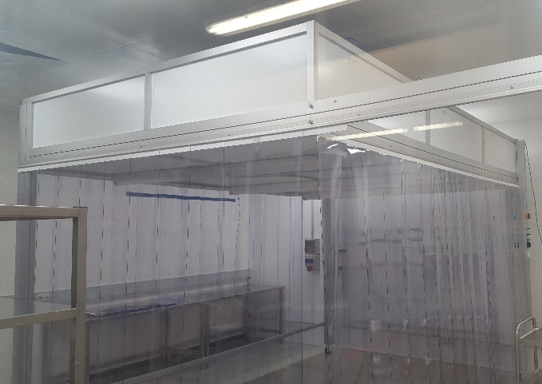
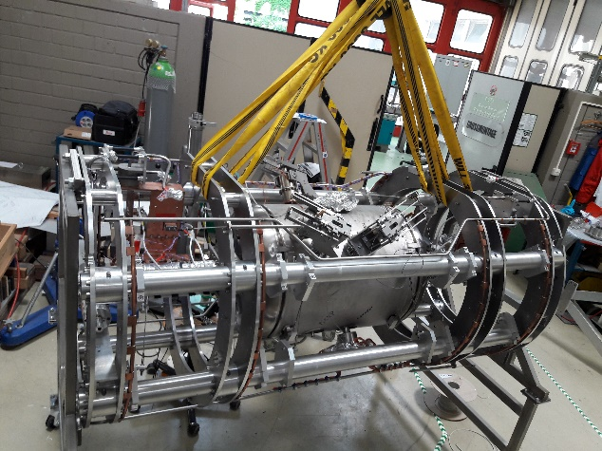
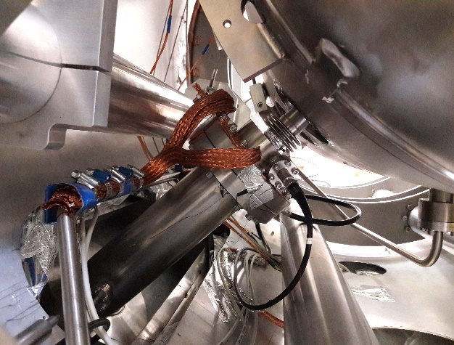
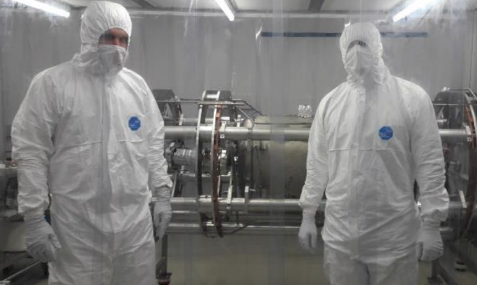
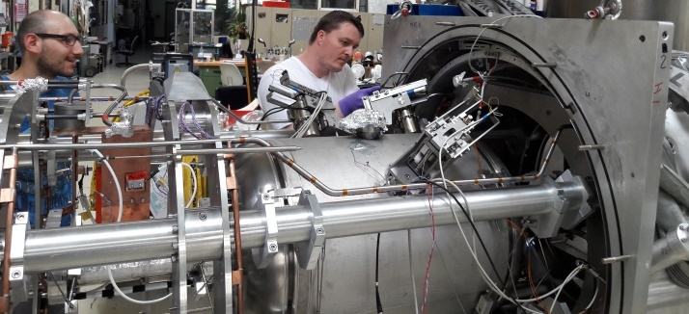
Assembly of Acceleration String at GSI
Upgrade of clean room
Outer part: ISO8 → ISO6
Inner part: ISO4
Integration into Cryostat

Slide 19
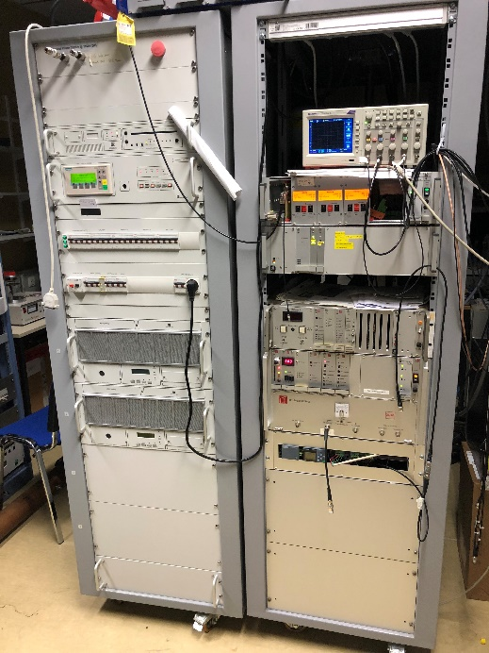
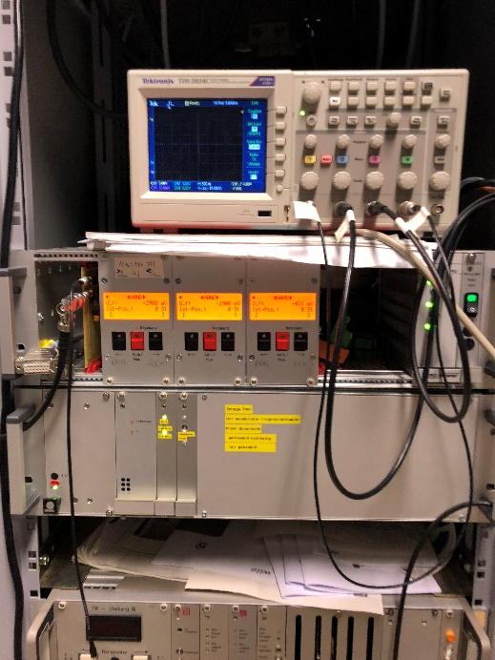
Test of Tuning System during Beam Commissioning
Problems measuring Q₀:
No calibration of He gas flow meter
to measure cryogenic losses
Determining Q₀ not possible
Input coupling:
Strongly over coupled to increase bandwidth
Q_{L} = 7.1 ∙ 10⁵, ∆f = 300 Hz
1.5 kW CW max. forward power
Max. E_{a} = 6.4 MV/m at 1.5 kW forward power
Tuning system
CW amplifier, 217 MHz, 5 kW
RF control system:
Amplitude, phase and frequency control
Operation of one slow tuner (tuner 2 & 3 standby, piezos not used)
Max. displacement during operation: 500 steps – 25 µm, ∆f = 700 Hz
Stable frequency operation: 1 step/min due to change of He level

Slide 20
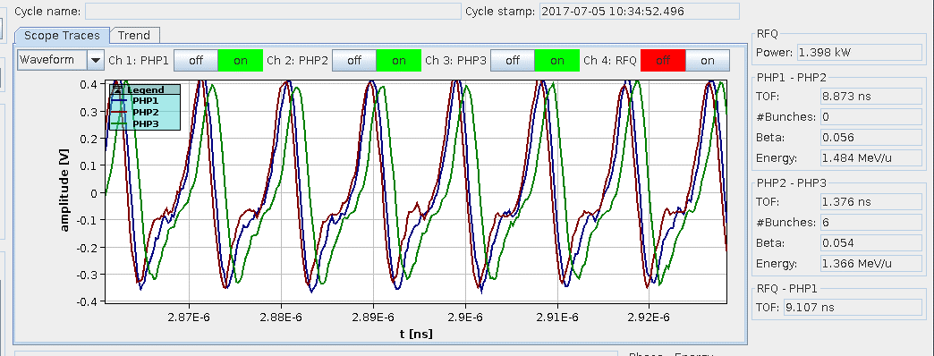
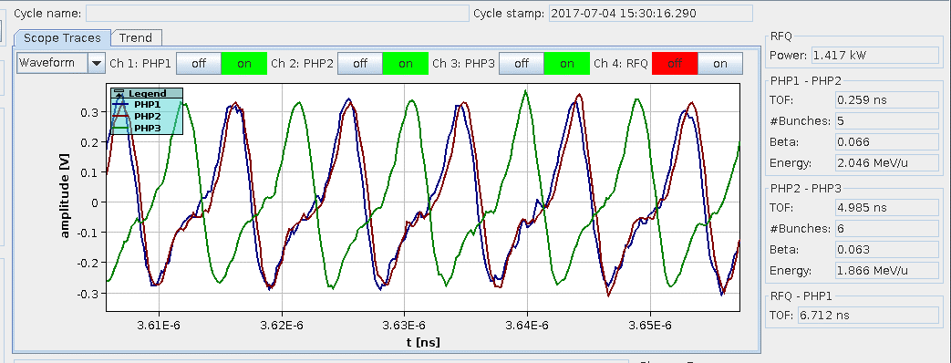
Time of Flight Measurements Ar⁹⁺
Beam input parameters:
50 Hz, 5 ms (25% beam duty)
1.36 MeV/u input energy
1.5 pµA (particle current)
Measurement of transient signal induced by traveling bunch
Acceleration! Energy gain of 0.5 MeV/u
Beam output parameters:
Design energy of 1.86 MeV/u
95% of beam transmission
15% of trans. emittance growth
0.25 ns bunch length (∆φ = 20°)
Test is successful!
cavity RF off
cavity RF on (CW), E_{a} = 3.6 MV/m
Systematic scan of RF phase and amplitude

Slide 21
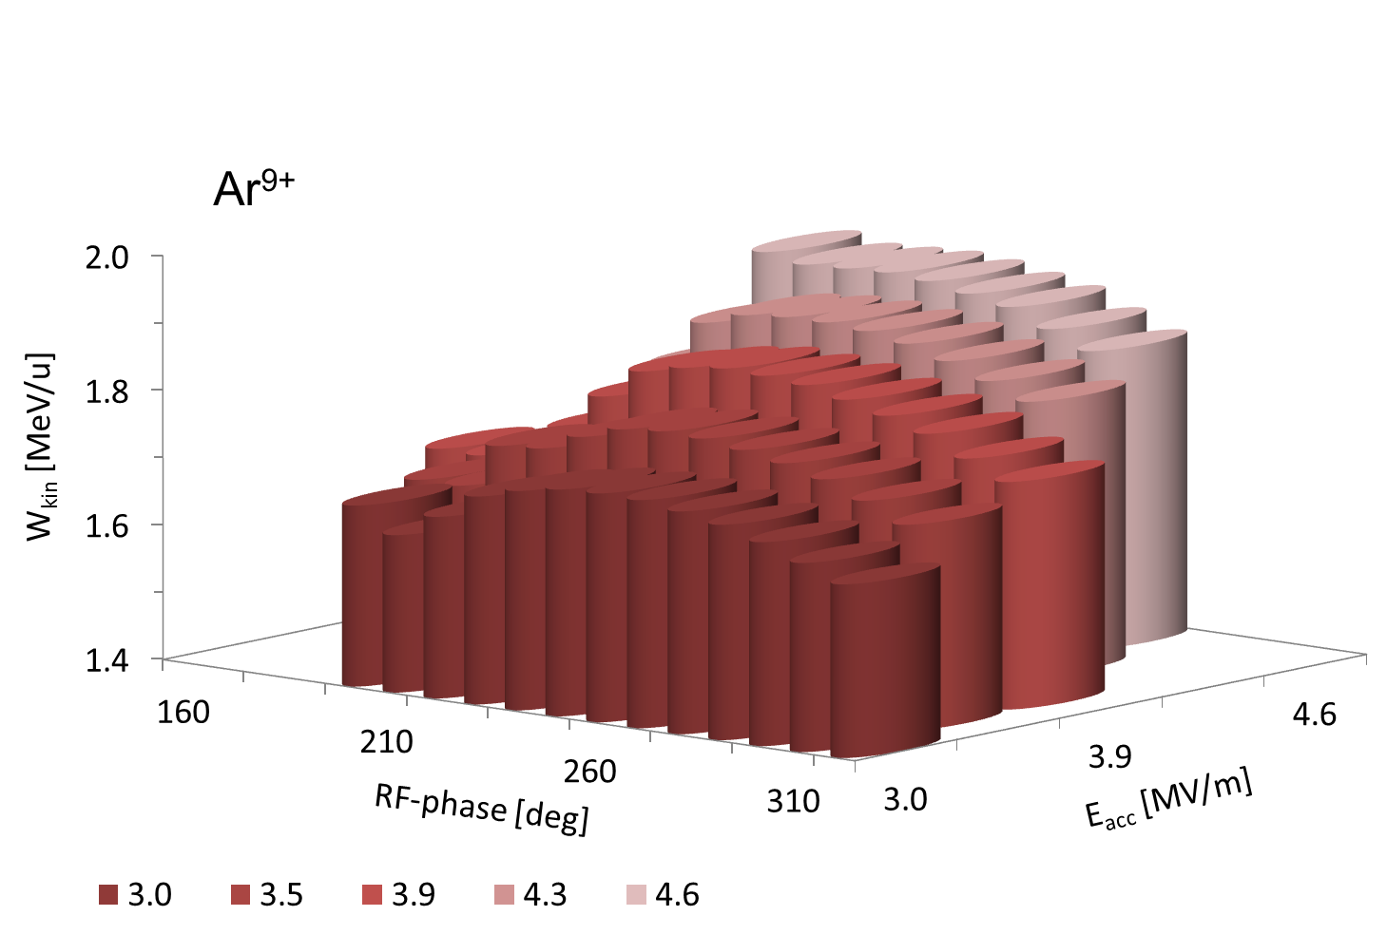
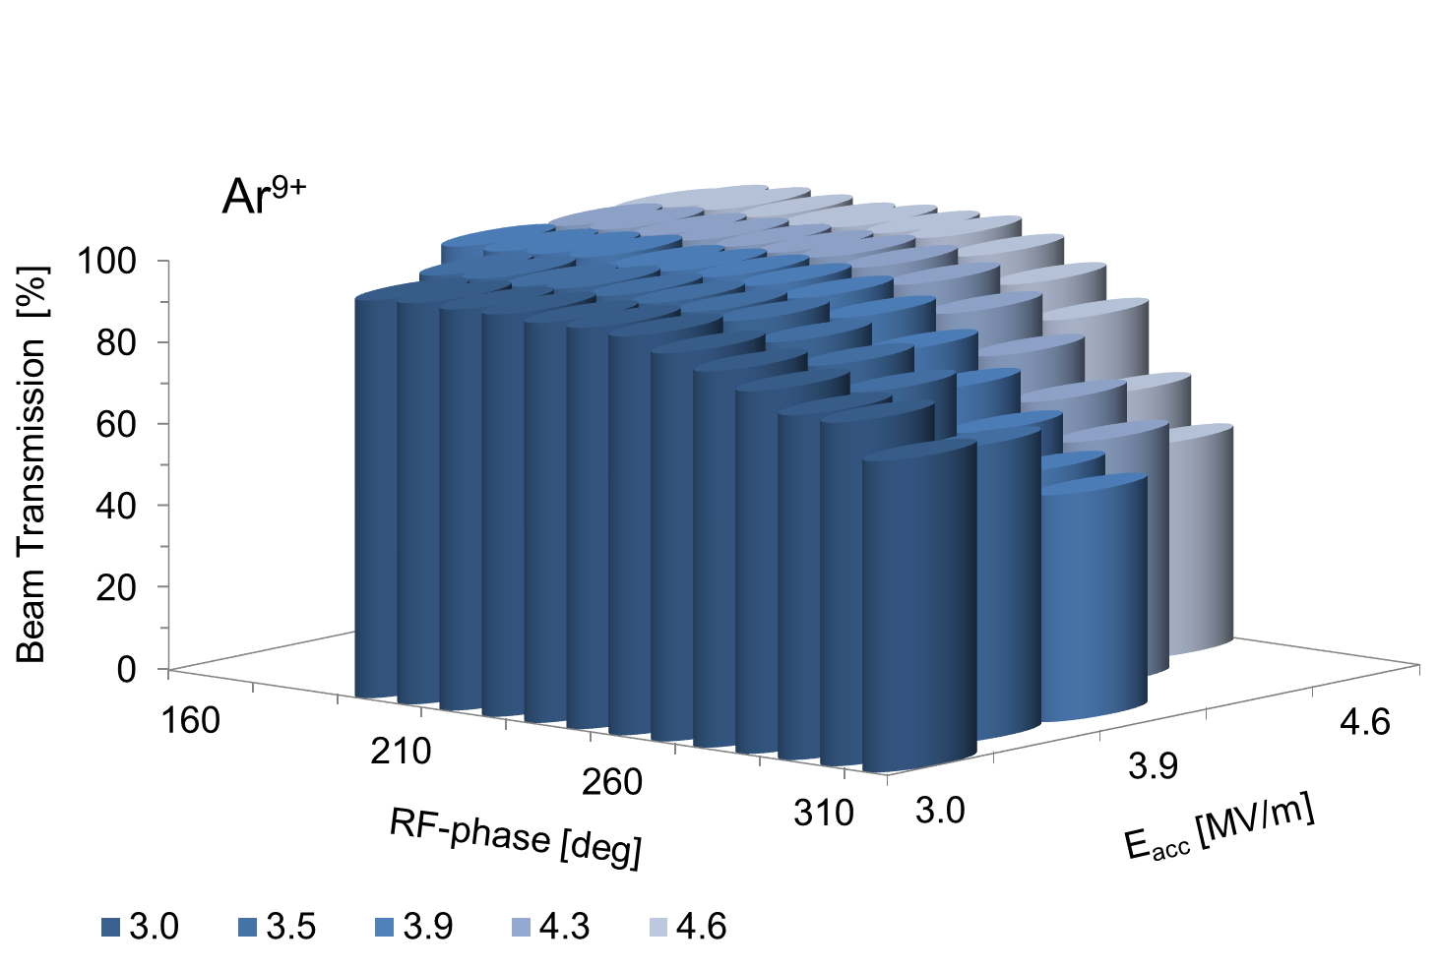
Beam Energy vs. RF Phase and Amplitude Ar⁹⁺
Changing phase and amplitude of RF power enables energy variation
Beam transmission is high for most of RF phases
2.2 MeV/u reached at 830 W forward power
Energy variation 1.4 - 2.2 MeV/u → Feature of EQUUS beam dynamics

Slide 22
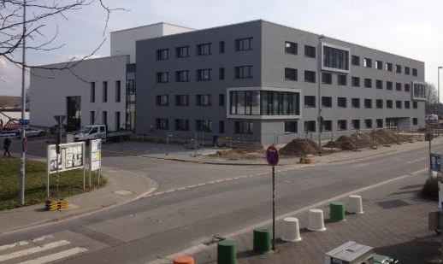
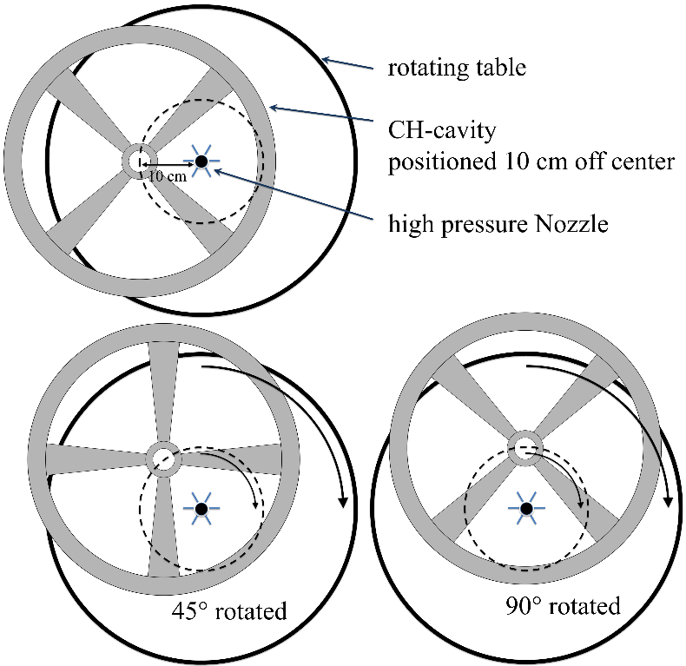
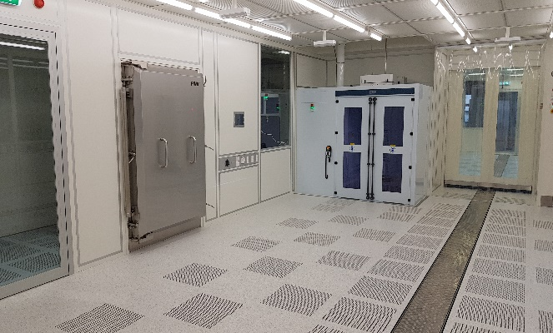
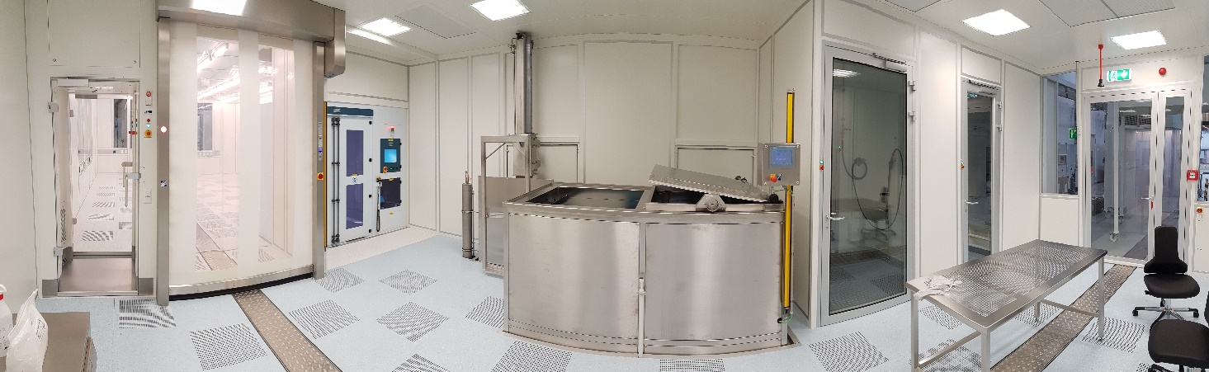

  Cavity Assembly, Preparation and Testing at HIM
    Infrastructure in Mainz:
    Clean room environment
    Cavity bakeout 120°C
    High Pressure Rinsing
    Setup for cavity RF
    testing at 4 K and 2 K
    Further improvement of
    cavity performance
Rinsing off axis
ISO-class 4
ISO-class 6
HPR

Slide 23

Acknowledgements
Thank you very much for your attention!
June 2017:
First beam test
Collaboration partners
GSI / HIM
KPH - Johannes Gutenberg University Mainz
IAP - Goethe University Frankfurt
Work supported by the BMBF, project number 05P15RFBA, MYRTE which is funded by the European Commission under Project-ID 662186 and Helmholtz International Center for FAIR.

Slide 24







GSI and the FAIR Facility
p-LINAC
SIS 100
UNILAC
SIS 18
Production of new atmoic nuclei
100 m
Production of antiprotons
Antiproton ring
Existing facility
Planned facility
Experimental and storage ring
Experiments
Existing GSI facility and future FAIR complex
Notes:
Inbetriebnahme UNILAC 1975

Slide 25
Requirements for FAIR and the SHE-Program
FAIR requirements:
high beam currents
low repetition rate (max. 3 Hz)
low duty factor (0.1 %, pulse length for SIS18 only 100 µs)
“Super Heavy Element” requirements:
relatively low beam currents
high repetition rate (50 Hz)
high duty factor (100 %, pulse length up to 20 ms)

Slide 26



What is the advantage of a sc CH Cavity?

Slide 27

What is the advantage of a sc CH Cavity?

Slide 28


Commissioning of Cryomodule and Solenoids
Superconducting solenoids were ramped at 9.3 T (0.2 A/s)
Standby losses of cryostat 3 W
Transversal drift of components during cooldown ±0.15 mm (tolerance: ±0.2 mm)

Slide 29

Fowler-Nordheim Plot
Fowler-Nordheim plot
for 2 different surface qualities

Slide 30




RF Conditioning and Testing of Power Couplers at Room Temperature
Results of Coupler #2:
5 kW reached with 5 Hz, 15 ms RF pulses
Few multipacting events
CW operation limited to 2.5 kW
(T₁ = 81°C, T₂ = 72°C)
Thermal losses at windows:
P₁ = 34 W, P₂ = 32 W
Problems with TiN coating, too thick?
Improved power coupler in production
I₂
T₂
I₁
T₁
Coupler #2
Coupler #1
Master thesis of J. List, IAP, Frankfurt University

Slide 31


Bandpass of Coupler Setup

Slide 32
Matching Line – Demonstrator
QT
QD
QD
HLI
1,4 MeV/u
cw Demonstrator
BSM
Mob
EMI
R1
x | y
R2
G
T
T
P
P
P
HLI provides Ar¹¹⁺, Ar⁹⁺, Ar⁶⁺, He²⁺ @ 1,4 MeV/u
Steering magnets
Additional Re-Buncher
Quadrupole doublet
Profile Grid
Phase probes for TOF measurement
Beam current transformers for transmission measurement
Bunch shape monitor (Feschenko monitor)
Slit-Grid emittance measurement device
Transversal matching is measured in 2015
6d characterization of the beam
→ Matching in 6d

Slide 33

Emittance Measurements
Ion species: ⁴⁰Ar¹¹⁺, ⁴⁰Ar⁹⁺, ⁴⁰Ar⁶⁺ (A/q=6.7),
50 Hz, 5ms, 25% beam duty, cw (rf duty), 1.5pµA (particle current),
≈95% (beam transmission), 0.460 MeV/u (ΔW), transv. emittance growth ≈12%

Slide 34


Slide 35

Next Phase: Advanced Demonstrator
New cryo module layout: CM1 containing demonstrator CH0 cavity, 2 short CH cavities CH1&2, 1 buncher and 2 solenoids
Simplified cavity design (easier manufacturing & surface processing, cost reduction)
CH1 & CH2 are already in production (delivery at 4th quarter of 2018)
Tendering for cryostat at 3rd quarter of 2018

Slide 36



Short CH Cavity Design
Design parameters of short CH cavities CH1 & CH2
β |  | 0.069
Frequency | MHz | 216.816
Cell number | # | 8
Length (βλ-definition) | mm | 381.6
Cavity diameter (outer) | mm | 400
Cell length | mm | 47.7
Aperture diameter | mm | 30
Dynamic bellow tuner | # | 2
Wall thickness | mm | 3-4
Accelerating gradient df/dp | MV/m Hz/mbar | 5.5 -13
E_{p}/E_{a} |  | 5.2
B_{p}/E_{a} | mT/(MV/m) | <10
G | Ω | 50
R_{a}/Q₀ |  | 1070
PhD thesis of M. Basten, IAP, Frankfurt University
CH1 w/o He vessel is currently being RF tested at 4 K @ IAP

Slide 37
Timeline of Advanced Demonstrator Project
Funding of the Advanced Demonstrator within POF3
Ordering of two short CH cavities
Tendering of cryostat, solenoids, buncher cavity
Delivery of short cavities
Delivery of cryostat, solenoids, buncher cavity
Assembly of cryomodule @ HIM
Beamtest @ GSI
User Operation
02/2015
09/2016
10/2018
11/2018
11/2019
02/2020
10/2020
>12/2020

