Slide 1

Cornell Theory
P. N. Koufalis
Cornell University

Slide 2
Part I: Collective Weak Pinning of Trapped Magnetic Flux
D. Liarte
J. P. Sethna
Part II: Gurevich Theory of AQS & Discussion of QP Overheating
J. T. Maniscalco
T. Arias
N. Sitaraman

Slide 3
Part I: Collective Weak Pinning of Trapped Magnetic Flux
D. Liarte
J. P. Sethna
Part II: Gurevich Theory of AQS & Discussion of QP Overheating
J. T. Maniscalco
T. Arias
N. Sitaraman

Slide 4
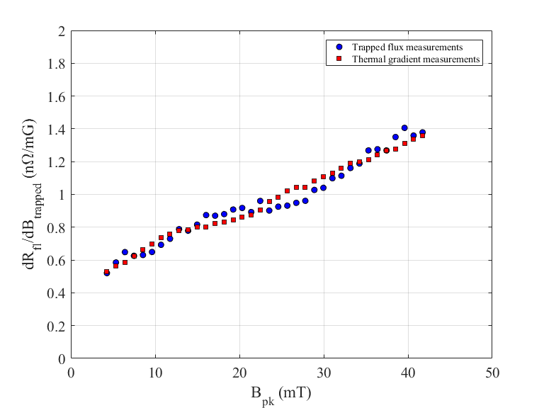
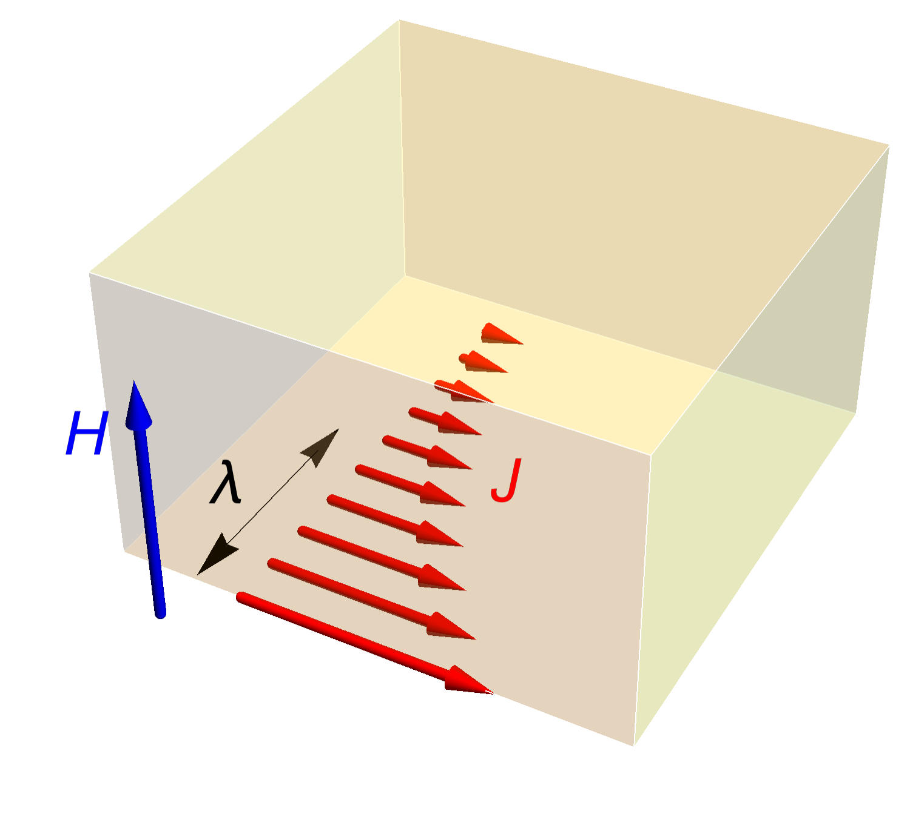


Collective Weak Pinning
Relation between power dissipation in superconductor with surface resistance:
$$P_{c}= \frac{1}{2}R_{S}\oint{{\left|H\right|}^{2}dS} and R_{S}=A\frac{ω^{2}}{T}e^{−Δ(T)/k_{B}T}+R_{i}$$
Here we consider only the component of the residual resistance due to trapped magnetic flux, $R_{fl}$
simple geometry simplifies theoretical analysis
$$\frac{R_{fl}}{B_{trap}}=aB_{rf}$$
depth into superconductor
Previous theories do not account for this linear dependence

Slide 5
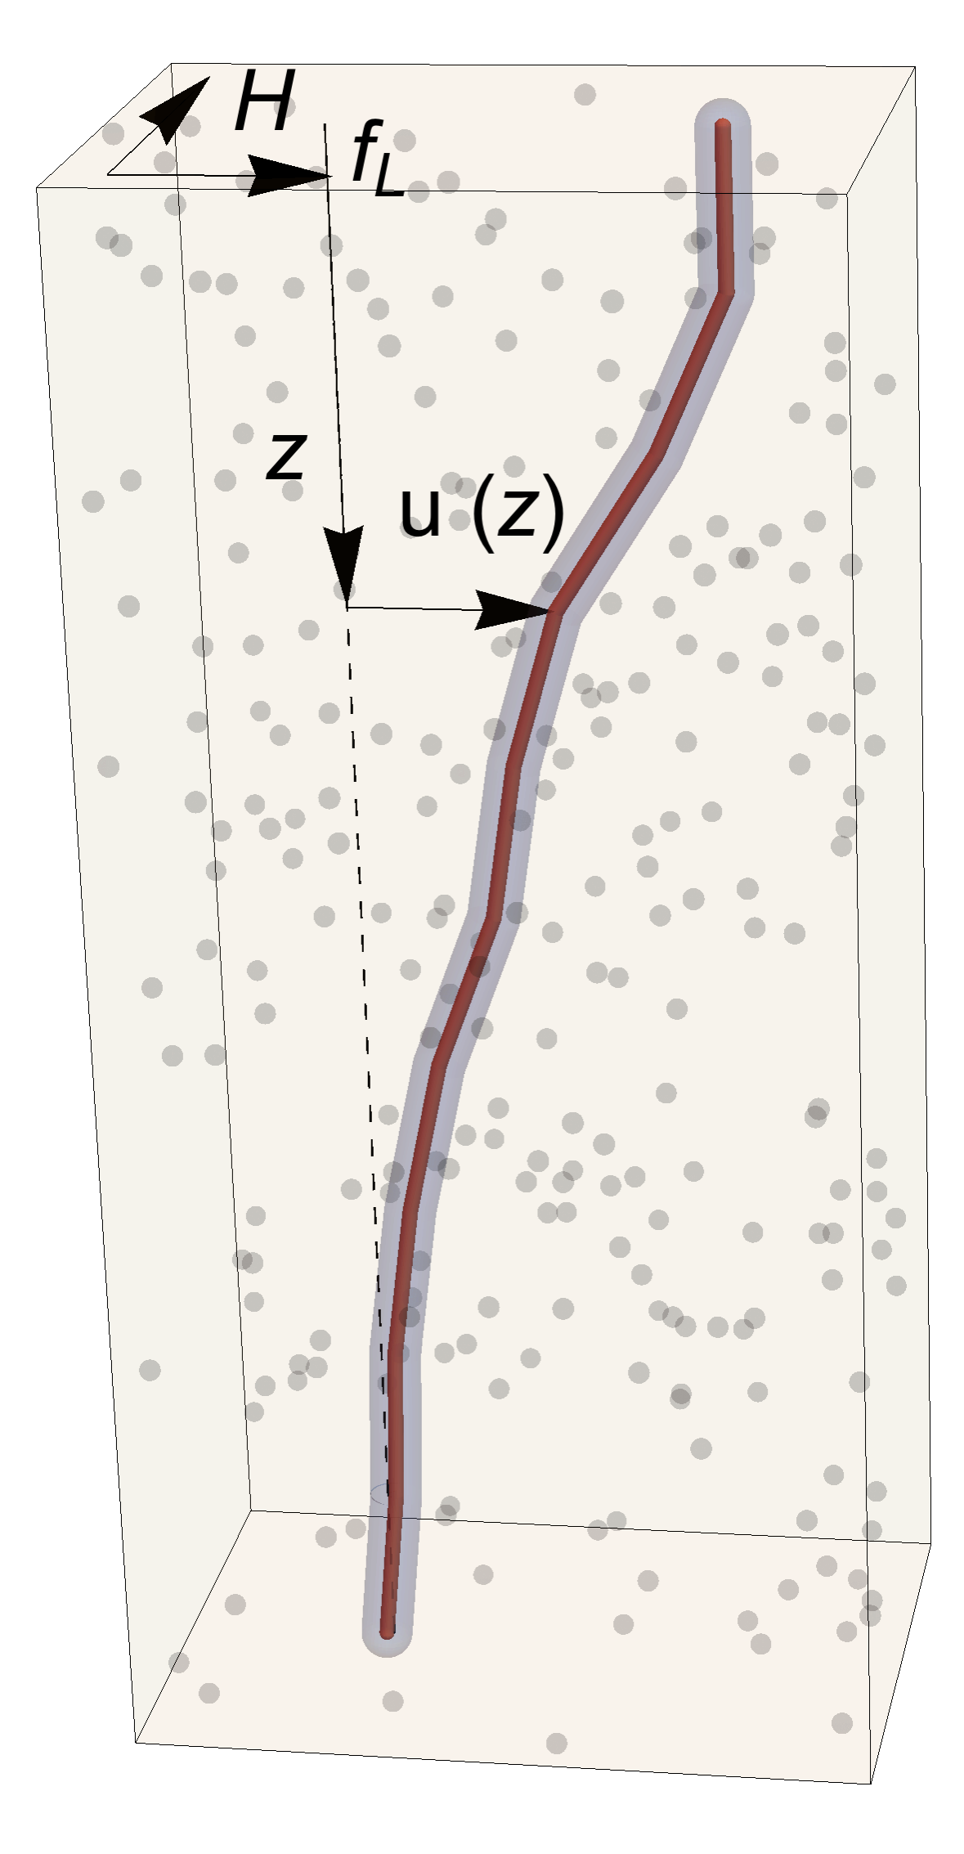
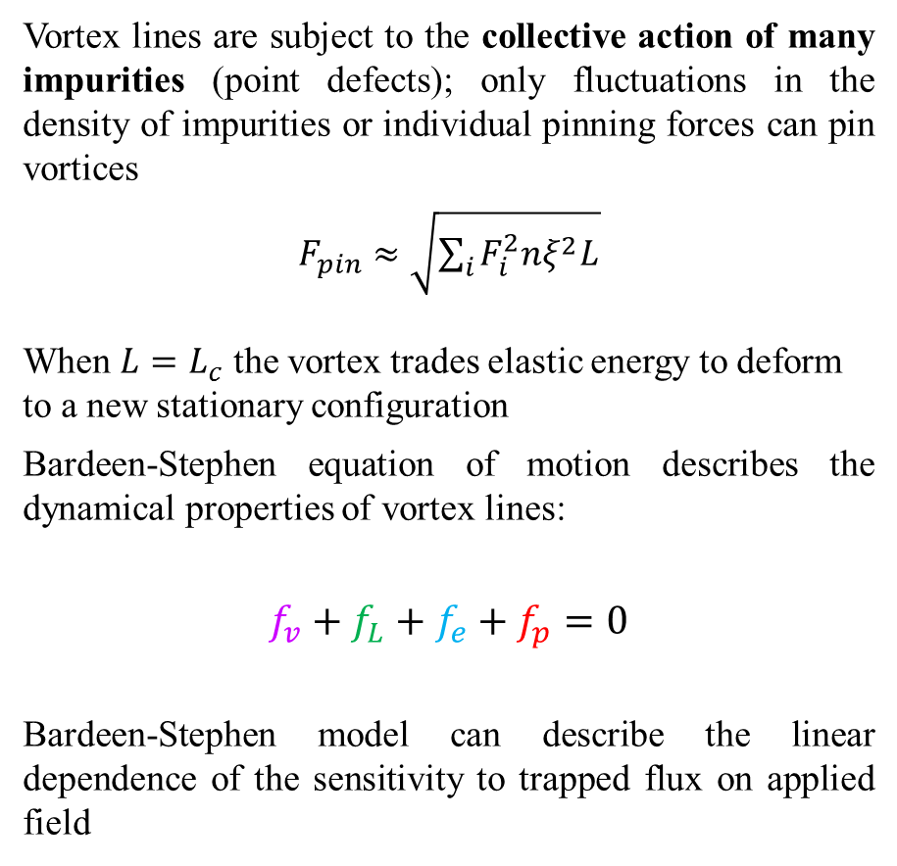
Bardeen-Stephen Model
Vortex lines are subject to the collective action of many impurities (point defects); only fluctuations in the density of impurities or individual pinning forces can pin vortices
$F_{pin}≈\sqrt{\sum_{i}{F_{i}^{2}nξ^{2}L}}$
When $L=L_{c}$ the vortex trades elastic energy to deform to a new stationary configuration
Bardeen-Stephen equation of motion describes the dynamical properties of vortex lines:
$$f_{v}+f_{L}+f_{e}+f_{p}=0$$
Bardeen-Stephen model can describe the linear dependence of the sensitivity to trapped flux on applied field
vortex line
impurities (point defects)
viscous
elastic
Lorentz
pinning
Notes:
At the critical length, the vortex can trade elastic energy to derfom to find a new stationary configuration
Lower case f is force per unit length
F_pin = accumulated pinning force over the depinning length L_c
F_i = individual pinning force

Slide 6
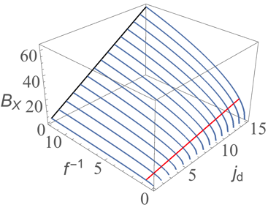




Hysteretic and Viscous Losses
Two regimes of losses exist: hysteretic losses (low $B_{rf}$ fields) and viscous losses (high $B_{rf}$ fields)
Crossover between two regimes occurs at $B_{X}$
We can derive material dependent approximate analytical solutions for $a$ and $B_{X}$.
Hysteretic losses:
$f_{p}$ dominates
Viscous losses:
$f_{v}$ dominates
$$\frac{R_{fl}}{B_{trap}}=aB_{rf}$$
Notes:
Crossover field is a function of depinning current and inverse frequency

Slide 7
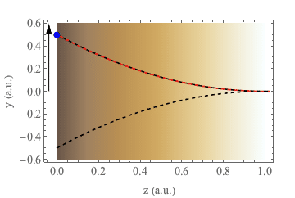
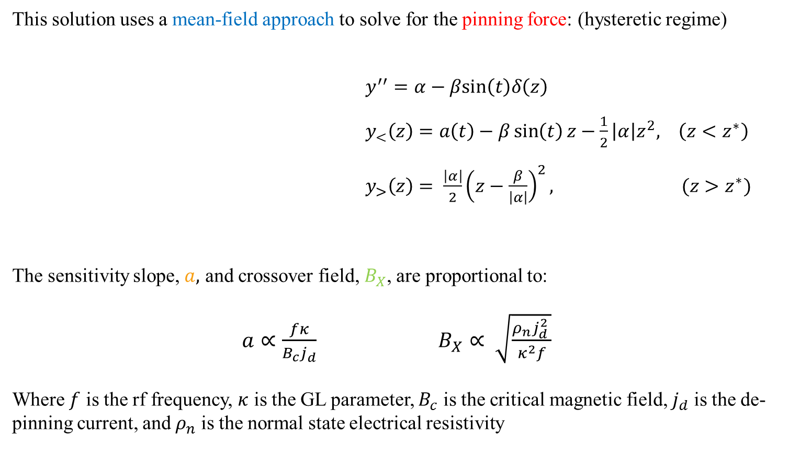
Mean Field Approach
This solution uses a mean-field approach to solve for the pinning force: (hysteretic regime)
$y^{′′}=α−βsin\left(t\right)δ\left(z\right)$
$y_{<}\left(z\right)=a\left(t\right)−β\sin\left(t\right)z−\frac{1}{2}\left|α\right|z^{2}, \left(z<z^{∗}\right)$
$y_{>}\left(z\right)= \frac{\left|α\right|}{2}{\left(z−\frac{β}{\left|α\right|}\right)}^{2}, (z>z^{∗})$
The sensitivity slope, $a,$ and crossover field, $B_{X}$, are proportional to:
$a∝\frac{fκ}{B_{c}j_{d}}$ $B_{X}∝ \sqrt{\frac{ρ_{n}j_{d}^{2} }{κ^{2}f}}$
Where $f$ is the rf frequency, $κ$ is the GL parameter, $B_{c}$ is the critical magnetic field, $j_{d}$ is the de-pinning current, and $ρ_{n}$ is the normal state electrical resistivity
Notes:
y> is the displacement far into the bulk (the stationary portion of the vortex line) and y< is the displacement close to the surface (i.e. the moving portion of the vortex line) and z* is the point at which the vortex line is ‘unzipped’
vortex oscillates slowly so that we can ignore the viscous term
Assumptions: vortex oscillates slowly so that we can ignore the viscous term and point force approximation (replace exponential decay of Lorentz force with delta function); the latter approximation is valid when the vortex oscillates over larger distances than the penetration depth

Slide 8
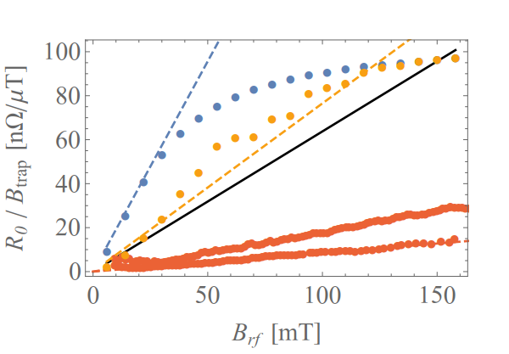
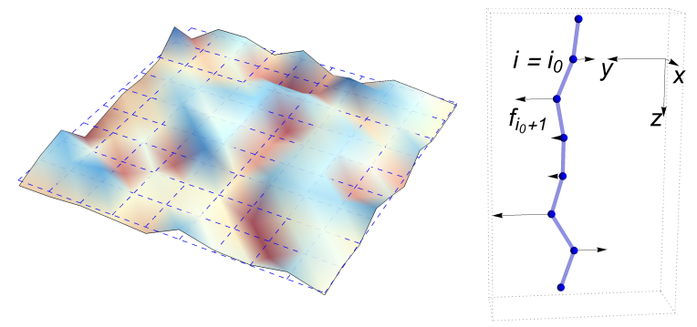
Local Disordered Potential Approach
Numerical simulation that adds the randomness of the impurities back in; used to corroborate the results of the mean field approach
The vortex line is discretized and a random local disordered potential is used to solve the equation of motion
CO-Infusion
(1.3 GHz)
Nb₃Sn (1.3 GHdfdfdfdfd
NbCu (100 MHz)
Mean field approach
Local Disordered Potential
Nb₃Sn (1.3 GHz)
Data
Notes:
Discrepancy can be due to vortex misalignment near the equator.

Slide 9
Part I: Collective Weak Pinning of Trapped Magnetic Flux
D. Liarte
J. P. Sethna
Part II: Gurevich Theory of AQS & Discussion of QP Overheating
J. T. Maniscalco
T. Arias
N. Sitaraman

Slide 10
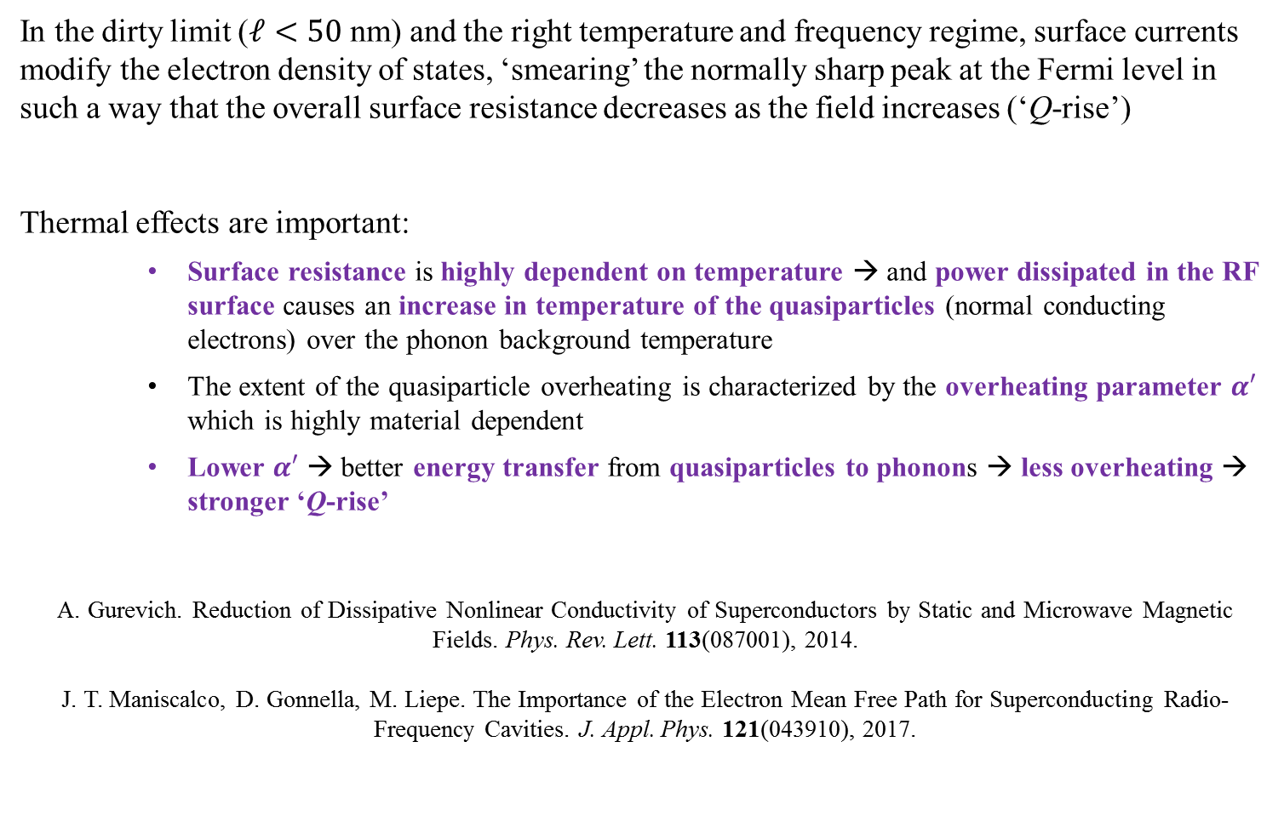
Gurevich Theory: Overview
In the dirty limit ($ℓ<50$ nm) and the right temperature and frequency regime, surface currents modify the electron density of states, ‘smearing’ the normally sharp peak at the Fermi level in such a way that the overall surface resistance decreases as the field increases (‘Q-rise’)
Thermal effects are important:
    Surface resistance is highly dependent on temperature → and power dissipated in the RF surface causes an increase in temperature of the quasiparticles (normal conducting electrons) over the phonon background temperature
    The extent of the quasiparticle overheating is characterized by the overheating parameter $α′$ which is highly material dependent
    Lower $α′$ → better energy transfer from quasiparticles to phonons → less overheating → stronger ‘Q-rise’
A. Gurevich. Reduction of Dissipative Nonlinear Conductivity of Superconductors by Static and Microwave Magnetic Fields. Phys. Rev. Lett. 113(087001), 2014.
J. T. Maniscalco, D. Gonnella, M. Liepe. The Importance of the Electron Mean Free Path for Superconducting Radio-Frequency Cavities. J. Appl. Phys. 121(043910), 2017.

Slide 11
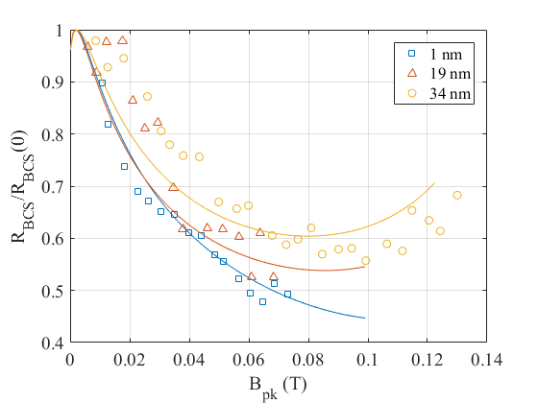

Mean Free Path Dependence
Experimentally, it is observed that a shorter mean free path → stronger ‘Q-rise’
High-temperature nitrogen-doped cavity data at $T=2.0 K$ with different mean free path values; theory works agrees with data better when $ℓ$ is small
Conclusion: impurities reduce mean free path and transfer energy from electrons to phonons
Example of Experimental Data with Theoretical Fit

Slide 12
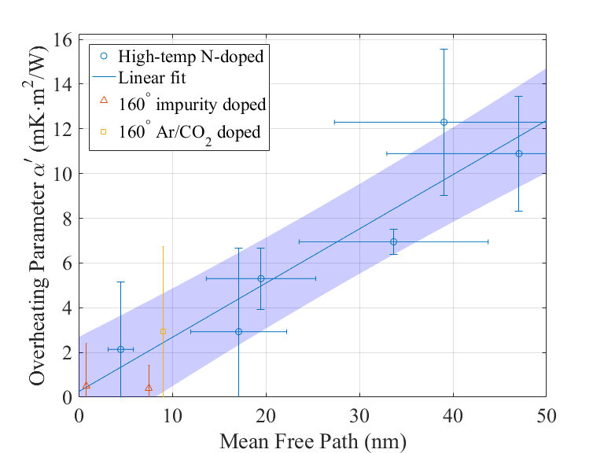

Theory vs. Experiment
Overheating parameter $α′$ was fit for many high-temperature nitrogen-doped cavities:
Linear correlations between $α′$ and $ℓ$; low temperature infusion results are consistent with the linear behavior found in high temperature nitrogen doped cavity data
Stronger Q-rise
less overheating
J. T. Maniscalco, D. Gonnella, M. Liepe. J. Appl. Phys. 121(043910), 2017.
stronger doping

Slide 13
DFT Calculations
DFT calculations by T. Arias and N. Sitaraman show that 2 at. % of C present in Nb, increases the electron-phonon coupling by a factor of 4; N and O increase the coupling even more
Impurities increase e-ph coupling → increases energy transfer → reduces overheating → stronger ‘Q-rise’
The strength of the electron-phonon coupling varies with species:
O
2 at. %
N
C
Nb

Slide 14
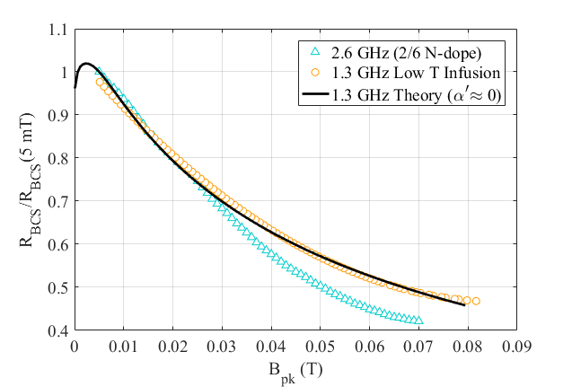
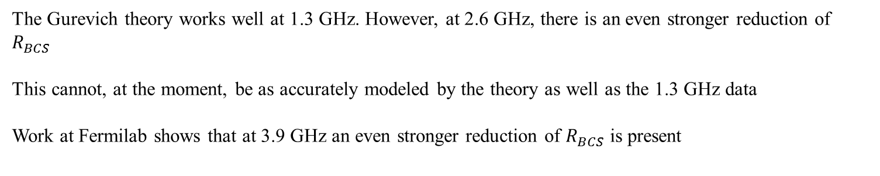
Frequency Dependence
See also: M. Martinello et al, “Advancement in the understanding of the field and frequency dependent microwave surface resistance of niobium,” in Proceedings of SRF2017, Lanzhou, China, 2017.
The Gurevich theory works well at 1.3 GHz. However, at 2.6 GHz, there is an even stronger reduction of $R_{BCS}$
This cannot, at the moment, be as accurately modeled by the theory as well as the 1.3 GHz data
Work at Fermilab shows that at 3.9 GHz an even stronger reduction of $R_{BCS}$ is present

Slide 15
THANK YOU FOR LISTENING
Please refer all questions to the appropriate people

