Slide 1




Insights from muSR
Bob Laxdal, TRIUMF
Tobi Junginger, Lancaster
TTC June 2018, RIKEN

Slide 2
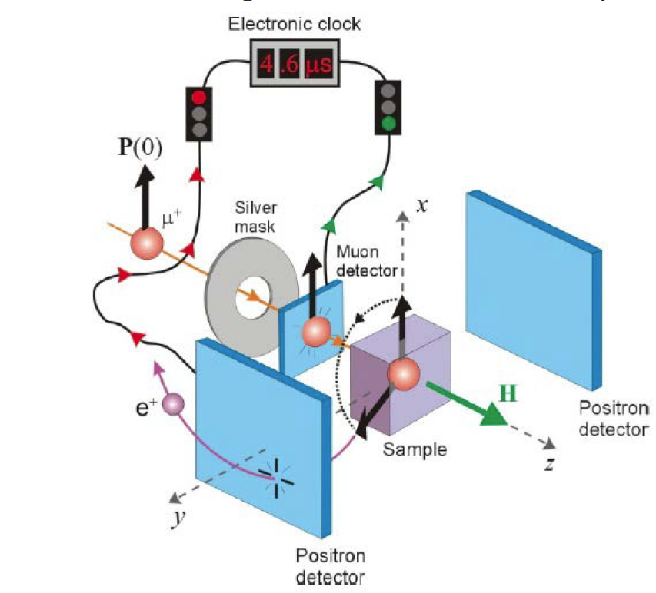
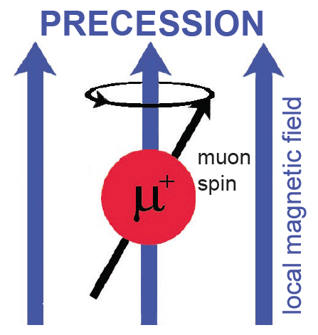

Material Science Probes at TRIUMF – muSR and β-NMR
TRIUMF has two world class material science probes in muSR and betaNMR – utilize the beta decay of a beam of polarized muons or 8Li ions respectively as probes of local magnetism
TRIUMF SRF group has been characterizing materials with muSR since 2013 (betaNMR studies coming soon)
A. Grassellino, C. Beard, P. Kolb, R. Laxdal, N. S. Lockyer, D. Longuevergne, and J. E. Sonier. Muon spin rotation studies of niobium for superconducting rf applications. Phys. Rev. ST Accel. Beams, 16:062002, 2013.
Method
Imbedded probes decay with emitted positrons or electrons correlated with direction of spin. Spin precession dependent on the magnetic field of the imbedded probe
µ⁺, ⁸Li
Atomic lighthouse

Slide 3
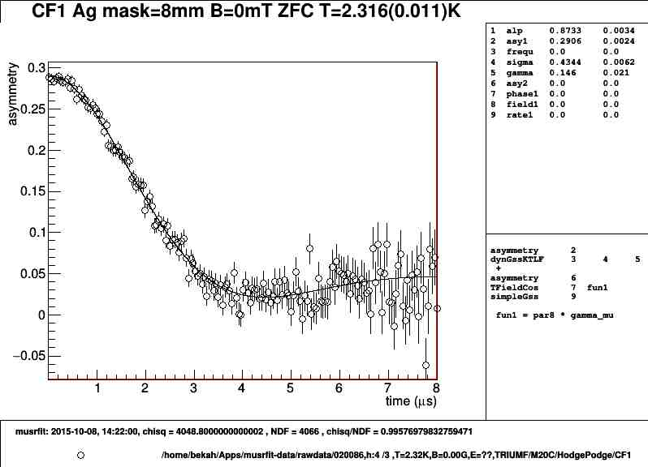
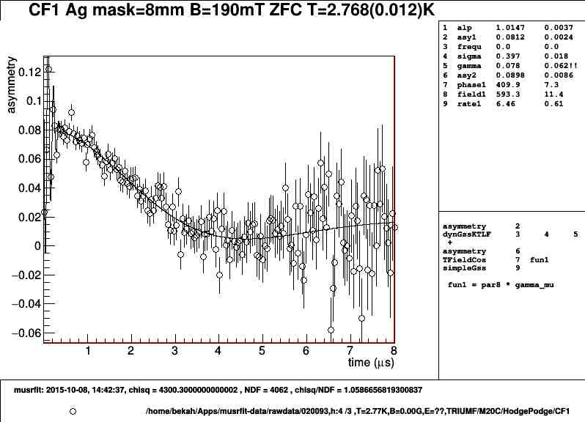
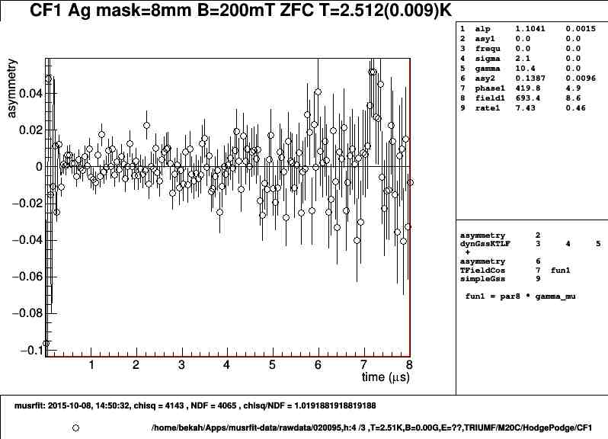
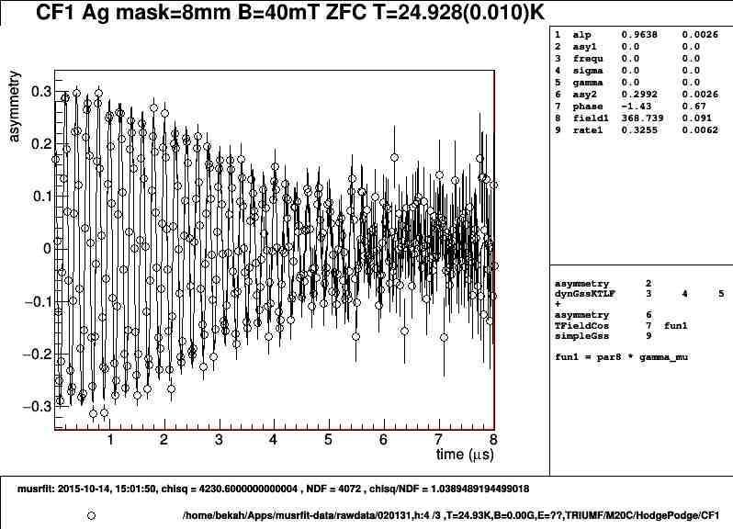
Using muSR as a local magnetometer
Meissner
Intermediate
Asy (0) from random fields
Vortex
Applied Magnetic Field [mT]
Normal
Asy (o) represents the fraction of the sampled volume that does not contain field

Slide 4
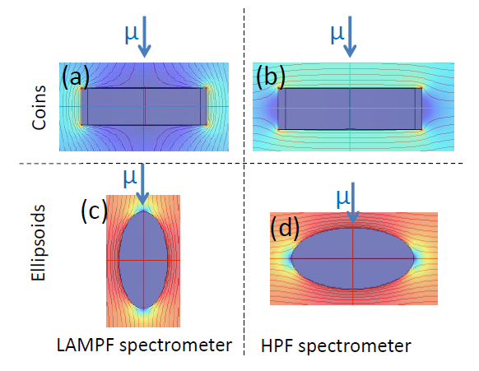
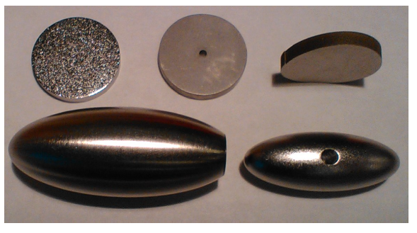
Samples and Geometry
Results are strongly geometry dependent
We can use sample shape and geometry to focus on pinning strength or field of first flux entry
Both are of interest to SRF

Slide 5
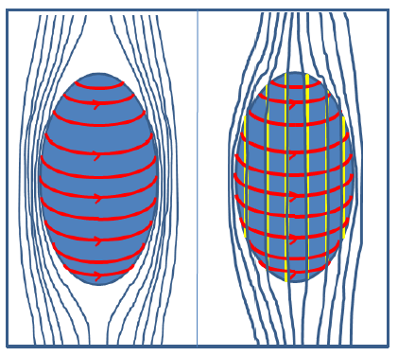
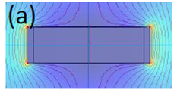
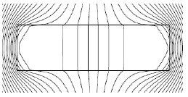
Flux entry and geometry
Meissner state
  Surface currents are set up to expel flux in the bulk
  Applied field is distorted by the object with increased flux at the edges (equator)
When the local flux exceeds H_{entry} flux breaks in at the edges
For pin free Type-II sample the fluxoids will redistribute for lowest energy
Pinning will resist flux redistribution

Slide 6


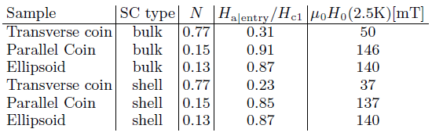
Normalizing break in field based on geometry and temperature
Assume first that flux breaks in at H_{edge}=H_{c1}=174mT (0K)
Expected applied field for flux entry at 2.5K assuming H_{c1}|_{0K}=174mT

Slide 7
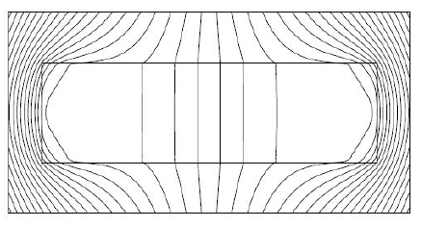
Field perpendicular to sample
the field is applied along the muon path and perpendicular to the sample surface
Field breaks in initially at the edges and redistributes to the center – pinning will delay redistribution
Useful for pinning characterization
pinning
Lampf Spectrometer

Slide 8
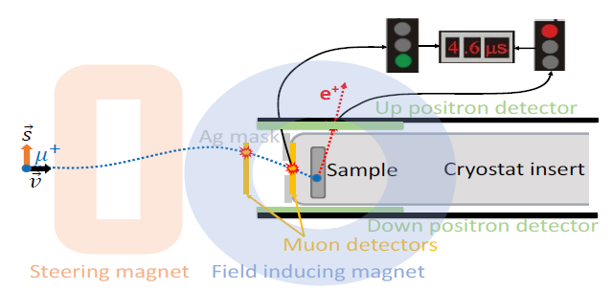
Field parallel to sample
The field is applied perpendicular to the muo path and parallel to the material surface
In this case the muon impinges in the region where field is expected to break in so is relatively free from pinning
Useful for field of first entry studies

Slide 9
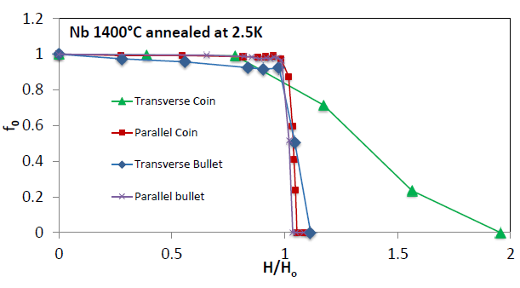
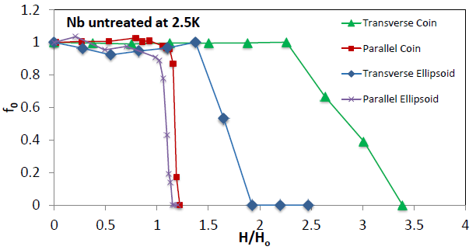
Pinning study
Comparing muSR results in different geometries can highlight pinning strength
We expect flux to break in at the normalized entry field H₀
Pinning is strong if transverse geometry is significantly different than parallel geometry
No pinning
Strong pinning
Field of first magnetic flux entry and pinning strength of superconductors for rf application measured with muon spin rotation
T. Junginger, S. H. Abidi, R. D. Maffett, T. Buck, M. H. Dehn, S. Gheidi, R. Kiefl, P. Kolb, D. Storey, E. Thoeng, W. Wasserman, and R. E. Laxdal
Phys. Rev. Accel. Beams 21, 032002 (2018) – Published 16 March 2018

Slide 10
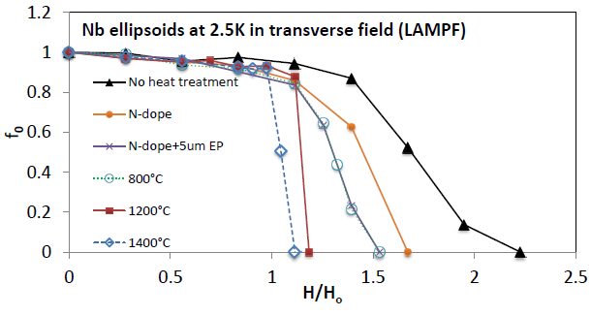
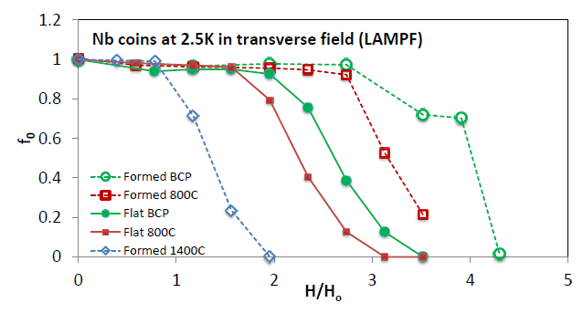
Pinning Data from Transverse Geometries
Figure 1:
Strong pinning in untreated sample
Doping (800C) reduces pinning – EP removes surface pinning
Higher temperatures 1200 and 1400 are effective at eliminating pinning
Figure 2:
Forming significantly enhnaces pinning
800C heat treatment reduces but does not eliminate pinning from forming
1400C eliminates pinning from forming dislocations

Slide 11
Pinning and processing temperature

Slide 12
Data from Parallel Geometries
Both coin and ellipsoid samples were used in parallel geometry to characterize the field of first penetration.
Samples include RRR Nb with various treatments (120C, 800C, doping [FNAL]) and also measured higher Tc coatings (MgB2 and Nb3Sn) [Temple, Cornell] on RRR Nb

Slide 13
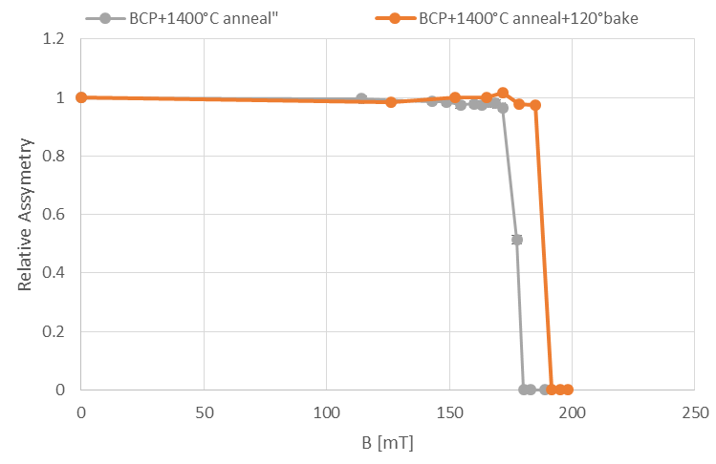
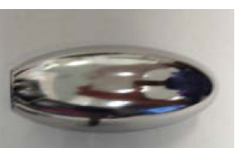
Field of first flux entry – 120C Bake
Findings: Baking at 120C in vacuum can enhance the field of first flux entry
Bake at 120C moved field of first flux entry in annealed sample from 174mT to 188mT
consistent with `dirty layer’ hypothesis
µ
Bulk Nb
B

Slide 14
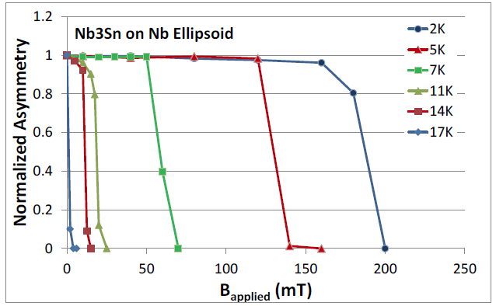
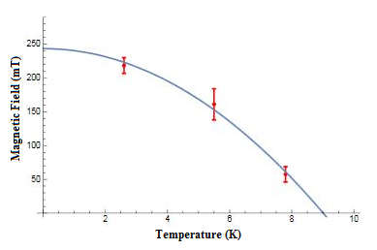
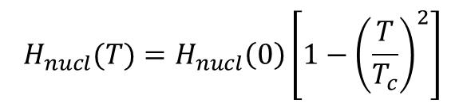
Nb3Sn coating in parallel geometry
Nb samples coated with 2μm Nb3Sn (Cornell)
Measurements in parallel geometry characterize coated Nb below 9.2K and characterize Nb3Sn above 9.2K
$$H_{nucl}(T)=H_{nucl}\left(0\right)\left[1−{\left(\frac{T}{T_{c}}\right)}^{2}\right]$$
H_{nucl}(0)=37.1 mT
T_{c}=17.3 K
H_{nucl}(0)=243+/-9 mT
T_{c}=9.01+/-0.08 K
µ
Coating
Bulk Nb
B

Slide 15
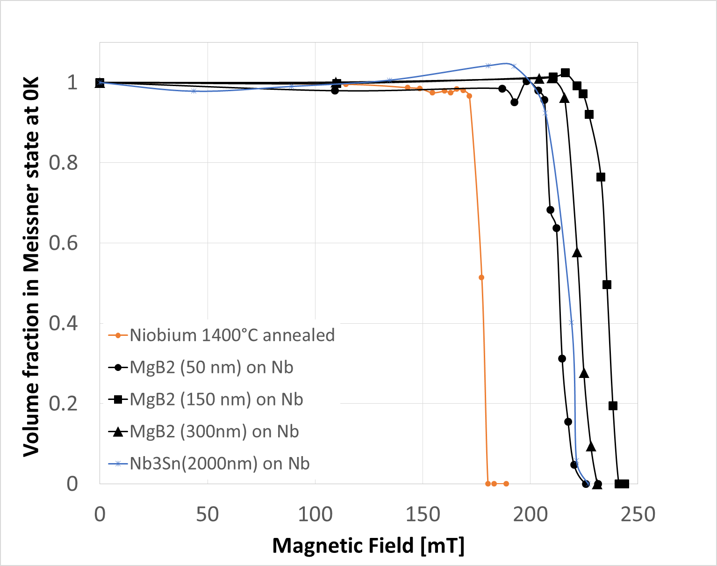
Field of first flux entry on coated samples
Recently MgB₂ and Nb₃Sn on niobium samples of different thickness have been tested.
Findings: A layer of a higher T_{c} material on niobium can enhance the field of first entry by about 40% from a field consistent with H_{c1} to a field consistent with H_{sh}.
This enhancement does not depend on material or thickness suggesting that superheating is indeed induced in niobium by the overlayer
Theoretical B_{c1}
Theoretical B_{sh}
Superheating in coated niobium, T Junginger, W Wasserman and R E Laxdal, Superconductor Science and Technology, Volume 30, Number 12, Published 7 November 2017

Slide 16
Summary
Summary
muSR is an useful tool to characterize bulk pinning strength in material
A dirty layer can enhance the field of first flux entry
A layer of higher T_{c} material on niobium can push the field of first flux entry from a field consistent with H_{c1} to a field consistent with H_{sh}

Slide 17
Acknowledgements
Thanks to TRIUMF SRF group and TRIUMF CMMS group for support.
Thanks to our collaborators for providing samples
FNAL – Anna Grassellino, Martina Martinello, Sam Posen
Cornell – Daniel Hall, Mathias Liepe
Temple – Teng Tan
JLab – Anne-Marie Valente

Slide 19
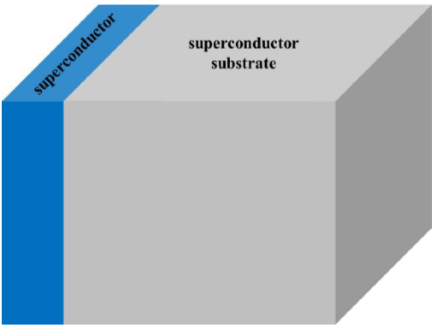
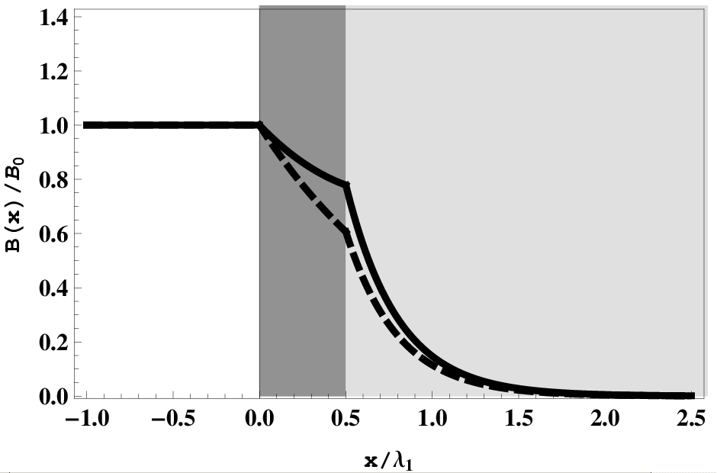
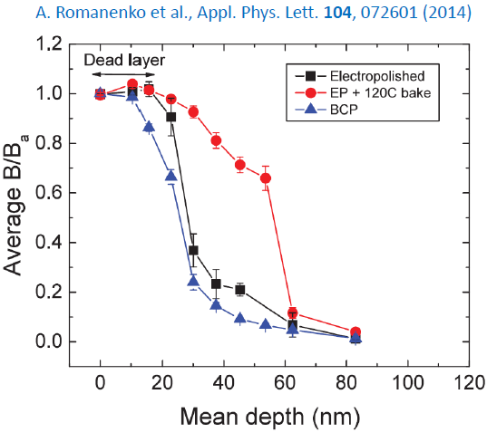
Fundamental studies – details of surface layer with beta-NMR
Beta-NMR is a unique facility to characterize magnetic properties of materials at surfaces and film interfaces
Perfect for SRF characterization of doping and new materials since it can `soft land’ the 8Li probe to allow sampling the local magnetic field of the superconductor through the London layer and at interfaces
Will be a unique facility in the world for diagnosing new treatments (doping), new materials (Nb3Sn) and new structures (SIS layers)
B
8Li range
From Kubo LCSW16
LE-muSR at PSI limited to low field
New beta-NMR line will allow surface studies up to 200mT
25mT

Slide 20
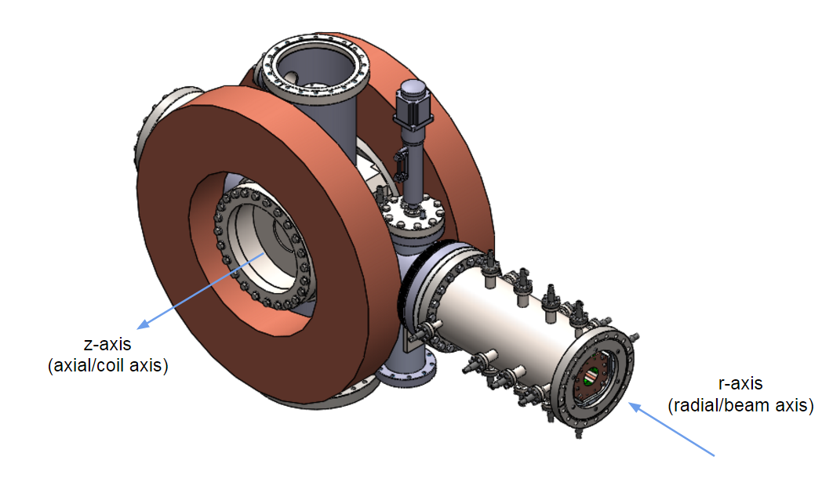
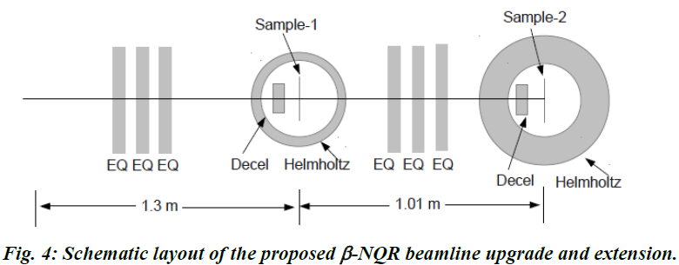
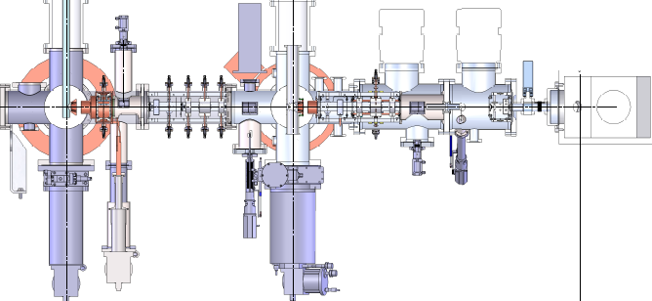
High Field Spectrometer for beta-NMR
Requires ability to apply a field parallel to the sample (to replicate rf fields) of strength near Hc1
New high field spectrometer has been designed, parts are in hand and installation will begin this year
H
Notes:
Beta nmr insert to allow probing of london layer near the limits of the meissner state with a field parallel to the surface – beta nmr allows soft landing and depth profiling – musr is a bulk probe – will shed light on loss mechanisms in rf surface

