Slide 1
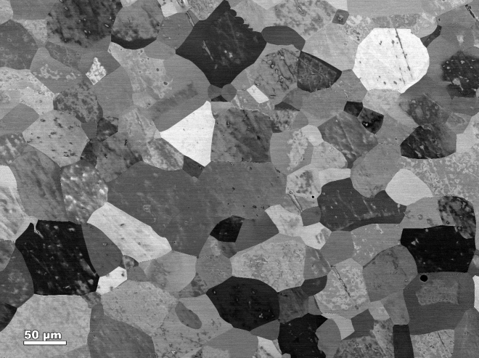
Sample Analysis: Understanding the RF performance of SRF cavities
TTC Meeting 2018
26-29 June 2018
RIKEN Nishina Center
Pashupati Dhakal,
G. Ciovati (JLAB)
S. Chetri, S. Balachandran and PJ Lee (NHMFL, FSU)

Slide 2
Motivations
SRF cavities research is mostly recipe based in order to achieve high Q and E_{acc}
Although it resulted in the higher Q and E_{acc}, the fundamental understanding is still lacking, for examples:
→ Role of low temperature baking
→ Role of doping and infusion
→ Role of flux expulsion and its dependence on cool down rate
→ Quench mechanism and cause of higher residual resistance
→ and so on
When we try some recipe, we process sample coupons along with SRF cavity for microstructure and magnetization studies, to better evaluate and relate the role of recipe/process modification on SRF cavity performance (either bad or good).
Analytical tool such as SEM, EBSD, XPS, magnetization, susceptibility, SIMS, PTC techniques are used.

Slide 3
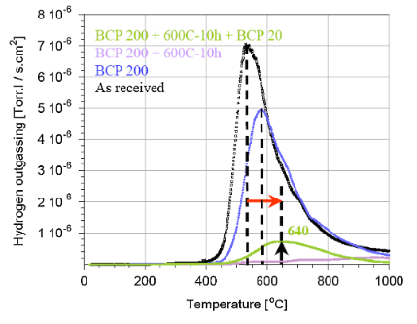
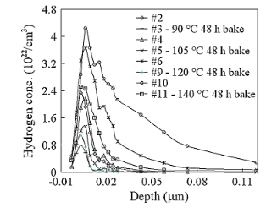
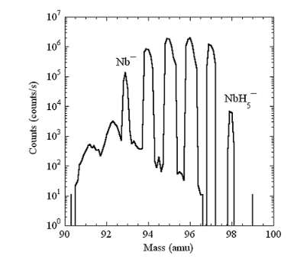
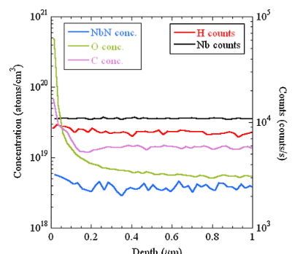
Pre-doping Era (understanding Q-slope, residual loss, hot and cold spot)
Ciovati et al., PRSTAB, 13, 022002 (2010)

Slide 4
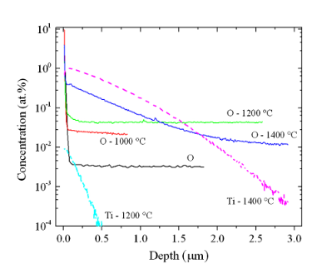
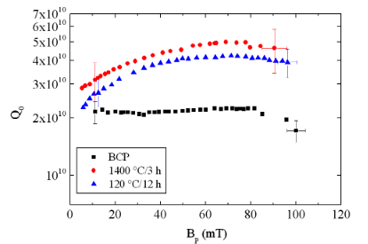
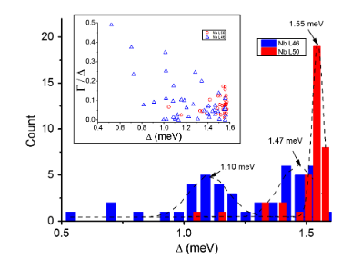
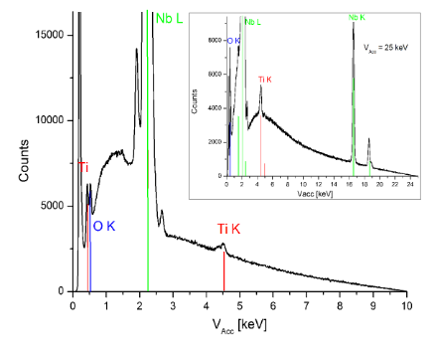
Doping Era (Ti Doping)
Dhakal et al., PRSTAB,16, 042001 (2013)
Ti diffused ~ 2 μm
Better superconducting gap
Traces seen with XRD to confirm the presence of Ti
Higher low field Q may be related to the trapping of hydrogen by Ti which prevents the formation of hydrides
→ Q-rise phenomenon was explained in terms of the broadening of DOS of quasiparticles in dirty limit

Slide 5
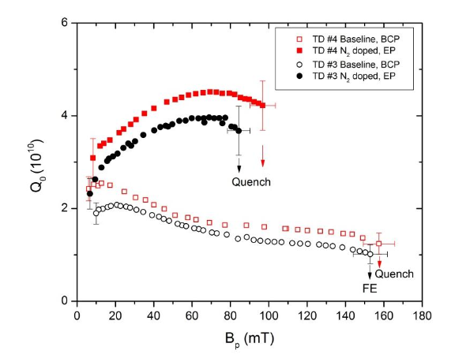
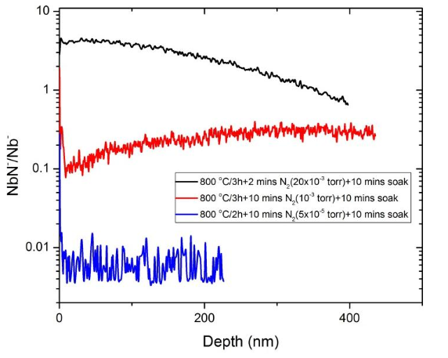
Doping Era (N-doping)
Dhakal et. al., IEEE Transactions on Applied Superconductivity ( Volume: 25, Issue: 3, June 2015 )
N diffused much deeper and surface NbN needed to be removed by EP
Higher low field Q may be related to the trapping of hydrogen by N (similar to Ti) which prevents the formation of hydrides
→ Q-rise phenomenon similar to Ti-doping

Slide 6
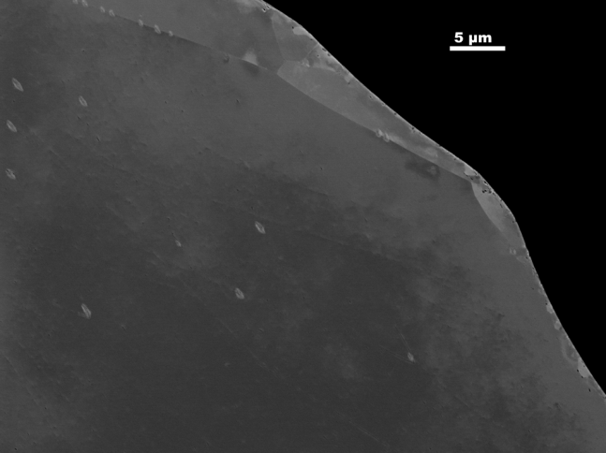
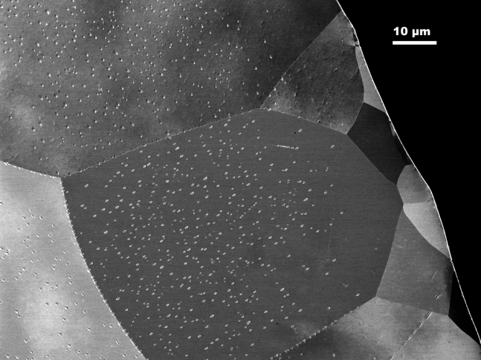
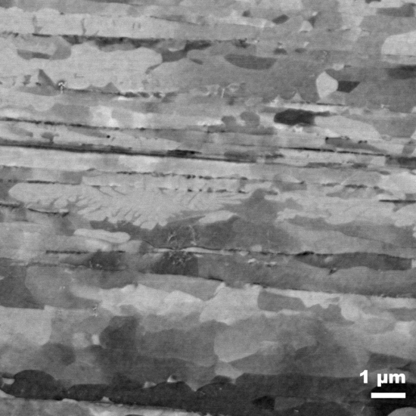
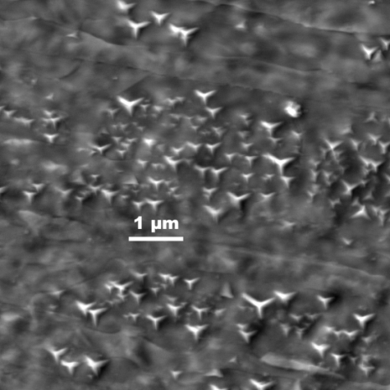
Doping Era (N-doping)
800 C/3h ( No Nitrogen)
As worked ->800 C+ 20 min N doping
GB
~15 µm
Hydrides close to surface
Longitudinal surface
Longitudinal surface
Nitrides on wire surface.
Near surface hydride debris absent in N doped sample- First direct evidence- Cross sectional microscopy

Slide 7
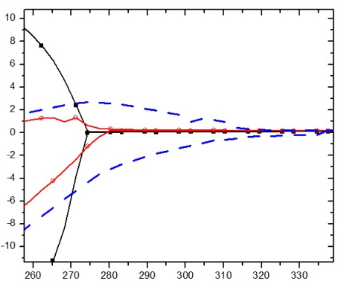
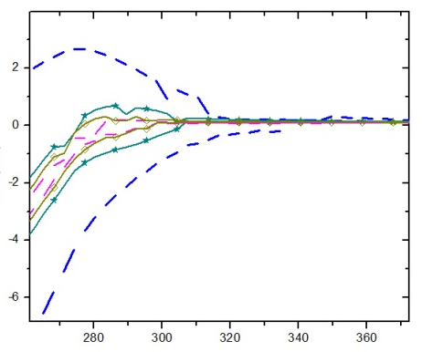
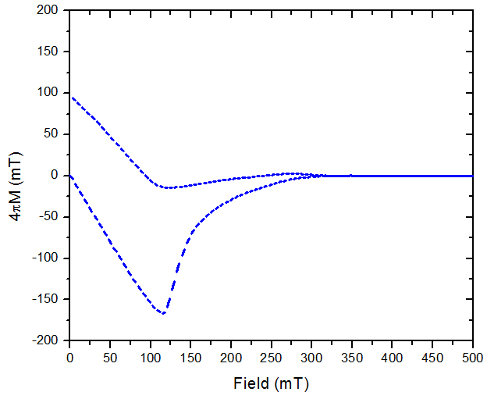
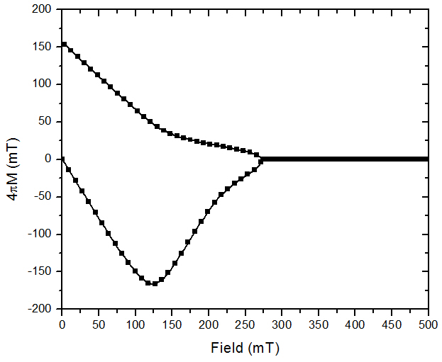
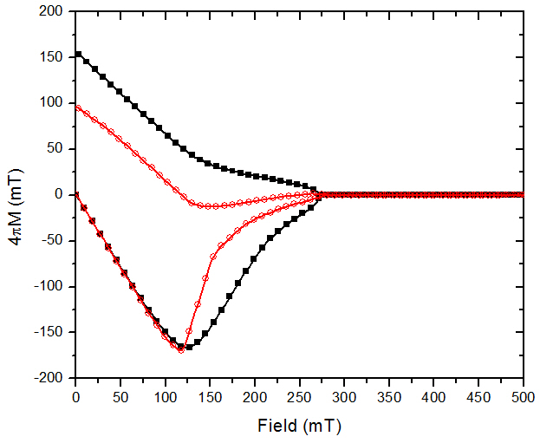
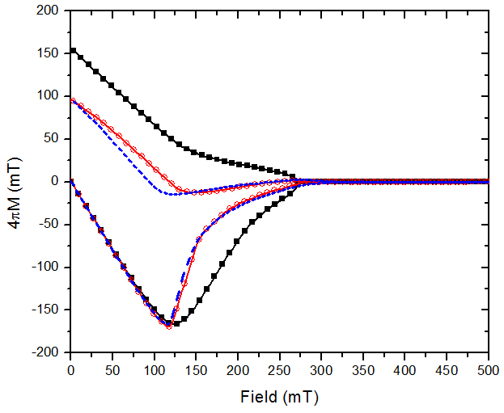
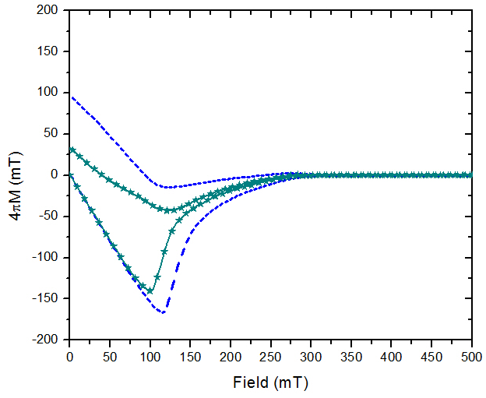
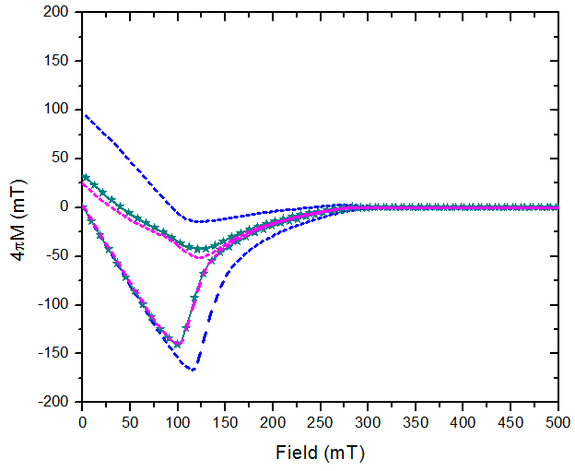
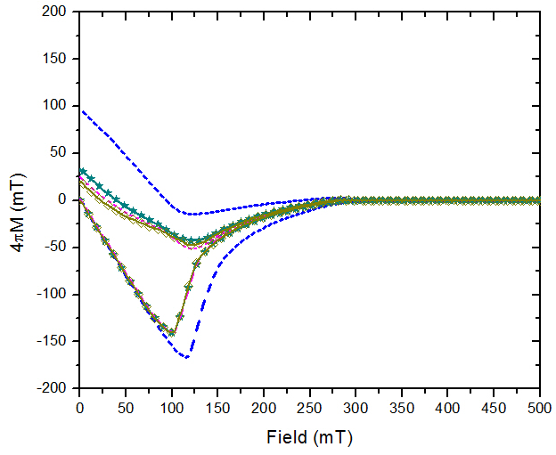

Magnetization/N-doping
S. Chetri, ASC 2016
T = 4.2 K
Trapped Field
1hBCP
1hBCP+800°C
20N30
20N30
+10μmEP
+20μmEP
+30μmEP
No N₂
N₂ doped
H_{c2} increased by N-doping.
EP reduces H_{c2} and also the trapped field.
Note: The “trapped fields” here are orders of magnitude greater than in SRF cavities
Pure Nb
1hBCP
1hBCP+ 800°C/3h
1hBCP+ 800°C/3h +20N30
20N30+ 10μmEP
20N30+ 20μmEP
20N30+ 30μmEP

Slide 8
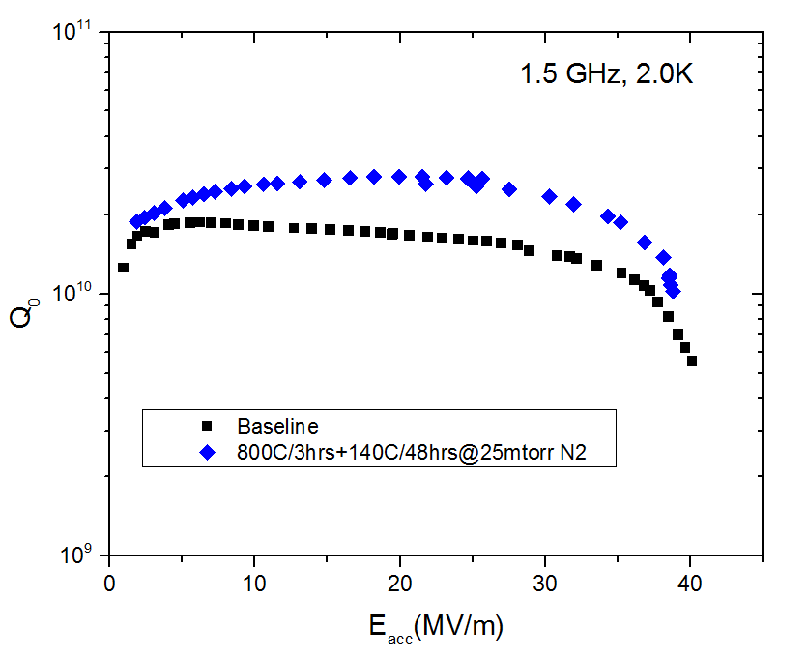
N treatment at low temperature/Jlab
P. Dhakal et al., PRAB 21 032001 (2018)

Slide 9
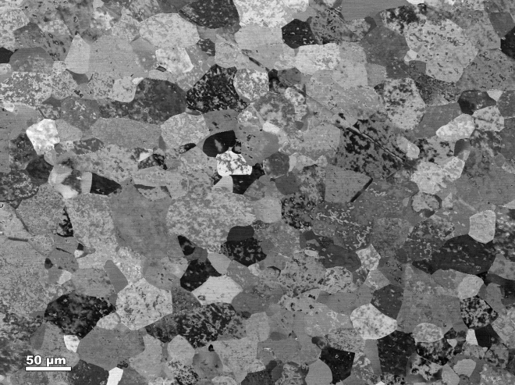
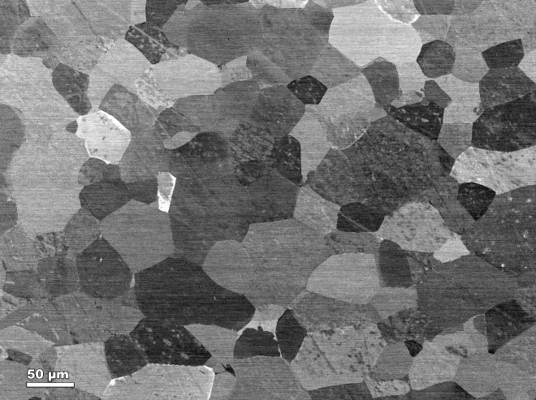
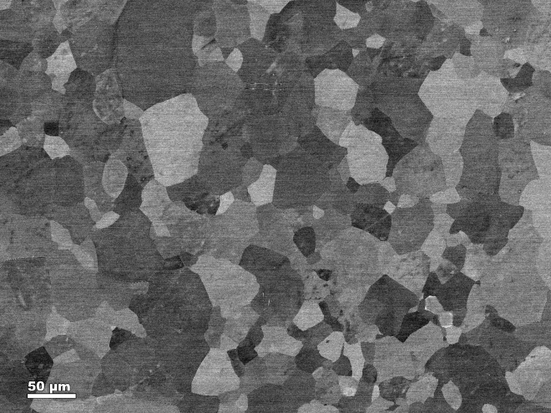
Coupon samples: N-Infusion/ Jlab, Microscopy/NHMFL/FSU
P. Dhakal et al., PRAB 21 032001 (2018)
800°C
800°C+N₂@120°C
Contrast in SEM Back scatter images is due to contributions from changes in crystallographic orientations (including defects), and atomic number
800°C+N₂@140°C
800°C+N₂@160°C

Slide 10
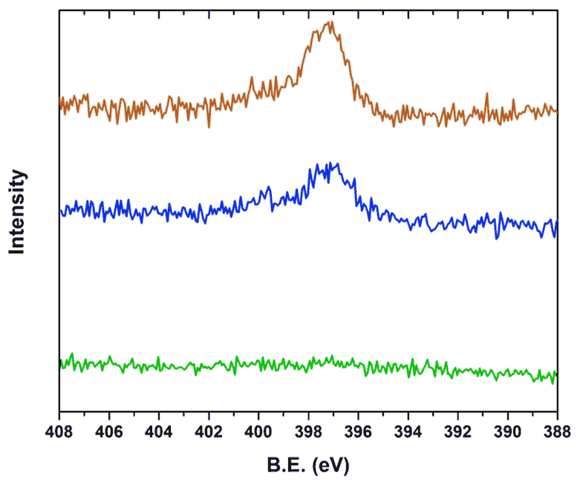
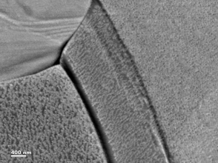
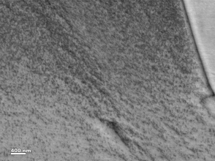
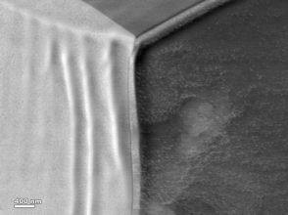
XPS Studies: SRF coupon analysis
N1s spectrum at 75° takeoff angle
800 °C/3h+N₂ 160 °C/48h
Nitrogen peaks detected in samples after 140 °C/48h, 160 °C/48h N infusion treatments but not for the 120 °C/48h N infusion
The in-grain surface structures could indicate nitride phases.
800 °C/3h+N₂ 140 °C/48h
Nitride (397 eV)
800 °C/3h+N₂120 °C/48h
Surface analysis by XPS: Presence of nitrogen in the form of nitride detected for ≥ 140 °C N infusion

Slide 11
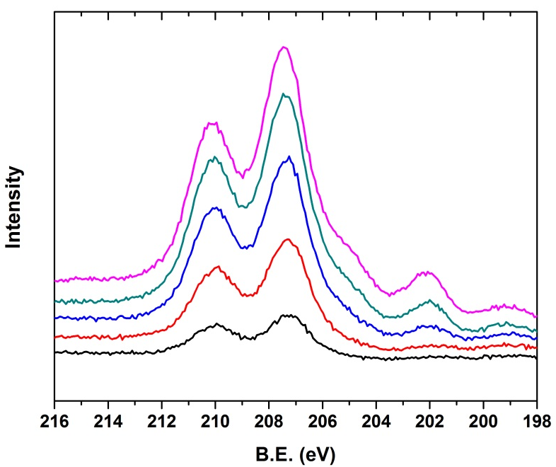
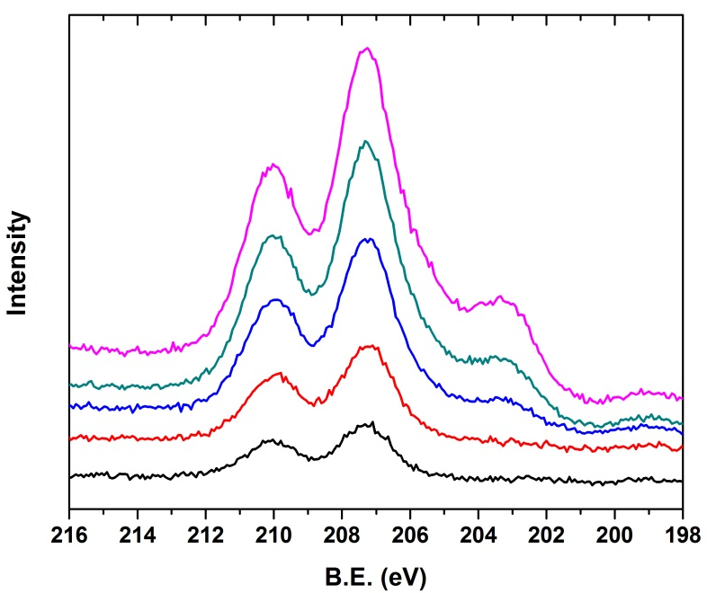
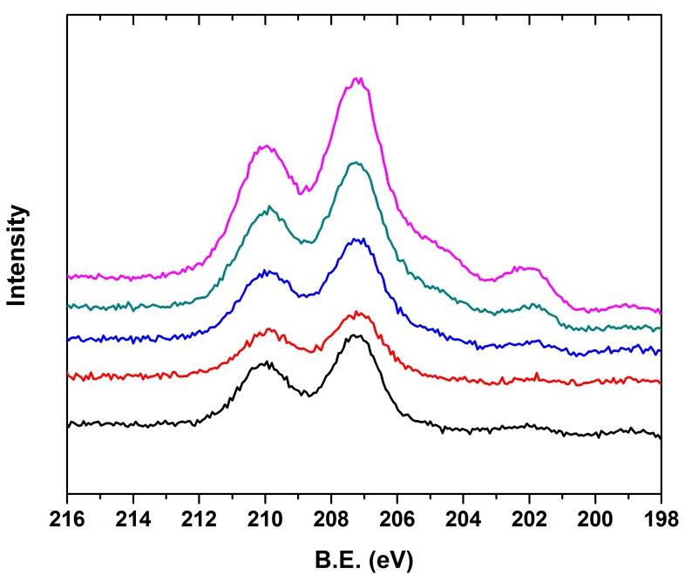
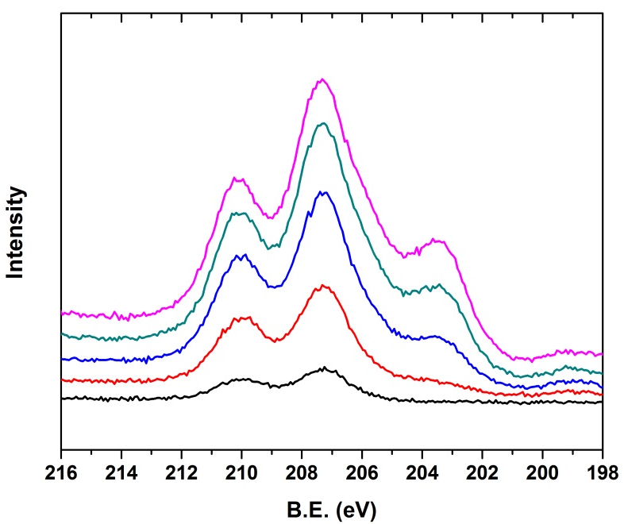
XPS Studies- Take off angle 75°, interaction depth ~7nm
Nb₂O₅
800 °C
800 °C
+N₂@140 °C
NbN_{1-x}O_{x}
Nb
Nb peak is absent => thicker dirty layer
Nb₂O₅
800 °C
+N₂@120 °C
800 °C
+N₂@160 °C
Nb
NbN_{1-x}O_{x}
NbN_{1-x}O_{x} is found on Nb baked at 140-160 °C in N atmosphere

Slide 12
XPS: Differences in take-off angle probes near surface layers
800 °C
800 °C+N₂@140 °C
Take-off angle (θ) | Information depth, x (nm)
15° | 1.94
30° | 3.75
45° | 5.30
60° | 6.50
75° | 7.24
800 °C+N₂@120 °C
800 °C+N₂@160 °C
In 120 °C “N-not-infused”
NbO appears
In 140-160 °C N-infused Nb,
lesser Nb₂O₅ concentration on the surface
Formation of NbN_{1-x}O_{x} phase
No bulk Nb observed up to 8 nm depth (thicker dirty layer).

Slide 13
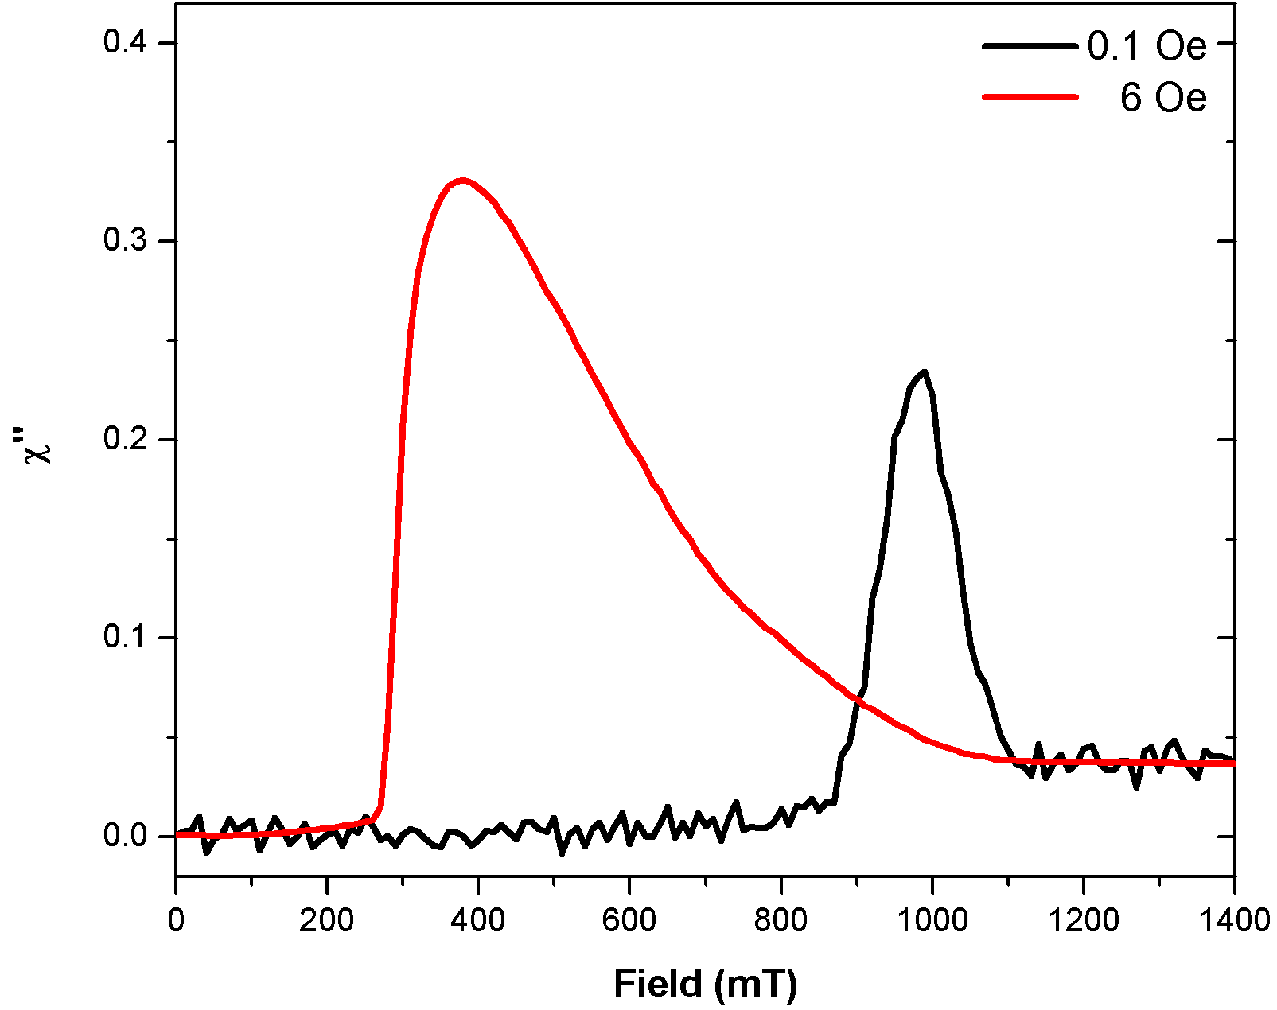
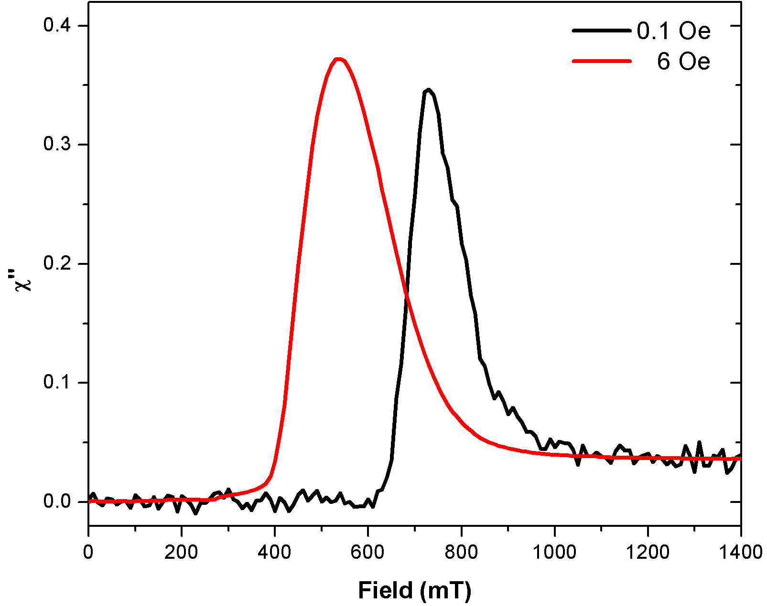
AC susceptibility: Surface sensitive superconducting measurements-FSU/NHMFL
800 °C+N₂@120 °C
800 °C+N₂@160 °C
T=4.2K
T=4.2K
Increasing AC amplitude from 0.1 Oe to 6 Oe probes thicker surface layers.
Determination of penetration depth of AC fields are in progress.
AC susceptibility measurements show correspondence with XPS data.
H_{c2}
(bulk Nb)
H_{c3}
H_{c3}
* Bulk H_{c2} of Nb (240 mT) reached with 6 Oe AC amplitude
* H_{c2} value is higher than 240mT after 6 Oe AC amplitude, indicating a dirty layer.

Slide 14
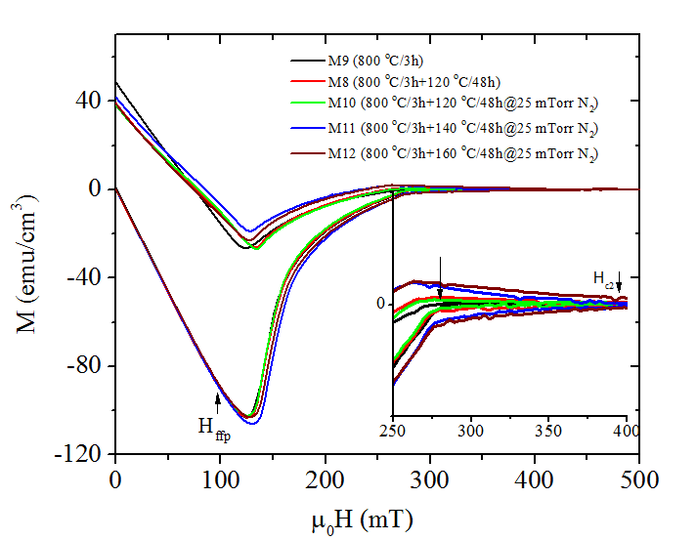
Bulk Magnetization measurements on cylindrical coupons-FSU/NHMFL
No significant difference in bulk pinning centers…
P. Dhakal et al., PRAB 21 032001 (2018)
T = 4.2 K
H_{c2}~280 mT
H_{c2}~430 mT (for F12)
Areas between the magnetization loop are almost identical (bulk pinning).
Bulk H_{c2} is increased in case of N-infusion at 140 °C and 160 °C. Infusion effect may be deep enough to affect bulk H_{c2}.

Slide 15
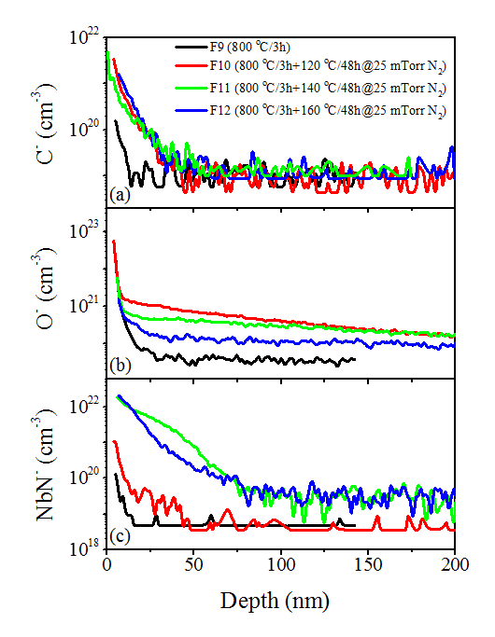
SIMS Studies on coupon samples- NCSU data
SIMS detection limits:
Element | Atomic percent (%) | Weight in ppm
O | 0.05 | 93
C | 0.02 | 23
N | 0.02 | 27
Oxygen profile consistence with earlier studies of LTB
Higher N concentration for 140 and 160C/48hrs treatments.
P. Dhakal et al., PRAB 21 032001 (2018)

Slide 16
Summary
Analytical tools are very valuable in order to understand effect of recipe modification to the performance of SRF cavities.
Understanding of SRF Nb surface is possible from coupon sample analysis, there are correlations found between cavity performance (large area averages) versus local measurements on coupons. Quantitative data, and statistics, are key.
XPS analysis on coupon samples are showing clear differences in Nb surface layer compositions depending on treatment.
  Presence of thick oxy-nitride layers present only after 140°C, 160°C N infusion.
  Sub-oxide layer compositions differ with treatments, presence of NbO detected in near surface layers after 120°C N infusion.
Superconducting measurements on coupon samples which include: PCT, AC susceptibility, and bulk magnetization measurements provides a length scale over which SRF surfaces can be characterized.
  AC susceptibility indicates the level of dirtiness of the surface Nb layers, these measurements show correlations with XPS data in N infused samples.
  Bulk magnetization measurements on N infused also indicate increased bulk H_{c2}
P. Dhakal et al., PRAB 21 032001 (2018)

Slide 17
Acknowledgements
This work was supported by the U.S. Department of Energy (Award Numbers DE-SC0009962 and DE-SC0009960). A portion of this work was performed at the National High Magnetic Field Laboratory, which is supported by National Science Foundation Cooperative Agreement No. DMR-1157490 (-2017) DMR-1644779 (2018-) and the State of Florida

Slide 18


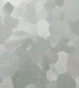
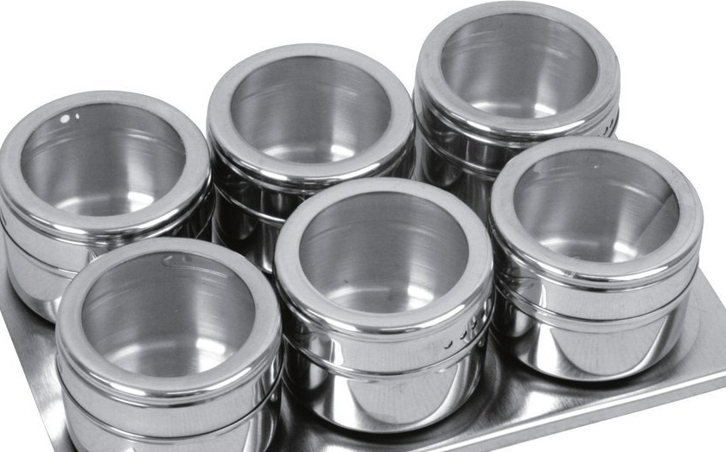
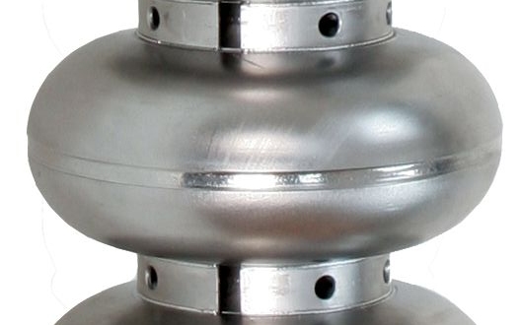
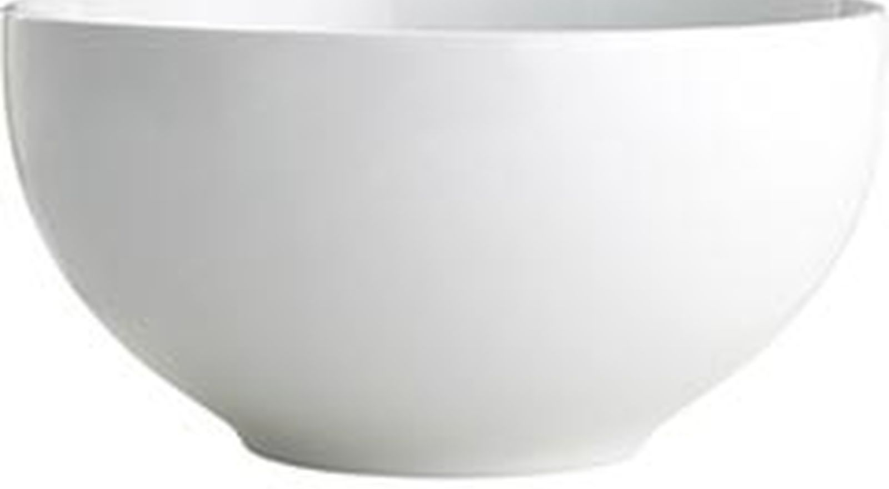

Recipe for high Q and high gradient
Nb
N₂
Ti
Thank you !!

