Slide 1
Sample analysis at KEK
Taro Konomi (KEK)

Slide 2
Contents
The vacuum furnace at J-PARC.
Surface composition analysis by using SIMS and XPS.
DC Magnetic property measurement using MPMS.

Slide 3
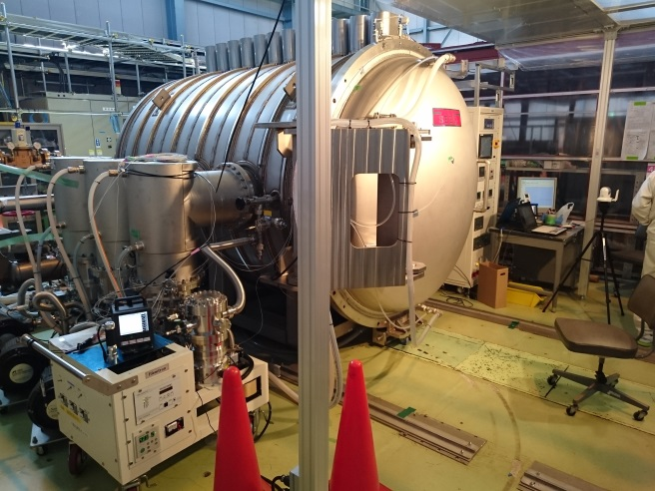
J-PARC furnace
J-PARC furnace has oil free pumps (3 TMP and 1 Cryopump).
After annealing, pressure reaches ~3E-6 Pa
Turbo pump 3unints: SIMADZU TMP3202M (3000L/sec x3)
Cryopump 1unint: ANELVA CAP220 (10000L/sec)

Slide 4
N-Infusion results
We tried N-infusion 6 times. In 5th and 6th trial, we installed two cavities each.
There are 2 type QE curves. In case of failure Q drops from ~10 MV/m.
# | Result | Series | Treatment | Cavity material
1 | Fail | R-2 | N-Infusion(800x3h+120x48h | FG (TD)
2 | Success | R-8c | N-Infusion(800x3h+120x48h) | FG(TD)
From 2nd infusion, base pressure during infusion was improved from 1E-2Pa to 1E-5Pa by changing the pumping unit.
3 | Success | R-9b | N-Infusion(800x3h+125x48h) | FG(TD)
N2 bottle was changed. Titanium bellows were annealed at 650 ºC x10 hours
4 | Fail | R-2 | N-Infusion(800x3h+160x48h) | FG(TD)
5 | Fail | R-9 | N-Infusion(800x3h+120x48h) | FG(TD)
5 | Success | R-10b |  | LG(CBMM)
N2 inlet line was baked again.
6 | Fail | R-2 | N-Infusion(800x3h+120x48h) | FG(TD)
6 | Fail | R-9b |  | FG(TD)

Slide 5
Sample analysis by D-SIMS @ULVAC
Oxygen and Carbon profiles seems to have the relationship with the maximum gradient and Qo.
－⁹³Nb －¹⁴N+ ⁹³Nb －¹H －¹²C －¹⁶O －¹⁸O －¹⁹F
800℃ Annealing
1st N-infusion
(Failure)
2nd N-infusion
(Success)
0
Depth (nm)
Depth (nm)
Depth (nm)
5
10
15
0
5
10
15
0
5
10
15

Slide 6
XPS measurement @ULVAC
Samples of 800ºC annealing, 1st and 2nd N-infusion were measured by XPS (ULVAC Inc.)
The depth profile of atomic concentration was measure by sputtering (sputter rate was 2.3 nm/min)
Oxygen depth profile is agree with the SIMS data.
―C1s ― O1s ― Nb3d ― N1s ― Cs3d
800 ºC annealing
1st trial N-infusion (failure)
2nd trial N-infusion (success)
~23nm
~23nm
~23nm

Slide 7
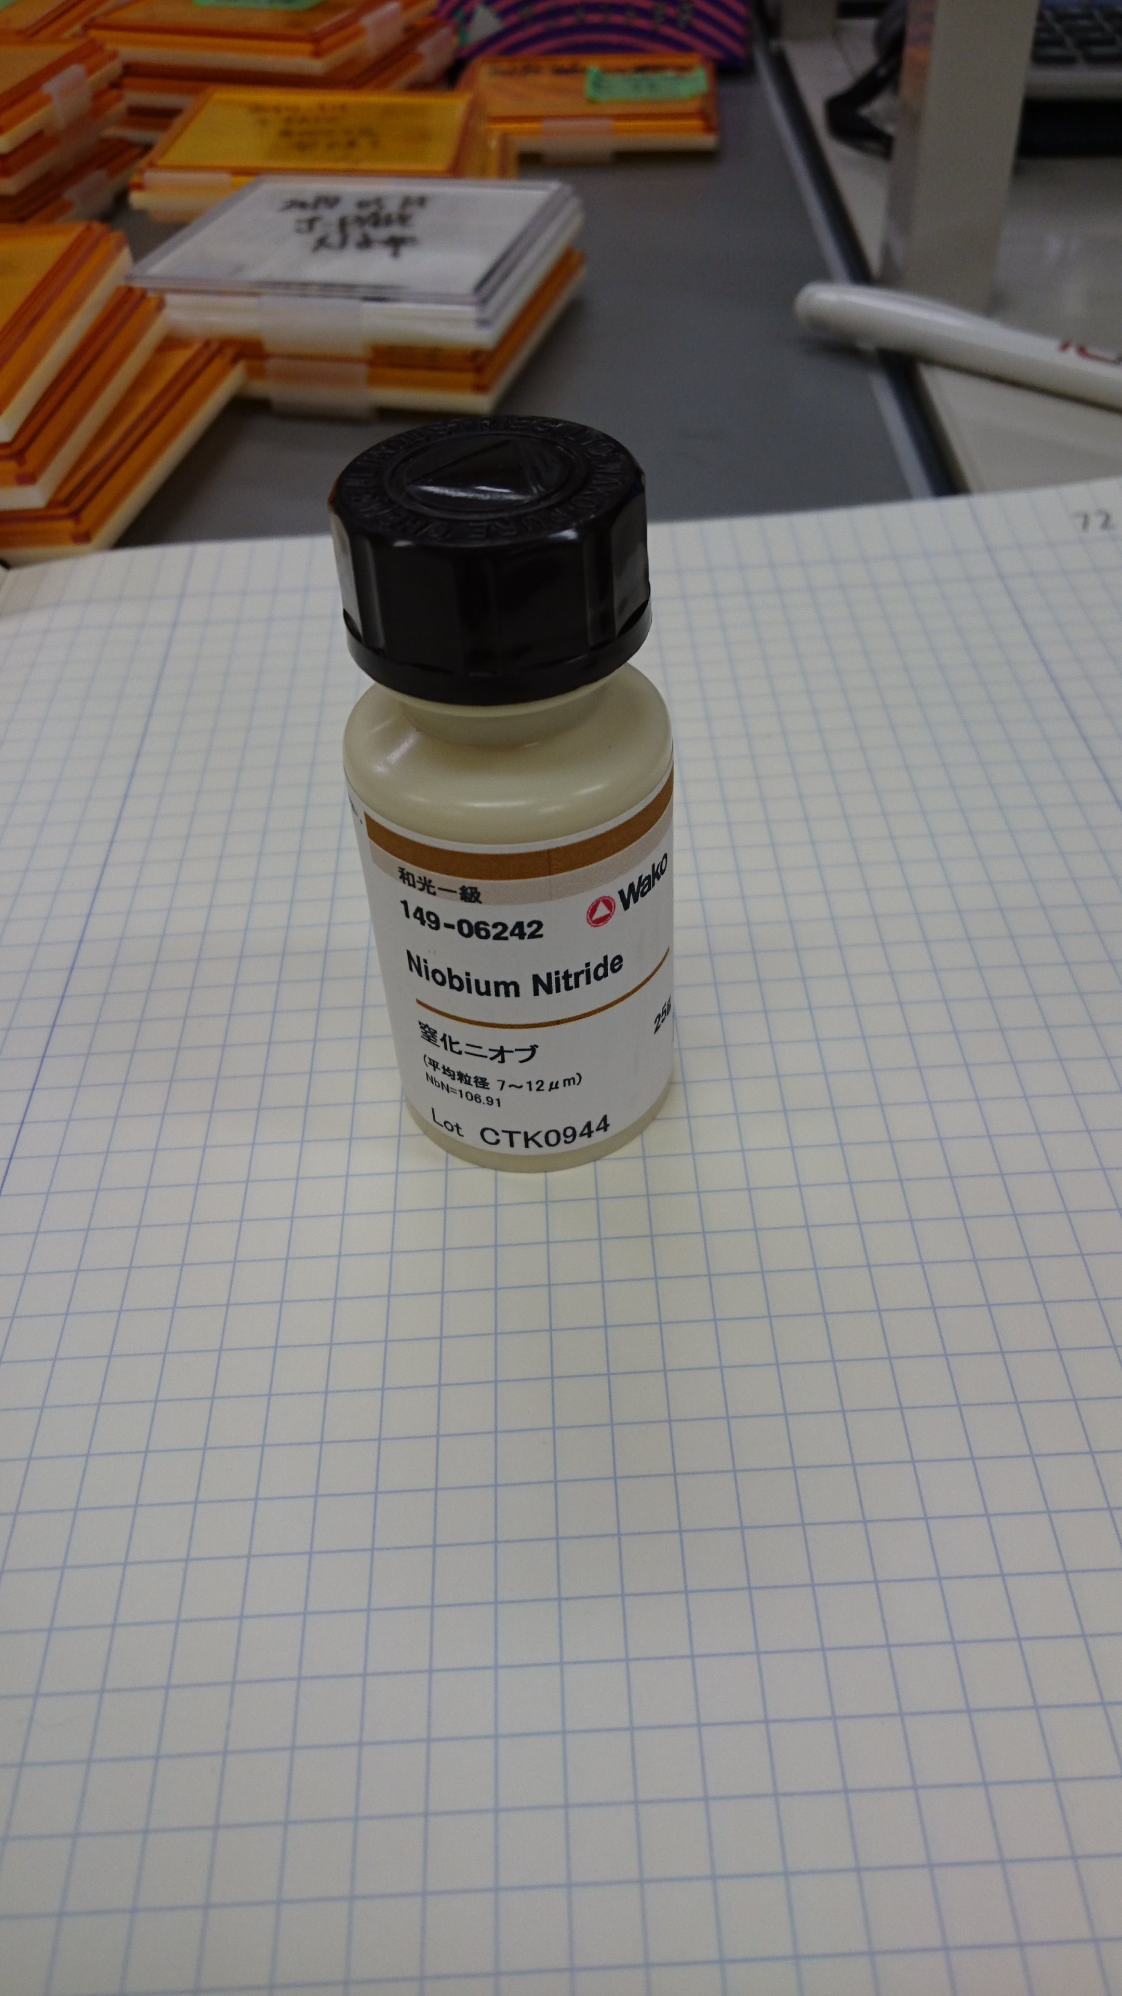
TOF-SIMS @ NIMS
Atomic Weight
Measurement of the TOF-SIMS @NIMS has started.
The mass resolution is ~0.01 (D-SIMS @ULVAC resolution is ~1)
From this measurement, ~107 mass in KEK sample seems Nb-CH₂.
  The peak thought to be Nb-N in D-SIMS measurement may be Nb-CH₂.
Nb: 92.90638
N: 14.0067
C: 12.0107
H: 1.00794
Nb-N: 106.909
Nb-CH₂: 106.922
Δ=0.13
NbN powder
N-dope sample
106.898
106.912
This peak is not Nb-N

Slide 8
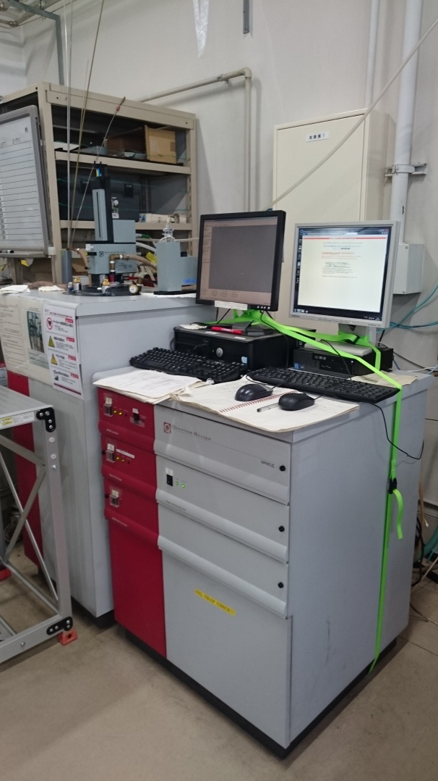
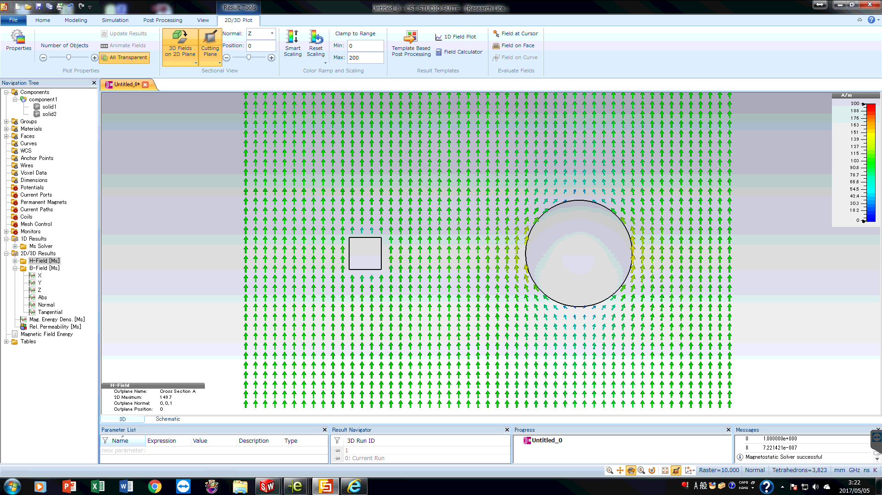
MPMS @Tohoku Univ.
We measured H_{c1}(Hvp) and H_{c2} of N-dope and N-infusion by using sphere shape sample.
  We could get very sharp edge at Hc1 (Hvp) which first flux enter to the sample.
    Enhancement factor of square samples are unknown.
  Enhancement factor at the sample equator is 150±1.5 %.
Φ2mm sphere sample
Fabrication error 2±0.005mm

Slide 9
MPMS @Tohoku Univ.
Hc1 (Hvp) is the edge in the (M-H)/H curve and calculated by multiplying by 1.5 factor.
Hc1 increases in order of N-dope < Anneal < N-infusion.
Transform (M-H)/H calculation
H_{c1} (H_{vp})/1.5
 | Hc1（Hvp） | Hc2
800℃ anneal +20um CP | 1740 G | ~3800 G
N-infusion (5th ) | 1770 G | ~3800 G
20min N-dope +10um CP | 1530 G | ~3800 G

Slide 10
Summary
N-infusion at J-PARC has the both successful and failed case .
We compared each sample by D-SIMS and XPS.
Carbon and Oxygen seems has the relation with Successful and failure case
From the TOF SIMS measurement. NbN peak measured in D-SIMS seems to be the Nb-CH₂ peak.
Hc1 was measured with 2mm sphere sample by SQUID MPMS
Hc1 increases in order of N-dope < Anneal < N-infusion.

