Slide 1
Surface study of nitrogen-infused Nb samples
- Arti Dangwal Pandey, DESY Hamburg
Notes:
Our observation:
NbN : 203.8 eV, NbC : 203.3 eV, NbO: 204.0 eV

Slide 2
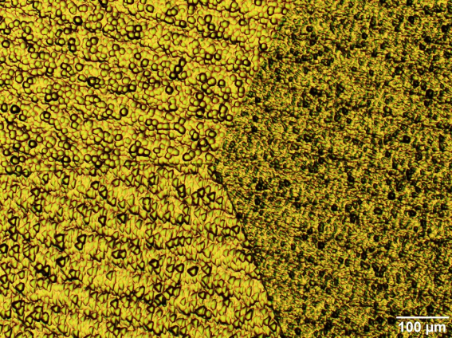
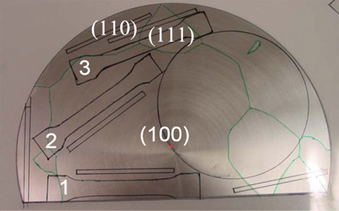
Optical inspection of as-received material
(100)
(111)
(100)
(110)
W. Singer et al, Phys. Rev. ST Accel. Beams 16, 012003 (2013)
Material : LG Nb from Heraeus: RRR > 300
Samples:
Single crystal Nb(100) : systematic XPS investigation results
- Nanopolishing – etch profiles were not observable in SEM
Tri-crystal Nb (100) (110) and (111) sample : microscopic observation
- Nanopolishing + ~100 micro m EP at FNAL
Notes:
One of the remaining disks from LG cavity production described in the paper:

Slide 3
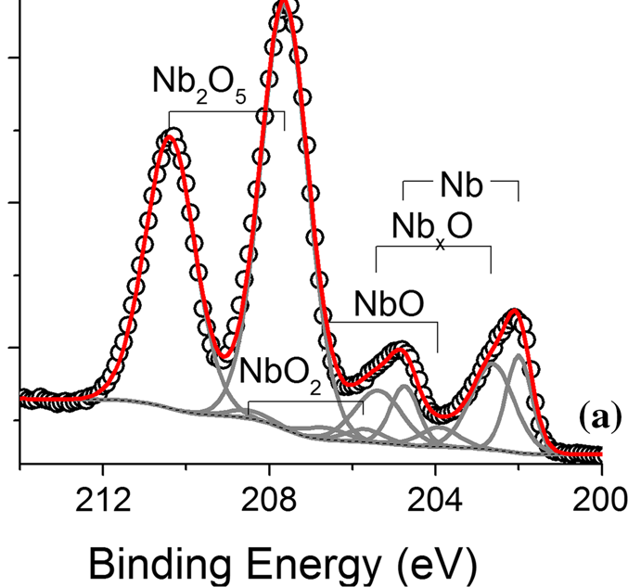
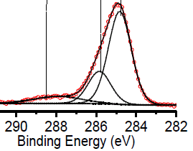
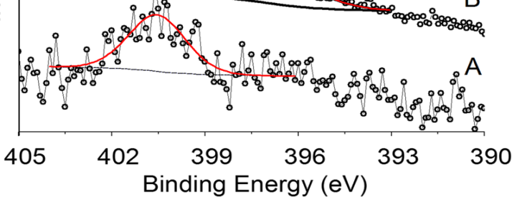
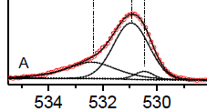
XPS of Nb
Chemically polished Nb
Nb 3d
A. Dangwal Pandey et al., J Material Science (2018) 53:10411–10422
C 1s
N 1s
O 1s
Nb₂O₅
NbO₂
NbO
Nb
Notes:
X-ray photoelectron spectroscopy , Our observation:
NbN : 203.8 eV, NbC : 203.3 eV, NbO: 204.0 eV

Slide 4
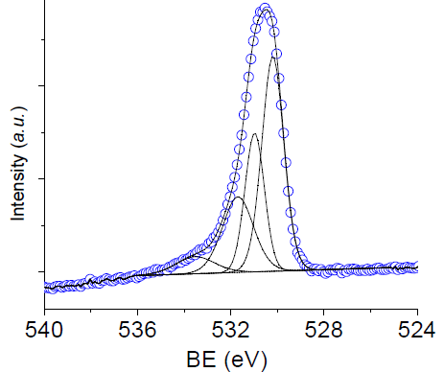
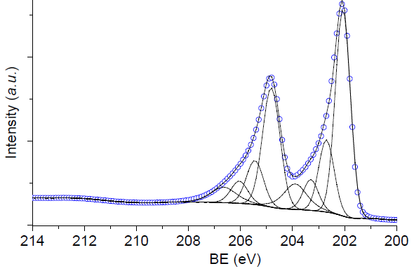
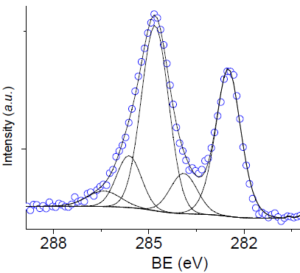
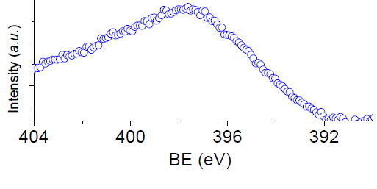
in-situ XPS on UHV-annealed Nb (100)
A simplified case as a starting point
O 1s
Nb 3d
Nb_{x}-O
Nb
Nb-O
Nb_{x}O
Nb-C
NbO
C 1s
sp³ C
Nb-C
sp² C
N 1s
T = 600 °C for 1.5 hours
P_{600°C} < 2 e⁻⁸ – 8 e⁻⁹ mbar
P_{base} = 8 e⁻¹⁰ mbar
Notes:
- Figure 1 presents a typical photoemission spectrum of the Nb 3d levels of a Nb ~110! sample annealed at 1400 K for ;20 min with 260 eV photons. This spectrum exhibits four peaks A, B, C, D at the following binding energies: 202.3, 203.7, 205.1, and 206.5 eV, respectively.
Variation of the binding energy of the Nb 3d5/2 level as a function of the valence of Nb atoms. Valence states of Nb atoms corresponding to peaks 2 and 3 are deduced.
- As oxygen atoms occupy interstitial sites in the bcc Nb lattice,23 we infer that the shifted Nb 3d levels in peak A could correspond to Nb6O and Nb4O compounds associated with the octahedral and tetrahedral sites, respectively ~Fig. 5!. Therefore, our analysis of photoemission spectra shows that oxygen dissolved in a Nb single crystal segregates during annealing in UHV and forms a NbOlike
overlayer covering a thin Nb metal layer enriched with interstitial oxygen atoms.

Slide 5
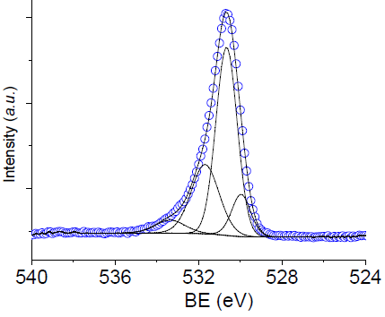
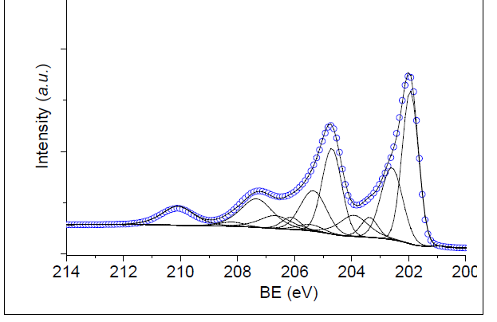
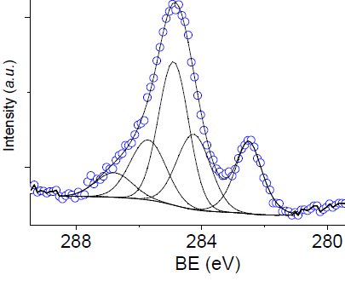
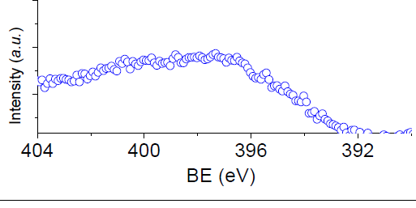
UHV annealed Nb(100)– after 1hr in air
O 1s
Nb 3d
Nb
Nb-O
Nb_{x}O
Nb-C
Nb_{x}-O
NbO
NbO₂
Nb₂O₅
C 1s
sp³ C
Nb-C
N 1s
T = 600 °C for 1.5 hours
P_{600°C} < 2 e⁻⁸ – 8 e⁻⁹ mbar
P_{base} = 8 e⁻¹⁰ mbar
Air-exposed : 1hour
Notes:
- Figure 1 presents a typical photoemission spectrum of the Nb 3d levels of a Nb ~110! sample annealed at 1400 K for ;20 min with 260 eV photons. This spectrum exhibits four peaks A, B, C, D at the following binding energies: 202.3, 203.7, 205.1, and 206.5 eV, respectively.
Variation of the binding energy of the Nb 3d5/2 level as a function of the valence of Nb atoms. Valence states of Nb atoms corresponding to peaks 2 and 3 are deduced.
- As oxygen atoms occupy interstitial sites in the bcc Nb lattice,23 we infer that the shifted Nb 3d levels in peak A could correspond to Nb6O and Nb4O compounds associated with the octahedral and tetrahedral sites, respectively ~Fig. 5!. Therefore, our analysis of photoemission spectra shows that oxygen dissolved in a Nb single crystal segregates during annealing in UHV and forms a NbOlike
overlayer covering a thin Nb metal layer enriched with interstitial oxygen atoms.

Slide 6
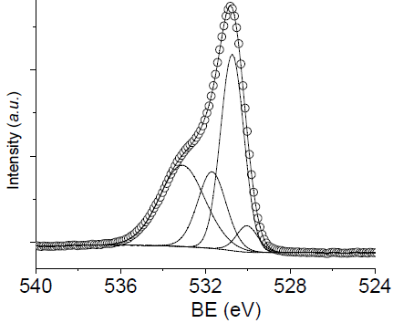
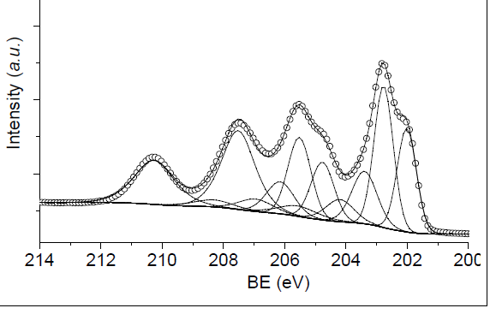
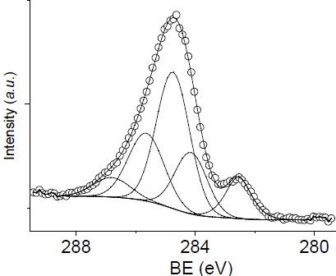
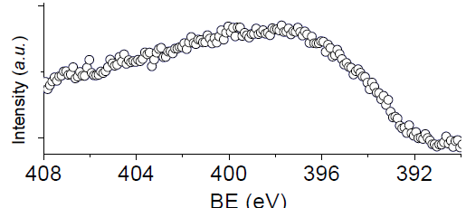
UHV annealed Nb(100)– after 1hr in air
O 1s, 70°
Nb 3d, 70°
Nb_{x}O
Nb
Nb-O
Nb-C
NbO
NbO₂
Nb₂O₅
C 1s, 70°
sp³ C
N 1s, 70°
Nb-C
Nb_{x}O with BE @ 202.6 eV :
- is extending on top surface together with Nb2O5
Notes:
- Figure 1 presents a typical photoemission spectrum of the Nb 3d levels of a Nb ~110! sample annealed at 1400 K for ;20 min with 260 eV photons. This spectrum exhibits four peaks A, B, C, D at the following binding energies: 202.3, 203.7, 205.1, and 206.5 eV, respectively.
Variation of the binding energy of the Nb 3d5/2 level as a function of the valence of Nb atoms. Valence states of Nb atoms corresponding to peaks 2 and 3 are deduced.
- As oxygen atoms occupy interstitial sites in the bcc Nb lattice,23 we infer that the shifted Nb 3d levels in peak A could correspond to Nb6O and Nb4O compounds associated with the octahedral and tetrahedral sites, respectively ~Fig. 5!. Therefore, our analysis of photoemission spectra shows that oxygen dissolved in a Nb single crystal segregates during annealing in UHV and forms a NbOlike
overlayer covering a thin Nb metal layer enriched with interstitial oxygen atoms.

Slide 7
UHV annealed Nb(100)– after 1hr in air
Nb
Nb₂O₅
Nb 3d
Nb_{x}C_{y} / NbO₂
NbO
Nb_{x}O
XPS
Detector
Nb-C
NbO
NbO₂
Nb₂O₅
Nb
Nb 3d
Nb
Nb_{x}O
Nb 3d, 70°
Nb_{x}O
Nb-C
Interstitial -rich
Nb
Nb_{x}O
NbO
Nb
NbO₂
Nb₂O₅
Nb_{x}O:
- extending to top surface Nb₂O₅
Nb_{x}C_{y}:
- enhanced compared to NbO- so closer to surface
Notes:
- Figure 1 presents a typical photoemission spectrum of the Nb 3d levels of a Nb ~110! sample annealed at 1400 K for ;20 min with 260 eV photons. This spectrum exhibits four peaks A, B, C, D at the following binding energies: 202.3, 203.7, 205.1, and 206.5 eV, respectively.
Variation of the binding energy of the Nb 3d5/2 level as a function of the valence of Nb atoms. Valence states of Nb atoms corresponding to peaks 2 and 3 are deduced.
- As oxygen atoms occupy interstitial sites in the bcc Nb lattice,23 we infer that the shifted Nb 3d levels in peak A could correspond to Nb6O and Nb4O compounds associated with the octahedral and tetrahedral sites, respectively ~Fig. 5!. Therefore, our analysis of photoemission spectra shows that oxygen dissolved in a Nb single crystal segregates during annealing in UHV and forms a NbOlike
overlayer covering a thin Nb metal layer enriched with interstitial oxygen atoms.

Slide 8
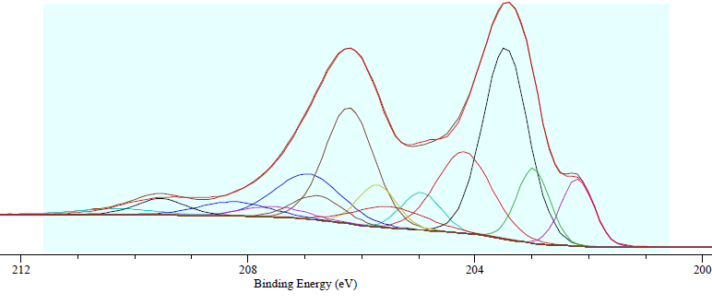
N-infused Nb(100)– after 1hr in air
N-infusion: (800 °C -2 hrs, 120°C in 0.03 mbar N₂ for 48 hrs)
-Besides already observed oxide and carbides phases: Hint for a different phase possibly Nb₂X_{y}O_{5-y}
X : C/N/O ?
- Nitrogen: Very week broad peak in the energy range 397 - 399 eV
- Surface Carbon :
sp² hybridization dominant
Nb_{x}O
Nb
Nb-C
NbO₂
NbO
Nb₂O₅
Nb₂X_{y}O_{5-y}
O 1s
N 1s
C 1s

Slide 9
N-infused Nb(100)– after 1hr in air
Nb₂O₅
XPS
Detector
Nb
Nb_{x}C_{y} / Nb₂X_{y}O_{5-y}/NbO₂
NbO
Nb
Nb_{x}O
Nb-C
NbO
Nb₂O₅
NbO₂
Nb
0°
Normal-exit XPS
Nb
Nb_{x}O
Nb₂X_{y}O_{5-y}
Nb_{x}O
Nb-C
Interstitial -rich Nb
Nb₂O₅
NbO₂
NbO
Nb-C : large amount
Nb_{x}O extending to top
70°

Slide 10
N-infused vs UHV-annealed Nb (100)
N-infused, in air for approx. 1 hr
Nb
Nb_{x}O
Nb-C : very larger amount
- different chambers used
- C segregating from bulk?
C-precipitates formed on this sample, but not on ultra-pure N-infused Nb
Less Nb_{x}O on diffused Nb
- Nb_{x}O extending to top
Slower Nb₂O₅ growth on N-infused Nb
higher NbO content
Nb-C
NbO₂
NbO
Nb₂O₅
Nb₂X_{y}O_{5-y}
UHV-annealed 600°C, in air for 1 hr
Nb
Nb_{x}O
Nb-C
NbO
NbO₂
Nb₂O₅

Slide 11
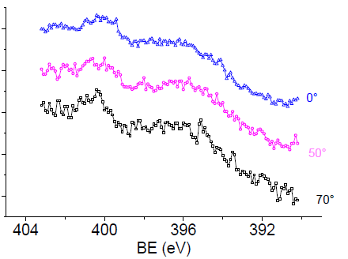
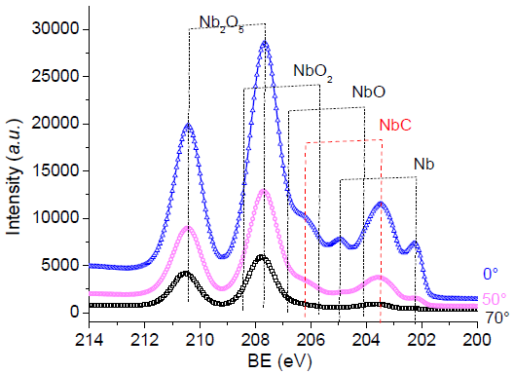
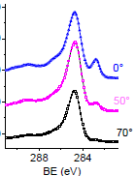
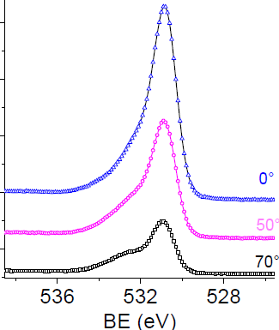
N-infused Nb(100) after HPR
N 1s
N b 3d
ads. N₂
C 1s
sp³ C
O 1s
Nb-O
Nb-C
Nb-C rich near-surface region

Slide 12
N-infusion +HPR: Microscopic study
Pt layer
C-rich precipitates on surface , C-rich layer just below the surface oxide
Negligible N level

Slide 13
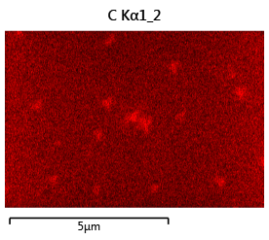
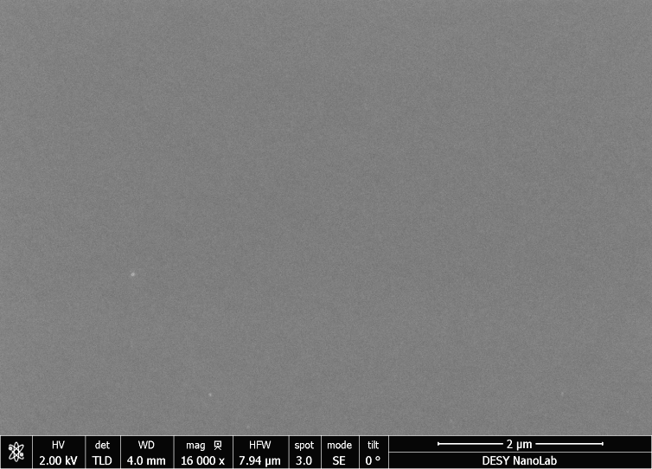
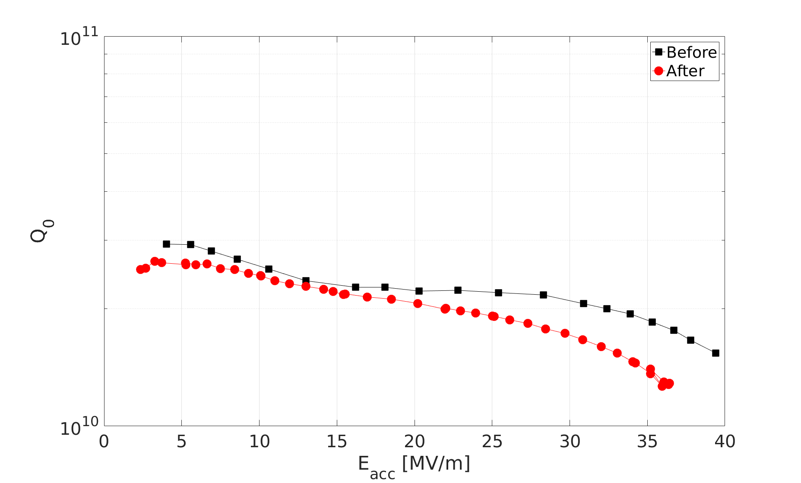
Nb Tri-crystal:
ADP_F2 : after EP and 800°C annealed with1DE3 FNAL in Jan 2018
(100)
(100)
(111)
(110)
C-rich precipitates:
Growth dependence of on the Nb grain orientation
Were not observed on :
2000°C UHV-annealed SC Nb (100),
EP LG Nb (100)
But observed on nano-polished LG Nb (100)
=> clean surface necessary to avoid the precipitates
Detrimental to cavity performance?

Slide 14
Summary:
Systematic XPS studies on nanopolished Nb (100) can track the surfaces changes on N-infused compared to UHV-annealed Nb(100) sample after an hour of air-oxidation:
- increased NbO and NbC but decreased Nb_{x}O content,
Slower Nb₂O₅ growth on N-infused Nb sample
Hint for new phase: NbX_{x}O_{5-x} ; X: O, C, N ?
Nb-N bonding : very week but observable peak for Nb-N
Electron microscopy investigatons confirmed carbon-rich layer below the surface oxide.
Tricrystal Nb: (100), (110) and (111) microscopic investigations revealed dependence of growth of C-rich preipitates on grain-orientation. Moreover, cleaner surface (EP vs. nanopolishing) seems to suppress their formation.
Nb₂O₅
Nb₂X_{y}O_{5-y}/NbO₂/Nb_{x}C_{y}
NbO
Nb
Nb_{x}O
Interstitial -rich Nb
Next steps: Pronounced intensity of Nb₂O₅ inhibits the detection of other phases in neighbouring BE range. To invstigate in detail Nb_{x}O and Nb₂X_{y}O_{5-y} phase
- In-situ XPS experiments and infusion in XPS load-lock
- Sputter depth profiling: preferntial sputtering issues- how SIMS avoid this?

Slide 15
Acknowledgements
Detlef Reschke
Nicholas Walker
Joern Schaffran
Marc Wenskat
Lea Steder
Christopher Bate
Heshmat Noei
Vedran Vonk
Thomas Keller
Andreas Stierle
Alena Prudnikava
Guilherme D. Semione
Satishkumar Kulkarni
Cooperation between:
DESY Nanolab – Prof. Andreas Stierle
DESY Linear Accelerator Technologies – Prof. Brian Foster
DESY Superconducting Accelerator Technologies – Dr. Hans Weise
Special thanks to: Dr. Waldemar Singer and Xenia Singer for providing the material.
- Anna Grassalino and her team for ongoing collaboration
between DESY and FNAL on N-infusion on cavities and samples
Thank you very much for your attention!

