Slide 1
SRF Gun Development at DESY
Electron beams for CW FELs
Detlef Reschke, Elmar Vogel and Jacek Sekutowicz
TTC Meeting 2018 at RIKEN Nishina Center (26. – 29. June)

Slide 2
Strong Team Effort
even more colleagues will join in future
DESY: Serena Barbanotti, Andrea Bellandi, Yury Bozhko, Julien Branlard, Thorsten Büttner, Michael Ebert, Matthias Felber, Ingmar Hartl, Birte van der Horst, Jens Iversen, Kay Jensch, Daniel Klinke, Denis Kostin, Wolf-Dietrich Möller, Bernd Petersen, Andrea Muhs, Detlef Reschke, Holger Schlarb, Manuela Schmökel, Jacek Sekutowicz, Detlef Sellmann, Sven Sievers, Lea Steder, Nicolai Steinhau-Kühl, Alexey Sulimov, Jan-Hendrik Thie, Elmar Vogel, Hans Weise, Stefan Wilke, Lutz Winkelmann
BNL: John Smedley
HZDR: Jochen Teichert
IFJ PAN: Mateusz Wiencek
NCBJ: Robert Nietubyc, Jerzy Lorkiewicz
HZB: Yegor Tamashevich

Slide 3
Electron Beams for Continuous Wave (CW) FELs
photocathode gun technology providing high brightness beams
design beam parameters | CW SRF Gun for XFEL | APEX-1 CW Gun for LCLS II (NC) | pulsed NC XFEL Gun
bunch train duty cycle [%] | 100 | 100 | 0.6
beam current [µA] | up to 25 | up to 60 | up to 27
bunch repetition rate [kHz] | 1 000 to 100 | 620 to 100 | up to 4 500
bunch charge [pC] | 20 to 250 | 10 to 300 | 20 to 1 000
transverse emittance [µm] | 0.4 to 0.8 | 0.2 to 0.6 | 0.2 to 1.0
beam energy at gun exit [MeV] | 3 | 0.75 | 6.1
RF parameters
operation frequency | 1.3 GHz | 186 MHz | 1.3 GHz
accelerating gradient [MV/m] | 21 | 19.5 | 31
electric peak (cathode) field [MV/m] | 40 | 19.5 | 60
RF input power | 750 W | ~ 100 kW | ~ 42 kW
The parameters of normal conducting (NC) pulsed guns can be met by superconducting (SC) guns operating continuous wave (CW).

Slide 4
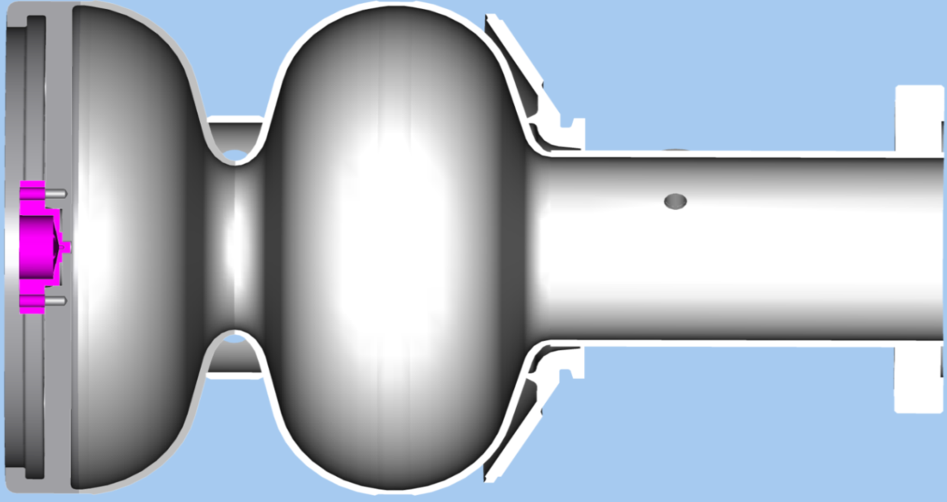
All Superconducting Gun
for optimal integration of cathodes in an ultra-clean SC cavity
existing cathode insertion systems still face challenges
w.r.t. multipacting, field emission, cathode heating, cathode lifetime, etc.
R&D still required and ongoing
e.g. performed at HZDR and HZB
indium gasket (T_{c} = 3.4 K, B_{c} = 28 mT)
DESY approach: superconducting (sc) cathode attached to the cavity backside
cleaning after cathode insertion in a clean room
cathode particles (lead) should not heat and quench the cavity
exchanging the cathode
only reasonable with cathode lifetimes above 100 days
Nb plug
lead coating (T_{c} = 7.2 K, B_{c} = 80 mT)
niobium (T_{c} = 9.2 K, B_{c} = 180 mT)

Slide 5
We Achieve the Required Gradients
results from cavity '16G2'
world record of cathode field in a SRF gun
deformed back wall,
very thick indium gasket

Slide 6
Quantum Efficiency (QE) and Cathode Lifetimes
successful collaboration with John Smedley (BNL) measuring the QE of DESY cathodes
successful collaboration with Jochen Teichert (HZDR) testing the lifetime of DESY cathodes
long time test
550 hours of irradiation
only small QE variations
Quantum Efficiency (QE)
sufficient for the specified bunch charge using an industry built laser
so far no degradation over time
Laser cleaning (at 248nm):
1st 1000 shots with 0.06 mJ/mm²
2nd 10000 shots with 0.06 mJ/mm²

Slide 7
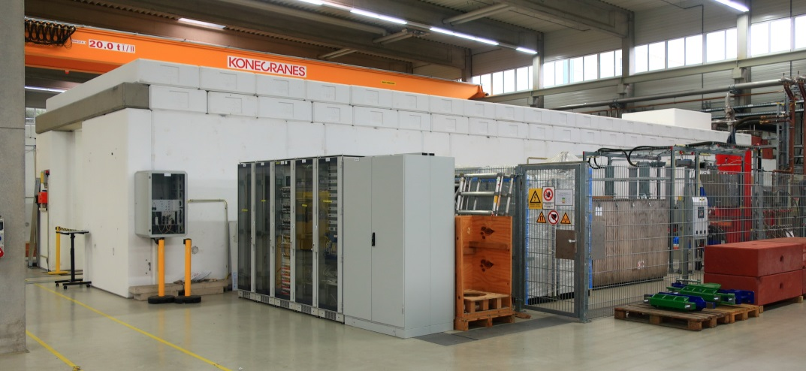
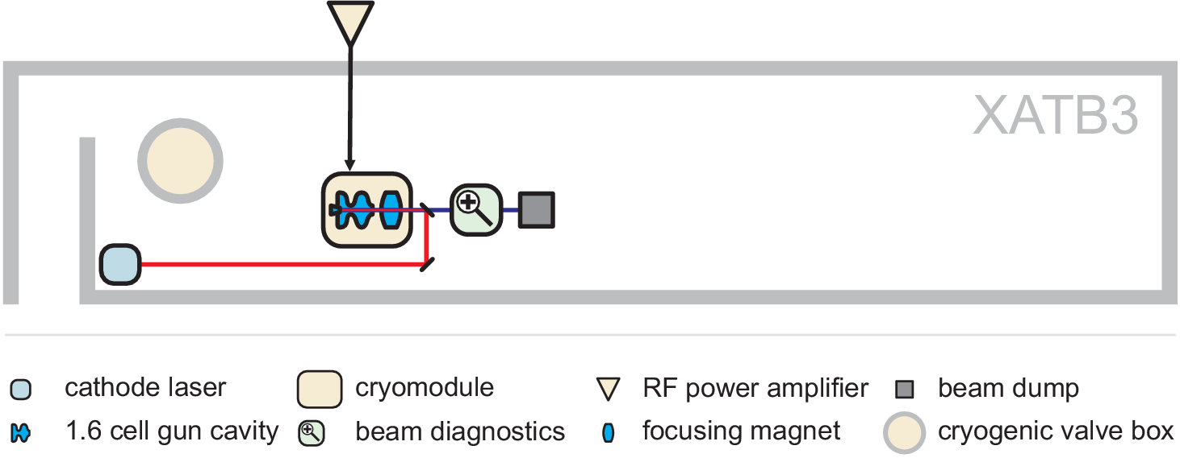
Next Step: Putting It All Together
Goal: Demonstration of a sufficiently long lifetime of the cathode irradiated with a laser in a cavity operating at the design gradient and generating electron bunches with charge up to 250 pC.

Slide 8
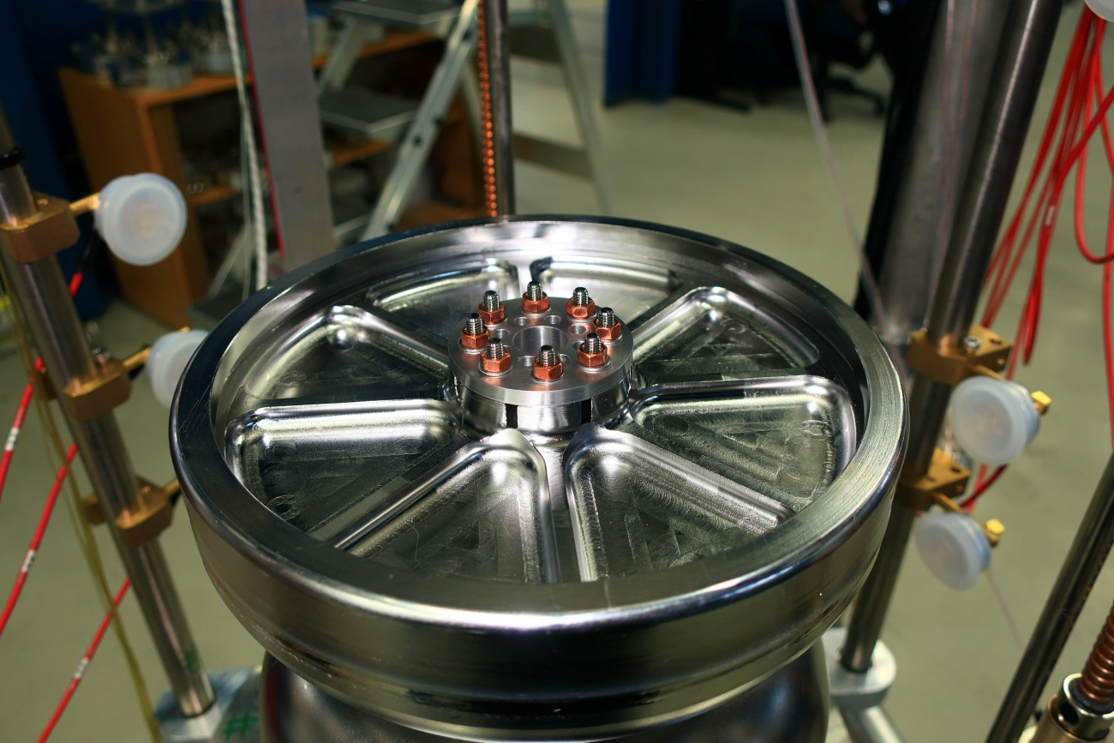
The New SRF Gun Cavities 16G3 and 16G4
built in spring 2017 together with industry
improved mechanical design of the backside
backside mechanically reinforced
titanium thread inserts
improved cathode plug design
design validation by a mechanical model
new auxiliaries like cavity handling frames
achievements
backside without deformation
leak tight

Slide 9
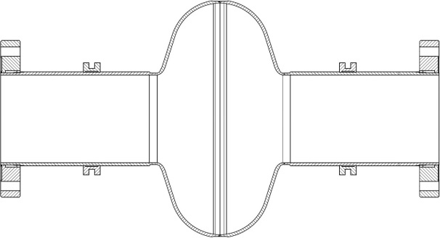
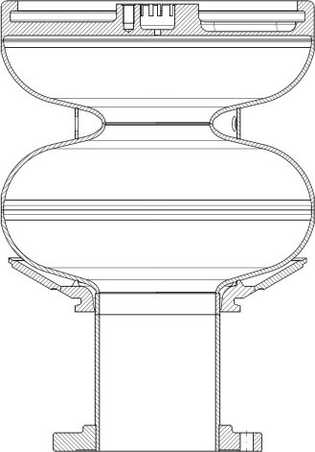
Surface Treatment for SRF Gun Cavities
similar to the ones applied at 9-cell accelerating cavities
at DESY we have well-established procedures for single- and nine-cell cavities
acid and water can flow through beam tubes
Gun cavity: The half cell and the small cathode hole
require a unique approach
Vertical EP done

Slide 10
Recipe and treatment
developments performed & improvements ongoing
adaptation of the electro polishing (EP) apparatus
new EP cathode has been developed avoiding dents at the backside
new high pressure (HPR) rinse nozzle head for optional cleaning of the half-cell and avoiding directly impacting the cathode area
developments ongoing
acrylic glass models to study the HPR
lead coating

Slide 11
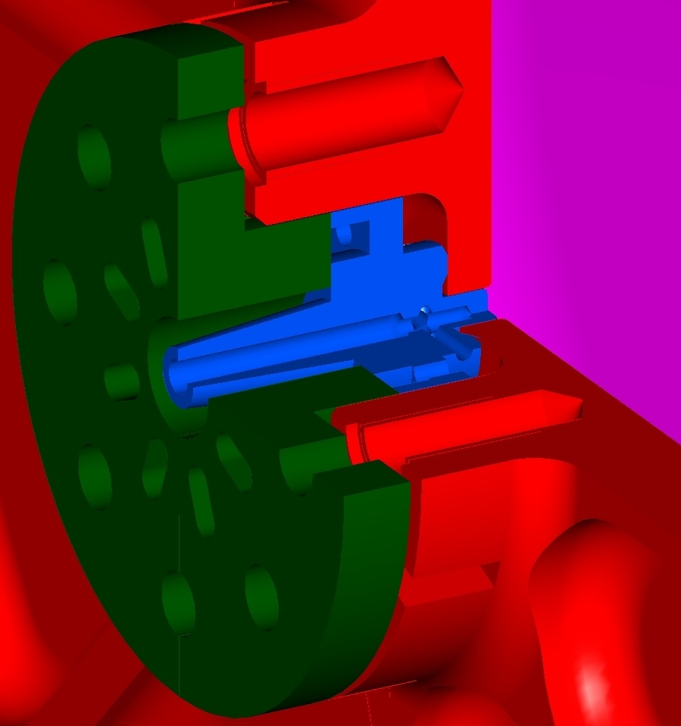
Cathodes and Cathode Plugs
three types under investigation
lead coated niobium plug
bulk lead disc on niobium plug
bulk lead plug
focus of R&D
preparation of niobium plugs before coating
lead coating (by NCBJ, Poland)
clean room compatibility
lead coating
niobium plug (blue) screwed to cavity backside

Slide 12
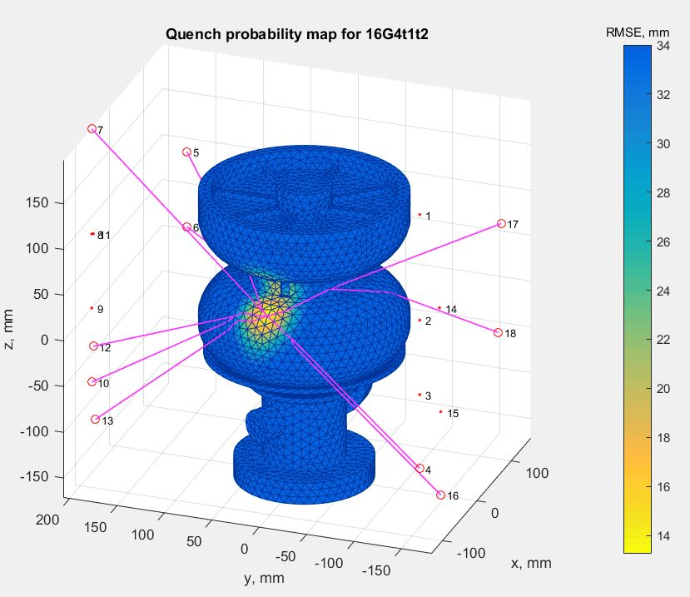
Cold tests of 16G3 and 16G4
vertical tests performed end 2017 and beginning 2018
at temperatures: 2 K, 1.8 K and 1.6 K
normal + slow cool down (from 12 K with ap. -0.1 K / min)
in all cases maximum gradients below spec. (40 MV/m)
E_{cath} = 23 MV/m to 37 MV/m
Q-value lower than expected
no/low field emission observed
'second sound' analysis done (preliminary: Quench close full cell equator and/or end plate)
some rough area at inner surface visible => suspicion for improper vertical EP treatment
next step: BCP + flash EP - like done with 16G2
goal: next vertical tests after BCP in Q4/2018

Slide 13
Cold tests of 16G3 and 16G4
vertical tests performed end 2017 and beginning 2018
at temperatures: 2 K, 1.8 K and 1.6 K
normal + slow cool down (from 12 K with ap. -0.1 K / min)
in all cases maximum gradients below spec. (40 MV/m)
E_{cath} = 23 MV/m to 37 MV/m
Q-value lower than expected
no/low field emission observed
'second sound' analysis done (preliminary: Quench at full cell equator and/or end plate)
some rough area at inner surface visible => suspicion for improper vertical EP treatment
next step: vertical BCP + flash EP - like done with 16G2
goal: next vertical tests after BCP in Q4/2018
Sketch of set-up for vertical BCP

Slide 14
SRF Gun Cryomodule
development and construction of the cryomodule
for future flexibility, HZDR and HZB SRF gun cavities should also fit
special features: ability to align the beam line when the module is cold, likewise the (cold) solenoid
there is a common interest from HZDR, HZB and DESY
meetings at HZB and HZDR
copies of this SRF gun cryomodule may later be used at all three laboratories
goal: design finalized in Q3/2018
first draft of the SRF gun cryomodule

Slide 15
Summary
achievements
required gradient surpassed in vertical test
QE sufficient for the specified bunch charge
no QE degradation (within 550+ hours)
integrated test activities include
improved SRF gun cavity design
surface treatment (ongoing)
cathodes and cathode plug design and treatment
SRF gun cryomodule (available Q2/2019)
cathode laser (expected at DESY Q2/2018)
adaptation of an AMTF test stand (done Q2/2019)
beam dynamics (looking for personnel started)

Slide 16
Thank you for your attention

Slide 17
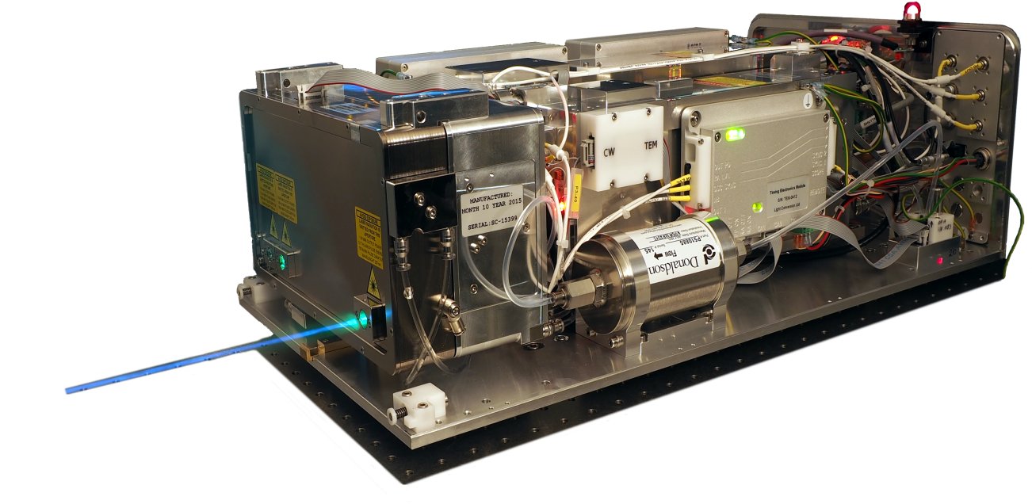
Cathode Laser
we are purchasing an industry built laser (Pharos), similar to the ones already used at DESY
after the laser arrives at DESY
setup of the laser in the laser laboratory
commissioning in Q3/2018
QE measurements of lead cathodes by copying the QE measurement setup from HZDR
studies for scanning the cavity backside to locate the cathode
setup: mirror chamber, dummy beam line, SRF cavity backside complete with cathode plug
laser parameter | specification
wavelengths | 1030 nm / 515 nm / 257 nm
pulse length (FWHM) | 150 fs – 15 ps (UV)
repetition rate | single-shot – 1.1285 MHz
average power in UV | 1 W @ 100 kHz 2 W @ 100 kHz (short period)
max. pulse energy in UV | 10 µJ @ 100 kHz (short term 20 µJ)
special features | output from oscillator for synchronization, actuator to stabilize laser oscillator, spare parts for fast harmonic module exchange

