Slide 1
Welcome to “PATRAS 2018” at DESY in Hamburg

Slide 2
Welcome back after 10 years!

Slide 3
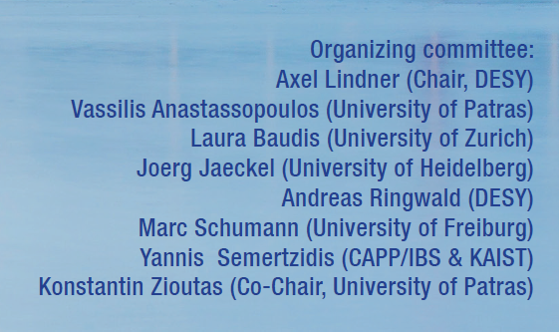
Thanks to “PATRAS 2018” organizing committee

Slide 4
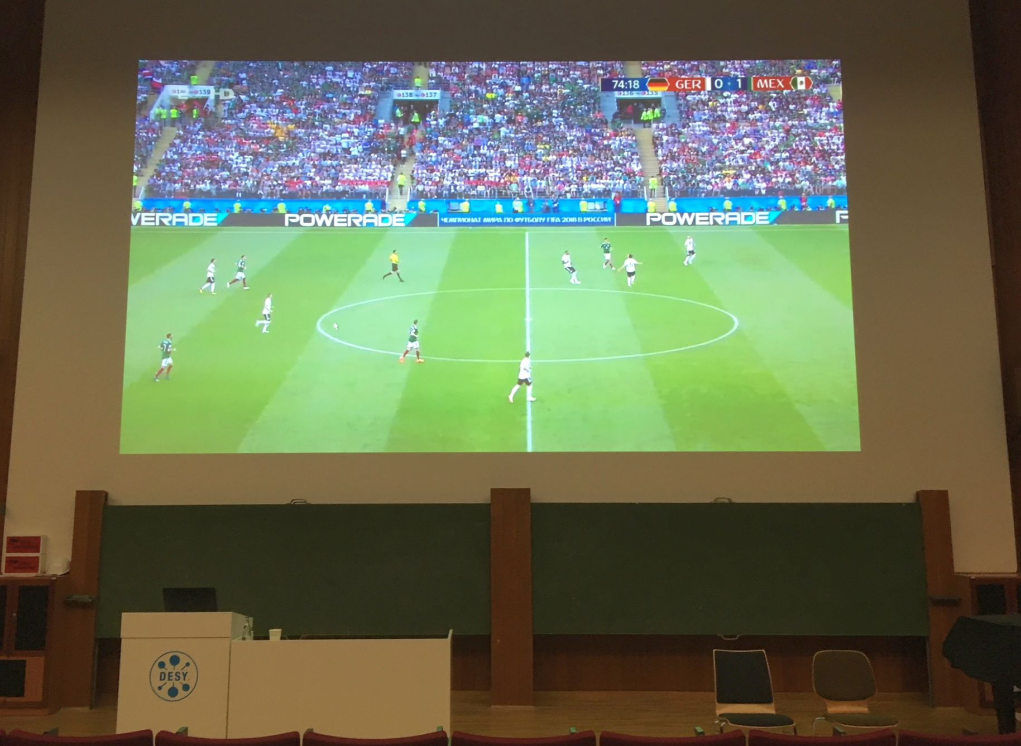
Now the floor is yours!

Slide 5
Now the floor is yours!
For the actual agenda see: https://indico.desy.de/indico/event/20012/timetable/#20180617
Please make sure to upload your materials at least the day before your presentation!
WLAN: "Patras2018" with the password "pheebaisan3o".
For any questions: axel.lindner@desy.de andreas.ringwald@desy.de

