Slide 1

Axion Search Experiment
with 18T HTS Magnet
Center for Axion and Precision Physics Research, IBS
Jin-Geun Kim
PATRAS workshop 6/20/2018

Slide 2
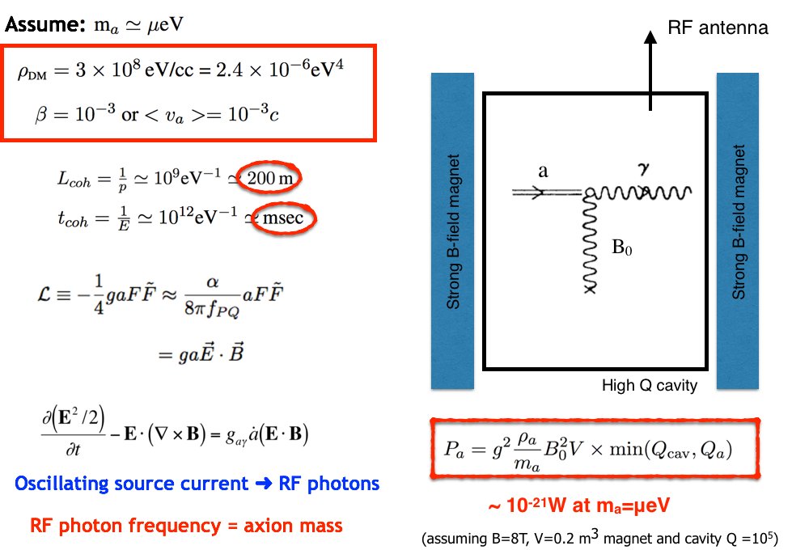
Axion Haloscope

Slide 3
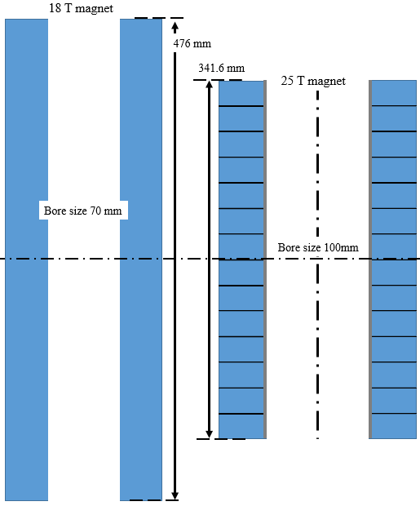
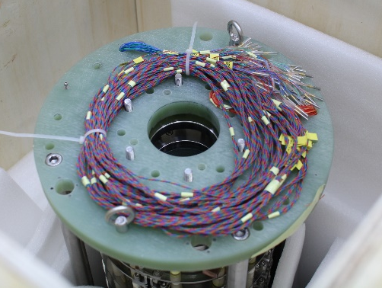
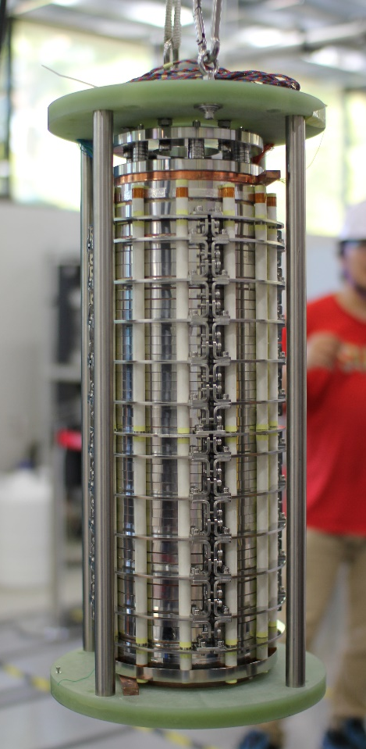
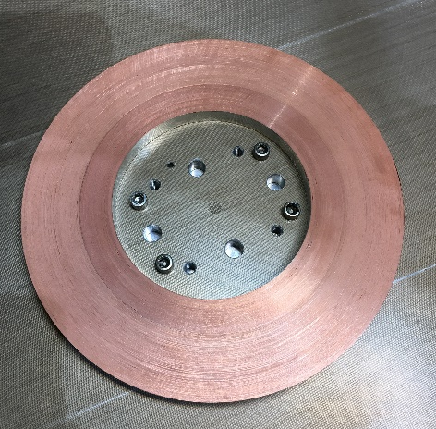
18 T no insulation magnet
1st coil
for 25 T magnet
1/28
44 double pancake coils

Slide 4
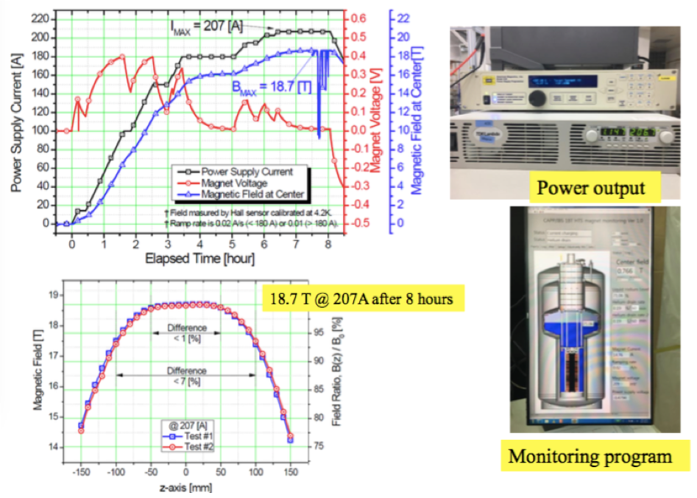
18T HTS Magnet

Slide 5
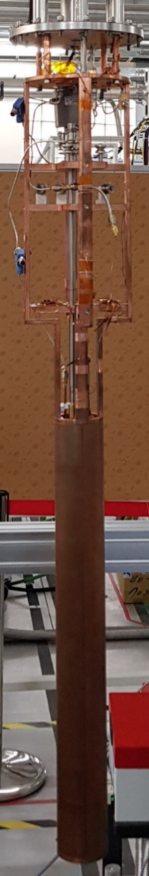
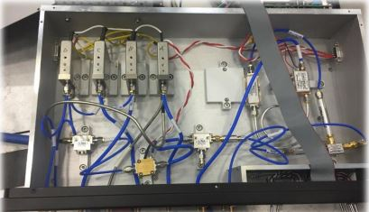
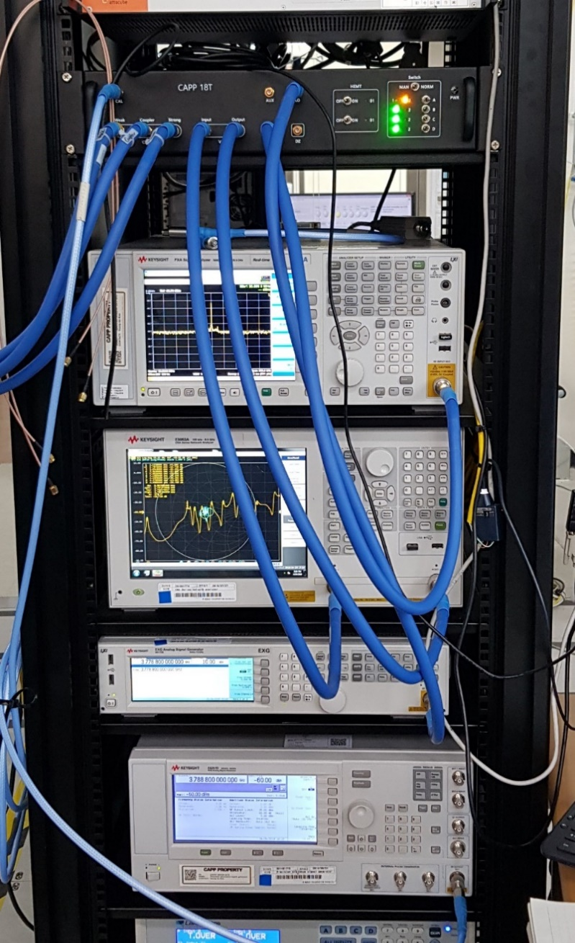
DAQ System
Spectrum analyzer
Room temperature amplifier
Room temperature(RT)-part
Network
Analyzer
(NA)
Signal
Genrator
(SG)
Spectrum
Analyzer
(SA)
Switch B
Input
1
Output
Network analyzer
2
2
2
Intermediate frequency(IF)
Amplifier
Swtich A
1
Switch C
Weak
1
Band pass filter(BPF)
Coupling
Cryogenics-part
Local oscillator (LO)
Mixer
Signal generator
coupler
coupler
Band pass filter(BPF)
2
Isolator
Cavity
Circulator
Low noise amplifier
(LNA)
1
Switch D
Radio frequency(RF)
Amplifier
Cavity
RF chain configuration

Slide 6
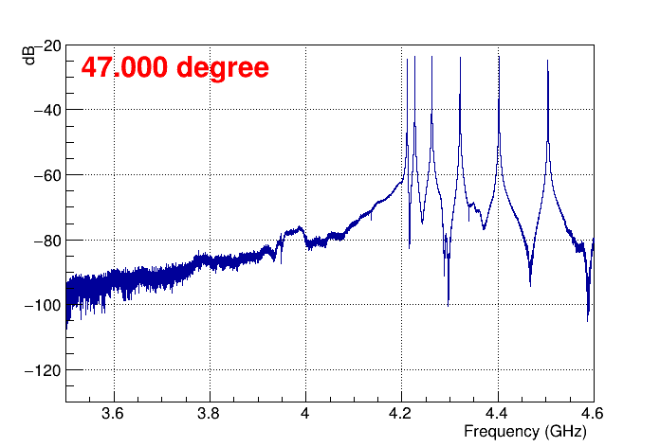
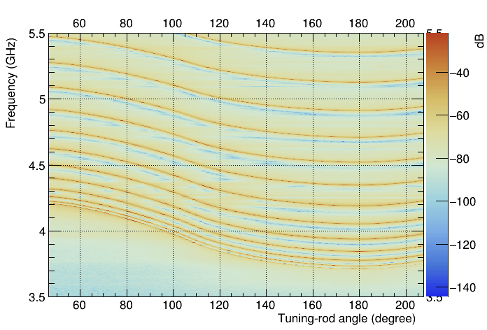
Cavity and Tuning-rod in 18T & 4K
Cavity cross section
Tuning rod

Slide 7
Background Noise in 18T & 4K
13 MHz, from signal generator
Noise measure

Slide 8
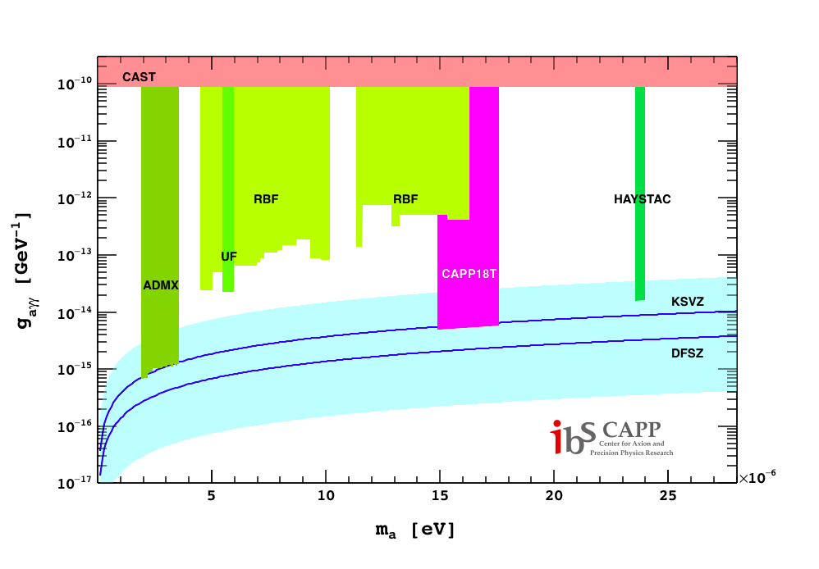
Projected Axion Search Goal

