Slide 1
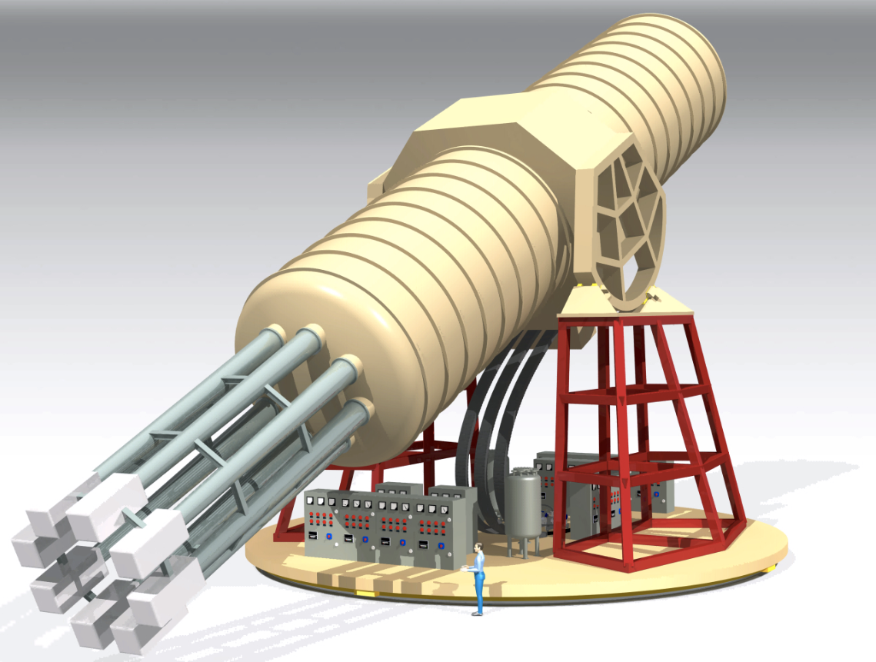

International AXion Observatory (IAXO): status and prospects
Igor G. Irastorza
Universidad de Zaragoza on behalf of the IAXO collaboration
14th AxionWIMP “Patras” conference, DESY, Hamburg, 20 June 2018

Slide 2
Axion motivation in a nutshell
Most compelling solution to the Strong CP problem of the SM
Axion-like particles (ALPs) predicted by many extensions of the SM (e.g. string theory)
Axions, like WIMPs, may solve the DM problem for free. (i.e. not ad hoc solution to DM)
Astrophysical hints for axion/ALPs?
  Transparency of the Universe to UHE gammas
  Stellar anomalous cooling → g_{aγ} ~ few 10⁻¹¹ GeV⁻¹ / m_{a} ~few meV ?
Relevant axion/ALP parameter space at reach of current and near-future experiments
Experimental efforts growing fast but still small (when compared e.g. to WIMPs…)
recent experimental review:
I. G. Irastorza & J. Redondo, PNPP2018 (arXiv:1801.08127)
New experimental approaches in the search for axion-like particles

Slide 3
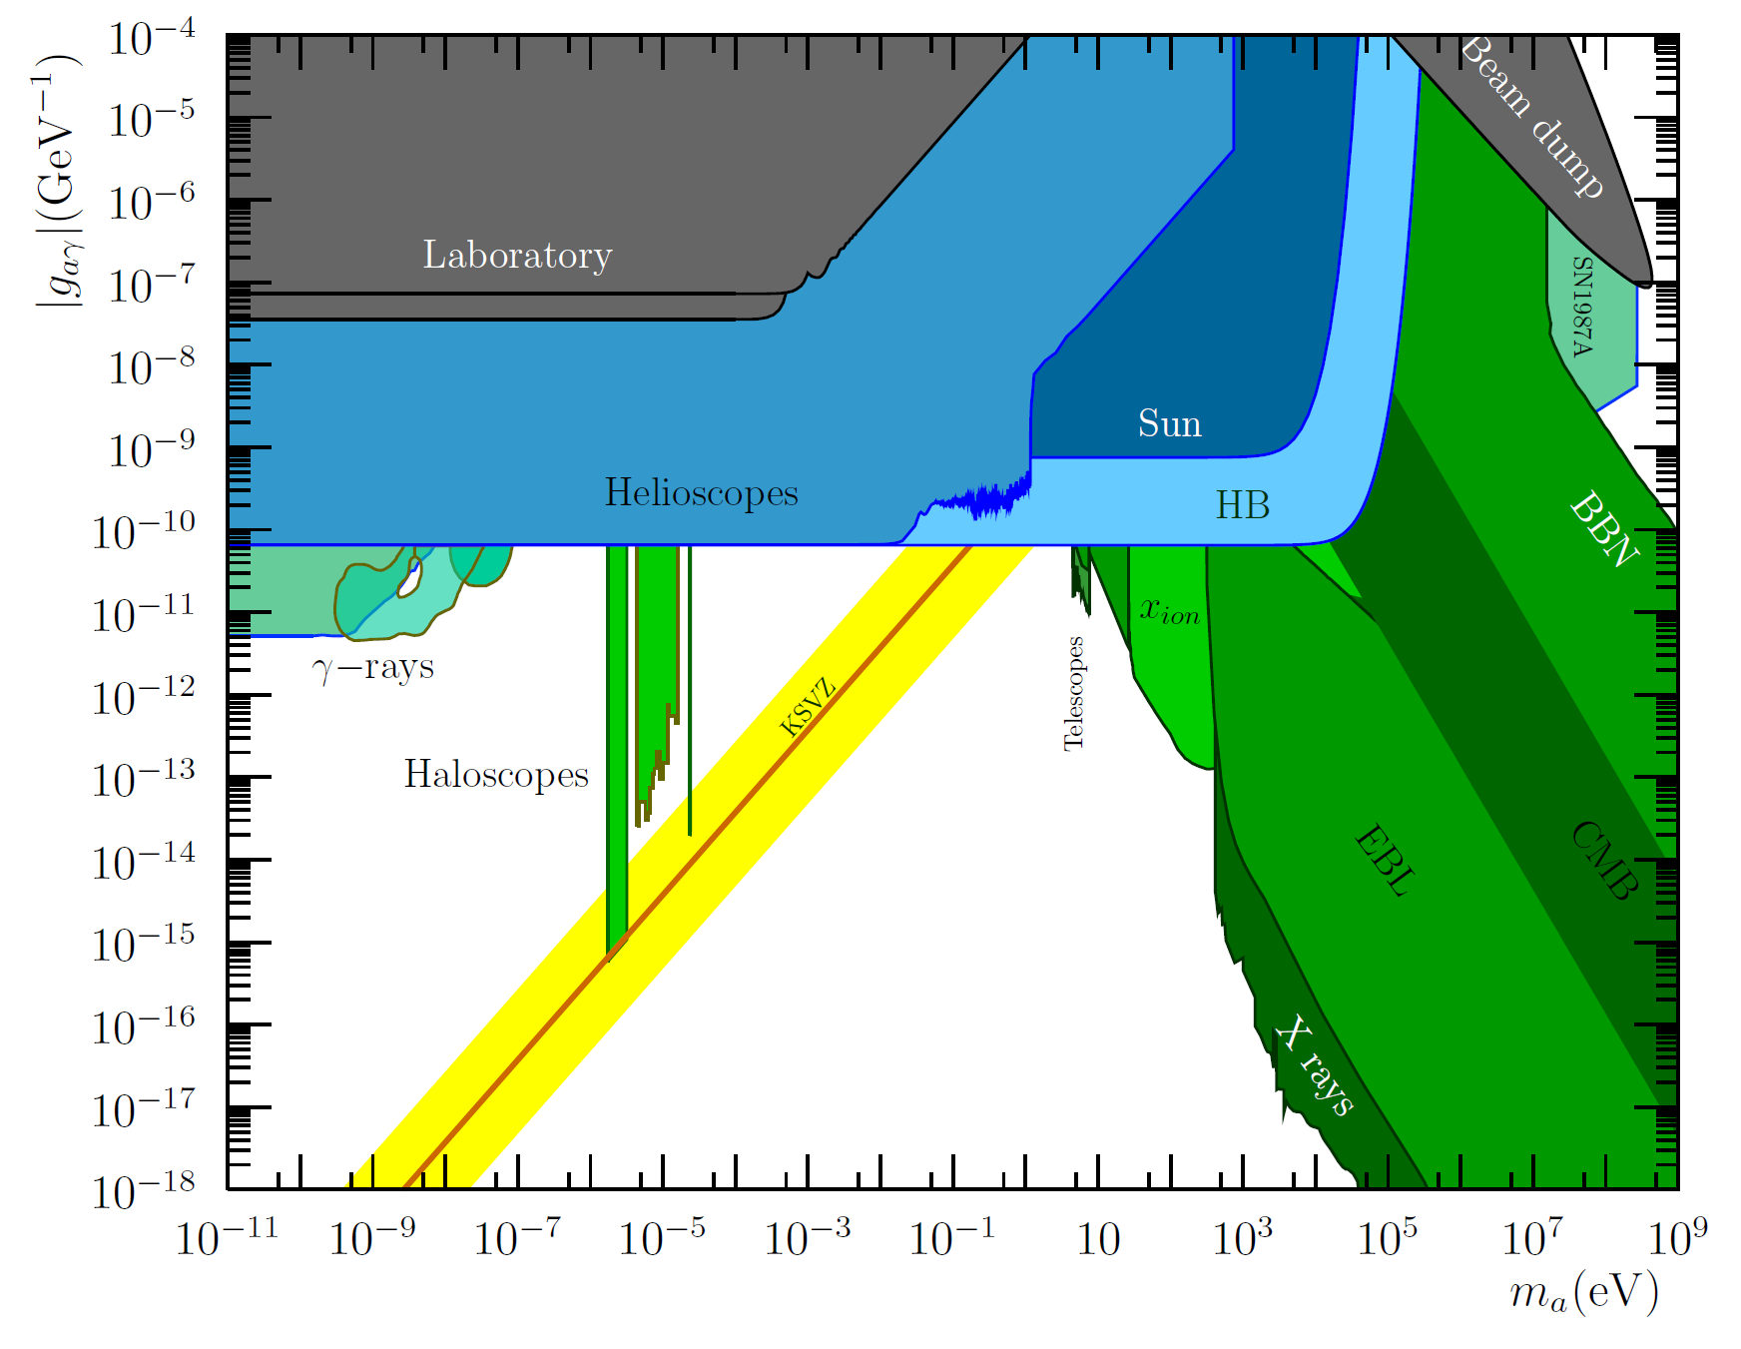

Axion/ALP searches motivation
IAXO
“Focuses of interest” in the ALP parameter space
Theory
Astrophysics
Cosmology
IAXO addresses partially all of them
meV+ QCD axion region exclusive target of IAXO

Slide 4



Detection of axions
Source | Experiments | Model & Cosmology dependency | Technology
Relic axions | ADMX, HAYSTAC, CASPEr, CULTASK, CAST-CAPP, MADMAX, ORGAN, RADES, QUAX, … | High | New ideas emerging, Active R&D going on,…
Lab axions | ALPS, OSQAR, CROWS, ARIADNE,… | Very low
Solar axions | SUMICO, CAST, (Baby)IAXO | Low | Ready for large scale experiment

Slide 5
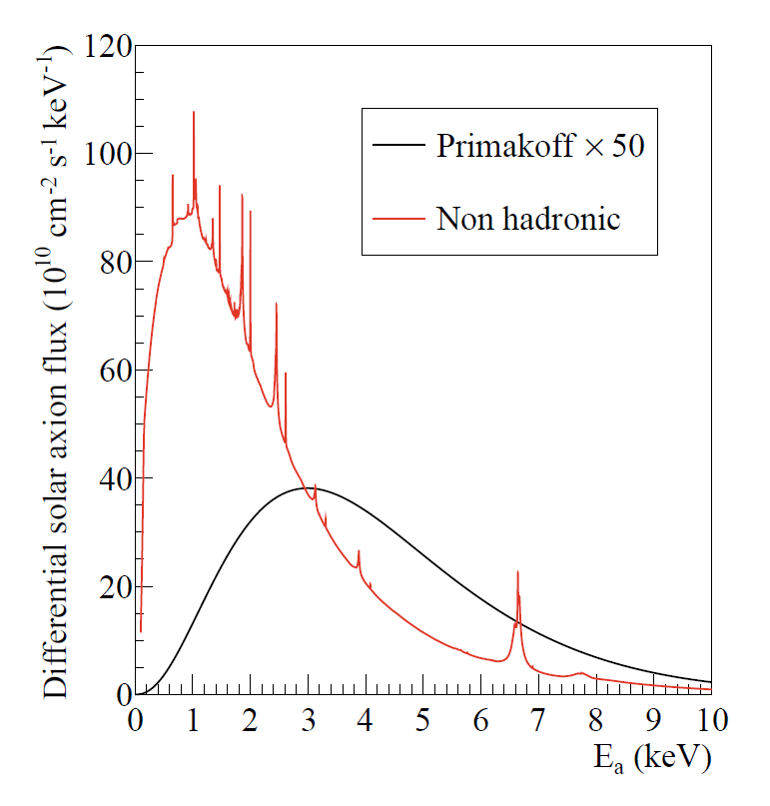
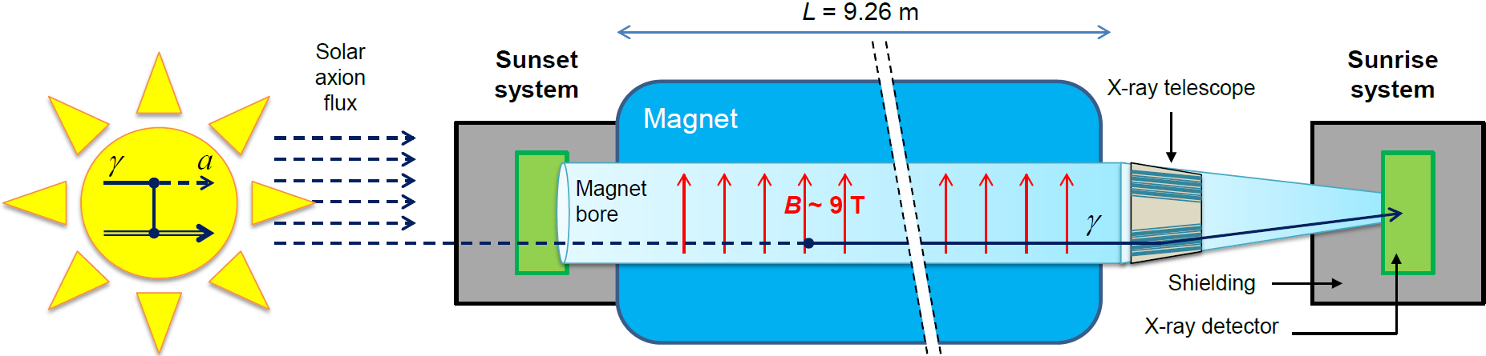
Axion Helioscopes
Previous helioscopes:
  First implementation at Brookhaven (just few hours of data) [Lazarus et at. PRL 69 (92)]
  TOKYO Helioscope (SUMICO): 2.3 m long 4 T magnet
Standard Primakoff spectrum
Axion helioscope concept
P. Sikivie, 1983
+ K. van Bibber, G. Raffelt, et al. (1989)
(use of buffer gas)
Non-hadronic “ABC” Solar axion flux at Earth
JCAP 1312 008
(only if axion couples to electron)
Current state-of-the-art:
CERN Axion Solar Telescope (CAST)
First helioscope using low background techniques & x-ray focusing

Slide 6
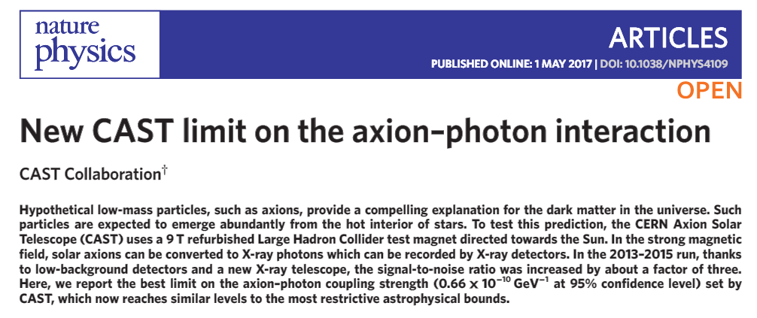
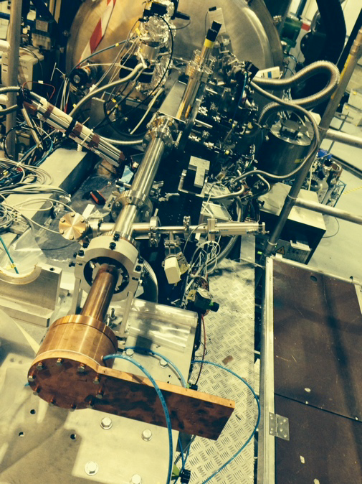
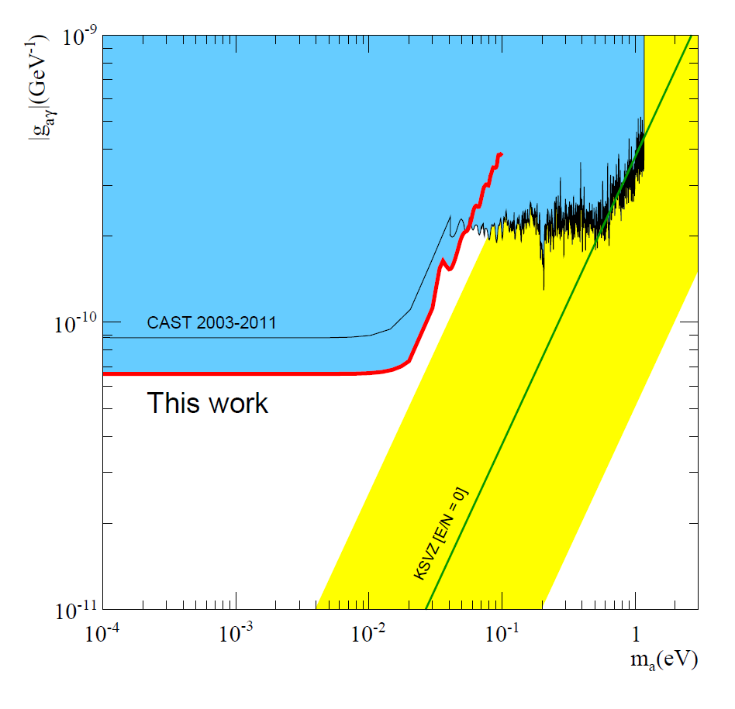

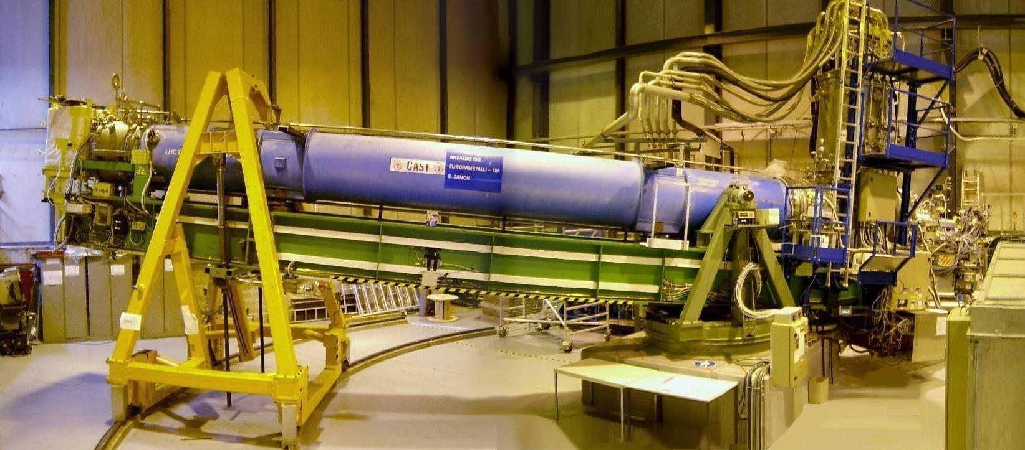
Latest CAST limit
IAXO pathfinder system at CAST:
x-ray focusing + low background detector combined in same system
Small-scale version of IAXO baseline detection lines
X-ray optics specifically built for axions
Low background Micromegas

Slide 7
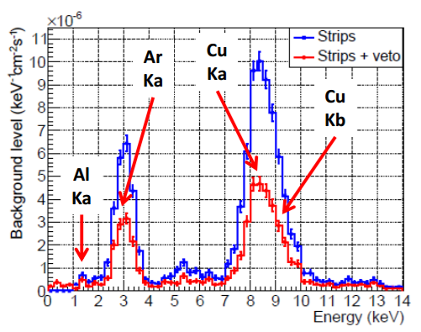
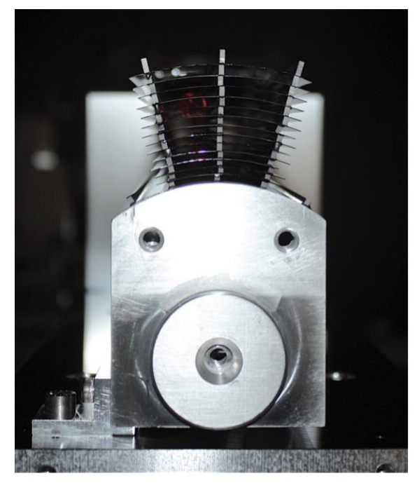
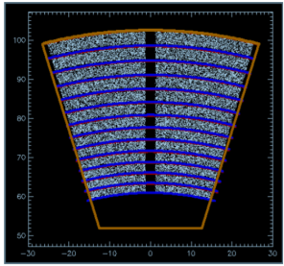
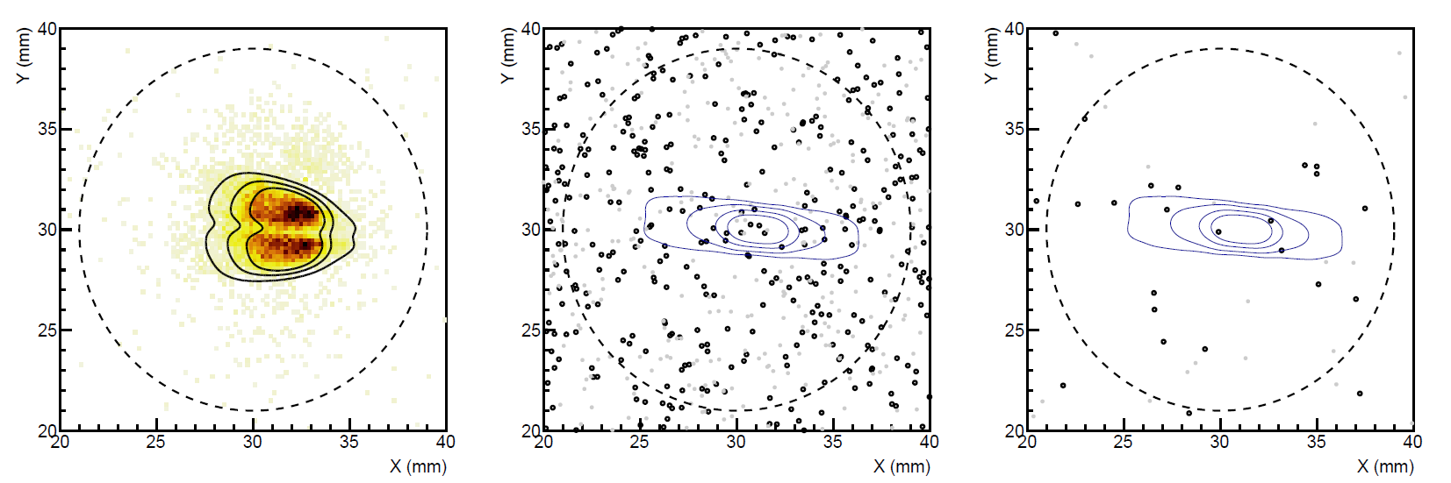
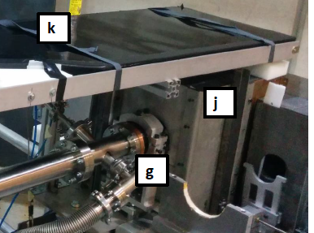
IAXO pathfinder system in CAST
Test MM detector + slumped-glass x-ray optics together
X-ray optics specifically built for axions
Detector: JCAP12 (2015)
Physics: Nature Physics (10.1038/nphys4109)
Background spectrum
Best SNR of any previous detector
290 tracking hour acquired (6.5 months operation)
3 counts observed in RoI (1 expected)
5 mm
Low background Micromegas at the focal point
Calibration data
“axion” data

Slide 8
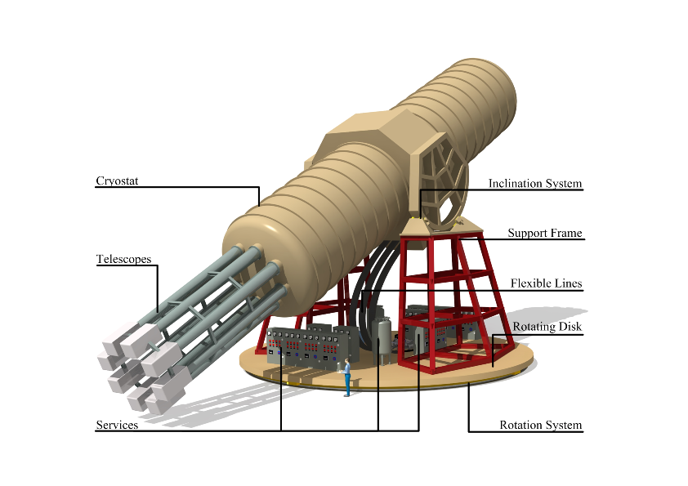
IAXO – Conceptual Design
Large toroidal 8-coil magnet L = ~20 m
8 bores: 600 mm diameter each
8 x-ray telescopes + 8 detection systems
Rotating platform with services

Slide 9
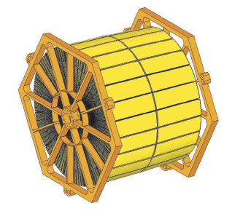
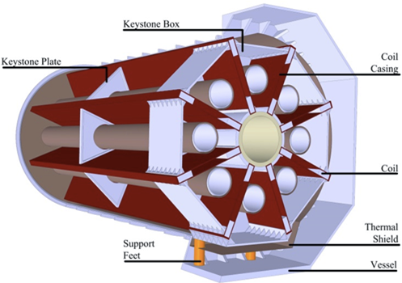
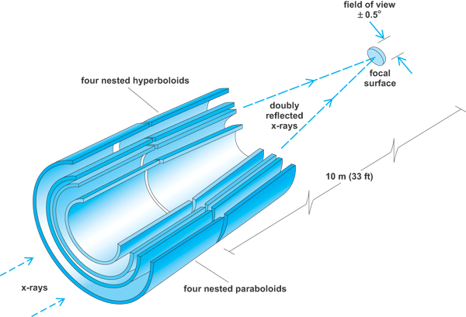
IAXO technologies
IAXO telescopes
Slumped glass technology with multilayers
Cost-effective to cover large areas
Similar to NuSTAR optics
Focal length ~5 m
60-70% efficiency
LLNL+UC+DTU
+ MIT + INAF
IAXO magnet
Superconducting “detector” magnet.
Toriodal geometry (8 coils)
Based on ATLAS toroid technical solutions.
CERN+CEA expertise
8 bores / 20 m long / 60 cm Ø per bore
Focal length
Baseline developed at:
IAXO Letter of Intent: CERN-SPSC-2013-022
IAXO Conceptual Design: JINST 9 (2014) T05002 (arXiv:1401.3233)

Slide 10
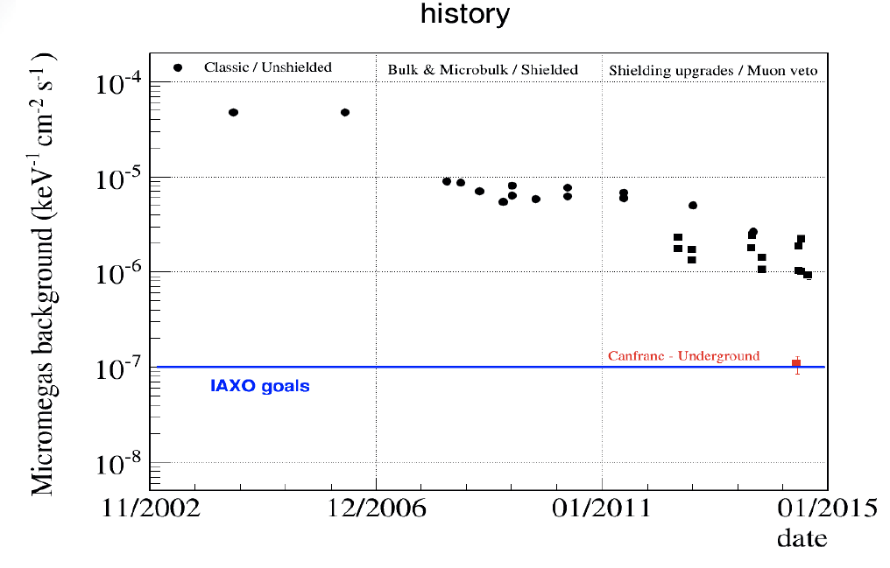
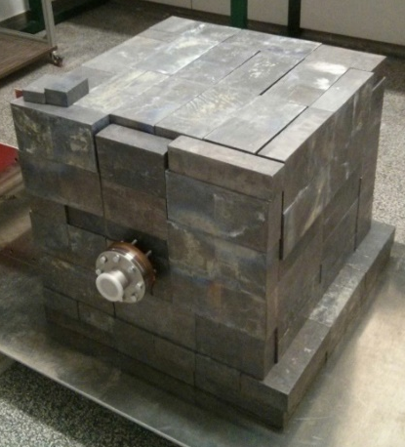
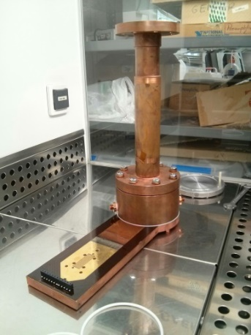
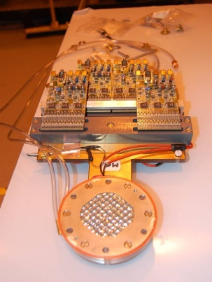
IAXO low background MM detectors
History of background improvement of Micromegas detectors at CAST
Goal background level for IAXO:
  10⁻⁷ – 10⁻⁸ c keV⁻¹ cm⁻² s⁻¹
Already demonstrated:
~8×10⁻⁷ c keV⁻¹ cm⁻² s⁻¹
  (in CAST 2014 result)
  10⁻⁷ c keV⁻¹ cm⁻² s⁻¹
  (underground at LSC)
IAXO goals
Nominal values at CAST
Active program of development.
IAXO-D0 test-platform to explore background sources and improve levels

Slide 11
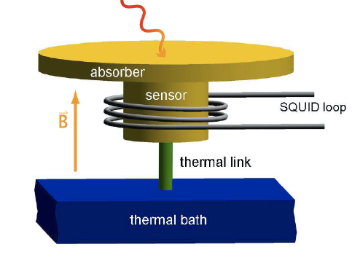
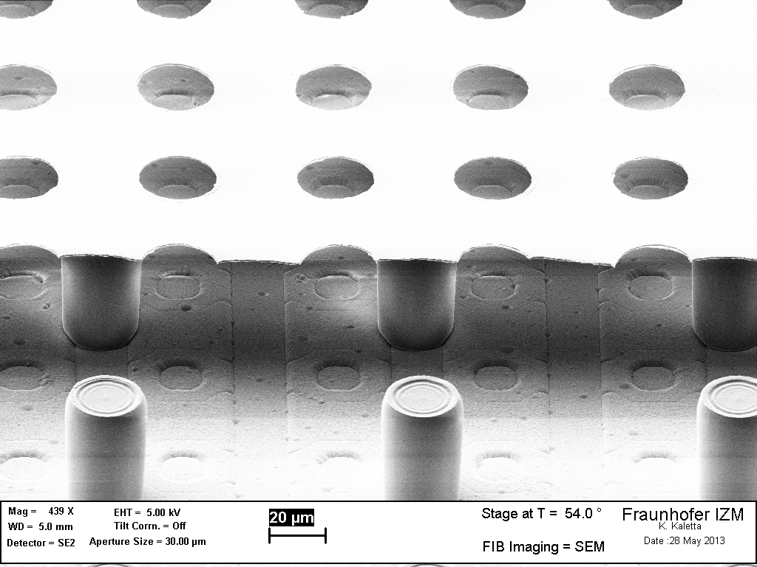
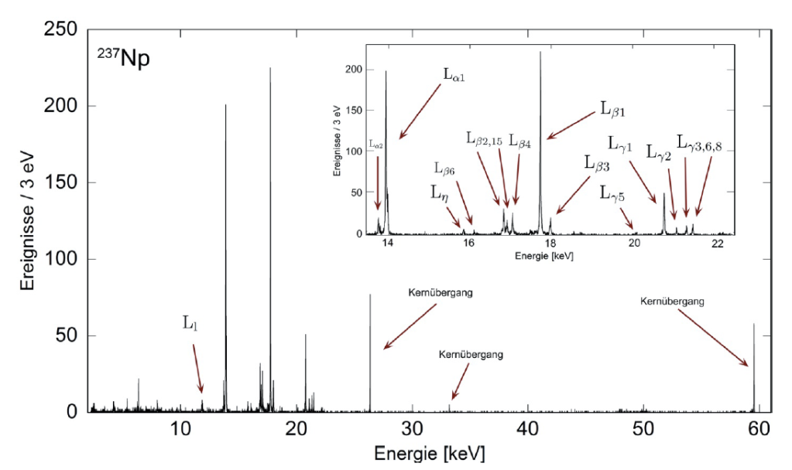
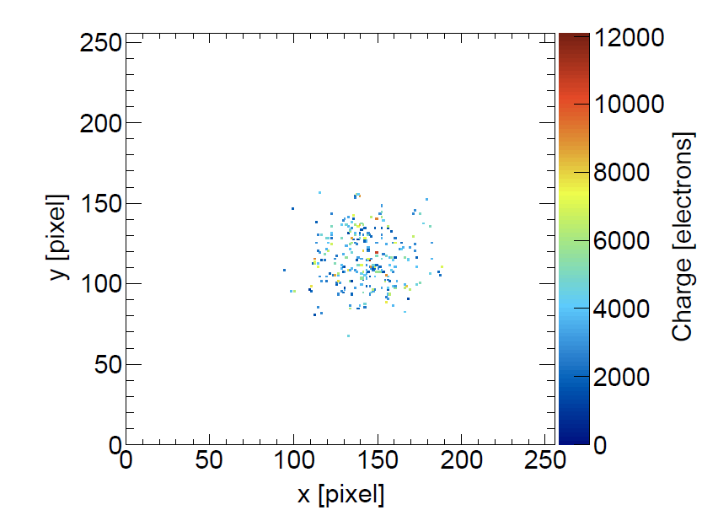
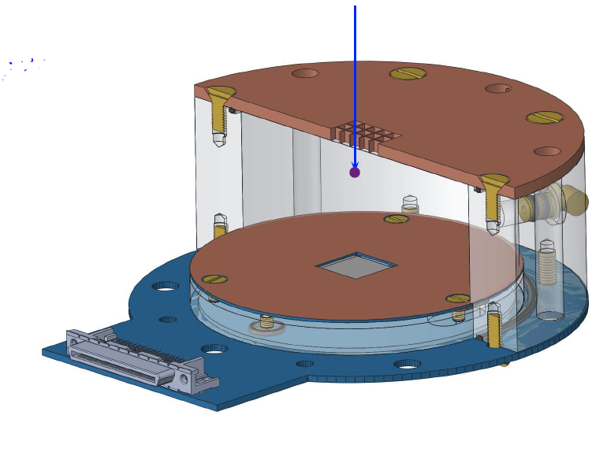
Additional detector technologies for IAXO
GridPix detectors (U. Bonn):
Micromegas on top of a CMOS chip (Timepix)
Very low threshold (tens of eV)
Tested in CAST
MMC detectors (U. Heidelberg):
Extremely low threshold and energy resolution (~eV scale)
Low background capabilities under study
Typical X-ray event
Single e- visible
See poster from L. Gastaldo on MMCs for IAXO
See talk from C. Krieger on Gridpix at CAST
Also:
Transition Edge Sensors (TES)
Si- detetors

Slide 12
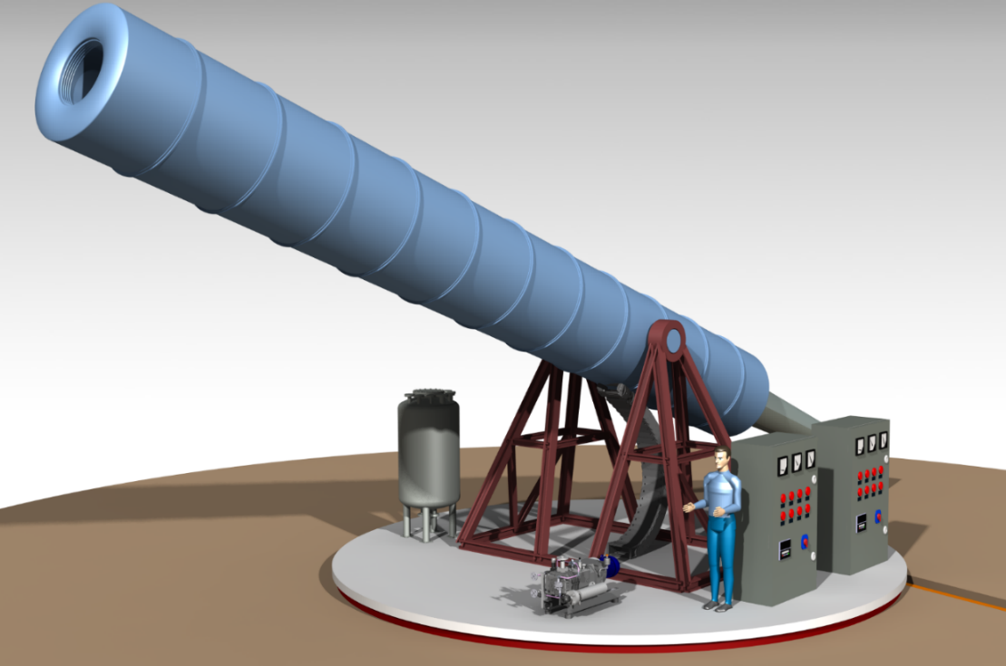
BabyIAXO
Intermediate experimental stage before IAXO
One single bore of similar dimensions of final IAXO bores → detection line representative of final ones.
Test & improve all systems. Risk mitigation for full IAXO
Will produce relevant physics
Move earlier to “experiment mode”
Magnet Technical Design ongoing at CERN
Free bore [m] | 0.6
Magnetic length [m] | 10
Field in bore [T] | 2.5
Stored energy [MJ] | 27
Peak field [T] | 4.1
10x CAST B²L²A
ERC-AvG 2017 IAXO+

Slide 13
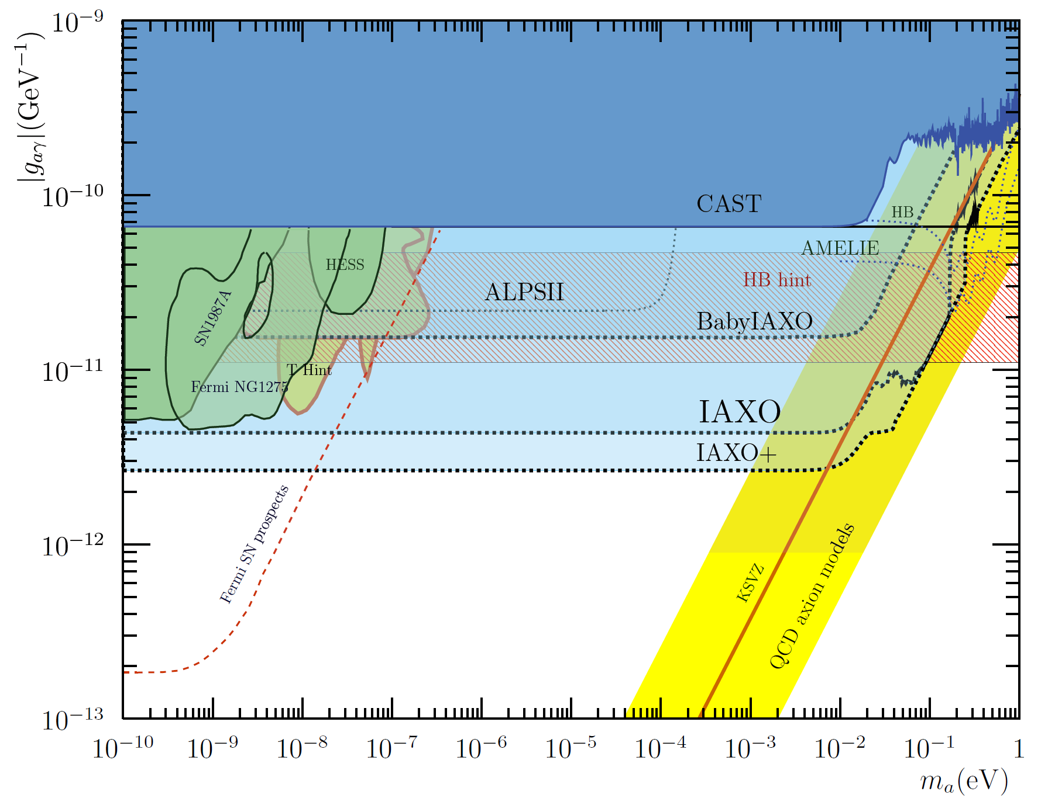
Helioscopes & astrophysics hints
BabyIAXO prospects:
10xFOM magnet + optics and detector from conservative scenario of LoI
IAXO+: enhanced scenario with x4 higher MFOM with respect LoI
… as well as a large fraction of the axion & ALP models invoked in the “stellar cooling anomaly”
But for this the g_{ae} is particularly interesting
IAXO will fully explore ALP models invoked to solve the “transparency hint”

Slide 14
IAXO & stellar cooling
Multiple stellar anomalies (HB, RG, WD, NS,..). Overall 3σ effect.
g_{ae} channel
IAXO will explore most of the relevant models (especially with IAXO+)
Only experiment with such capability
Region of QCD axion models that solve the stellar anomaly
M. Giannotti et al.
JCAP 1710 (2017) 010
arXiv:1708.02111

Slide 15
IAXO most recent milestones & plans
Collaboration formally established in last year’s collaboration meeting at DESY (last July):
  17 institutions to sign IAXO bylaws
  Management structure defined.
Near term goal defined for the collaboration: BabyIAXO
  Full intermediate experiment with relevant physics potential
Experimental site for IAXO: Strong interest from DESY
BabyIAXO Magnet under design at CERN.
IAXO progress is being followed by “Physics Beyond Colliders” process at CERN (to provide feedback for the European Strategy Part Phy)
MoU under preparation with financial plan. ERC funding obtained.
Solid plans towards BabyIAXO. Construction could happen in 2-3 years.

Slide 16
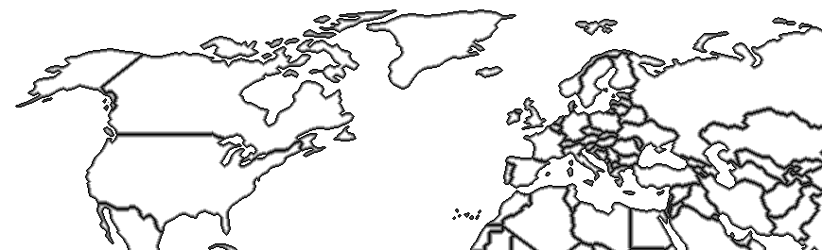
IAXO collaboration
17 institutions from Germany, Spain, US, France, Russia, Croatia, S. Africa, CERN.
DESY (Germany)
U. Bonn (Germany)
U. Heidelberg (Germany)
St. Petersburg (Russia)
MIT (US)
U. Mainz (Germany)
CEA (France)
INR-Moscow (Russia)
LLNL (US)
CERN
RBI (croatia)
U. Barry (US)
INAF-Milano (Italy)
U. Zaragoza (Spain)
CNM (Spain)
U. Cape Town (S. Africa)
ICCUB (Spain)
Likely to grow in the future, more groups showing interest…
New partners welcome…

Slide 17
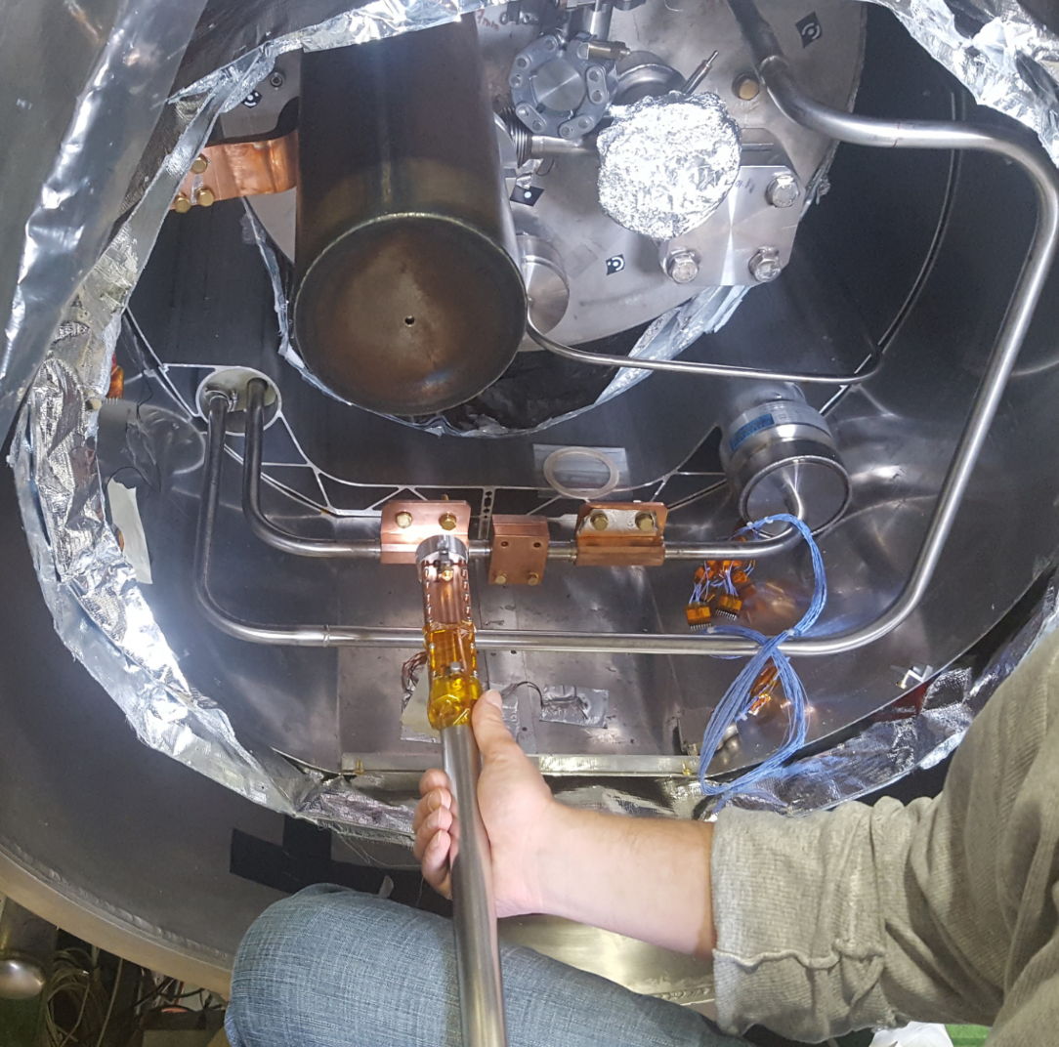
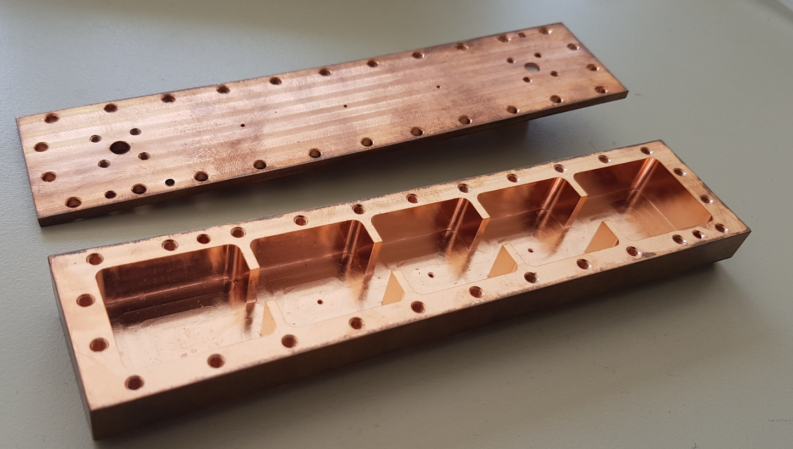
Additional physics cases
Use of (Baby)IAXO large magnetic volume for axion DM setups.
Various possible arrangements in IAXO. Leverage the huge magnetic volume available:
  Single large cavity tuned to low masses
  Thin long cavities tuned to mid-high masses. Possibility for directionality. Add several coherently? → e.g. RADES R&D
  Pick-up coils for vely low mass detection
RADES concept: array of small cavities interconnected with irises:
Installed successfully in CAST last year, and first engineering run took place Nov-Dec2017
See poster from S. Arguedas

Slide 18

Conclusions
Important milestones regarding establishment of the collaboration
Near term plans towards BabyIAXO better defined.
Project backed up by ERC AdV grant. Expected to move forward quicker in next years…
Great opportunity for our community.
New partners are welcome!

