Slide 1
Modified Gravity, After LIGO
Ignacy Sawicki
CEICO, Prague

Slide 2
Summary
LIGO has measured the speed of GWs to be that of light
I will discuss how to construct theories where this is not the case and argue that all these type of theories are now not viable
I will show that, if anything, LSS data would like gravity to be “slightly weaker” and show that after LIGO this is very hard to achieve in the context of a modification of gravity

Slide 3
LorenTZ Invariance $⇒$ One Speed
$p_{μ}p^{μ}=m^{2}$
$ω^{2}=k^{2}+m^{2}$
$ω≈k+\frac{m^{2}}{2k}+…$
Notes:
LI means this is the only dispertion relation you can write down
In the short-wavelength limit speed is always 1, with small frequency-dependent correction
LIGO constrained the mass of graviton on the basis of this to be < 10^-22 eV

Slide 4
BUT: A Solution BreakS LI
Cosmology is a background with a preferred direction
$∇_{μ}φ$ $A_{μ}$ $u_{μ}$
Mix/non-linear kinetic terms
$P\left({\left(∂φ\right)}^{2}\right)$, $P\left(F_{μν}^{2}\right)$, ${\left(∂φ\right)}^{2}R$, $G_{μν}∇_{μ}∇_{ν}φ$
Effective acoustic metric
$𝒢_{μν}∂^{μ}δφ∂^{ν}δφ=0$ with e.g. $𝒢_{μν}∝g_{μν}+D∇_{μ}φ∇_{ν}φ$
Notes:
LI means this is the only dispertion relation you can write down
In the short-wavelength limit speed is always 1, with small frequency-dependent correction
LIGO constrained the mass of graviton on the basis of this to be < 10^-22 eV

Slide 5
Effective Metric for GW
$$𝒢_{μν}=Ω\left(g_{μν}+D_{μν}\right)$$
Notes:
LI means this is the only dispertion relation you can write down
In the short-wavelength limit speed is always 1, with small frequency-dependent correction
LIGO constrained the mass of graviton on the basis of this to be < 10^-22 eV

Slide 6
Effective Metric for GW
Disformal
$$𝒢_{μν}=Ω\left(g_{μν}+D_{μν}\right)$$
Conformal
Notes:
LI means this is the only dispertion relation you can write down
In the short-wavelength limit speed is always 1, with small frequency-dependent correction
LIGO constrained the mass of graviton on the basis of this to be < 10^-22 eV

Slide 7
Effective Metric for GW
$$𝒢_{μν}=Ω\left(g_{μν}+D_{μν}\right)$$
GWs are null rays of effective metric
$𝒢_{μν}k^{μ}k^{ν}=0$ with $h=h_{TT}(x)e^{−ik_{μ}x^{μ}}$
Dispersion relation (cosmology)
$$\left(1+D_{00}\right)ω^{2}=k^{2}$$
Notes:
LI means this is the only dispertion relation you can write down
In the short-wavelength limit speed is always 1, with small frequency-dependent correction
LIGO constrained the mass of graviton on the basis of this to be < 10^-22 eV

Slide 8
Effective Metric for GW
$$𝒢_{μν}=Ω\left(g_{μν}+D_{μν}\right)$$
Action for GWs (cosmology)
$S_{h}=\frac{M_{Pl}^{2}}{8}\int{dtd^{3}xa^{3} Ω\left(1+D_{00}\right)\left({\dot{h}}^{2}−c_{T}^{2}{\left(∂_{k}h\right)}^{2} \right)}$
Speed of tensors: $c_{T}^{2}≡{\left(1+D_{00}\right)}^{−1}$
Effective Planck mass: $M_{∗}^{2}≡M_{Pl}^{2}Ω\left(1+D_{00}\right)$
Redefine to Einstein frame $⇒$ now coupled in EM action
Notes:
LI means this is the only dispertion relation you can write down
In the short-wavelength limit speed is always 1, with small frequency-dependent correction
LIGO constrained the mass of graviton on the basis of this to be < 10^-22 eV

Slide 9
The LIGO MEASUREMENT
August 17, 2017: GW signal detected by aLIGO (GW170817)
GRB detection by Fermi (GRB170817A)
Luminosity distance from GW: ${40}_{−14}^{+8} Mpc$
Time delay $1.7 s$ after coalescence
$$\left|c_{T}^{2}−1\right|<{1⋅10}^{−15}$$

Slide 10
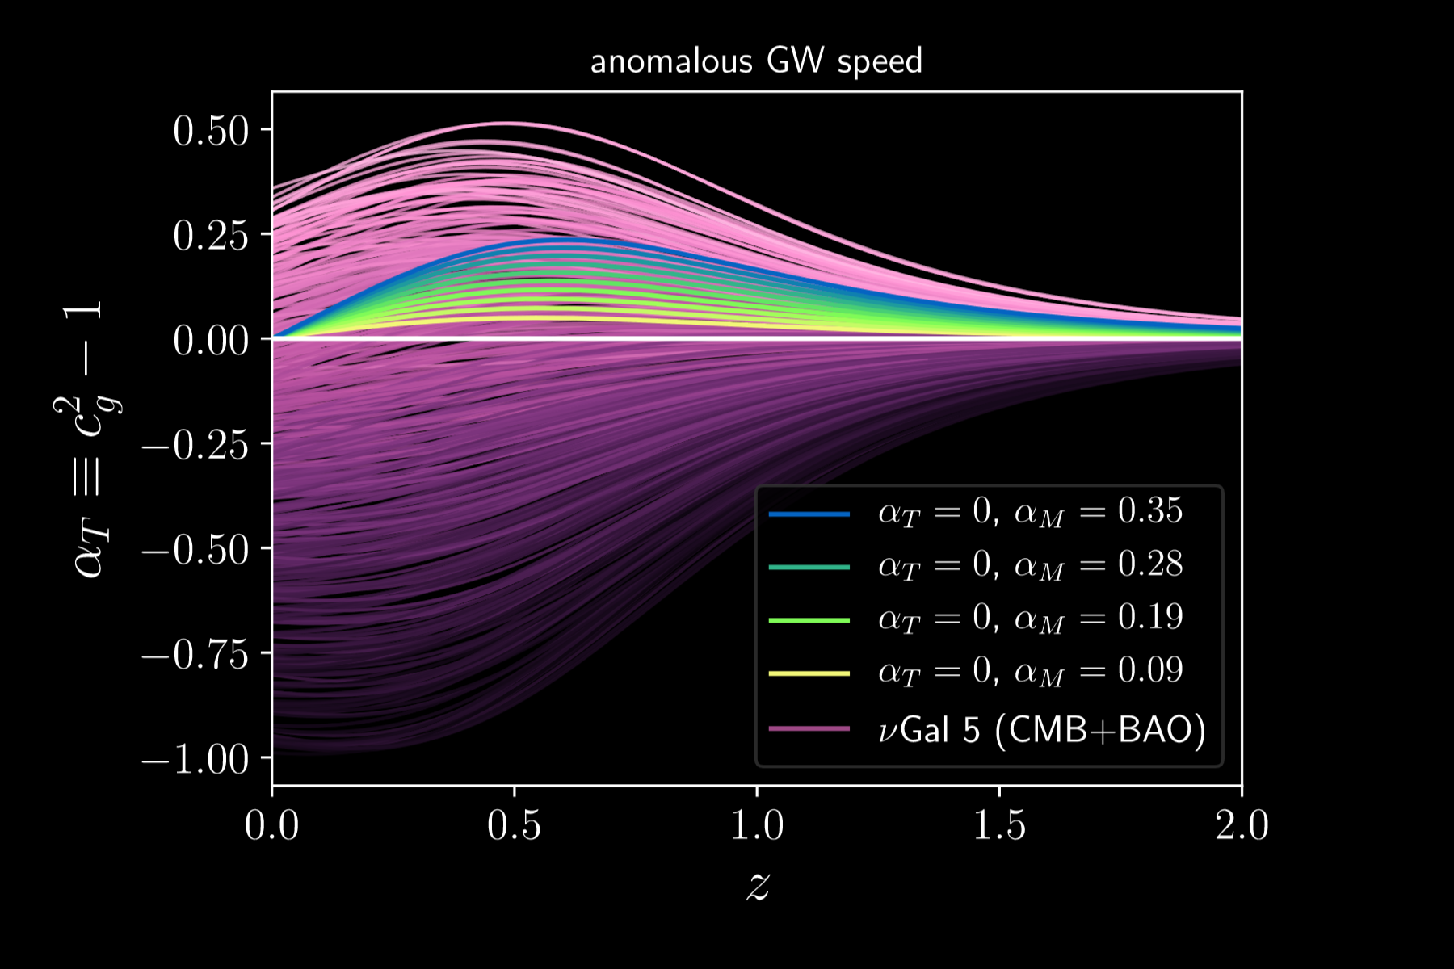
Caveats
Source is at redshift $z∼0.01$. This is a local measurement
The universe is not homogeneous of scales of $λ_{GW}∼3 km$.
Ezquiaga and Zumalácarregui (2017)

Slide 11
from Now: Assume $c_{T}^{2}=1$
Operators leading to disformal couplings to gravity highly suppressed
E.g. for scalar-tensor galileons
$$M_{c_{T}}≳1000 M_{Λ}$$
GW and photon metrics are, at most, conformally related:
$$𝒢_{μν}=Ωg_{μν}$$

Slide 12
Dark ENERGY

Slide 13
what is there to Explain?
W. Freedman

Slide 14
what is there to Explain?
DES 1st Year
Ruíz and Huterer

Slide 15
What is the hope?
$ρ+p<0$ helps with all observables, but ghosts
$$S_{p.f.}=\int{dV\frac{ρ+p}{H^{2}}\left(δ{\dot{φ}}^{2}−c_{s}^{2}{\left(∂_{i}δφ\right)}^{2}\right)}$$
Imperfect fluid for dark energy can stabilise this

Slide 16
Modified GW $⇔$ Gravitational SLIP
$$ds^{2}=−\left(1+2Ψ\right)dt^{2}+a^{2}\left(δ_{ij}+h_{ij}\right)dx^{i}dx^{j}$$ $h_{ij}=−2Φδ_{ij}+h_{ij}^{TT}$
E.g. for scalar-tensor theories
$$\ddot{h}+\left(2+α\right)H\dot{h}−c_{T}^{2}∂^{2}h=0$$
$$Ψ−Φ=\left(c_{T}^{2}−1\right)Φ+α δφ/\dot{φ}$$
$$η=\frac{Φ}{Ψ}≠1$$

Slide 17
Is Slip Necessary?
Planck 3-yr
Growth
Lensing

Slide 18
LIGO and ScalaR-Tensor Models
 | Lagrangian | Properties
Perfect fluid | $$K(X)$$ | $$w>−1$$
KGB | $$G(X)□φ$$ | $$μ>1,η=1$$
Brans-Dicke/f(R) | $$ω\left(φ\right)R$$ | $$μ>1, η=\frac{1}{2}$$
Horndeski-4 | $$G_{4}\left(X\right)R$$ | $$c_{T}^{2}≠1$$
Horndeski-5 | $$G_{5}(X)R_{μν}∇^{μ}∇^{ν}φ$$ | $$c_{T}^{2}≠1$$
GPLV-4 | $$F_{4}$$ | $$c_{T}^{2}≠1$$
GPLV-5 | $$F_{5}$$ | $$c_{T}^{2}≠1$$

Slide 19
LIGO and ScalaR-Tensor Models
 | Lagrangian | Properties
Perfect fluid | $$K(X)$$ | $$w>−1$$
KGB | $$G(X)□φ$$ | $$μ>1,η=1$$
Brans-Dicke/f(R) | $$ω\left(φ\right)R$$ | $$μ>1, η=\frac{1}{2}$$
Horndeski-4 | $$G_{4}\left(X\right)R$$ | $$c_{T}^{2}≠1$$
Horndeski-5 | $$G_{5}(X)R_{μν}∇^{μ}∇^{ν}φ$$ | $$c_{T}^{2}≠1$$
GPLV-4 | $$F_{4}$$ | $$c_{T}^{2}≠1$$
GPLV-5 | $$F_{5}$$ | $$c_{T}^{2}≠1$$
 | $$F_{4}=−G_{4}/2X$$ | $$μ≷1,η≠1$$

Slide 20
LIGO and ScalaR-Tensor Models
 | Lagrangian | Properties | Comment
Perfect fluid | $$K(X)$$ | $$w>−1$$ | Not solution
KGB | $$G(X)□φ$$ | $$μ>1,η=1$$ | ISW
Brans-Dicke/f(R) | $$ω\left(φ\right)R$$ | $$μ>1, η=\frac{1}{2}$$ | Chameleons
Horndeski-4 | $$G_{4}\left(X\right)R$$ | $$c_{T}^{2}≠1$$
Horndeski-5 | $$G_{5}(X)R_{μν}∇^{μ}∇^{ν}φ$$ | $$c_{T}^{2}≠1$$
GPLV-4 | $$F_{4}$$ | $$c_{T}^{2}≠1$$
GPLV-5 | $$F_{5}$$ | $$c_{T}^{2}≠1$$
 | $$F_{4}=−G_{4}/2X$$ | $$μ≷1,η≠1$$ | White Dwarfs

Slide 21
Vectors and TensorS
Vector-tensor models of two general types
Einstein-Aether with a constraint
Generalised Proca, with a symmetry
After LIGO for all vector models:
No slip, $η=1$
$μ>1$
Massive gravity: tensor-tensor models
In principle no new information, but no viable model valid for all cosmology exists
$m_{h}>{10}^{−21} eV$

Slide 22
BONUS: Constraining M_{pl} EVOLUTION
Amendola, IS, Kunz, Saltas (2017)
$$α_{M}=\frac{d\ln{M_{∗}^{2}}}{d\ln{a}}$$
$\ddot{h}+\left(2+α_{M}\right)ℋ\dot{h}+k^{2}h=0$
LISA BH mergers with optical counterparts
+ BAO from Euclid/LSST
$$σ_{α_{M}}∼0.03÷0.1$$
$$h_{a}aM_{∗}=const$$
$$A_{γ}a=const$$
$$d_{GW}={\left(1+z\right)}^{α_{M}/2}d_{L}$$

Slide 23
Wrapping UP
From the point of view of cosmology $c_{T}=c_{γ}$
No operators coupling gravity/EM disformally (e.g. TeVeS)
If anything, large-scale structure data would prefer
w<–1, gravity weaker than GR and gravitational slip
After LIGO, this is very difficult

