Slide 1
Data Management and Analysis
Mastering the Data Challenge in MATTER
Michael Bussmann
Institute of Radiation Physics
MATTER AND TECHNOLOGIES
Notes:
VIEL kürzer, nur ein prägnantes (einleitendes) Beispiel

Slide 2
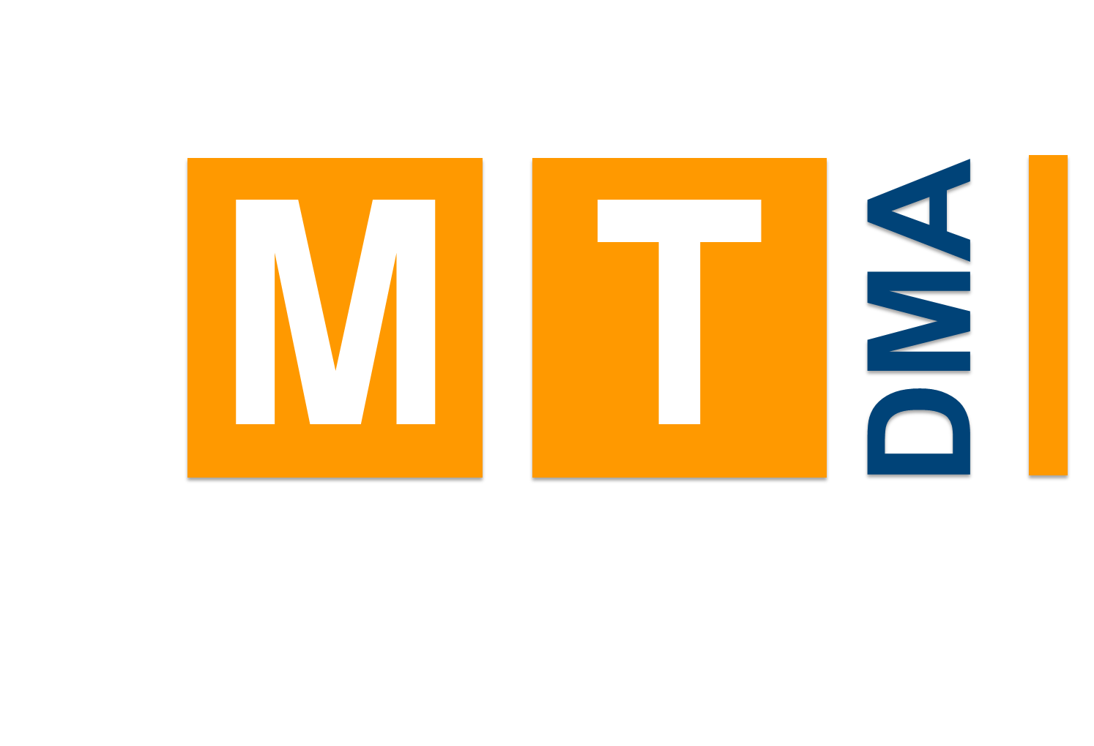
From DTS to the proposed DMA
Currently, the topic DTS deals with aspects of fast data acquisition and parallel data analysis. It does not include domain scientists and is not connected to the data management at large scale facilities. It thus only includes only a subset of what DMA aims to achieve.
DMA is thus specifically designed to
work as a cross-program activity within MATTER
include domain scientists as co-developers and to bring them together with method scientists
develop and provide digital methods for research in MATTER on all scales, from research infrastructures to single investigators
MT
ARD
DTS
DMA
MU
MML
Notes:
End with future!

Slide 3
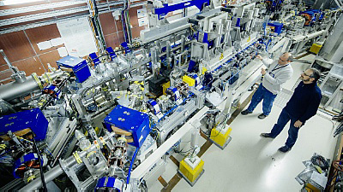
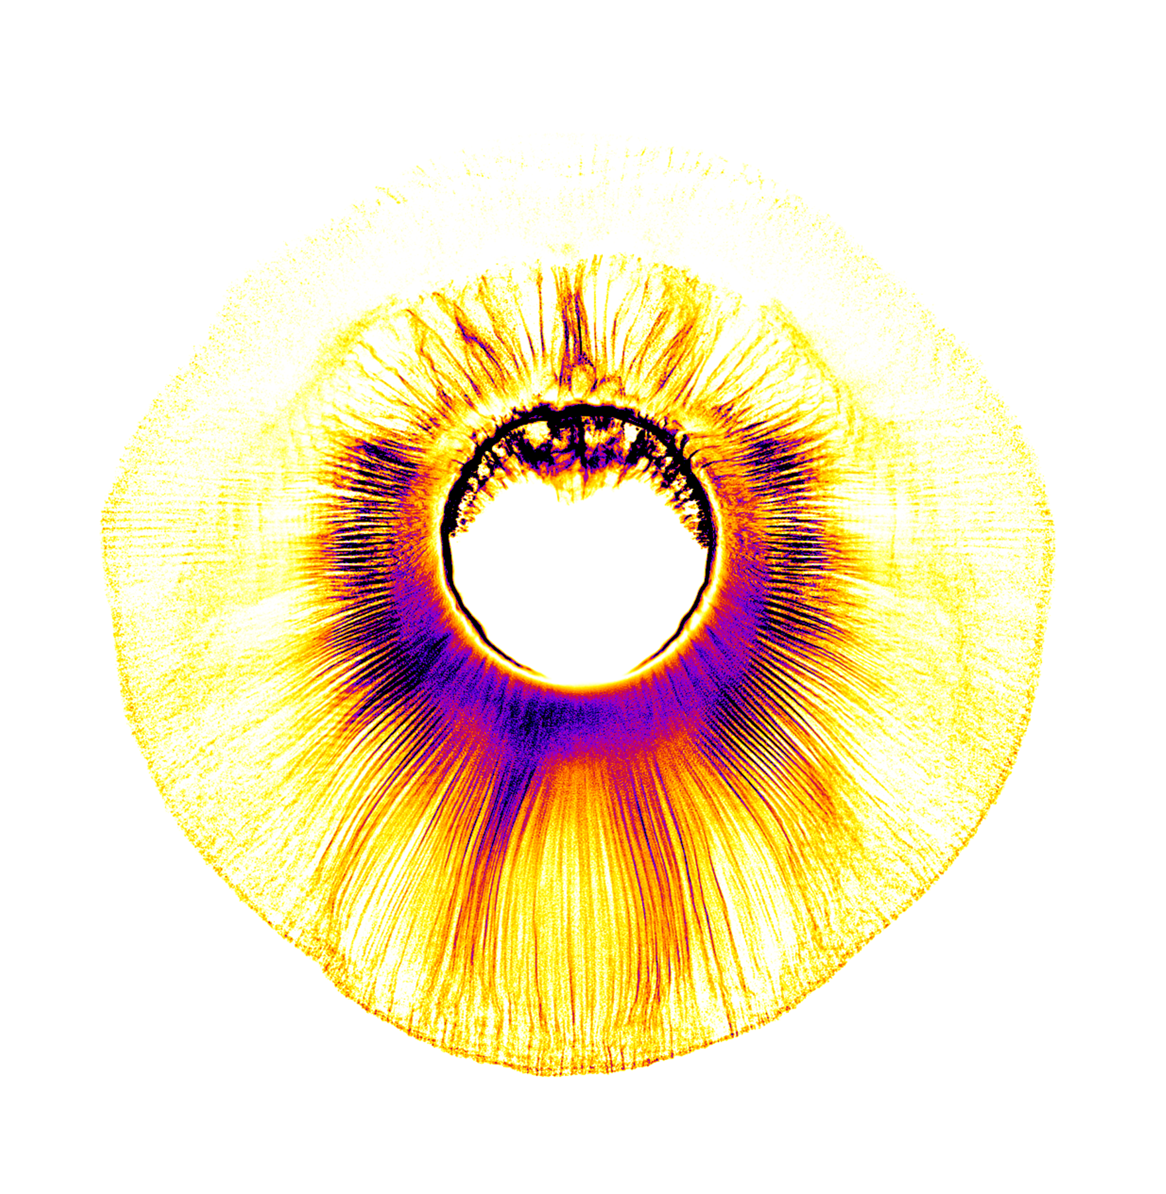
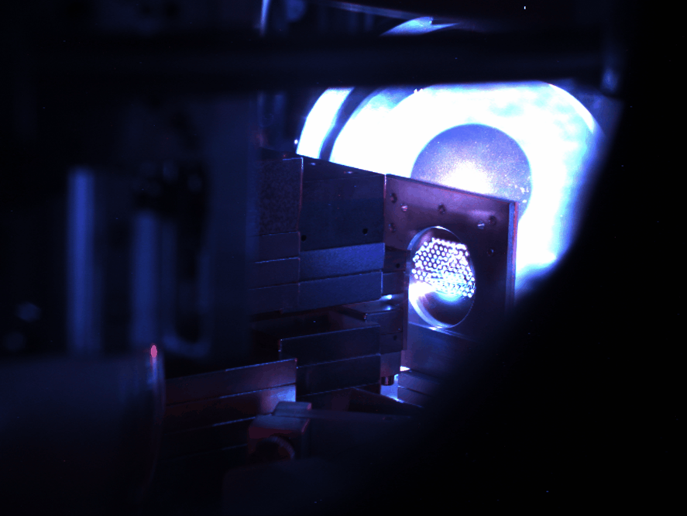
Data Management & Analysis (proposal)
The MATTER Information Fabric
The Digital Scientific Method
The Digital Experiment & Machine
Digital transformation of MATTER Science & Research
MT
ARD
DTS
DMA
MU
MML
Notes:
Introduce Data Challenge before, do not say subtopics, emphasize future

Slide 4
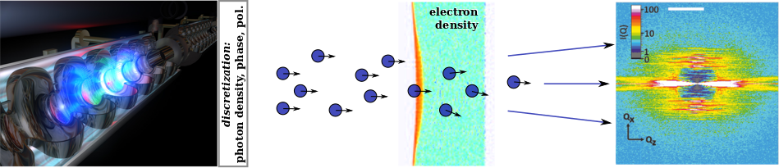
Data Management & Analysis (proposal)
The MATTER Information Fabric
Digital transformation of large-scale facilities
Facility-wide data lifecycle management
The Digital Scientific Method
Method research & co-development
Near data computing
Machine learning
The Digital Experiment & Machine
User-oriented scientific workflows & tools
Start-to-end simulations
Online analysis with feedback
Scattering
Image
XFEL
Target
Notes:
Introduce Data Challenge before, do not say subtopics, emphasize future

