Slide 1
Statusbericht DTS
Marc Weber

Slide 2
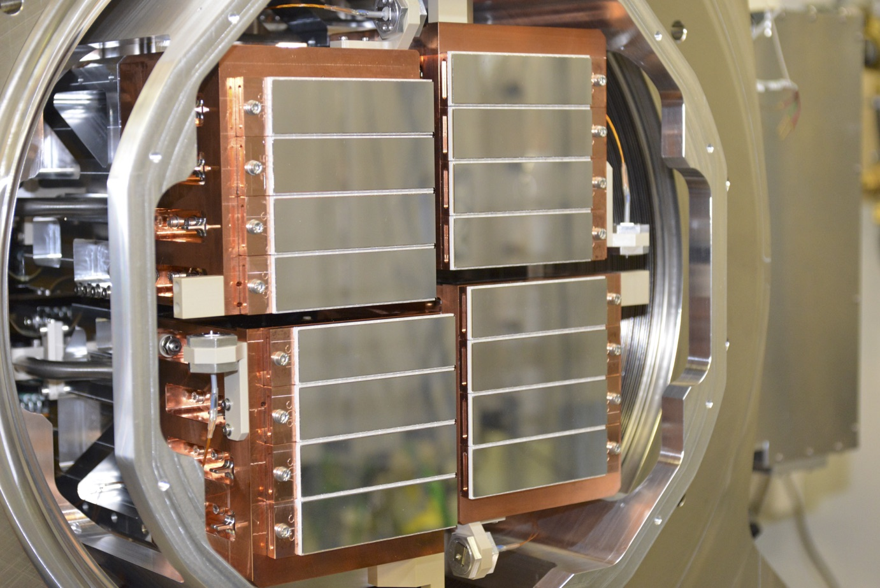
Auslieferung des ersten 1M-AGIPD
European XFEL ist seit Herbst 2017 in Nutzerbetrieb
AGIPD ist vollständig funktionsfähig
1 Million Pixeln
Einzelphotonenempfindlichkeit
Dynamischer Bereich von 104 Photonen pro Pixel
Bildfrequenz von 4,5 MHz
→ schnellster großflächige Röntgendetektor
Der 1M-AGIPD-Detektors am European XFEL

Slide 3
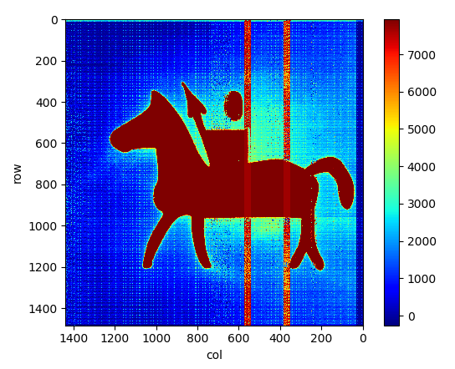
Percival – Nachweis weicher Röntgenstrahlung
Einsatz für FLASH, PETRA und andere Röntgenlichtquellen
2 Millionen Pixel
jeweils 27 x 27 µm²
bildgebende Sensorfläche 4 x 4 cm²
Erste Messungen mit weicher Röntgenstrahlung für ca. Mitte 2018 geplant
Ein mit der Röntgenkamera Percival P2M aufgenommenes Kalibrationsbild

Slide 4
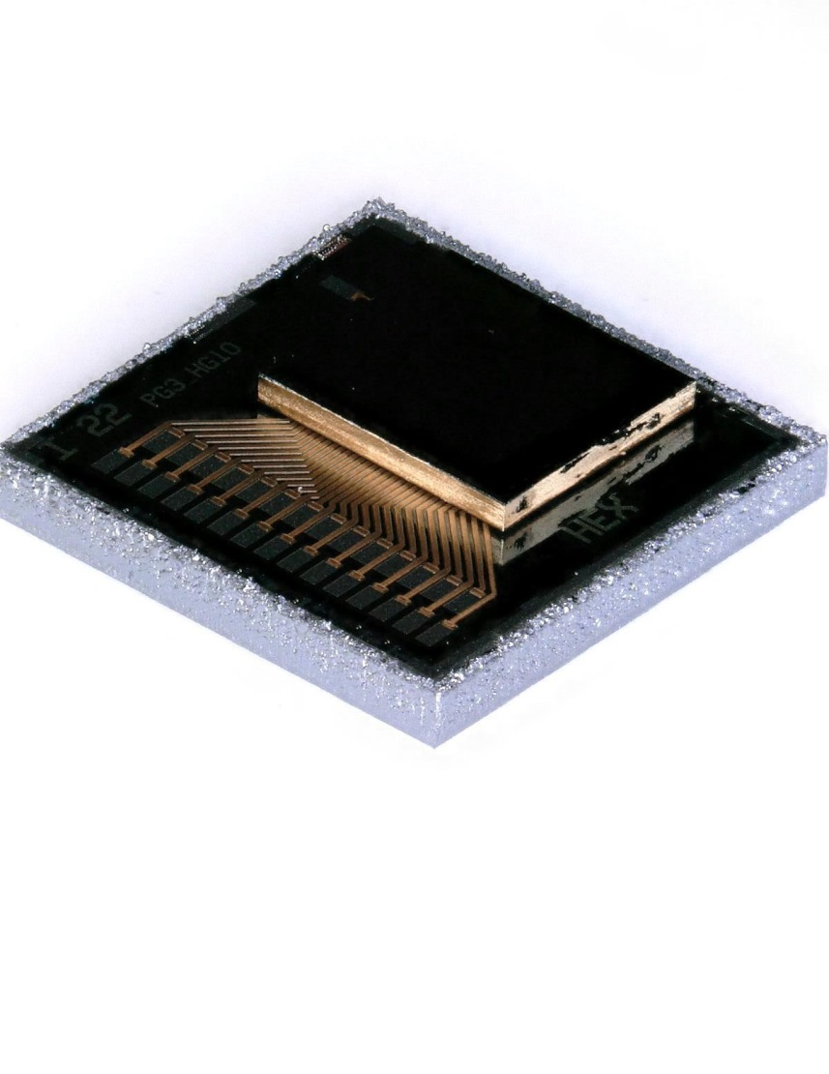
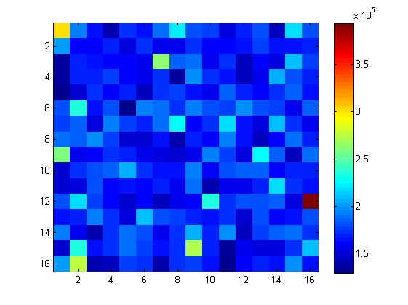
Digitaler Siliziumphotomultiplier
Zusammenarbeit mit Halbleiterlabor München
Erster vollständiger Prototyp
Jede SiPM-Diode digital auslesbar.
Dadurch hohe Ortsauflösung und vereinfachte
Signalverarbeitung
Zeitinformation mit Auflösung von 77 ps
Erster Prototyp eines digitalen SiPM Moduls mit 16 x 16 Pixeln
Dunkelrate bei Raumtemperatur

Slide 5
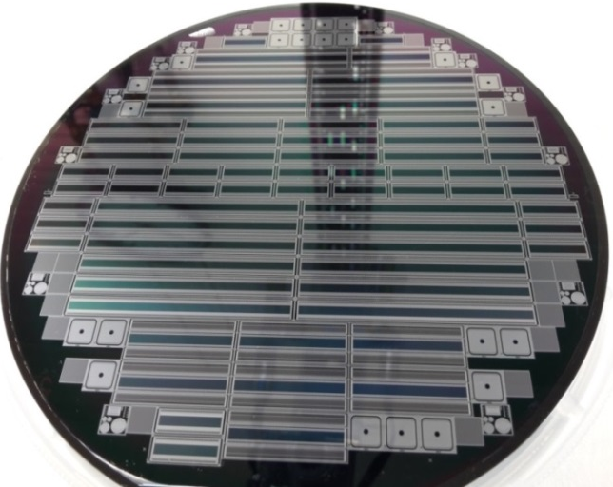
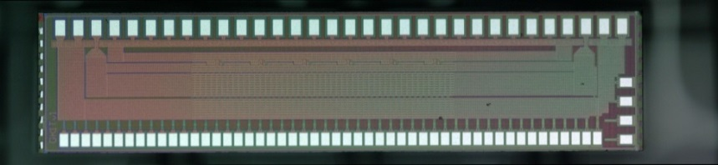


New sensor technology and front-end ASICs
  KALYPSO sensor wafer
Array size: 512, 1024 and 2048 channels
Channel pitch: 25 and 45 µm
Anti-reflecting coating layers, optimized:
  Near – InfraRed (1050 nm)
  Near – UltraViolet (350 nm)
  Visible-light (400-850 nm)
1024 pixel @ pitch 45 µm
1024 pixel @ pitch 25 µm
512 pixel @ pitch 25 µm
2048 pixel @ pitch 25 µm
IEKP diode
512 pixel @ pitch 45 µm
  KALYPSO front-end ASICs
Adaptive frame rate over 10 Mfps @ full occupancy
Noise of ~ 300 e⁻ (ENC) @ maximum frame rate
  Gotthard-HR-10MHz ASIC - UMC 110 nm technology

Slide 6




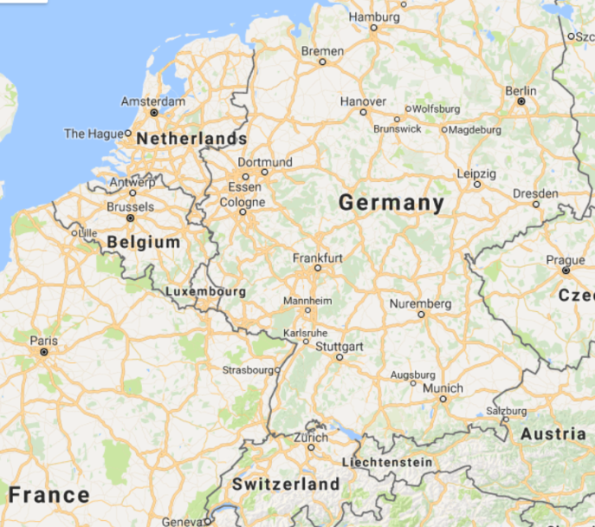
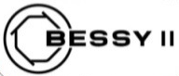






Impact
Modern beam diagnostics relies on: custom ASIC design, high-frequency technologies, custom superconducting or semiconductor design and fabrication, high-density interconnect technologies, high-throughput DAQ and more
Close collaboration between ARD and DTS centered at KIT
KAPTURE and KALYPSO are fundamental for understanding the beam dynamics of ultra-short bunches
World-leading tool for beam diagnostics, both detectors systems have been exported successfully to other accelerator facilities:
DESY Hamburg / Eu-XFEL
TU Dortmund / DELTA
HZDR Dresden / ELBE
HZB Berlin / BESSY II - VSR
DESY Hamburg / FLASH
SOLEIL-Sync. (Paris)
PSI / Swiss Light Source
SLS

Slide 7
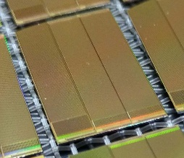
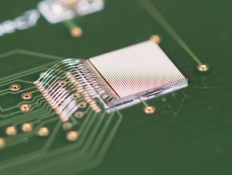
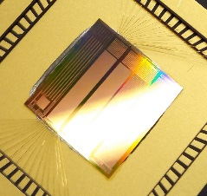

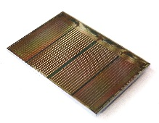
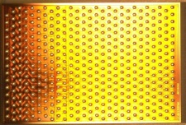
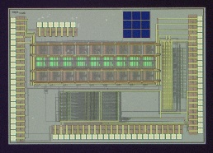
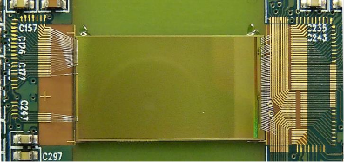
Time line of chip submissions (KIT-ADL)
Switcher
Photon
DCD
MuPix8

Slide 8
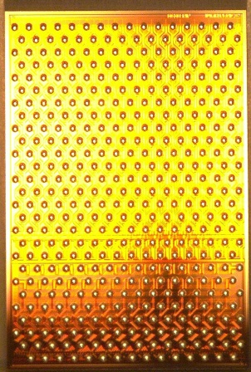
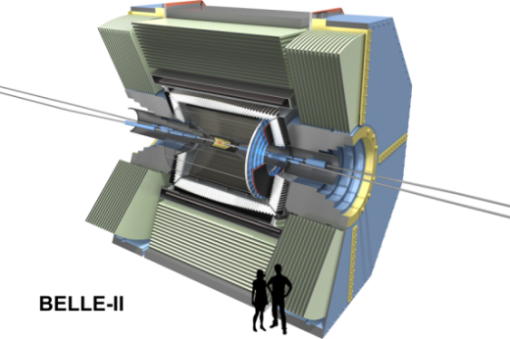
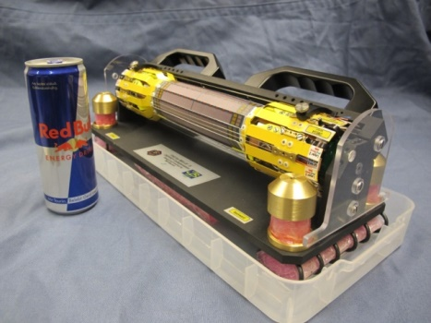
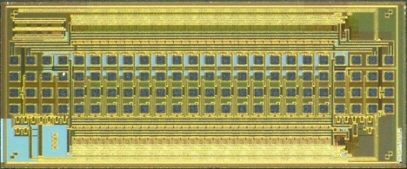
ASICs for Belle II
Belle II – a large particle physics experiment in Tsukuba/Japan
Readout ICs for Belle II pixel detector module are developed by KIT-ADL
Novel circuits, ~500 ASICs produced, tested and delivered
Detector assembly ongoing
5 mm
Control ASIC:
fast high-voltage drivers
Readout ASIC:
256 radiation-hard ADCs

Slide 9
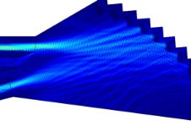
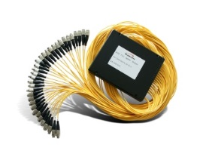
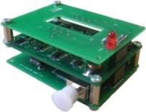
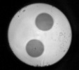
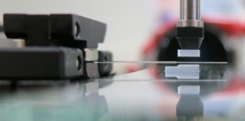
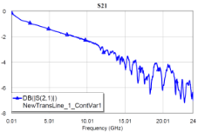
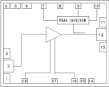
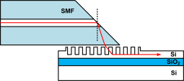
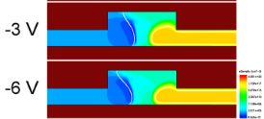
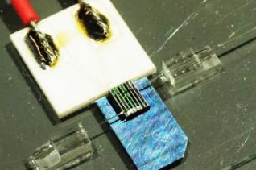
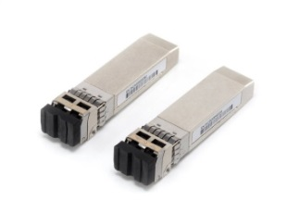
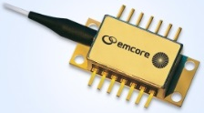
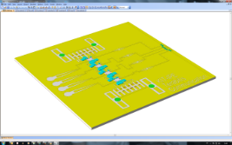



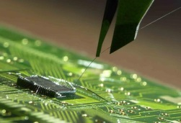
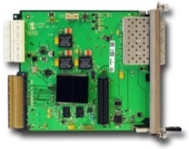

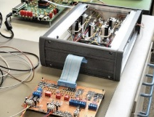
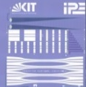
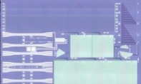
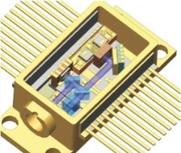
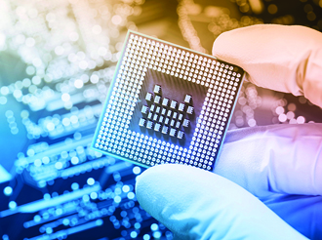
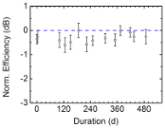
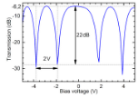
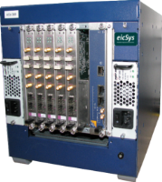
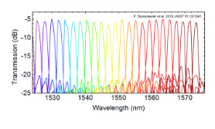
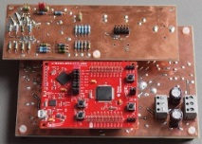
Terabits/seconds… We build the entire system
Laser source
Photonic chip
Packaging
Modulator driver
Optical receiver
Laser drivers
Optical simulation
WDM splitter
Electrical simulation
Electrical simulation
DFB lasers
Process development
Photonic packaging
Receiver modules
RF circuit design
Chip layout
Electrical packaging
Firmware development
WDM combiner
Chip fabrication
Assembly
Control electronics
Control electronics
System development
Characterization
Mechanical housing

Slide 10
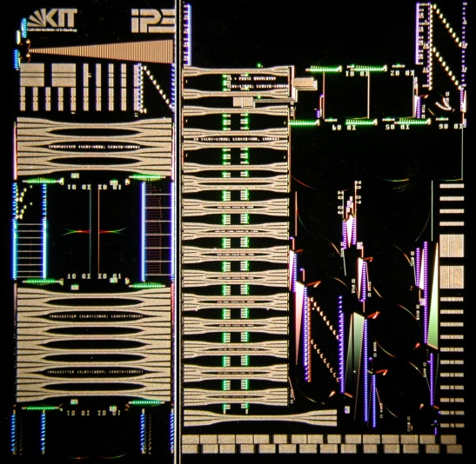
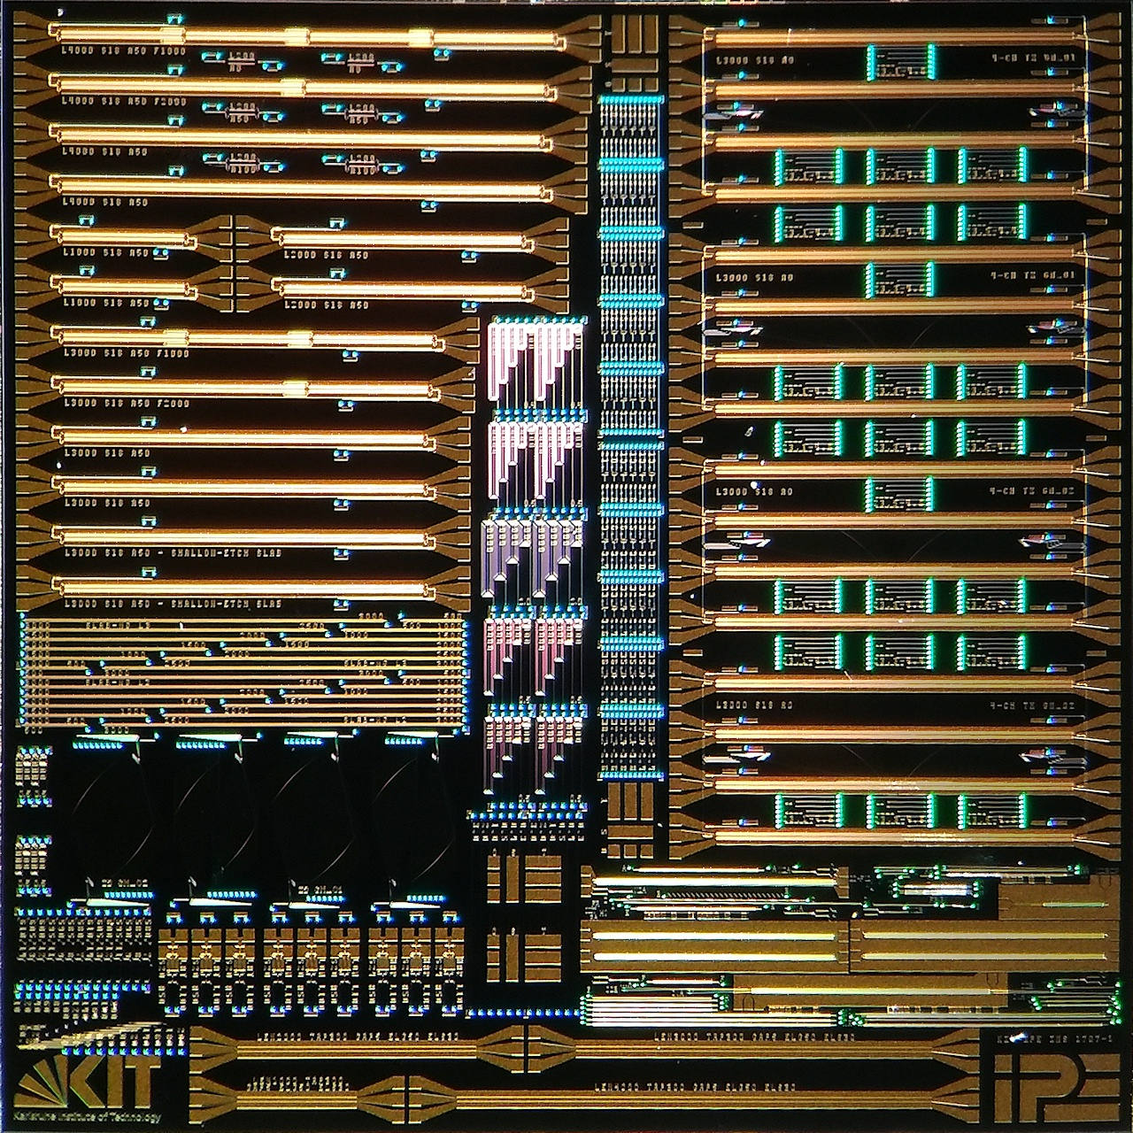
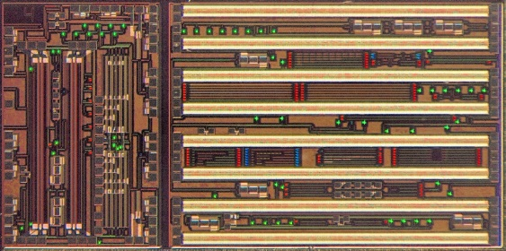
Silicon Photonic Chips
Started from scratch
Photonic chip design challenging: no comprehensive tools, no standard processes
Many functional designs
Innovative and
world-best features
Compact WDM systems
2013
2015
2018
2.4 × 4.9 mm²
10 × 10 mm²
9.3 × 9.3 mm²

Slide 11
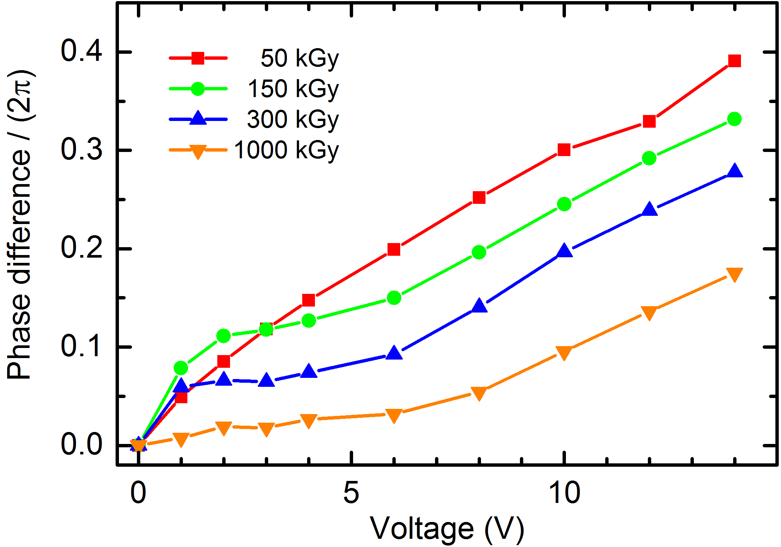
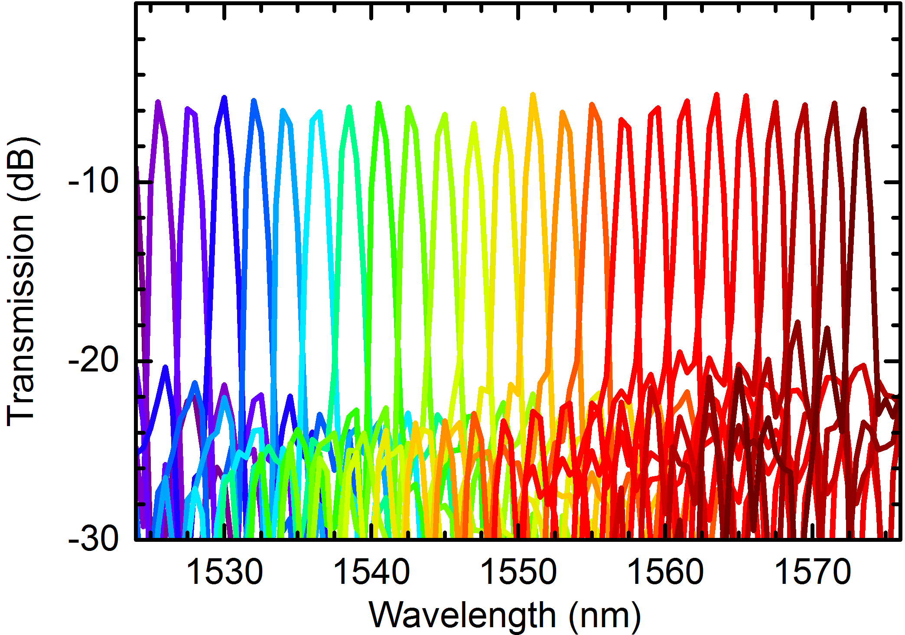

Silicon Photonic Chips
Highest measured radiation hardness of pn-modulators
Fast modulators
Excellent (de-)multiplexers
Chip arrived in February 2018
Nickel fragments at
X-ray at KIT
2013
2015
2018
2.4 × 4.9 mm²
10 × 10 mm²
9.3 × 9.3 mm²

Slide 12





Status…
40 Gb/s demonstrator near completion
Concept allows scaling to 5 Tb/s
KIT ideal environment
Competences in all required fields
We build the entire system
Photon science
Collaborations:

Slide 13
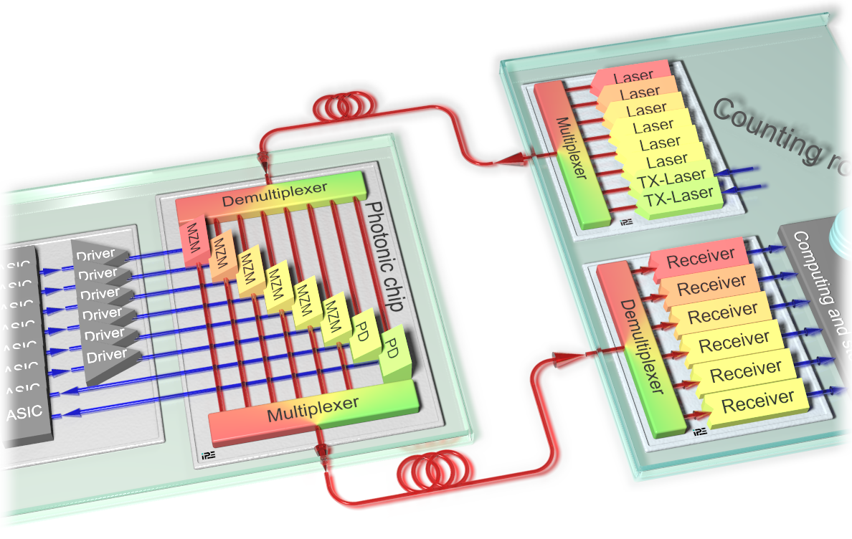

… and Vision
Downlinks with monolithically integrated
Ge-photodiodes
Dynamically reconfigurable Rx and Tx
channels (patent pending)
Higher modulation formats for higher
data rate
Monolithic integration of sensors, ASICs, photonics

Slide 14


Superconducting sensors
Superconducting sensors
  Transition Edge Sensors (TES)
  Kinetic Inductance Detectors (KID)
  Bolometer
  Metallic Magnetic Calorimeters (MMC)
Application fields
  Atomic / molecular physics
  Metrology
  Nuclear Physics
  Particle Physics
  → neutrino mass determination
The Electron Capture ¹⁶³Holmium experiment ECHo^{[1]} will measure the electron neutrino mass by analyzing the energy spectrum in the electron capture process of ¹⁶³Ho.
[1] Gastaldo et.al., Eur. Phys. J. Special Topics 226, 1623–1694 (2017)

Slide 15

Parallel vs. frequency-multiplexed readout
Parallel readout
Frequency division
multiplexed readout
in
#_{channel} * 10 wires
2 wires
(4-8 GHz, 1 channel every 10 MHz)
in
out
frequency comb
Cryostat
out
T=20 mK
MMC Pixel
response
~10 wires / channel = ~60000 wires for ECHo
2 wires / 400 channel =
~30 wires for ECHo

Slide 16

MMCs: Conclusion
Superconducting sensors such as MMCs require
highly specialized readout electronics
Proof-of-concept after only 1.5 years
RU5 will deliver readout electronics for ECHo until 2021
Vision: RU5 strives to provide world-leading MMC readout electronics

Slide 17




Scientific challenges at keV energies
Imaging bio-systems
Mega
pixels
Molecular dynamics
High dynamic range
High rates
Soft X-rays
Low-energy radiation
~ keV electrons
Neutrino mass
Low noise
Ultimate energy
resolution
Dark Matter searches
Low rates
Good time
resolution
keV X-rays and electrons
eV photons
Perfect match to strategy of MATTER

Slide 18




Distributed Detector Lab (DDL)
Distributed infrastructure, competence center and hothouse of technology
We will push for the installation of DDL in Helmholtz
Partners from universities, Leibniz, MPG and PTB
DDL will provide key technologies to MATTER and university partners
HSS is crucial first stepping stone to DDL

Slide 19
Nächste Schritte DDL
Diskussion der großen Linie mit H. Dosch
Konkretisierung der Inhalte und Infrastrukturen (wesentliche Aspekte wie das Post-processing von Halbleitersensoren und die Supraleitenden Detektoren sind schon sehr weit)
Ausarbeitung eines Antrags

Slide 20











Sensors, ASICs and Interconnects
Data Transmission and Processing
Detector Systems
Readout and production of superconducting sensors
Optical data transmission beyond LHC
Sensors
Terabit/s Optical Data Transmission
HGF-Cube
Readout Electronics
Intelligent Programmable Electronics
Compact Gaseous Detectors
Fast Photon and X-ray Detectors
Fast Timing Detector Systems
Fast Timing Detector Systems
Interconnect, Packaging and Innovative Materials
Parallel Processing
CMOS Sensor
Systems
Pioneering HVCMOS Sensors

Slide 21
POF IV
ST1 Sensors and ASICs (H. Graafsma)
Semiconductors | (high-Z, radiation-hardness of Si, avalanche diodes, diamond) | DESY, GSI, KIT
Cryogenic sensors | (bolometric and thin-film high-temperature superconductors) | KIT
Integrated electrical and optical circuits | (and monolithic sensors) | DESY, GSI, KIT
Interconnects, Packaging and Innovative Materials |  | DESY, GSI, KIT
ST2 From sensors to systems (A. Kopmann)
Tbit/s Optical Data Transmission |  | KIT
Advanced multiplexing techniques | (for fast, energy-resolving detectors, examples are GHz MMC readout, multi-channel THz cameras, Tristan readout) | KIT
Massively parallel heterogeneous digital systems |  | DESY, GSI, KIT
ST3 Demonstrator systems (C. Schmidt) The systems included should evolve with time and be updated at least twice during PoF IV. We will establish several systems with joint contributions by several centers.
Photon Science | (optical data transmission, XFEL-upgrades) | DESY, KIT?
Astroparticle physics | (Neutrino masses, Dark Matter) | DESY, KIT
Beam diagnostics | (Kalypso, diamond detectors) | DESY?, GSI?, KIT
Particle physics, hadrons and nuclei | (Track triggering, pixel sensors for vertexing and calorimetry, gaseous detectors) | DESY, GSI, KIT

Slide 22
Nächste Schritte: DTS Struktur
Abfrage bei den Zentren, wer sich in welchem Subthema und Arbeitspaket engagiert
Welche Proekte werden für die Demonstratorsysteme vorgeschlagen
Welche Personen stehen als Koordinatoren zur Verfügung
Optimierung der Namen der STs und Workpackages

