Slide 1
Schedule and Priorities
2018 / 2019

Slide 2
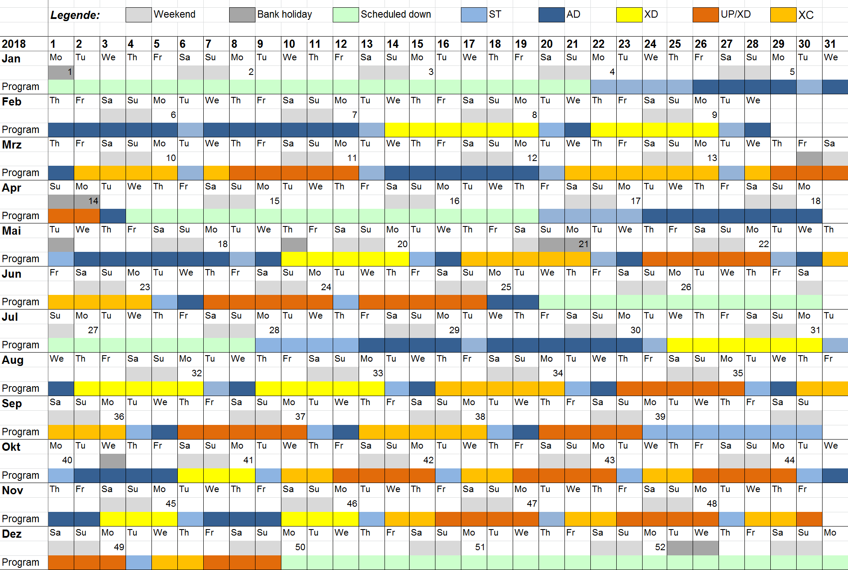
Updated 2018 schedule

Slide 3
Updated 2018 schedule with overlay from an overall perspective
Acc. And XTD installation & commissioning; start-up
start-up
SASE1 tuning
SASE3 1st lasing
Setup
Beam thr. SASE2
Shutdown for CS9 + SASE2 completion
SASE2 1st lasing
SASE2 comm.
Setup
1st EUE
Setup
1st EUE
1st EUE
Shutdown for Interlock
Shutdown
Und. gap tuning + incr. bunches
Comm. SASE1+3
Comm. SASE1 + 3
Setup
2nd EUE
Setup
Setup
2nd EUE
Setup
2nd EUE
Acc. buffer
AD + XD?
2nd EUE
2nd EUE
2nd EUE
AD + XD?
3rd EUE
3rd EUE
3rd EUE
3rd EUE
3rd EUE
Winter shutdown

Slide 4
Updated 2018 schedule from the SASE1 perspective
SASE1 main activities; start-up
start-up
SASE1 tuning
comm. w. beam?
Setup
1st EUE
Setup
1st EUE
1st EUE
Setup
1st EUE
Setup
1st EUE
1st EUE
Commissioning
Commissioning
Setup
2nd EUE
Setup
Setup
2nd EUE
Setup
2nd EUE
2nd EUE
2nd EUE
2nd EUE
Commissioning – no user experiments
Commissioning
Winter shutdown

Slide 5
Updated 2018 schedule from the SASE3 perspective
XTD4+10 installation & commissioning
start-up
SASE3 1st lasing
SASE3 instr. interlock tests
Electronics Comm.
Electronics Commissioning (BH Modules, Loops & Firmware)
Electronics Commissioning (Beckhoff Loops & Firmware, E2E)
Control System Commissioning (Karabo & E2E)
Comm. SASE 3
Commissioning of XTDs and Instruments with X-rays
Commissioning of XTDs and Instruments with X-rays
Setup & conduct very first experimental trials
3rd EUE
3rd EUE
3rd EUE
3rd EUE
3rd EUE
Winter shutdown

Slide 6
Updated 2018 schedule from the SASE2 perspective
Acc. And XTD installation & commissioning; start-up
start-up
Beam thr. SASE2
Shutdown for CS9 + SASE2 completion
SASE2 1st lasing
SASE2 comm.
SASE2 instr. interlock tests
SASE2 instr. interlock tests
Electronics & Control System Commissioning MID + HED Opt.
Electronics & Control System Commissioning MID + HED Opt.
Electronics & Control System Commissioning MID + all HED
Elec.+Contr.Sys.
Commissioning of MID with X-rays
MID X-ray Comm.

Slide 7
Scope 2018/19 / Order of priorities
SASE1 tunnel operation
SASE1 instrument operation
SASE3 tunnel readiness ➔ SASE3 tunnel operation
SASE2 tunnel readiness ➔ SASE2 tunnel operation
SASE3 instrument readiness ➔ SASE3 instr. operation
SASE2 instrument readiness ➔ SASE2 instr. Operation
SASE1 tunnel & instrument completion
SASE3 tunnel & instrument completion
SASE2 tunnel & instrument completion

Slide 8
1. SASE1 tunnel operation
Tasks & effort required to operate the tunnel:
(including items for Day-1 or required to meet promises in Call for Proposals)
  Accelerator: Achieve >0.5 mJ and good pointing stability (matching our optics)
  Accelerator / XFEL: Improve undulator controls & adjustments / reduce losses / PBBA (K-mono-based undulator segment tuning and analysis)?
  Accelerator: Good understanding of the FEL gain curve (only 1 attempt)
  Accelerator: Working kicker magnets (picking of pulses)
  Accelerator / Diagnostics: Measurement of the spectral jitter and bandwidth
  Optics: Installation & commissioning of distribution mirror cooling (2nd half 2018)
  Diagnostics commissioning of MCP, Hirex, K-Mono (now 50% → 75%)
  (required for improvements of the accelerator)
  CAS & ITDM: Tunnel DAQ reliability / commissioning (66% done)
  Related: FXE: reliable XGM readout
  Vacuum & CAS: Final implementation of vacuum controls (80% done).
  FXE: Installation & commissioning of diamond grating
  FXE: Commissioning of 4 bounce monochromator
  (AE+CAS-support required, basic functionality has to be achieved in April shutdown!)
  AE & SPB: Pulse picker has to be comissioned (35%) with beam (0%)
  SPB: Update attenuator foils
  FXE: Improvement of BKR-controls, Karabo-DOOCS bridge to access camera data for tuning

Slide 9
2. SASE1 instrument operation
Tasks & efforts required to operate the instruments:
(including items for Day-1 or required to meet promises in Call for Proposals)
  October:
    SPB: CSS & vacuum works partially done, laser table done…
    CAS: Exchange of data between DOOCS and Karabo ➔ done
    CAS: Improve Control Software: Scan tool being tested @ FXE ➔ still not working
    ITDM: Improve DAQ: Data storage and handling, detector performance
    waiting for opportunity to conduct high speed test (300/512 bunches) ➔ done
    (slow data performance was also improved)
  December:
    ITDM: Test of new storage system + expansion of InfiniBand network ➔ done
    AE: Test of train builder (at least LPD) ➔ done
    Accelerator & SPB/SFX: Improvement of the focal properties
  From beginning of 2018:
    SPB: KB-mirror installation (25%), integration & commissioning
    FXE: Improvement of Data Analysis, e.g. analysis of LPD images, figure of merits…
    FXE: Installation, commissioning and integration of two-tile LPD (req. in August)
    (SAXS/WAXS solid state experiment, could potentially be a different 2d Detector)

Slide 10
3. SASE3 tunnel readiness
Achieve first lasing: 1st attempt in Nov. 17 → 8.2.2018
  Diagnostics: FEL- & SR-Imager: com. w. beam done
  XGM being commissioned with beam
  Vacuum: General vacuum sector interlock test done
Major works finished XTD4+10 : End of Jan. 18
  Vacuum & Optics: Beam shutters final connection to XFEL missing
  Mirrors, soft X-ray Monochromators installed
  Diagnostics: MCP + K-Mono (installed, now com. w. beam),
  Pop-Ins (installed, being commissioned w. beam)
Simultaneous operation of SASE1+3: 8.2.2018
  To be discussed with Acc. and incorporated into schedule

Slide 11
3. SASE3 tunnel operation
Tasks & effort required to operate the tunnel:
(including items for Day-1 or required to meet promises in Call for Proposals)
Vacuum & Optics:
  Gas attenuator commissioning (-April)
  Beam shutter cabling MPS to XFEL (April)
  Installation of mirror M5 (April)
  Installation, test and commissioning of mirror cooling (after SASE1 cooling)
  Soft monochromator (synchronous movement required, lacks Karabo-Interface, required for instrument commissioning & user experiments
  ➔ needs to run in July, to allow proper commissioning with beam)
  Diffraction order dump slits (required in July)
  Photon beam loss monitors (required for long pulse trains ➔ Sep. 2018)
Diagnostics:
  Exit Slit imagers and Exit Slits: tech. commissioning (-April)
  PES: commissioning (Rem. tech. com., e.g. Beckhoff-loops VAC and MOV in April shutdown. Commissioning with beam in May)
  K-mono: resolve in-vacuum issues (in April shutdown)

Slide 12
4. SASE2 tunnel readiness
Achieve first lasing: 1st attempt in Mar. 18 → Apr.-May
  Beam shutter only XS2, XGM in XTD1, FEL-&SR-Imager, Vacuum in XTD1 with controls, interlock, DAQ until start, latest end of April shutdown
  (consider workload during April shutdown!)
  Vacuum XTD6 + MCP
Major works finished XTD1+6: Apr. 18 → End of Q2 2018
  Vacuum & Optics: Mirrors, CRL-1, Vacuum + beamshutter + DAQ in XTD6
  Diagnostics: K-Mono, XGM in XTD6, MCP, Pop-Ins and other Imagers
  Split&Delay Unit (to be closed by June/July?)
  High resolution monochromator (only arrives in October!)
  MID: CRL-2, Solid Att., Slits, further Imagers, Si-mono
  HED: CRL-2, further Imagers, 4-bounce standard Si-mono
Simultaneous operation of SASE1+3+2: End of Q2 2018
  To be discussed with Acc. and incorporated into schedule

Slide 13
5. SASE3 instrument readiness
TGA
  AC ready until Feb. / Apr. 18, Elec. ready until Mar. 18
  IT ready until end of March 18
Beckhoff electronics
  Cabling Phase II done until Jan.18 → so far 50% SCS, SQS 70% → beg. of May 18
  Day 1 hardware BH done until Feb. 18 (90%)
  Beckhoff electronics E2E done until Jul. 18
Instrument installation
  Major time of installation: Feb. – Apr. 18
  Installation of KB-systems SCS + SQS: April 2018
  SQS: AQS-chamber
  SQS: Commissioning of SQS fiber laser (Sep.-Oct. 2018)
  ITDM: Installation / Configuration / Commissioning of DAQ
Instrument commissioning without beam
  Installation of Rad. Saf. Interlocks in Apr. 18
  Installation of Laser Interlock until April, commissioning in May

Slide 14
6. SASE2 instrument readiness
TGA
  AC ready until Mar. / Apr. 18, Electricity ready until Apr. 18
  IT ready end of April 2018
Beckhoff electronics (MID Opt. / MID / HED Opt. / HED)
  Cabling Phase II done until May/July/Sep.18 (20% MID + 10% HED done)
  → July / mid. Aug / Sep / Q1 19
  Day 1 hardware BH done until Feb./Mar./June 18 → June / July / Aug. / Q4 18
  Beckhoff electronics E2E done until Sep. 18 / Oct. 18 / Jan. 19
  → Sep. / Oct. / Q4 18 / first half 2019
Instrument installation
  Major time of installation: Q4 2017 - Q1 2018
  MID: AGIPD ready for installation in Feb. 18
  HED: Integration of Jungfrau-, ePIX-detectors
  ITDM: Installation / Configuration / Commissioning of DAQ
Instrument commissioning without beam
  Installation of Rad. Saf. Interlocks in July 18
  Installation of Laser Interl. in Mar.-Apr., commissioning in May

Slide 15
7. SASE1 tunnel & instrument completion
Tunnel:
  HiRex: Gotthard II – 25 required for resolution / MHz rate DAQ (shot2shot spectra!)…
  Upgrade to gated imager (for picking a pulse image in the train)
FXE:
  Jungfrau + Gotthard detector planning, cabling, integration & commissioning
  Additional cabling (I/O, more motors from JJ…)
SPB/SFX:
  Jungfrau + Gotthard + AGIPD4M detector planning, cabling, integration & commissioning
  Additional work for downstream region (day 2 / SFX)
  Additional rackroom D.23 until Q1 2019

Slide 16
8. SASE3 tunnel & instrument completion
Tunnel:
  Undulators: Self-seeding, Circular polarization undulator, Helical afterburner
  Diagnostics: Full PES operation, Exit-Slit Imagers
SCS:
  Additional rackspace beyond day 2 required?
  Setup of PP-Laser system incl. the instrument laser hutch (early 2019)
  2nd user endstation XRD (Q2 2019)
  hRIXS + chemistry station (2nd half 2019)
SQS:
  Additional rackspace beyond day 2 required?
  NQS + REMI-chambers (for later 3rd EUE user proposals in early 2019)
  Refocussing optics for spectral and timing diagnostics (2nd half 2019)
Third experiment (TR-XPES):
  No power + cable trays, lighting, rad. shielding, chicanes, air conditioning, rackroom, rad. safety interlocks…

Slide 17
9. SASE2 tunnel & instrument completion
Tunnel:
  Undulators: Self-seeding, HED: 400 fs delay chicane…?
  Diagnostics: Hirex 2
MID:
  Integration of Jungfrau-, ePIX-, Gotthard-detectors…
  Split&Delay Unit in MID-Opticshutch
  Setup of PP-Laser system incl. the instrument laser hutch
HED / HIBEF-UC:
  Setup of HIBEF AGIPD, Gotthard and smaller detectors
  Installation & commissioning of Amplitude (April-Nov.) and DiPOLE (Nov. 2018 -)
  Setup of PP-Laser system incl. the instrument laser hutch
  Interaction area 2: Rails (MEA), cabling phase 2b (IA2 HIBEF components)
Third experiment:
  No hutch and no infrastructure planned…

