Slide 1
Tests on Chess 2 ASIC
Dionisio Doering, Yubo Han_{IHEP} , Pietro Caragiulo, Larry Ruckman, Camillo Tamma, Mazin Khader_{UIUC}, Murtaza Safdari, Su Dong

Slide 2
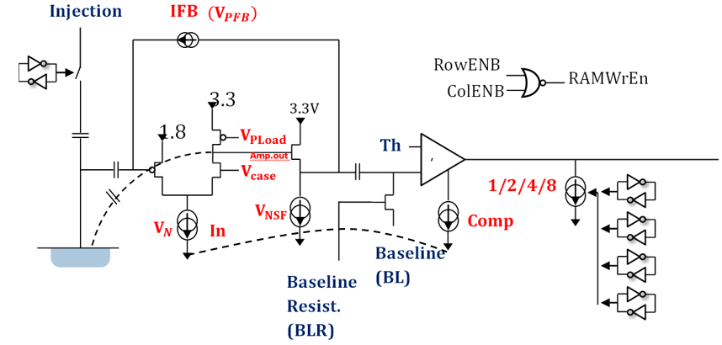
Pixel description

Slide 3
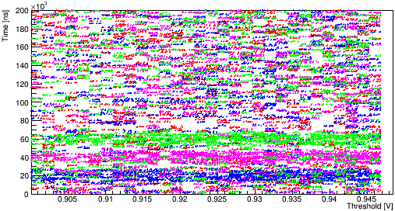
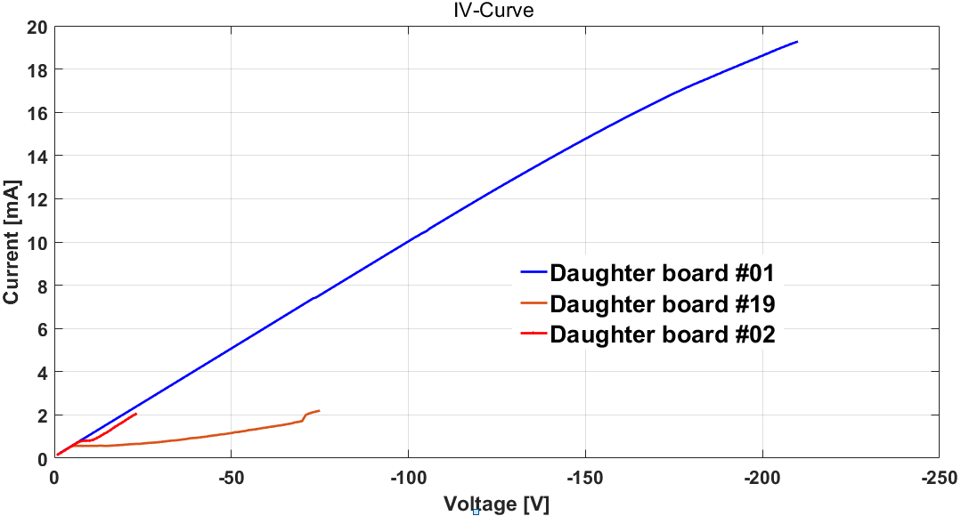
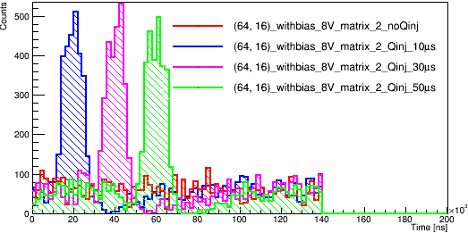
Outline
Review
IV curve with 2mA current limit
tests with different bias voltage-> varied range of Threshold with signal
tests with LED as signal source-> weak signal observed
Tests
mechanical setup upgrade
tests with laser diode at 650nm

Slide 4
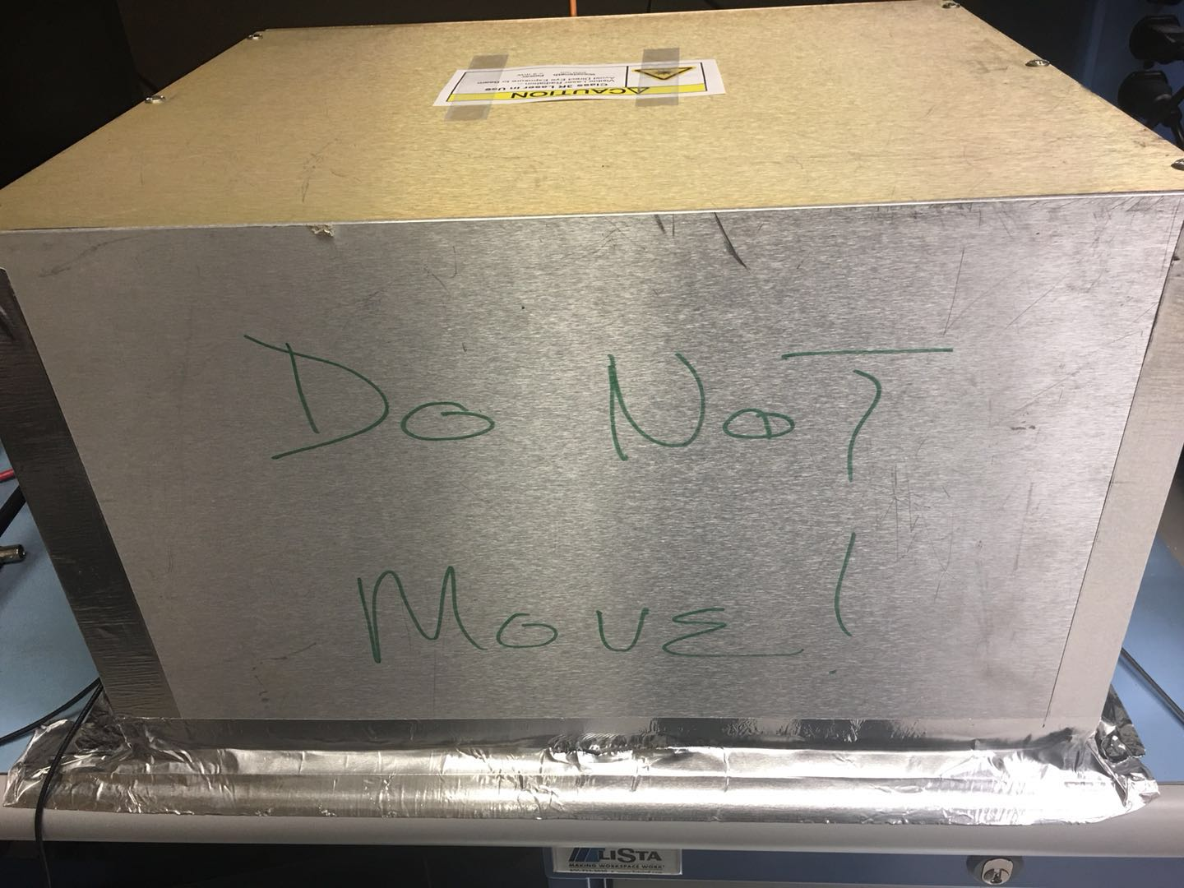
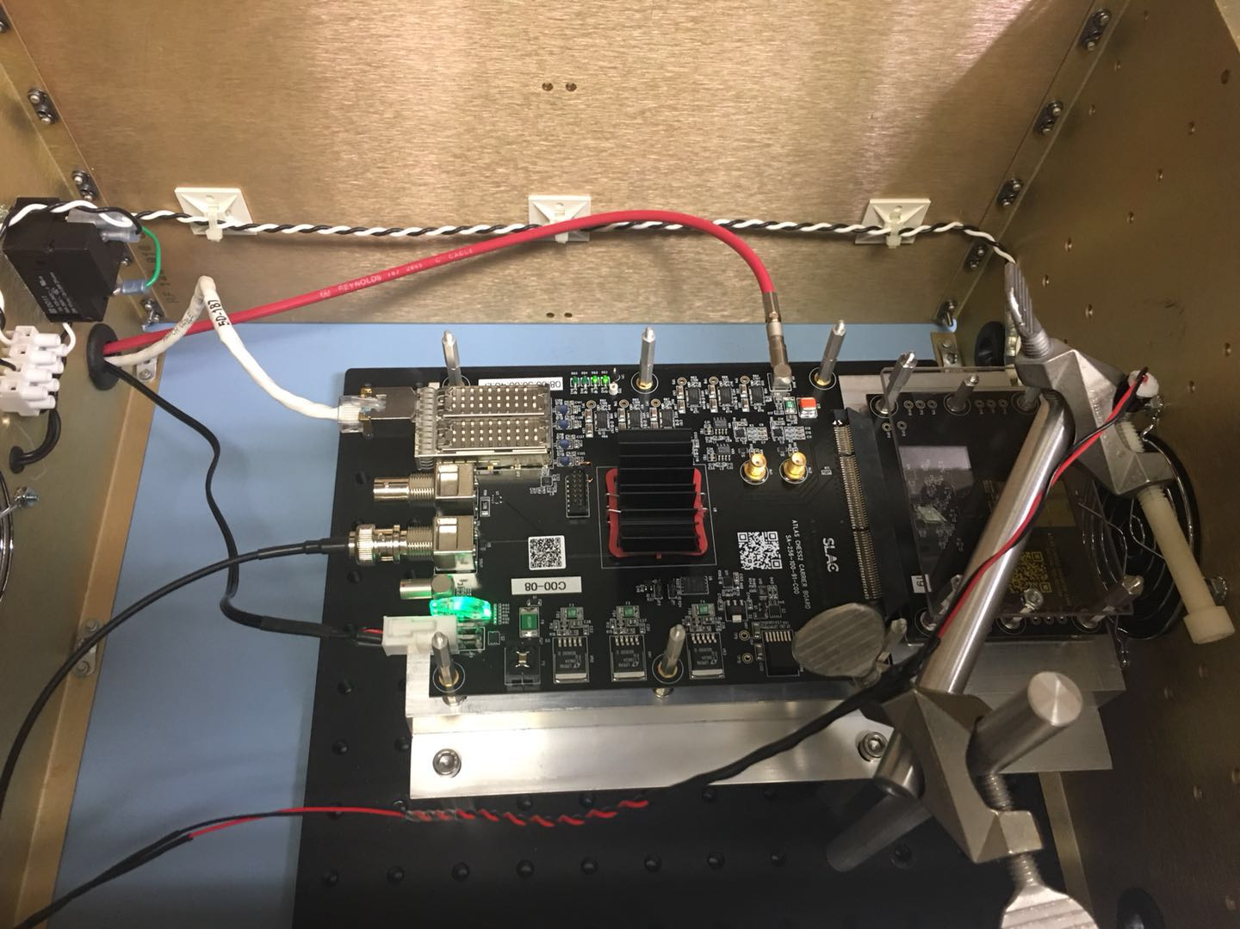
The mechanical setup
Inlet
outlet
A box to provide a dark testing environment
Still have Peltier module on the back side of the daughter board.
two opening on the box allowing two fans to blow the heated air out of the box.
Metal structure to raise the board near to the fan.
Metal arm holding the laser diode.
laser diode with 5mW max power (triggered by Qinj pulse)
Hold the laser: 3D position control

Slide 5
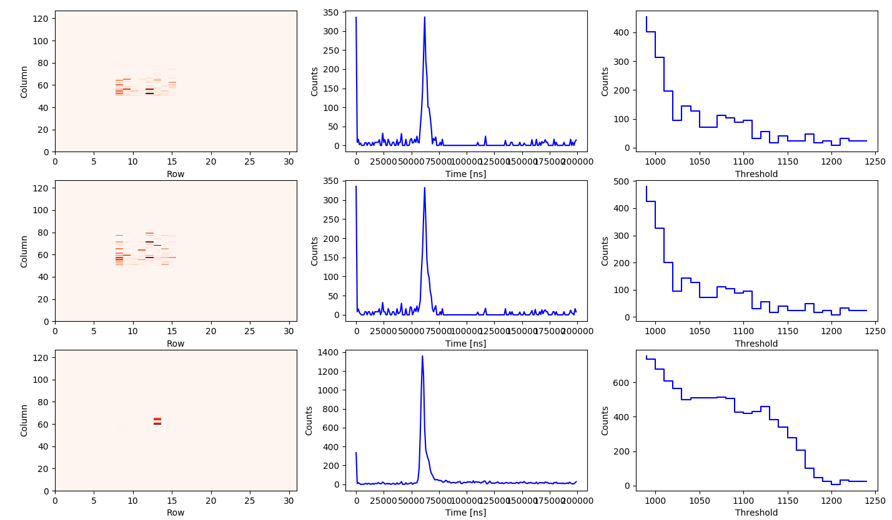
Locate the target pixel
Daughter board #19
High resistivity
192.168.3.28
Test:
Set the power supply of laser to 5V (pulser output 5V pulses)
Position the laser above matrix2
.~8cm from the daughter board
Bias voltage -8V
Fix the BL at 0.75V
Threshold sweep: 0.8-1.0V
nCounts=100
Gradually narrow the test area
Compare the results from the 3 matrix.
Target pixel (60,13)
Matrix 0
Matrix 1
Matrix 2

Slide 6
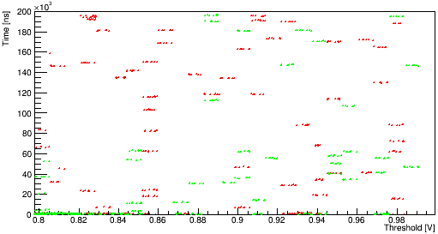
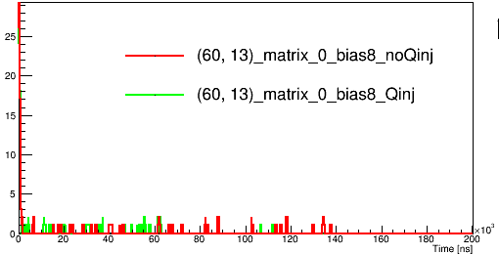
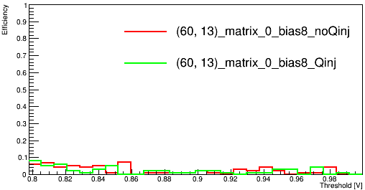
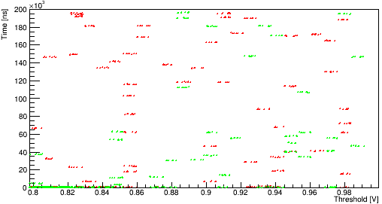
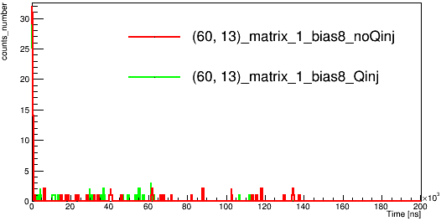
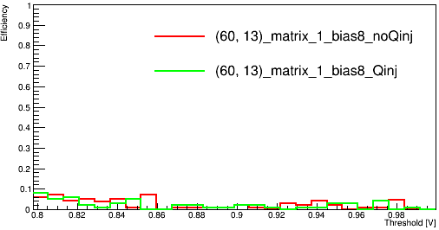
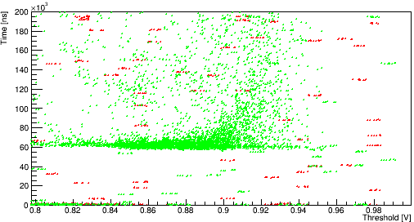
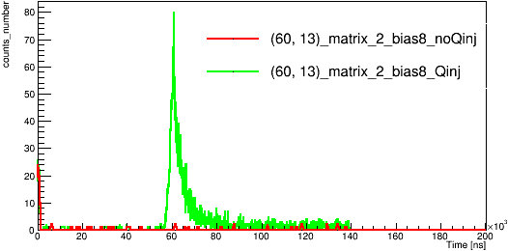
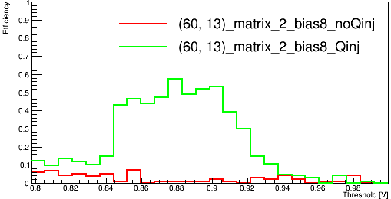
Tests results of （60,13）
Daughter board #19
High resistivity
192.168.3.28
Laser vs no laser
Time vs Threshold
hit_number vs Time
Efficiency vs Threshold
Bias voltage -8V
Threshold: 0.8-1.0V
nCounts=100
Only Matrix2 will have signal
Obvious signal observed with normal event number
(tests with LED was taking 15 times of normal event number )
Matrix 0
Matrix 1
Matrix 2

Slide 7
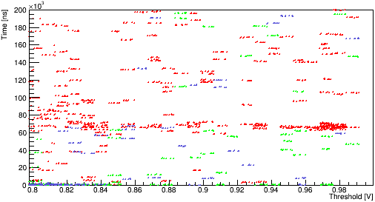
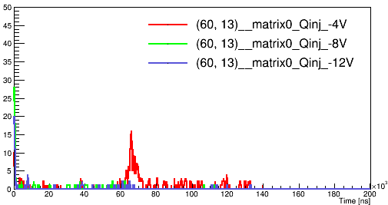
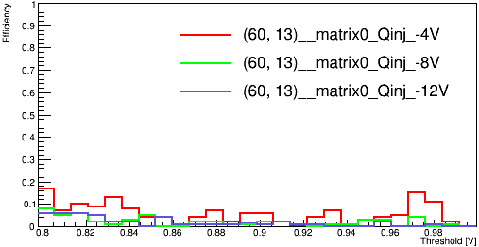
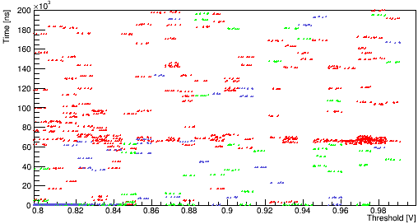
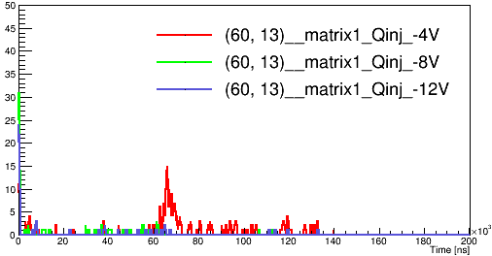
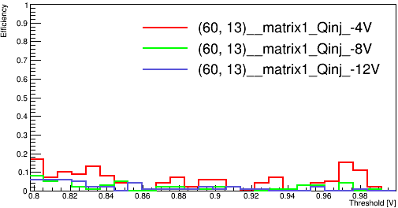
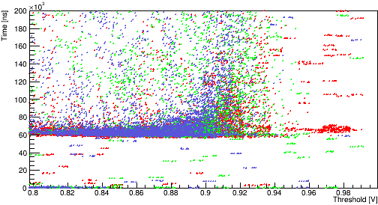
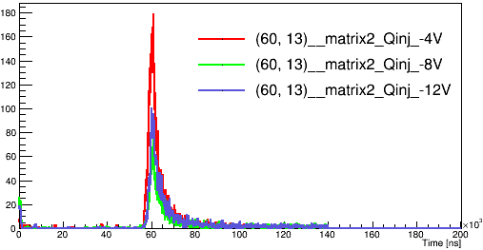
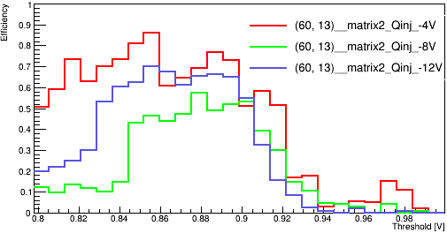
Tests results of （60,13）
Daughter board #19
High resistivity
192.168.3.28
Different bias voltage
Time vs Threshold
hit_number vs Time
Efficiency vs Threshold
Bias voltage -4, -8 ,-12V
Threshold: 0.8-1.0V
The other two matrix will also react to the laser with bias voltage at -4V.
Part of the time information reported by the 3 matrix like at Threshold of 0.98V were remarkably similar->cross talk? Register address problem?(Phenomenon needs to be understood)
Matrix 0
Matrix 1
Matrix 2

Slide 8
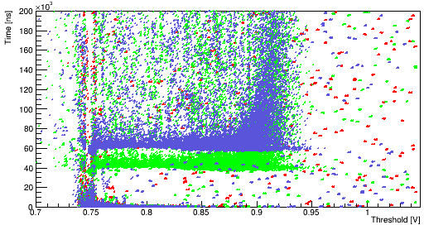
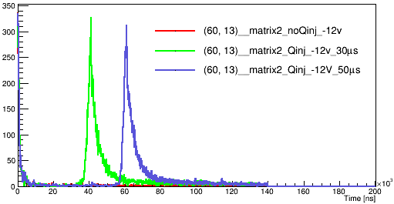
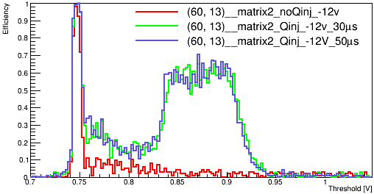
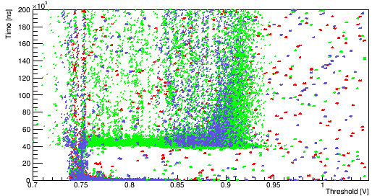
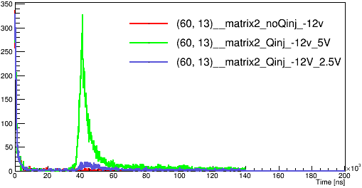
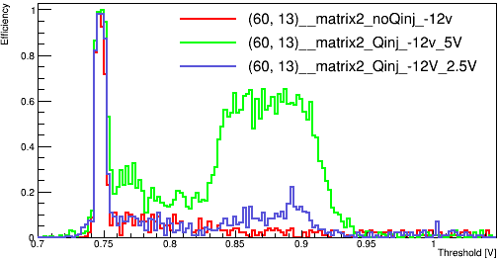
Tests results of (60,13)
Daughter board #19
High resistivity
192.168.3.28
Signal only received on Matrix2
Different delay of the trigger
Bias voltage： -12V
Laser(30μs, 50μs) vs no Laser
Different time information reported.
Same efficiency distribution vs Threshold.
Different pulse amplitude (to trigger the laser)
Bias voltage： -12V
Laser(2.5V,5V)vs no Laser
Less hit count at 2.5v
Efficiency cut off at Threshold~0.93V
Signal depleted for Threshold range of 0.75-0.85

Slide 9
Summary and Next
Upgraded mechanical setup with pulsing laser diode
Tests with laser:
large signal observed with less statistic(compare to the tests with LED)
high signal to noise rate at Threshold=0.84~0.9V (BL=0.75V)
Phenomenon to be understood:
* Origin of synchronized “shadow hits" on other matrices
* Shadow hit rate depends on bias and threshold settings
Next:
Try to resolve the laser cross marker
Read different pixel from different matrix-> check if they still reporting similar time information.
Stream readout to speed up the test.

